Slide 1
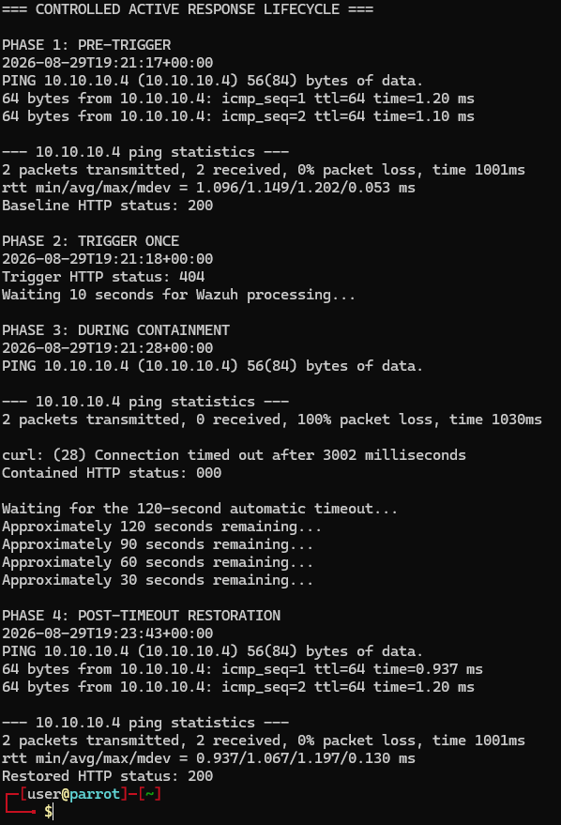
AUTOMATED CONTAINMENT & RECOVERY
COMPLETED • VALIDATED
Wazuh active response
A level-10 Suricata alert triggered a guarded, source-specific firewall block and automatic 120-second recovery.
DISPOSITION
Detect, contain, and recover completed with no residual firewall rule.
1 controlled trigger • 120-second block • 18 verified artifacts
WAZUH ACTIVE RESPONSE • STAKEHOLDER REPORT • Ryan Bryant • August 29, 2026
01
Notes:
[Sources]
- Direct lab evidence captured by Ryan Bryant, August 29, 2026.
[/Sources]

Slide 2
EXECUTIVE OUTCOME
One high-confidence alert exercised the full response lifecycle
The lab proved rule matching, guarded execution, selective containment, timed rollback, and final-state verification.
100120
120s
0
Wazuh rule ID
containment window
residual rules
Level 10 required the expected source, destination, and Suricata signature.
The source lost ICMP and HTTP reachability until Wazuh issued the delete action.
The exact labeled iptables rule was absent after automatic recovery.
EXECUTIVE CONCLUSION
The response reduced manual reaction time while keeping blast radius, duration, rollback, and evidence explicitly controlled.
WAZUH ACTIVE RESPONSE • STAKEHOLDER REPORT • Ryan Bryant • August 29, 2026
02
Notes:
[Sources]
- Metrics are drawn from Wazuh manager evidence, endpoint response logs, and the pre/during/post network test.
[/Sources]

Slide 3
DETECTION CHAIN
A verified detection became a reversible endpoint action
Guardrails were validated before the manager was allowed to execute the response.
Detect & authorize
Contain & record
Recover & verify
01
02
03
Suricata SID 1000001 matched the controlled URI; Wazuh rule 100120 verified source 10.10.10.5 and destination 10.10.10.4.
A root:wazuh script inserted one labeled iptables DROP rule and logged a successful add action.
After 120 seconds, Wazuh sent delete; the script removed only its rule; ping and HTTP 200 returned.
Control point: source allowlist, destination, signature, exact label, self-test, permissions, backups, logtest, and rollback were verified before triggering.
WAZUH ACTIVE RESPONSE • STAKEHOLDER REPORT • Ryan Bryant • August 29, 2026
03
Notes:
[Sources]
- Guardrails are supported by the script self-test, file permissions, rule test, and documented rollback evidence.
[/Sources]

Slide 4
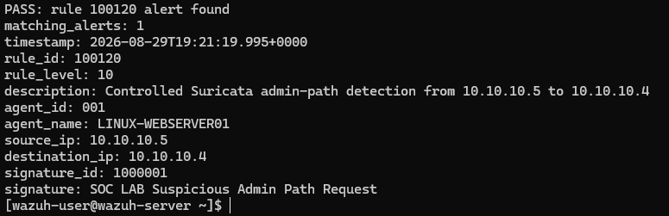
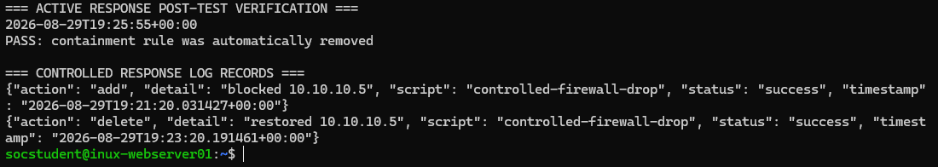
EVIDENCE
Independent artifacts prove authorization, impact, and recovery
Manager, network, and endpoint evidence align on the same controlled response.
Baseline 200 • containment 000 • restored 200
Manager alert • rule 100120 • level 10 • expected source and SID
Endpoint log • successful add and delete • rule removed
WAZUH ACTIVE RESPONSE • STAKEHOLDER REPORT • Ryan Bryant • August 29, 2026
04
Notes:
[Sources]
- Evidence screenshots: manager alert, response lifecycle, and endpoint add/delete log.
[/Sources]

Slide 5
RISK AND OPERATING IMPACT
Automation accelerated a bounded, reversible response
The exercise validates one bounded workflow, not production false-positive rates or enterprise firewall diversity.
CONTAINMENT VALUE
SAFETY BOUNDARY
RECOVERY CONFIDENCE
Reaction became immediate
Blast radius stayed explicit
Rollback was observable
A verified SIEM alert automatically blocked the authorized source without waiting for a manual firewall change.
Only one source, destination, signature, and exact labeled rule were permitted by the script.
Successful delete logs, restored ping and HTTP 200, and an absent residual rule confirmed recovery.
Limit: one controlled source and iptables backend do not establish production false-positive rates, repeated-offender behavior, IPv6 handling, or multi-endpoint reliability.
WAZUH ACTIVE RESPONSE • STAKEHOLDER REPORT • Ryan Bryant • August 29, 2026
05
Notes:
[Sources]
- Operating implications are analyst inferences from the controlled lab findings.
[/Sources]

Slide 6
RECOMMENDED NEXT STEPS
Operationalize the response capability
Priorities preserve safety as the workflow expands beyond a single lab endpoint.
Exact guardrails
Require allowlists, exact conditions, labeled rules, and a short default timeout for every automated block.
01
Rollback monitoring
Alert on failed add/delete actions and regularly test that timed recovery still succeeds.
02
Change controls
Require backups, self-tests, rule validation, peer review, and an owner before activation.
03
Response metrics
Track triggers, successful adds/deletes, duration, recurrence, exceptions, and business impact.
04
Decision request: preserve the integration and advance only through a limited pilot with exception handling, rollback alerts, and named ownership.
WAZUH ACTIVE RESPONSE • STAKEHOLDER REPORT • Ryan Bryant • August 29, 2026
06
Notes:
[Sources]
- Recommendations are analyst inferences; Wazuh Active Response docs: https://documentation.wazuh.com/current/user-manual/capabilities/active-response/how-to-configure.html
[/Sources]

