Slide 1
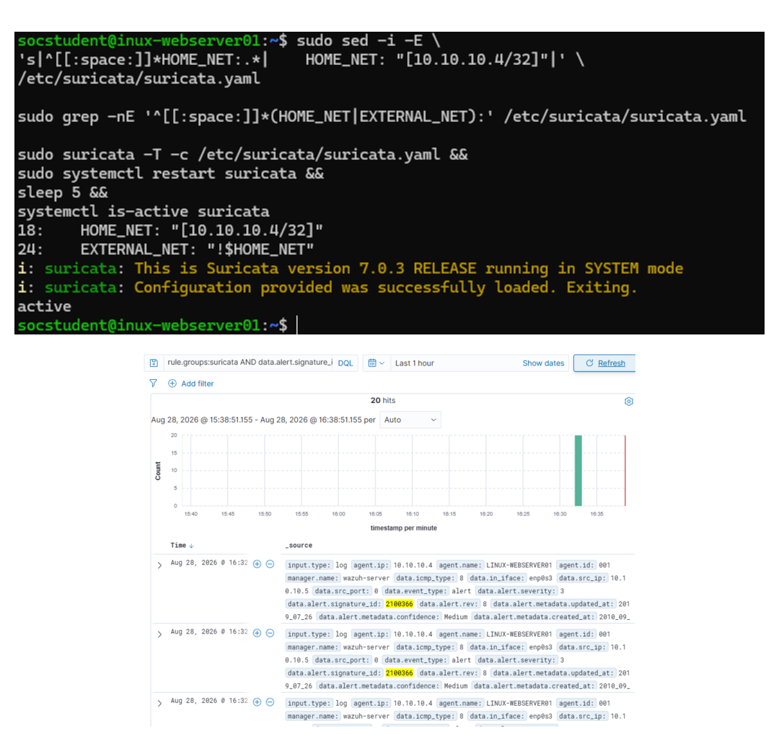
NETWORK IDS & SIEM VALIDATION
COMPLETED • VALIDATED
Suricata + Wazuh IDS monitoring
A network sensor converted controlled ICMP and HTTP traffic into searchable Wazuh alerts with preserved context.
DISPOSITION
21 end-to-end alerts validated across default and custom detections.
20 ICMP alerts • 1 custom HTTP alert • 15 verified artifacts
SURICATA IDS + WAZUH • STAKEHOLDER RECAP • Ryan Bryant • August 28, 2026
01
Notes:
[Sources]
- Direct lab evidence captured by Ryan Bryant, August 28, 2026.
- https://documentation.wazuh.com/current/proof-of-concept-guide/integrate-network-ids-suricata.html (accessed August 28, 2026)
[/Sources]

Slide 2
EXECUTIVE OUTCOME
Twenty-one alerts validated the full monitoring chain
The lab proved sensor health, EVE JSON collection, default and custom rule matching, and evidence integrity.
20
1
15
default ICMP alerts
custom HTTP alert
verified artifacts
SID 2100366 matched each controlled echo request.
SID 1000001 captured GET /soc-lab-admin-test.
Configuration, tests, alerts, and timestamps passed SHA-256.
EXECUTIVE CONCLUSION
Suricata detected traffic without disrupting service; Wazuh preserved the network and HTTP context needed for triage.
SURICATA IDS + WAZUH • STAKEHOLDER RECAP • Ryan Bryant • August 28, 2026
02
Notes:
[Sources]
- Direct lab alert exports and SHA-256 verification, August 28, 2026.
[/Sources]

Slide 3
DETECTION CHAIN
Packet visibility became actionable SIEM telemetry
Each stage was validated before the next service or rule change was accepted.
Configure & validate
Exercise coverage
Correlate & verify
01
02
03
Suricata 7.0.3 monitored enp0s3 with HOME_NET scoped to 10.10.10.4/32; syntax and service health were verified.
Parrot generated 20 ICMP requests and one lab-only HTTP path request while the protected web service remained available.
Wazuh indexed 21 alerts with source, destination, signature, protocol, and HTTP context; 15 artifacts passed SHA-256.
Control point: sensor configuration and Wazuh collector syntax were validated before each restart.
SURICATA IDS + WAZUH • STAKEHOLDER RECAP • Ryan Bryant • August 28, 2026
03
Notes:
[Sources]
- Direct lab configuration and service-status evidence, August 28, 2026.
- https://docs.suricata.io/en/latest/output/eve/eve-json-format.html (accessed August 28, 2026)
- https://documentation.wazuh.com/current/user-manual/reference/ossec-conf/localfile.html (accessed August 28, 2026)
[/Sources]

Slide 4
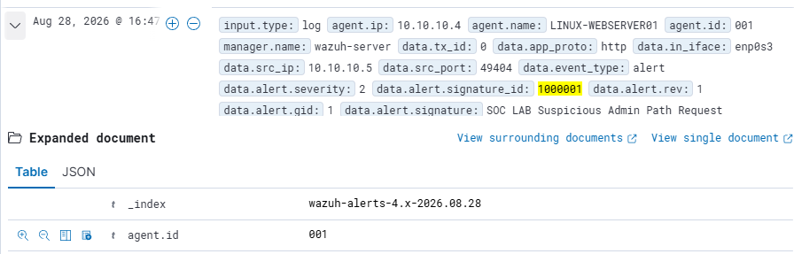
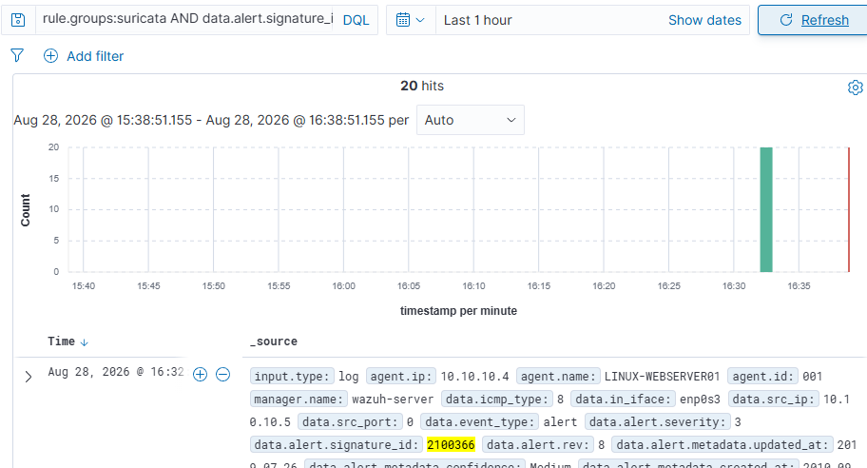
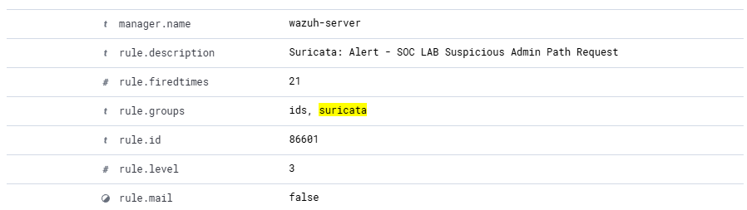
EVIDENCE
The SIEM preserved default and custom detection context
Screenshots confirm alert volume, signature IDs, source, destination, protocol, URI, status, and rule metadata.
Custom SID 1000001 • GET admin-path request
20 Wazuh hits • Suricata SID 2100366 • rule 86601
URI /soc-lab-admin-test • HTTP 404 • source 10.10.10.5
SURICATA IDS + WAZUH • STAKEHOLDER RECAP • Ryan Bryant • August 28, 2026
04
Notes:
[Sources]
- Direct Wazuh Discover screenshots and Suricata alert exports, August 28, 2026.
[/Sources]

Slide 5
RISK AND OPERATING IMPACT
The IDS increased visibility without service disruption
The exercise validates monitoring behavior, not enterprise-scale throughput or attacker attribution.
DETECTION VALUE
AVAILABILITY
EVIDENCE CONFIDENCE
Network activity became searchable
The web service remained online
Counts and artifacts reconciled
Default and custom Suricata alerts reached Wazuh with packet, flow, signature, and HTTP fields.
ICMP returned 20/20 and Apache answered the controlled request while Suricata observed passively.
The 20-to-20 and 1-to-1 alert paths matched; all 15 preserved files passed SHA-256.
Limit: this controlled lab did not measure encrypted-traffic visibility, false-positive rates, packet loss under load, or production retention.
SURICATA IDS + WAZUH • STAKEHOLDER RECAP • Ryan Bryant • August 28, 2026
05
Notes:
[Sources]
- Direct lab availability, alert-count, and integrity evidence, August 28, 2026.
[/Sources]

Slide 6
RECOMMENDED NEXT STEPS
Operationalize the network detection capability
Priorities address sensor health, rule governance, alert quality, and cross-source triage.
Sensor health
Alert on interface loss, Suricata failure, stale EVE output, agent gaps, and missing Wazuh ingestion.
01
Rule governance
Version-control local rules and require syntax validation, peer review, and rollback paths before deployment.
02
Noise tuning
Baseline alert volume, add thresholds and exceptions, and document tuning decisions without weakening coverage.
03
Cross-source correlation
Join network alerts with endpoint and authentication telemetry to increase confidence and speed triage.
04
Decision request: preserve the integration and advance to a tuned pilot with health monitoring and rule-change controls.
SURICATA IDS + WAZUH • STAKEHOLDER RECAP • Ryan Bryant • August 28, 2026
06
Notes:
[Sources]
- Recommendations are analyst inferences from the controlled lab findings.
- https://docs.suricata.io/en/latest/rules/intro.html (accessed August 28, 2026)
- https://docs.suricata.io/en/latest/rule-management/suricata-update.html (accessed August 28, 2026)
[/Sources]

