Slide 1
RB.
INCIDENT RECAP
CONTROLLED SECURITY EXERCISE · 24 AUGUST 2026
Web Attack Simulation
Incident Recap
EXERCISE STATUS
Closed
No compromise confirmed
Packet capture, host-log correlation, impact assessment, and evidence preservation across an isolated Parrot-to-Ubuntu lab.
10.10.10.5 → 10.10.10.4
Parrot Security to Ubuntu Server
AUTHORIZED
ISOLATED
EVIDENCE-LED
RYAN BRYANT · STAKEHOLDER INCIDENT RECAP
01
Notes:
Open by stating that this is a controlled home-lab simulation, not a real breach. The business takeaway is that the evidence shows multiple suspicious behaviors but no successful compromise.
[Sources]
- Author-generated lab evidence, 24 August 2026
- https://www.wireshark.org/docs/wsug_html_chunked/

Slide 2
RB.
EXECUTIVE OUTCOME
DECISION-READY SUMMARY
Suspicious activity was visible. Impact was not.
0
4
6
784
confirmed compromises
activity phases
hashed evidence files
captured packets
WHAT LEADERS SHOULD KNOW
The target stayed available. The traversal request was rejected (400), the SQLi-shaped request reached a missing endpoint (404), and all three SSH attempts were denied. No data disclosure, authenticated session, persistence, or outage was observed.
RYAN BRYANT · STAKEHOLDER INCIDENT RECAP
02
Notes:
Emphasize evidence-based language: attempted activity does not equal successful exploitation. These metrics come from the saved PCAP, server logs, and integrity manifest.
[Sources]
- Author PCAP: web-attack-incident-2026-08-24.pcapng
- Author Apache and OpenSSH log excerpts
- https://httpd.apache.org/docs/2.4/logs.html

Slide 3
RB.
EVENT TIMELINE
WHAT HAPPENED
A short, controlled sequence created a clear timeline
18:17
18:21
18:29
18:35
18:44–46
Baseline
Recon
Traversal
SQLi-shaped
SSH attempts
HTTP GET / returned 200
22/80 open · 8080 filtered
Malformed request returned 400
Missing endpoint returned 404
Three invalid-user denials
Exercise window bounded by saved lab-start.txt and lab-end.txt timestamps.
RYAN BRYANT · STAKEHOLDER INCIDENT RECAP
03
Notes:
Walk left to right. The exact timestamps and labels allow the packet capture and host logs to be joined into one chronology.
[Sources]
- Author Apache log excerpt, 24 August 2026
- Author OpenSSH auth.log excerpt, 24 August 2026
- Author start/end timestamp files

Slide 4
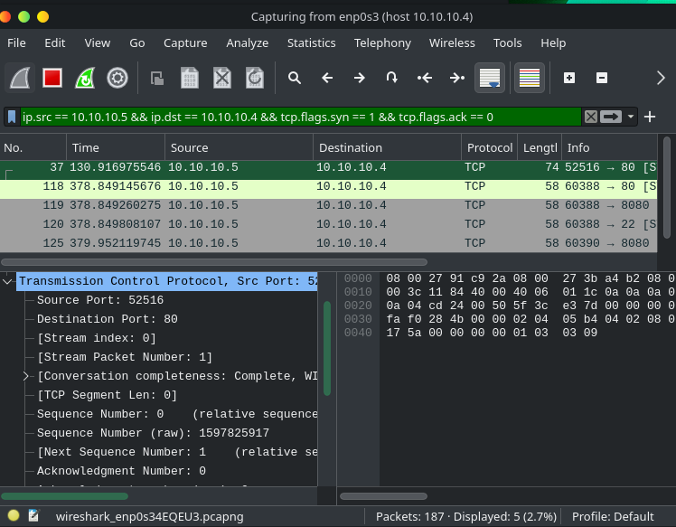
RB.
NETWORK EVIDENCE
WIRESHARK + NMAP
Reconnaissance exposed the attack surface—not a breach
OBSERVED
22/tcp
OPEN · SSH
80/tcp
OPEN · HTTP
8080/tcp
FILTERED
Interpretation: discovery activity; no payload execution or post-exploitation behavior.
RYAN BRYANT · STAKEHOLDER INCIDENT RECAP
04
Notes:
A SYN scan determines which ports respond. Nmap defines an open port as an application actively accepting TCP connections; filtered indicates that probes cannot determine whether a port is open, often because packet filtering blocks the probes.
[Sources]
- Author Wireshark screenshot: 7d835dd0-883f-401f-ba85-e4ec61e23dd8.png
- https://nmap.org/book/synscan.html
- https://nmap.org/book/man-port-scanning-basics.html

Slide 5
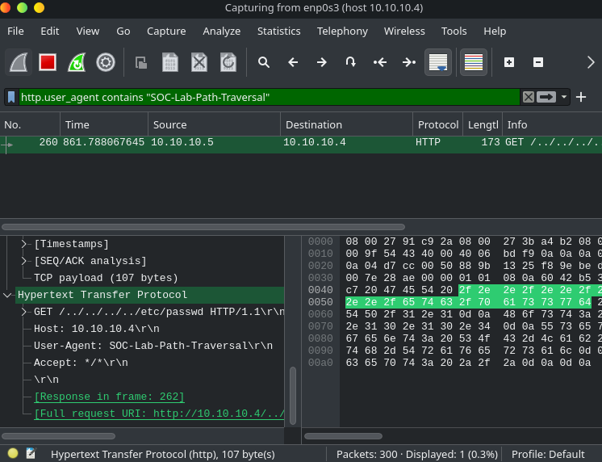
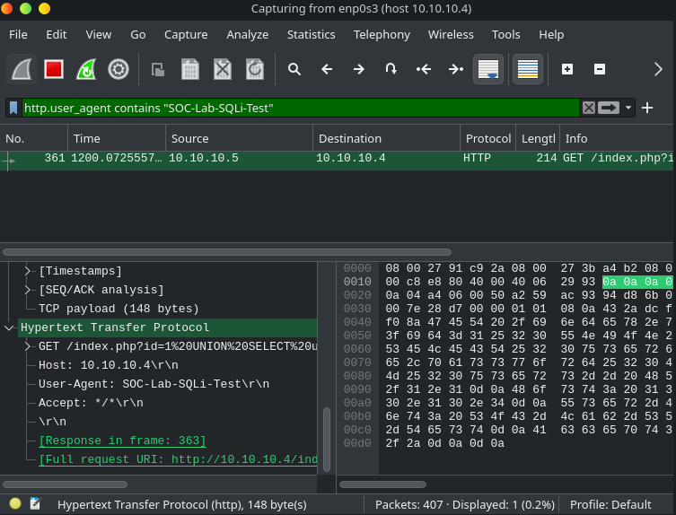
RB.
WEB EVIDENCE
APPLICATION-LAYER ACTIVITY
Two attack-shaped requests; two defensive outcomes
PATH TRAVERSAL
HTTP 400 · malformed request rejected
SQLI-SHAPED
HTTP 404 · endpoint absent
Neither response demonstrates file disclosure or database execution.
RYAN BRYANT · STAKEHOLDER INCIDENT RECAP
05
Notes:
The exact URIs and unique User-Agent labels are visible in Wireshark and Apache. State the limitation clearly: traffic evidence proves the attempts reached the server, not that they succeeded.
[Sources]
- Author Wireshark screenshots: d007c5bb-6ab2-4278-bd0a-f44a63544394.png and b532cb93-377e-4c31-93e7-a3512b6ad78a.png
- Author Apache access.log excerpt
- https://httpd.apache.org/docs/2.4/logs.html
- https://attack.mitre.org/techniques/T1190/

Slide 6
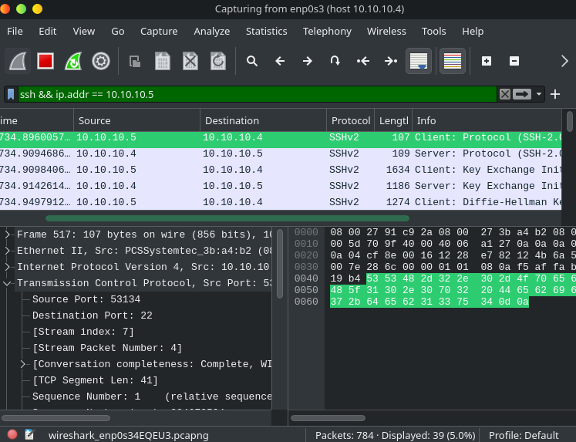
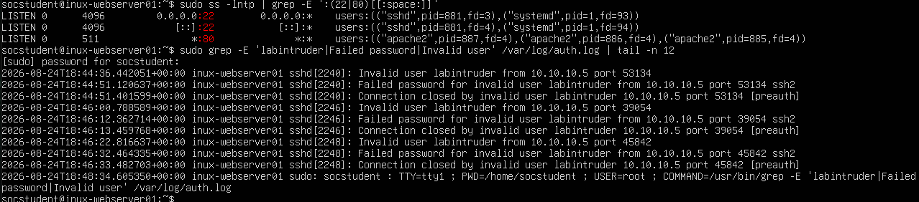
RB.
IDENTITY EVIDENCE
AUTHENTICATION CONTROLS
Three failed SSH attempts were denied and corroborated
PORT CORRELATION
Wireshark source port 53134 matches the first auth.log attempt.
Outcome: invalid user · failed password · connection closed · no authenticated session
RYAN BRYANT · STAKEHOLDER INCIDENT RECAP
06
Notes:
Explain why source-port correlation matters: it joins network and endpoint views of the same connection. All three attempts ended before authentication succeeded.
[Sources]
- Author Wireshark screenshot: e2828eb6-8d9f-4fe5-8331-122d4c37db5a.png
- Author OpenSSH auth.log screenshot: 72fe4c1b-ef1f-4b93-bf4b-92b6cf3228dd.png
- https://attack.mitre.org/techniques/T1110/001/

Slide 7
RB.
CONFIDENCE + INTEGRITY
WHY THE CONCLUSION IS DEFENSIBLE
Independent evidence sources converge on the same story
PACKET CAPTURE
SERVER LOGS
INTEGRITY MANIFEST
IPs · ports · TCP flags · full HTTP URIs · SSHv2 sessions
Apache status codes · request labels · invalid users · denial events
PCAP · two log excerpts · recon output · start/end timestamps
HIGH-CONFIDENCE CONCLUSION
SHA-256
Attempts occurred; controls held; no compromise was demonstrated.
6 / 6
RYAN BRYANT · STAKEHOLDER INCIDENT RECAP
07
Notes:
Confidence comes from corroboration, not a single screenshot. The hash manifest makes later integrity checks possible; Wireshark display filters change the view, not the contents of the saved capture.
[Sources]
- Author SHA-256 manifest screenshot: de5bbb02-1cd3-4420-8aa2-e0483f0a8ef9.png
- https://www.wireshark.org/docs/wsug_html_chunked/ChWorkDisplayFilterSection.html

Slide 8
RB.
NEXT ACTIONS
RECOMMENDATIONS
FINAL DISPOSITION: CLOSED
Keep the controls that worked. Close the gaps before exposure.
01
Reduce exposure
Keep unused ports filtered; publish only required services.
02
Harden identity
Prefer SSH keys; limit password auth; add rate limiting.
03
Protect applications
Patch, validate inputs, and monitor traversal/SQLi patterns.
04
Improve detection
Alert on scans, invalid users, and repeated failures.
05
Preserve evidence
Synchronize time; retain PCAPs and log excerpts with hashes.
RYAN BRYANT · STAKEHOLDER INCIDENT RECAP
08
Notes:
Close with action ownership rather than attack details. This exercise demonstrated that layered telemetry and basic controls can distinguish suspicious attempts from actual impact.
[Sources]
- https://www.wireshark.org/docs/wsug_html_chunked/
- https://nmap.org/book/man-port-scanning-basics.html
- https://httpd.apache.org/docs/2.4/logs.html
- https://attack.mitre.org/techniques/T1046/
- https://attack.mitre.org/techniques/T1190/
- https://attack.mitre.org/techniques/T1110/001/

