Slide 1
ABCUSA’s Clergy and Congregations
Dr. Ryan Burge
Eastern Illinois University

Slide 2
Survey Background
Sent an email invitation to as many ABC pastors we could find
Conducted from October 25th – November 7th
In total, received a full survey response from 168 clergy

Slide 3
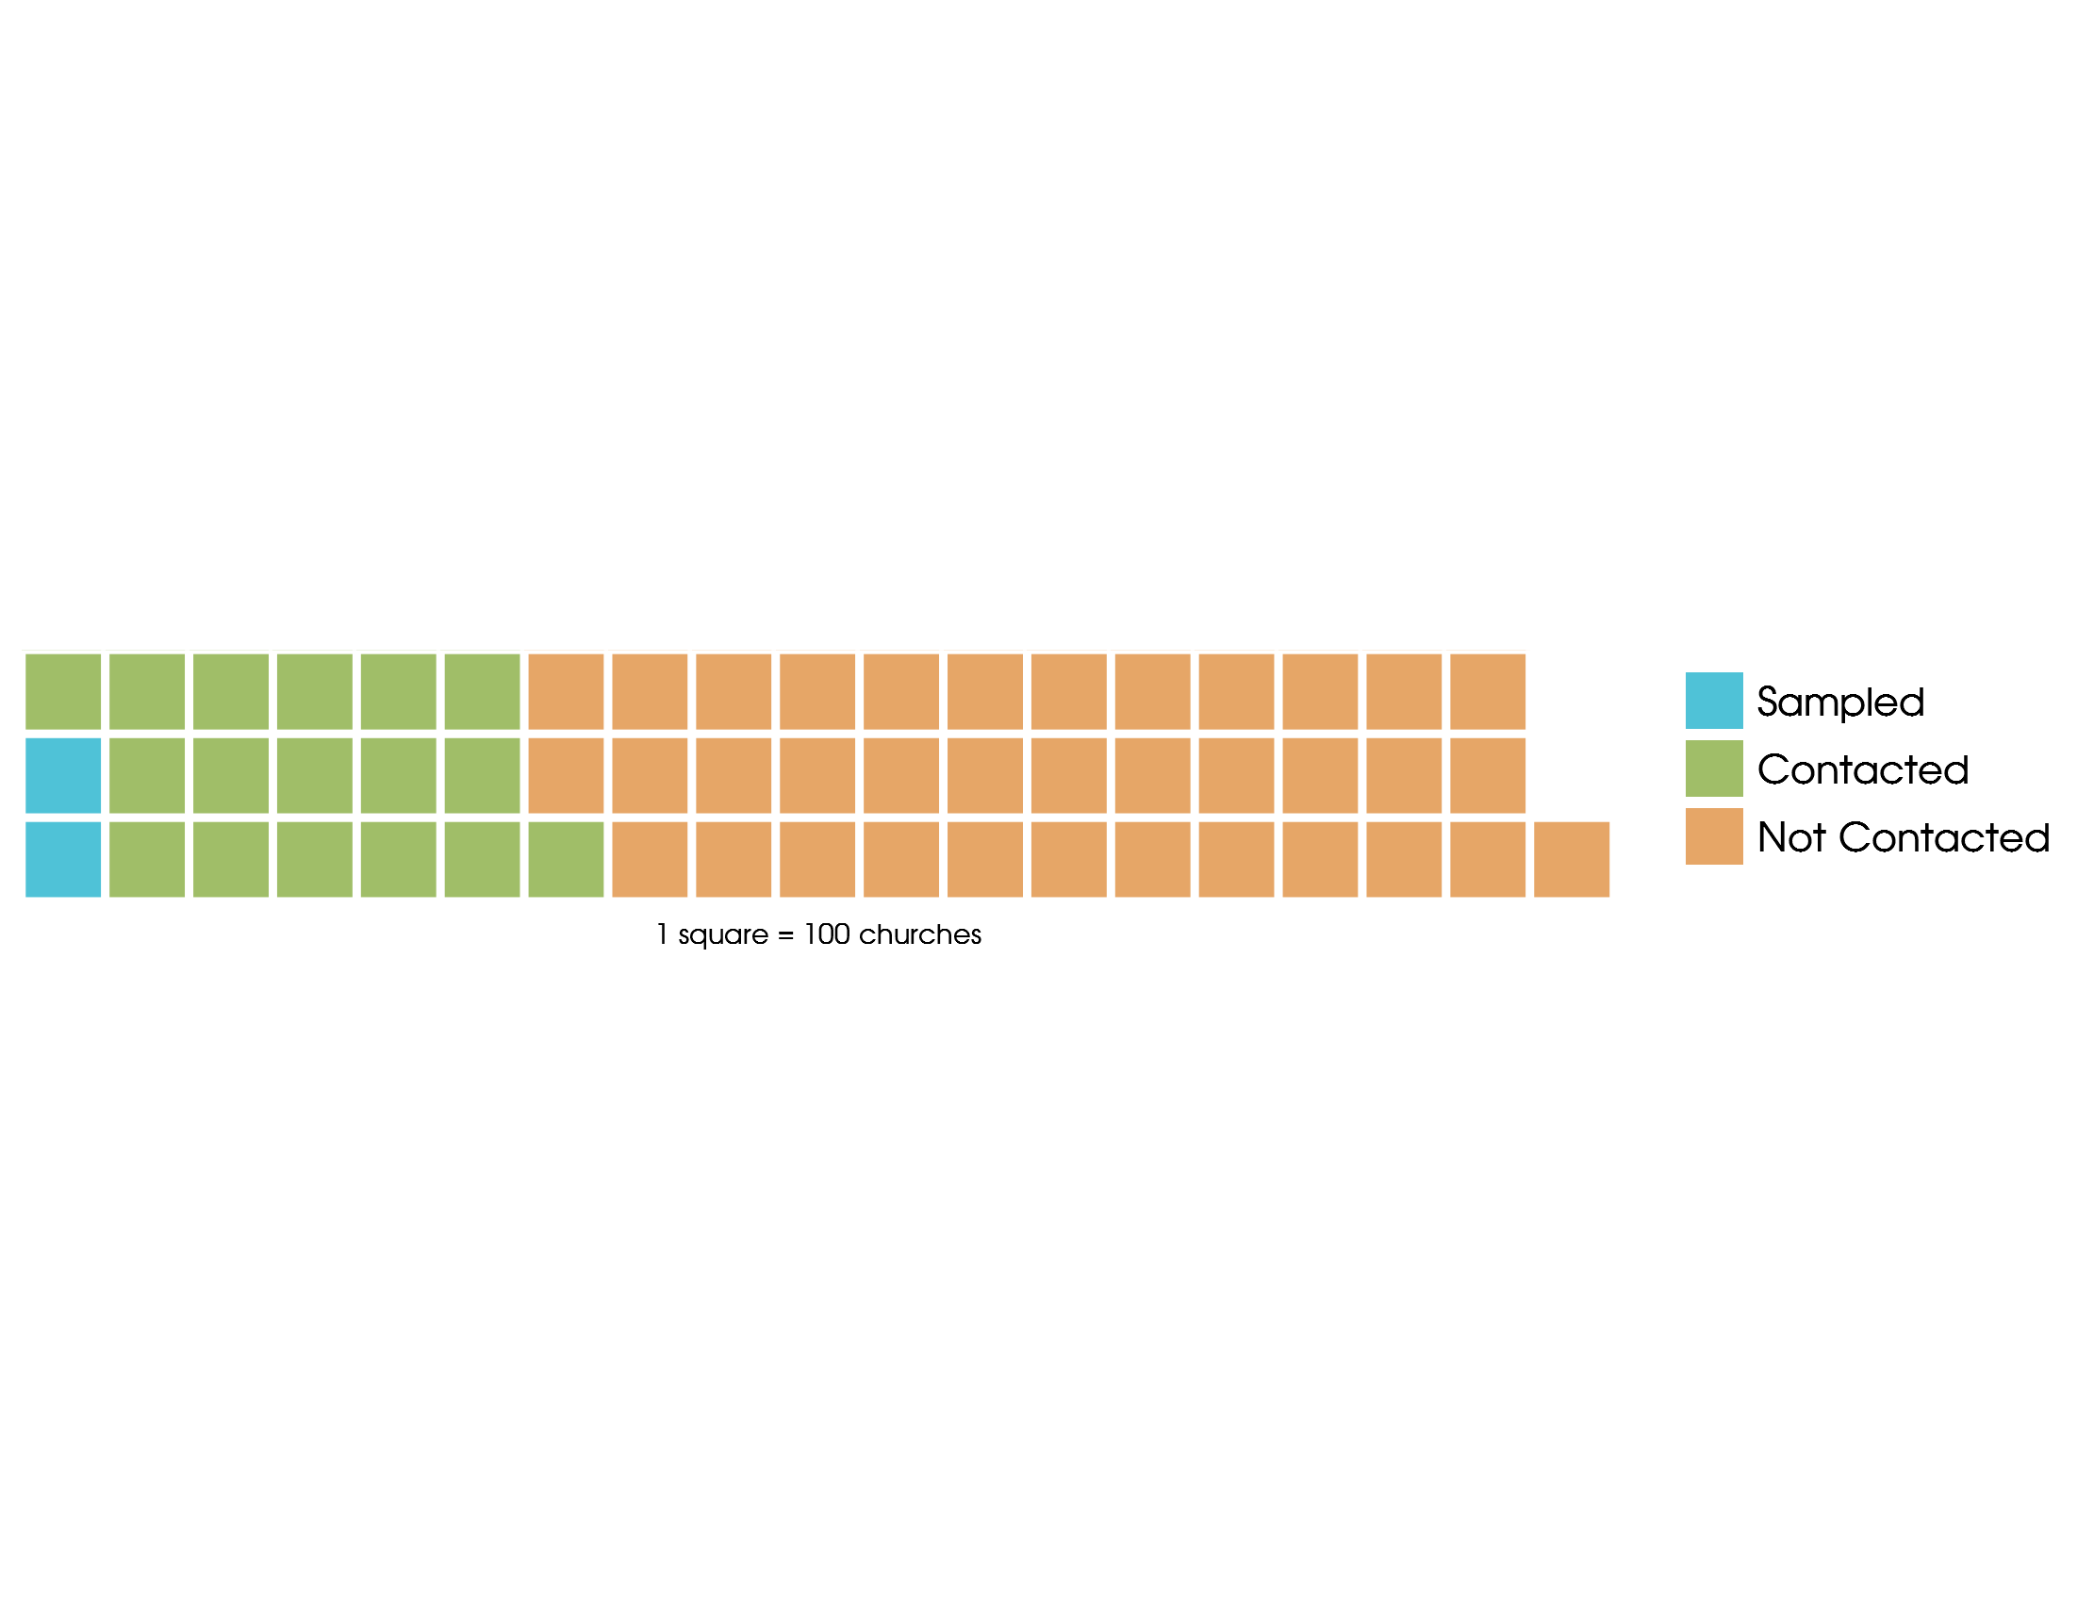

Slide 4
Two Additional Data Sources
Cooperative Clergy Study
Surveys clergy in several established denominations
Greek Orthodox, PCUSA, RCA, SBC, UMC
Provides a good reference group for ABC clergy
Cooperative Congressional Election Study
Large survey of American voters
2016 Survey had 64,600 Respondents
608 ABCUSA self-identified adherents
How are ABC clergy different than ABC laity?

Slide 5
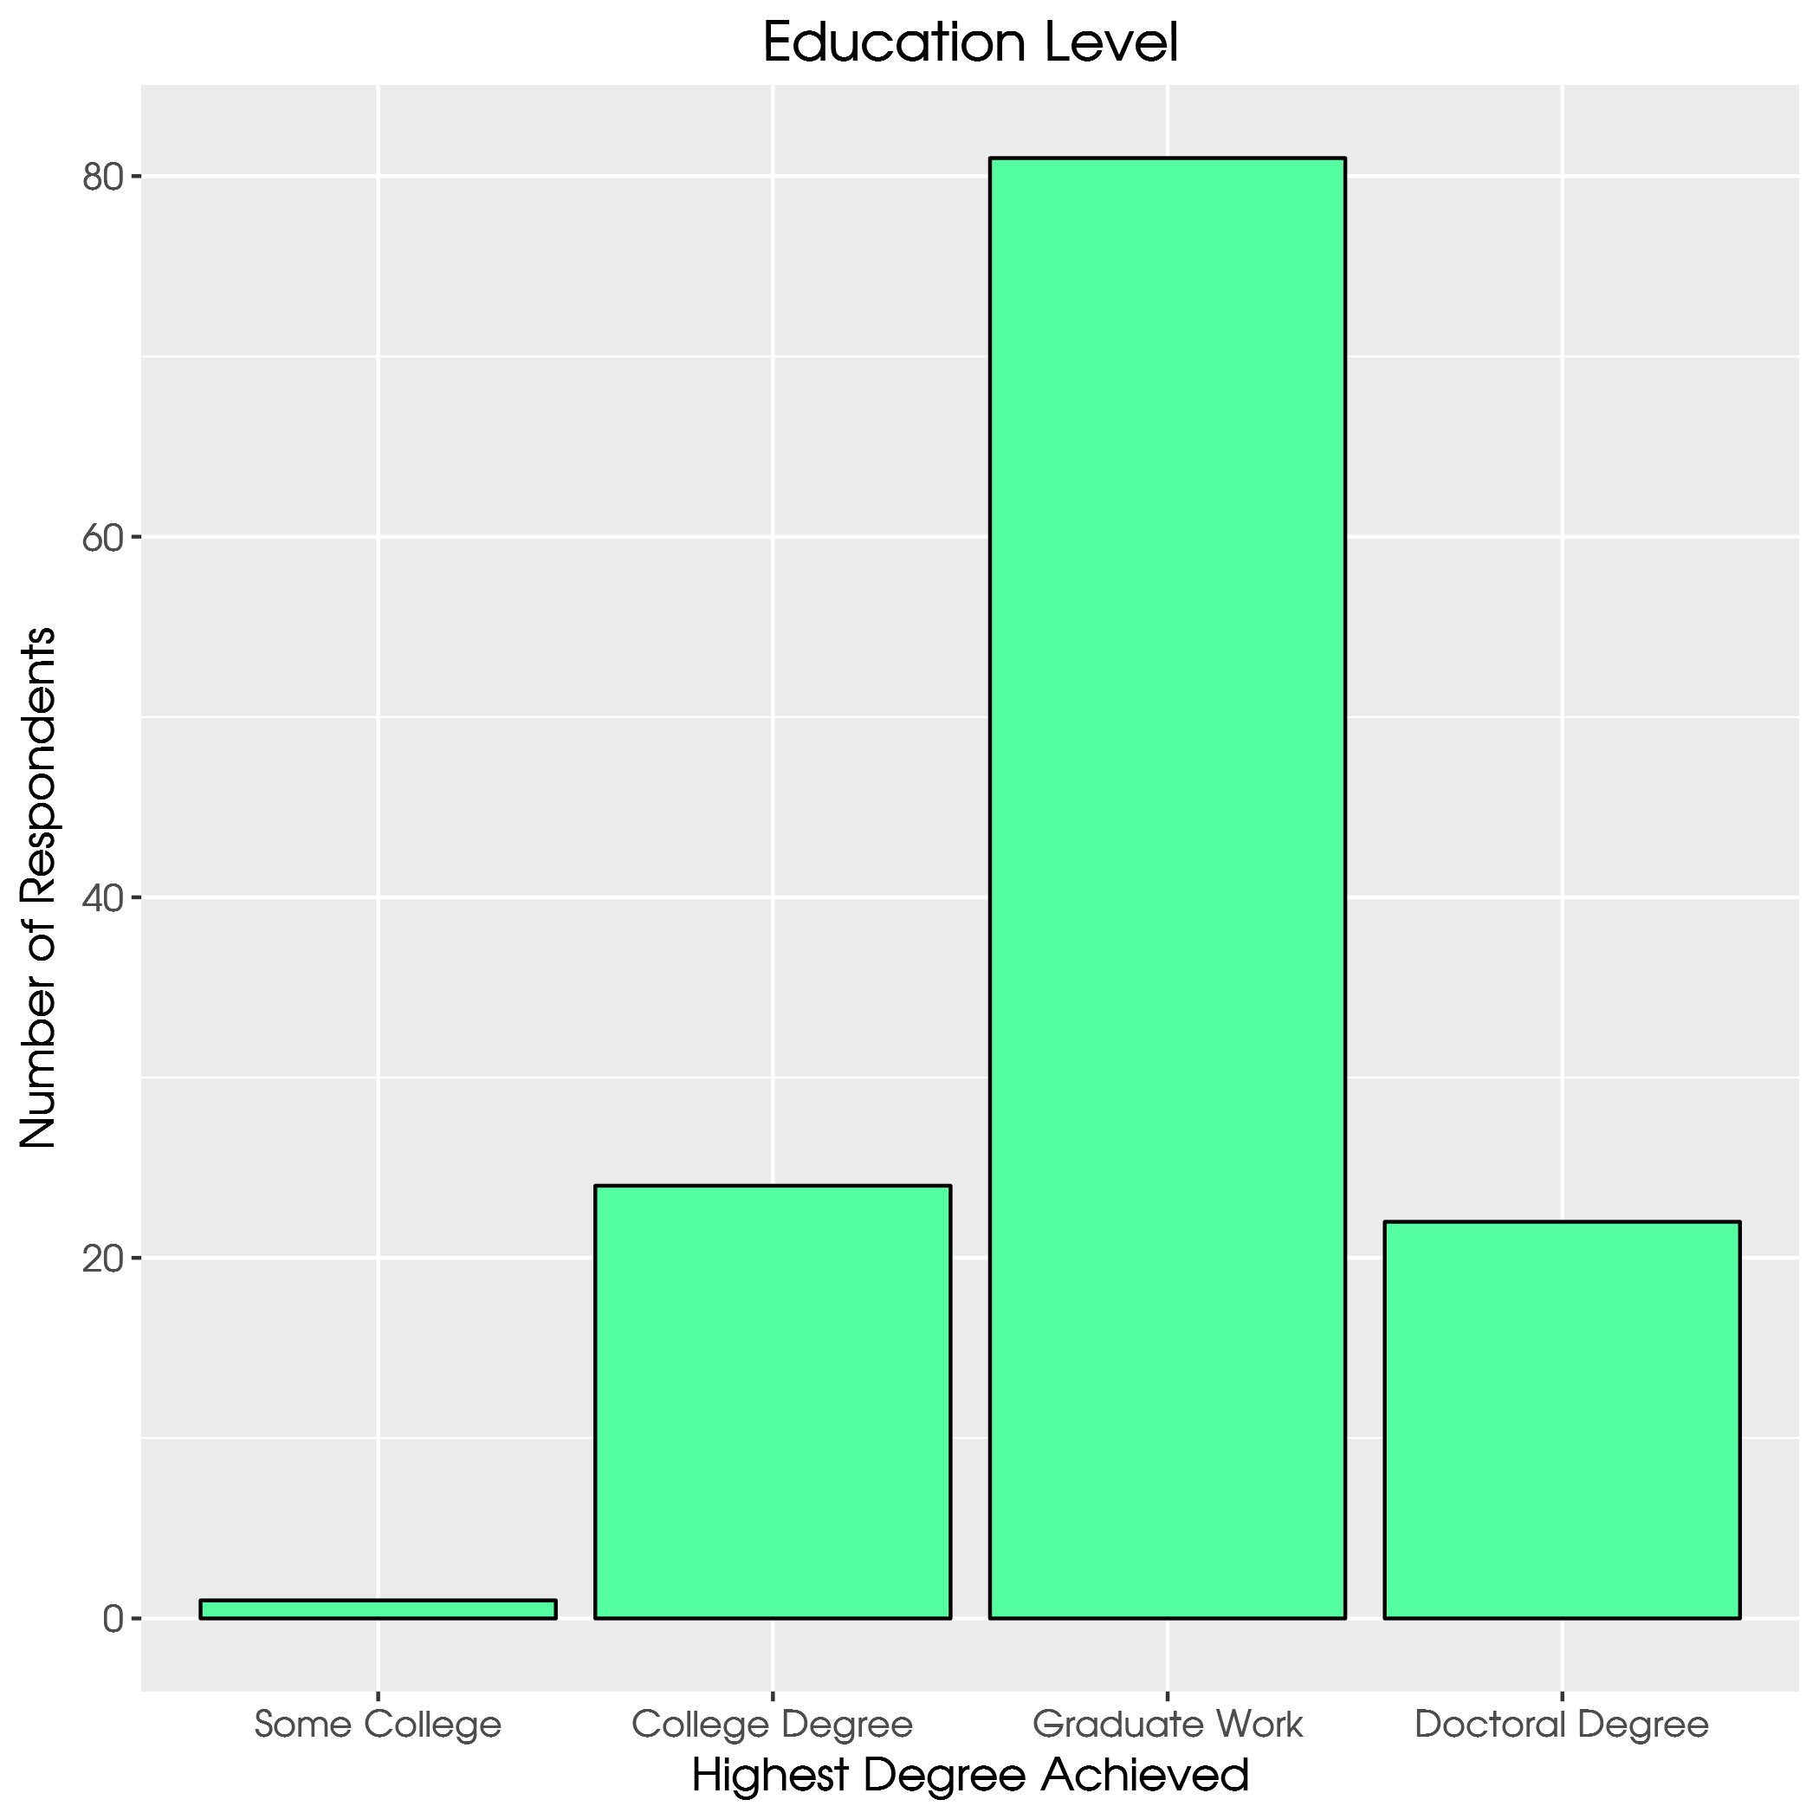

Slide 6
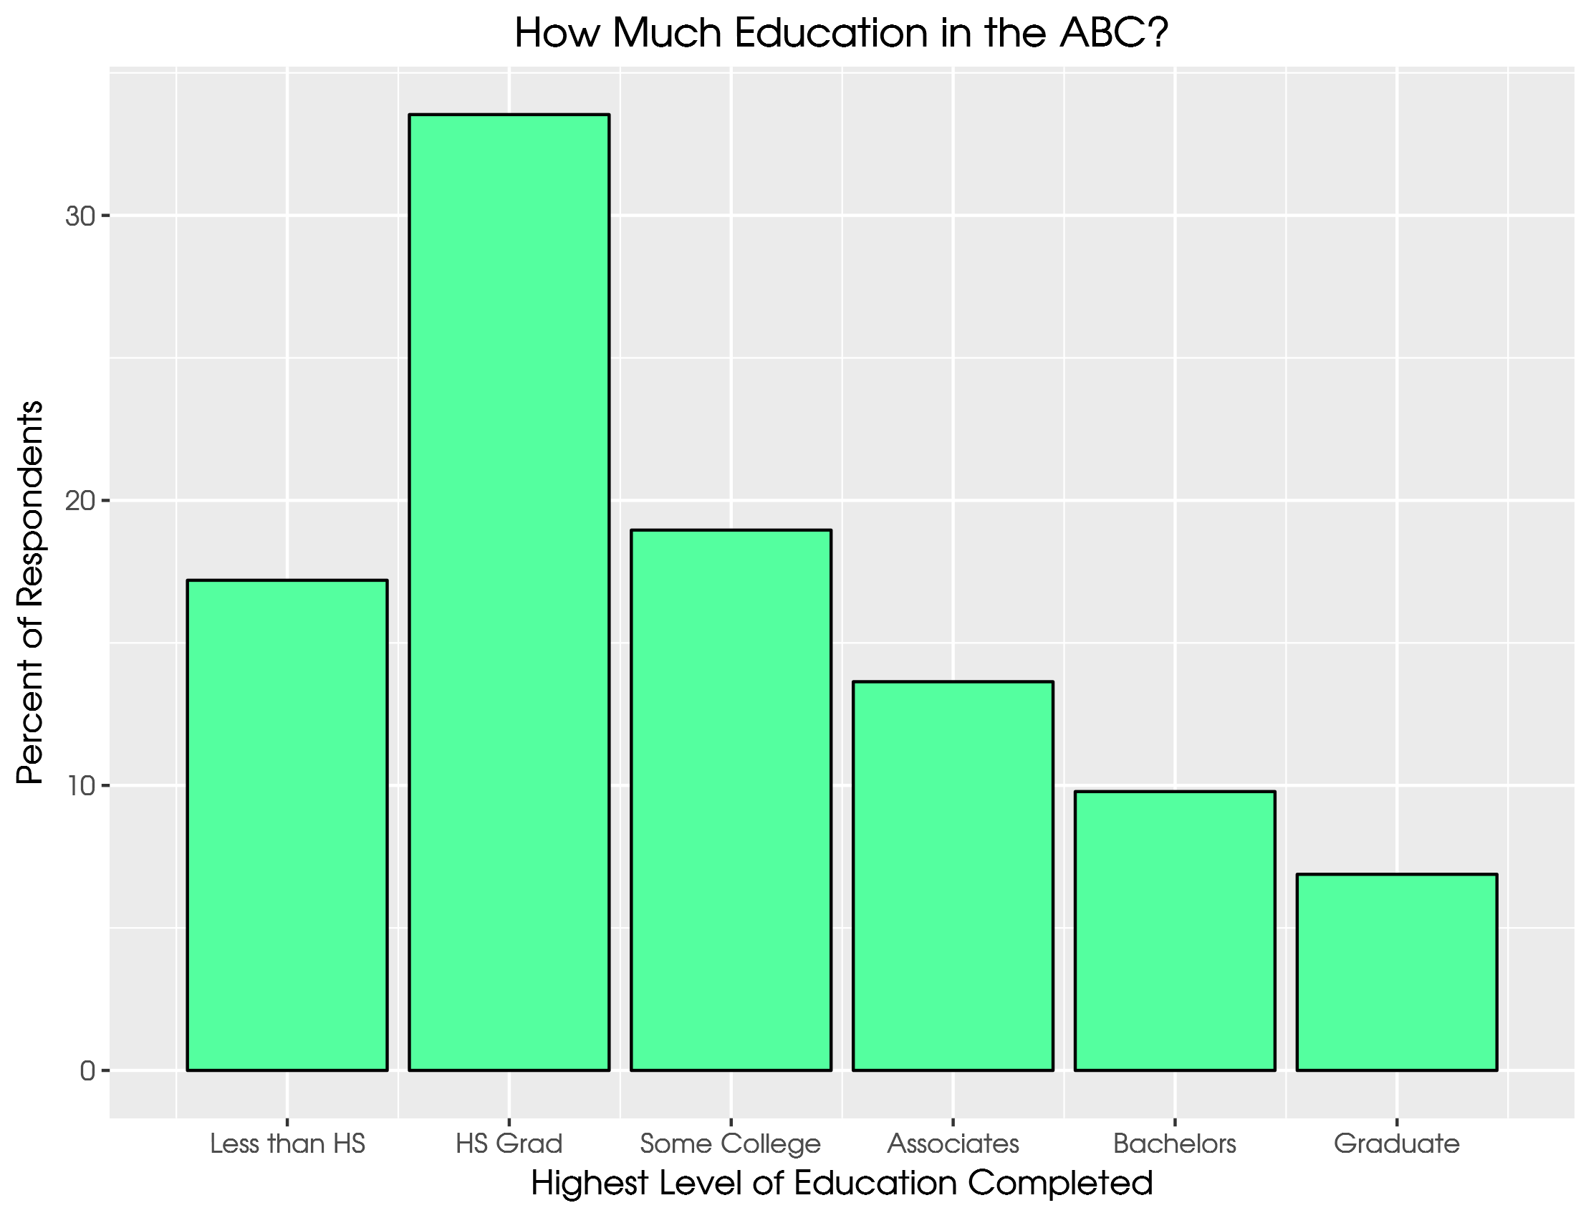

Slide 7
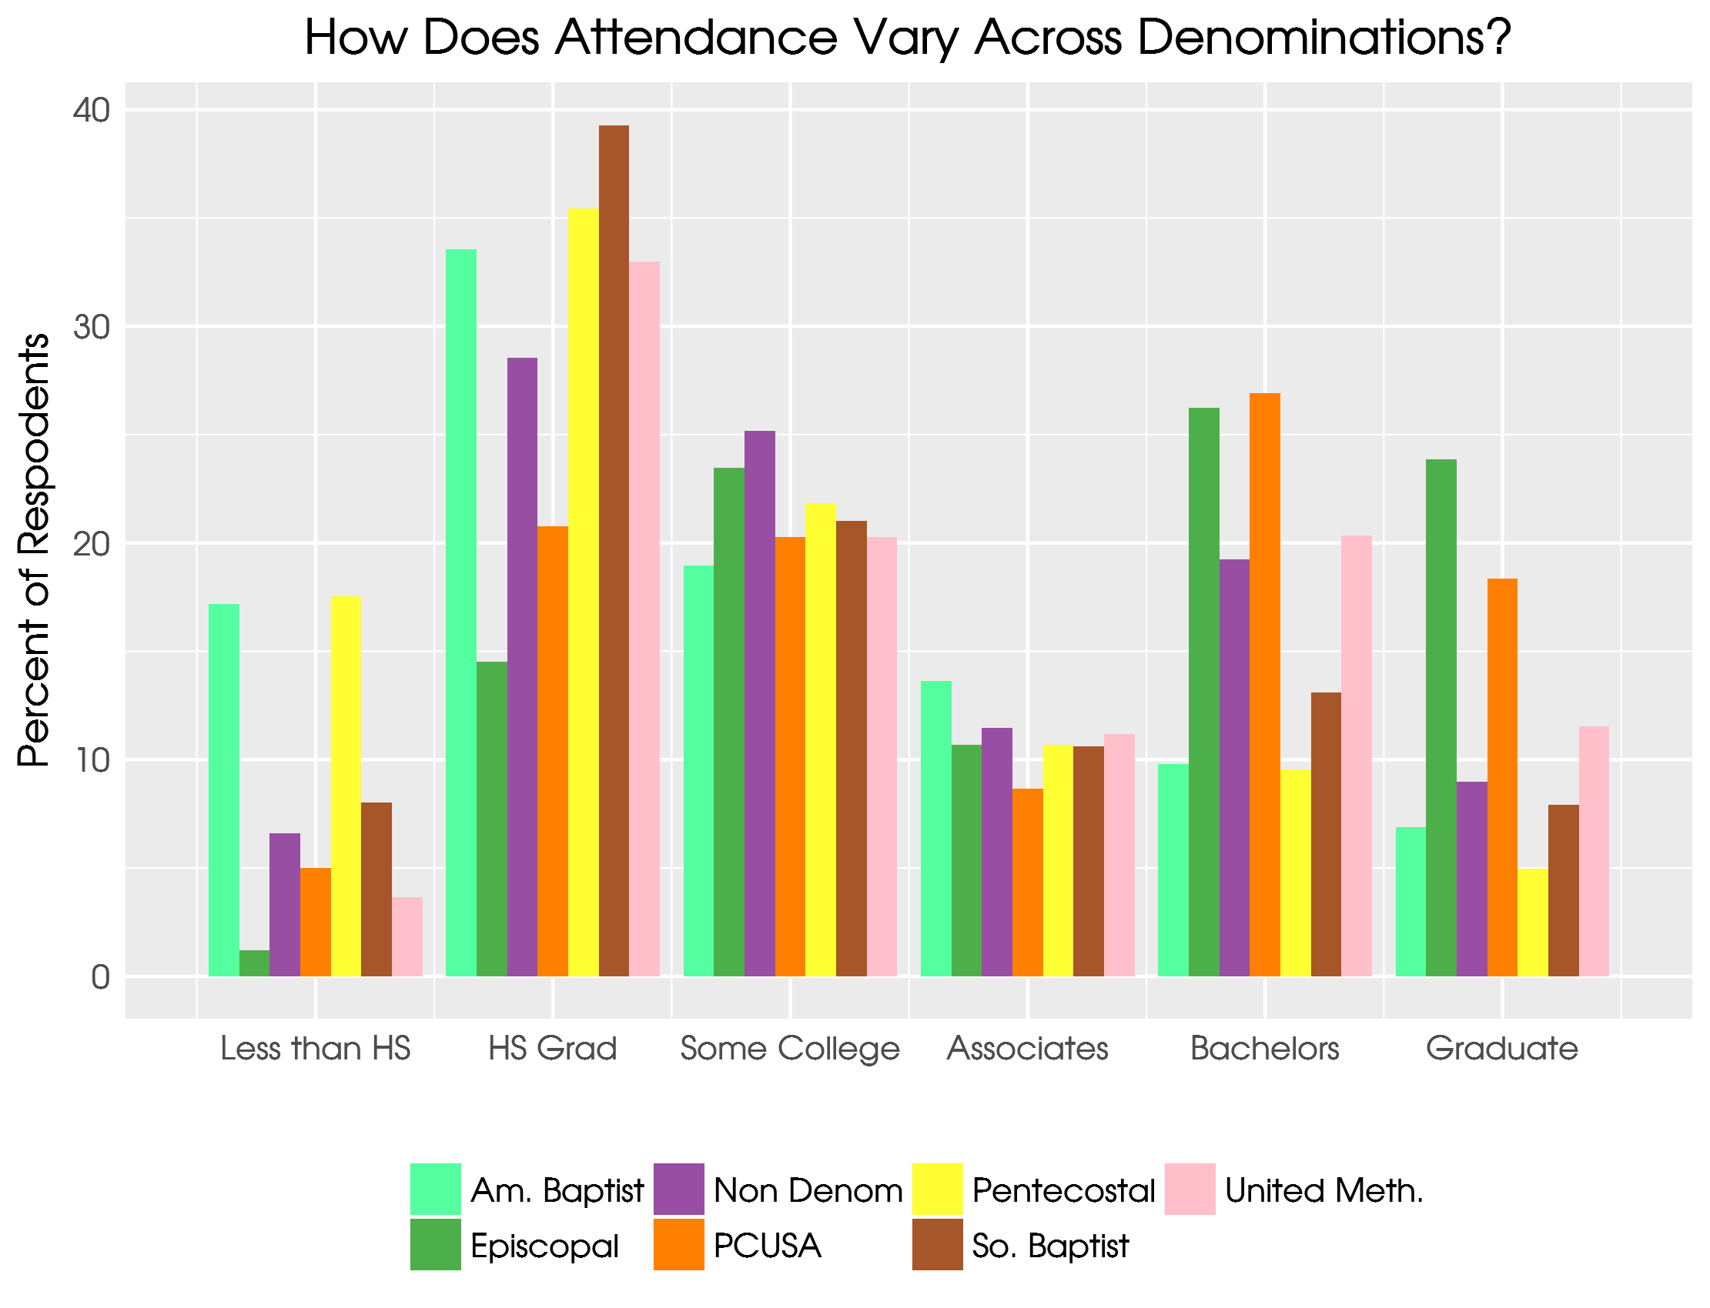

Slide 8
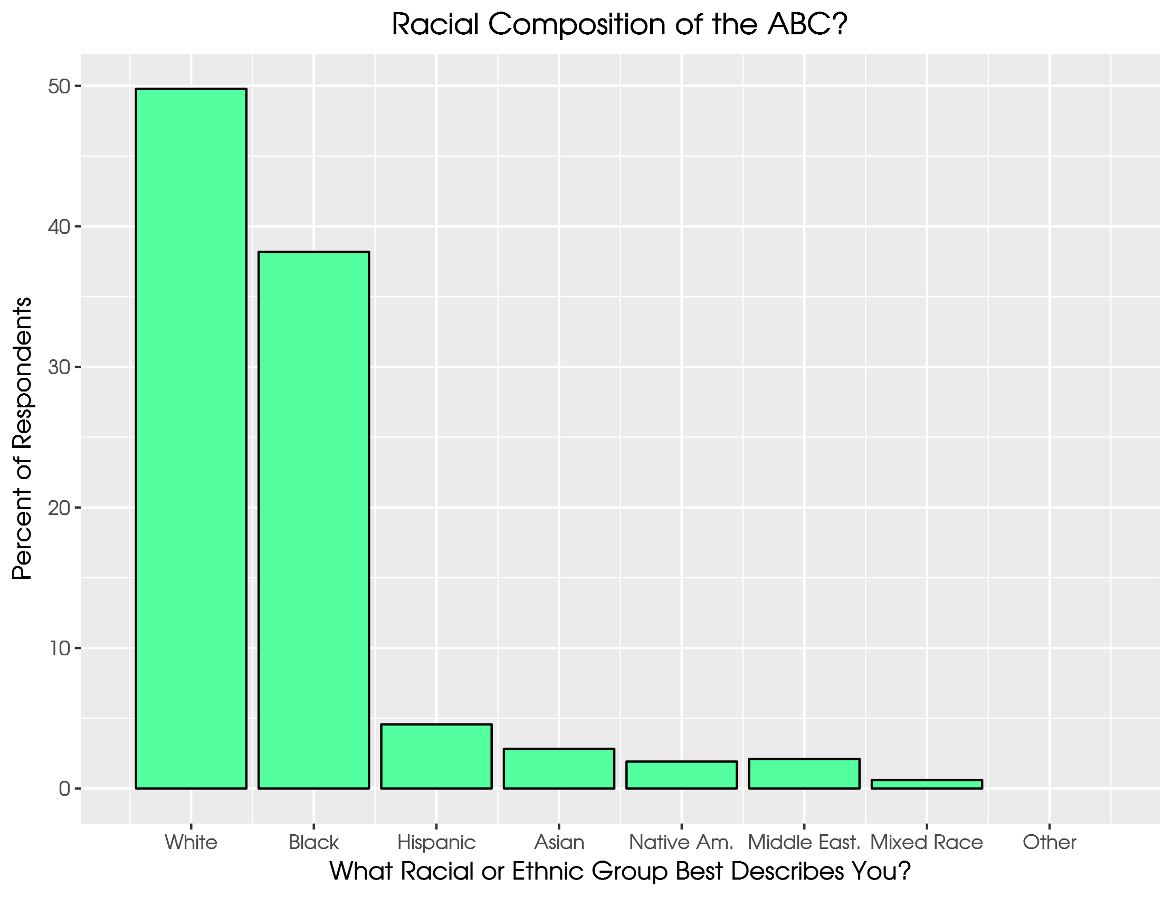

Slide 9
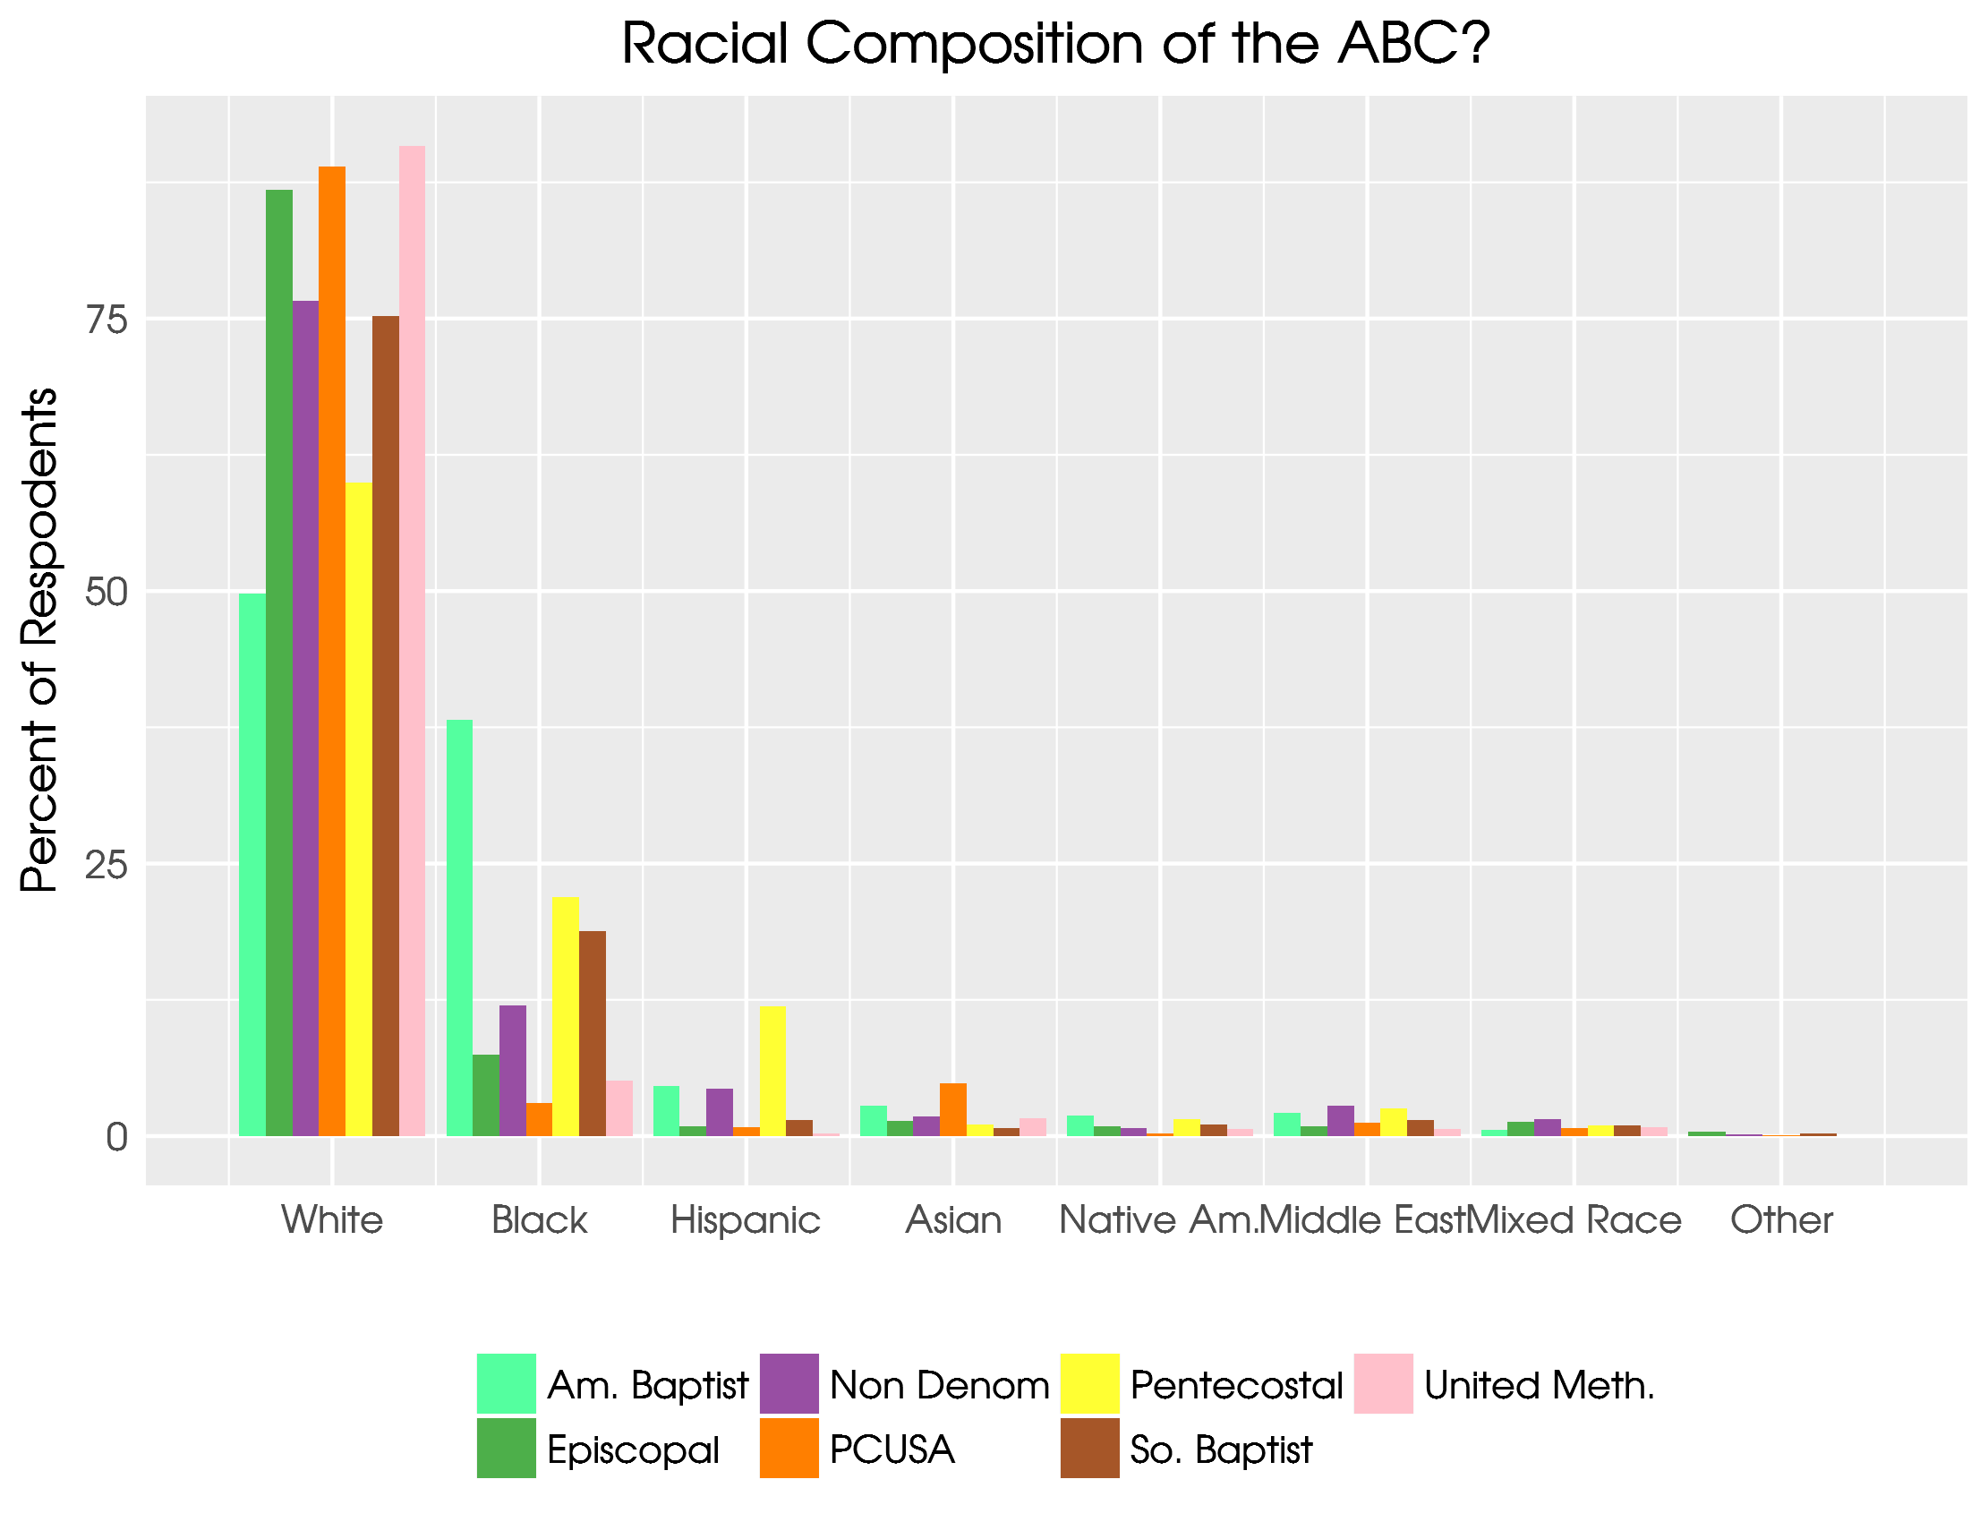

Slide 10
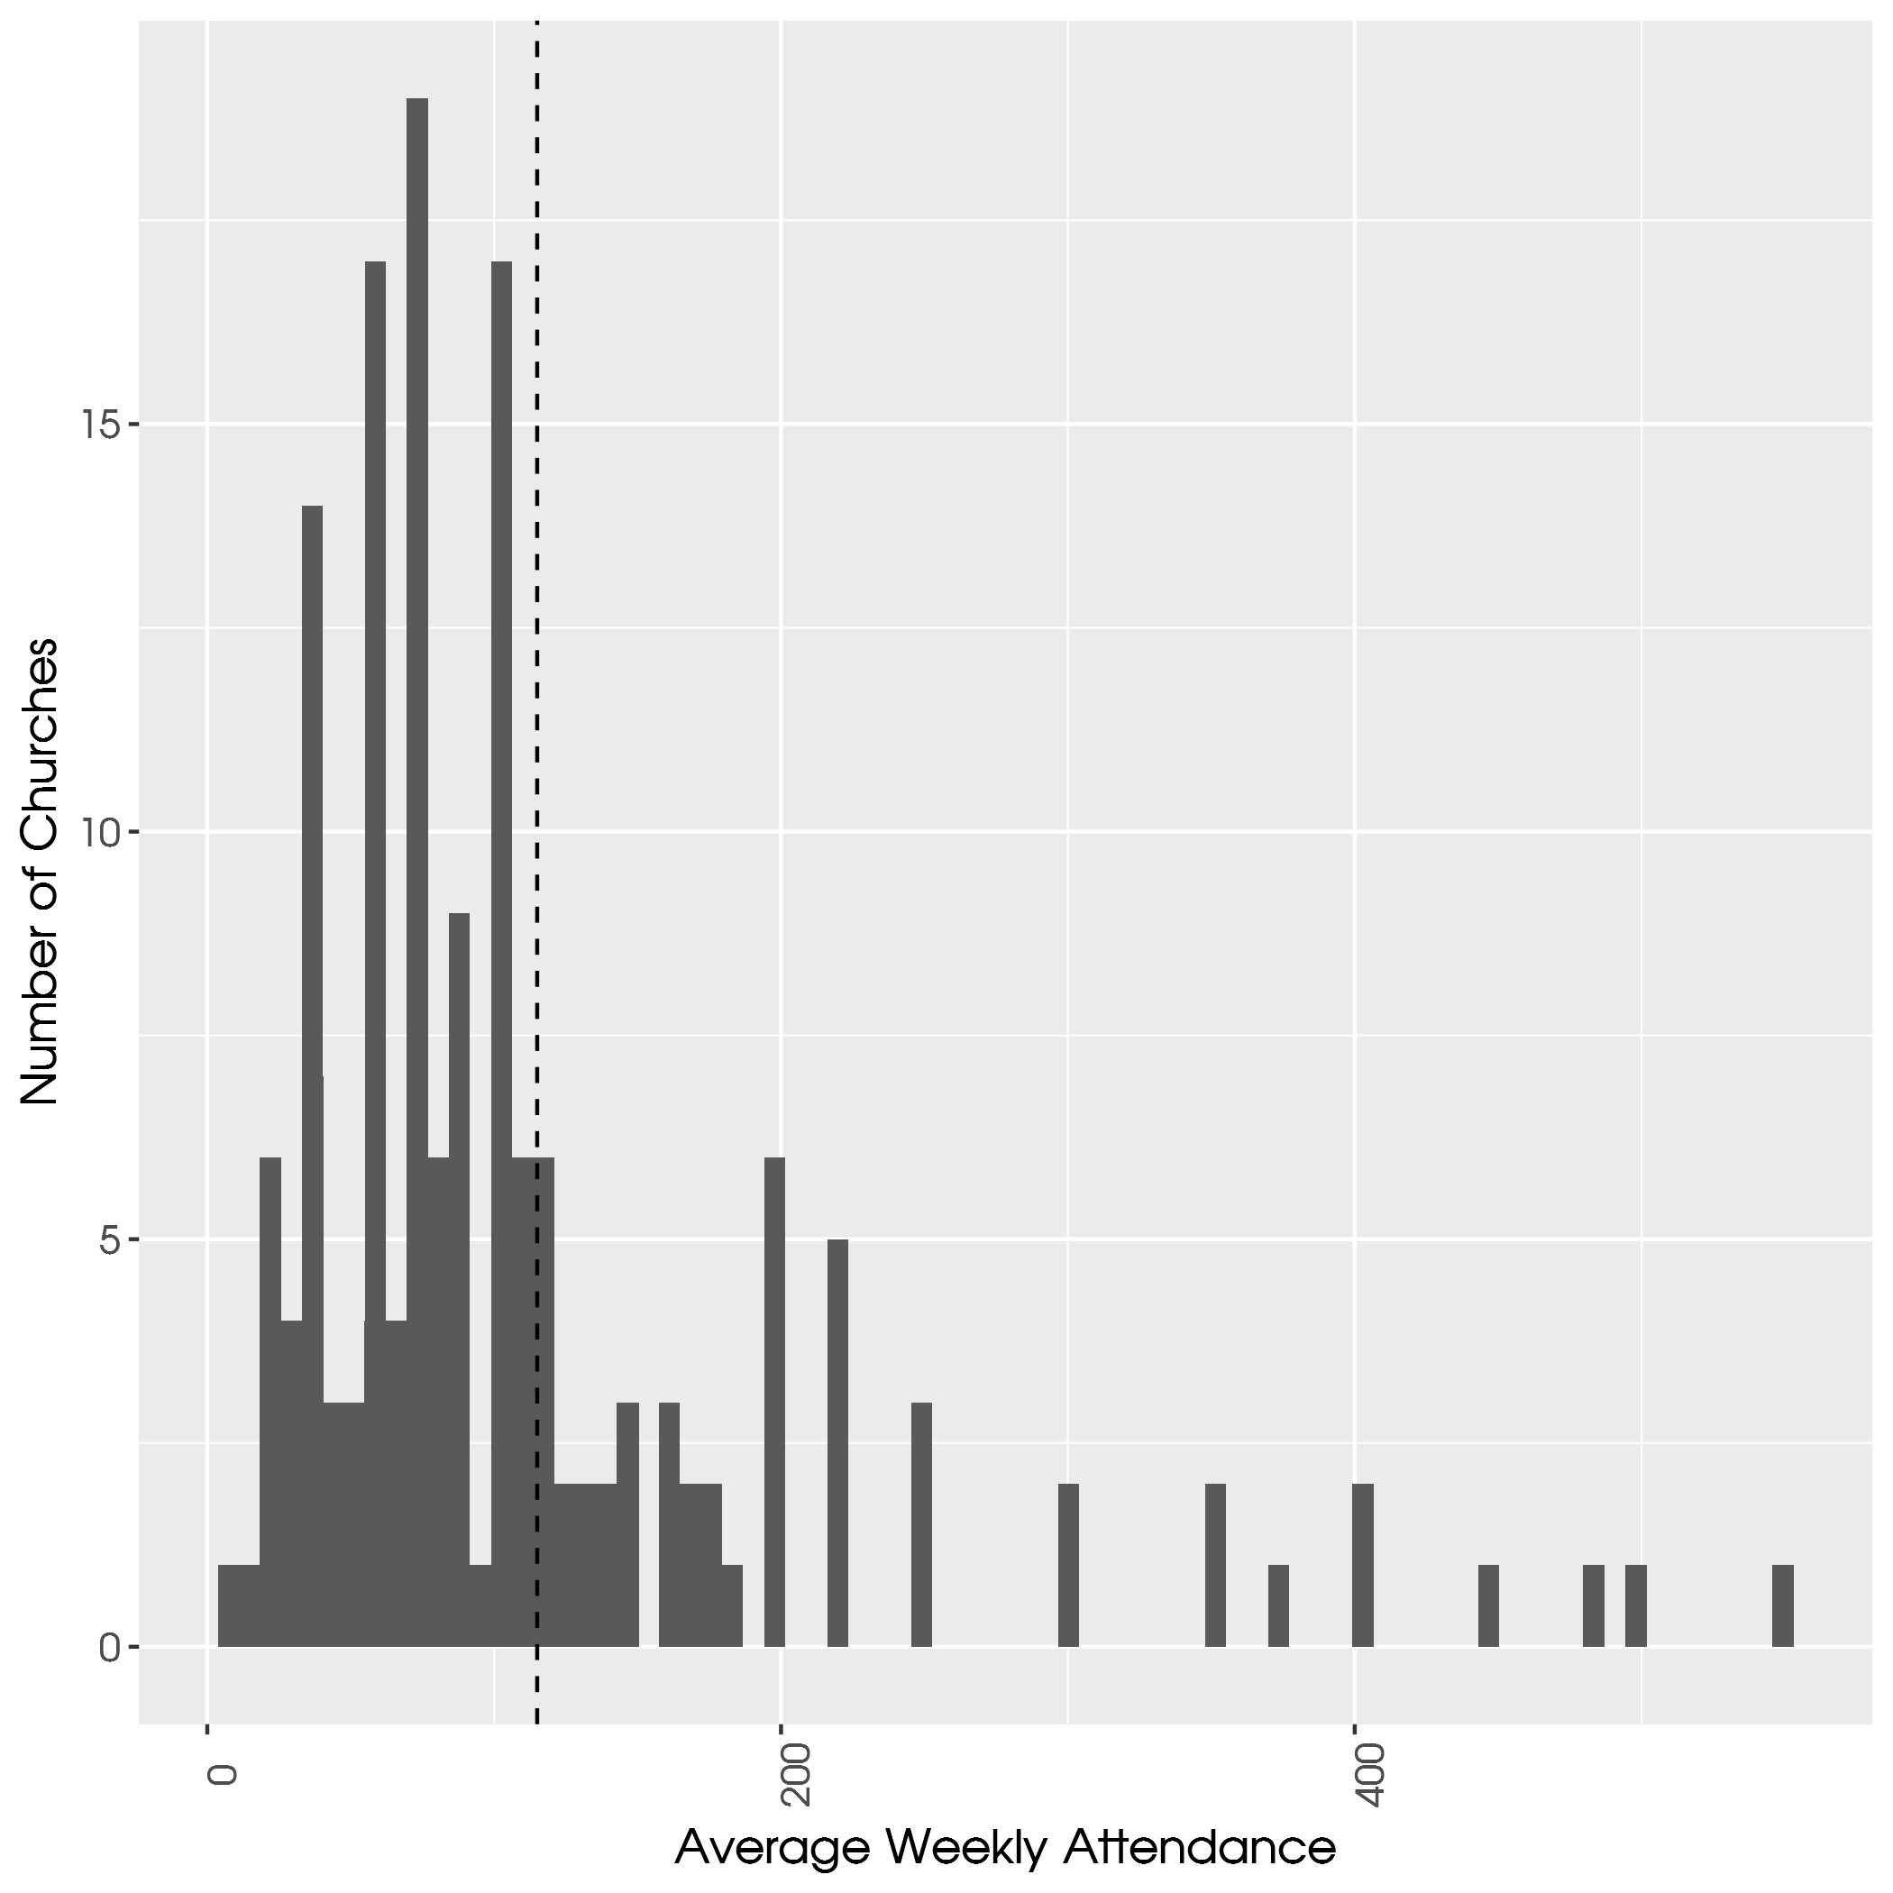

Slide 11
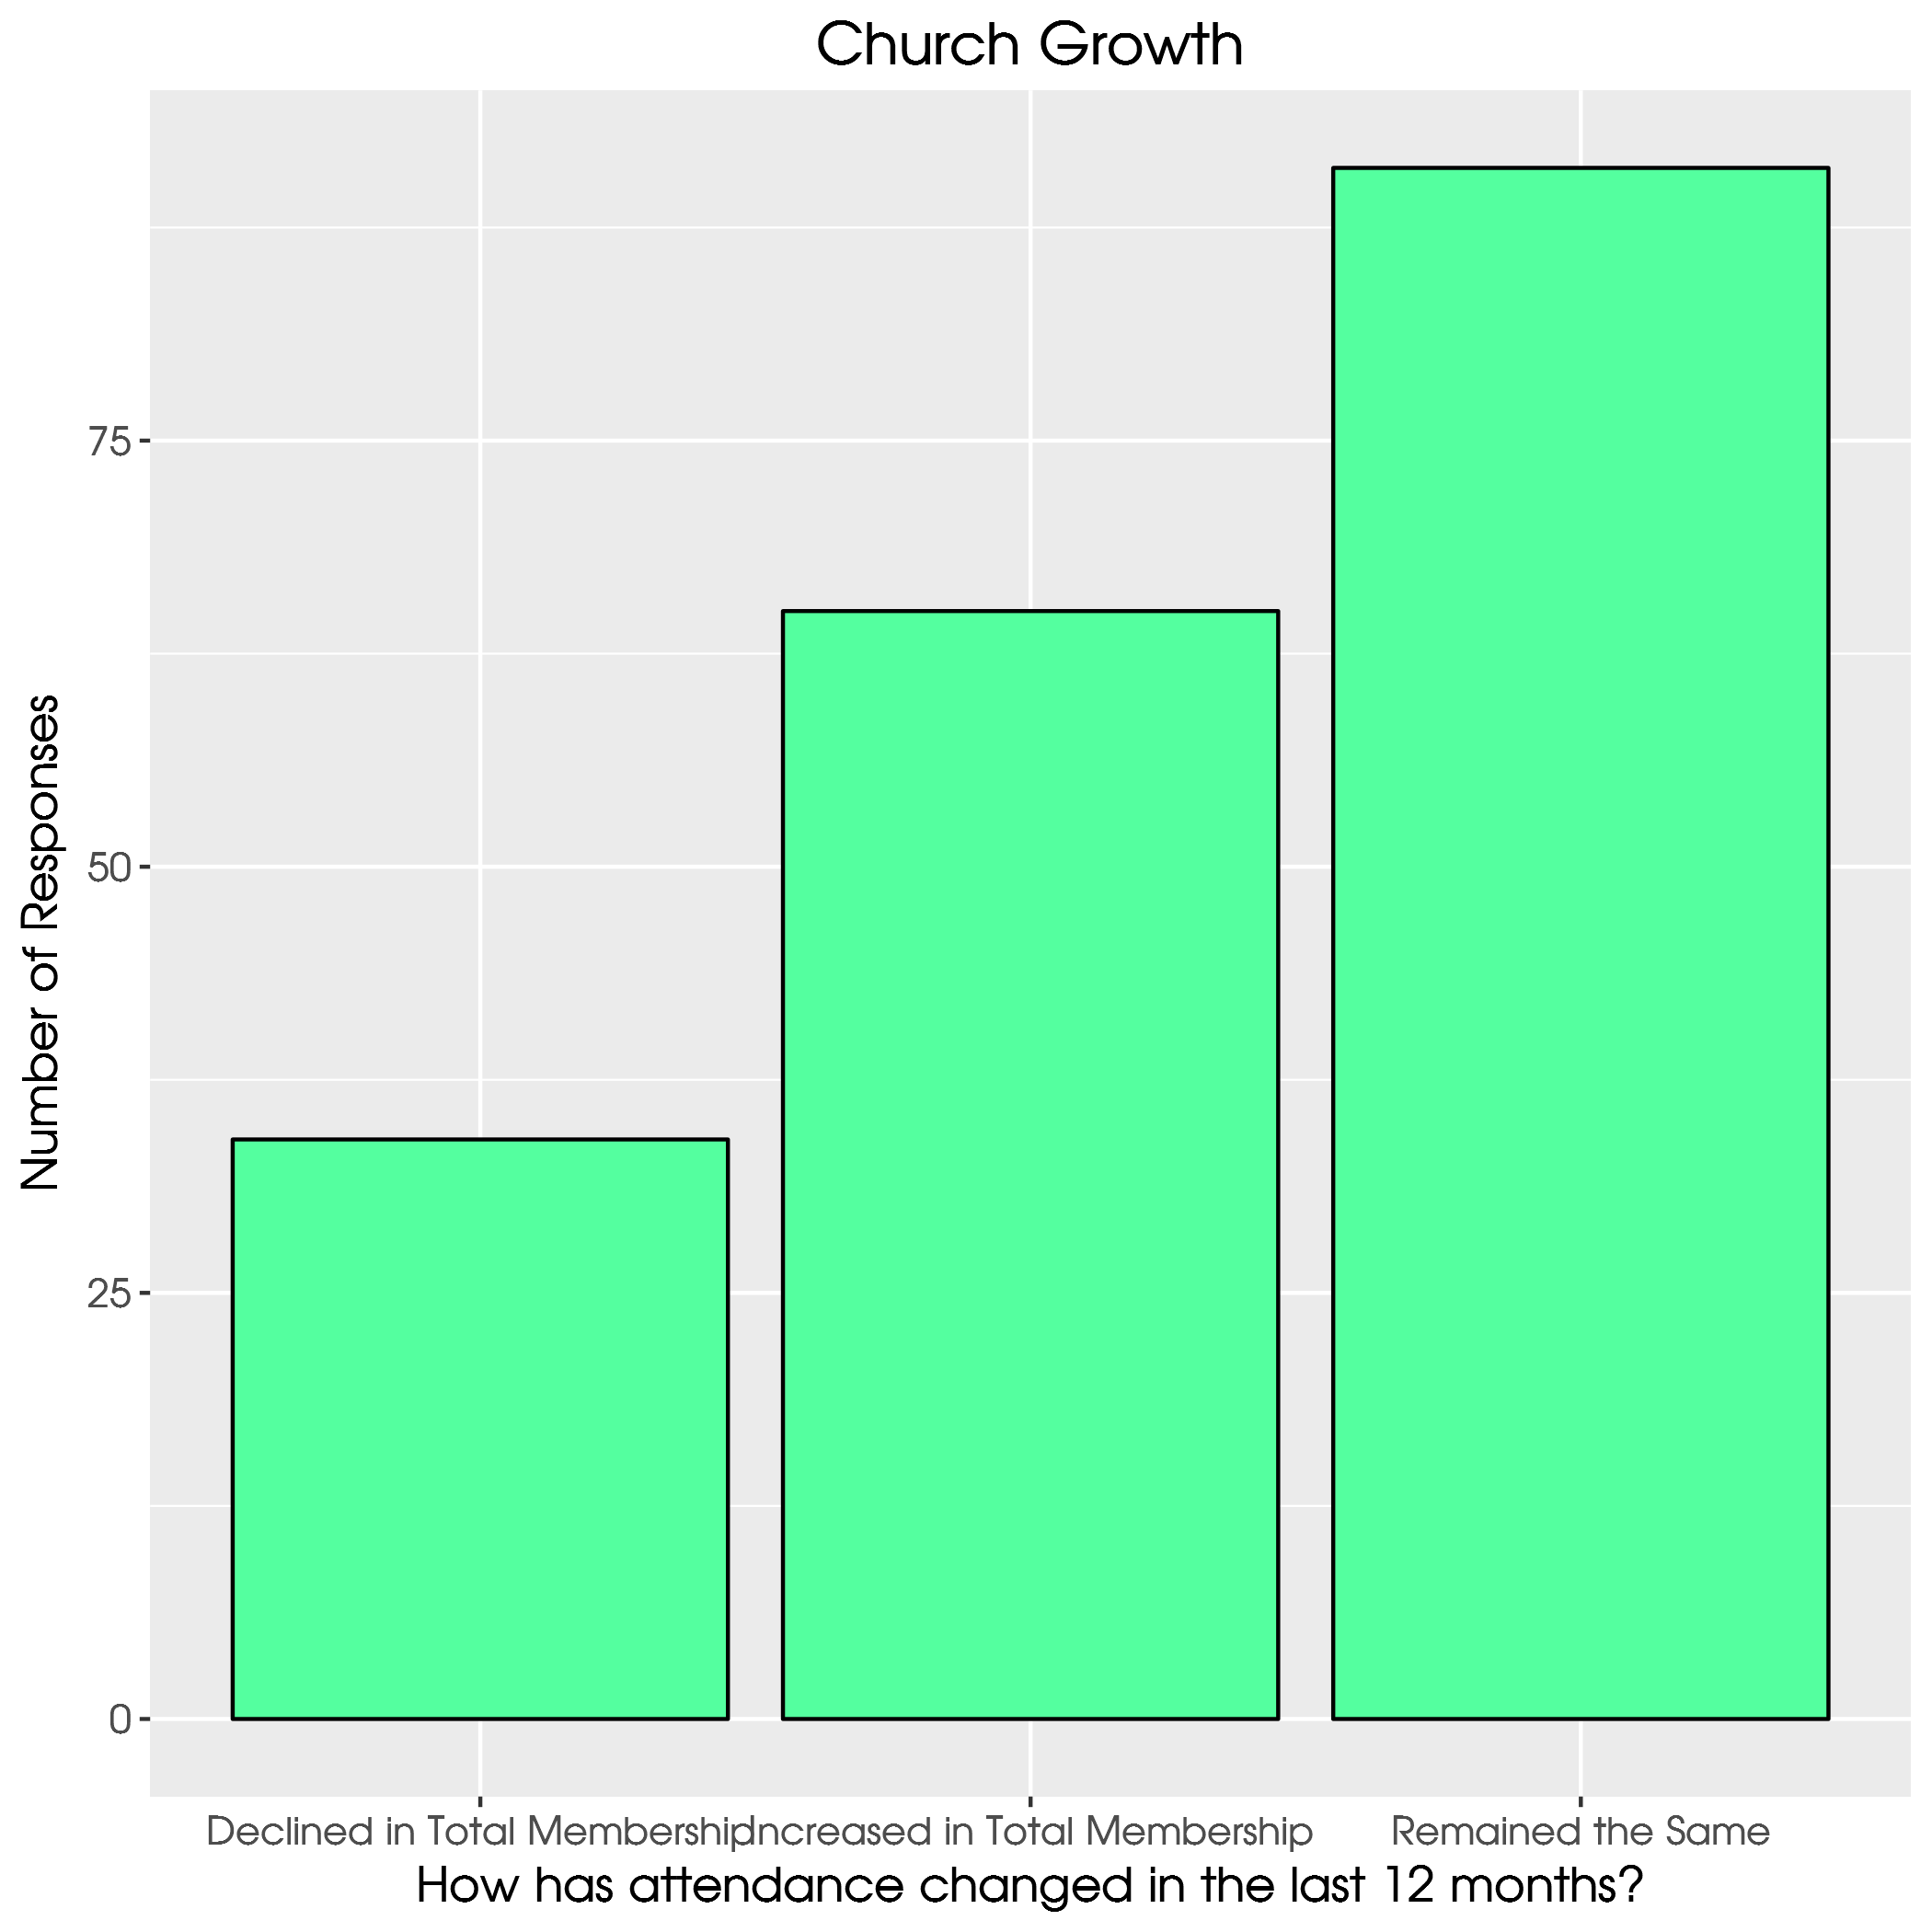

Slide 12
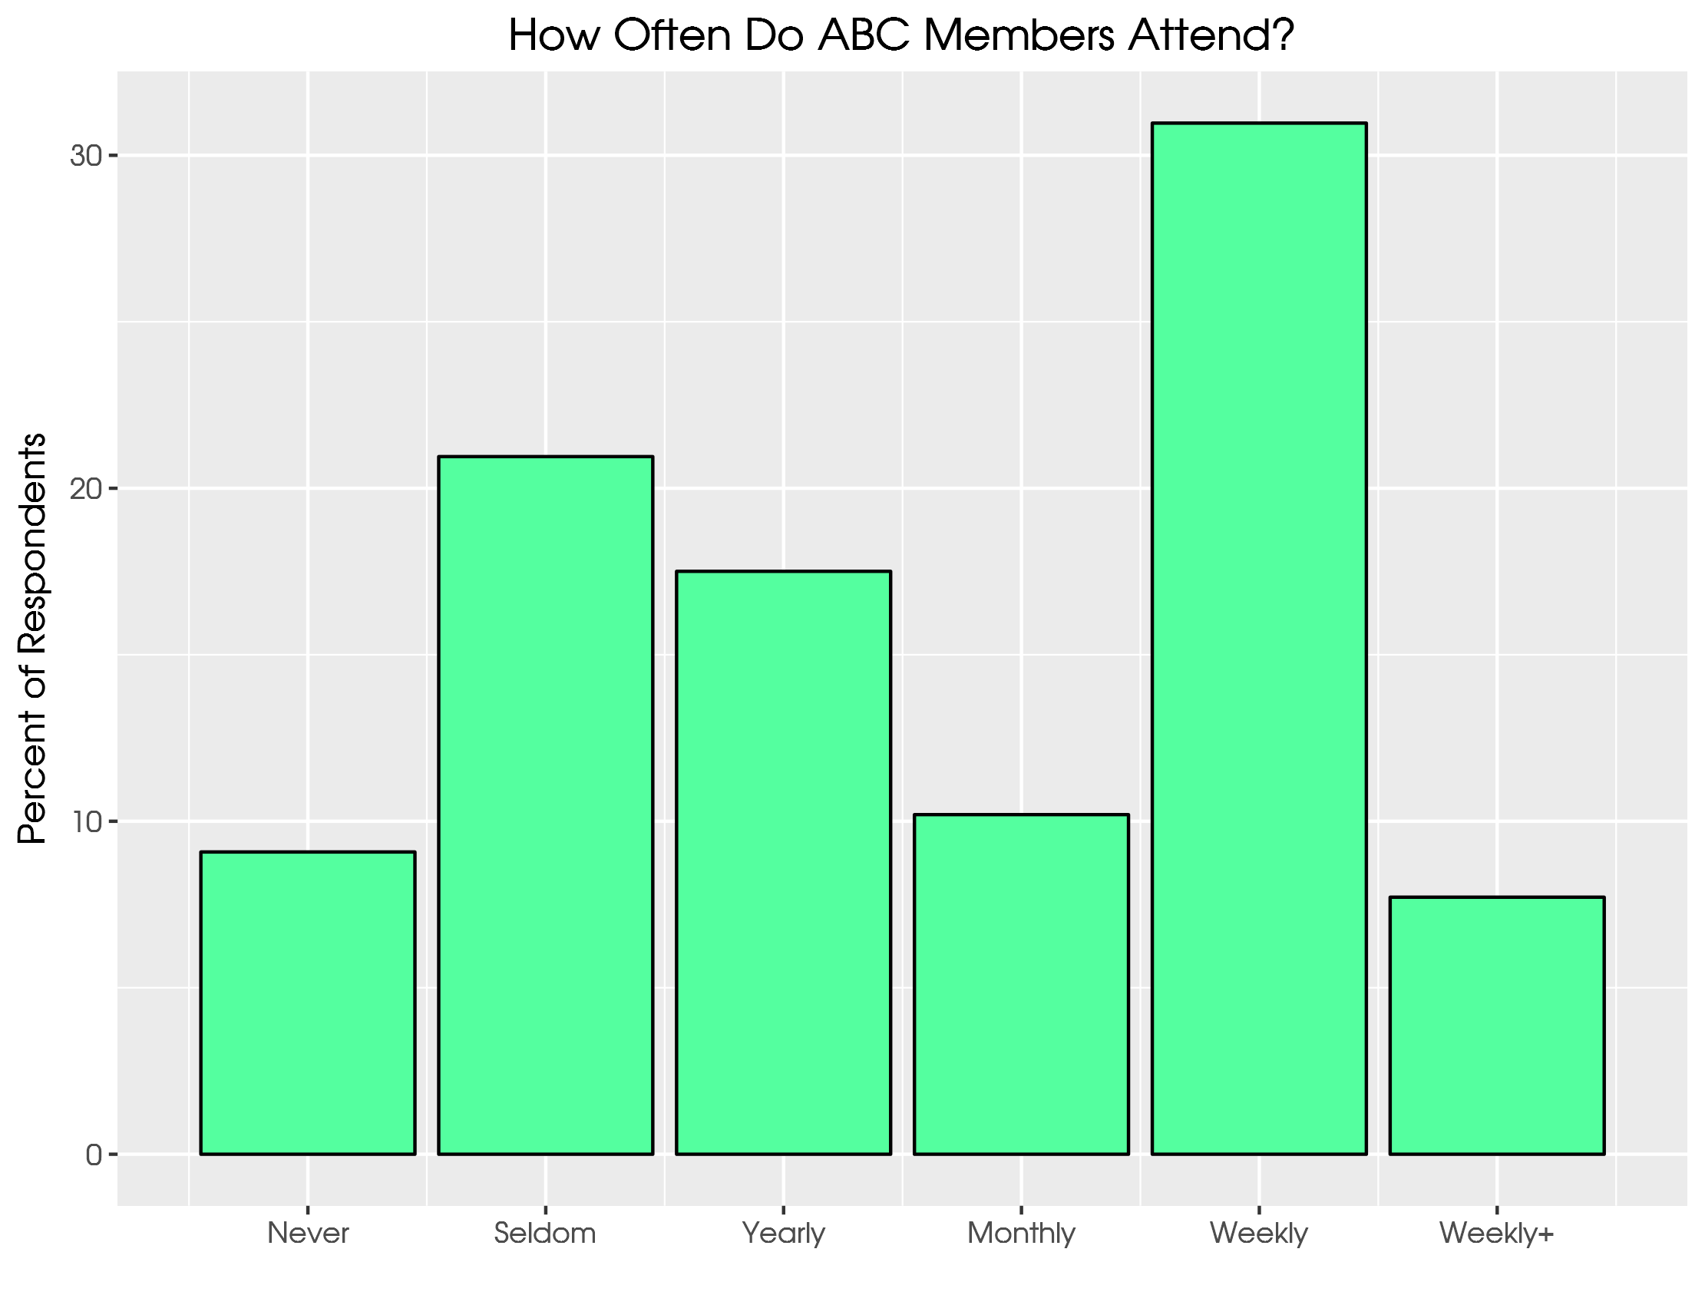

Slide 13
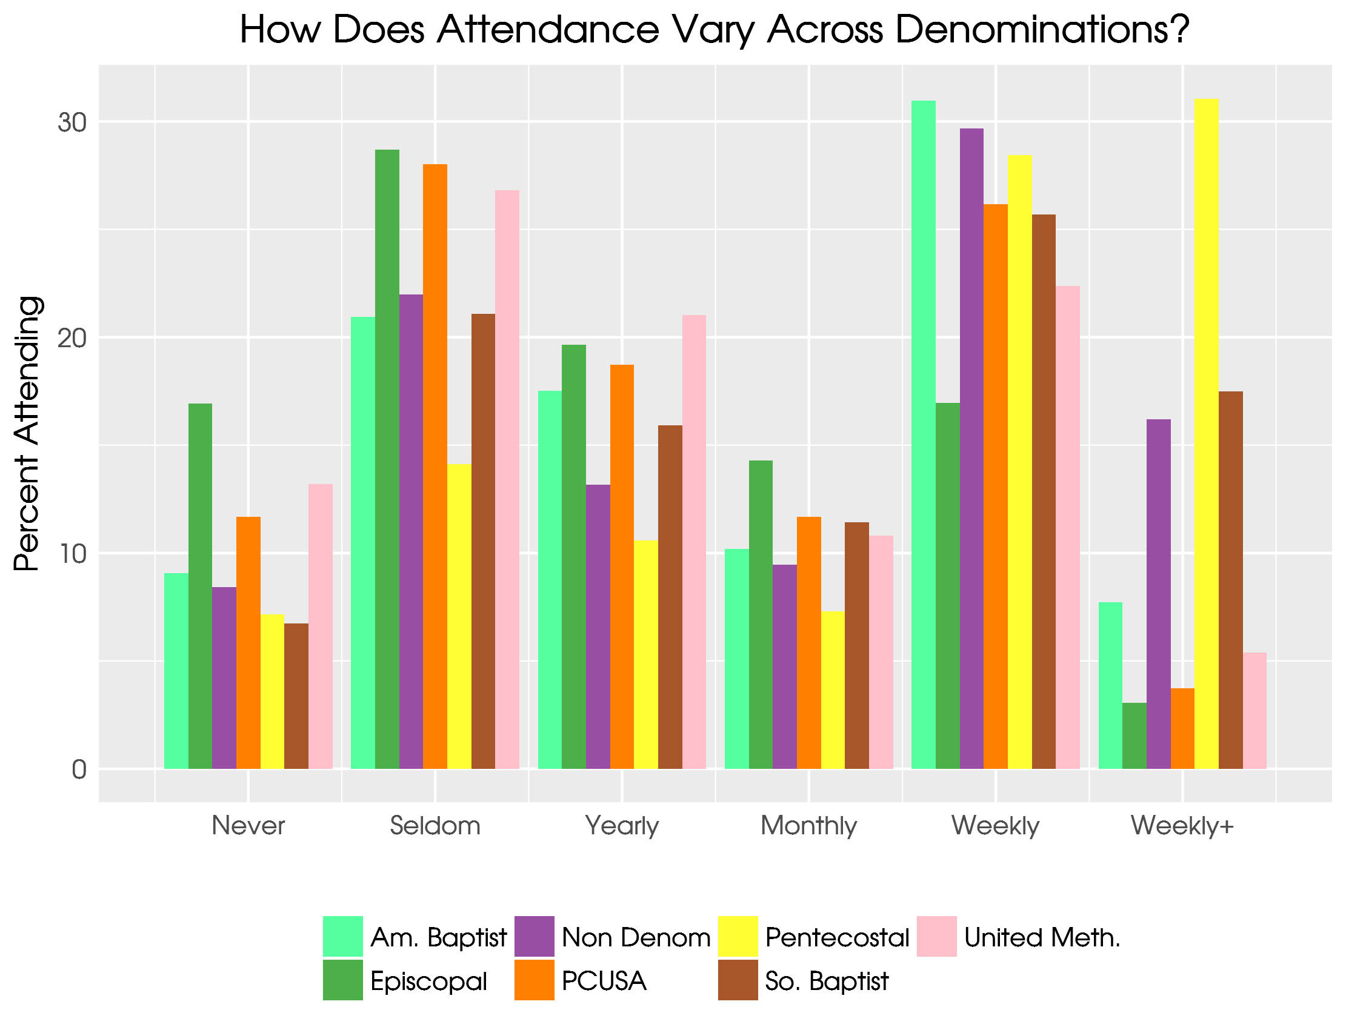

Slide 14
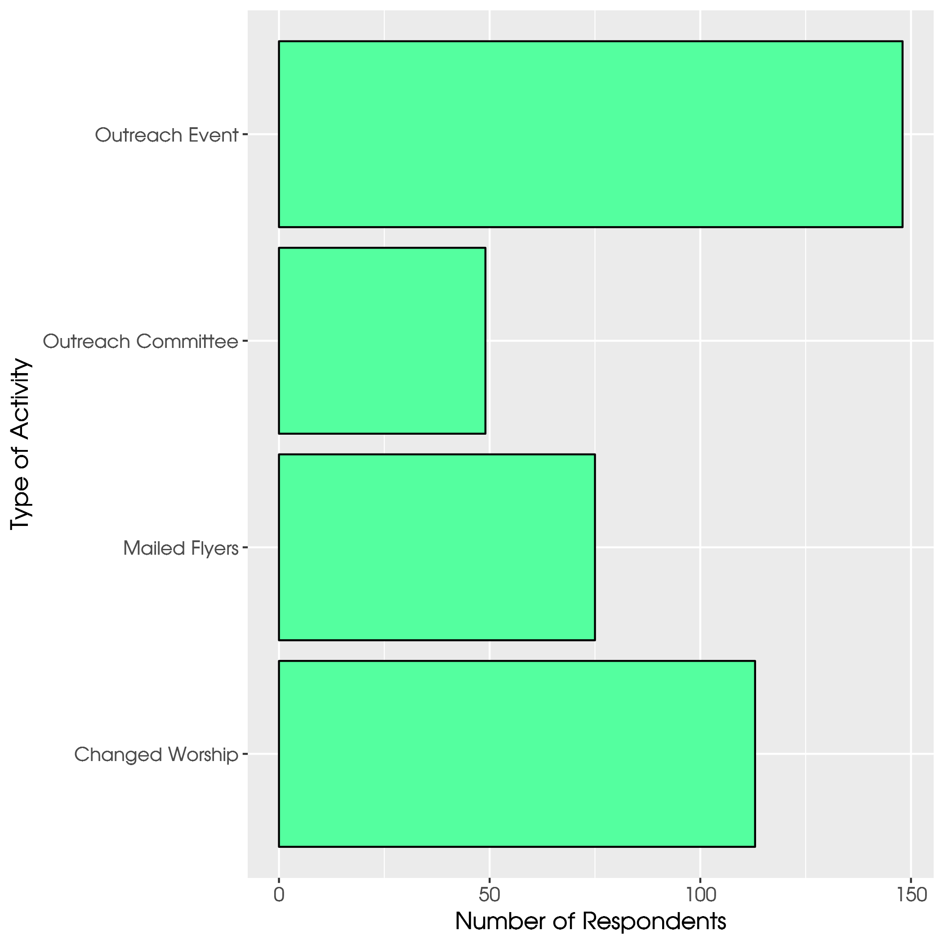

Slide 15
How involved should your denomination be?
Does the ABC-USA need to be more or less involved with social and political issues?
Should the ABC-USA be more or less involved in debating social and political issues inside the religious body?
Should the ABC-USA be more or less engaged in presenting its social and political views to government?
Responses options range from Much Less (1) to Much More (7)
Three questions summed and indexed from 0 to 1.

Slide 16
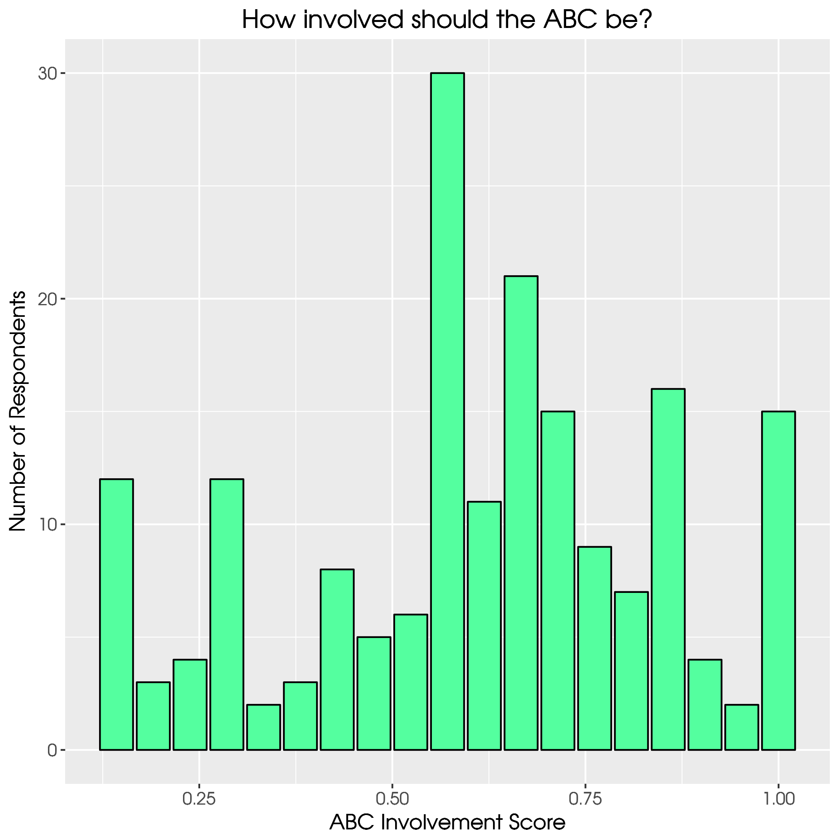

Slide 17
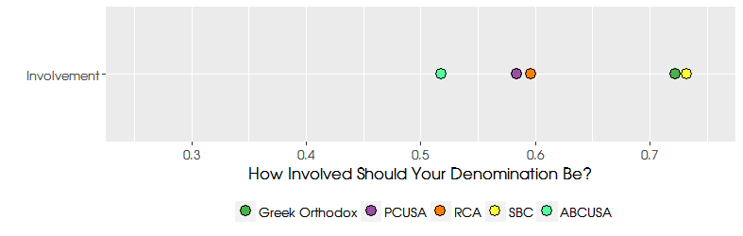

Slide 18
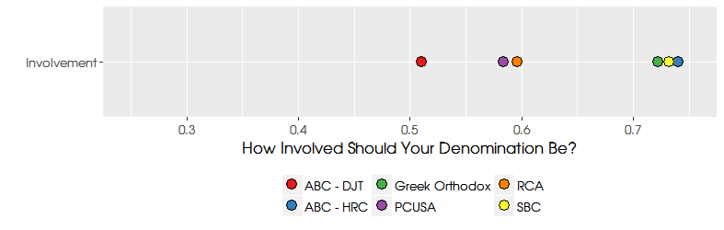

Slide 19
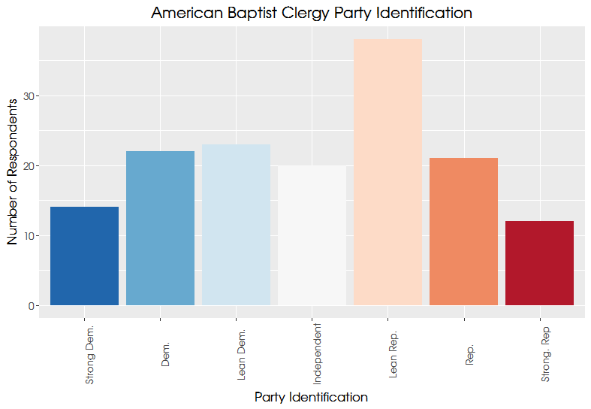

Slide 20
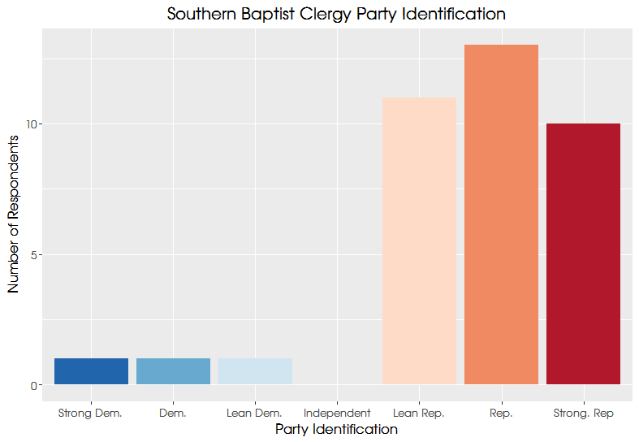

Slide 21
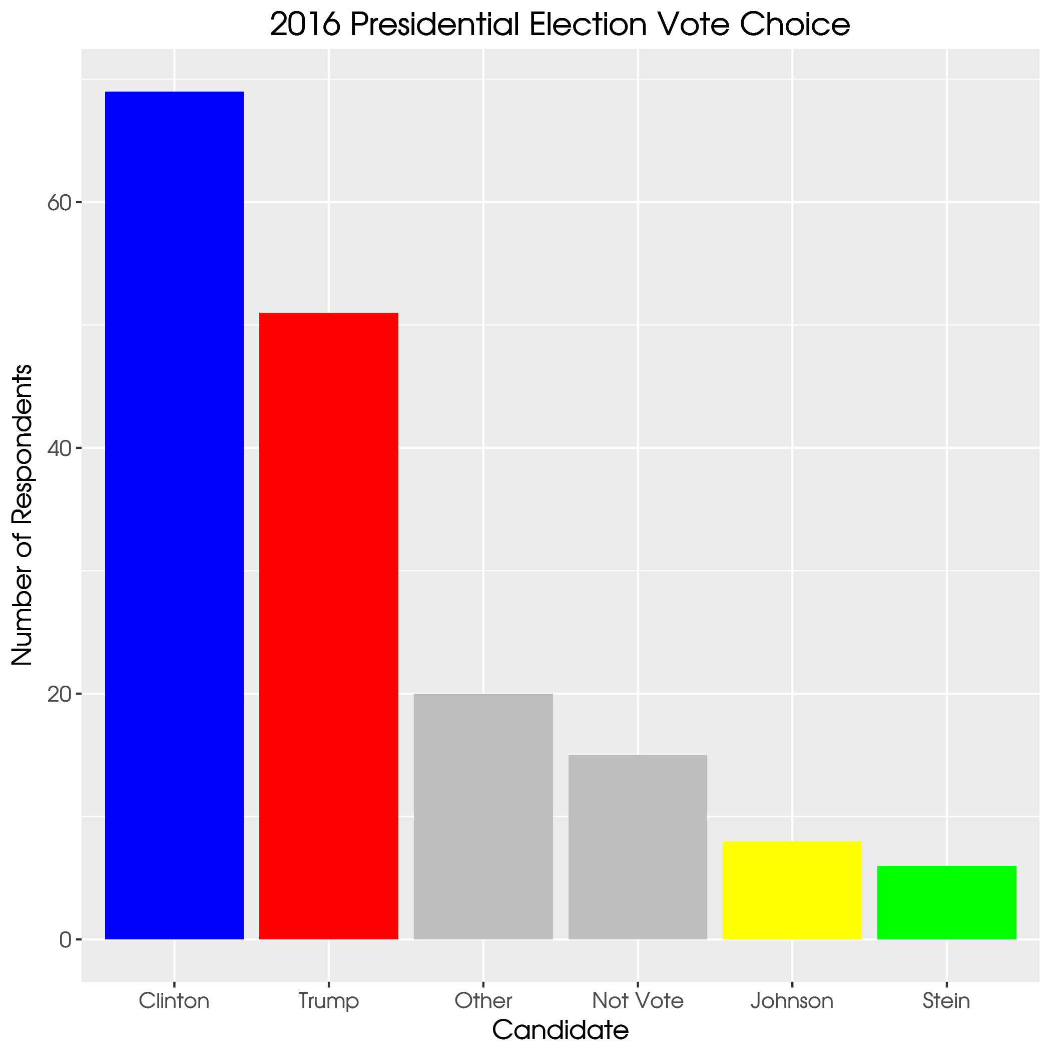

Slide 22
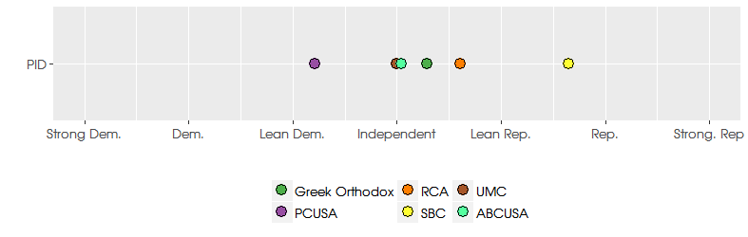

Slide 23
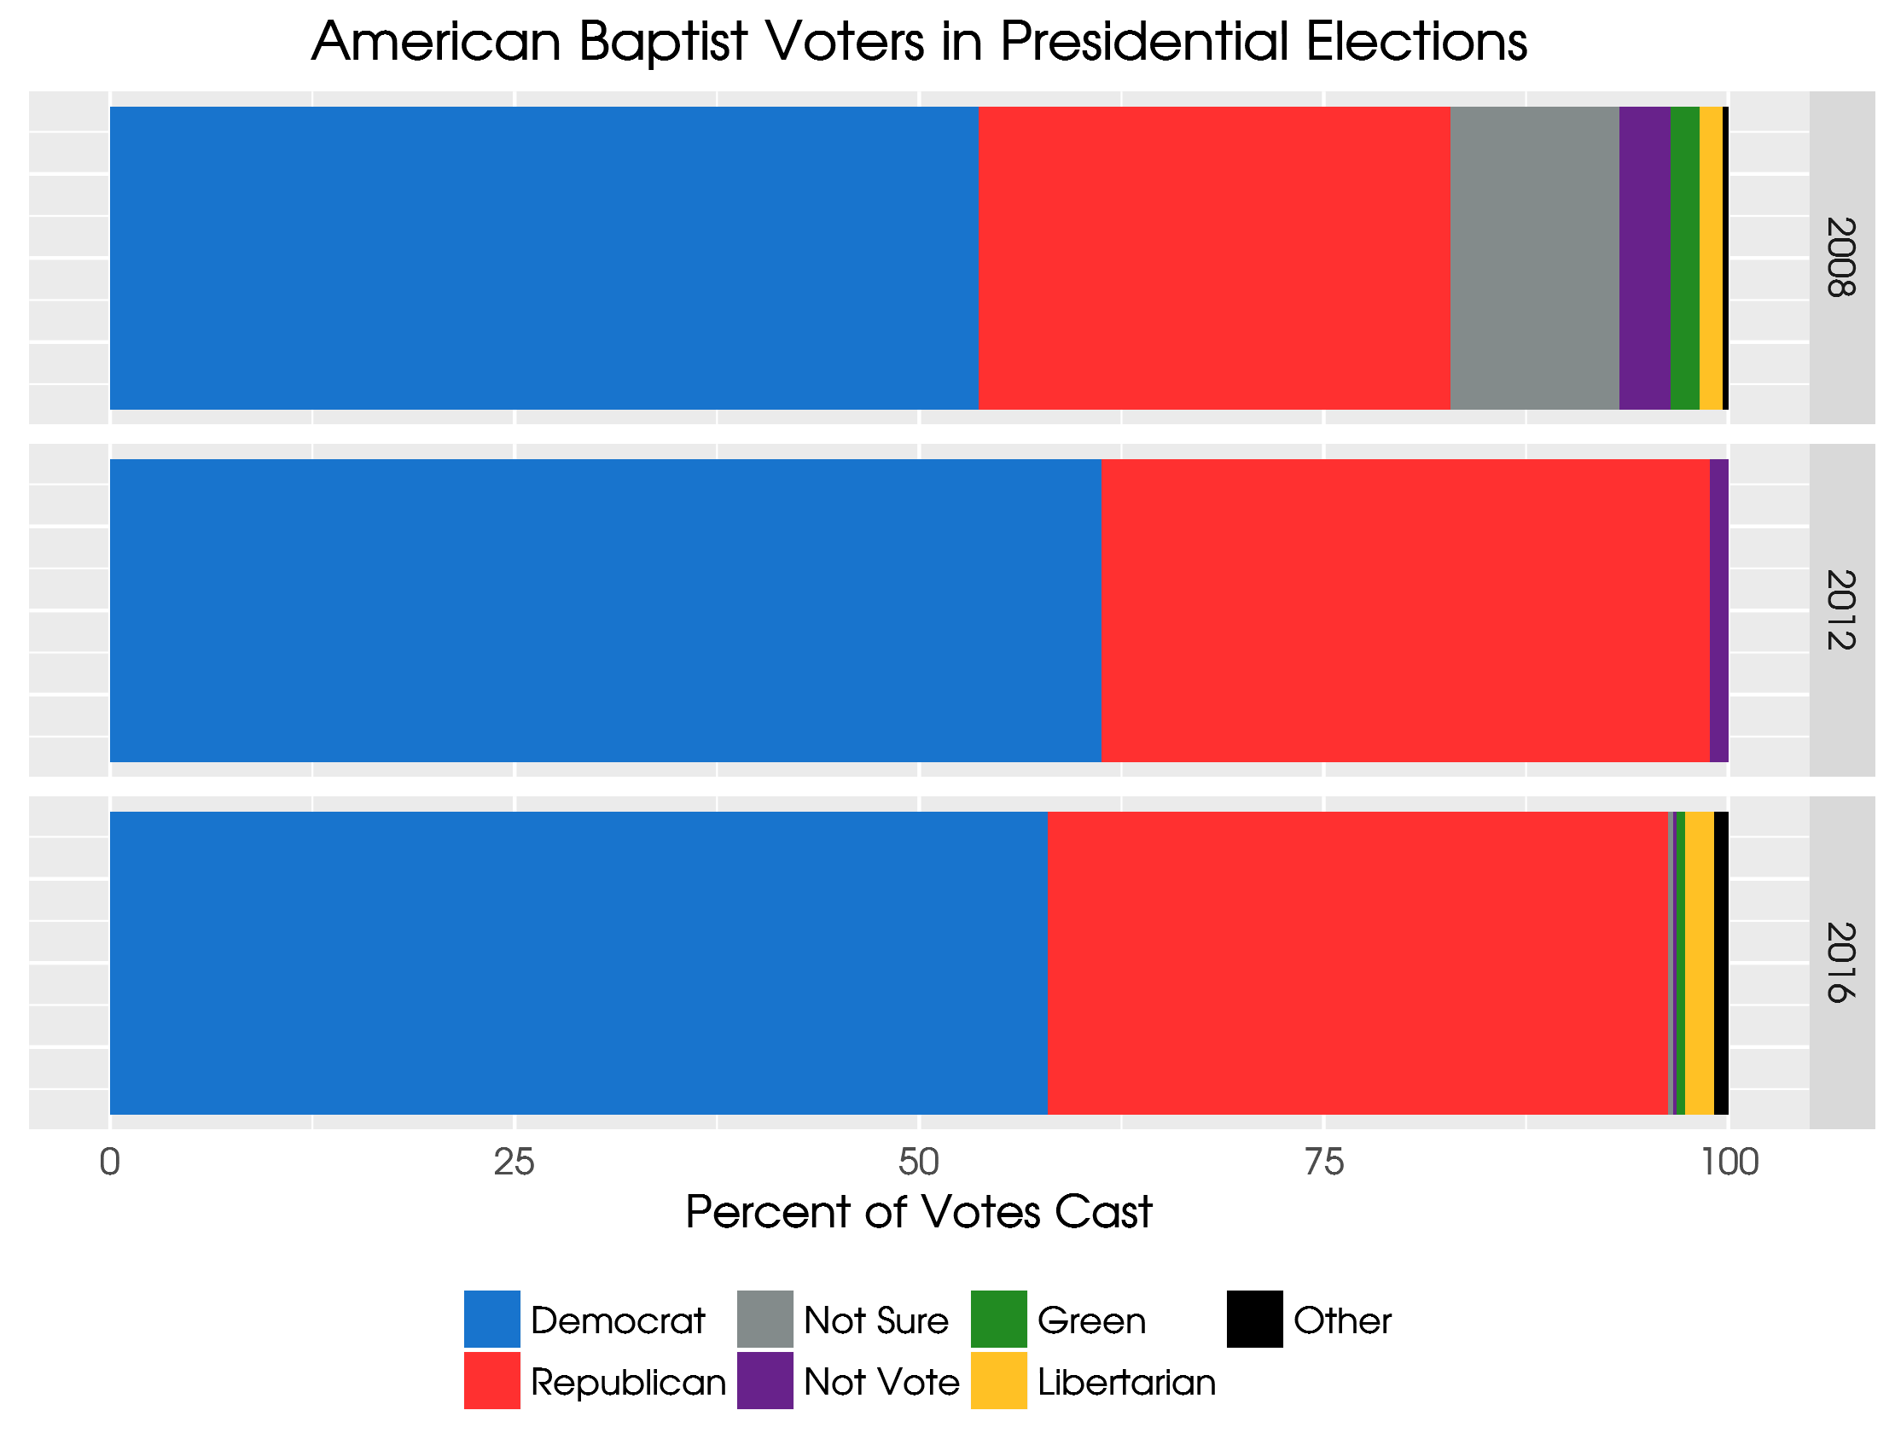

Slide 24
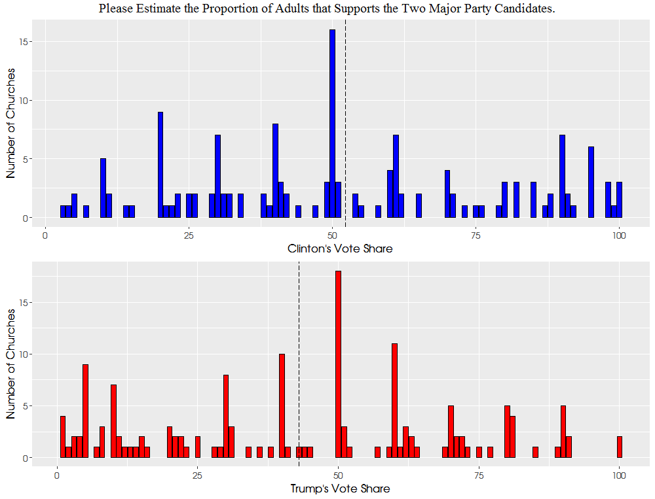

Slide 25
A note on clergy perceptions of the congregation’s politics
The average vote share for Clinton was 52.2% and the average vote for Trump was 43%.
Trump voting clergy believe that, on average, 67% of their congregations are Trump supporters
Clinton supporting clergy perceive that 68% of their congregants are like them politically
Liberal clergy are finding liberal congregations, and conservative clergy find like minded churches

Slide 26
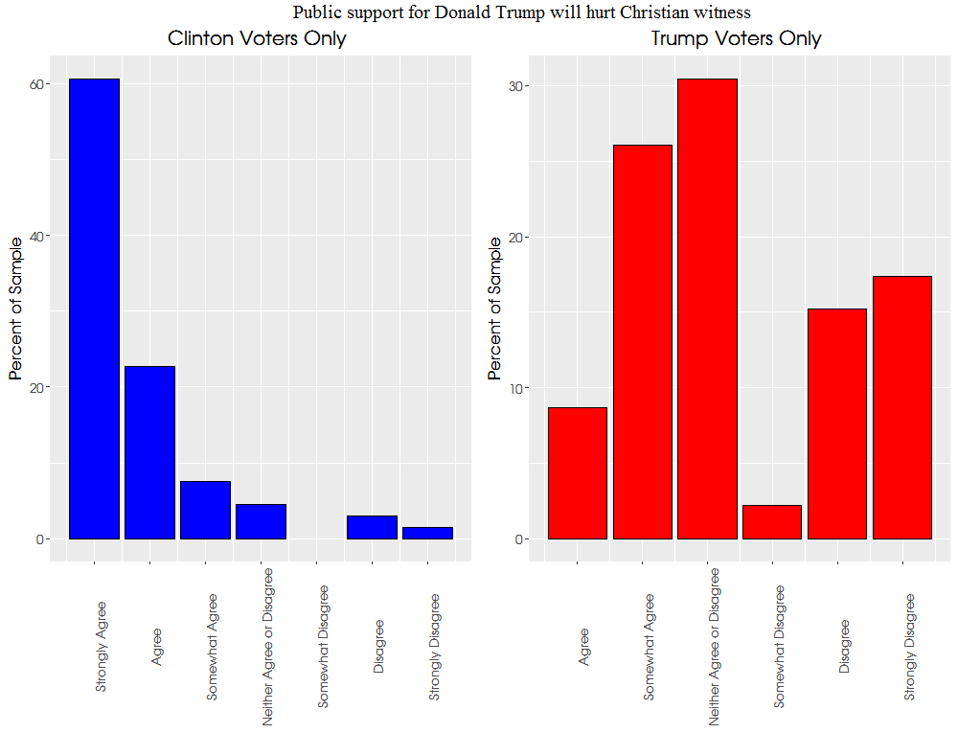

Slide 27
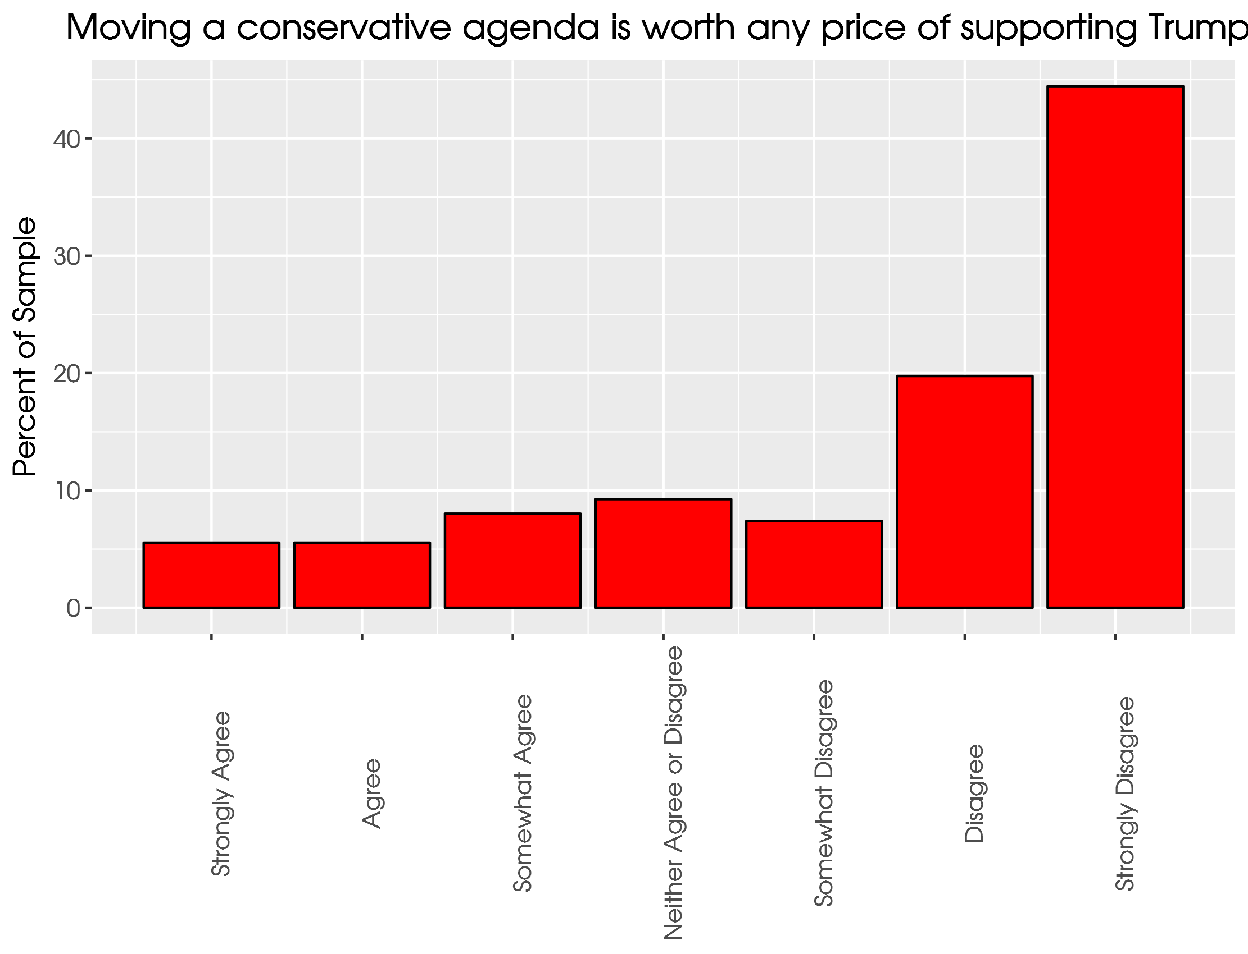

Slide 28
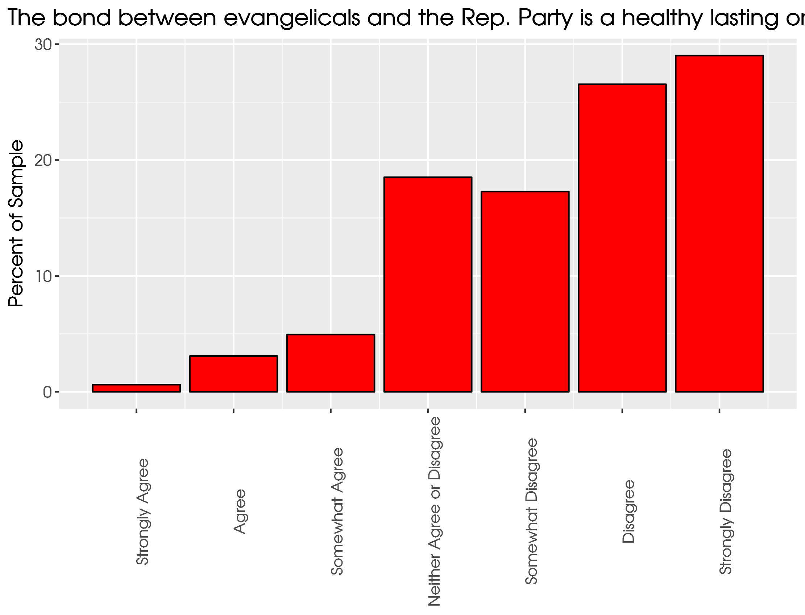

Slide 29
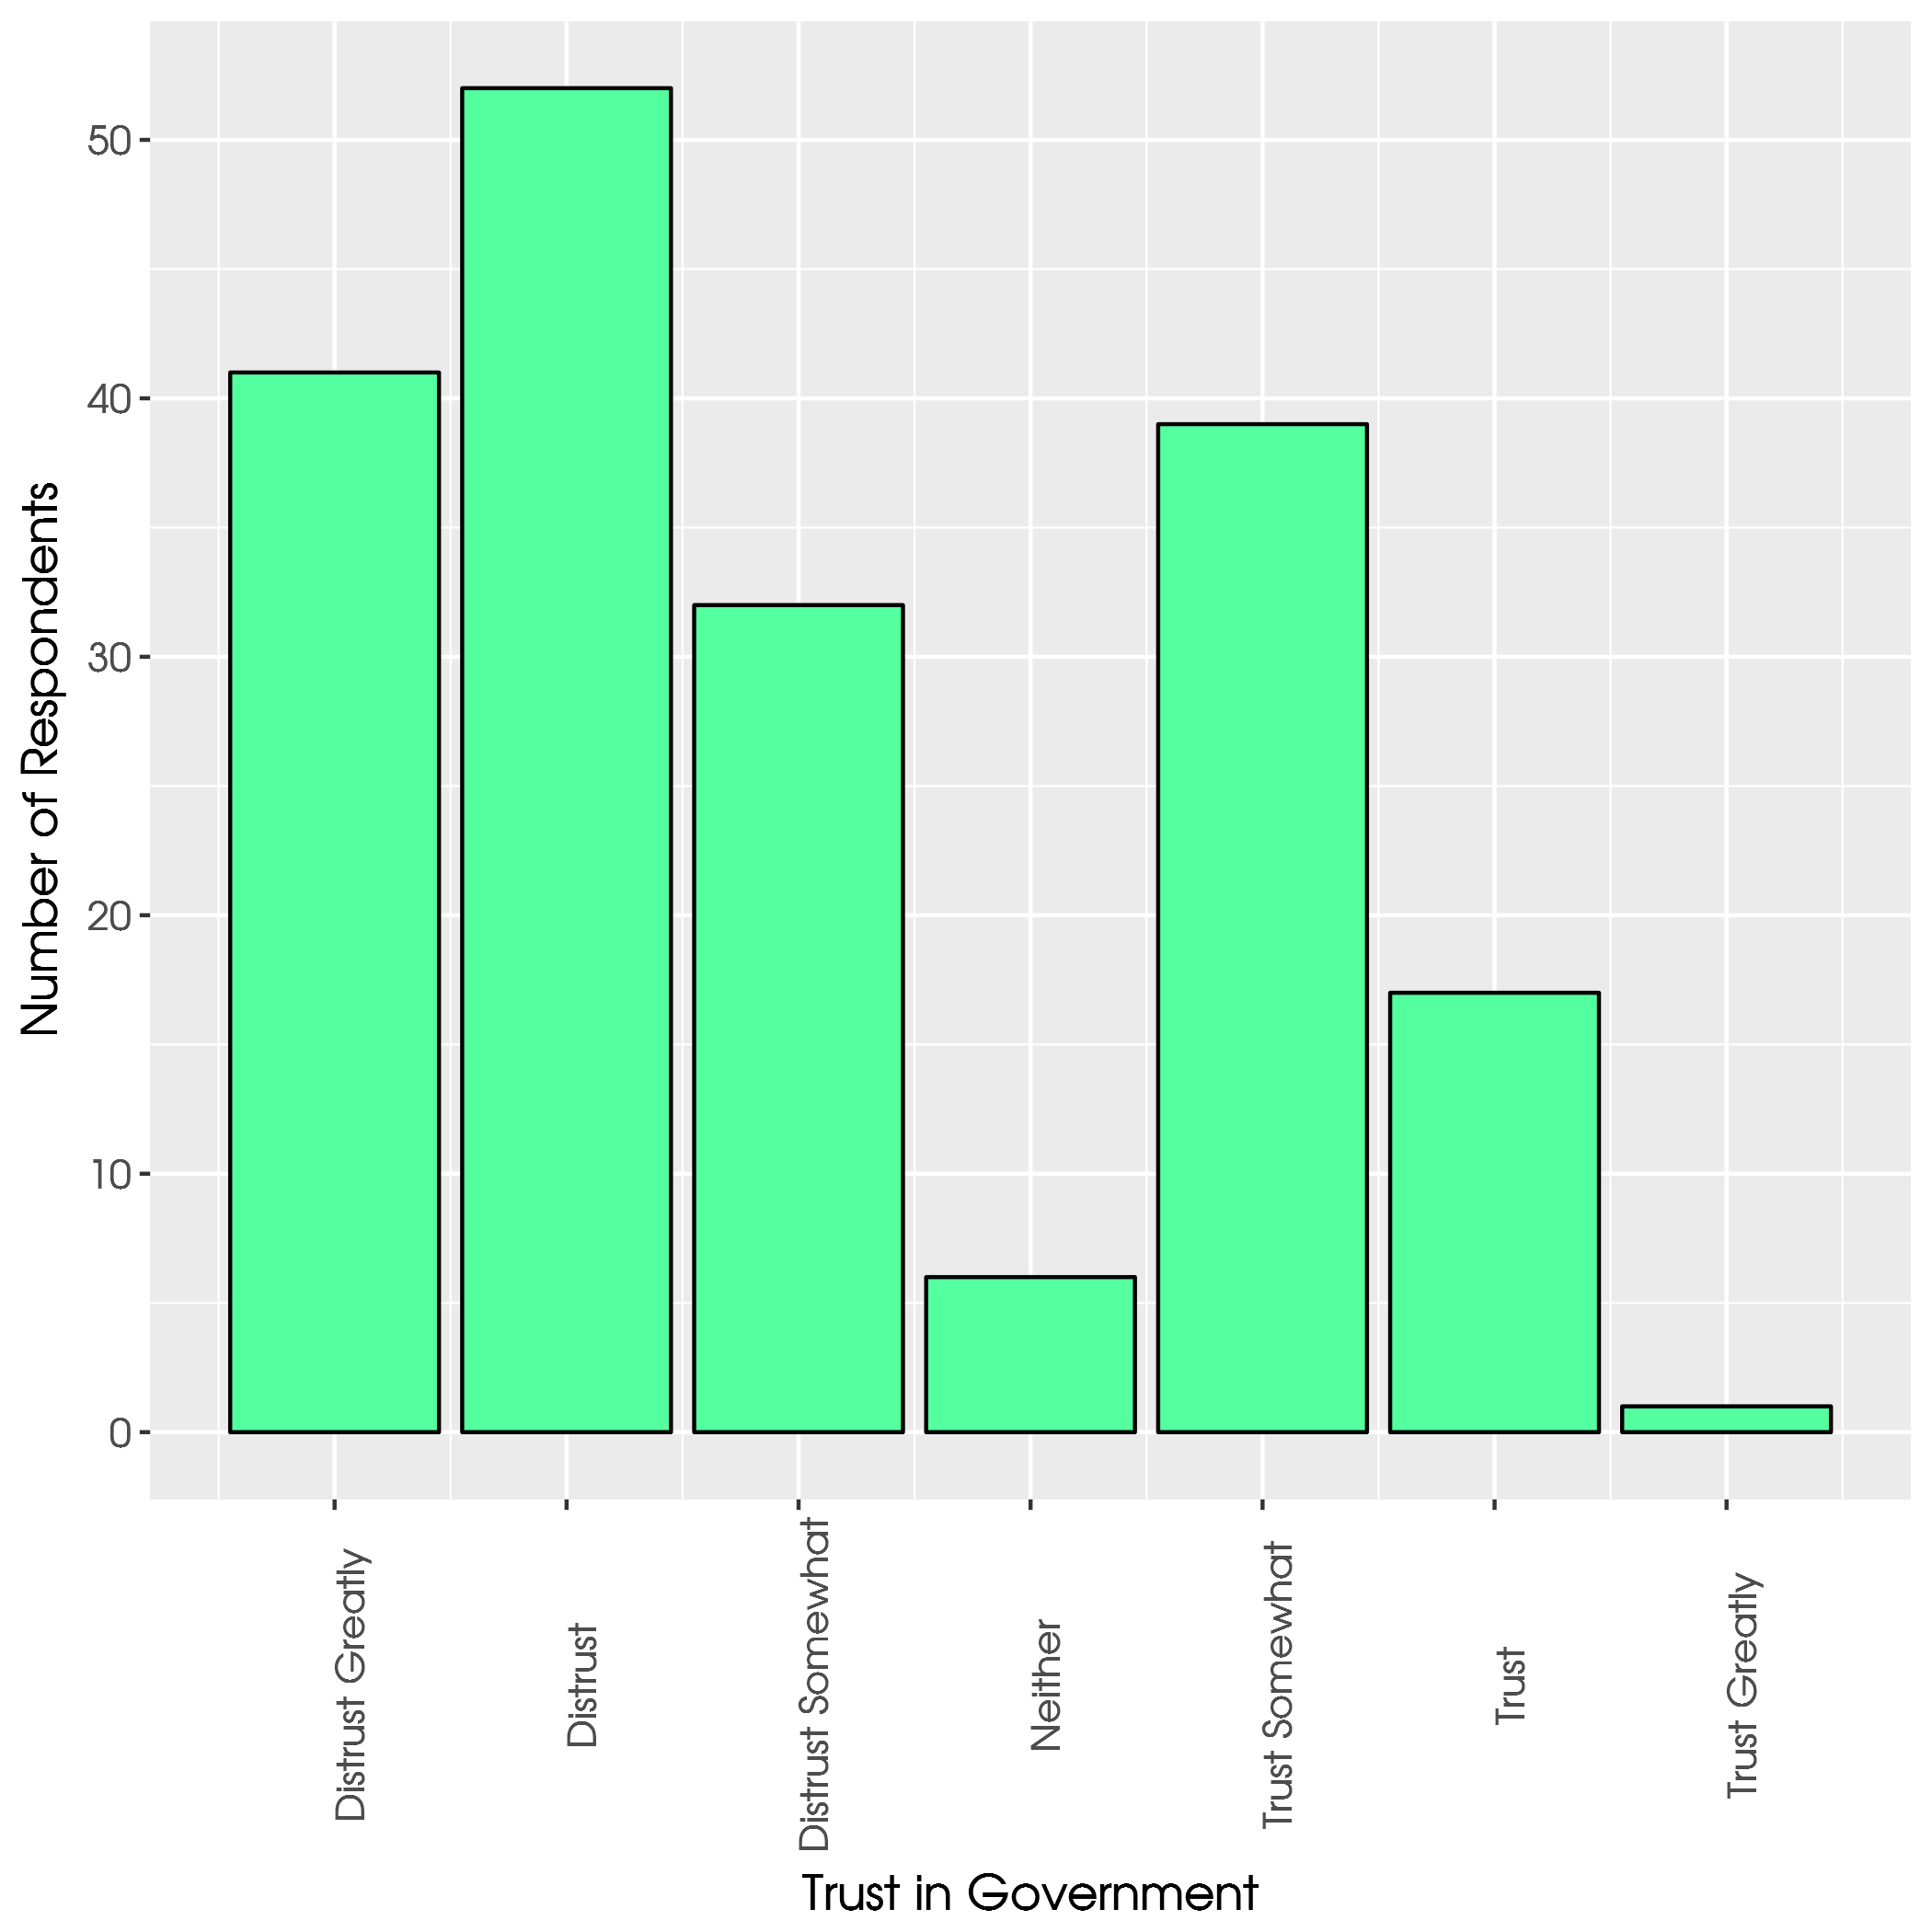

Slide 30
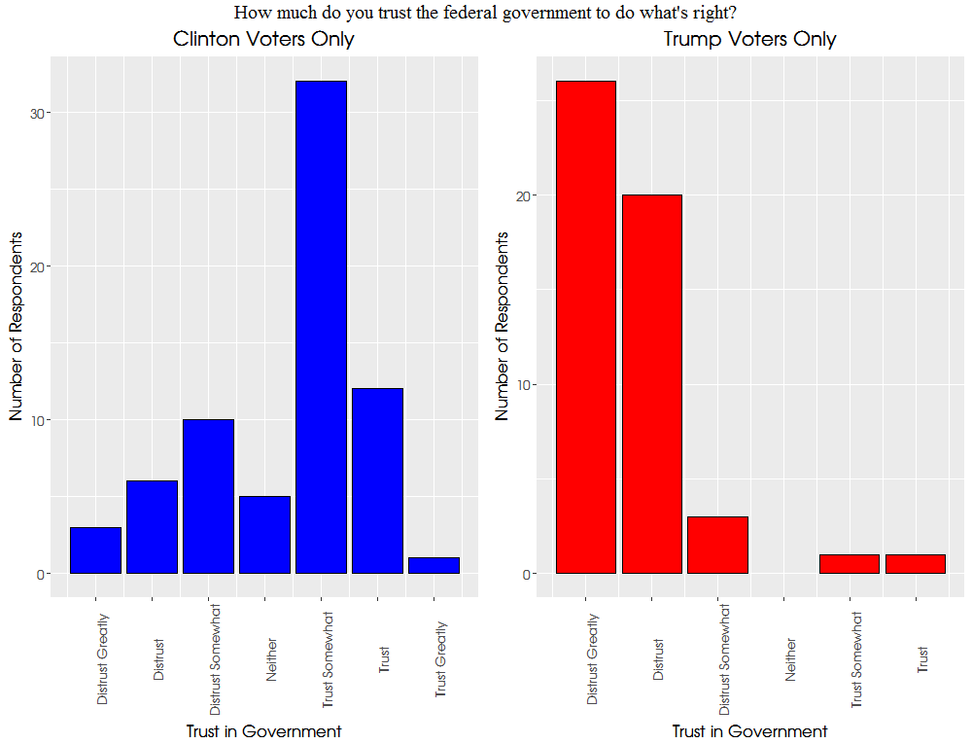

Slide 31
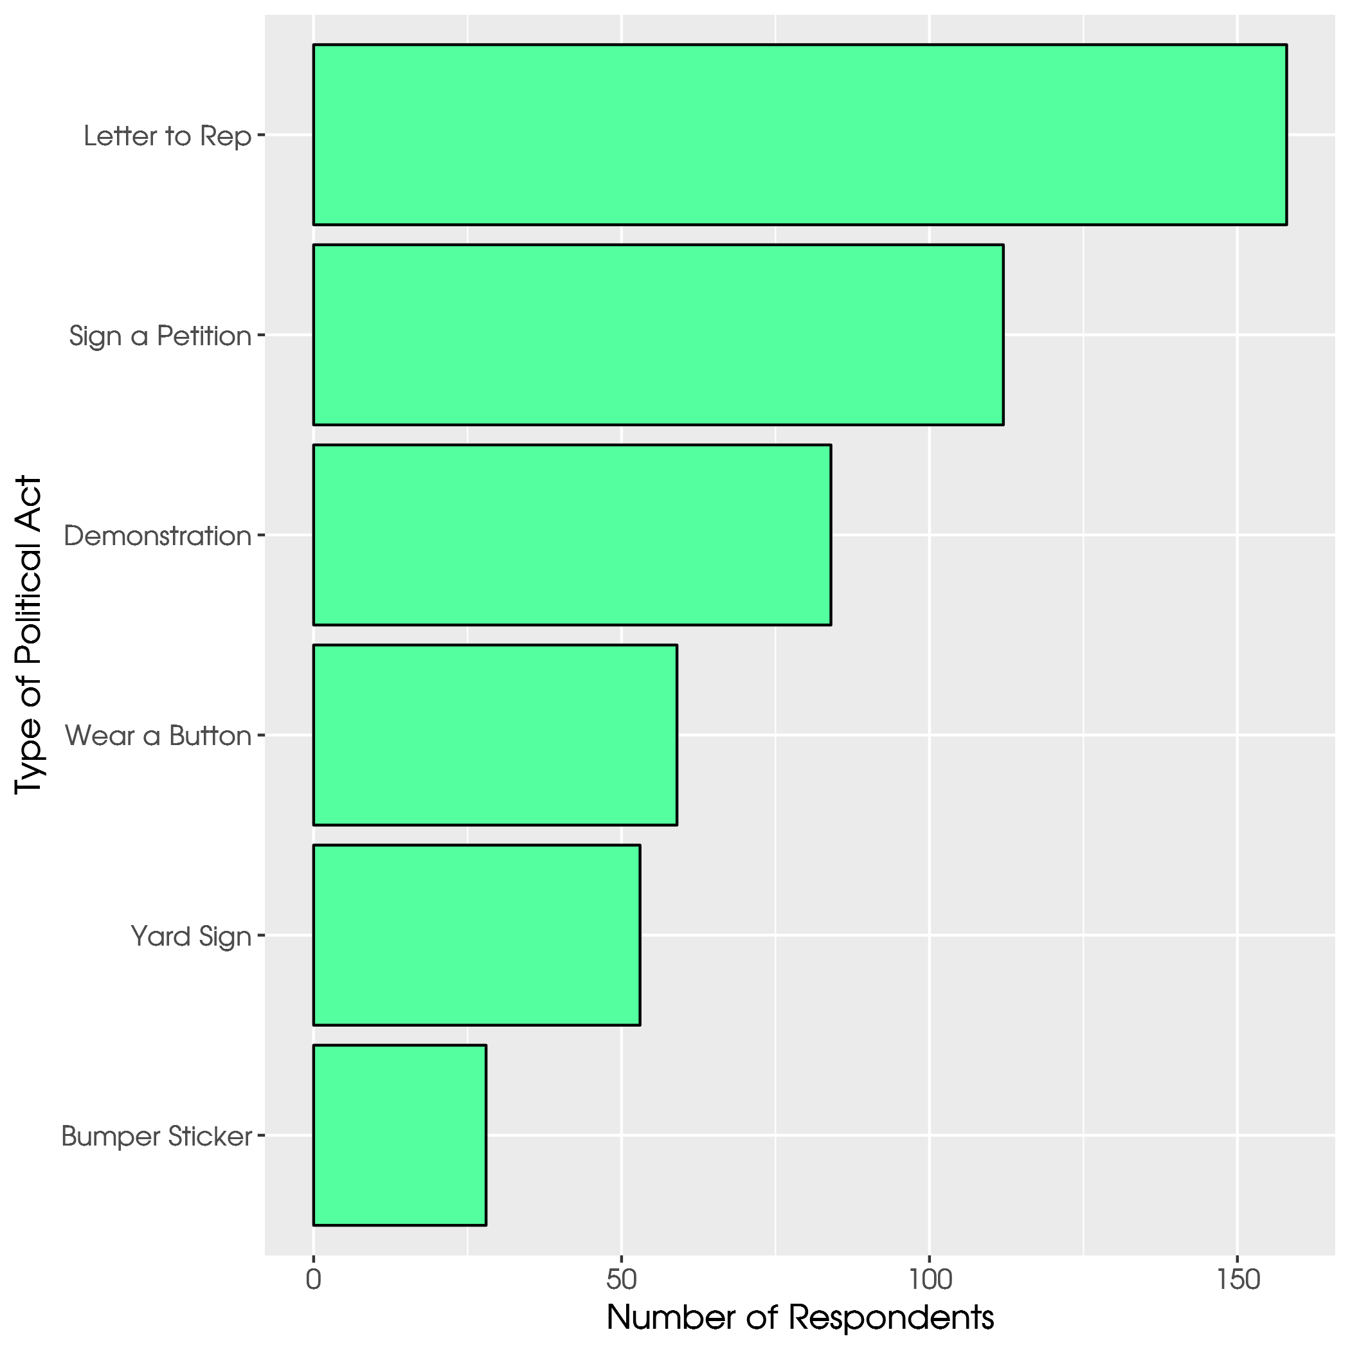

Slide 32
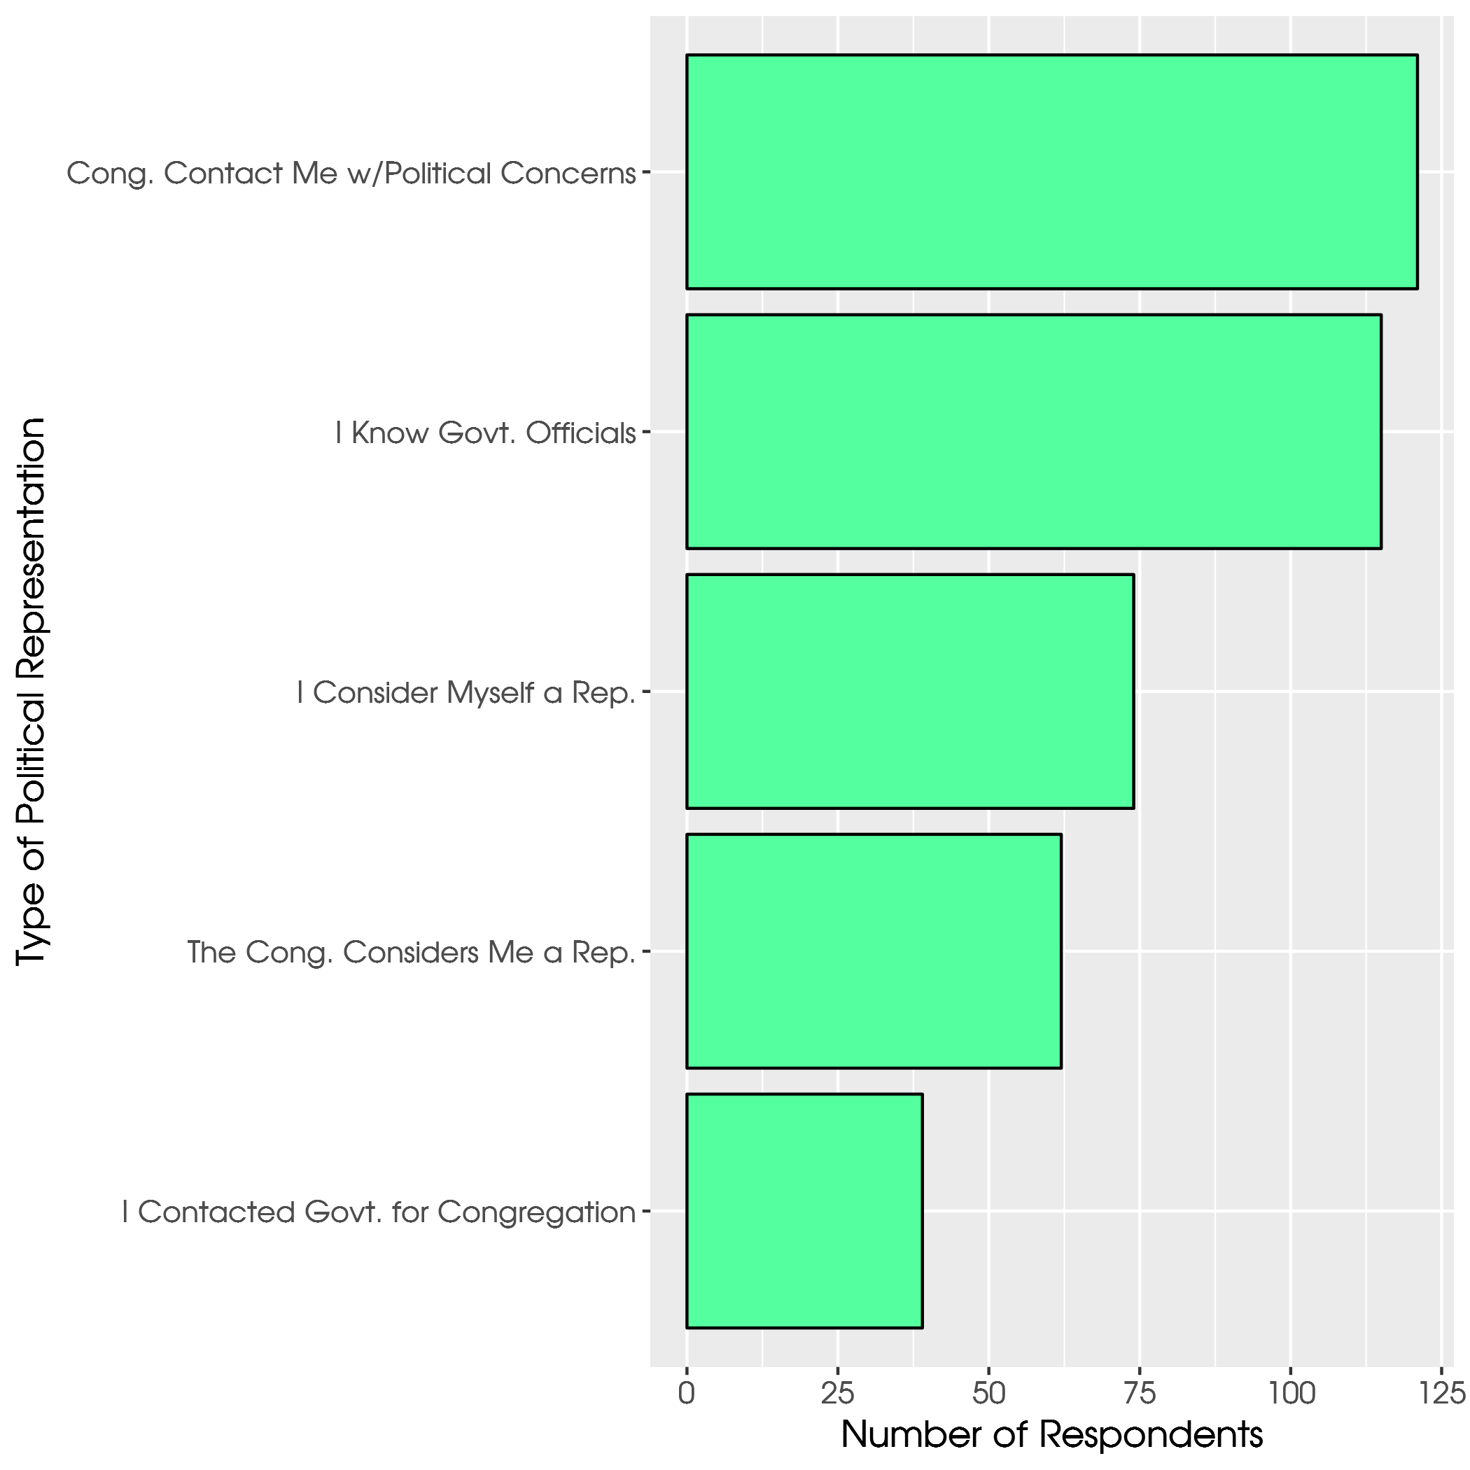

Slide 33
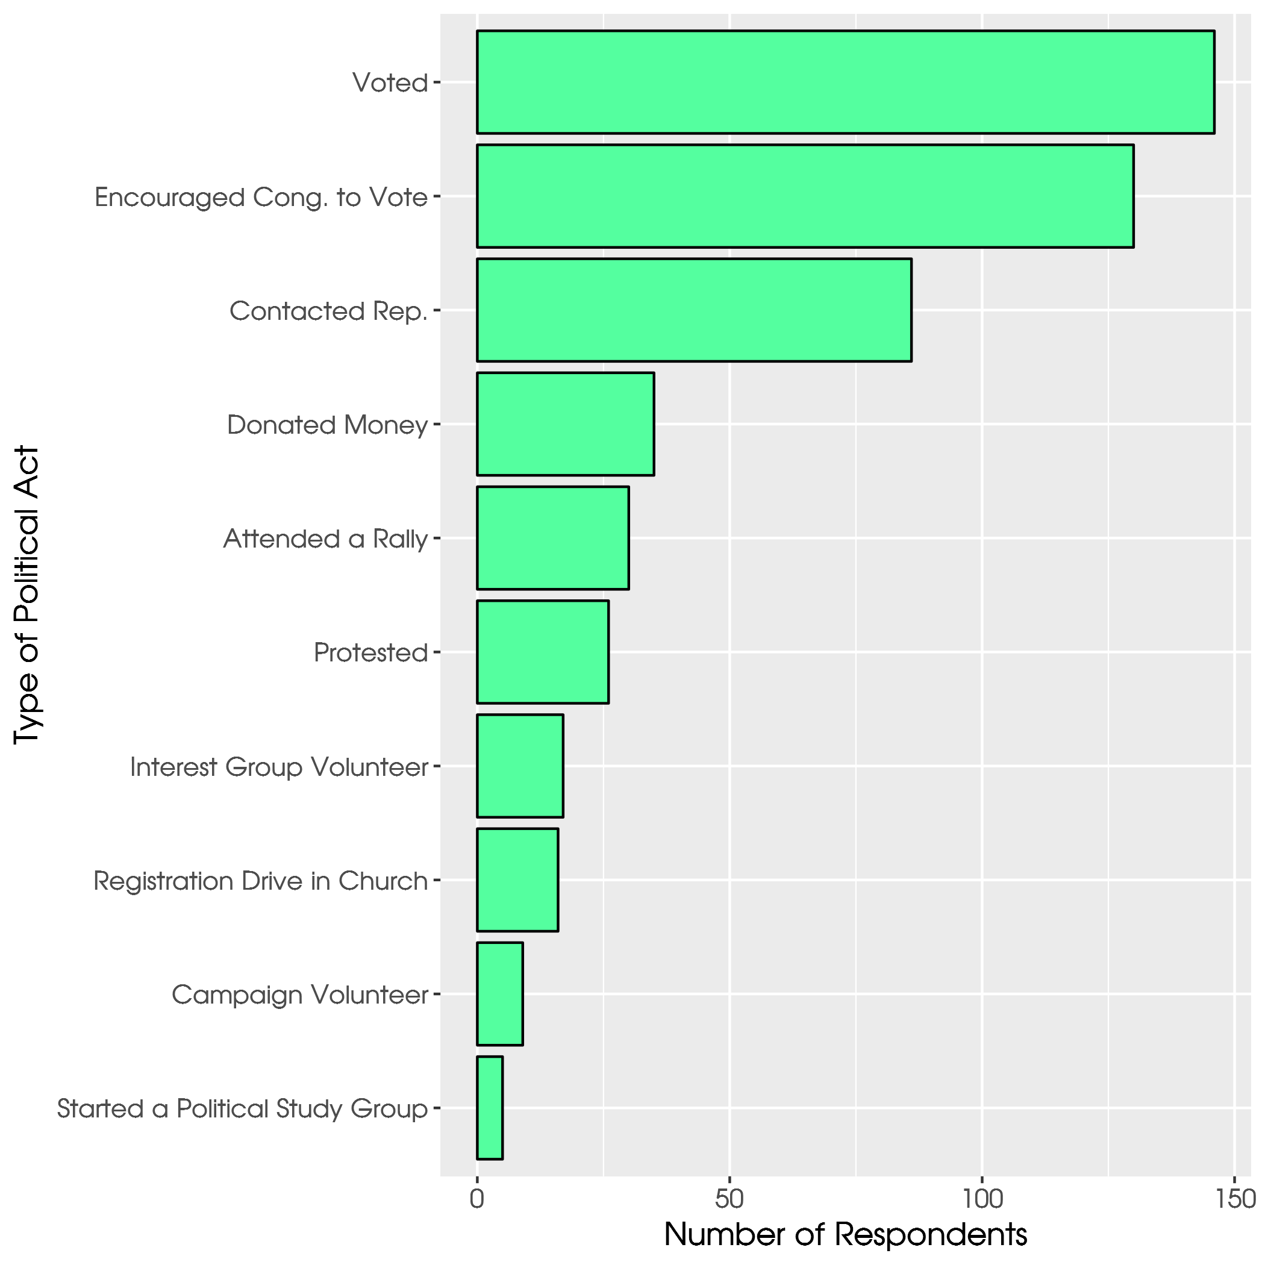

Slide 34
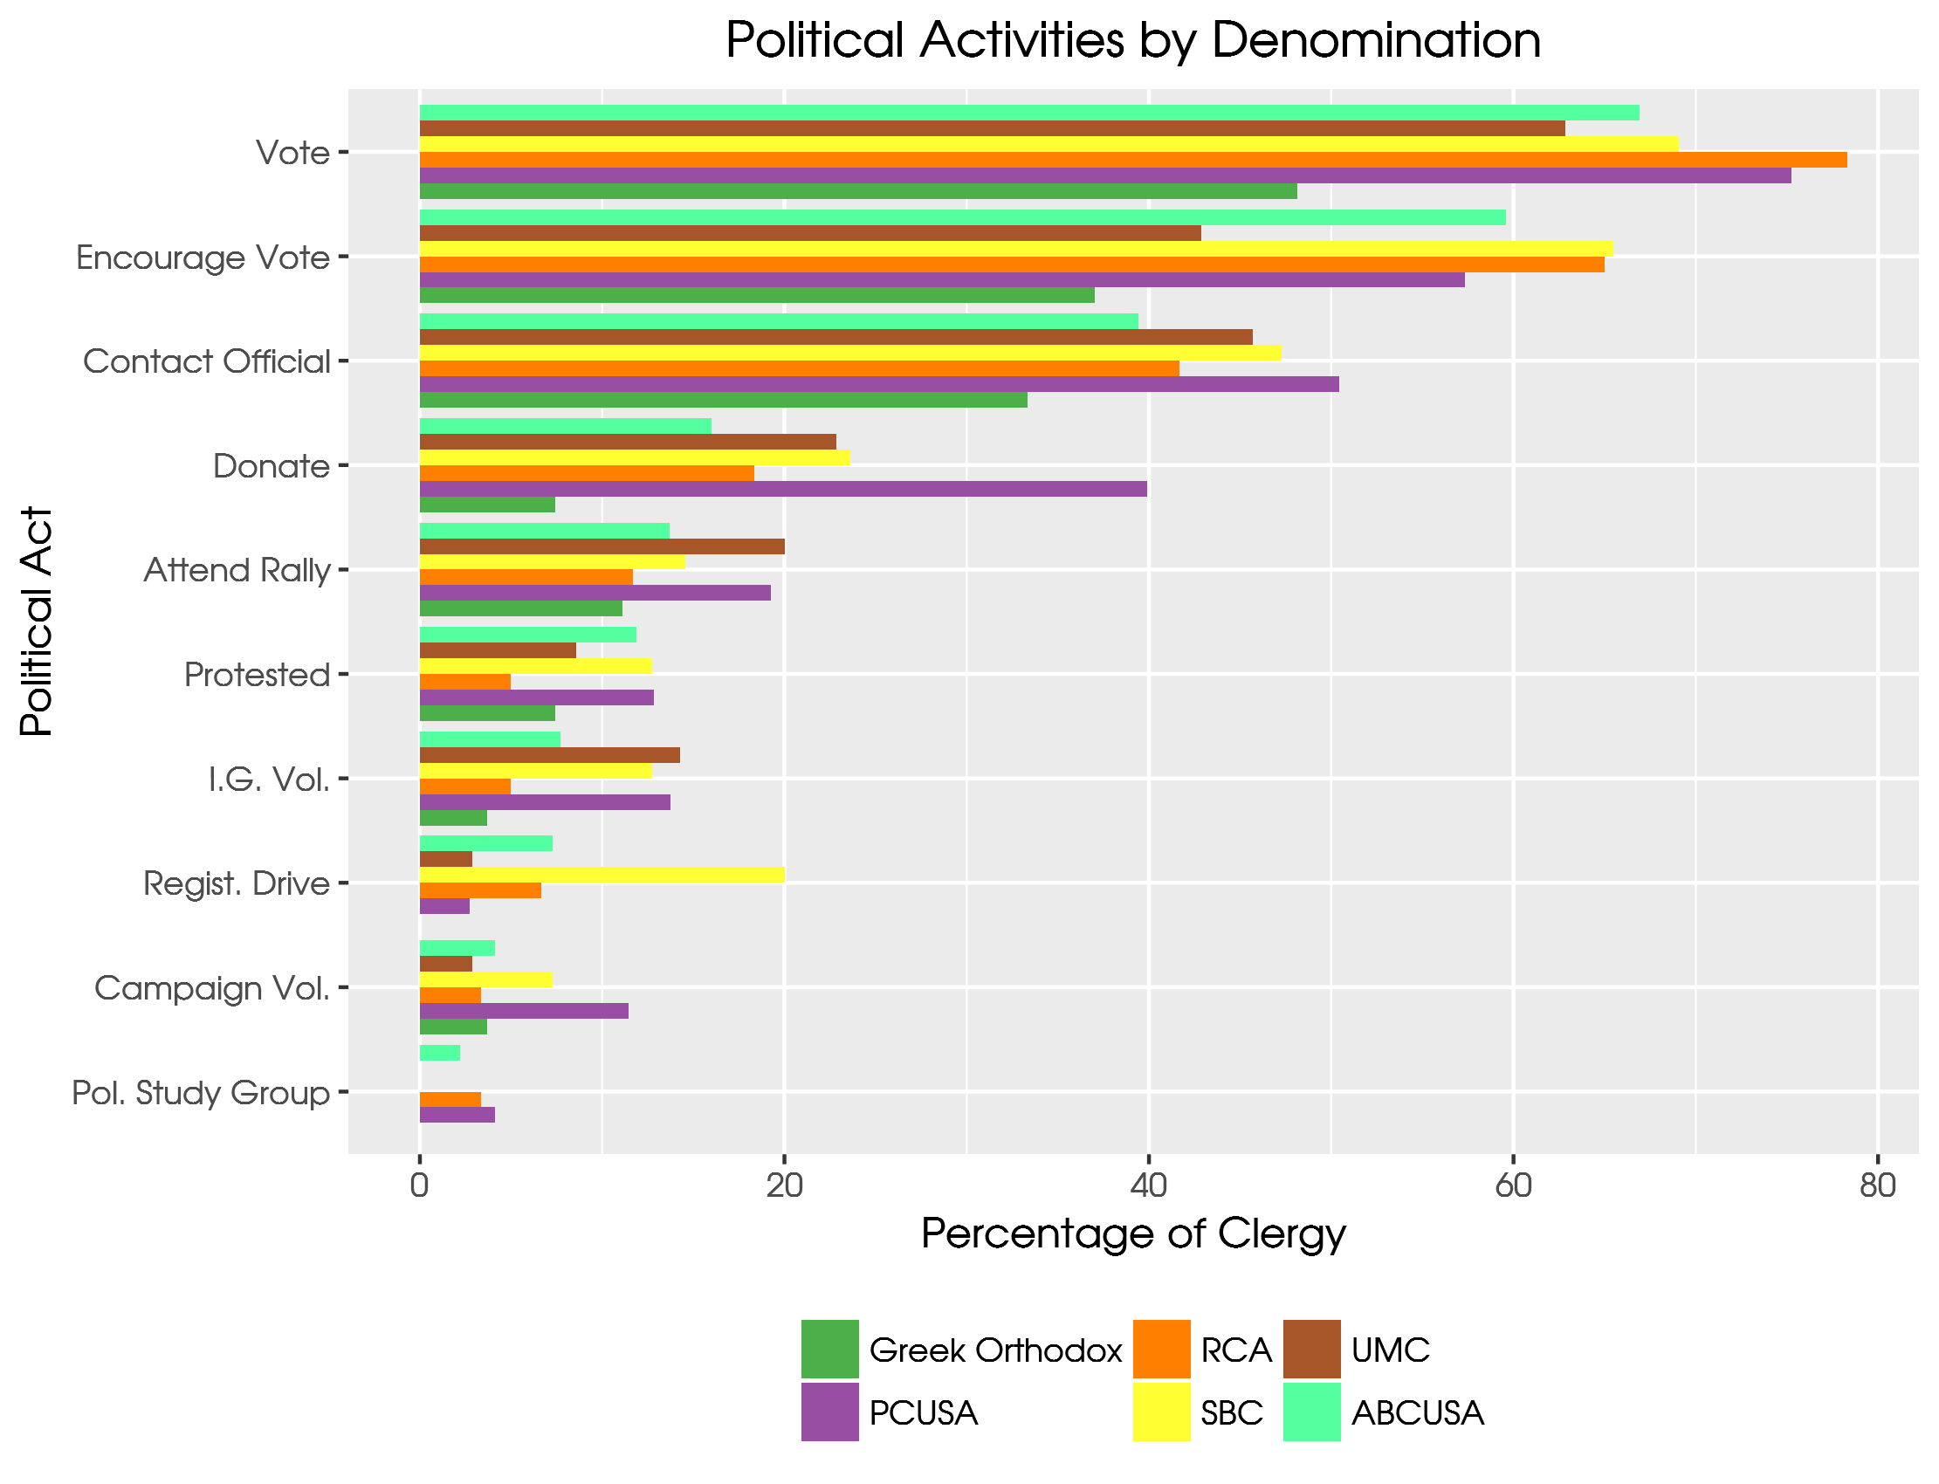

Slide 35
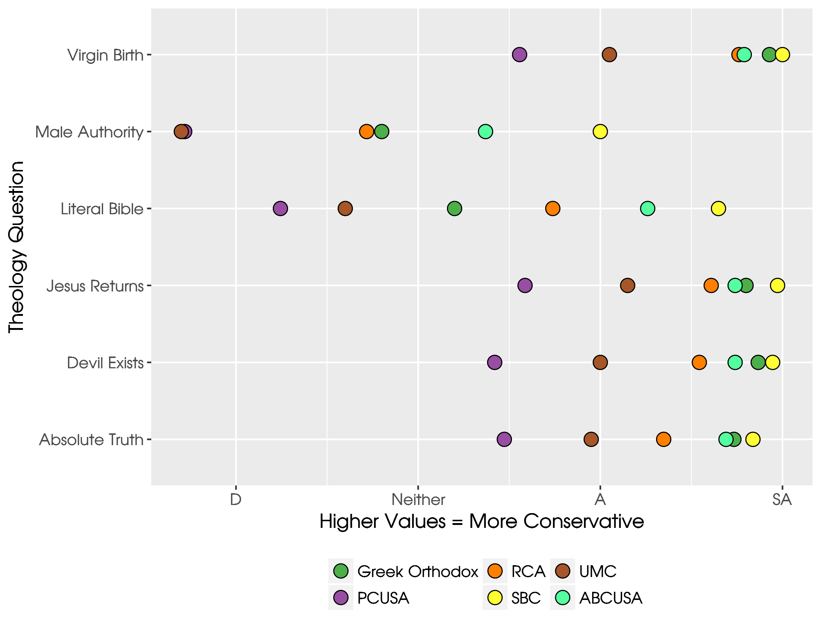

Slide 36
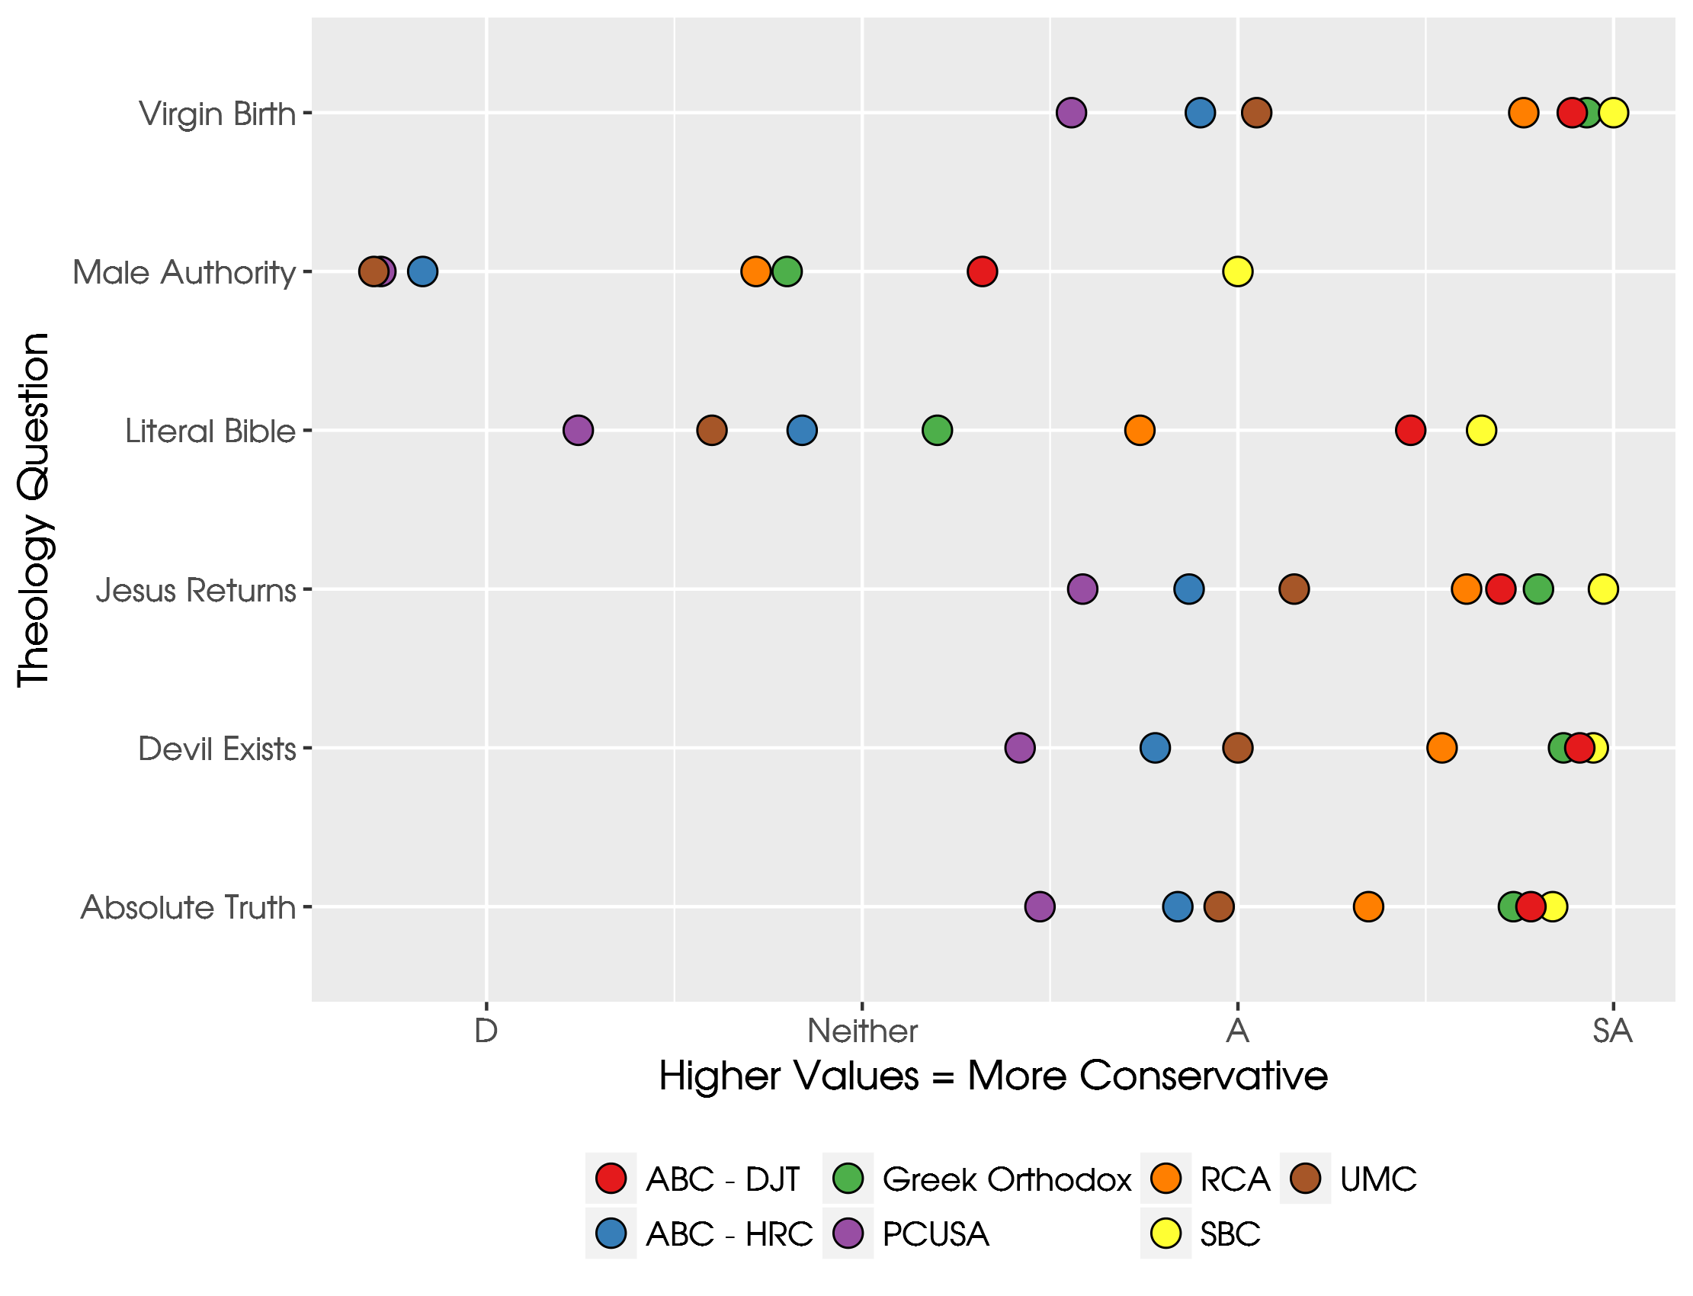

Slide 37
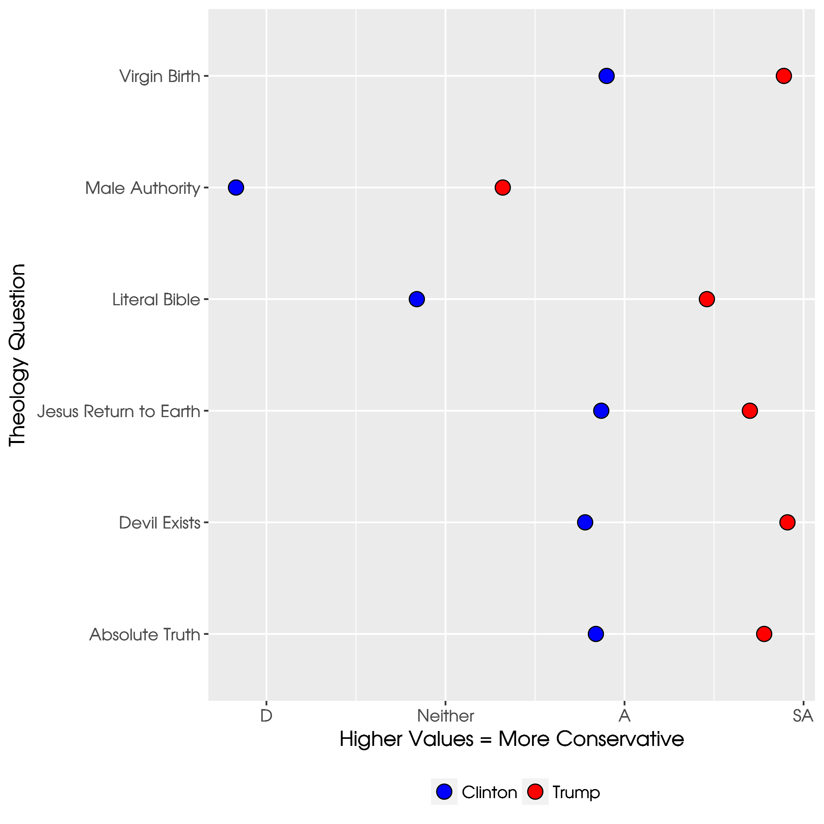

Slide 38
Religious Authority Values
The more clergy can step out of the way of the congregation the better
It is important for the congregation to construct their own salvation
The Gospel is what the congregation makes of it
I believe there are many valid interpretations of the Bible
The church must adapt to a postmodern culture in order to spread the Gospel
Respond: Strongly Agree to Strongly Disagree
5 = Agreement with Religious Authority

Slide 39
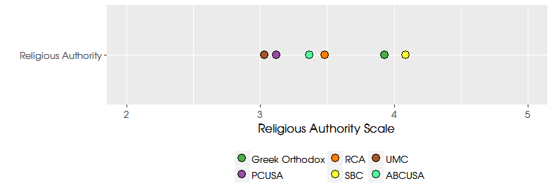

Slide 40
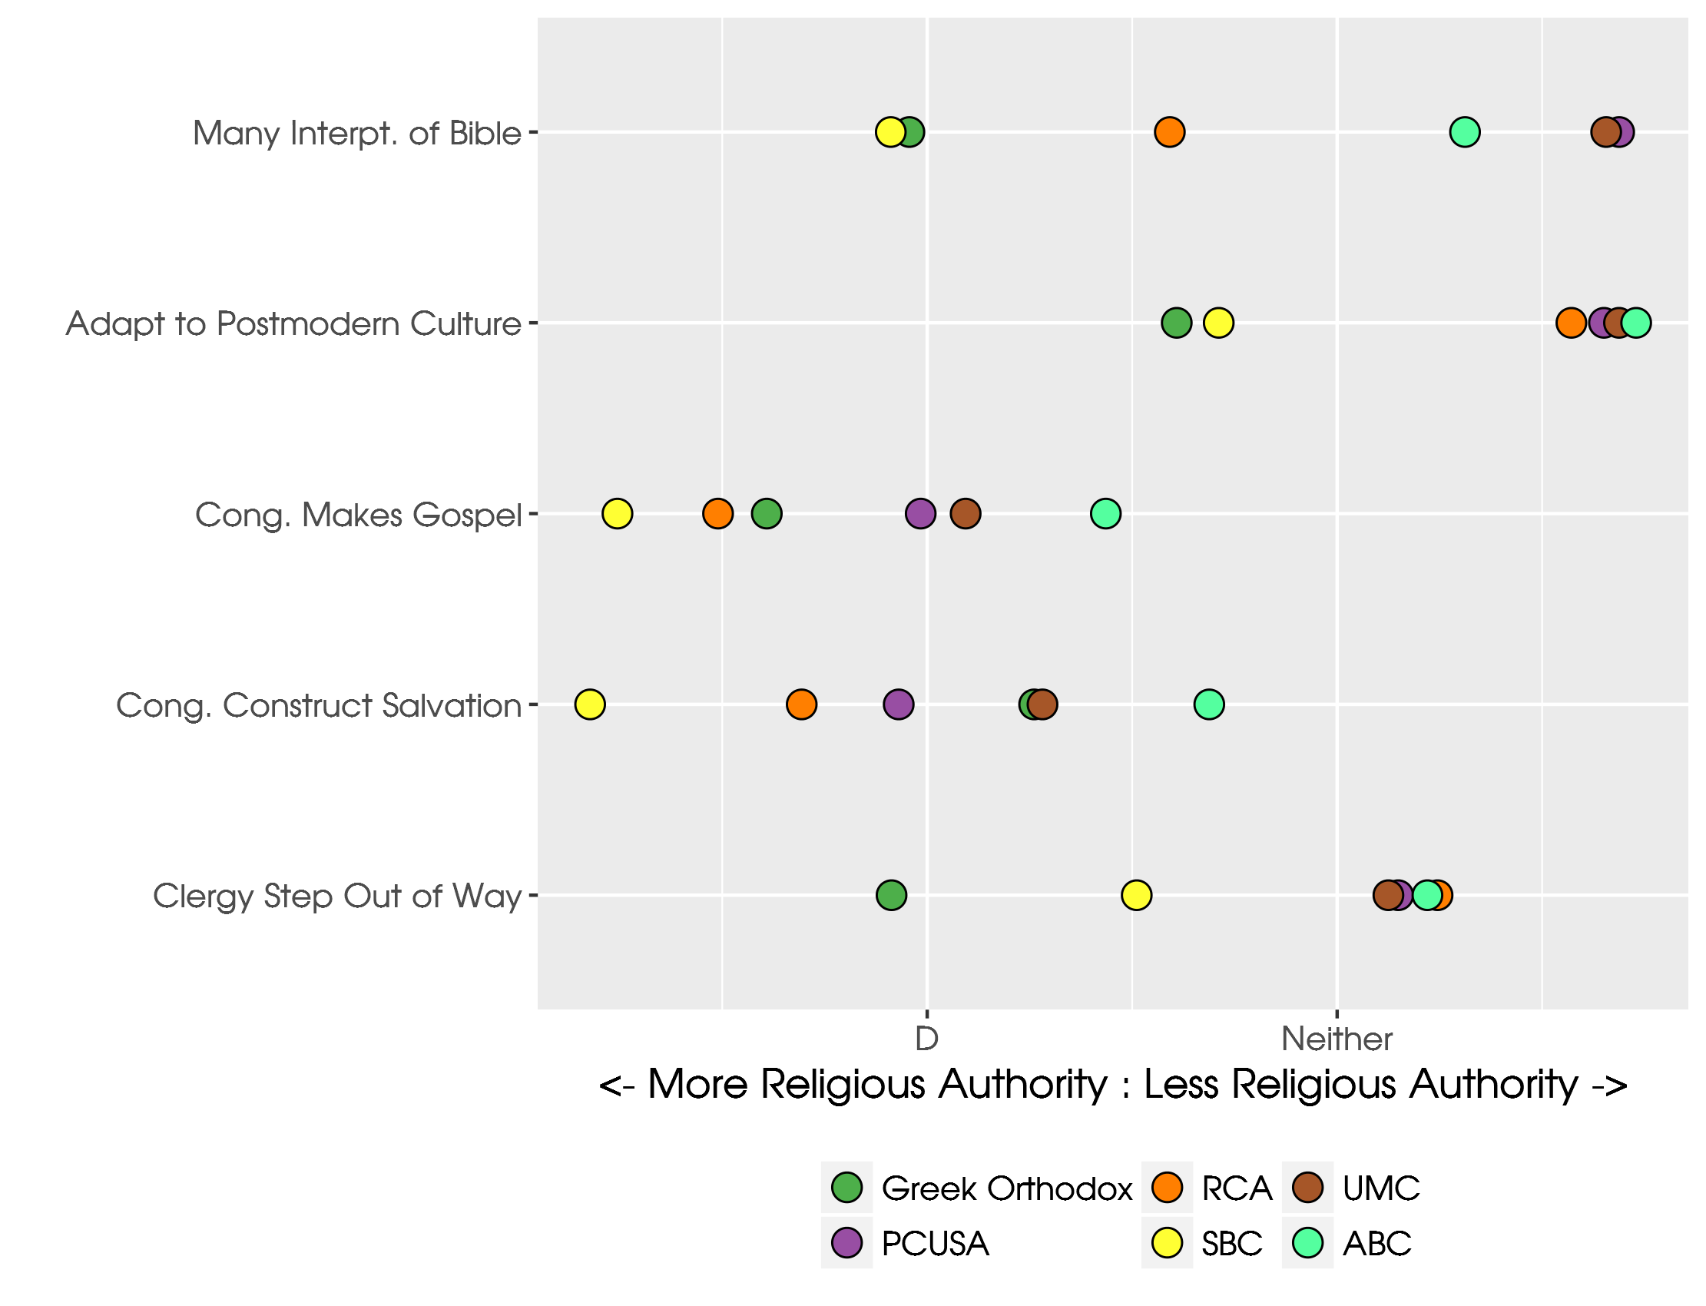

Slide 41
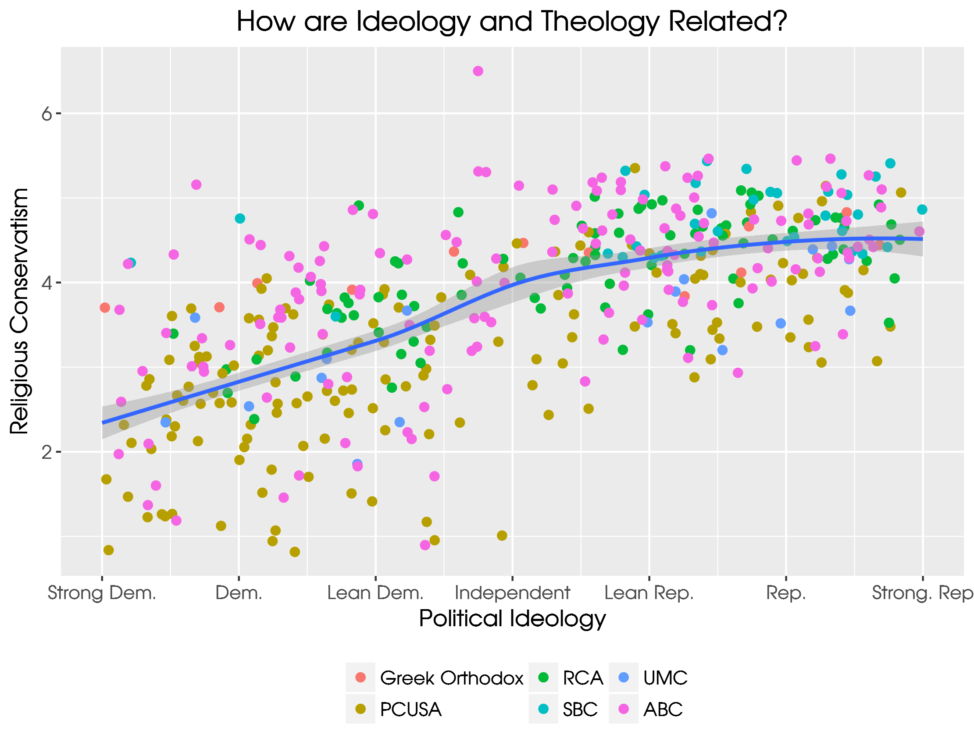

Slide 42
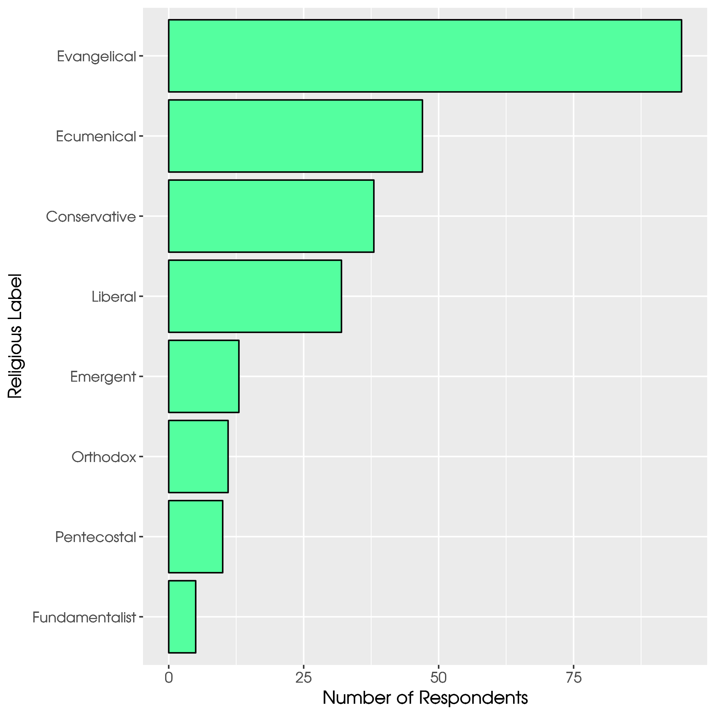

Slide 43
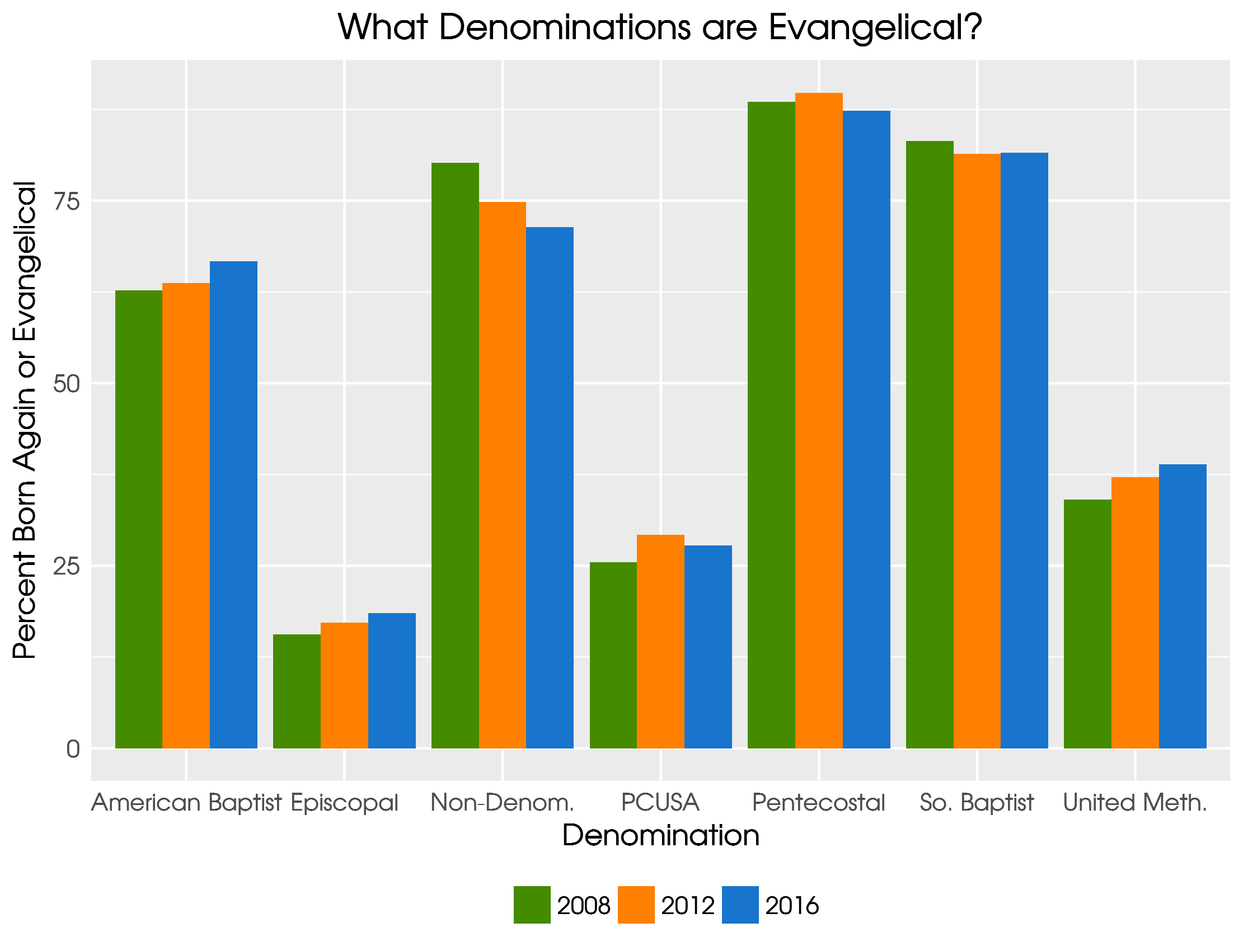

Slide 44
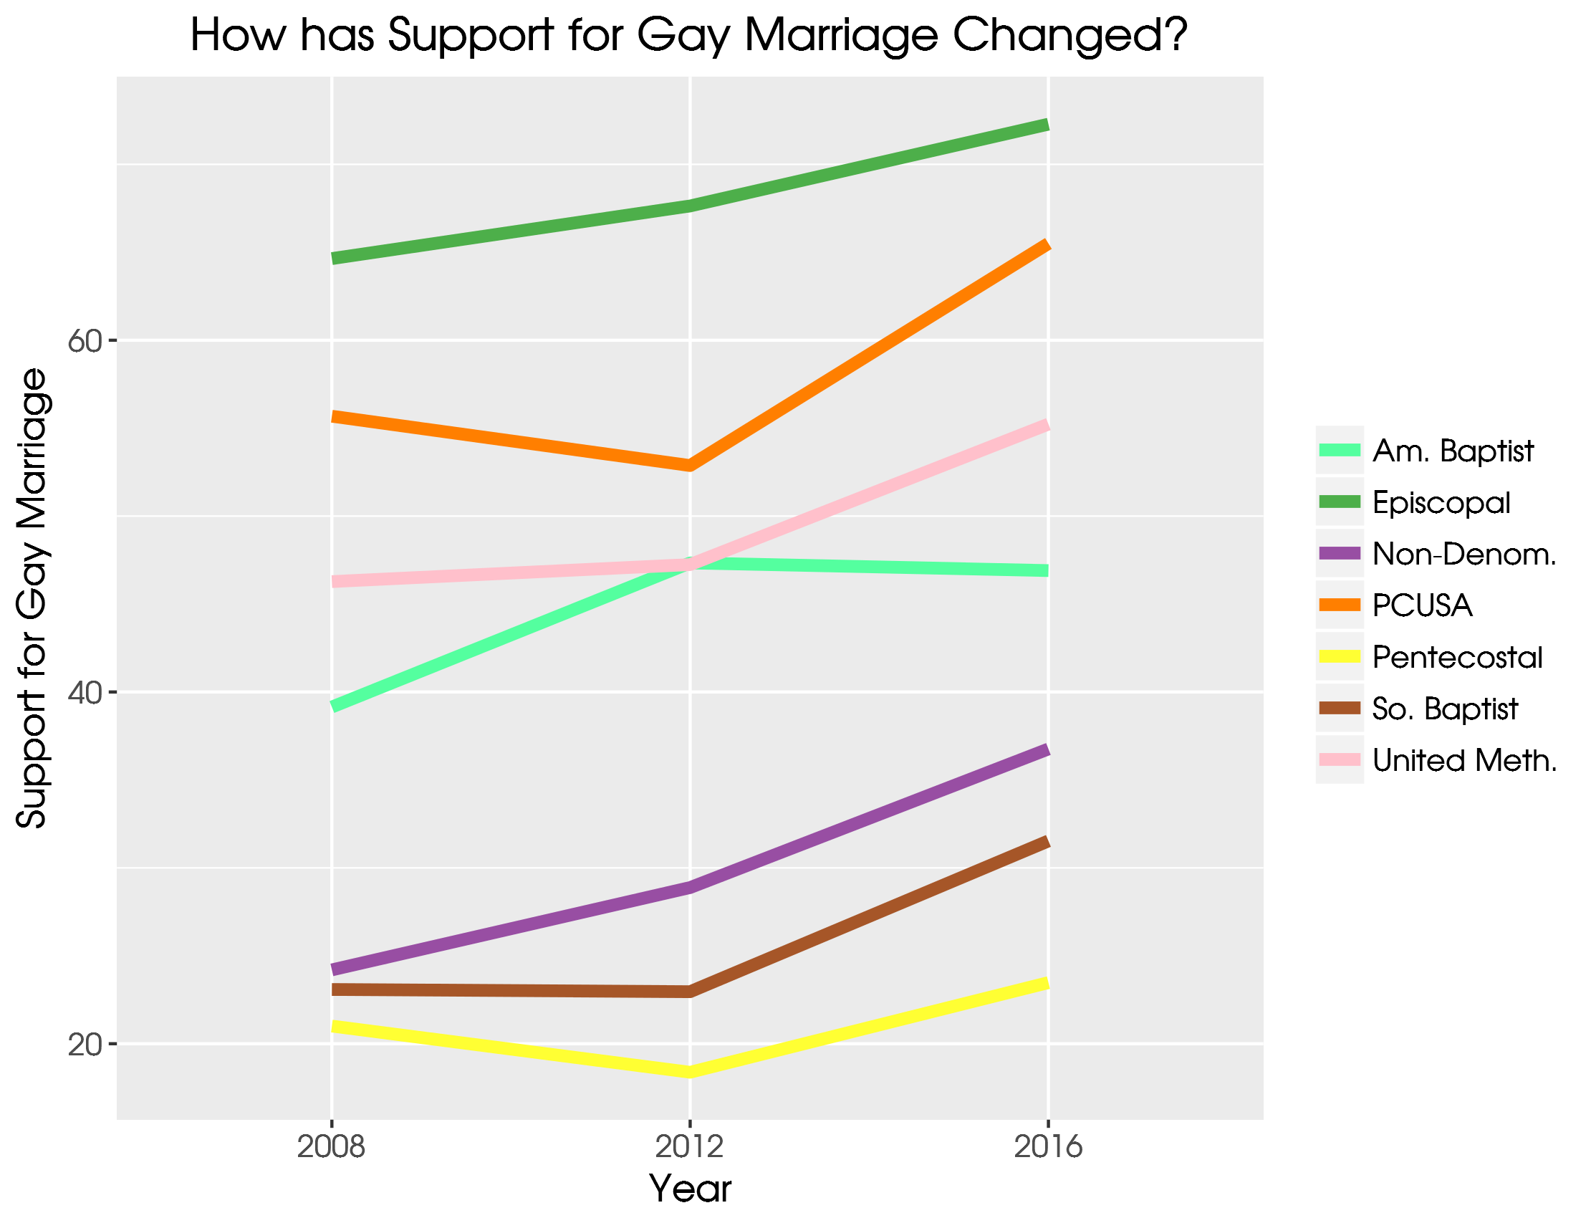

Slide 45
