Slide 1

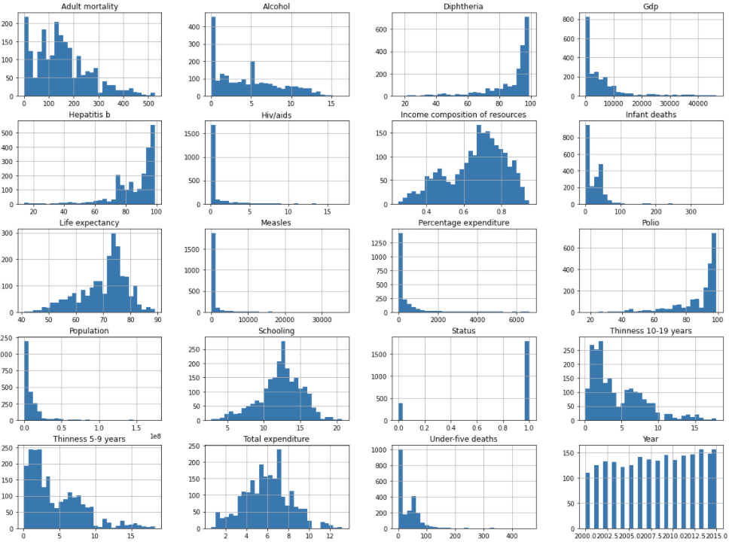
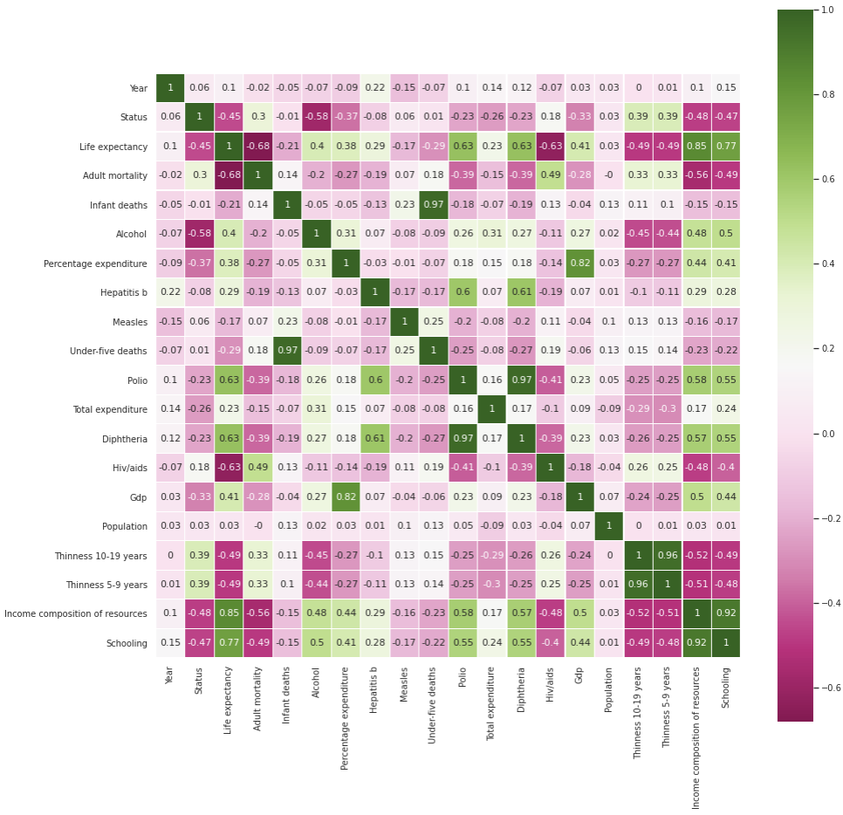
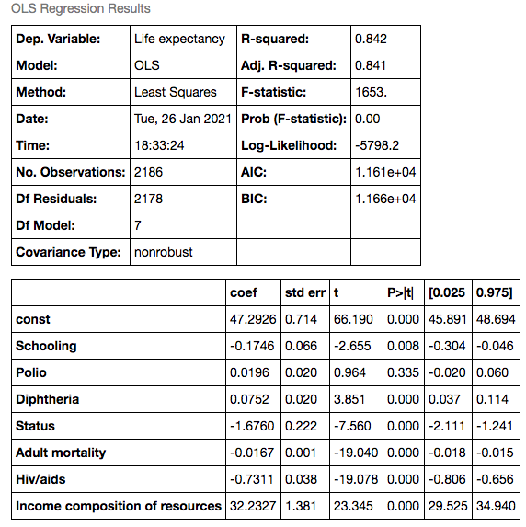
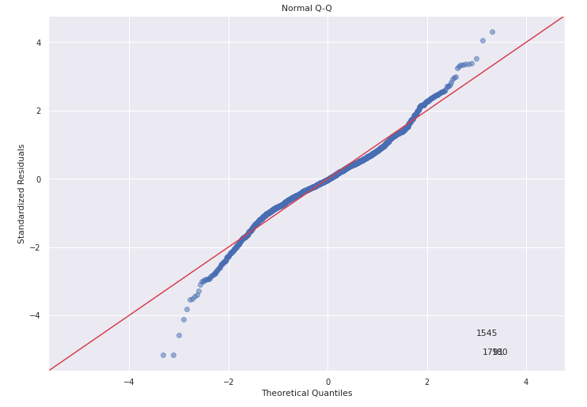
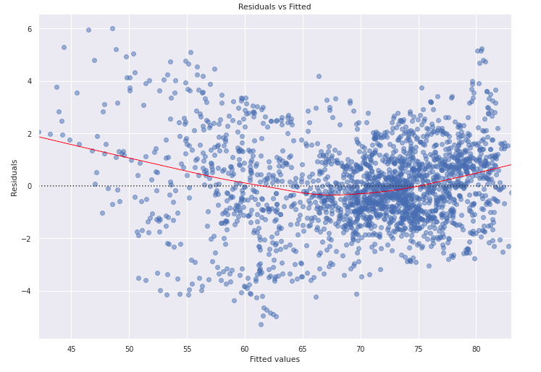

Infographic Resume
Predicting Life Expectancy using Regression
Spencer Weis, Ryan Conroy, Travis Fekkers
Goal
To create a regression model that will accurately predict the life expectancy of a country given information regarding heath, social, and economic factors.
Data:
The dataset used is maintained by the Global Health Observatory (part of the WHO). It contains information on life expectancy, health factors, and other information for 193 countries from the years 2000-2015. The dataset contains 22 columns with 2,938 rows of data (20 predictive variables), and these.
Country, Year, Status, Life expectancy, Adult Mortality, Infant deaths, Alcohol, Percentage expenditure, Hepatitis B, Measles, BMI, Under-five deaths, Polio, Total expenditure, Diphtheria, HIV/AIDS, GDP, Population, Thinness 1-19 hears, Thinness 5-9 years, Income composition of resources, Schooling
Models/Algorithms
Models Tested
We ran 3 multilinear regression models, the first our two columns with the highest correlation to our target. We ran another with the addition of the Polio and Diphtheria columns to see if these immunizations (which also had higher correlations to our target) made an impact on our model’s ability to predict a country’s life expectancy. The last model was built with the top 6 columns with the highest correlations to our target and Status.
Our column with the highest correlation to Life expectancy was Income composition of resources, which had a correlation of 0.8545. This is because countries with a high Income composition of resources value are better able to utilize their resources to care for their citizens.
First model – Multiple Linear Regression
Income compostion of Resources, Schooling
Training R2: 0.736
Test R2: 0.715
Second Model– Multiple Linear Regression
Income compostion of Resources, Schooling, Polio, Diptheria
Training R2: .765
Test R2: .753
Third Model– Multiple Linear Regression
Income compostion of Resources, Schooling, Polio, Diptheria, Status, Adult Mortality, Hiv/Aids
TrainingR2: .841
Test R2:.842
Fourth Model- Tree Regression
Income compostion of Resources, Schooling, Polio, Diptheria, Status, Adult Mortality, Hiv/Aids
Training R2: .992
Test R2: .946
Statistics
Analysis
Residual Plots
Through our model, we could interpret that income composition of resources seems to have the most effect on predicting life expectancy.
Coefficient= 32.23
T-value= 23.35… p-value=0.000
Developing vs. developed country was an interesting interpretation from the model too. With everything else held constant, individuals from developing countries are predicted to live 1.68 years less than an individual from a developed country.

