Slide 1
On the Relationship Between
Generalized Covariance Union and the Minimal Enclosing Ellipsoid Problem
  A Thesis Presentation
  by Ryan Calhoun
  Dr. Jeffrey Uhlmann, Thesis Supervisor

Slide 2
On the Relationship Between
Generalized Covariance Union
and the Minimal Enclosing Ellipsoid Problem
What is Generalized Covariance Union?
What is the Minimal Enclosing Ellipsoid Problem?
  How are these two related?
  What is the significance of this relationship?

Slide 3
Outline
Generalized Covariance Union (GCU)‏
  Terms and notation
  Formulation of GCU
  Context of use in data fusion
  Plots
Minimal Enclosing Ellipsoid of Ellipsoids (MEEE)‏
Analysis of relationship between GCU and MEEE
Discussion

Slide 4


Terms and notation (GCU)‏
Estimate given by mean-covariance pair (m,M)‏
  Mean m is an n-vector
  Covariance M is an nxn matrix
(m,M) is consistent if M is at least as large as the expected squared error associated with m:
or equivalently
is positive semidefinite.

Slide 5
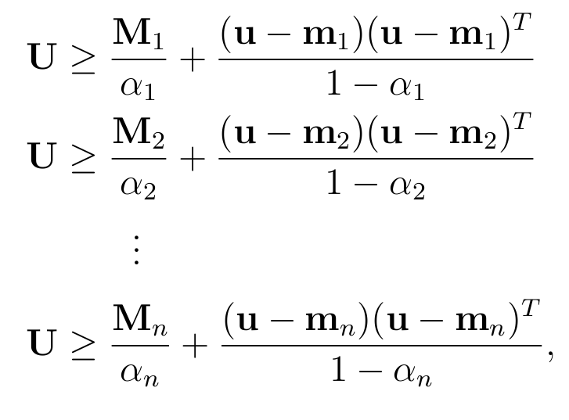
Formulation of GCU
GCU is a constrained minimization problem:
To find (u,U), minimize |U| subject to
where each α_{i} is in the range (0,1).

Slide 6
Context of GCU in Data Fusion
All estimates consistent?
yes
no
Known correlation?
All estimates known at once?
no
yes
Partially known correlation?
yes
no
yes
no
Kalman
Split CI
CI
CU
GCU

Slide 7
Context of GCU in Data Fusion
All estimates consistent?
yes
no
Known correlation?
All estimates known at once?
no
yes
Partially known correlation?
yes
no
yes
no
Kalman
Split CI
CI
CU
GCU

Slide 8
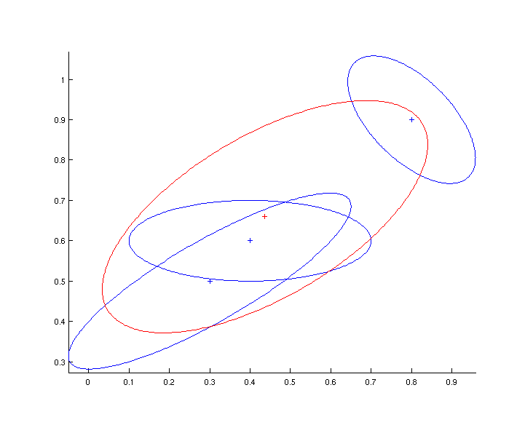
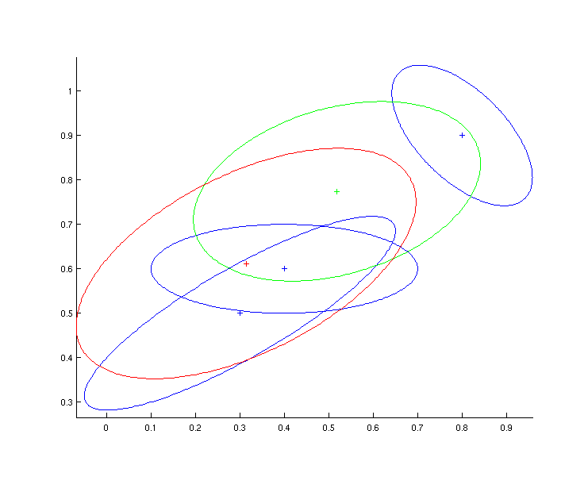
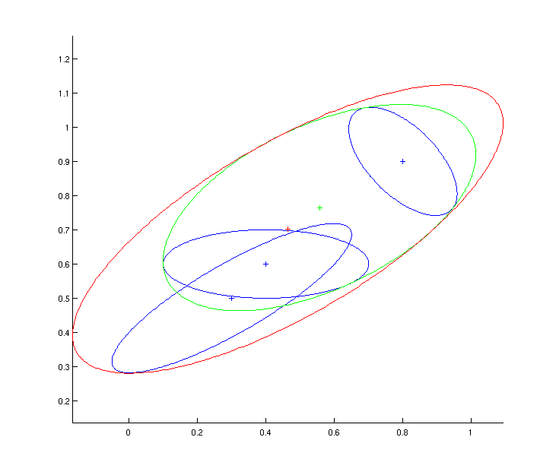
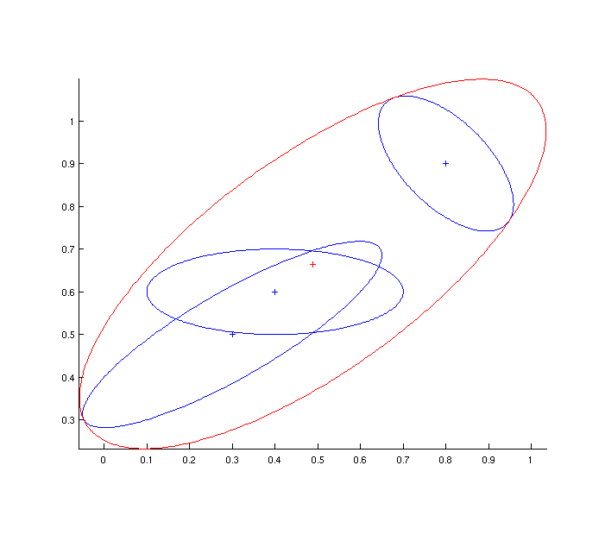
CU vs GCU
CU Batch
CU Pairwise
GCU Batch
GCU Pairwise

Slide 9
2D GCU Plot – 3 inputs

Slide 10
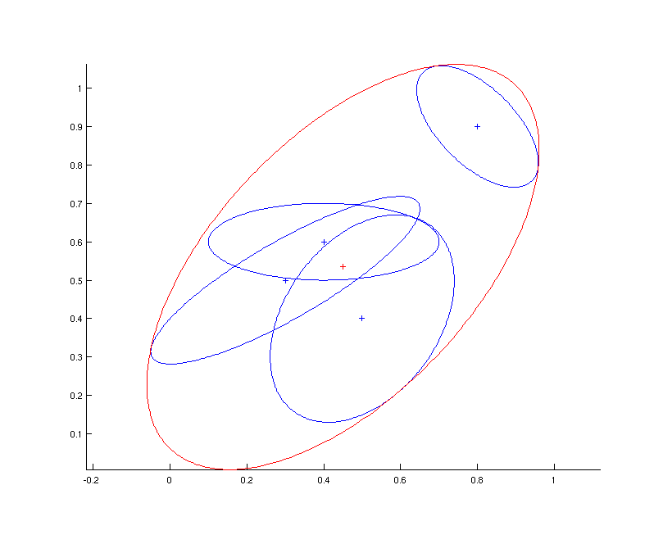
2D GCU Plot – 4 inputs

Slide 11
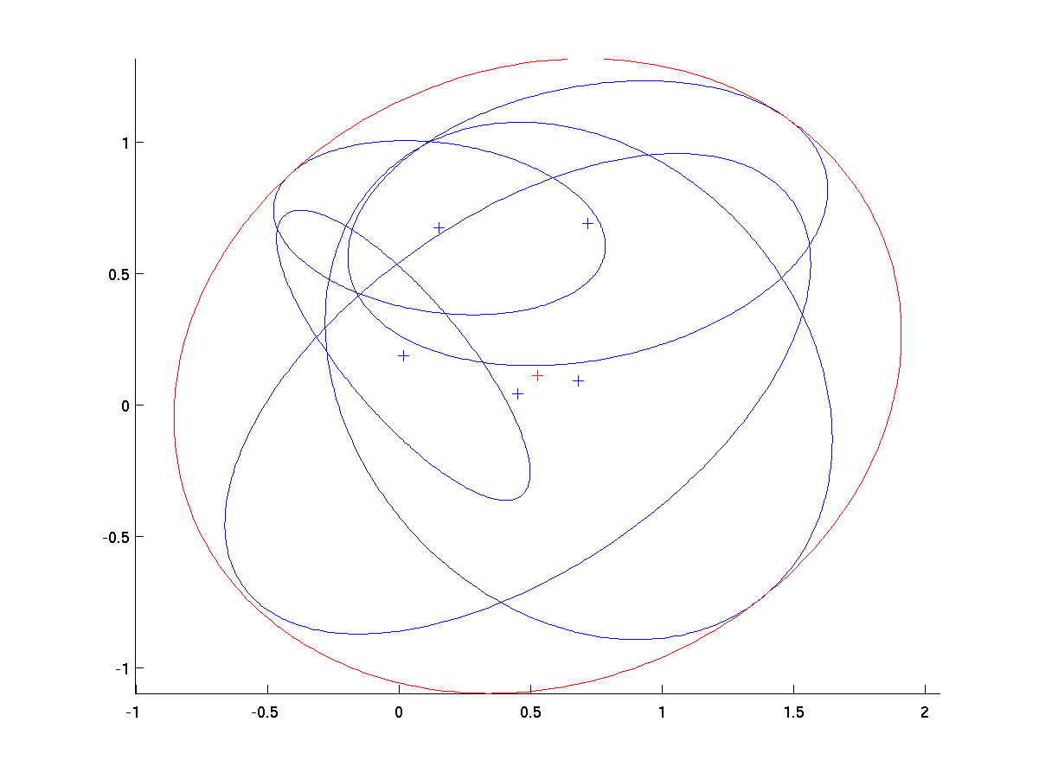
2D GCU Plot – 5 inputs

Slide 12
Outline
Generalized Covariance Union (GCU)‏
Minimal Enclosing Ellipsoid of Ellipsoids (MEEE)‏
  Uses in computational geometry
  Notation
  Formulation of MEEE
  Test for enclosure
Analysis of relationship between GCU and MEEE
Discussion

Slide 13
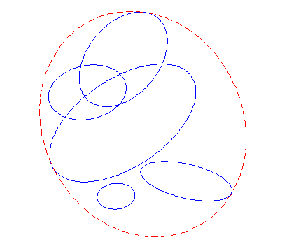
Uses of MEEE in Computational Geometry
Ellipsoid gives more precise bounding volume than sphere or box
Objects can be grouped in ellipsoid hierarchy to simplify tasks
  Collision detection
  Ray tracing

Slide 14

Notation (MEEE)‏
An ellipsoid is given by
where A_{i} is an nxn matrix, b_{i} is an n-vector, and c_{i} is a scalar.
This multiplies into a degree 2n polynomial in x.

Slide 15
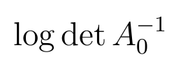
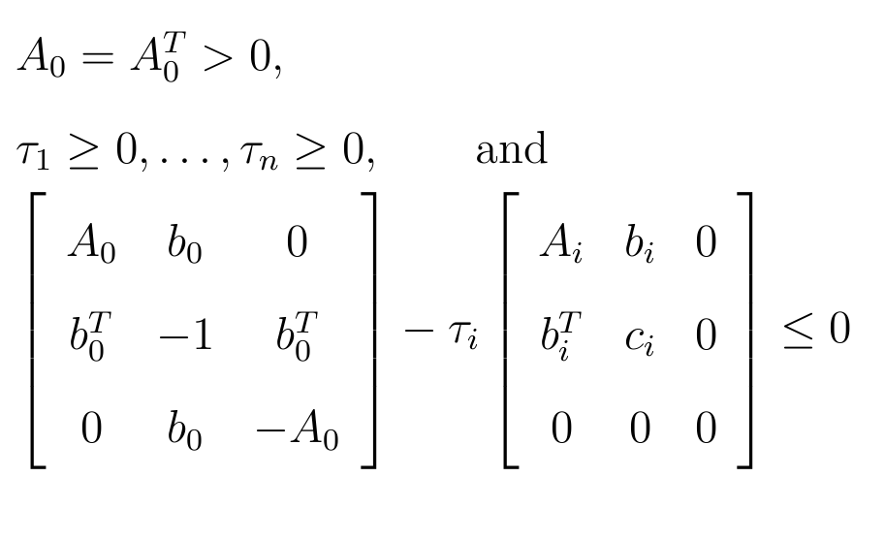
Formulation of MEEE - 1
The enclosing ellipsoid ε0 is found in the variables A₀, b₀, and τ₁...τ_{n}, by minimizing
subject to

Slide 16


Formulation of MEEE - 2
The final ellipse is
where c₀ is given by

Slide 17
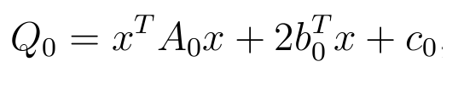

Test for Ellipsoid Enclosure - 1
Given an ellipse Q₀
which should enclose Q₁
find the min and max Q₀= λ which intersects Q₁.

Slide 18
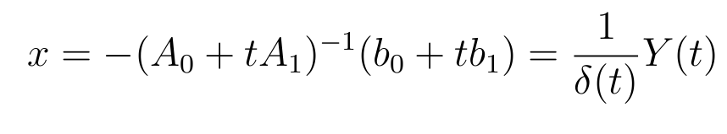
Test for Ellipsoid Enclosure - 2
Use Lagrange multiplier to find λ_{min} and λ_{max}.
Find the roots of
where
and δ(t) is the determinant of (A₀+tA₁).
Q₀ at each x(t = P(t)_{roots}) gives each possible λ.
  If λ_{max} ≤ 0, then ε₀ properly contains ε₁.

Slide 19
Outline
Generalized Covariance Union (GCU)‏
Minimal Enclosing Ellipsoid of Ellipsoids (MEEE)‏
Analysis of relationship between GCU and MEEE
  Transformation between covariance and ellipsoid
  General behavior of α parameter
  1D Example
  2D Example
  Extension to higher dimensions
Discussion

Slide 20
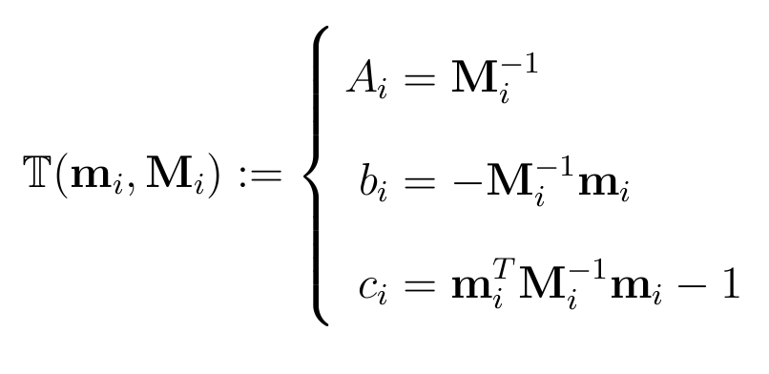
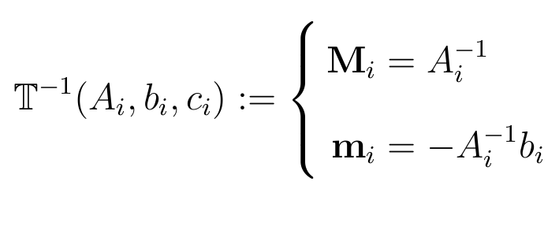
Covariance-Ellipsoid Transformation
Transform mean-covariance pair to ellipsoid notation:
Transform ellipsoid to mean-covariance notation:

Slide 21
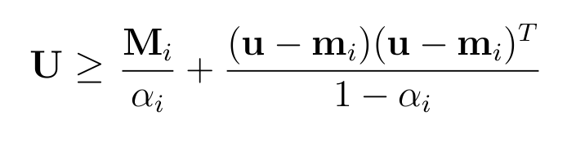
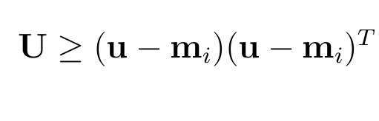
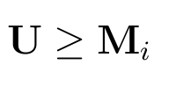
General Behavior of α Parameter - 1
Given the general GCU constraint
  If M_{i} is a zero matrix, reduces to
  If m_{i} and u are coincident, reduces to

Slide 22
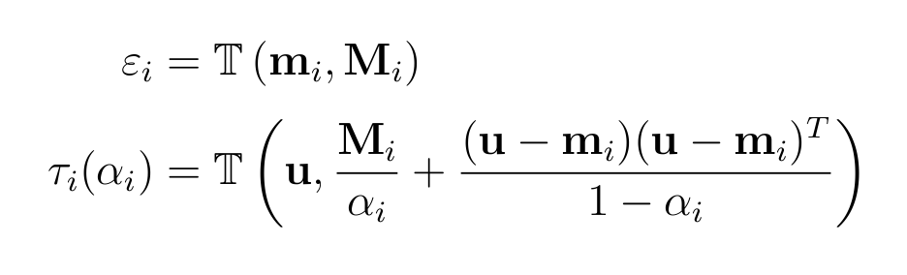
General Behavior of α Parameter - 2
Examine only RHS of GCU constraint
Transform mean-covariance into ellipsoid notation:

Slide 23
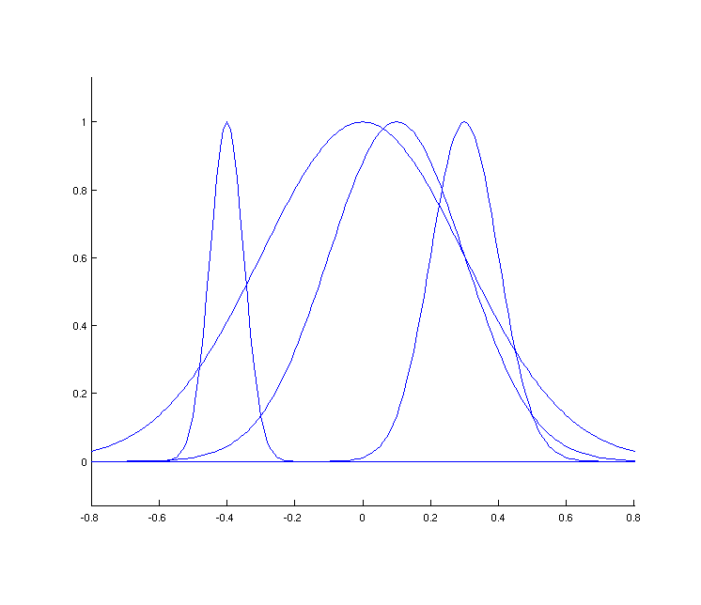
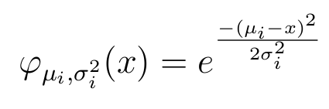
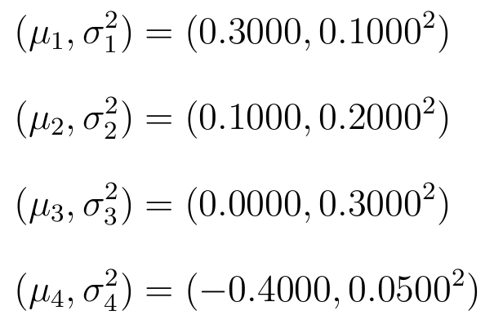
1D Example - 1
The Gaussian function in one dimension is

Slide 24
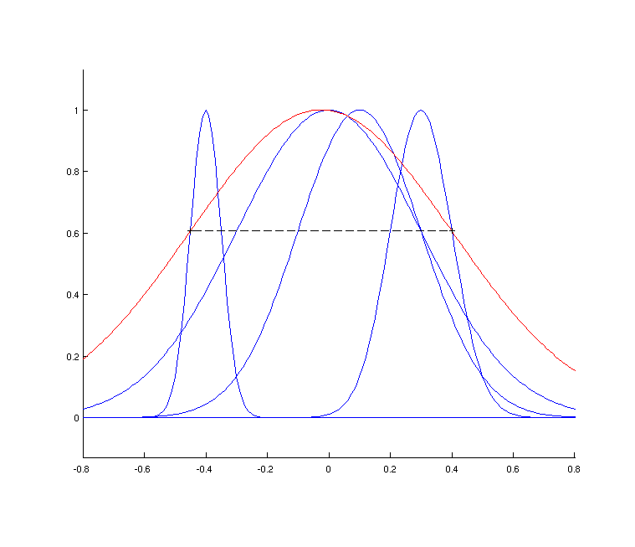
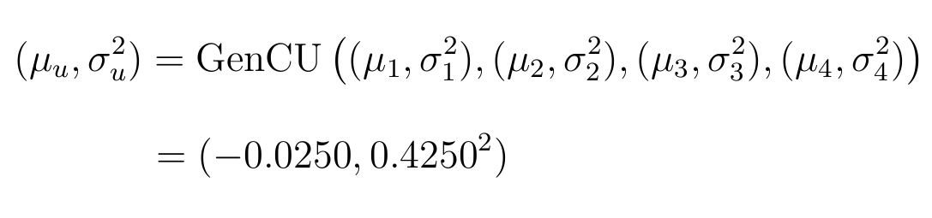
1D Example - 2

Slide 25
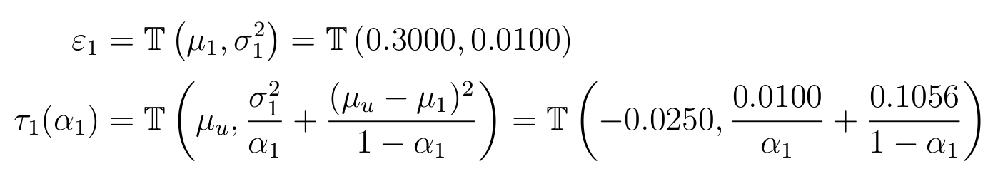
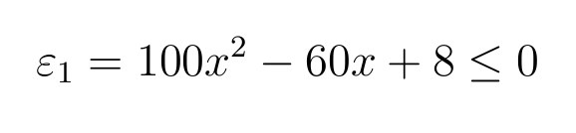
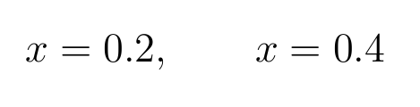
1D Example - 3
Applying the ellipsoid transformation gives
ε₁ can be written as
with roots

Slide 26
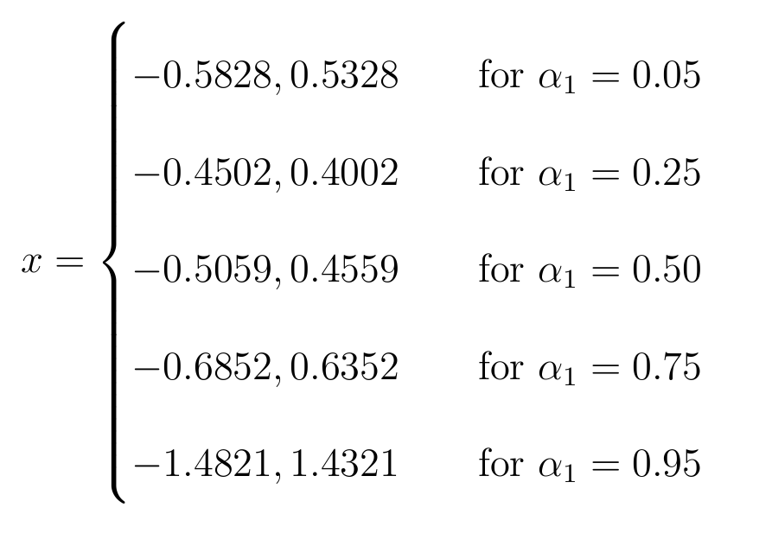
1D Example - 4
Evaluating τ₁(α₁) for different values of α₁ yields
which all contain the roots of ε₁:

Slide 27
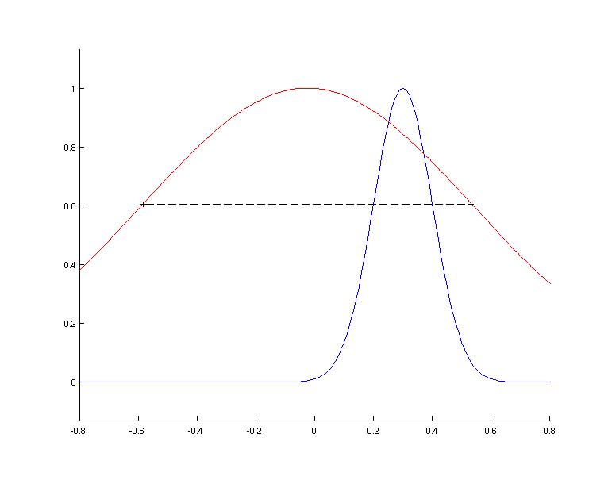
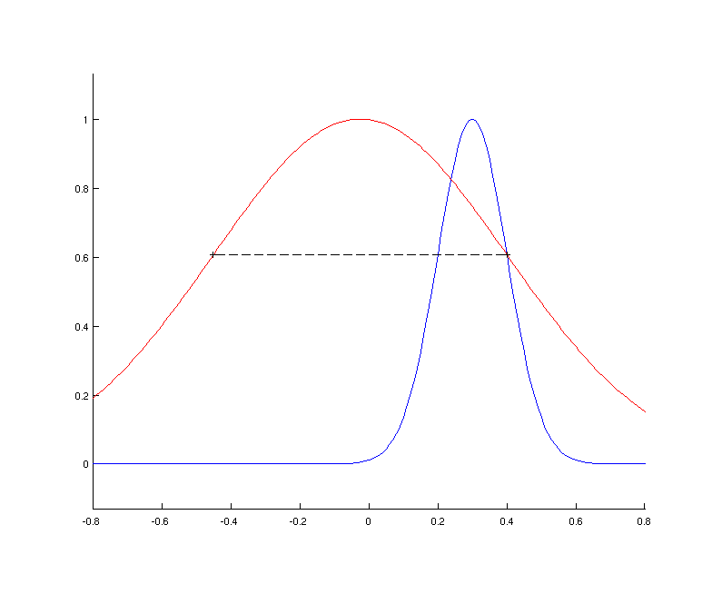
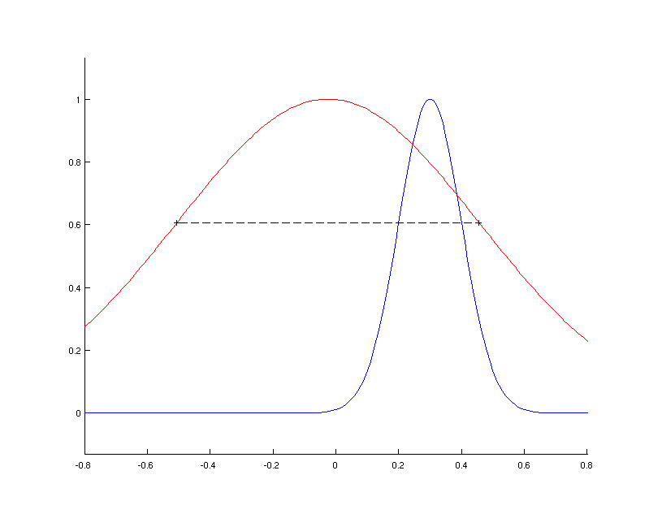
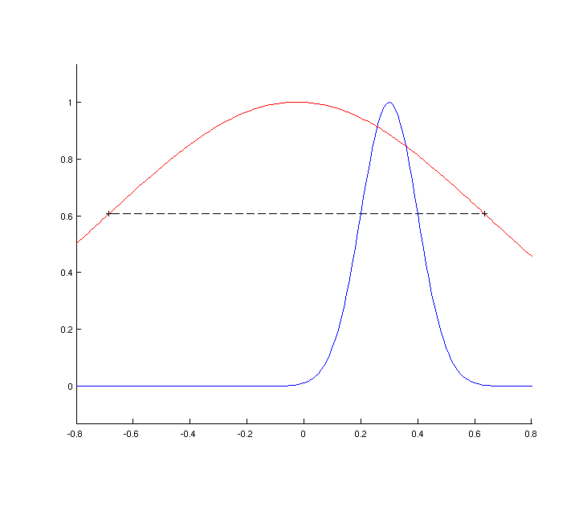
1D Example - 5
α₁ = 0.05
α₁ = 0.25
α₁ = 0.50
α₁ = 0.75

Slide 28
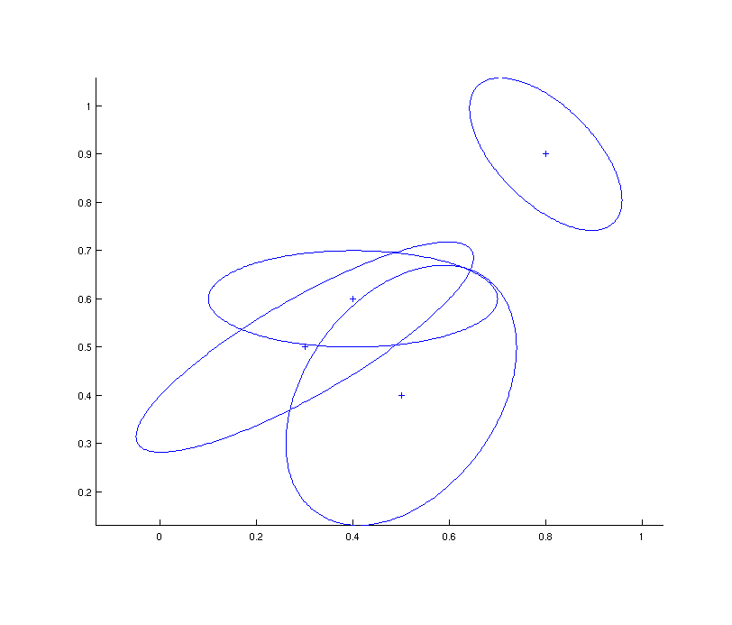
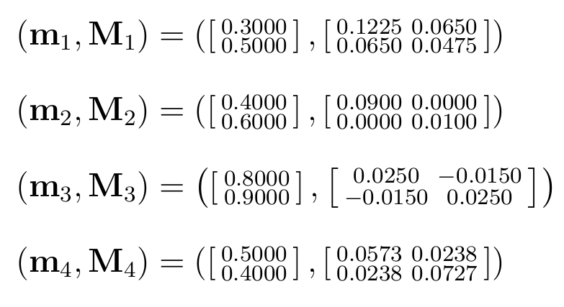
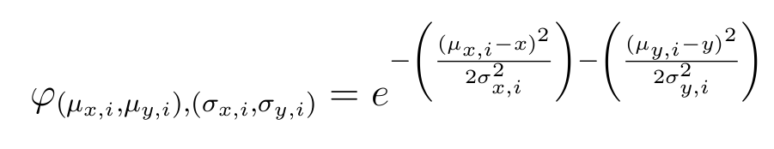
2D Example - 1
The Gaussian function in two dimensions is

Slide 29
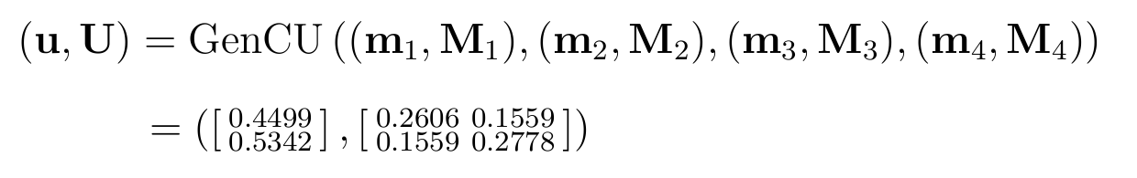
2D Example - 2

Slide 30
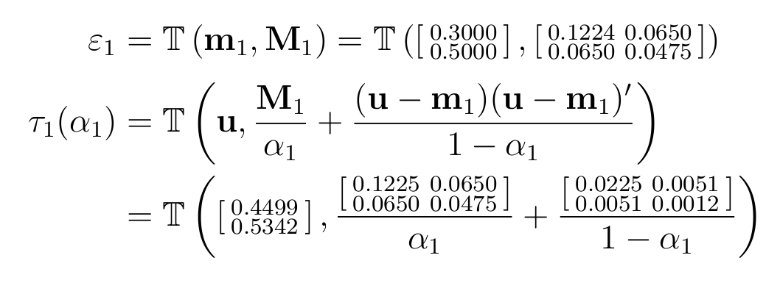
2D Example - 3
Applying the ellipsoid transformation gives

Slide 31
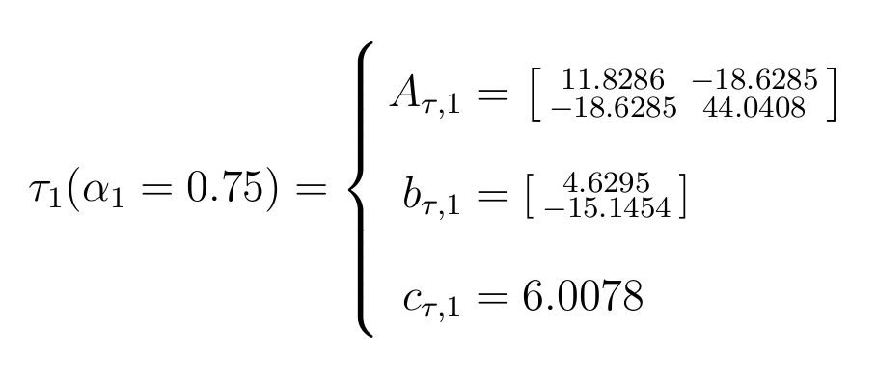
2D Example - 4
By selecting different values for α₁, such as α₁= 0.75
it is possible to apply the Lagrange technique to τ₁ and ε₁, and test if λ_{max} ≤ 0.
  In this case, λ_{max} = -0.0696

Slide 32
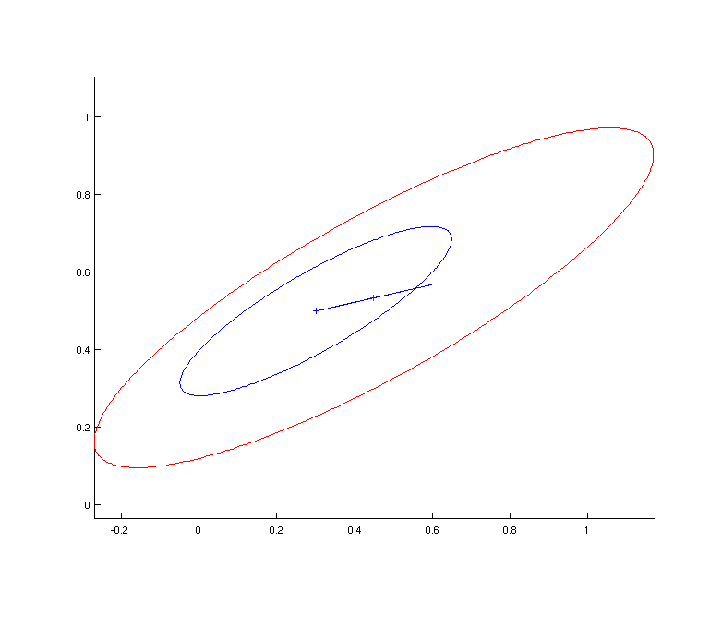
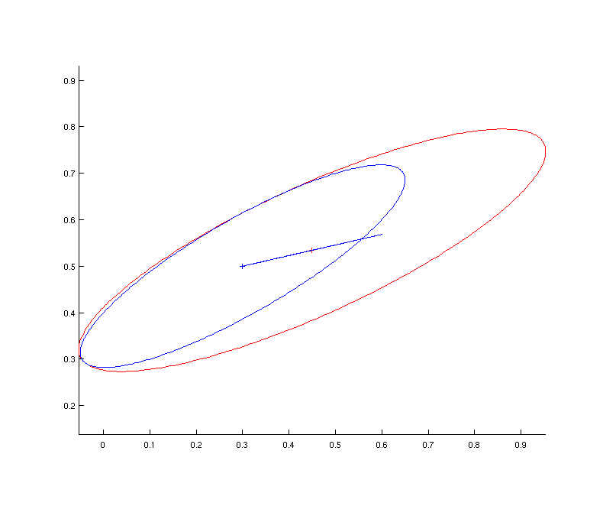
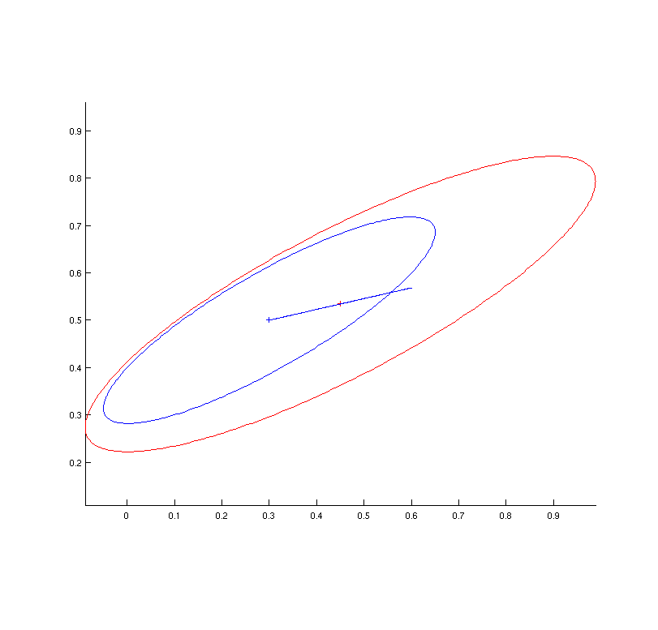
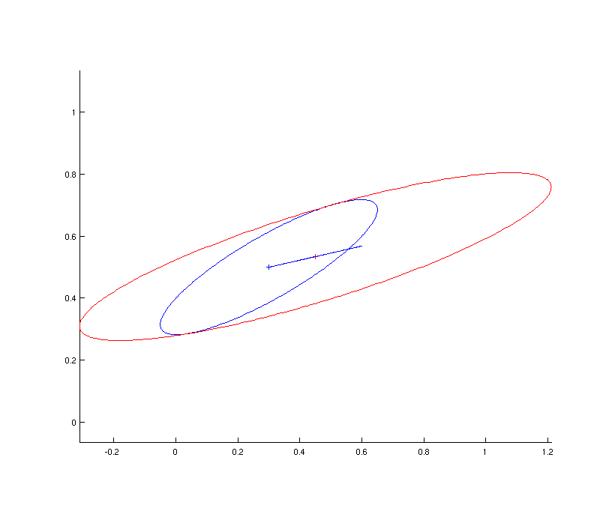
2D Example - 5
α₁ = 0.25
α₁ = 0.50
α₁ = 0.75
α₁ = 0.95

Slide 33
Extension to Higher Dimensions
Visualization in 3D and higher becomes increasingly difficult.
Covariance-ellipsoid transformation and Lagrange minimization test still work in any dimensionality.
  Lagrange polynomial is order 2n, so tests become more expensive.

Slide 34
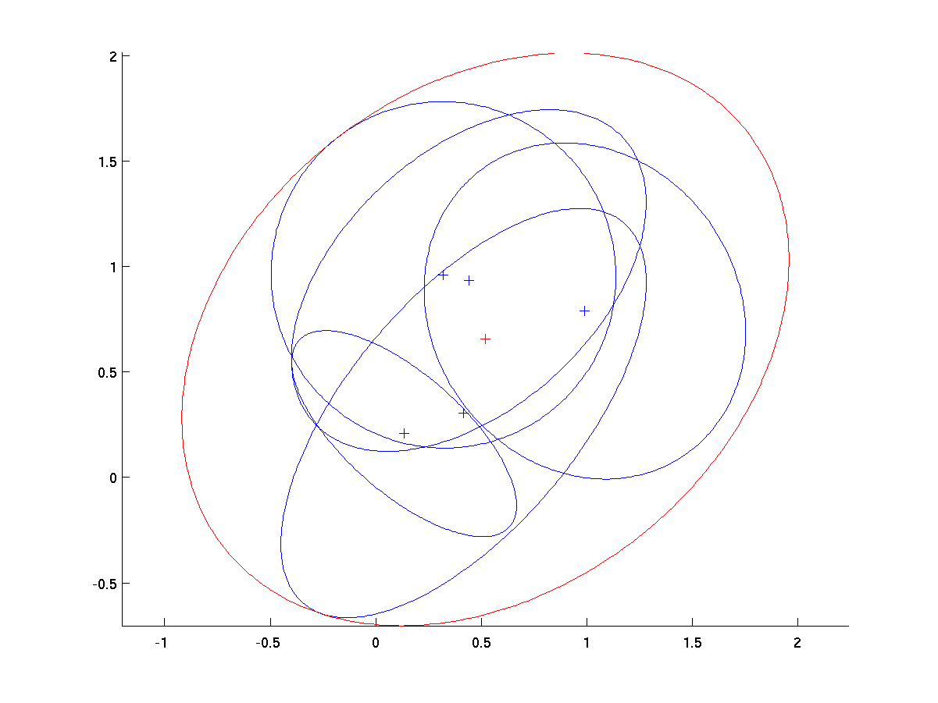
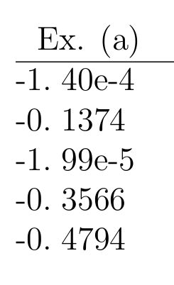
Additional Examples - (a)‏
  λ_{max} for 5 inputs

Slide 35
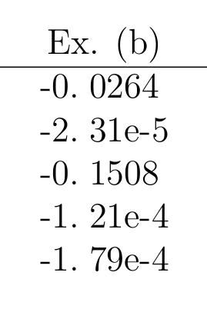
Additional Examples - (b)‏
  λ_{max} for 5 inputs

Slide 36
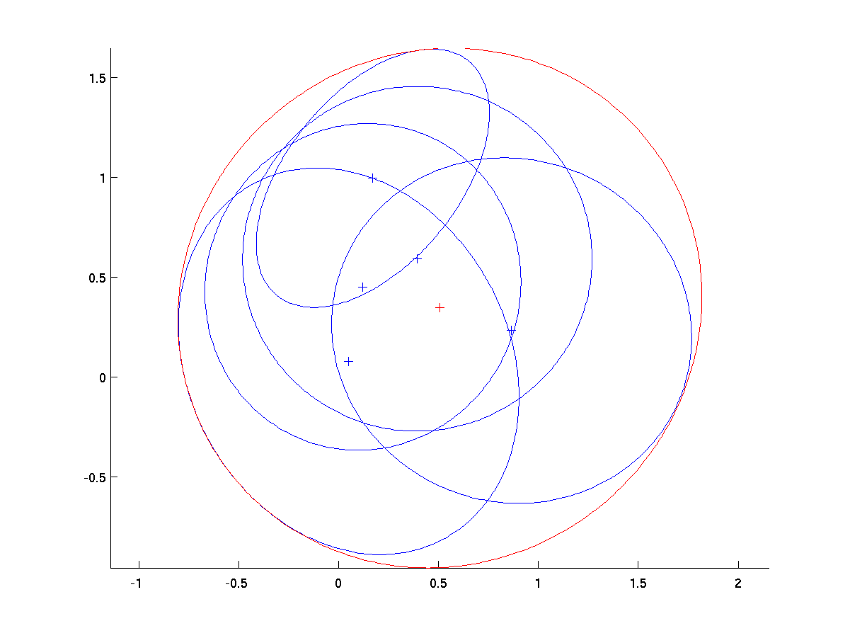
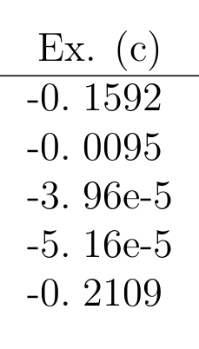
Additional Examples - (c)‏
  λ_{max} for 5 inputs

Slide 37
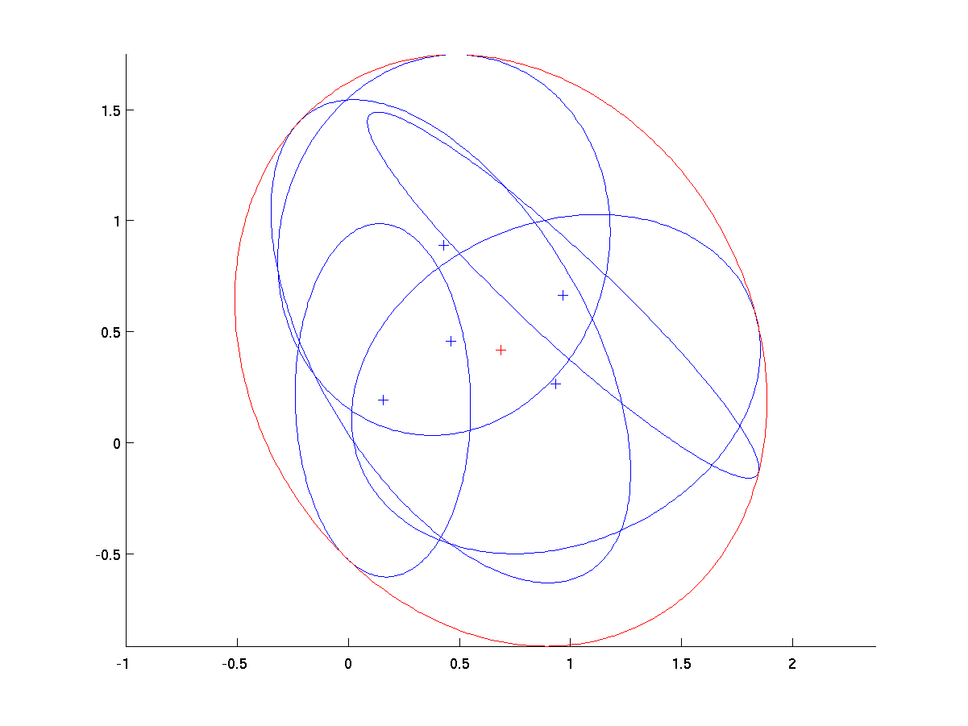
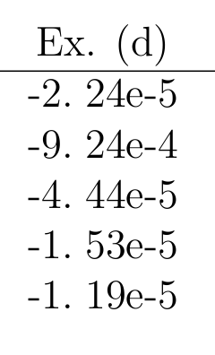
Additional Examples - (d)‏
  λ_{max} for 5 inputs

Slide 38
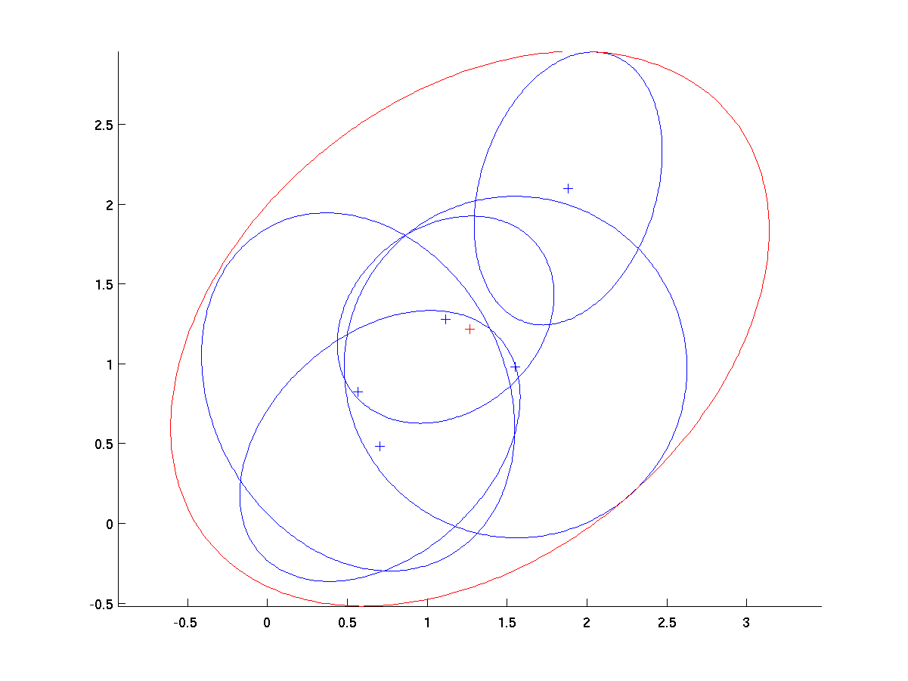
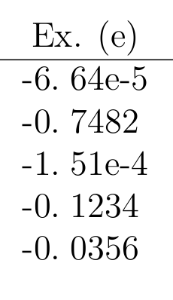
Additional Examples - (e)‏
  λ_{max} for 5 inputs

Slide 39


Additional Examples - (f)‏
  λ_{max} for 5 inputs

Slide 40
Outline
Generalized Covariance Union (GCU)‏
Minimal Enclosing Ellipsoid of Ellipsoids (MEEE)‏
Analysis of relationship between GCU and MEEE
Discussion
  Significance of results
  Relevance of classwork to research
  Future work

Slide 41
Significance of Results
CU/GCU implementation is not real-time for large dimensionality
Possible use of more well-established MEEE tools to solve GCU
Possible indication of wider relationship between data fusion and computational geometry
  May lead to other areas of crossover between these fields
  Shared/merged research may lead to improved implementations

Slide 42
Relevance of Classwork to Thesis Research

Slide 43
Future Work
Rigorous mathematical proof still needed
Further investigation into relationship planned for possible journal article

