Slide 1
Guide to Computer Forensics and Investigations Sixth Edition Chapter 1
Understanding The Digital Forensics Profession and Investigations

Slide 2
Objectives
Describe the field of digital forensics
Explain how to prepare computer investigations and summarize the difference between public-sector and private-sector investigations
Explain the importance of maintaining professional conduct
Describe how to prepare a digital forensics investigation by taking a systematic approach
Describe procedures for private-sector digital investigations
Explain requirements for data recovery workstations and software
Summarize how to conduct an investigation, including critiquing a case

Slide 3
An Overview of Digital Forensics (1 of 3)
Digital forensics
The application of computer science and investigative procedures for a legal purpose involving the analysis of digital evidence after proper search authority, chain of custody, validation with mathematics, use of validated tools, repeatability, reporting, and possible expert presentation.
In October 2012, an ISO standard for digital forensics was ratified - ISO 27037 Information technology - Security techniques

Slide 4
An Overview of Digital Forensics (2 of 3)
The Federal Rules of Evidence (FRE) was created to ensure consistency in federal proceedings
Signed into law in 1973
Many states’ rules map to the FRE
FBI Computer Analysis and Response Team (CART) was formed in 1984 to handle cases involving digital evidence
By late 1990s, CART teamed up with Department of Defense Computer Forensics Laboratory (DCFL)

Slide 5
An Overview of Digital Forensics (3 of 3)
The Fourth Amendment to the U.S. Constitution protects everyone’s right to be secure from search and seizure
Separate search warrants might not be necessary for digital evidence
Every U.S. jurisdiction has case law related to the admissibility of evidence recovered from computers and other digital devices

Slide 6
Digital Forensics and Other Related Disciplines (1 of 3)
Investigating digital devices includes:
Collecting data securely
Examining suspect data to determine details such as origin and content
Presenting digital information to courts
Applying laws to digital device practices
Digital forensics is different from data recovery
Which involves retrieving information that was deleted by mistake or lost during a power surge or server crash
Forensics investigators often work as part of a team, known as the investigations triad

Slide 7
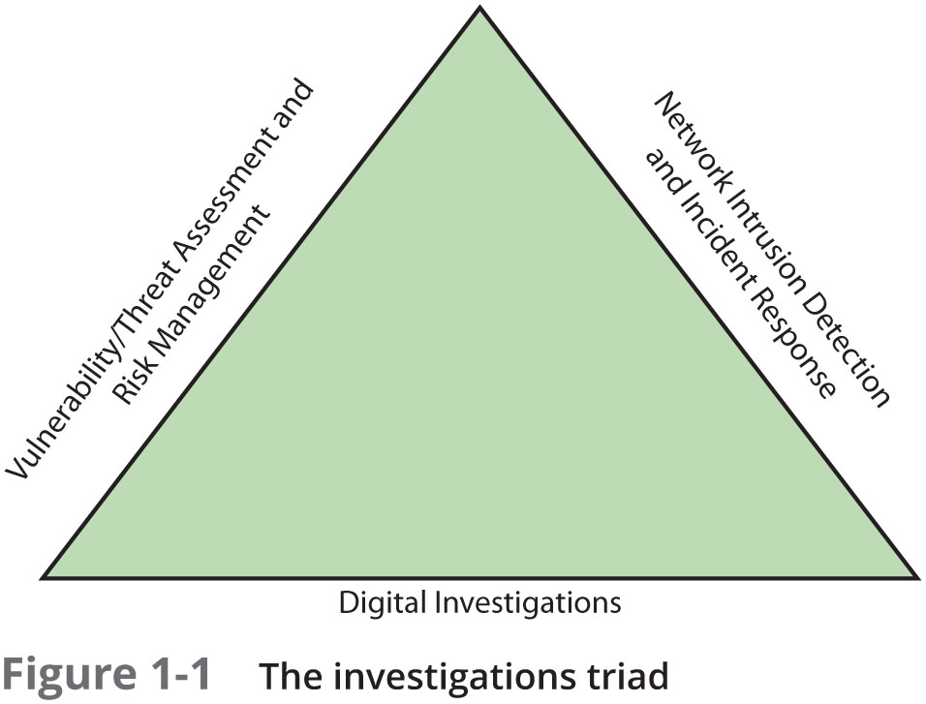
Digital Forensics and Other Related Disciplines (2 of 3)

Slide 8
Digital Forensics and Other Related Disciplines (3 of 3)
Vulnerability/threat assessment and risk management
Tests and verifies the integrity of stand-along workstations and network servers
Network intrusion detection and incident response
Detects intruder attacks by using automated tools and monitoring network firewall logs
Digital investigations
Manages investigations and conducts forensics analysis of systems suspected of containing evidence

Slide 9
A Brief History of Digital Forensics
By the early 1990s, the International Association of Computer Investigative Specialists (IACIS) introduced training on software for digital forensics
IRS created search-warrant programs
ASR Data created Expert Witness for Macintosh
ILook is currently maintained by the IRS Criminal Investigation Division
AccessData Forensic Toolkit (FTK) is a popular commercial product

Slide 10
Understanding Case Law
Existing laws can’t keep up with the rate of technological change
When statutes don’t exist, case law is used
Allows legal counsel to apply previous similar cases to current one in an effort to address ambiguity in laws
Examiners must be familiar with recent court rulings on search and seizure in the electronic environment

Slide 11
Developing Digital Forensics Resources
To supplement your knowledge:
Develop and maintain contact with computing, network, and investigative professionals
Join computer user groups in both the pubic and private sectors
Example: Computer Technology Investigators Network (CTIN) meets to discuss problems with digital forensics examiners encounter
Consult outside experts

Slide 12
Preparing for Digital Investigations (1 of 3)
Digital investigations fall into two categories:
Public-sector investigations
Private-sector investigations

Slide 13
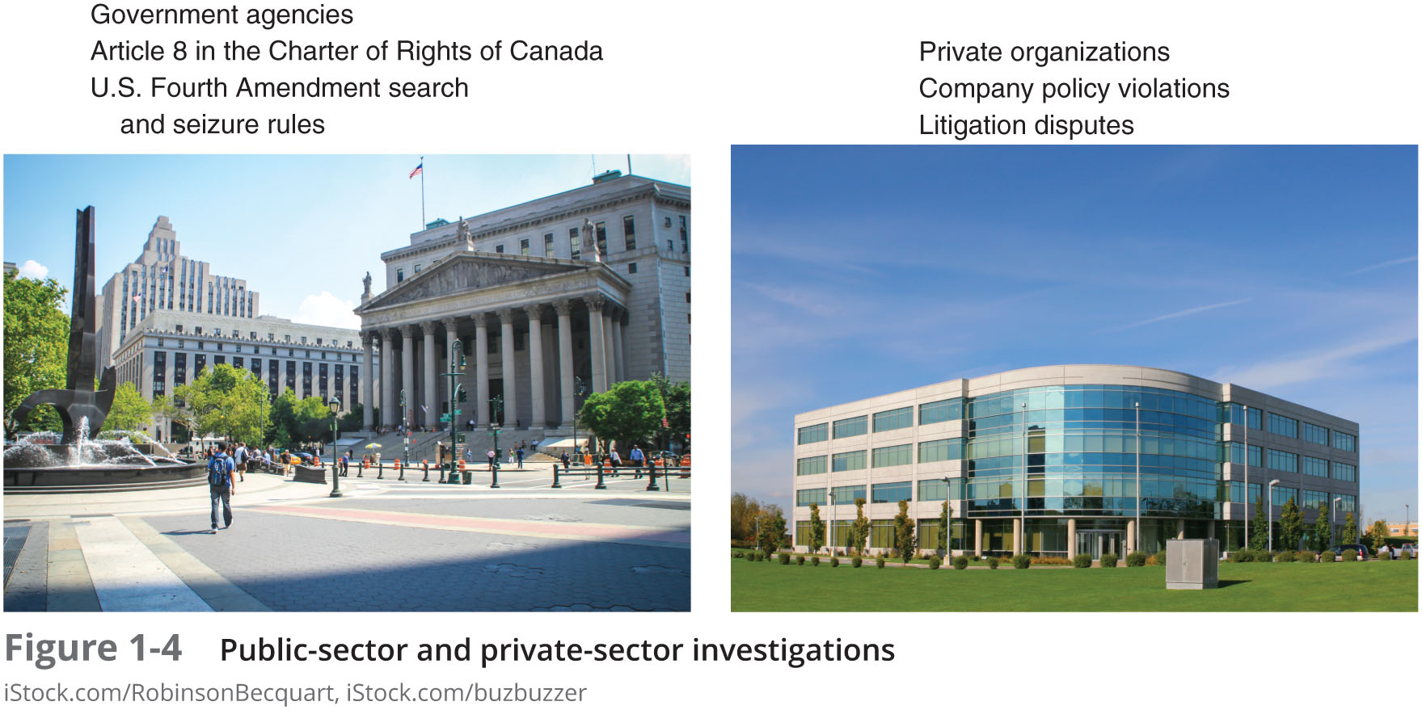
Preparing for Digital Investigations (2 of 3)

Slide 14
Preparing for Digital Investigations (3 of 3)
Public-sector investigations involve government agencies responsible for criminal investigations and prosecution
Fourth Amendment to the U.S. Constitution
Restrict government search and seizure
The Department of Justice (DOJ) updates information on computer search and seizure regularly
Private-sector investigations focus more on policy violations

Slide 15
Understanding Law Enforcement Agency Investigations
When conducting public-sector investigations, you must understand laws on computer-related crimes including:
Standard legal processes
Guidelines on search and seizure
How to build a criminal case
The Computer Fraud and Abuse Act was passed in 1986
Specific state laws were generally developed later

Slide 16
Following Legal Processes (1 of 2)
A criminal investigation usually begins when someone finds evidence of or witnesses a crime
Witness or victim makes an allegation to the police
Police interview the complainant and writes a report about the crime
Report is processed and management decides to start an investigation or log the information in a police blotter
Blotter is a historical database of previous crimes

Slide 17
Following Legal Processes (2 of 2)
Digital Evidence First Responder (DEFR)
Arrives on an incident scene, assesses the situation, and takes precautions to acquire and preserve evidence
Digital Evidence Specialist (DES)
Has the skill to analyze the data and determine when another specialist should be called in to assist
Affidavit - a sworn statement of support of facts about or evidence of a crime
Must include exhibits that support the allegation

Slide 18
Understanding Private-Sector Investigations (1 of 8)
Private-sector investigations involve private companies and lawyers who address company policy violations and litigation disputes
Example: wrongful termination
Businesses strive to minimize or eliminate litigation
Private-sector crimes can involve:
E-mail harassment, falsification of data, gender and age discrimination, embezzlement, sabotage, and industrial espionage

Slide 19
Understanding Private-Sector Investigations (2 of 8)
Businesses can reduce the risk of litigation by publishing and maintaining policies that employees find easy to read and follow
Most important policies define rules for using the company’s computers and networks
Known as an “Acceptable use policy”
Line of authority - states who has the legal right to initiate an investigation, who can take possession of evidence, and who can have access to evidence

Slide 20
Understanding Private-Sector Investigations (3 of 8)
Business can avoid litigation by displaying a warning banner on computer screens
Informs end users that the organization reserves the right to inspect computer systems and network traffic at will

Slide 21
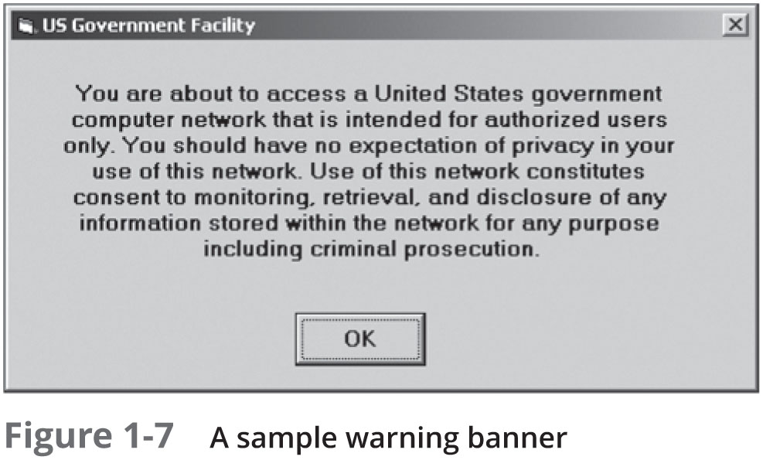
Understanding Private-Sector Investigations (4 of 8)

Slide 22
Understanding Private-Sector Investigations (5 of 8)
Sample text that can be used in internal warning banners:
Use of this system and network is for official business only
Systems and networks are subject to monitoring at any time by the owner
Using this system implies consent to monitoring by the owner
Unauthorized or illegal users of this system or network will be subject to discipline or prosecution

Slide 23
Understanding Private-Sector Investigations (6 of 8)
Businesses are advised to specify an authorized requester who has the power to initiate investigations
Examples of groups with authority
Corporate security investigations
Corporate ethics office
Corporate equal employment opportunity office
Internal auditing
The general counsel or legal department

Slide 24
Understanding Private-Sector Investigations (7 of 8)
During private investigations, you search for evidence to support allegations of violations of a company’s rules or an attack on its assets
Three types of situations are common:
Abuse or misuse of computing assets
E-mail abuse
Internet abuse
A private-sector investigator’s job is to minimize risk to the company

Slide 25
Understanding Private-Sector Investigations (8 of 8)
The distinction between personal and company computer property can be difficult with cell phones, smartphones, personal notebooks, and tablet computers
Bring your own device (BYOD) environment
Some companies state that if you connect a personal device to the business network, it falls under the same rules as company property

Slide 26
Maintaining Professional Conduct
Professional conduct - includes ethics, morals, and standards of behavior
An investigator must exhibit the highest level of professional behavior at all times
Maintain objectivity
Maintain credibility by maintaining confidentiality
Investigators should also attend training to stay current with the latest technical changes in computer hardware and software, networking, and forensic tools

Slide 27
Preparing a Digital Forensics Investigation
The role of digital forensics professional is to gather evidence to prove that a suspect committed a crime or violated a company policy
Collect evidence that can be offered in court or at a corporate inquiry
Investigate the suspect’s computer
Preserve the evidence on a different computer
Chain of custody
Route the evidence takes from the time you find it until the case is closed or goes to court

Slide 28
An Overview of a Computer Crime
Computers can contain information that helps law enforcement determine:
Chain of events leading to a crime
Evidence that can lead to a conviction
Law enforcement officers should follow proper procedure when acquiring the evidence
Digital evidence can be easily altered by an overeager investigator
A potential challenge: information on hard disks might be password protected so forensics tools may be need to be used in your investigation

Slide 29
An Overview of a Company Policy Violation
Employees misusing resources can cost companies millions of dollars
Misuse includes:
Surfing the Internet
Sending personal e-mails
Using company computers for personal tasks

Slide 30
Taking a Systematic Approach (1 of 2)
Steps for problem solving
Make an initial assessment about the type of case you are investigating
Determine a preliminary design or approach to the case
Create a detailed checklist
Determine the resources you need
Obtain and copy an evidence drive

Slide 31
Taking a Systematic Approach (2 of 2)
Steps for problem solving (cont’d)
Identify the risks
Mitigate or minimize the risks
Test the design
Analyze and recover the digital evidence
Investigate the data you recover
Complete the case report
Critique the case

Slide 32
Assessing the Case
Systematically outline the case details
Situation
Nature of the case
Specifics of the case
Type of evidence
Known disk format
Location of evidence
Based on these details, you can determine the case requirements

Slide 33
Planning Your Investigation (1 of 5)
A basic investigation plan should include the following activities:
Acquire the evidence
Complete an evidence form and establish a chain of custody
Transport the evidence to a computer forensics lab
Secure evidence in an approved secure container

Slide 34
Planning Your Investigation (2 of 5)
A basic investigation plan (cont’d):
Prepare your forensics workstation
Retrieve the evidence from the secure container
Make a forensic copy of the evidence
Return the evidence to the secure container
Process the copied evidence with computer forensics tools

Slide 35
Planning Your Investigation (3 of 5)
An evidence custody form helps you document what has been done with the original evidence and its forensics copies
Also called a chain-of-evidence form
Two types
Single-evidence form
Lists each piece of evidence on a separate page
Multi-evidence form

Slide 36
Planning Your Investigation (4 of 5)

Slide 37
Planning Your Investigation (5 of 5)

Slide 38
Securing Your Evidence (1 of 2)
Use evidence bags to secure and catalog the evidence
Use computer safe products when collecting computer evidence
Antistatic bags
Antistatic pads
Use well padded containers
Use evidence tape to seal all openings
CD drive bays
Insertion slots for power supply electrical cords and USB cables

Slide 39
Securing Your Evidence (2 of 2)
Write your initials on tape to prove that evidence has not been tampered with
Consider computer specific temperature and humidity ranges
Make sure you have a safe environment for transporting and storing it until a secure evidence container is available

Slide 40
Procedures for Private-Sector High-Tech Investigations
As an investigator, you need to develop formal procedures and informal checklists
To cover all issues important to high-tech investigations
Ensures that correct techniques are used in an investigation

Slide 41
Employee Termination Cases
The majority of investigative work for termination cases involves employee abuse of corporate assets
Incidents that create a hostile work environment are the predominant types of cases investigated
Viewing pornography in the workplace
Sending inappropriate e-mails
Organizations must have appropriate policies in place

Slide 42
Internet Abuse Investigations (1 of 2)
To conduct an investigation you need:
Organization’s Internet proxy server logs
Suspect computer’s IP address
Suspect computer’s disk drive
Your preferred computer forensics analysis tool

Slide 43
Internet Abuse Investigations (2 of 2)
Recommended steps
Use standard forensic analysis techniques and procedures
Use appropriate tools to extract all Web page URL information
Contact the network firewall administrator and request a proxy server log
Compare the data recovered from forensic analysis to the proxy server log
Continue analyzing the computer’s disk drive data

Slide 44
E-mail Abuse Investigations (1 of 2)
To conduct an investigation you need:
An electronic copy of the offending e-mail that contains message header data
If available, e-mail server log records
For e-mail systems that store users’ messages on a central server, access to the server
Access to the computer so that you can perform a forensic analysis on it
Your preferred computer forensics analysis tool

Slide 45
E-mail Abuse Investigations (2 of 2)
Recommended steps
Use the standard forensic analysis techniques
Obtain an electronic copy of the suspect’s and victim’s e-mail folder or data
For Web-based e-mail investigations, use tools such as FTK’s Internet Keyword Search option to extract all related e-mail address information
Examine header data of all messages of interest to the investigation

Slide 46
Summary (1 of 3)
Digital forensics involves systematically accumulating and analyzing digital information for use as evidence in civil, criminal, and administrative cases
Investigators need specialized workstations to examine digital evidence
Public-sector and private-sector investigations differ; public-sector typically require search warrants before seizing digital evidence

Slide 47
Summary (2 of 3)
Always use a systematic approach to your investigations
Always plan a case taking into account the nature of the case, case requirements, and gathering evidence techniques
Both criminal cases and corporate-policy violations can go to court
Plan for contingencies for any problems you might encounter
Keep track of the chain of custody of your evidence

Slide 48
Summary (3 of 3)
Internet abuse investigations require examining server log data
For attorney-client privilege cases, all written communication should remain confidential
A bit-stream copy is a bit-by-bit duplicate of the original disk
Always maintain a journal to keep notes on exactly what you did
You should always critique your own work

