Slide 1
IST 210 Organization of Data Normalization Penn State Abington
Dr. S. Gokhan Ozden
gokhan@psu.edu

Slide 2
Normal Forms
Normal Forms are one aspect of denoting a database's correctness of design
When you create your own database, it won't start out so perfect
Knowing normal forms will lead to better design

Slide 3
First Normal Form (1NF)
No duplicate rows/records
Records with all columns set to the same values as another row
Each columns should be used appropriately
Don't put a phone number in an address
Order of columns should not matter
Don't assume column 2 is the first name

Slide 4
First Normal Form (1NF)
Only one piece of info per column
Values must be atomic/indivisible
This breaks the rule:
Customers.PhoneNumber having a value of "215-867-5309, 314-592-6536"
Don't repeat groups
Don't add columns to achieve multiple fields
This breaks the rule:
Customers.PhoneNumber1
Customers.PhoneNumber2

Slide 5
Second Normal Form (2NF)
Must be 1NF, but with further restrictions
All non-key columns depend on the entire PK
The last column here breaks the rule:
Paychecks.EmployeeID
Paychecks.PayDate
Paychecks.EmployeeDateOfBirth
EmployeeDateOfBirth violates the rule. It only depends on 1 part of the key (the EmployeeID)
All 1NF tables with single-field PKs are 2NF
Composite key uniquely identifying a paycheck

Slide 6
Third Normal Form (3NF)
Must be 2NF, but with further restrictions
All non-key fields depend directly on the PK
The last field here breaks the rule
MovieAwards.Type
MovieAwards.Year
MovieAwards.WinnerName
MovieAwards.WinnerDateOfBirth
Composite Primary Key e.g. Oscars/2010 GoldenGlobe/2009
Depends indirectly on the entire PK

Slide 7
Problems When Not "Normal"
Querying can get ugly
How to search for a phone number if you packed 3 into one field? Or 3 separate fields on a row?
Updating can get ugly
If repeating an address in many records, you must update all those addresses when it changes

Slide 8
Complying To Normal Forms
Typically, it involves creating another table
And using keys to relate to the original table

Slide 9
What Form Is It?
Table Item with fields:
ItemID
StoreID
ManufacturerID
ManufacturerAddress
Style
Price
ItemID, StoreID → ManufacturerID, ManufacturerAddress, Style, Price
ItemID → ManufacturerID, ManufacturerAddress, Style
Fulfills 1NF requirements
Underlining is a way to denote the primary key fields
But not 2NF because ManufacturerID, ManufacturerAddress, and Style depend only on ItemID

Slide 10
Make It 2NF Compliant
Table Item
ItemID
ManufacturerID
ManufacturerAddress
Style
Table StorePricing
StoreID
ItemID
Price
Split into two tables.
Each field is dependent on its table's PK
Is this also 3NF compliant?
No, because ManufacturerAddress is not directly related to ItemID
It's indirectly related
ItemID → ManufacturerID → ManufacturerAddress

Slide 11
Make It 3NF Compliant
Table Item
ItemID
ManufacturerID (FK)
Style
Table StorePricing
StoreID
ItemID (FK)
Price
Table Manufacturer
ManufacturerID
ManufacturerAddress
Now it's 3NF compliant
And that also means it's 2NF and 1NF compliant
Each normal form requires the adherence to the previous one

Slide 12
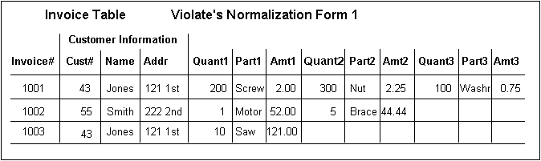
Another Normalization
Why not 1NF?
Source: Steve Litt
Because repeated groups (Quant, Part, Amt)

Slide 13
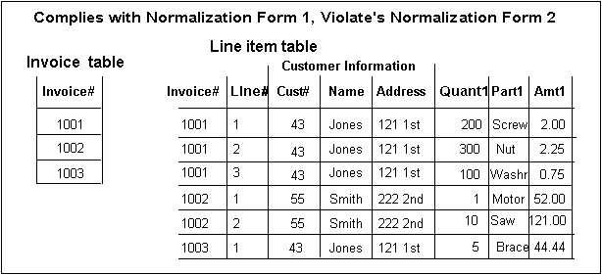
1NF, but not 2NF
Why not 2NF?
Because customer not dependent on entire PK
Only dependent on the invoice number
PK

Slide 14
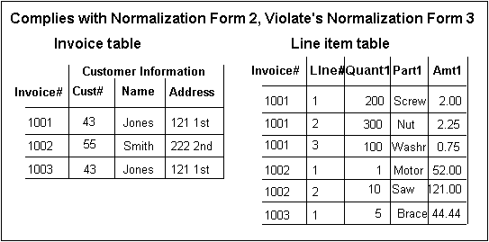
2NF, but not 3NF
Why not 3NF?
Customer info not directly dependent on PK
Name/Address dependent on Cust#
PK

Slide 15
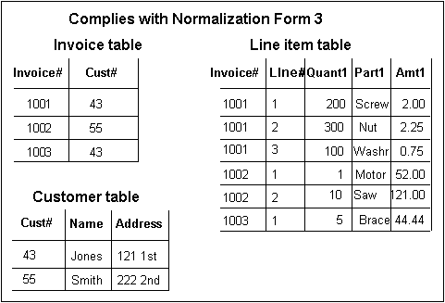
Finally, 3NF

