Slide 1
12
The Investigation of Computer-Related Crime

Slide 2
Chapter Objectives
After completing this chapter, you should be able to:
  Explain and understand the search warrant application process appropriate to electronic evidence at a single-location crime scene.
  Identify hardware and storage devices potentially containing evidence of a crime.

Slide 3
Chapter Objectives
After completing this chapter, you should be able to:
  Explain and understand the legal standards and best current practices for the documentation of a single-location electronic crime scene.
  Explain and describe the best current practices for the collection, preservation, transportation, and storage of electronic evidence.

Slide 4
Chapter Objectives
After completing this chapter, you should be able to:
  Explain and describe the best current practices for the collection, preservation, transportation, and storage of electronic evidence.
  Distinguish between single-scene, multiple-scene, and network crimes.

Slide 5
Chapter Objectives
After completing this chapter, you should be able to:
  Communicate an understanding of network architectures and standards relevant to network investigations.
  Identify sources of assistance for multiple-scene and network operations.

Slide 6
Chapter Objectives
After completing this chapter, you should be able to:
  Identify categories of evidence and probable locations of that evidence.
  Broadly outline procedures for preserving and collecting network trace evidence.

Slide 7
Investigator Roles and Responsibilities
The mission of police, from patrol officers to forensic specialists depends greatly on their department's size and organization.
  First Responders
  Investigators
  Forensic Analysts
  Private Police-Corporate Security
  Subject Matter Experts

Slide 8
Search Warrants and
Electronic Evidence
Criminal investigators must establish probable cause in an affidavit in application for a search warrant.
  Computer Systems
  External Storage Media
  Handheld Devices and Other Electronic Devices
  Networking Equipment

Slide 9
Search Warrants and
Electronic Evidence
Executing the Search Warrant
  Priority Concerns: Investigators must assess the potential danger to themselves.
  Securing the Scene: Procedures for securing a crime scene typically include removing suspects, witnesses, and bystanders for the area to be searched.
  Handling Ongoing Activity: The one certain rule is: If it is off, leave it off.

Slide 10
Search Warrants and
Electronic Evidence
Examining the Crime Scene
  Any unavailable alteration should be documented so well that it can later be resembled exactly as it was.
  After safety is assured, and the scene is secure, the entire scene should be photographed before altering it.

Slide 11
Search Warrants and
Electronic Evidence
Collection and Preservation of Evidence
  All evidence collection activities may be later called into question by the defense.
  The National Institute of Justice has outlines clear procedures for the collection and preservation of evidence.

Slide 12
Search Warrants and
Electronic Evidence
Packing and Transportation of Evidence
  If transport is required, package the components as fragile cargo.
  Actions taken should not add, modify, or destroy data stored on a computer or other media.

Slide 13
Search Warrants and
Electronic Evidence
Storage of Seized Evidence
  Investigators typically turn evidence of to an evidence custodian for safe storage until trial.
  This evidence is held in an evidence locker.

Slide 14
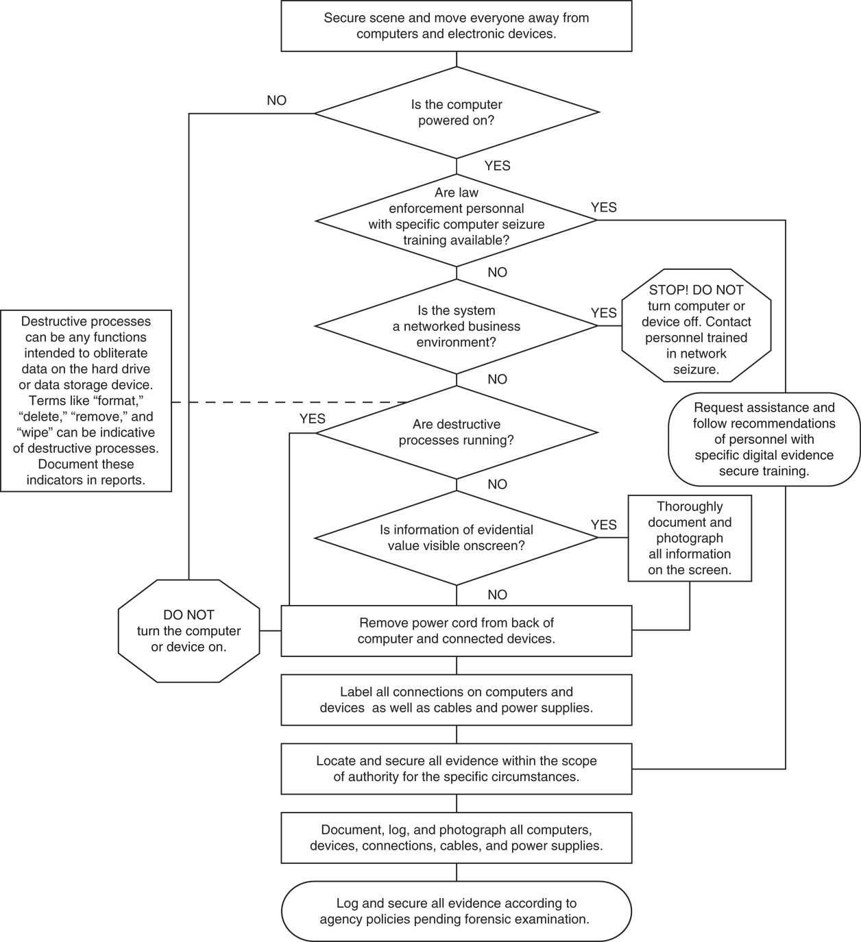
FIGURE 12.1 Collecting digital evidence flow chart

Slide 15
Multiple-location and Network Crime Scenes
Multiple-scene computer crimes are much more complicated than single-scene.
  Networked environments may contain evidence on multiple machines using multiple operating systems in multiple physical locations.

Slide 16
Identifying Network Architectures
Investigators are not charged with maintaining or understanding the full complexities of network architectures.
  Intranet: A WAN that uses common addressing and transfer protocol suite called TCP/IP.
  Internet: A network of networks owned and maintained by various private, corporate, and government systems.

Slide 17
Multiple-location and Network Crime Scenes
Distinguishing Single-Scene, Multiple-Scene, and Network Crime Scenes
  The distinction made is not based on technical differences, so much as functional differences for investigations.
  A multiple-scene crime involves more than one computer, with the possibility of an intervening network.

Slide 18
Modeling Network Transactions
At the most fundamental level, all networks can be described with the Open Systems Interface (OSI) Model.

Slide 19
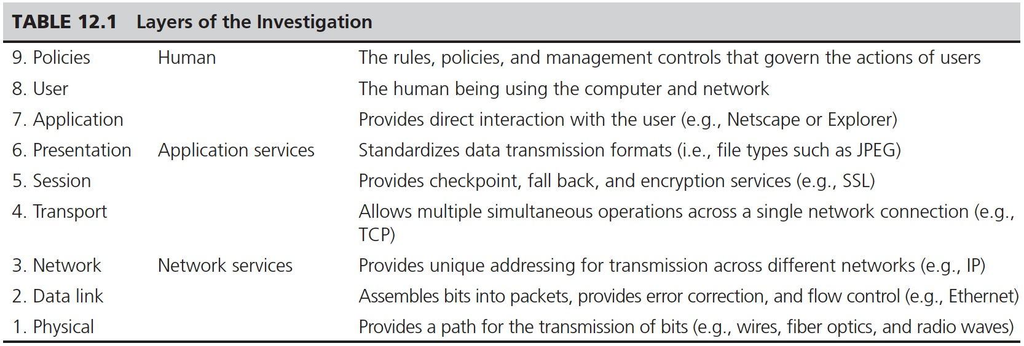
TABLE 12.1 Layers of the Investigation

Slide 20
Key Information for Locating Network Trace Evidence
Logs are identifies often associated with a level of the OSI model.
  MAC Address
  IP Address
  DNS
  PPP

Slide 21
Presenting Digital Evidence at Trial
The hearsay rule prohibits any statement made outside a present proceeding while is offered as evidence of the truth of matters asserted therein.
  Exceptions include:
    Using notes on witness stand
    Business records
    Presenting best evidence

