Slide 1
Differential expression and functional analysis of breast tumor biopsies from women before/after Letrozole treatment
Gene Expression Data Analysis and Visualization
Final Project, Summer 2021
Ryan Yancey (ryancey3)

Slide 2
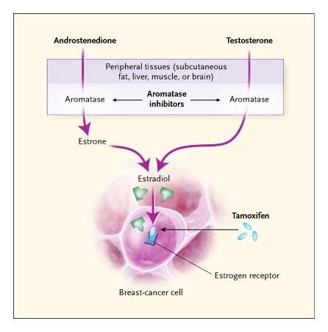
Introduction
Letrozole is an aromatase inhibitor prescribed to post-menopausal women with breast cancer¹
Aromatase inhibitors function by reducing the production of estrogen within cells (endogenous estrogen)²
Aromatase inhibitors are preferred over estrogen competitors, as they tend to have fewer agonist effects
Source: https://www.nejm.org/doi/10.1056/NEJMra023246
Notes:
https://medlineplus.gov/druginfo/meds/a698004.html
https://www.nejm.org/doi/10.1056/NEJMra023246

Slide 3
Study background^{3,4}
In the study analyzed, 58 post-menopausal women had biopsies taken both before, and after they underwent a 10-14 day treatment regiment of Letrozole (2.5 mg/day orally)
Cases were only considered if the tumors were confirmed ER-positive
The “pre-treatment” samples were taken at diagnosis (~2 weeks prior to treatment) and the ”post-treatment” samples were taken immediately following treatment
  Thus, all biopsies were taken approximately 3-4 weeks apart from each other
Notes:
https://pubmed.ncbi.nlm.nih.gov/17885619/
https://www.ebi.ac.uk/arrayexpress/experiments/E-GEOD-5462/

Slide 4
Sequence of steps in analysis
Import, cleanup, and factorization of annotation data
Quality analysis of raw microarray data
Between-array sample outlier detection/removal
Array normalization and quality analysis (RMA)
Filtering out lowly-variable genes
Linear modeling with Empirical Bayes statistics
Multiple comparison adjustment and feature selection
Unsupervised clustering of selected features
Classification analysis of selected features
Functional annotation of selected features

Slide 5
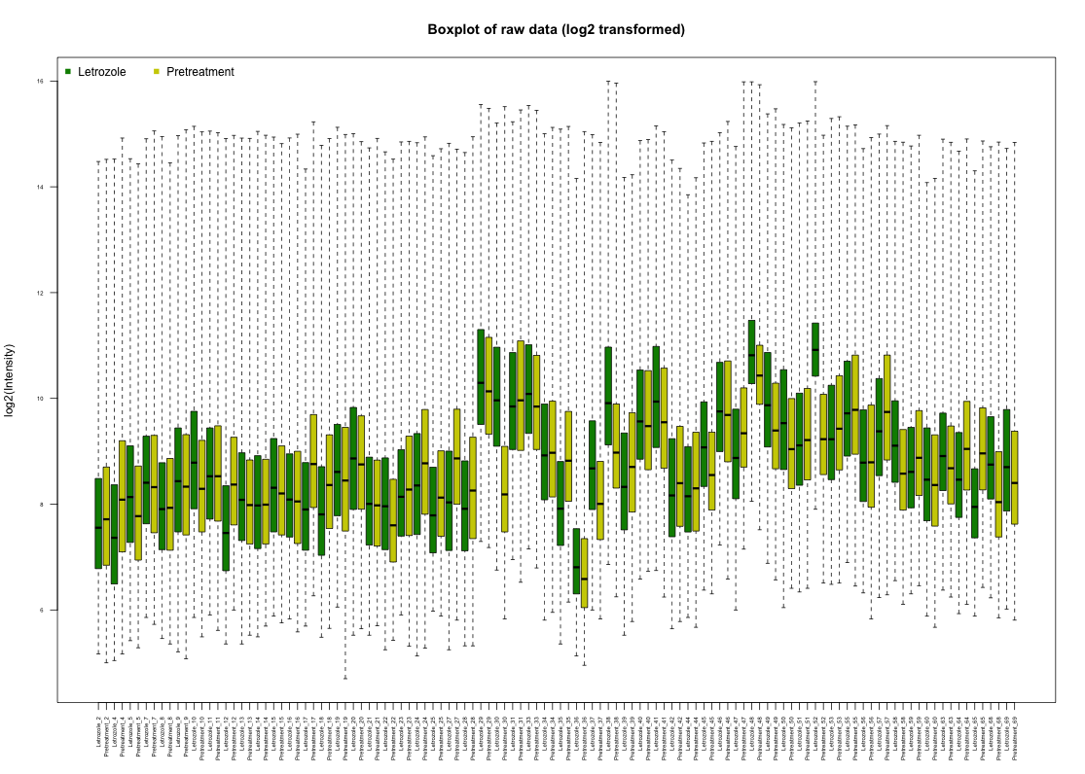
Quality Analysis
Raw intensities were log₂ transformed to adjust for low-expression skew
Boxplot demonstrates that there is a large amount of variability between the arrays, but the arrays themselves have similar IQRs.
This indicates that the samples will definitely need to undergo some sort of normalization, and a few outliers may exist.

Slide 6
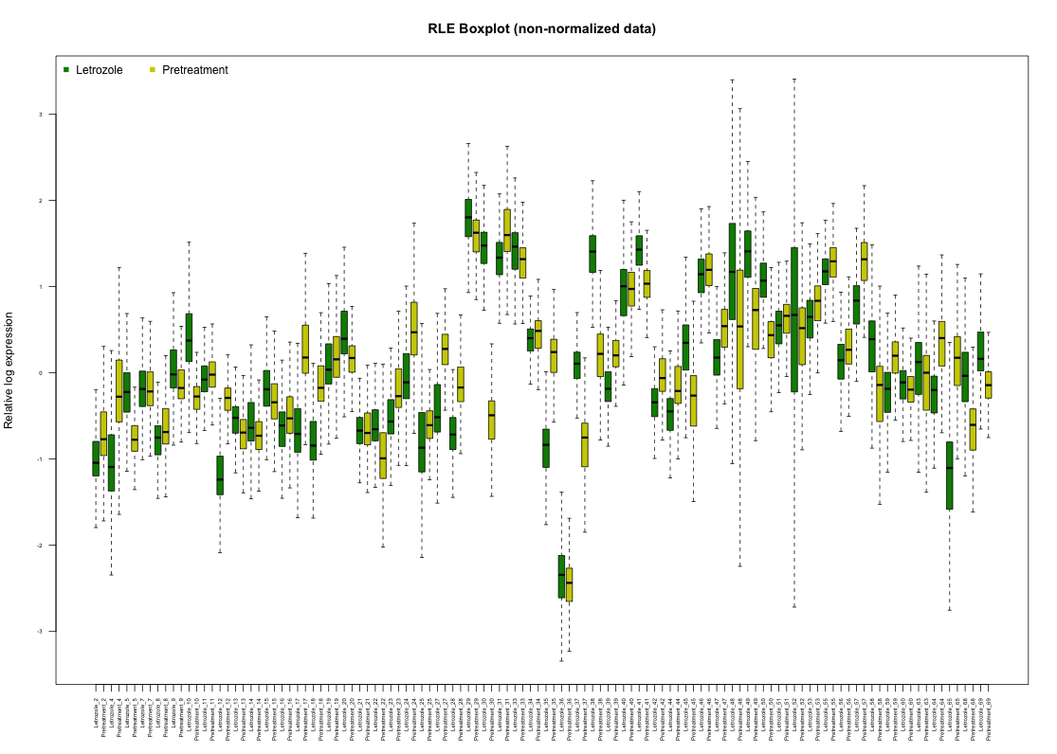
Quality Analysis (continued)
Relative log expression (RLE) was calculated on log2 transformed raw data
Briefly, each row medians for each gene between-arrays were subtracted from each gene within-arrays. This allows for the visualization of large variance between arrays that doesn’t appear to originate from biological sources.
This plot seems to demonstrate that there exists a substantial source of variation in patient 48, and patient 52. Multiple steps are taken to determine if these are outliers or not. We will also determine if batch effects exist between patients with dimensionality reduction (next slide)
48
52
36

Slide 7
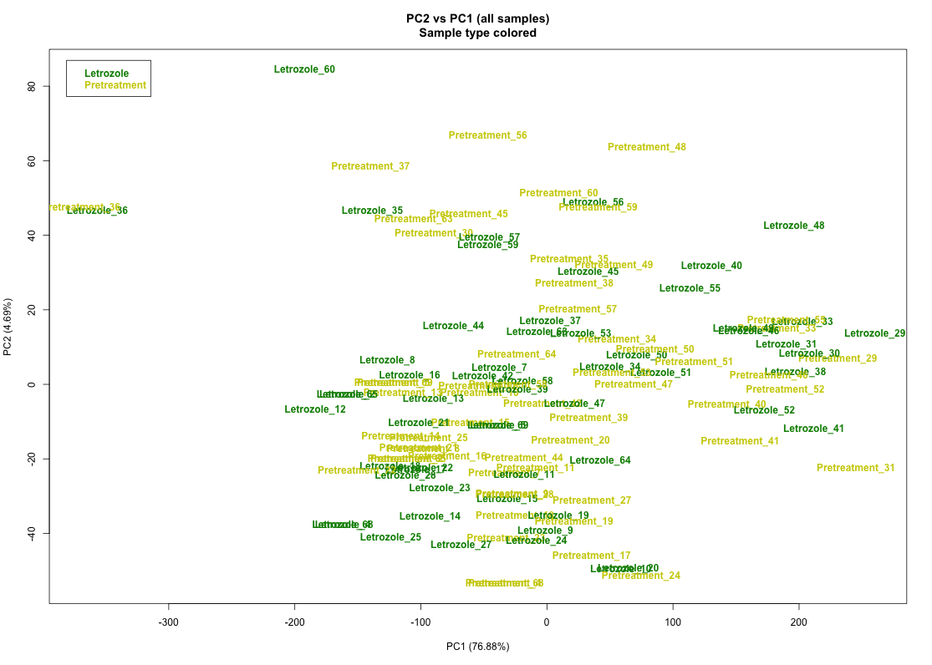
Quality Analysis (continued)
The first two principal components were plotted against each other to determine if batch effects existed between pre-treatment/post-treatment tumor samples from each individual patient.
If it did, we would expect all Pretreatment_#/Letrozole_# samples for each # to cluster near each other on the PC1 axis (accounts for >75% of the variation).
This does not occur in this data set, except possibly with patient 36 (left side of PCA plot). All other samples cluster in one central mass on PC1. Further investigation is required to reach a conclusion on patient 36.
We can therefore assume that patient samples are comparable to one another.
36

Slide 8
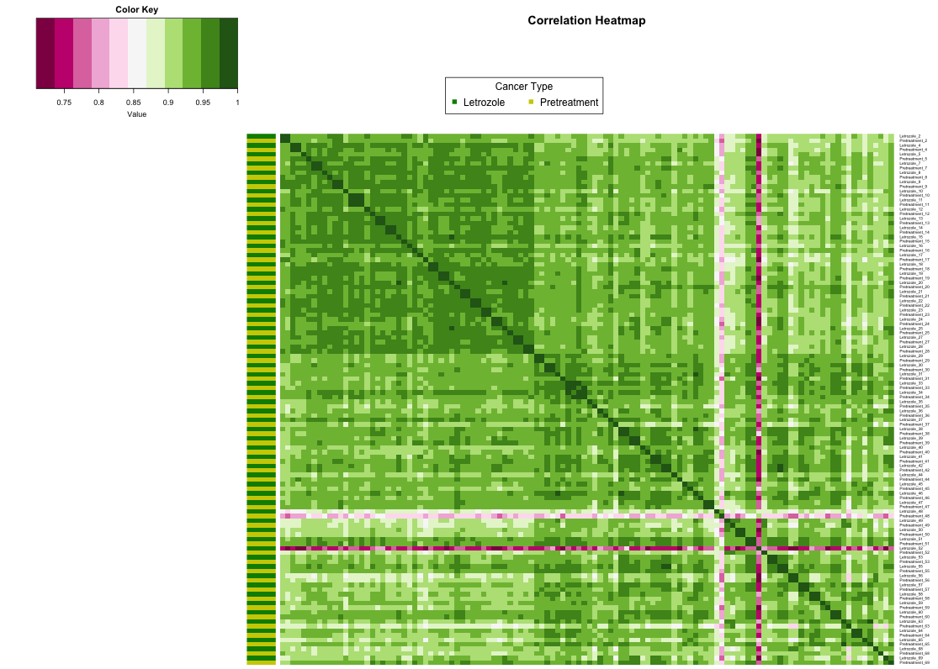
Outlier Detection and Removal
Heatmaps with and without clustering were plotted to visualize sample-sample correlation.
With most microarray data, only a select set of genes probed are differentially expressed, thus most genes should be similarly expressed.
Samples should be quite highly correlated in good quality microarray data.
The non-clustered heatmap to the left indicates that a few samples (pink rows) are potential outliers from the other arrays.
Patients 48 and 52 will be further scrutinized and potentially removed. These were also highlighted in the RLE plot.
Clustering the samples will also potentially highlight less-obvious outliers (next slide).
Patient 48
Patient 52

Slide 9
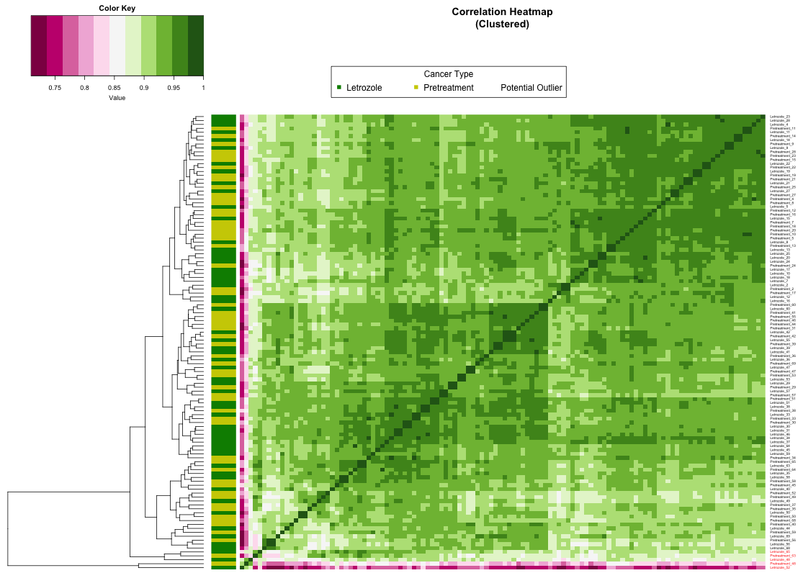
Outlier Detection and Removal (continued)
I wrote a method which generates this heatmap and highlights the sample labels that break apart early on in hierarchical clustering.
This highlights that patients 48, 52, and now possibly patients 63 and 65 as potential outliers.
Patients 48, 52, 63, and 65 cluster early and
separate from the main set of samples

Slide 10
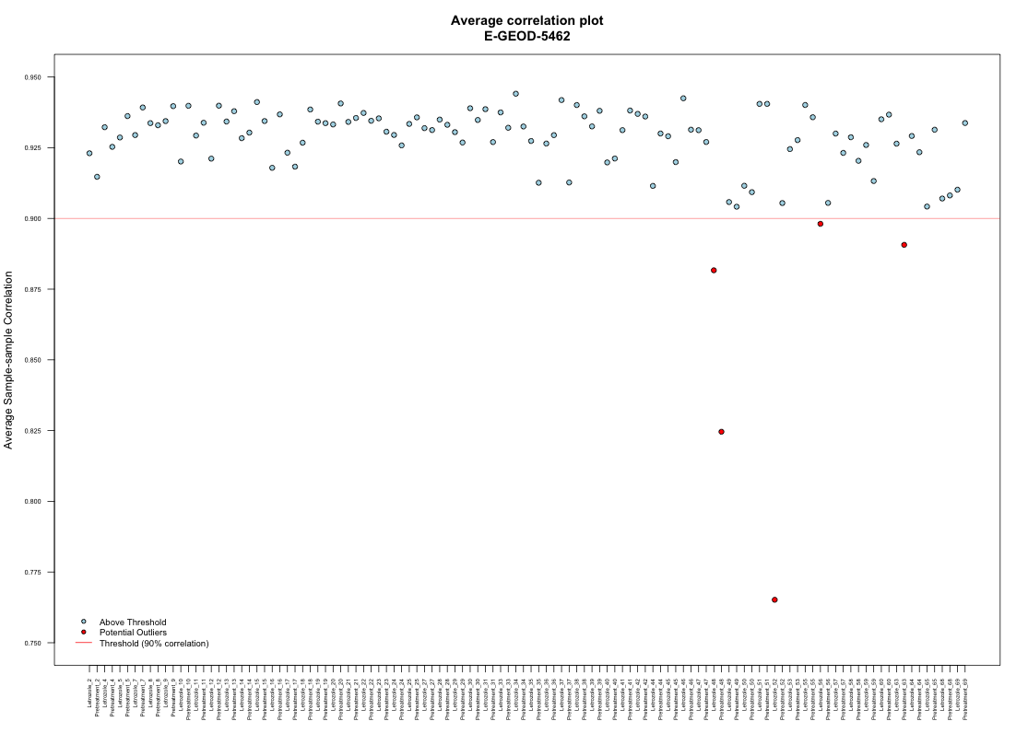
Outlier Detection and Removal (continued)
Finally, the average correlation was taken for each array and the results were plotted.
A conservative threshold of 90% correlation was used. Samples that fell below this threshold were colored red.
Patients 48, 52, 56 and 63 were flagged in this plot.

Slide 11
Outlier Detection and Removal (conclusions)
Taken together, I chose to remove only those samples which appeared as outliers in multiple analyses. The intersection between the clustering heatmap and the average correlation plot flagged outliers was taken.
In total, samples from patient 48, 52, and 63 were omitted from the original data set. Both the pre-treatment, and post-treatment arrays for these patients were taken out of consideration, so in total 6 arrays were removed.
Following outlier removal, I proceeded to normalize the arrays with the RMA normalization method.

Slide 12
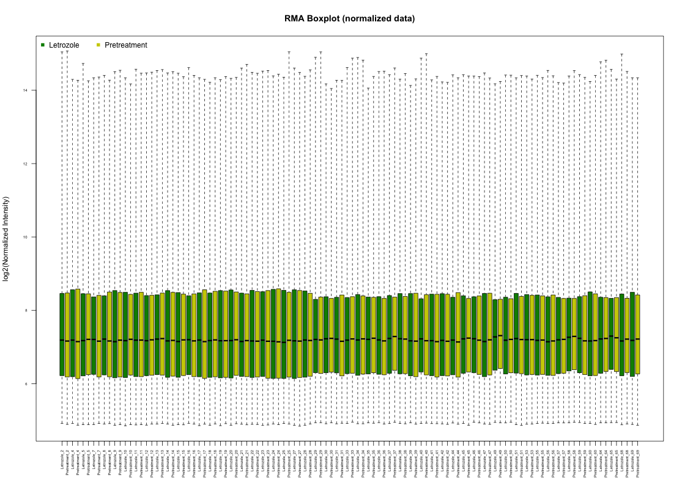
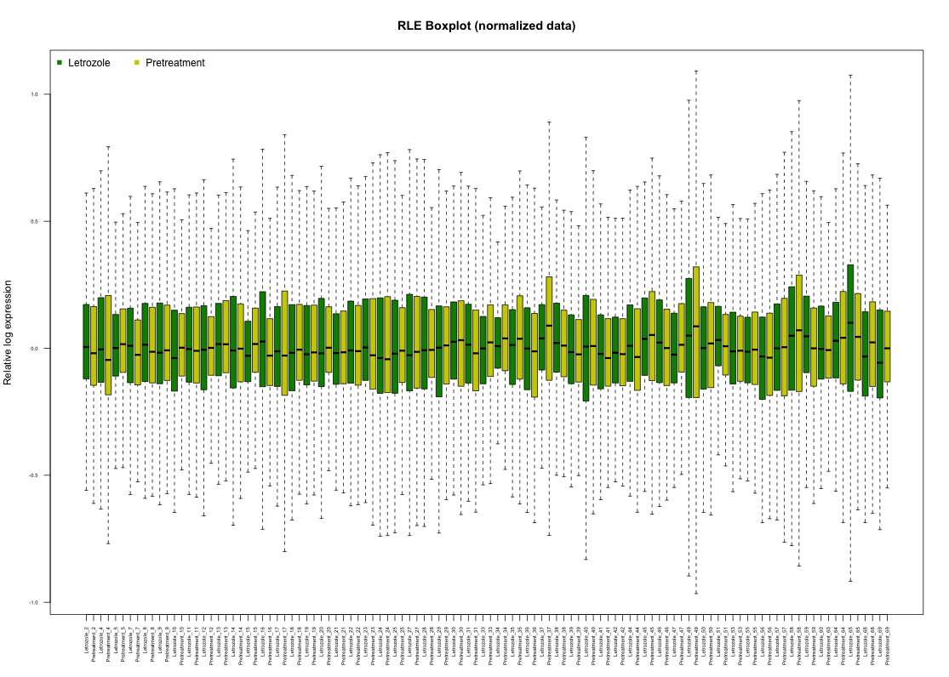
Array RMA Normalization/Quality Analysis
After RMA normalization, all the arrays have similar medians and IQRs. The same is seen in post-RMA normalized RLE plots.

Slide 13
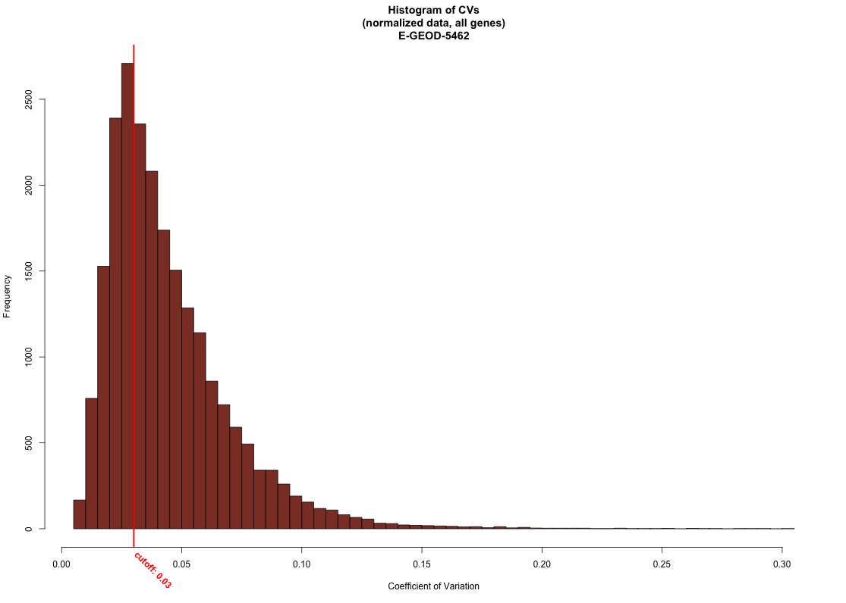
Gene Filtering
The coefficient of variance (CV) was calculated for each gene across all the retained, normalized arrays.
A threshold was set at the shorth of the CVs (the shortest interval covering half the values in the arrays).
In this case, the threshold was set at a CV of 0.03 (red vertical line). All genes with CVs below that value were removed.

Slide 14
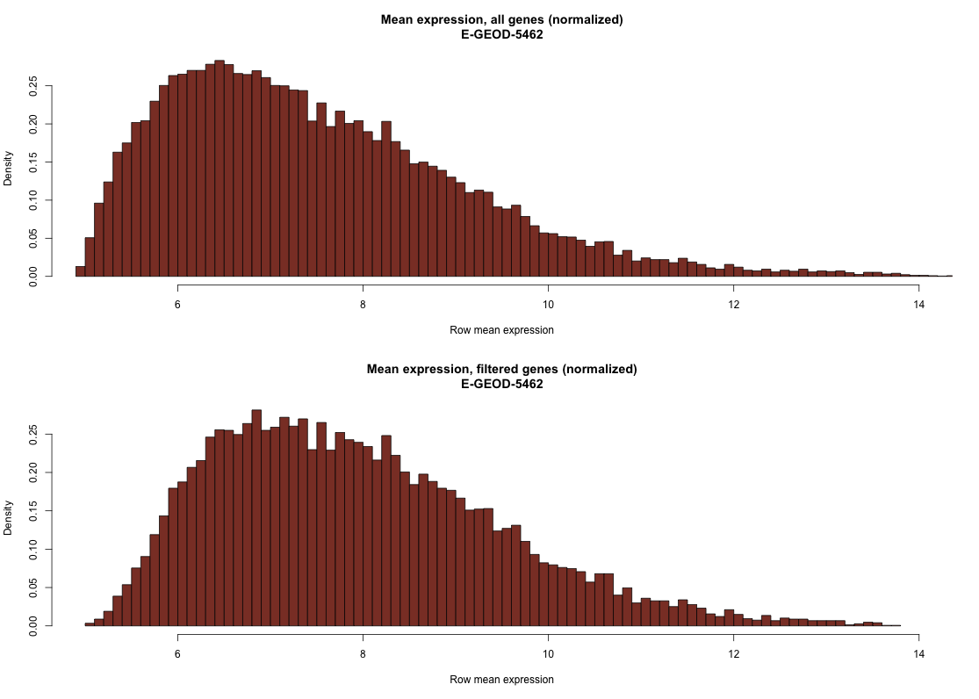
Gene Filtering (continued)
Removing genes below the threshold value brought the distribution of the means closer to a negative binomial distribution.

Slide 15
Linear modeling
The limma package in R was used to fit the expression data to a linear model.
Briefly, a model matrix was generated to contrast the differences in expression between pre-treatment and post-treatment samples.
Within patient correlations were shown not to be a major source of variation in the data, so they were not blocked (PCA plots and HCA heatmaps demonstrated this earlier)
After the linear modeling, p-values were extracted and adjusted with the Benjamini & Hochberg False Discovery Rate (FDR) method.
Data were further filtered to only contain those genes with FDR’s lower than 0.05 (not equal to), and absolute (non-log) Fold Changes greater than 1.25.

Slide 16
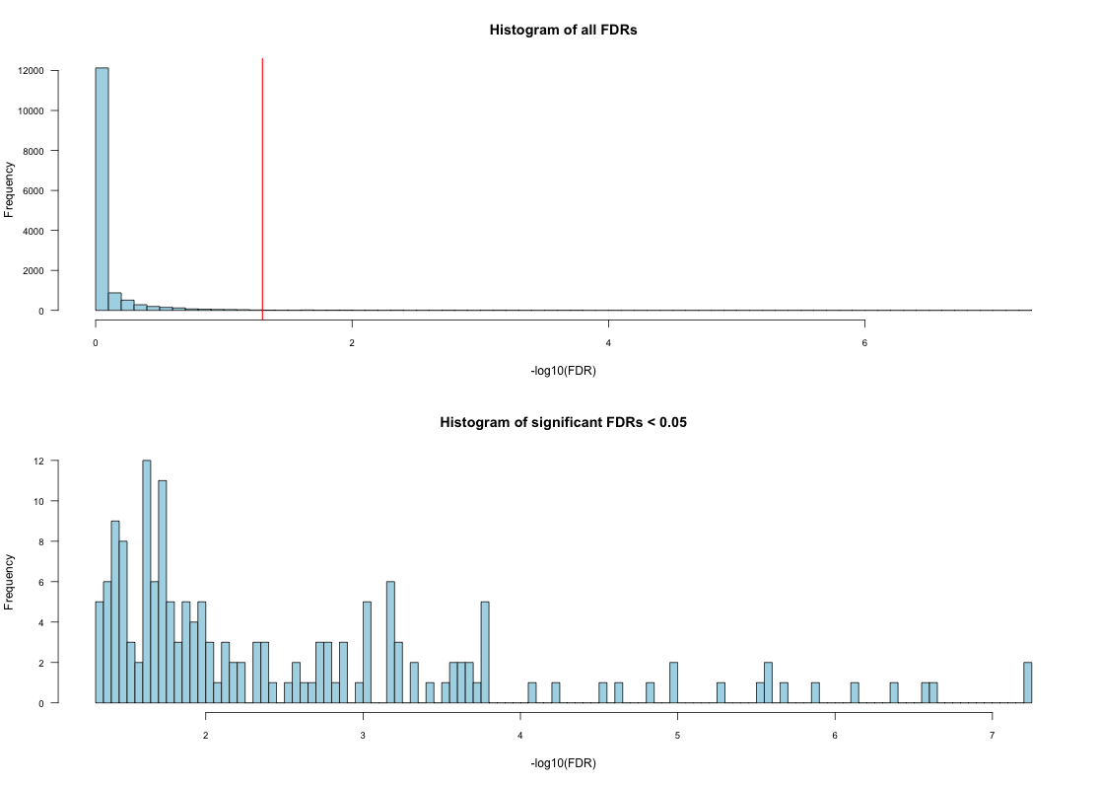
Test Correction and Feature selection
After filtering by this metric, only 167 genes remained.
After this initial filtering, the intersection between the 167 significant p-values and those genes with linear absolute FC values greater than 1.25 were selected.
This additional filtering reduced the data to 125 genes of interest.

Slide 17
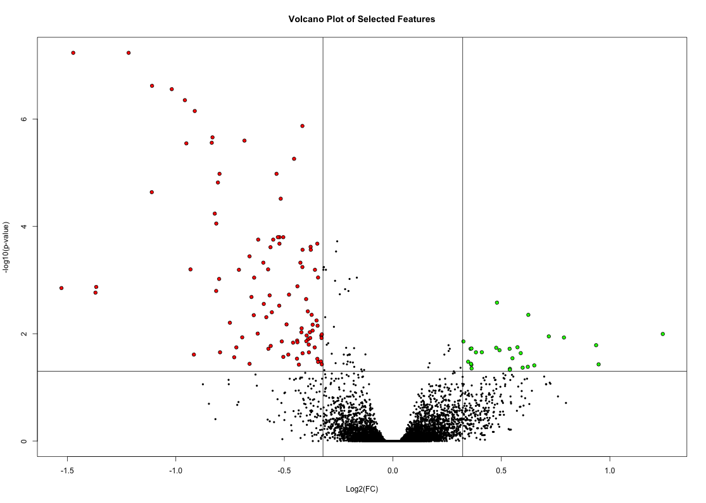
Test Correction and Feature Selection (continued)
As a visualization, I plotted the –log10 transformation of the adjusted p-values against the log2(FC) values obtained from the linear modeling.
Clearly, the majority of genes retained by this filtering process were downregulated significantly.

Slide 18
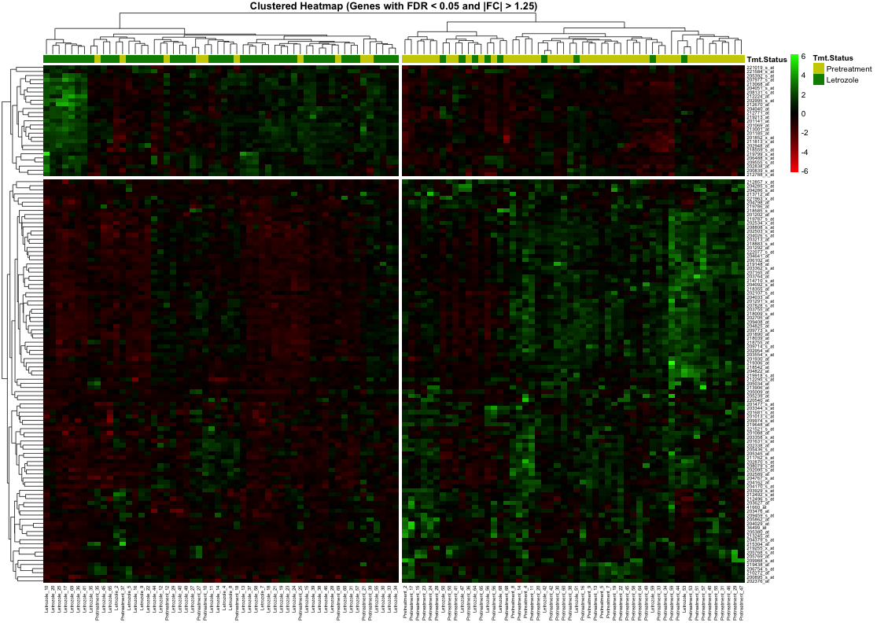
Clustering selected features
Once the final gene list was obtained, the 125 features of interest were subjected to unsupervised hierarchical clustering. A heatmap was plotted with the columns corresponding to samples, and each row corresponding to one of the 125 genes selected.
Patient samples clustered (imperfectly) along their treatment status.
Additionally, the genes selected fell into one of two broad categories: those upregulated and those downregulated (the majority) in response to the 10-14 day aromatase inhibitor treatment.
One could argue there exists a third cluster wherein genes were moderately downregulated after treatment, but I chose to avoid this grey area and partition them into upregulated/downregulated clusters.

Slide 19
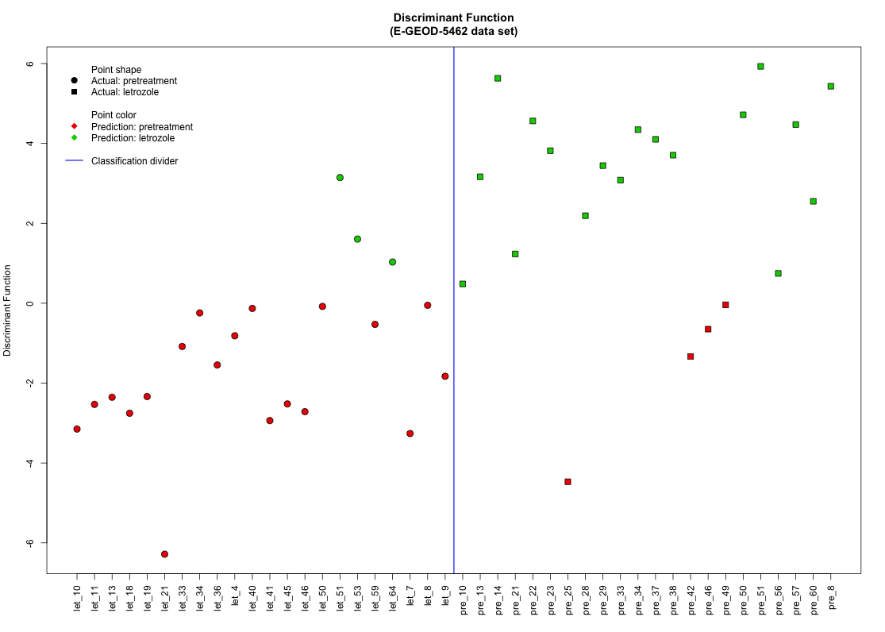
Classification
Next, the 125 selected features were used to determine their ability to predict the classification of samples.
60% of each class (pre-treatment, post-treatment) were randomly sampled and used as the training set for a linear discriminant analysis model.
The remaining 40% were subjected to classification with this model and the results were plotted to the left.

Slide 20
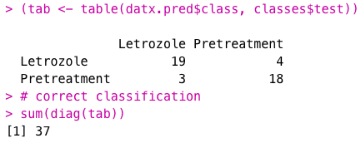
Classification (continued)
The confusion matrix below is the result of the machine learning model built and tested on the remaining 40% of samples (the test set)
In total, 37 of the 44 samples (84%) were classified correctly when the model was built on only 125 genes. Only 7 samples (16%) were placed into the wrong class.

Slide 21
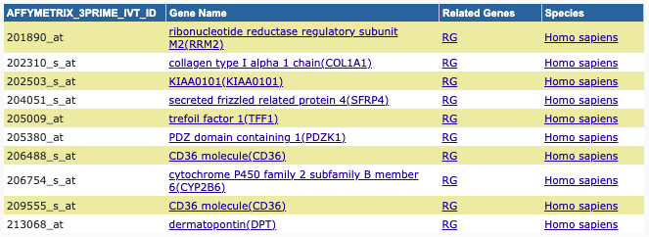
Functional annotation
Finally, the top 5 upregulated and top 5 downregulated genes were extracted and run through the DAVID annotation tool, and the genes were discovered. Two IDs mapped to the CD36 molecule.

Slide 22
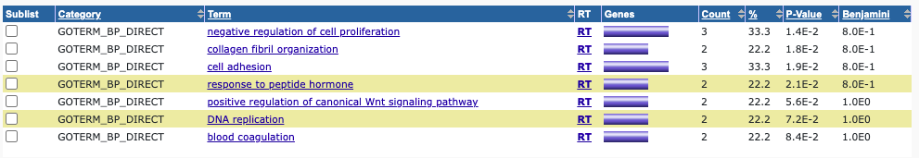
Functional annotation (continued)
When run through the annotation tool, GO terms for ”growth factor binding” and terms surrounding “cell proliferation” were enriched.
Additionally, the “ECM-receptor interaction” KEGG pathway was highlighted with functional annotation.

Slide 23
Conclusions
Expression of genes broadly involved in cellular proliferation and response to growth hormones were altered in response to Letrozole treatment.
The top 125 genes (those with FDR < 0.05 and |FC| > 1.25) were able to partition patient samples into the correct classification (pre-/post-Letrozole treatment) with an error rate of only 16%.
A large majority of these genes were downregulated in response.
This type of research and experimental modeling is important for individualized medicine. More specific models can be built for Letrozole treatment with analyses like this.

Slide 24
References
Letrozole: MedlinePlus Drug Information. https://medlineplus.gov/druginfo/meds/a698004.html.
Smith, I. E. & Dowsett, M. Aromatase Inhibitors in Breast Cancer. http://dx.doi.org/10.1056/NEJMra023246 https://www.nejm.org/doi/10.1056/NEJMra023246 (2009) doi:10.1056/NEJMra023246.
Miller WR, Larionov AA, Renshaw L, Anderson TJ, White S, Murray J, Murray E, Hampton G, Walker JR, Ho S, Krause A, Evans DB, Dixon JM. Changes in breast cancer transcriptional profiles after treatment with the aromatase inhibitor, letrozole. Pharmacogenet Genomics. 2007 Oct;17(10):813-26. doi: 10.1097/FPC.0b013e32820b853a. PMID: 17885619.
E-GEOD-5462 < Browse < ArrayExpress < EMBL-EBI. https://www.ebi.ac.uk/arrayexpress/experiments/E-GEOD-5462/.

