Slide 1
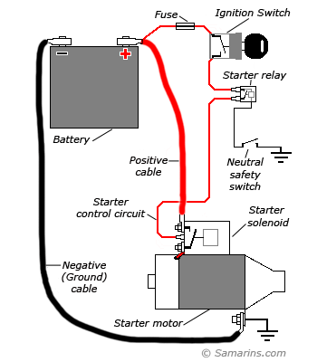
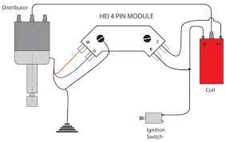
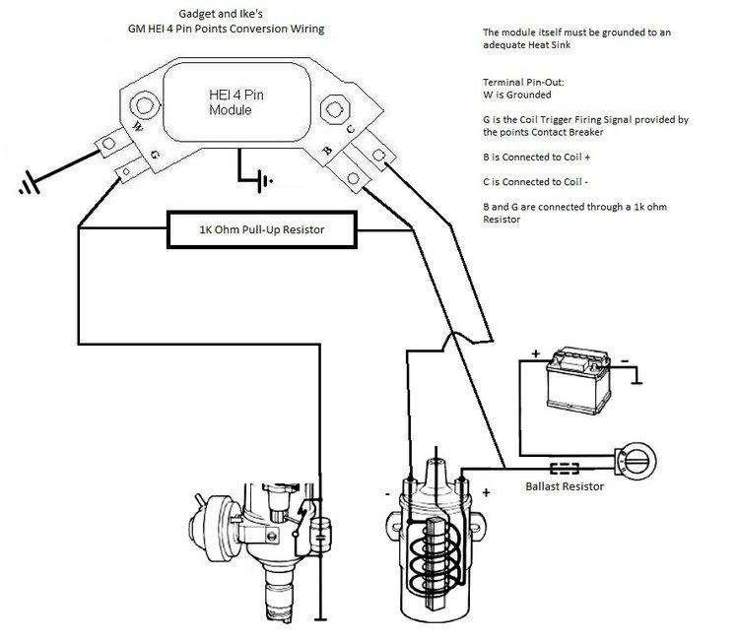
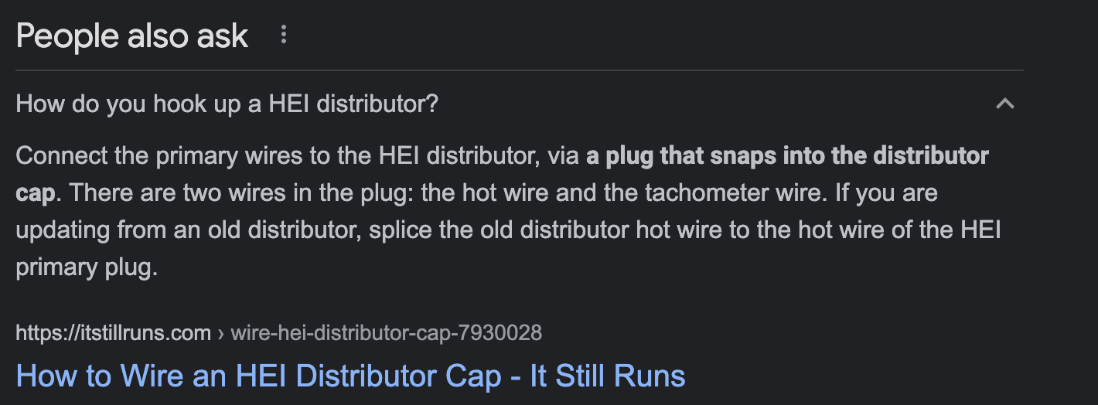

Slide 2

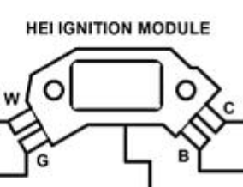

ALTERNATOR
BATT
GND
COIL
BATTERY
STARTER
DIST
IN
OUT
BATT
BATT
W
NEG
G
POS
GND
IGN
GND
GND
IGN
IGNITION
BATT
GND

