Slide 1
Credit Risk Analytics
Default Prediction for Consumer Lending
Machine Learning Pipeline
July 2026

Slide 2
Agenda
What we will cover
01
Executive Summary
Key findings and business impact
02
Business Context
The near-prime lending opportunity
03
Data Exploration
Dataset overview and risk driver analysis
04
Feature Engineering
Building 182 predictive features
05
Model Development
Five-model comparison and selection
06
Model Performance
Holdout evaluation and metrics
07
Model Explainability
SHAP analysis and feature importance
08
Business Simulation
Policy scenarios and profit optimization
09
Risk Segmentation
Five-tier risk bucket system
10
Conclusion & Next Steps
Summary and path forward
2 / 15

Slide 3
Executive Summary
Project overview and key results
Best Model
Test AUC
Default Rate
Threshold
LightGBM
0.768
8.07%
0.485
Optimal Profit
Profit vs. Rules
Approval Rate
Risk-Adj. Return
$112.6M
1,298% lift
67.1%
26.83%
The model generates $104.5M more profit than current rule-based underwriting — a 1,298% improvement
· Training data: 307,511 applicants with 182 engineered features from the Home Credit dataset
· LightGBM selected from 5 candidates: AUC 0.768, Gini 0.536, 69.7% recall at optimal threshold
· External credit scores (EXT_MEAN) identified as dominant risk driver (0.47 SHAP importance)
· Flexible threshold allows tuning for growth or capital preservation without retraining
· Collections prioritization via top-5% flagging yields $52,575 net benefit
3 / 15

Slide 4
Business Context
The near-prime lending opportunity
The Challenge
Business Impact
Near-prime borrowers (credit scores 580–680) are underserved by traditional banks. They carry elevated default risk (~8%) but represent a $200B+ market opportunity. Accurate risk assessment is the key to serving this segment profitably.
A 5-point AUC improvement (0.75 → 0.80) is estimated to reduce net charge-offs by 15–20%
For a $625M portfolio, this translates to $2–3M in annual savings.
Our model achieves AUC of 0.768 — capturing the majority of this upside.
The AI model generates $104.5M more profit than current rule-based underwriting.
Why Default Prediction Matters
→ Origination: Decline high-risk or adjust terms before funding
→ Pricing: Risk-segmented pricing retains good customers
→ Capital: Better prediction reduces Basel III reserve requirements
→ Collections: PD scores prioritize high-risk accounts
4 / 15

Slide 5
Data & Exploratory Analysis
Home Credit Default Risk dataset and key risk drivers
Dataset Summary
Top Risk Drivers Found
· 307,511 loan applicants from Home Credit (Kaggle)
EXT_SOURCE_2: 6.2× risk differential
Bottom decile: 18.35% default Top decile: 2.97% default
· 122 raw features: demographics, credit scores, loan details
· Target: TARGET — 8.07% default rate (90+ days past due)
Age gradient: 2.4× risk differential
Youngest (18-25): 11.74% default Oldest (60+): 4.92% default
· Clean data: no duplicates, DAYS_EMPLOYED artifact identified
· 18% of applicants have the unemployment artifact flag
Correlation leader: EXT_SOURCE_3
Pearson r = -0.179 (strongest signal)
DAYS_EMPLOYED artifact is informative
Unemployed: 5.40% default Employed: 8.66% default
5 / 15

Slide 6
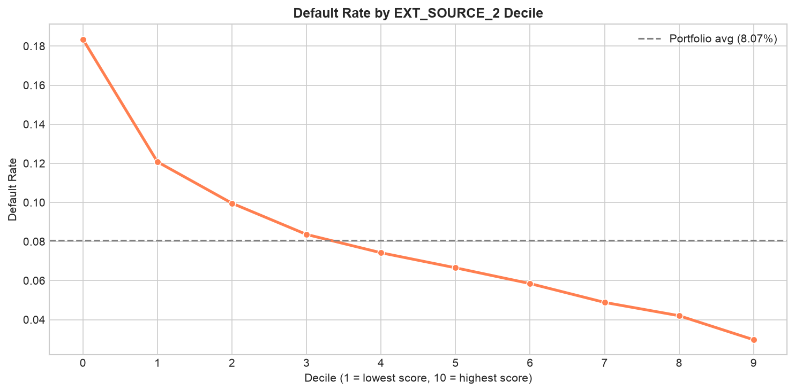
Data Quality & Pipeline
From raw data to model-ready features
Feature Engineering Pipeline
Domain Features
DTI, LTI, ANNUITY_RATE, EXT_MEAN composite, 10+ engineered ratios
Encoding
Frequency encoding for high-cardinality, one-hot for nominal, ordinal for ordered
Missing Values
62 missing-indicator flags + median/mode imputation; zero NaN remaining
Scaling
RobustScaler for numeric features; domain-informed capping at P0.1–P99.9
Interactions
5 interaction features: EXT_2×3, DTI×EXT2, AGE_INCOME, LTI×EXT2, CAREER_INDEX
Final Set
182 features, 307,511 applicants, zero missing values
6 / 15

Slide 7
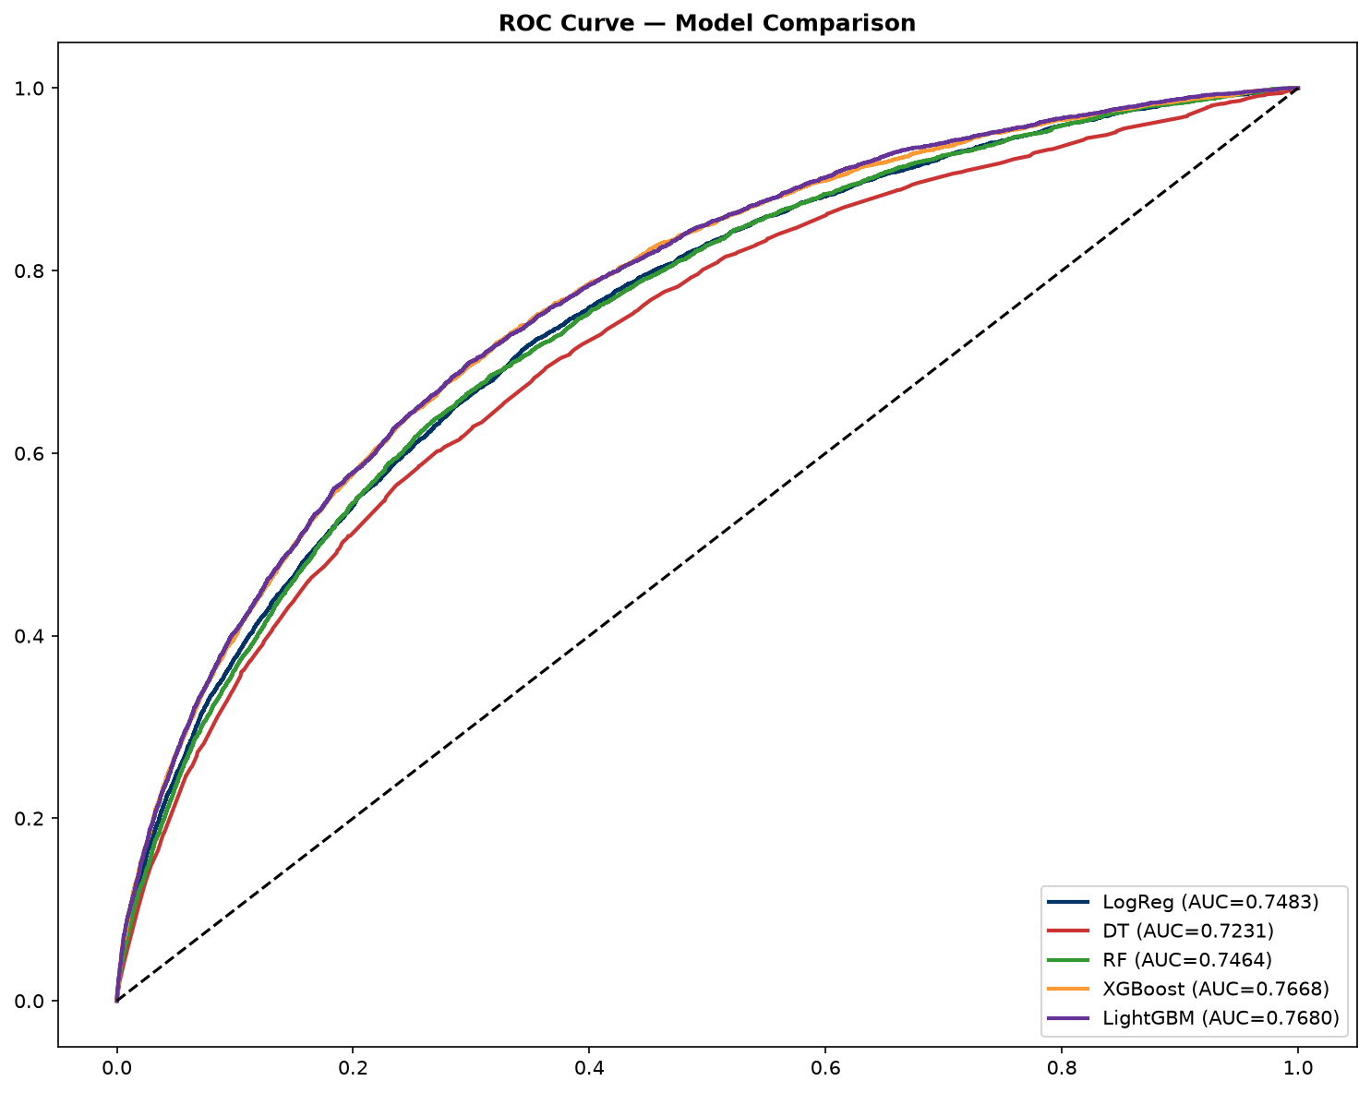
Model Development
Five candidate models trained and compared
Data Split: 80/20 → 246,008 training, 61,503 holdout test
Model | AUC | Avg Prec | Precision | Recall | F1 | Selection
LightGBM | 0.7680 | 0.258 | 0.176 | 0.676 | 0.279 | ✓ Selected
XGBoost | 0.7668 | 0.256 | 0.181 | 0.651 | 0.283
Logistic Reg. | 0.7483 | 0.236 | 0.159 | 0.677 | 0.258
Random Forest | 0.7464 | 0.227 | 0.183 | 0.590 | 0.279
Decision Tree | 0.7231 | 0.202 | 0.145 | 0.678 | 0.239
Why LightGBM Won
• Highest AUC and average precision
• Efficient leaf-wise tree growth w/ early stopping
• Early stopping at 326 rounds, no overfitting
• Native missing value handling

Slide 8
Model Performance
LightGBM evaluation on held-out test set (61,503 applicants)
AUC-ROC
Gini Coeff.
Avg Precision
Recall @ thresh
0.768
0.536
0.258
69.7%
Confusion Matrix (threshold = 0.485)
Model Limitations & Cautions
 | Predicted Repaid | Predicted Default | Total
Actual: Repaid | 39,774 (TN) | 16,764 (FP) | 56,538
Actual: Default | 1,504 (FN) | 3,461 (TP) | 4,965
Total | 41,278 | 20,225 | 61,503
! AUC of 0.768 vs. aspirational target of 0.80
! Single-table features — multi-table may improve performance
! No temporal validation (random split, not time-based)
! 17% precision at threshold — cost of false positives
! No formal fairness / calibration audit completed yet
8 / 15

Slide 9
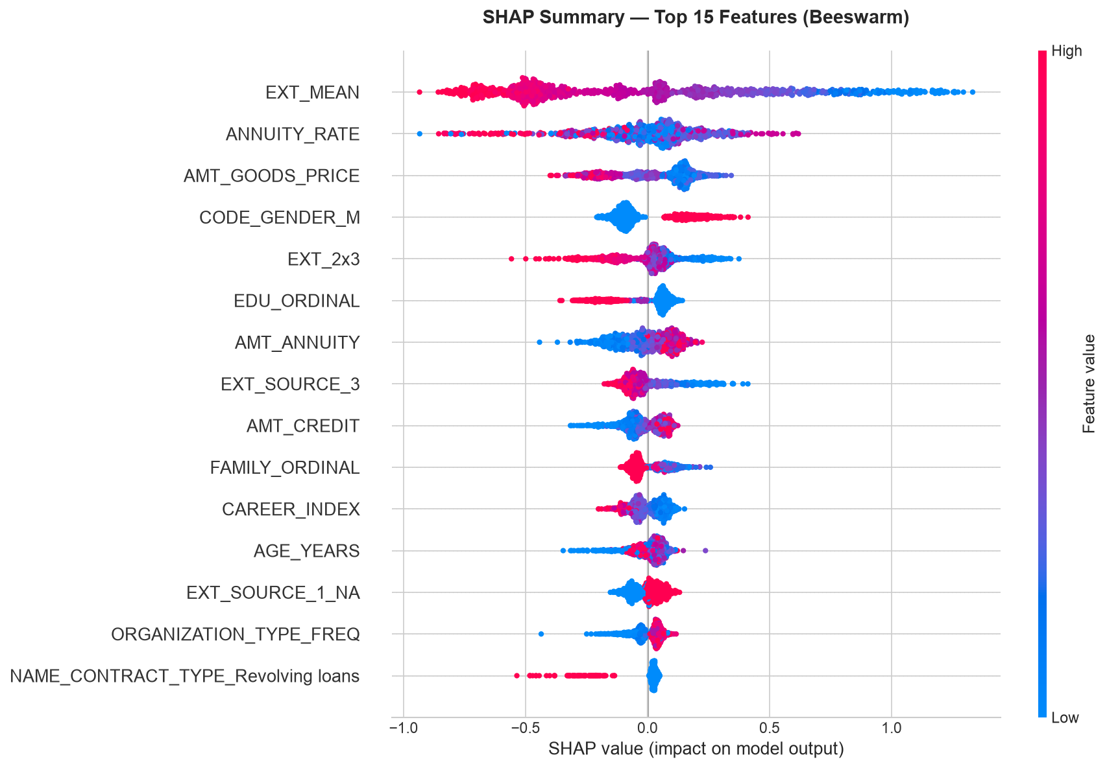
Model Explainability
SHAP analysis reveals what drives default predictions
Rank | Feature | Mean |SHAP| | Business Interpretation
1 | EXT_MEAN | 0.4695 | Composite external creditworthiness
2 | ANNUITY_RATE | 0.1704 | Annuity-to-credit ratio
3 | AMT_GOODS_PRICE | 0.1416 | Loan goods price
4 | CODE_GENDER_M | 0.1244 | Gender (requires fairness audit)
5 | EDU_ORDINAL | 0.0942 | Education level
What This Means
• External credit scores dominate — EXT_MEAN alone accounts for nearly half of all model explanatory power
• Financial ratios (ANNUITY_RATE) provide significant independent signal beyond raw credit scores
• Demographic features in top-10 → formal fairness assessment needed for regulatory compliance
• Permutation importance validates SHAP: same top features, consistent rankings
9 / 15

Slide 10
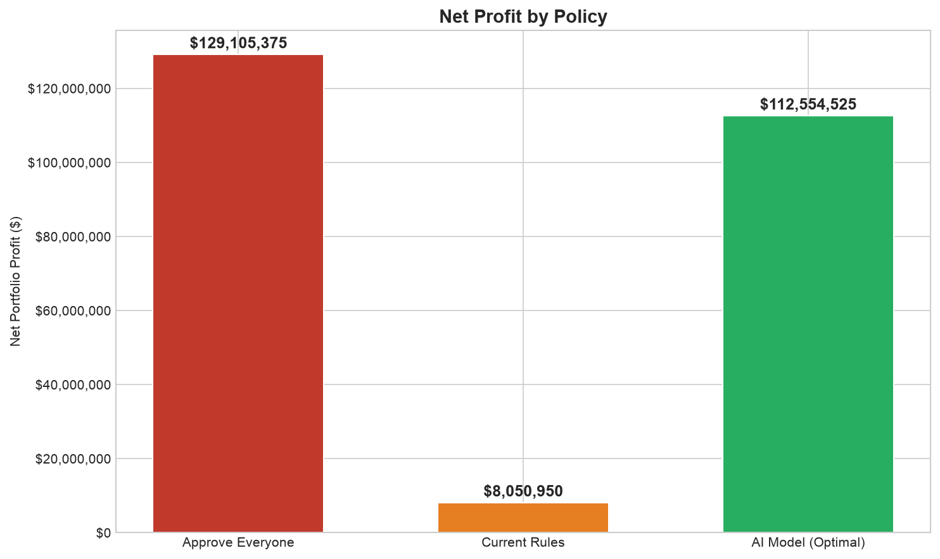
Business Simulation
Five policy scenarios compared on a $625M portfolio
Policy | Approval | Loans Funded | Default Rate | Net Profit | RAR
Approve All | 100% | 50,000 | 8.11% | $129.1M | 20.66%
AI Optimal (τ=0.485) | 67.1% | 33,561 | 3.62% | $112.6M | 26.83%
Conservative (τ=0.30) | 40.1% | 20,038 | 2.24% | $72.0M | 28.73%
Aggressive (τ=0.70) | 89.4% | 44,701 | 5.77% | $133.4M | 23.87%
Current Rules | 4.6% | 2,276 | 2.50% | $8.1M | 28.30%
Key Finding
The AI model at optimal threshold generates $112.6M in profit vs. $8.1M from current rules.
That's a $104.5M improvement — 1,298% more profit.
The AI model approves 67.1% of applicants vs. just 4.6% under current rules.
The profit curve is flat between τ=0.30 and 0.60, enabling flexible risk appetite.
10 / 15

Slide 11
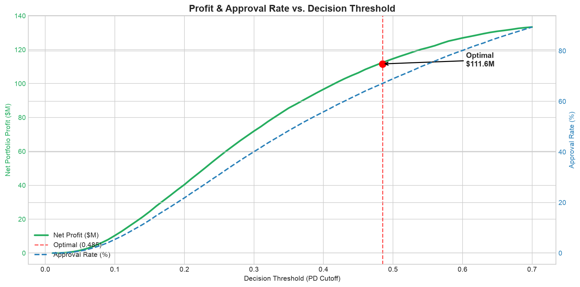
Profit Threshold Analysis
The optimal decision boundary balances risk and reward
Threshold Flexibility
The optimal threshold τ=0.485 was chosen to maximize the F2 score, weighting recall twice as heavily as precision — appropriate for credit risk.
At τ=0.485:
• Precision = 0.171 | Recall = 0.697
• Catches 69.7% of all defaults
• 3,461 true positives; 16,764 false positives
Adaptability Across Cycles:
Conservative (τ=0.30): 40% approval, 28.7% RAR
→ Recession-ready capital preservation
Aggressive (τ=0.70): 89% approval, $133.4M profit
→ Growth-phase market expansion
No retraining needed — the single threshold parameter adjusts risk appetite instantly.
11 / 15

Slide 12
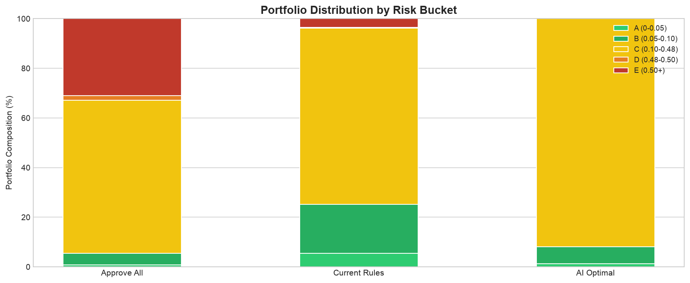
Risk Segmentation & Strategy
Five-tier risk bucket system for targeted portfolio management
Risk Bucket | PD Range | Underwriting | Strategy
A — Lowest Risk | < 2% | Auto-approve | Preferred rates, fast funding
B — Low Risk | 2–5% | Auto-approve | Standard terms
C — Medium Risk | 5–10% | Standard review | Standard terms, document check
D — High Risk | 10–30% | Enhanced review | Higher APR, reduced amount
E — Highest Risk | > 30% | Likely decline | Manual underwriting only
Recommended Approach
• Target 60–70% approval rate to balance market reach with risk
• Maintain exposure: < 30% in Bucket D accounts
• Buckets A–B: fully automated approval
• Buckets D–E: proactive collections monitoring
• Review threshold quarterly vs. performance + macro conditions
Risk buckets enable differentiated strategies across underwriting, pricing, and collections.
12 / 15

Slide 13
Collections Optimization
Using PD scores to prioritize collections on the active portfolio
Metric | Value | Note
AI-Approved Loans | 33,561 | Portfolio at optimal threshold
Actual Defaults | 1,214 | 3.62% default rate
Top 5% Flagged for Collections | 1,679 | Highest PD accounts
Defaults Caught in Top 5% | 119 | 9.8% of all defaults
Savings per Intervened Default | $1,500 | Early intervention reduces LGD
Total Loss Savings | $178,500 | 119 defaults × $1,500
Collections Cost | $125,925 | $75 per account
Net Collections Benefit | $52,575 | Savings minus cost
Operational Impact
The PD score enables targeted collections that produce a positive net benefit even with modest per-account savings.
Each dollar spent on collections yields $1.42 in recovered losses.
The model can also be used to:
• Automate early intervention triggers
• Route high-risk accounts to senior collectors
• Calculate optimal collection effort per account
The collections use case has a lower precision requirement than underwriting — even modest lift in recovery rate produces positive ROI
13 / 15

Slide 14
Current Rules vs. AI Model
Why a multi-dimensional model outperforms single-variable filters
Current Rule-Based Policy
AI Model-Based Policy
Filter: EXT_SOURCE_2 < 0.30
Rejects 95.4% of applicants
Approach:
Multi-dimensional model (182 features)
Filter: DTI > 0.45
No additional impact (already filtered)
Decision:
Probability-based threshold (τ=0.485)
Filter: PREV_DEFAULT_RATE > 0
No additional impact
Filter: LTI > 8
No additional impact
Approval Rate:
67.1%
Default Rate:
3.62%
Result:
Only 4.6% approved
Net Profit:
$112.6M
Net Profit:
$8.1M
Risk-Adj. Return:
26.83%
Comparison Summary
The AI model generates $104.5M more profit (1,298% improvement) while approving 67% of applicants vs. 4.6%.
The current rules rely on a single variable (EXT_SOURCE_2) that is overly conservative. The AI model assesses creditworthiness holistically across 182 features, correctly identifying low-risk applicants even among those with moderate external credit scores.
14 / 15

Slide 15
Conclusion & Next Steps
Summary of achievements and path forward
What Was Delivered
Planned Enhancements
✓ LightGBM model with AUC 0.768 on holdout test data
Multi-table aggregation
Bureau, previous apps, installment payments
Impact: Target: +0.03 AUC
✓ Full pipeline: EDA → feature engineering → modeling → explainability → simulation
✓ Seven executed Jupyter notebooks with complete documentation
Fairness assessment
Disparate impact analysis and bias mitigation
Impact: Regulatory compliance
✓ Production-ready inference module (src/inference.py) with CLI and API
✓ Comprehensive reports: model card, simulation results, .docx, .pptx
Model calibration
Platt scaling for calibrated probabilities
Impact: Accurate EL calculations
✓ 30+ publication-quality figures for stakeholder presentations
Inference API
Package inference module as deployable service
Impact: Real-time underwriting
Temporal validation
Time-based train/test split
Impact: Generalization confidence
The model generates $104.5M more profit than current rules. Flexible threshold allows tuning for growth or capital preservation across business cycles.
15 / 15

