Slide 1

Introduction
Ryan Cheley (He/Him)
Senior Regional Director of Business Informatics
Director of Engineering
Djangonaut Space Navigator
Admin of Django Commons
Notes:
REMINDER: Speak slowly

Slide 2


Introduction
Husband
Father
Sports Fan
🎉
🎓
Notes:
My wife and I celebrated our 20 year wedding anniversary last summer
We also sent our daughter off to college last August
Dodgers
And
Firebirds

Slide 3
How to find me
Website: https://ryancheley.com/
Mastodon: https://mastodon.social/@ryancheley
GitHub: https://github.com/ryancheley/
LinkedIn: https://www.linkedin.com/in/ryan-cheley/

Slide 4
Error Culture
What the heck are all of these emails I get for anyway?

Slide 5
Definition

Slide 6
Alert Definition
a warning of a danger, threat, or problem, typically with the intention of having it avoided or dealt with.

Slide 7
Assumptions

Slide 8
Assumptions
Done via email
Are automated

Slide 9
Conversation
Notes:
This talk is really a way to start a conversation … with me right after the talk during the Q&A
During the conference
or once you’re back at work next week at your organization

Slide 10
What is it?
Notes:
Specifically, what it is

Slide 11
Why it happen?
Notes:
Why it happens

Slide 12
When it Start?
Notes:
When it starts

Slide 13
Who it happen to?

Slide 14
Am I in it?
Notes:
how to tell if you're in an organization that suffers from it

Slide 15
How do I get out?
Notes:
It may not be as hard as you think!

Slide 16
What is Error Culture?

Slide 17
How Many of you have heard the term Error Culture before?
Notes:
How many of you have heard the term ‘Error Culture’ before?

Slide 18
A culture that accepts error notifications and ignores them, encouraging a reactive fire fighting culture, instead of proactive culture of problem solving

Slide 19
Is that Bad?

Slide 20
YES!

Slide 21
Why is it bad?
Low Signal to Noise Ratio
Wait until the 💩 hits the fan

Slide 22
Why does Error Culture happen?

Slide 23
Why does it happen?
Lack of Understanding
What
Why
Who
Notes:
Lack of understanding of
What the error is
Why it’s important
Who it impacts

Slide 24
Why does it happen?
Error/Alert Fatigue

Slide 25
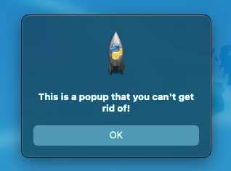
Why does it happen?
Notes:
REMINDER: talk slowly
Have you ever had to click ‘OK’ a bunch of times? Have you ever had users complain about how many times they have to click OK?

Slide 26
Why does it happen?
Hero Culture
Notes:
TIME: ~ 5 minutes
Potentially most insidiously …Hero Culture

Slide 27
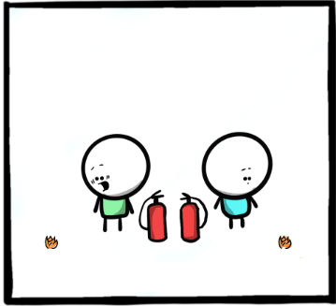
Notes:
These next few slides have one of my favorite comics from
The Work Chronicles comic
“Prevention and Cure” https://workchronicles.com/prevention-and-cure/
we find our hero finding a problem
ACTION: Describe the image

Slide 28
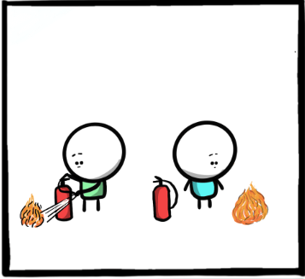
Notes:
we find our hero watching the problem get bigger
ACTION: Describe the image

Slide 29
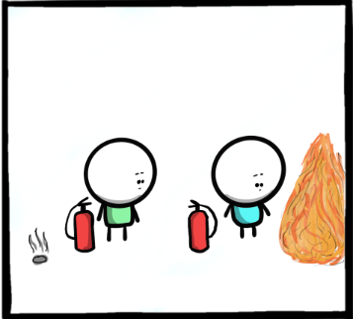
Notes:
and bigger
ACTION: Describe the image

Slide 30
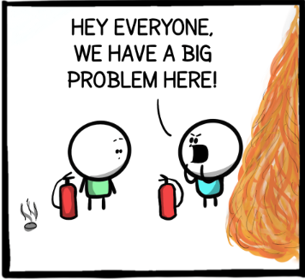
Notes:
our hero tells everyone about the problem that they have ‘found’
ACTION: Describe the image

Slide 31
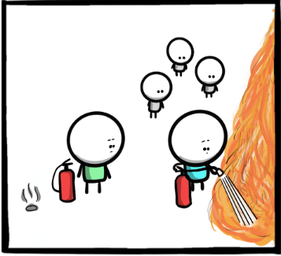
Notes:
our hero fixes the problem
ACTION: Describe the image

Slide 32
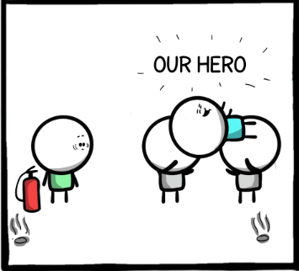
Notes:
our hero is recognized for their efforts
ACTION: Describe the image

Slide 33
Notes:
How many of you have ever been the person the the LEFT? (Point to your RIGHT →)
How many of you have been the person on the RIGHT? (Point to your LEFT ←)
Which one *feels* better? The one on the RIGHT (Point to your LEFT ←)
which one is actually better for problem solving? The one on the LEFT (Point to your RIGHT →)

Slide 34
When does Error Culture Start?

Slide 35
Internal
External
Notes:
Two main classes of reasons

Slide 36
Internal
WE need to be notified when THIS happens
MIGHT be useful
Opted In
Notes:
WE need to be notified when THIS happens … Example needed
This alert MIGHT be useful … example needed
Opted In … Perhaps you’re sent an alert of an error but there is no context, or missing context

Slide 37
External
Best Practice
Default Enabled Alerts
Notes:
When a consultant indicates that it is ‘best practice’ to be notified of an alert but doesn’t provide more context. This is similar to the WE need to be notified about THIS from the internal section before
When defaults for external software come with enabled alerts but no context or steps for resolution

Slide 38
Who does it happen to?
Notes:
You might be surprised at the answer … or maybe not

Slide 39
People in Tech
Developers
Help Desk Folks
System Administrators
Network Administrators
Directors of Engineering
Chief Technical Officers
Notes:
Since we're at a tech conference, the obvious answer is folks in tech. This can be ....

Slide 40
Office Workers
Administrative Assistants
Office Managers
Customer Service Representatives
Account Managers
Notes:
but you might not realize this has the potential to happen in other areas of life as well.

Slide 41
Sectors / Industries
Healthcare
Education
Agriculture
Hospitality
Notes:
Healthcare
Education
Agriculture
Hospitality

Slide 42
Anyone!
Notes:
Honestly, this can happen to anyone!

Slide 43
Am I in it?
Notes:
How can you tell?

Slide 44
Ask yourself a few questions
Notes:
TIME: 11 minutes
How can you tell?

Slide 45
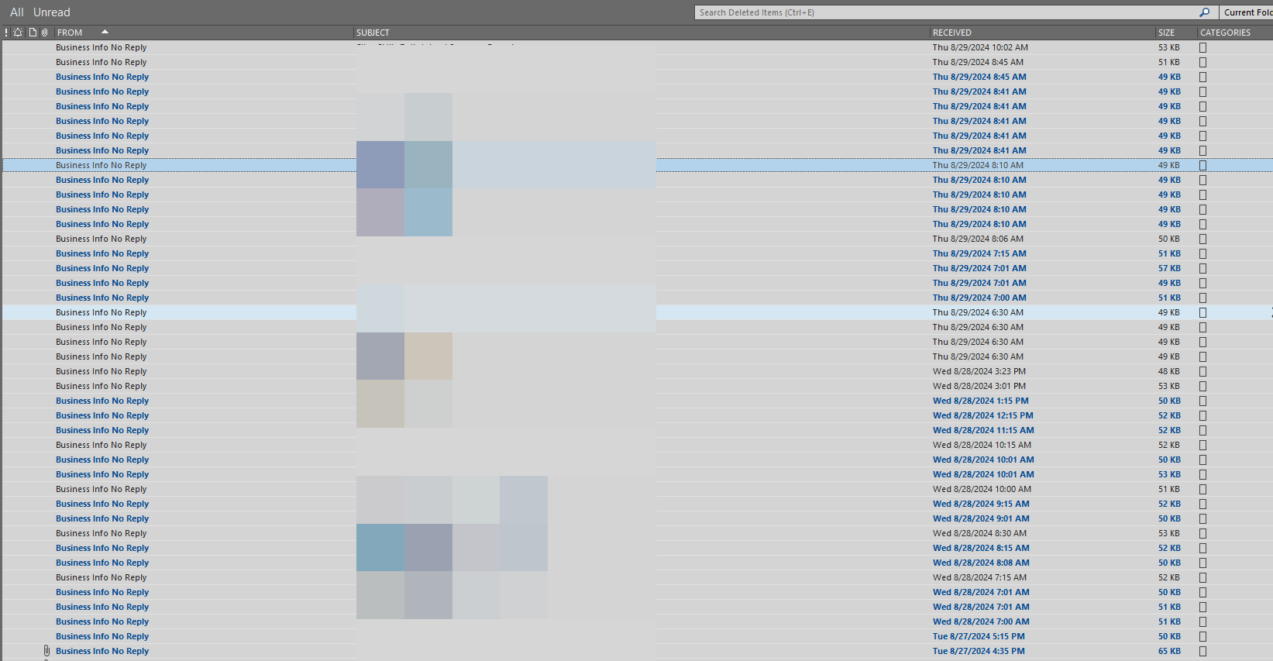
Question 1
Notes:
Does your deleted inbox look something like this?
With a whole bunch of items from a no-reply style email address?

Slide 46
Question 1
Is your deleted items filled with lots of emails from no reply style email addresses that you didn’t even read … you just deleted them?

Slide 47
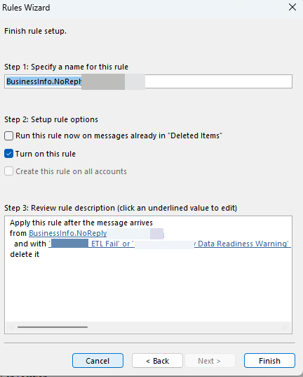
Notes:
But we’re all smart people in this room, so maybe you get 'smart' and create a rule to get rid of that email so you don't have to see it any more?

Slide 48
Question 2
Do you have a rule that just deletes emails?
Notes:
Question: Do you have rules in place to delete these no-reply style emails?

Slide 49
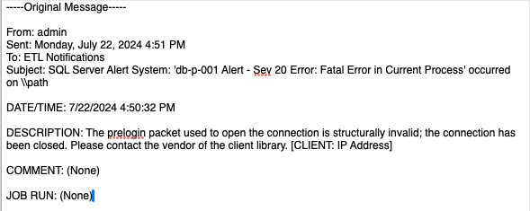
Which Library?
What IP Address?
Notes:
Maybe you get alerts with no context that are NOT actionable … NEXT SLIDE

Slide 50
Question 3
Do you get alerts and have no idea why or what to do about them?
Notes:
Question: Do you have rules in place to delete these no-reply style emails?

Slide 51
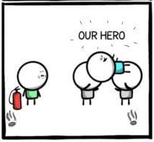
Notes:
Do you have experiences similar to the one we saw in Prevention and Cure?

Slide 52
Question 4
Are people rewarded for waiting until problems they knew about are big enough to alert everyone about and then resolve them?
Notes:
Stated Another way:
Do you see others around you put out fires that you BOTH knew were coming
and did nothing until the fire got BIG enough to let EVERYONE know about
… and then they get ‘rewarded’ for putting out the fire?

Slide 53
If you answered yes …
Notes:
to one or more of the questions from before

Slide 54
You’re in an Error Culture

Slide 55
Convinced
Notes:
Hopefully I’ve convinced you that Error Culture is bad

Slide 56
How can I fix it?
Notes:
And you might ask …

Slide 57
Good News!

Slide 58
Good news!
Individual Contributor
Chief Technical Officer
Notes:
No matter where you are in the 'ladder' at work (i.e. IC, or CTO) you can make a change
You can have agency

Slide 59
Where to start?

Slide 60
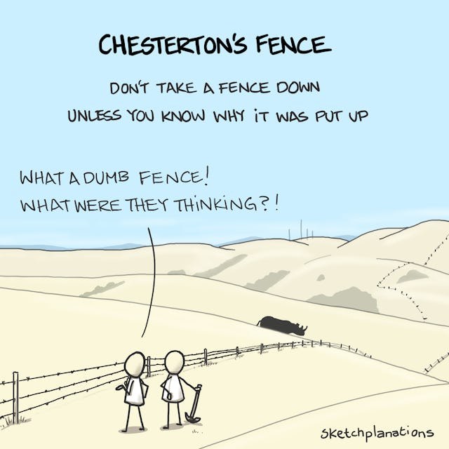
Notes:
A word of caution … change should not be made
until the reasoning
behind the current state of affairs
is understood
And how can you gather information to understand?

Slide 61
Ask Questions

Slide 62
Is the Alert Important?
Notes:
If the answer is …

Slide 63
NO

Slide 64
Delete the Alert
But not JUST the alert
The mechanism that generates the alert
Notes:
Because we don’t want ANYONE to have to delete this alert

Slide 65
Is the Alert Important?

Slide 66
YES
Notes:
Great!

Slide 67
Important Alert!
Notes:
We have an important alert

Slide 68
Is the Alert Actionable?

Slide 69
What does an Actionable Alert Look Like?

Slide 70

VERB
Notes:
TIME: ~16 minutes
ACTION: Describe the image
The superhero Verb from Schoolhouse Rocks
School house rocks was a short cartoon on between other cartoons on Saturday mornings in the 1980s

Slide 71
Examples

Slide 72
Bad
Subject: Super Important Alert about the Server!
Message: The server is unresponsive!
Notes:
Which server?

Slide 73
Better
Subject: Super Important Alert about the Server!
Message: The server do-web-005 is unresponsive
Notes:
We know **which** server now, but what am I supposed to do about it?

Slide 74
Best
Subject: Super Important Alert about the Server!
Message: The server do-web-005 is unresponsive. To resolve this **do** X
Notes:
an actionable alert should have a verb in it ... i.e. the server is unresponsive. To fix this, **do** X ...
The verb here is do

Slide 75
Best
Subject: Super Important Alert about the Server!
Message: The server do-web-005 is unresponsive. To resolve this REBOOT the server
Notes:
an actionable alert should have a verb in it ... i.e. the server is unresponsive. To fix this, **do** X ... The verb here is reboot

Slide 76
Actionable Alert!
Notes:
we have an actionable alert now, NEXT SLIDE

Slide 77
Why …
does the alert exist?
Notes:
we have an actionable alert now, but do we know WHY we have the alert? If not, we should determine the **WHY** and document it

Slide 78
Why …
Is it important?
Notes:
knowing why an alert exists can help you to determine if it's still needed in the future

Slide 79
Best
Subject: Super Important Alert about Server!
Message: The server do-web-005 is unresponsive. To resolve this REBOOT the server
See this link for details on the alert.
Notes:
Here, we’ve added a link to our Knowledge Management System to help provide context for the alert

Slide 80
Example Link
The server do-web-005 is a test server on Digital Ocean. It is used for project ABC which is set to be retired on January 1, 2025
Notes:
Since today is February 8. 2025 …
maybe this alert isn’t important anymore
But I’d need to verify before disabling the alert

Slide 81
Example Link
The server do-web-005 is a production server on Digital Ocean. It is a mission critical server for claims adjudication
Notes:
oh no ... drop everything and get this taken care of now!

Slide 82
Alert Context
Link
Embedded
Notes:
In my examples the context was provided by links …
But embedded context can work as well
No one size fits all

Slide 83
Who …
Should be notified?
Notes:
make sure the *right* people are being notified

Slide 84
Best
Subject: Super Important Alert about the Server!
Message: The server do-web-005 is unresponsive. To resolve this reboot the server
See this link for details on the alert.

Slide 85
Example Link
The server do-web-005 is a production server on Digital Ocean. It is a mission critical server for claims adjudication
Notes:
oh no ... drop everything and get this taken care of now!

Slide 86
Are these the right people?
Claims team
Business Analyst
Developer
Notes:
The Claims team and the Business Analyst can't do anything; given the security infrastructure, the developer might not be able to do anything either!
This might be good information for them to have, but sending an actionable alert to the wrong people doesn’t help anything

Slide 87
Right People
Server Administrator
Notes:
this is a person that can actually perform the action of **do** from above

Slide 88
Frustration
Actionable
Important
Best Case
Time
Waste
Confusion
Right
People
Notes:
Frustration -> What am I supposed to do with this information?
Time Waste -> Why did I just do this?
Confusion -> what am I supposed to do?

Slide 89
Conclusion

Slide 90
Pervasive
Notes:
Error Culture is / can be pervasive.

Slide 91
Make it better
Notes:
But you can make it better

Slide 92
Ask Questions

Slide 93
Make Sure that your Alerts are
Actionable
Important
Sent to the Right People
Notes:
- actionable with a VERB
- have their importance / why documented in our KMS
- are sent to the *right* people

Slide 94
Questions?

Slide 95
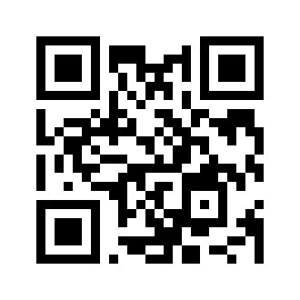
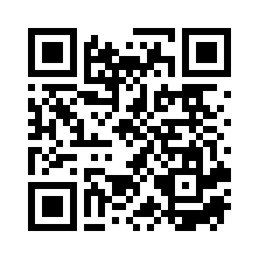
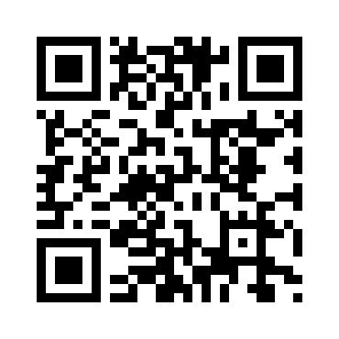
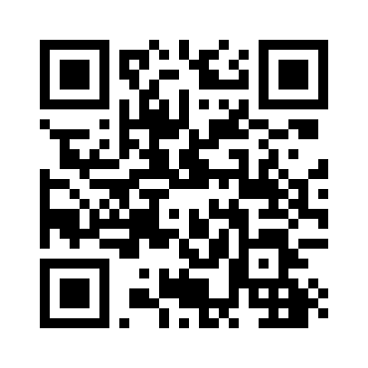
Find me
Site | QR Code
Blog https://ryancheley.com/
Mastodon https://mastodon.social/@ryancheley
GitHub https://github.com/ryancheley/
LinkedIn https://www.linkedin.com/in/ryan-cheley/

