Slide 1
Introduction
Ryan Cheley
Senior Regional Director of Business Informatics
Director of Engineering
Notes:
REMINDER: Speak slowly

Slide 2


Introduction
Husband
Father
Sports Fan
🎉
🎓
Notes:
My wife and I celebrated our 20 year wedding anniversary earlier this year and sent our daughter off to college last month
Dodgers and Firebirds (only 18 more days until opening night!)

Slide 3
How to find me
Website: https://ryancheley.com/
Mastodon: https://mastodon.social/@ryancheley
GitHub: https://github.com/ryancheley/
LinkedIn: https://www.linkedin.com/in/ryan-cheley/

Slide 4
Error Culture
What the heck are all of these emails I get for anyway?
Notes:
Sub title: What the heck are all of these emails I get for anyway?
QUESTION: How many of you have heard the term ‘Error Culture’ before?

Slide 5
Definition

Slide 6
Alert Definition
a warning of a danger, threat, or problem, typically with the intention of having it avoided or dealt with.
Notes:
a warning of a danger, threat, or problem, typically with the intention of having it avoided or dealt with.

Slide 7
Assumptions

Slide 8
Assumptions
Done primarily via email
Are automated
Notes:
Error Culture specifically in the context of alerts that come from emails
Definition: Alert is defined as a warning of a danger, threat, or problem, typically with the intention of having it avoided or dealt with.

Slide 9
Conversation
Notes:
This talk is really a way to start a conversation … with me or those at your organization

Slide 10
What is it?
Notes:
Specifically, what it is

Slide 11
Why it happens?
Notes:
Why it happens

Slide 12
When does it Start?
Notes:
When it starts

Slide 13
Who does it happen to?
Notes:
You might be surprised at the answer … or maybe not

Slide 14
Am I in it?
Notes:
how to tell if you're in an organization that suffers from it

Slide 15
How do I get out?
Notes:
It may not be as hard as you think!

Slide 16
What is Error Culture?
Notes:
How many of you have heard the term ‘Error Culture’ before?

Slide 17
A culture that accepts error notifications and ignores them, encouraging a reactive fire fighting culture, instead of proactive culture of problem solving

Slide 18
Is that Bad?

Slide 19
YES!

Slide 20
Why is it bad?
Low Signal to Noise Ratio
Wait until the 💩 hits the fan

Slide 21
Why does Error Culture happen?
Notes:
How many of you have heard the term ‘Error Culture’ before?

Slide 22
Why does it happen?
Lack of Understanding
What
Why
Who
Notes:
Lack of understanding of
What the error is
Why it’s important
Who it impacts

Slide 23
Why does it happen?
Error/Alert Fatigue
Notes:
If I have to click ‘OK’ on one more fucking pop up …

Slide 24
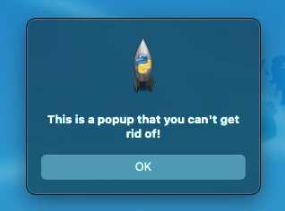
Why does it happen?
Notes:
REMINDER: talk slowly
Have you ever had to click ‘OK’ a bunch of times? Have you ever had users complain about how many times they have to click OK?

Slide 25
Why does it happen?
Hero Culture
Notes:
TIME: ~ 5 minutes
And most insidious …

Slide 26
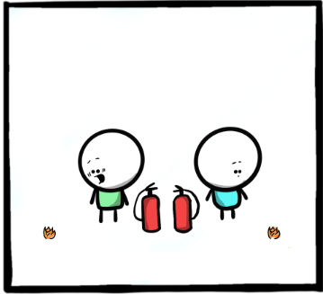
Notes:
These next few slides have one of my favorite comics from
The Work Chronicles comic
“Prevention and Cure” https://workchronicles.com/prevention-and-cure/
we find our hero finding a problem
ACTION: Describe the image

Slide 27
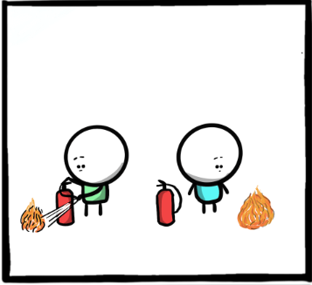
Notes:
we find our hero watching the problem get bigger
ACTION: Describe the image

Slide 28
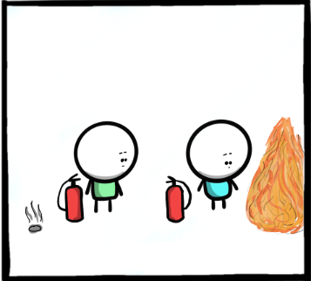
Notes:
and bigger
ACTION: Describe the image

Slide 29
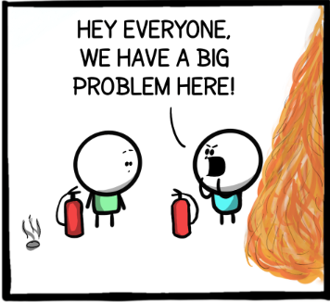
Notes:
our hero notifies everyone about the problem
ACTION: Describe the image

Slide 30
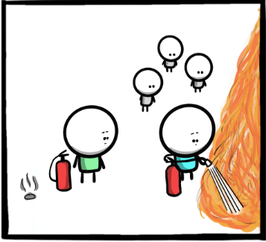
Notes:
our hero fixes the problem
ACTION: Describe the image

Slide 31
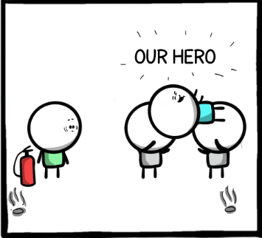
Notes:
our hero is recognized for their efforts
ACTION: Describe the image

Slide 32
Notes:
How many of you have ever been the person the the LEFT? (Point to your RIGHT →)
How many of you have been the person on the RIGHT? (Point to your LEFT ←)
Which one *feels* better? The one on the RIGHT (Point to your LEFT ←)
which one is actually better for problem solving? The one on the LEFT (Point to your RIGHT →)

Slide 33
When does Error Culture Start?
Notes:
Specifically what it is

Slide 34
Internal Reasons
External Reason
Notes:
Two main classes of reasons

Slide 35
Internal
Notes:
When someone decides that ‘we’ need to be notified of when ‘this’ happens again

Slide 36
WE
Notes:
When someone decides that ‘we’ need to be notified of when ‘this’ happens again

Slide 37
THIS
Notes:
When someone decides that ‘we’ need to be notified of when ‘this’ happens again

Slide 38
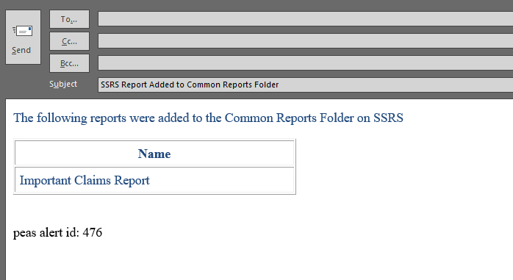
Internal
Notes:
This report is sent to the team of report developers when it happens

Slide 39
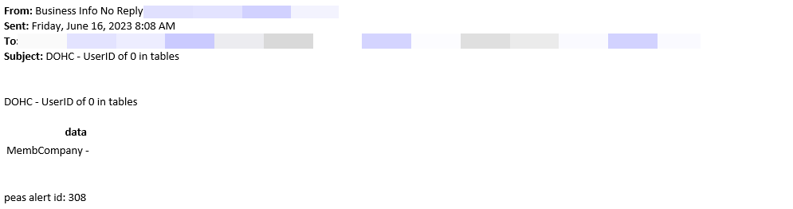
Internal
Notes:
I may need

Slide 40
Might be Useful

Slide 41
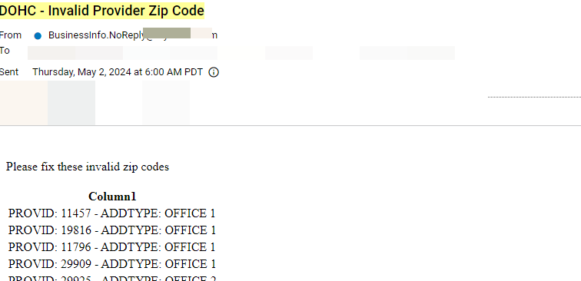
Internal
Notes:
ACTION: Slow Down!
When an alert is created because it ‘might’ be useful but doesn’t provide full context for why

Slide 42
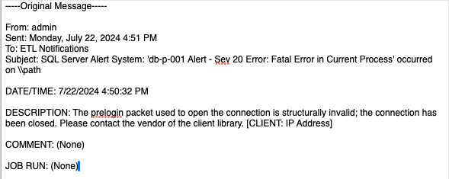
Internal
Which one?
What IP Address?
Notes:
Sometimes you just get opted into Alerts and aren't notified
This is an actual message the ETL team received.
There is very little information about what the problem is (which client library)? What IP Address?
There was literally NOTHING they could do …. and the message was sent ONLY to them.

Slide 43
External
Best Practice
Default Enabled Alerts
Notes:
Unfortunately, I don’t have any examples I can show here, but
When a consultant indicates that it is ‘best practice’ to be notified of an alert but doesn’t provide more context. This is similar to the WE need to be notified about THIS from the internal section before
When defaults for external software come with enabled alerts but no context or steps for resolution

Slide 44
Who does it happen to?
Notes:
You might be surprised at the answer … or maybe not

Slide 45
People in Tech
Developers
Help Desk Folks
System Admins
Network Admins
Directors of Engineering
Chief Technical Officers
Notes:
Since we're at a tech conference, the obvious answer is folks in tech. This can be ....

Slide 46
Office Workers
Administrative Assistants
Office Managers
Customer Service Representatives
Account Managers
Notes:
but you might not realize this has the potential to happen in other areas of life as well.

Slide 47
Other Areas
Healthcare
Education
Agriculture
Hospitality
Notes:
Healthcare
Education
Agriculture
Hospitality

Slide 48
Anyone!
Notes:
Honestly, this can happen to anyone!

Slide 49
Am I in it?
Notes:
How can you tell?

Slide 50
Ask yourself a few questions
Notes:
TIME: 11 minutes
How can you tell?

Slide 51
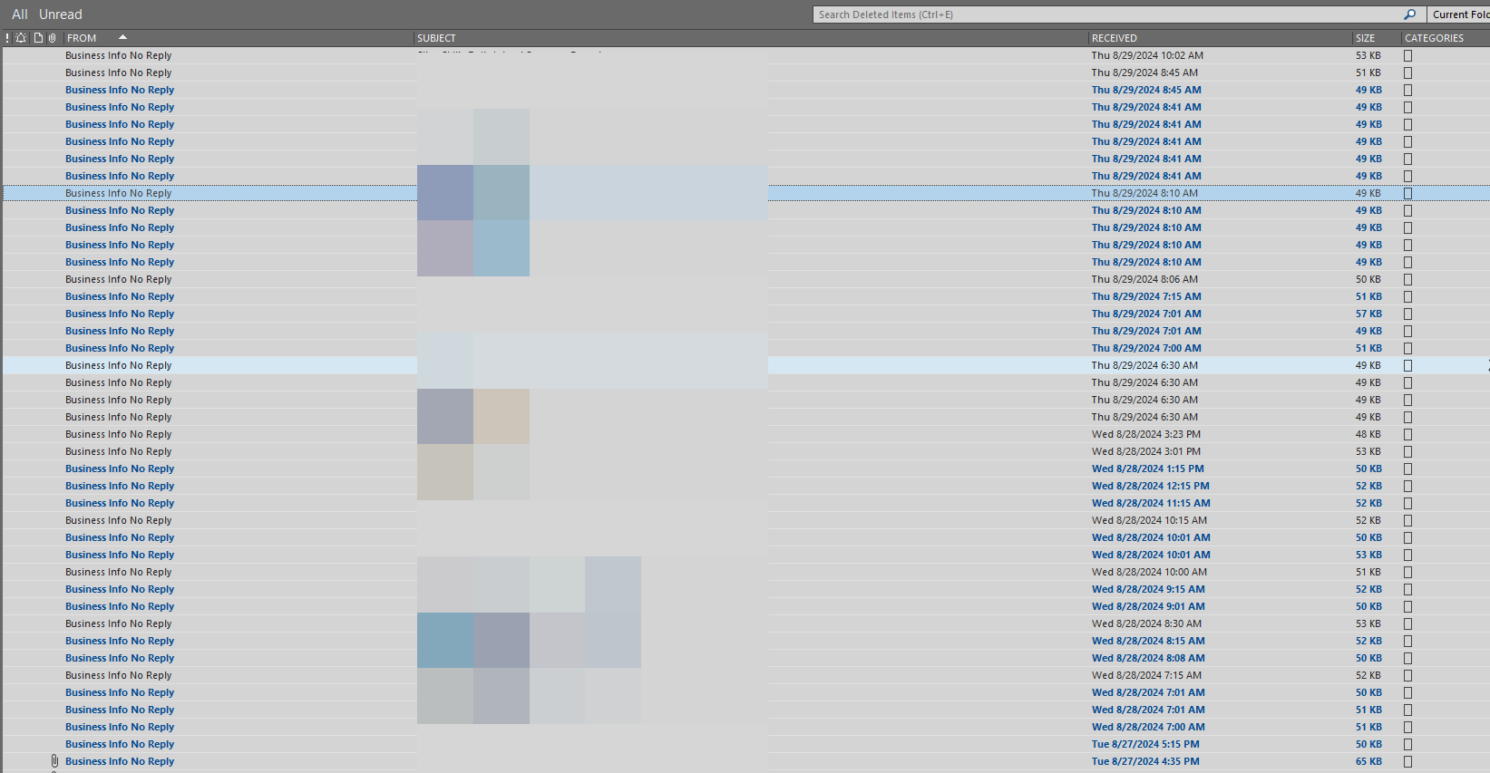
Question 1
Notes:
Question: Do you receive emails or alerts from no-reply style email addresses where your first reaction is to just delete them

Slide 52
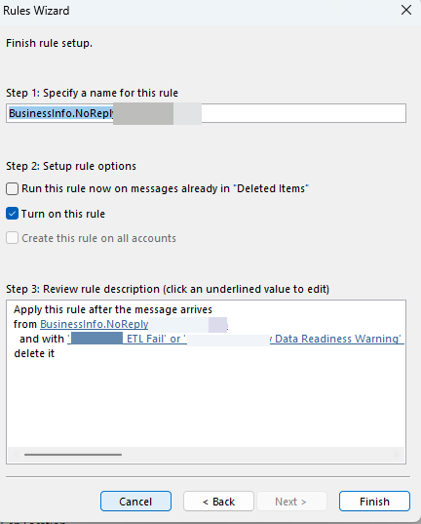
Question 2
Do you have a rule that just deletes emails?
Notes:
But we’re all smart people in this room, so maybe you get 'smart' and create a rule to get rid of that email so you don't have to see it any more?
Question: Do you have rules in place to delete these no-reply style emails?

Slide 53
Question 3
Notes:
Question 3: Do you receive alerts or errors and have NO idea why?

Slide 54
Question 3
Do you get alerts and have no idea why?
Notes:
But we’re all smart people in this room, so maybe you get 'smart' and create a rule to get rid of that email so you don't have to see it any more?
Question: Do you have rules in place to delete these no-reply style emails?

Slide 55
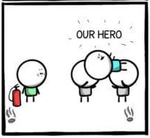
Question 4
Notes:
Do you see others around you put out fires that you BOTH knew were coming
and did nothing until the fire got BIG enough to let EVERYONE know about
… and then they get ‘rewarded’ for putting out the fire?

Slide 56
If you answered yes …
Notes:
to one or more of the questions from before

Slide 57
You’re in an Error Culture
Notes:
to one or more of the questions from before

Slide 58
Convinced
Notes:
Hopeully I’ve convinced you that Error Culture is bad

Slide 59
How can I fix it?

Slide 60
Good News!

Slide 61
Good news!
Individual Contributor
Chief Technical Officer
Notes:
No matter where you are in the 'ladder' at work (i.e. IC, or CTO) you can make a change

Slide 62
Where to start?

Slide 63
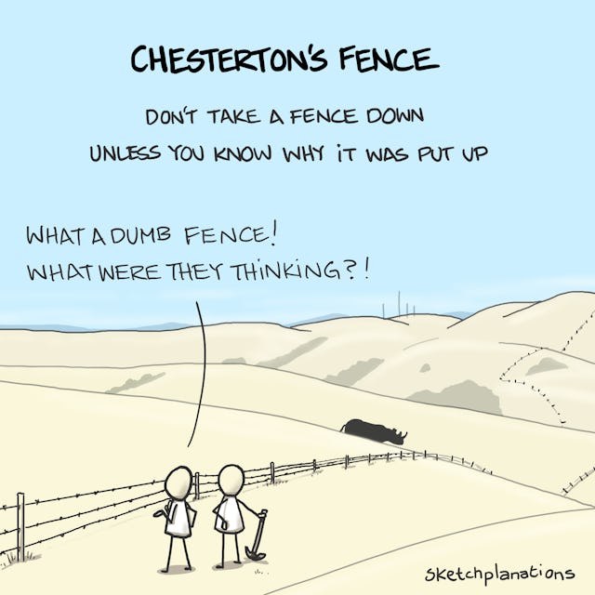
Notes:
A word of caution … change should not be made
until the reasoning behind the current state of affairs
is understood

Slide 64
Ask Questions

Slide 65
Is the Alert Important?
Notes:
If the answer is …

Slide 66
NO

Slide 67
Delete the Alert
But not JUST the alert
The mechanism that generates the alert

Slide 68
Is the Alert Important?
Notes:
If when you ask the question “Id the alert important?” and the answer is …

Slide 69
YES
Notes:
Great!

Slide 70
Important Alert!
Notes:
We have an important alert

Slide 71
Is the Alert Actionable?

Slide 72
What does an Actionable Alert Look Like?

Slide 73

VERB
Notes:
TIME: ~16 minutes
ACTION: Describe the image
The superhero Verb from Schoolhouse Rocks

Slide 74
Examples

Slide 75
Bad
Subject: Super Important Alert about the Server!
Message: The server is unresponsive!
Notes:
Which server?

Slide 76
Better
Subject: Super Important Alert about the Server!
Message: The server do-web-005 is unresponsive
Notes:
We know **which** server now, but what am I supposed to do about it?

Slide 77
Best
Subject: Super Important Alert about the Server!
Message: The server do-web-005 is unresponsive. To resolve this **do** X
Notes:
an actionable alert should have a verb in it ... i.e. the server is unresponsive. To fix this, **do** X ...
The verb here is do

Slide 78
Best
Subject: Super Important Alert about the Server!
Message: The server do-web-005 is unresponsive. To resolve this REBOOT the server
Notes:
an actionable alert should have a verb in it ... i.e. the server is unresponsive. To fix this, **do** X ... The verb here is reboot

Slide 79
Actionable Alert!
Notes:
we have an actionable alert now, but do we know WHY we have the alert? If not, we should determine the **WHY** and document it

Slide 80
Why does the alert exist?
Notes:
we have an actionable alert now, but do we know WHY we have the alert? If not, we should determine the **WHY** and document it

Slide 81
Why …
Is it important?
Notes:
knowing why an alert exists can help you to determine if it's still needed in the future

Slide 82
Best
Subject: Super Important Alert about Server!
Message: The server do-web-005 is unresponsive. To resolve this REBOOT the server
See this link for details on the alert.
Notes:
Here, we’ve added a link to our Knowledge Management System to help provide context for the alert

Slide 83
Example Link
The server do-web-005 is a test server on Digital Ocean. It is used for project ABC which is set to be retired on September 1, 2024
Notes:
Since today is September 23, 2024 …
maybe this alert isn’t important anymore

Slide 84
Example Link
The server do-web-005 is a production server on Digital Ocean. It is a mission critical server for claims adjudication
Notes:
oh no ... drop everything and get this taken care of now!

Slide 85
Alert Context
Link
Embedded

Slide 86
Who …
Should be notified?
Notes:
make sure the *right* people are being notified

Slide 87
Best
Subject: Super Important Alert about the Server!
Message: The server do-web-005 is unresponsive. To resolve this reboot the server
See this link for details on the alert.

Slide 88
Are these the right people to notify?
Claims team
Business Analyst
Developer
Notes:
The Claims team and the Business Analyst can't do anything; given the security infrastructure, the developer might not be able to do anything either!
This might be good information for them to have, but sending an actionable alert to the wrong people doesn’t help anything

Slide 89
Right People
Server Admin
Notes:
this is a person that can actually perform the action of **do** from above

Slide 90
Best Alert
Actionable
Important
Sent to the Right People
Notes:
- actionable with a VERB
- have their importance / why documented in our KMS
- are sent to the *right* people

Slide 91
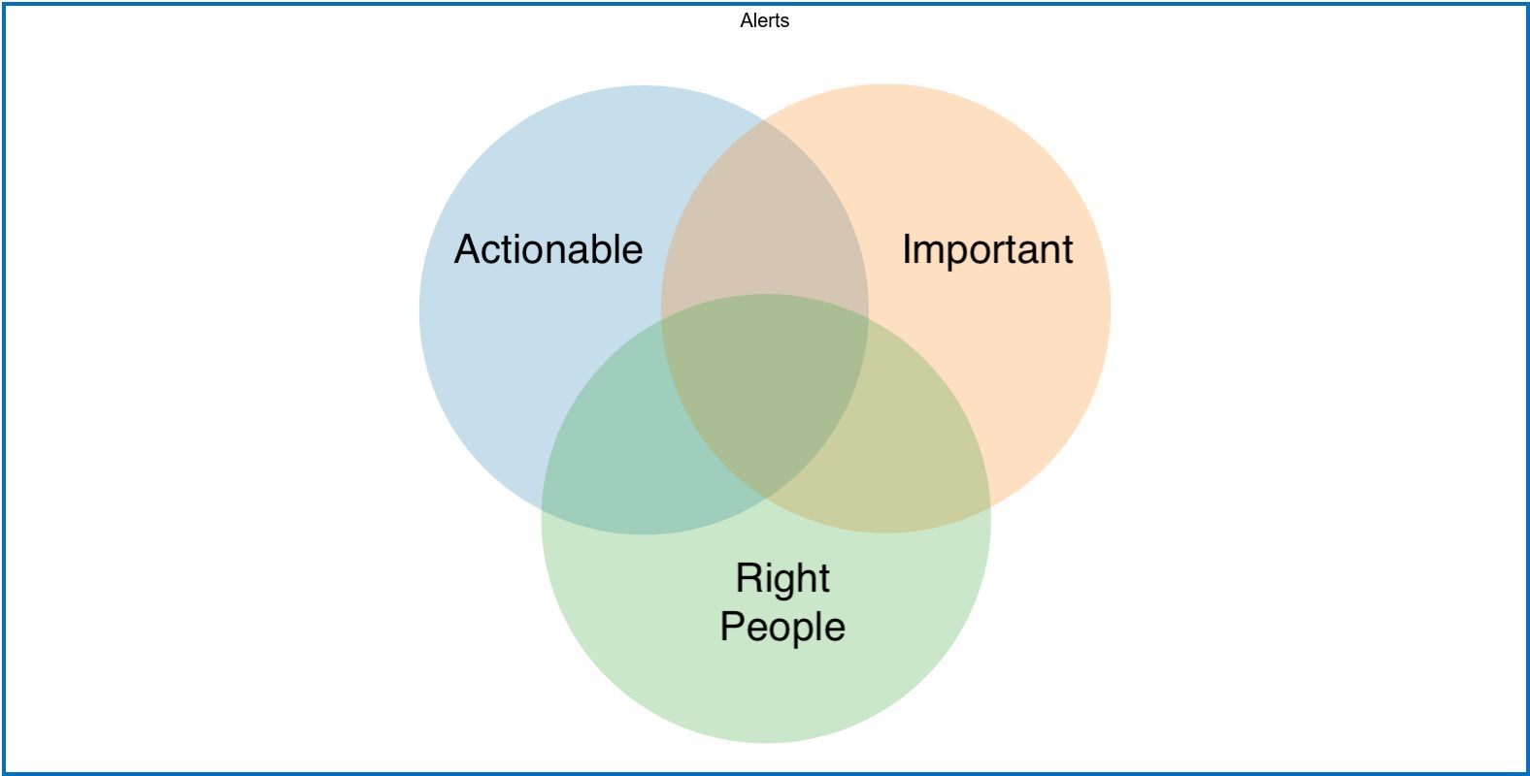
Frustration
Best Case
Time Waste
Confusion
Notes:
Frustration -> What am I supposed to do with this information?
Time Waste -> Why did I just do this?
Confusion -> what am I supposed to do?

Slide 92
Conclusion

Slide 93
Pervasive
Notes:
Error Culture is / can be pervasive.

Slide 94
Make it better
Notes:
But you can make it better

Slide 95
Ask Questions

Slide 96
Make Sure that your Alerts are
Actionable
Important
Sent to the Right People
Notes:
- actionable with a VERB
- have their importance / why documented in our KMS
- are sent to the *right* people

Slide 97
Special Thanks
Adrienne Franke
Carolyn Zimmerman
Mario Munuz
Trey Hunner
Notes:
These amazing people gave me the motivation and encouragement to be here today and I just wanted to make sure I said thank you!

Slide 98
Questions?

Slide 99
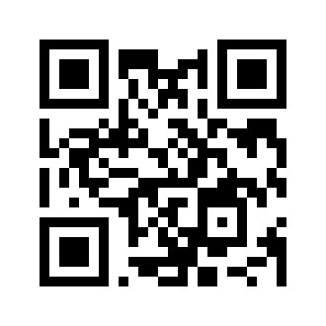
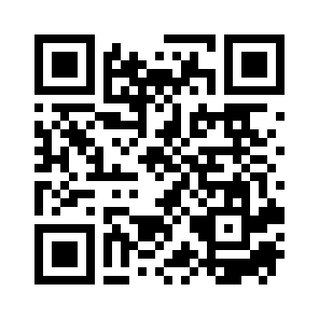
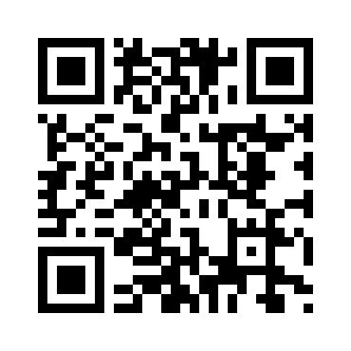
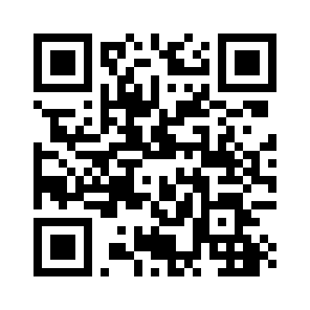
Find me
Site | QR Code
Blog https://ryancheley.com/
Mastodon https://mastodon.social/@ryancheley
GitHub https://github.com/ryancheley/
LinkedIn https://www.linkedin.com/in/ryan-cheley/

