Slide 1
Introduction
Ryan Cheley
Senior Regional Director of Business Informatics
Director of Engineering

Slide 2
Introduction
Husband
Father
Sports Fan
Notes:
My wife and I celebrated our 20 year wedding anniversary earlier this year and sent our daughter off to college last month
Dodgers and Firebirds (only 18 more days until opening night!)

Slide 3
How to find me
Website: https://ryancheley.com/
Mastodon: https://mastodon.social/@ryancheley
GitHub: https://github.com/ryancheley/
LinkedIn: https://www.linkedin.com/in/ryan-cheley/

Slide 4
Error Culture
What the heck are all of these emails I get for anyway?
Notes:
Sub title: What the heck are all of these emails I get for anyway?

Slide 5
Assumptions

Slide 6
Assumptions
Definition
Done primarily via email
Are automated
Notes:
Error Culture specifically in the context of alerts that come from emails
Definition: Alert is defined as a warning of a danger, threat, or problem, typically with the intention of having it avoided or dealt with.

Slide 7
Conversation
Notes:
This talk is really a way to start a conversation … with me or those at your organization

Slide 8
What is it?
Notes:
Specifically, what it is

Slide 9
Why it happens?
Notes:
Why it happens

Slide 10
When does it Start?
Notes:
When it starts

Slide 11
Who does it happen to?
Notes:
You might be surprised at the answer … or maybe not

Slide 12
Am I in it?
Notes:
how to tell if you're in an organization that suffers from it

Slide 13
How do I get out?
Notes:
It may not be as hard as you think!

Slide 14
What is it?
Notes:
How many of you have heard the term ‘Error Culture’ before?

Slide 15
A culture that accepts error notifications and ignores them, encouraging a reactive fire fighting culture, instead of proactive culture of problem solving

Slide 16
Is that Bad?

Slide 17
YES!

Slide 18
Yes!
Low Signal to Noise Ratio
Wait until the 💩 hits the fan

Slide 19
Why does it happen?
Lack of Understanding
What
Why
Who
Notes:
Lack of understanding of
What the error is
Why it’s important
Who it impacts

Slide 20
Why does it happen?
Error/Alert Fatigue
Notes:
If I have to click ‘OK’ on one more fucking pop up …

Slide 21
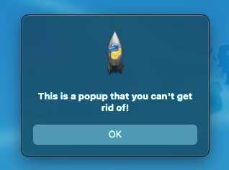
Why does it happen?
Notes:
Because users are prompted repeatedly to click OK

Slide 22
Why does it happen?
Hero Culture
Notes:
TIME: ~ 5 minutes
And most insidious …

Slide 23
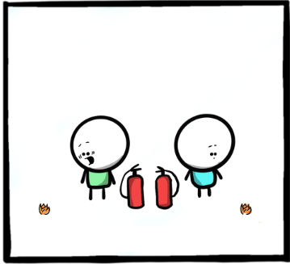
Notes:
These next few slides have one of my favorite comics from The Work Chronicles comic “Prevention and Cure” https://workchronicles.com/prevention-and-cure/
we find our hero finding a problem
ACTION: Describe the image

Slide 24
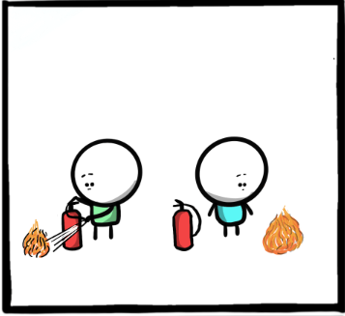
Notes:
we find our hero watching the problem get bigger
ACTION: Describe the image

Slide 25
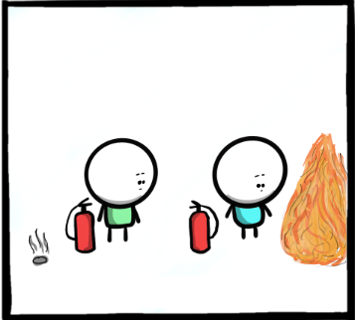
Notes:
and bigger
ACTION: Describe the image

Slide 26
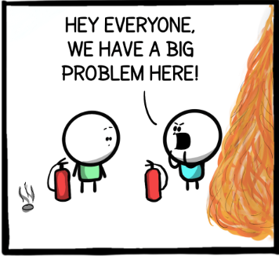
Notes:
our hero notifies everyone about the problem
ACTION: Describe the image

Slide 27
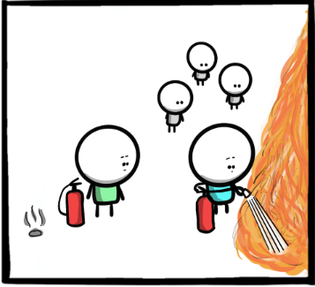
Notes:
our hero fixes the problem
ACTION: Describe the image

Slide 28
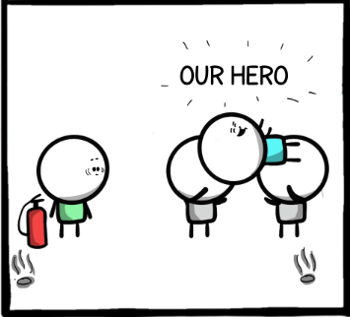
Notes:
our hero is recognized for their efforts
ACTION: Describe the image

Slide 29
Notes:
how many of you have ever been the person the the left? How many of you have been the person on the right? which one *feels* better? which one is actually better for problem solving?

Slide 30
When does it Start?
Notes:
Specifically what it is

Slide 31
Internal Reasons
External Reason

Slide 32
Internal
Example Here
Notes:
When someone decides that ‘we’ need to be notified of when ‘this’ happens again

Slide 33
Several Examples of ‘This’ and ‘We’

Slide 34
Internal
Zip Code Alert Example Here
Notes:
ACTION: Slow Down!
When an alert is created because it ‘might’ be useful but doesn’t provide full context for why

Slide 35
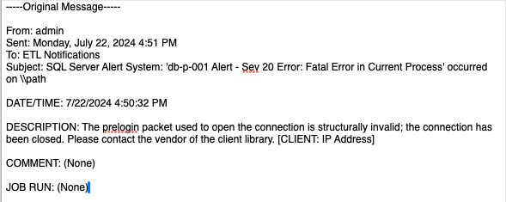
Internal
Notes:
Sometimes you just get opted into Alerts and aren't notified
This is an actual message the ETL team received.
There is very little information about what the problem is (which client library)? What IP Address?
There was literally NOTHING they could do …. and the message was sent ONLY to them.

Slide 36
External
Example Here
Notes:
When a consultant indicates that it is ‘best practice’ to be notified of an alert but doesn’t provide more context

Slide 37
External
Example Here
Notes:
When defaults for external software come with enabled alerts but no context or steps for resolution

Slide 38
Who does it happen to?
Notes:
You might be surprised at the answer … or maybe not

Slide 39
People in Tech
Developers
Help Desk Folks
Sys Admins
Network Admins
Directors’ of Engineering
CTOs
Notes:
Since we're at a tech conference, the obvious answer is folks in tech. This can be ....

Slide 40
Office Workers
Administrative Assistants
Data Analysts
Account Managers
C Suite Execs
Notes:
but you might not realize this has the potential to happen in other areas of life as well.

Slide 41
Other Areas
Fill in your own blanks here
Notes:
It probably happens in any sector where people need to be notified when something is wrong

Slide 42
Anyone!
Notes:
Honestly, this can happen to anyone!

Slide 43
Am I in it?
Notes:
How can you tell?

Slide 44
Ask yourself a few questions
Notes:
TIME: 11 minutes
How can you tell?

Slide 45
Question 1
Example of no-reply style email that you just delete
Notes:
Question: Do you receive emails or alerts from no-reply style email addresses where your first reaction is to just delete them

Slide 46
Question 2
Example of an email from a no-reply email address with the rule that just deletes it
Notes:
But we’re all smart people in this room, so maybe you get 'smart' and create a rule to get rid of that email so you don't have to see it any more?
Question: Do you have rules in place to delete these no-reply style emails?

Slide 47
Question 3
Notes:
Question 3: Do you receive alerts or errors and have NO idea why?

Slide 48
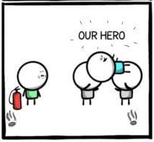
Question 4
Notes:
Do you see others around you put out fires that you BOTH knew were coming … and then they get ‘rewarded’ for putting out the fire?

Slide 49
If you answered yes …
Notes:
to one or more of the questions from before

Slide 50
You’re in an Error Culture
Notes:
to one or more of the questions from before

Slide 51
Convinced
Notes:
Maybe I’ve convinced you that Error Culture is bad

Slide 52
How do I get out?
Notes:
Other than just quitting your job

Slide 53
How can I fix it?

Slide 54
Good News!

Slide 55
Good news!
Individual Contributor
CTO
Notes:
No matter where you are in the 'ladder' at work (i.e. IC, or CTO) you can make a change

Slide 56
Where to start?

Slide 57
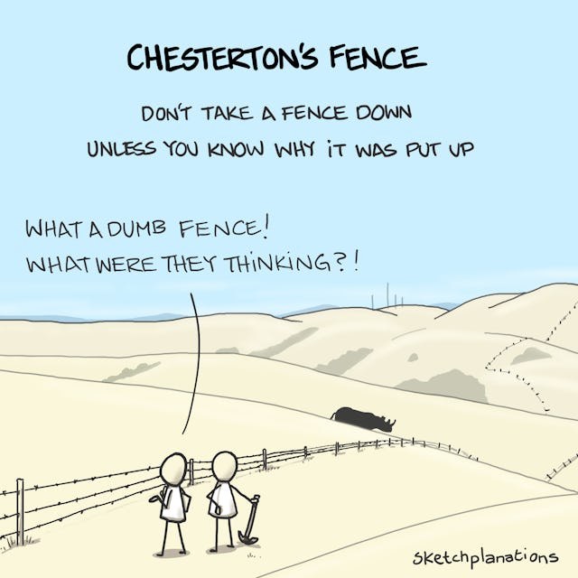
Notes:
A word of caution … change should not be made until the reasoning behind the current state of affairs is understood

Slide 58
Ask Questions

Slide 59
Is the Alert Important?
Notes:
If the answer is …

Slide 60
NO

Slide 61
Delete the Alert
But not JUST the alert
The mechanism that generates the alert

Slide 62
Is the Alert Important?
Notes:
If the answer is …

Slide 63
YES
Notes:
Great!

Slide 64
Important Alert!
Notes:
We have an important alert

Slide 65
Is the Alert Actionable?

Slide 66
What does an Actionable Alert Look Like?

Slide 67

VERB
Notes:
TIME: ~16 minutes
ACTION: Describe the image
The superhero Verb from Schoolhouse Rocks

Slide 68
Examples

Slide 69
Bad
Subject: Super Important Alert about Server!
Message: The server is unresponsive!
Notes:
Which server?

Slide 70
Better
Subject: Super Important Alert about Server!
Message: The server do-web-005 is unresponsive
Notes:
We know **which** server now, but what am I supposed to do about it?

Slide 71
Best
Subject: Super Important Alert about Server!
Message: The server is unresponsive. To resolve this **do** X
Notes:
an actionable alert should have a verb in it ... i.e. the server is unresponsive. To fix this, **do** X ... The verb here is X

Slide 72
Best
Subject: Super Important Alert about Server!
Message: The server do-web-005 is unresponsive. To resolve this REBOOT the server
Notes:
an actionable alert should have a verb in it ... i.e. the server is unresponsive. To fix this, **do** X ... The verb here is reboot

Slide 73
Actionable Alert!
Why does the alert exist?
Notes:
we have an actionable alert now, but do we know WHY we have the alert? If not, we should determine the **WHY** and document it

Slide 74
Why …
Is it important?
Notes:
knowing why an alert exists can help you to determine if it's still needed in the future

Slide 75
Best
Subject: Super Important Alert about Server!
Message: The server do-web-005 is unresponsive. To resolve this do X
See this link for details on the alert.
Notes:
an actionable alert should have a verb in it ... i.e. the server is unresponsive. To fix this, **do** X ... The verb here is X

Slide 76
Example Link
The server do-web-005 is a test server on Digital Ocean. It is used for project ABC which is set to be retired on September 1, 2024
Notes:
Hmmm … maybe this alert isn’t important anymore

Slide 77
Example Link
The server do-web-005 is a production server on Digital Ocean. It is a mission critical server for claims payments
Notes:
oh no ... drop everything and get this taken care of now!

Slide 78
Alert Context
Link
Embedded

Slide 79
Who …
Should be notified?
Notes:
make sure the *right* people are being notified

Slide 80
Best
Subject: Super Important Alert about Server!
Message: The server do-web-005 is unresponsive. To resolve this reboot the server
See this link for details on the alert.

Slide 81
Are these the right people to notify?
Claims team
Business Analyst
Developer
Notes:
The Claims team and the Business Analyst can't do anything; given the security infrastructure, the developer might not be able to do anything either!
This might be good information for them to have, but sending an actionable alert to the wrong people doesn’t help anything

Slide 82
Right People
Server Admin
Notes:
this is a person that can actually perform the action of **do** from above

Slide 83
Best Alert
Actionable
Important
Sent to the Right People
Notes:
- actionable with a VERB
- have their importance / why documented in our KMS
- are sent to the *right* people

Slide 84
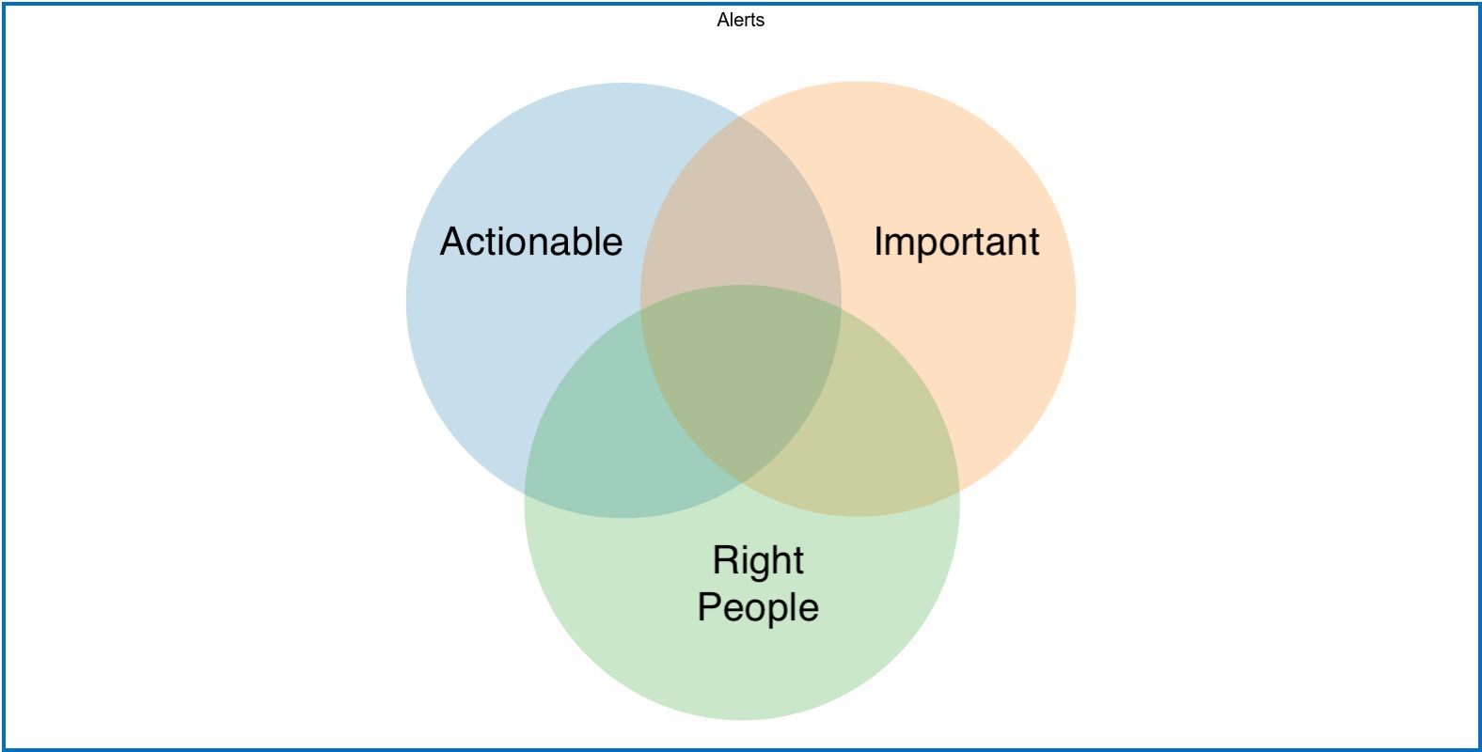
Frustration
Best Case
Time Waste
Confusion
Notes:
Frustration -> What am I supposed to do with this information?
Time Waste -> Why did I just do this?
Confusion -> what am I supposed to do?

Slide 85
Conclusion
Notes:
Error Culture is / can be pervasive.

Slide 86
Pervasive
Notes:
Error Culture is / can be pervasive.

Slide 87
Make it better
Notes:
But you can make it better

Slide 88
Ask Questions
Notes:
Ask questions to make sure that alerts are actionable, documented, and sent people that can actually resolve the problem!

Slide 89
Special Thanks
Adrienne Franke
Carolyn Zimmerman
Mario Munuz
Trey Hunner

Slide 90
Questions?

Slide 91
Find me
Website: https://ryancheley.com/
Mastodon: https://mastodon.social/@ryancheley
GitHub: https://github.com/ryancheley/
LinkedIn: https://www.linkedin.com/in/ryan-cheley/

