Slide 1
Contributing to Django
How I learned to stop worrying and just try to fix an ORM Bug

Slide 2
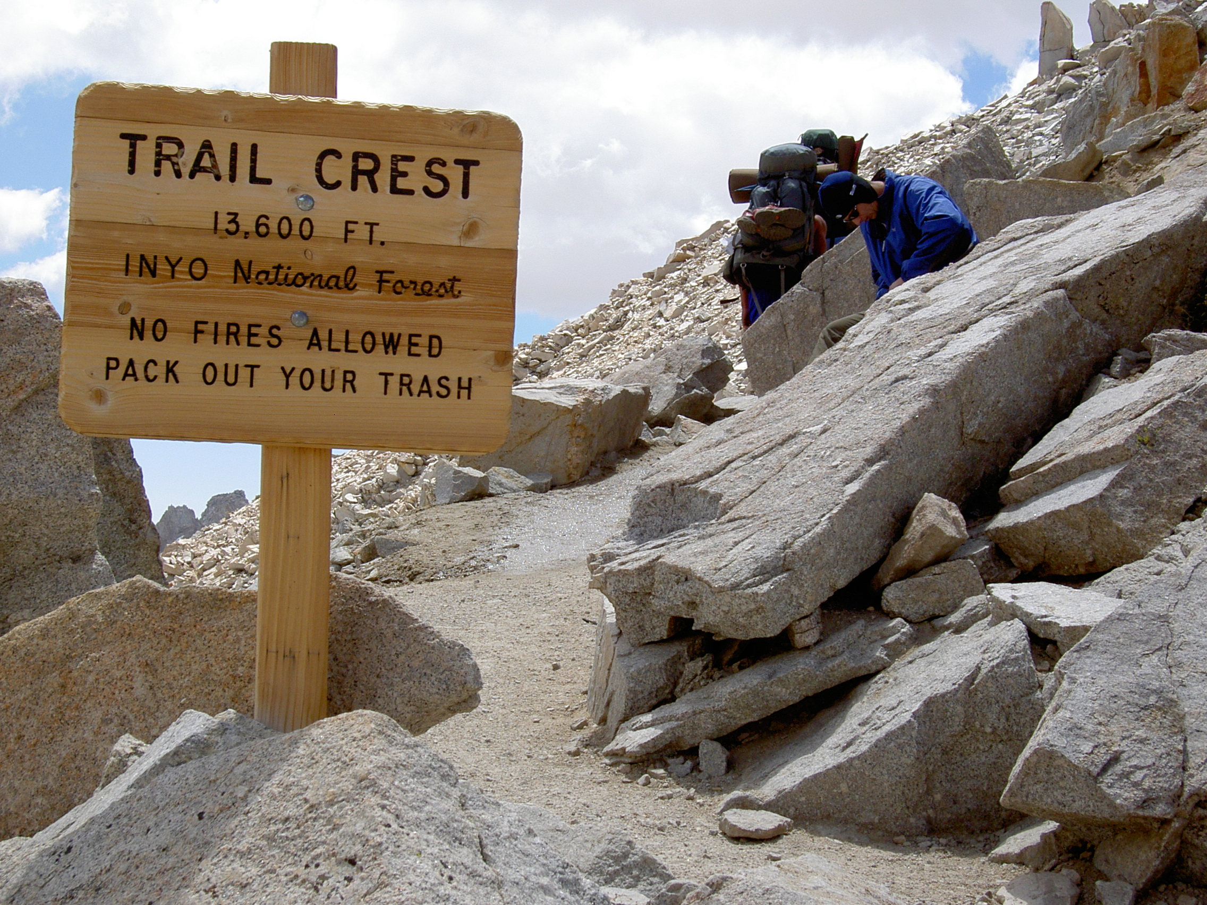
Notes:
# Notes
There I was ... at the top of the Mt Whitney Portal, roughly 13.6 ft (4159 m) above sea level
I had spent the last 7 days hiking to get here.
I was only 3 miles from the summit of Mt Whitney ... but I wasn't sure I could go any further.
My hiking companions told me I didn't look so good. Truth be told, I didn't feel so good either.
Did I make it to the summit?
And what does this story have to do with contributing to Django?

Slide 3
DjangoCon US
Notes:
I’ve been trying to make it to DjangoCon US since 2018
That year, I had a work conference I had to attend.
It happened again in 2019
I was *determined* to go in 2020 ... but we all know what happened there
I was able to attend the online version in 2021
And then I finally made it in person 2022
Picture of DjangoCon that Paulo had of you
And it was amazing.

Slide 4
2018
Notes:
I’ve been trying to make it to DjangoCon US since 2018
That year, I had a work conference I had to attend.

Slide 5
2019
Notes:
It happened again in 2019

Slide 6
2020
Notes:
I was *determined* to go in 2020 ... but we all know what happened there

Slide 7
2021
Notes:
I was able to attend the online version in 2021

Slide 8
2022
Notes:
And then I finally made it in person 2022
Picture of DjangoCon that Paulo had of you
And it was amazing.

Slide 9
Notes:
Add picture from Twitter that Paulo took and posted

Slide 10
Sprints
Notes:
I was very excited about attending the sprints and working on *something* ORM related
My strategy for finding a ticket was to find something old, that seemed straightforward(ish) and then just go for it.
After about 15 minutes of looking around I finally settled on

Slide 11
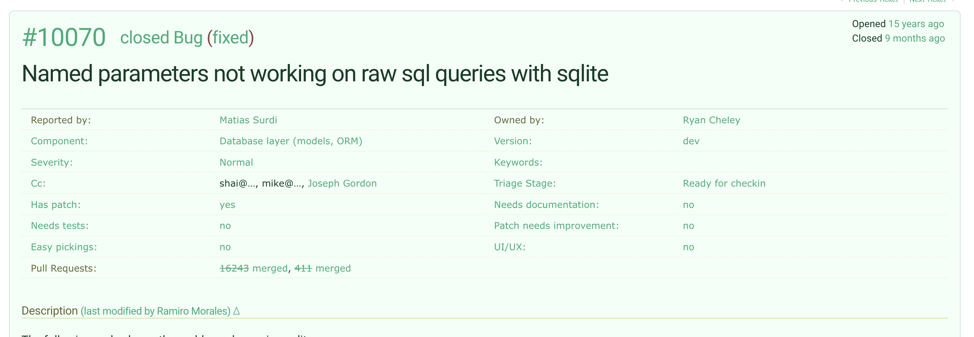

Slide 12
Reviewing the Ticket
Notes:
I spent time reviewing the ticket and then speaking with Simon Charette about it. We agreed that it actually didn’t seem to be a problem anymore!

Slide 13
Marking the Ticket as Done 🎉
Notes:
Marking the Ticket as Done!

Slide 14
Letting everyone know!
Notes:
I was so excited that I let the world know about it on the bird site

Slide 15
Home
Notes:
And then I headed home having ‘fixed’ a bug in the ORM
….
And I felt *really* good about this

Slide 16

Notes:
I felt like the King of the World

Slide 17
But then …

Slide 18
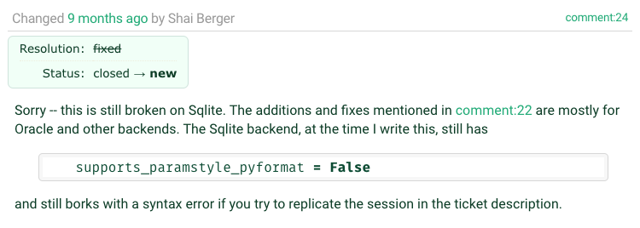

Slide 19
Oh no!
Notes:
I was faced with two potential choices:

Slide 20
Ignore
Notes:
Ignore the bug. It had been a bug for YEARS and didn’t seem to have caused any MAJOR issues

Slide 21
Fix
Notes:
Try to work it on my own
I also had lots of feelings surrounding the discovery of the bug still existing

Slide 22
Embarrassment
Notes:
I tweeted out it
I had people at DjangoCon US 2022 ASK ME HOW I DID IT!

Slide 23
Disappointment
Notes:
Letting people down (whether on not this was actually the case is an entire different discussion perhaps)

Slide 24
Fear
Notes:
Imposter Syndrome – Can I work on this on “my own”

Slide 25
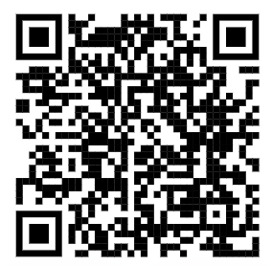
Community
Notes:
Because of a talk that Carlton Gibson gave at DjangoCon US 2018 “Your Framework Needs You”, I decided to give it a shot, even though I would be on my own mostly

Slide 26
Working on the Ticket
Notes:
I went to work on the ticket and did what most of us do when we’re assigned a Bug for work, or on a personal project
Replicate the Bug
Read some docs
Write some code
Write down what you’re learning as you’re learning … because we all do this, right?
I didn’t, until I saw this talk by Simon Willison at DjangoCon US 2022

Slide 27
1. Replicate
Notes:
Replicate the Bug

Slide 28
2. Read
Notes:
Read some docs

Slide 29
3. Write
Notes:
Write some code

Slide 30
4. Test
Notes:
Test the code that you wrote

Slide 31
5. Write
Notes:
Write down what you’re learning as you’re learning … because we all do this, right?
I didn’t, until I saw this talk by Simon Willison at DjangoCon US 2022

Slide 32
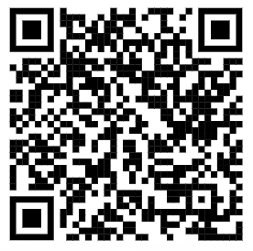
Public Notes
Notes:
At DjangoCon 2022 Simon Willison gave a great talk which included an idea called ‘public notes’. I highly recommend watching that talk and implementing the public notes idea
Essentially you use an issue (in this case a GitHub issue) as a spot to work through a problem and leave yourself bread crumbs for what you’ve tried and learned, basically doing what you would do in the ‘scientific method’

Slide 33
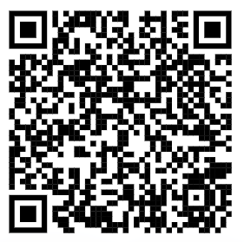
My Public Notes
Notes:
In my notes there’s a lot of back and forth, two steps backward, 1 step forward kind of things, but even looking at it now, I can see my thought process for how the bug ended up getting fixed

Slide 34
The fix
Notes:
Ultimately the fix was made but it wasn’t just *me* that did this. I had a lot of help in getting the code to the right spot.
Nick Pope
Shia Berger
Simon Charette
Mariusz Felisiak

Slide 35
Nick

Slide 36
Shia

Slide 37
Simon

Slide 38
Mariusz

Slide 39
Lessons
Notes:
Any time you use the word ‘just’ in a statement, there’s potentially a lot to unpack.
In this room if I say something like “It’s just Assembly” or “It’s just Machine Language” while presenting a solution to a problem, that ‘just’ can turn off a lot of people.
And so I say this with as much kindness as possible given that this is a room full of Djangonauts and Pythonistas

Slide 40
The Django ORM …

Slide 41
Is **just** Python

Slide 42
In fact, all of Django …

Slide 43
Is **just** Python

Slide 44
Looking at Tickets
Notes:
So when you go to look for a ticket to take, remember that there is an amazing community here that wants to see you succeed … and at the end of the day the code

Slide 45
Is **just** Python

Slide 46
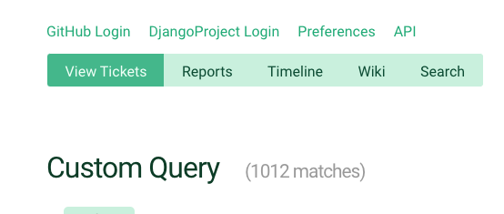
Notes:
So when you’re ready to dive in to one of the currently <> open tickets, just keep that in mind

Slide 47
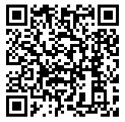
Trac
Notes:
And because this is Django, there is great documentation on how to triage tickets and work through them

Slide 48
Notes:
Back to Mt Whitney
I was **only** three miles from the summit, but I just wasn’t feeling **it**.
My fellow hikers didn’t discourage me from continuing, but they didn’t really encourage me either.
I didn’t make it to the summit that day and it’s been a regret kind of ever since.
But why am I telling this story? What does this have to do with fixing a bug in the Django ORM.
When the bug wasn’t resolved I had an option to just give up.
But the community helped me to work through it. The solution that was ultimately submitted and merged wasn’t just mine, it was through the hard work of a couple of different people.
This community wants you to succeed. They want you to learn.
If this community had been up there with me that day, I’m 100% sure that I would have made it to the summit because of the encouragement that is provided and the determination to want **you** to succeed

Slide 49
Thank you

