Slide 1
Contributing to Django
How I learned to stop worrying and just try to fix an ORM Bug

Slide 2
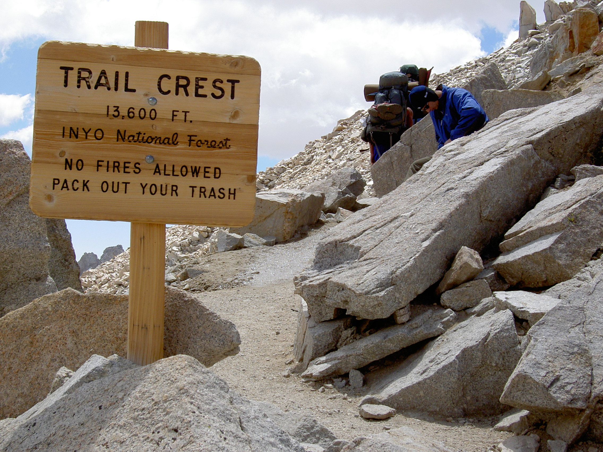
Notes:
# TODO
Add image of Mt Whitney pinnacle
# Notes
There I was ... at the top of the Mt Whitney Portal, roughly 13.6 ft (4159 m) above sea level
I had spent the last 7 days hiking to get here.
I was only 3 miles from the summit of Mt Whiteney ... but I wasn't sure I could go any further.
My hiking companions told me I didn't look so good. Truth be told, I didn't feel so good either.
Did I make it to the summit?
And what does this story have to do with contributing to Django?

Slide 3
DjangoCon US
Notes:
Hoped to make it to Django Con US 2018 but work intervened
And again, in 2019
Was going to go in 2020 ... but we all know what happened there
I finally made it in 2022!
Picture of DjangoCon that Paulo had of you
And it was amazing.

Slide 4
2018
Notes:
Hoped to make it to Django Con US 2018 but work intervened

Slide 5
2019
Notes:
And again, in 2019

Slide 6
2020
Notes:
Was going to go in 2020 ... but we all know what happened there

Slide 7
2021
Notes:
I made it to the Online version 🎉

Slide 8
2022
Notes:
But in 2022 I finally made it in person

Slide 9
Notes:
Add picture from Twitter that Paulo took and posted

Slide 10
Sprints
Notes:
I was very excited about attending the sprints and working on *something* ORM related
My strategy for finding a ticket was to find something old, that seemed straightforward(ish) and then just go for it.
After about 15 minutes of looking around I finally settled on

Slide 11
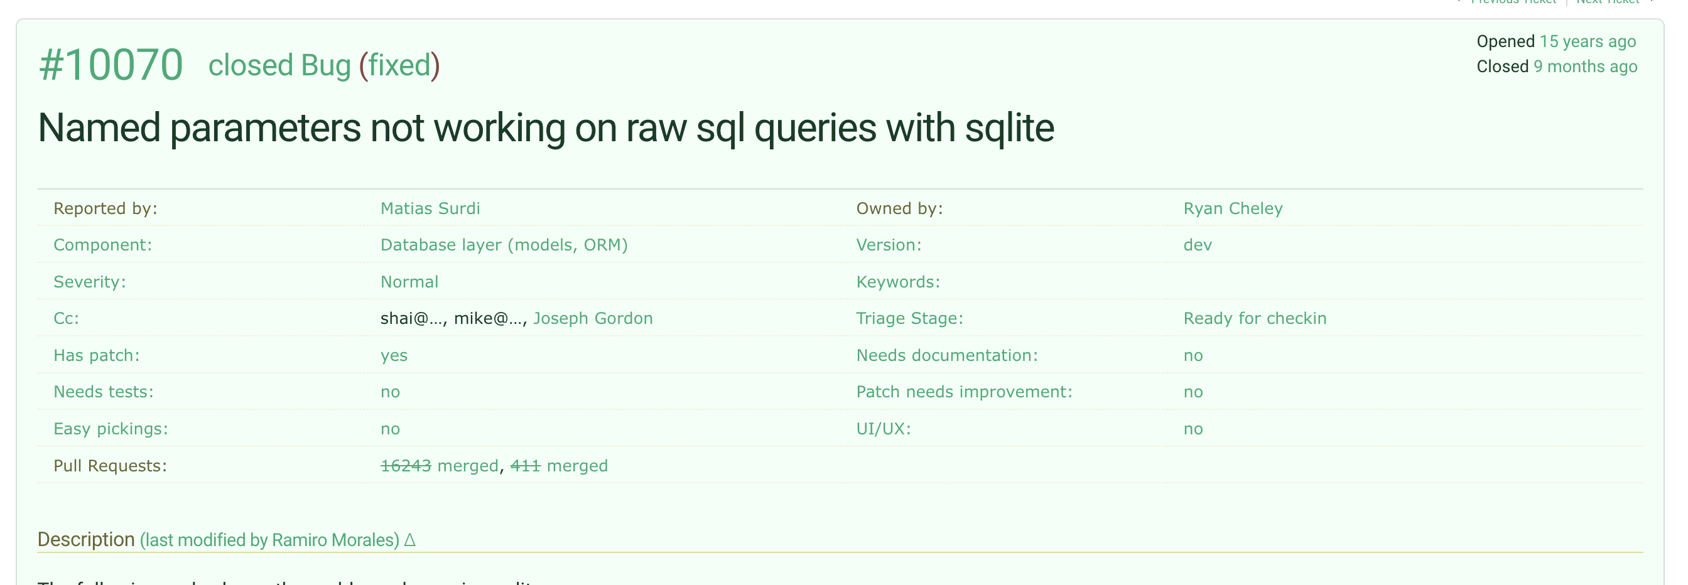

Slide 12
Reviewing the Ticket
Notes:
I spent time reviewing the ticket and then speaking with Simon Charette about it. We agreed that it actually didn’t seem to be a problem anymore!

Slide 13
Marking the Ticket as Done 🎉
Notes:
Marking the Ticket as Done!

Slide 14
Letting everyone know!
Notes:
I was so excited that I let the world know about it on the bird site

Slide 15
Home
Notes:
And then I headed home having ‘fixed’ a bug in the ORM
….
And I felt *really* good about this

Slide 16
But then …

Slide 17
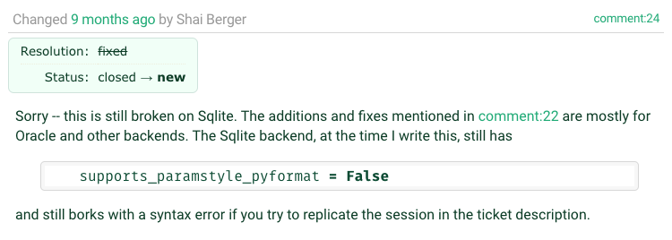

Slide 18
Oh no!
Notes:
I was faced with two potential choices:
Ignore the bug. It had been a bug for YEARS and hadn’t really caused any MAJOR issues
Try to work it on my own
I also had lots of feelings surrounding the discovery of the bug still existing

Slide 19
Embarrassment
Notes:
I tweeted out it
I had people at DjangoCon US 2022 ASK ME HOW I DID IT!

Slide 20
Fear
Notes:
Imposter Syndrome – Can I actually work on this on “my own”
Letting people down (whether on not this was actually the case is an entire different discussion perhaps)

Slide 21
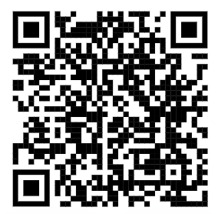
Community
Notes:
Ultimatly I decided to give it a shot, even though I would be on my own mostly because of a talk that Carlton Gibson gave at DjangoCon US 2018 “Your Framework Needs You”

Slide 22
Working on the Ticket
Notes:
So I went to work on the ticket and did what most of us do when we’re assigned a ticket for work, or on a personal project
Replicate the Bug
Read some docs
Write down what you’re learning as you’re learning … because we all do this, right?
I didn’t, until I saw this talk by Simon Willison at DjangoCon US 2022

Slide 23
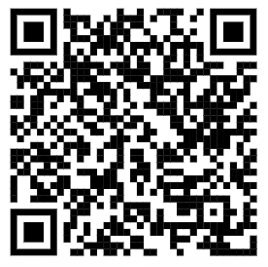
Public Notes
Notes:
At DjangoCon 2022 Simon Willison gave a great talk which included an idea called ‘public notes’. I highly recommend that talk
Essentially you use an issue (in this case a GitHub issue) as a spot to work through a problem and leave yourself bread crumbs for what you’ve tried and learned.

Slide 24
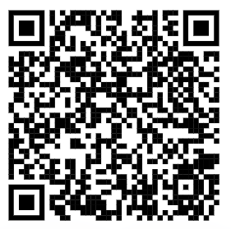
My Public Notes
Notes:
At DjangoCon 2022 Simon Willison gave a great talk which included an idea called ‘public notes’. I highly recommend that talk
Essentially you use an issue (in this case a GitHub issue) as a spot to work through a problem and leave yourself bread crumbs for what you’ve tried and learned.
In my notes there’s a lot of back and forth, two steps backward, 1 step forward kind of things, but even looking at it now, I can see my thought process for how the bug ended up getting fixed

Slide 25
The fix
Notes:
Ultimately the fix was made but it wasn’t just *me* that did this. I had a lot of help in getting the code to the right spot.
Nick Pope
Shia Berger
Simon Charette
Mariusz Felisiak

Slide 26
Lessons
Notes:
Any time you use the work ‘just’ in a statement, there’s potentially a lot to unpack.
In this room if I say something like “It’s just Rust” or “It’s just Go” while presenting a solution to a problem, that ‘just’ can turn off a lot of people.
And so I say this with as much kindness as possible given that this is a room full of Djangonauts and Pythonists

Slide 27
The Django ORM …

Slide 28
It’s **just** Python

Slide 29
In fact, all of Django …

Slide 30
It’s **just** Python

Slide 31
Looking at Tickets
Notes:
So when you go to look for a ticket to take, remember that there is an amazing community here that wants to see you succeed … and at the end of the day

Slide 32
It’s **just** Python

Slide 33
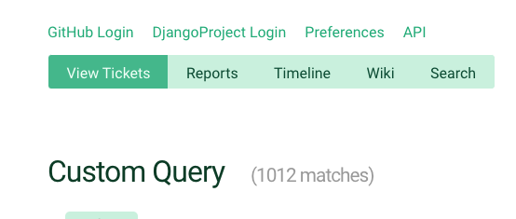
Notes:
So when you’re ready to dive in to one of the currently <> open tickets, just keep that in mind

