Slide 1
E-Commerce Dataset Case Study
Presenter: Ryan Chui

Slide 2
Outline
Introduction & motivation
Dataset and Data pre-processing steps
Exploratory of Data Analysis
Segmentation
Conclusion and limitation

Slide 3

Introduction & Motivation
Dataset has information of 100k orders from 2016 to 2018.
Understanding what consumers exactly need, want, and wish for can help business unlock insights, boost sales, build customer loyalty and serve ideal target customers.
Develop segmentation technique to identify consumer purchase history, habit, changing behavior, loyalty level.
Notes:
input might not be fixed size like image but a sequence like words and we need to understand from the data prior in the sequence info to determine output. RNN maintains h(t) at each timestep of sequence processed.

Slide 4
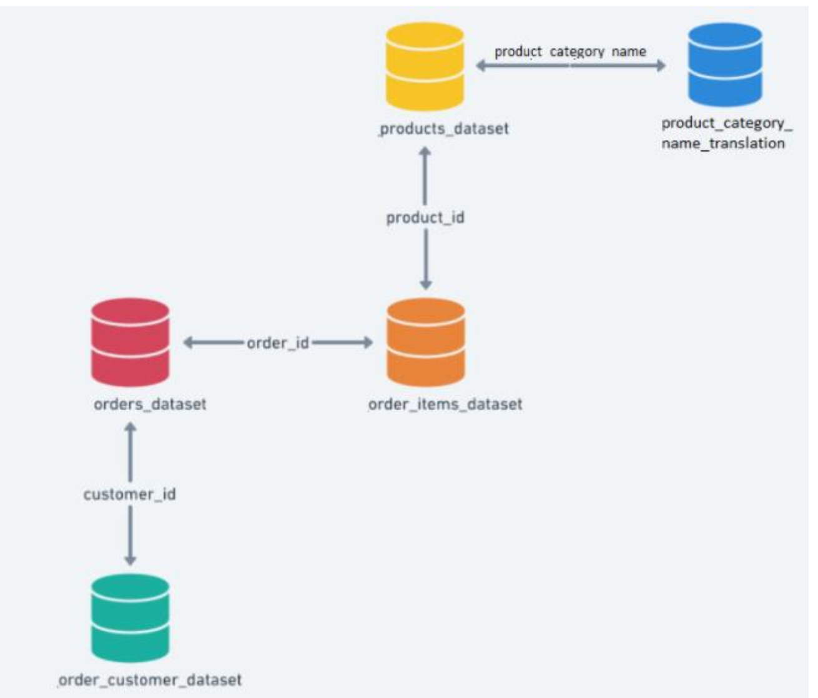
Dataset & Data pre-processing steps
Dataset:
5 Datasets are given.
Shared labels.
Data-preprocessing steps:
Perform Many-to-one method to join by two key columns label.
No duplicate row.
Analyze ~113000 rows. 27 data labels consist of product ID, seller ID, product category, delivery location and status etc.
Some Missing values are replaced by median as they are less liable to be distorted by outliers compared to mean.

Slide 5
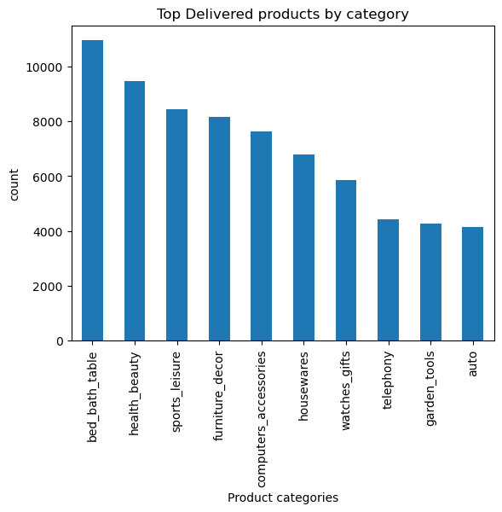
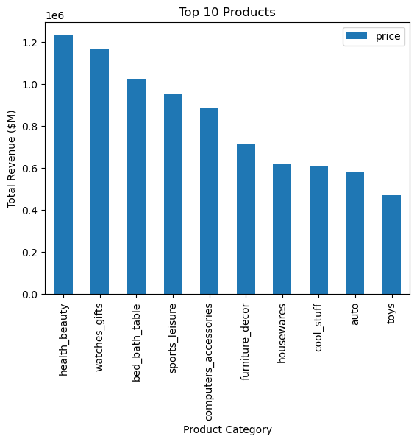
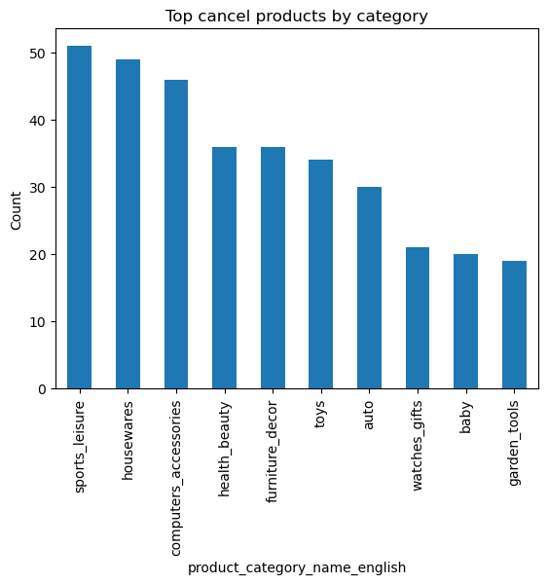
Exploratory of Data Analysis
Most customers purchased in the bed bath table category, followed by health beauty, and sports leisure.
Health Beauty, watches gifts and bed bath n’ table are some of the most revenue generated area.
Roughly 98% delivered and 0.5% cancellation rate. Customers tend to cancel items in the sport, housewares and computer accessories category.

Slide 6
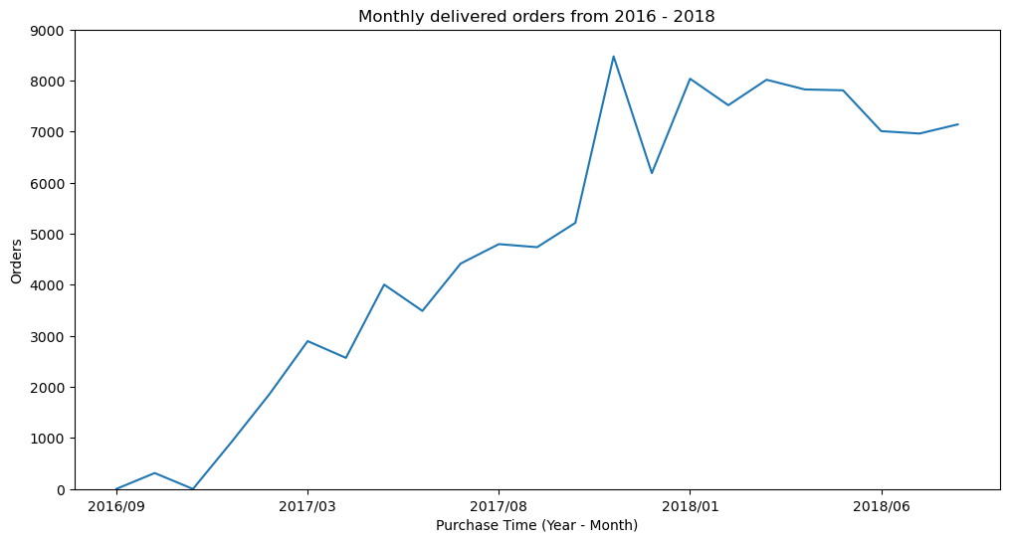
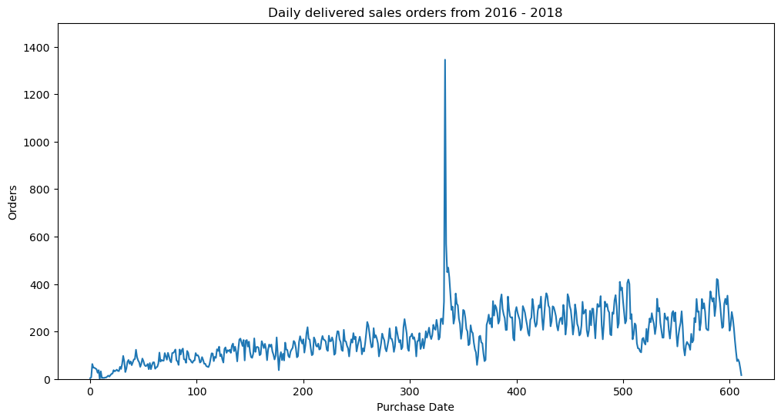
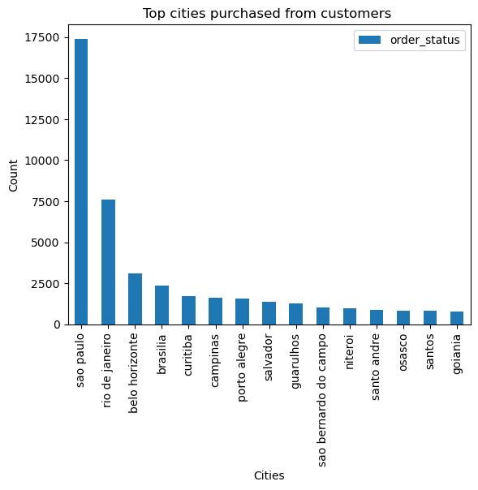
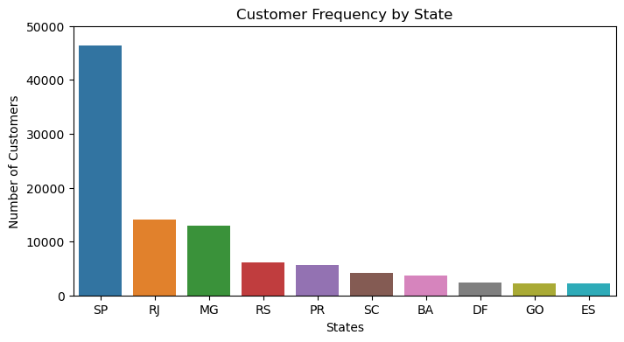
Exploratory of Data Analysis
Highest delivered transaction occurs in the month of Nov 2017 with 8475 orders, and the lowest transaction price occurs in the month Dec 2016 with only 1 order being placed.
Most products are purchased by customers from São Paulo.
Most popular products are ordered and delivered to São Paulo, Rio de Janeiro, Minas Gerais.

Slide 7
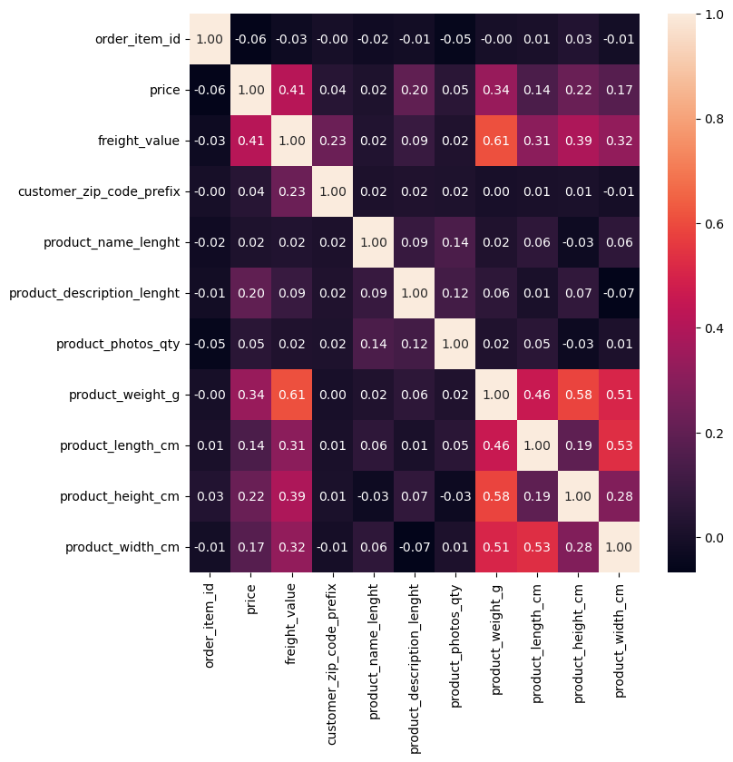
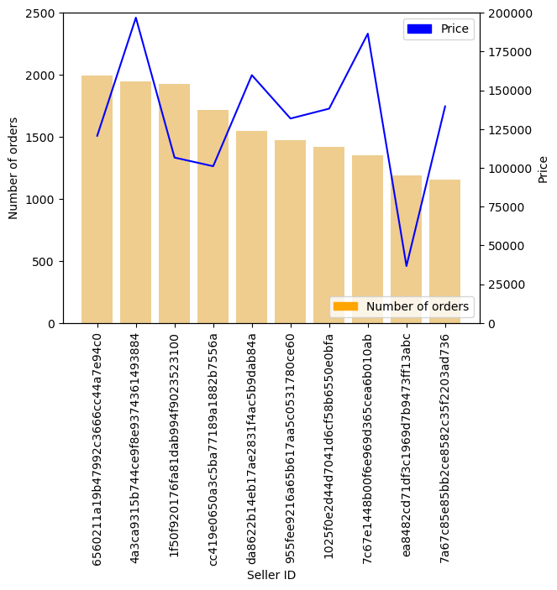
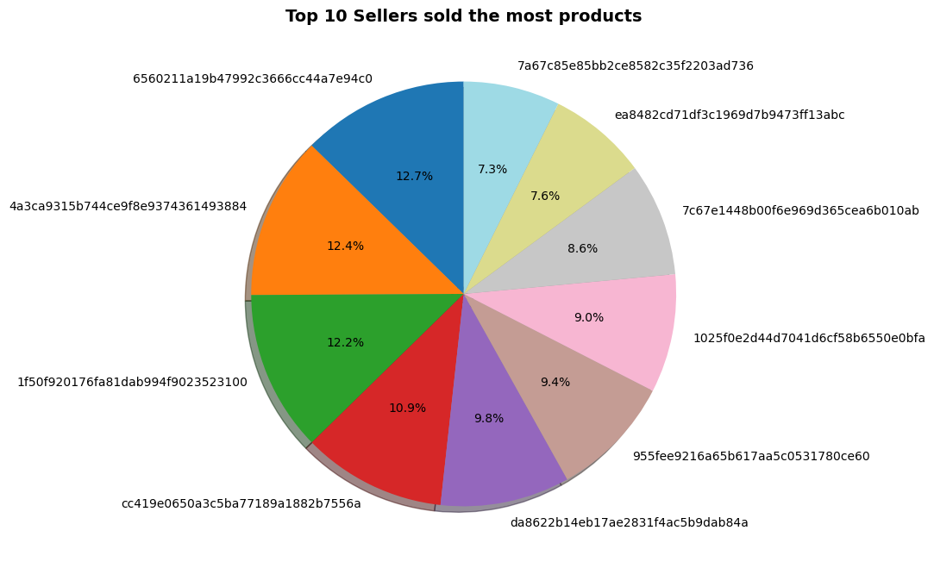
Exploratory of Data Analysis
Among 29170 sellers, the top performance seller sold 1996 products worth of $120703 (exclude freight), and the second top seller sold 1949 items worth of $196882 exclude freight.
Correlation plot suggests there are some positive correlations between freight value and product weight, product dimensionality, and price and freight value.

Slide 8
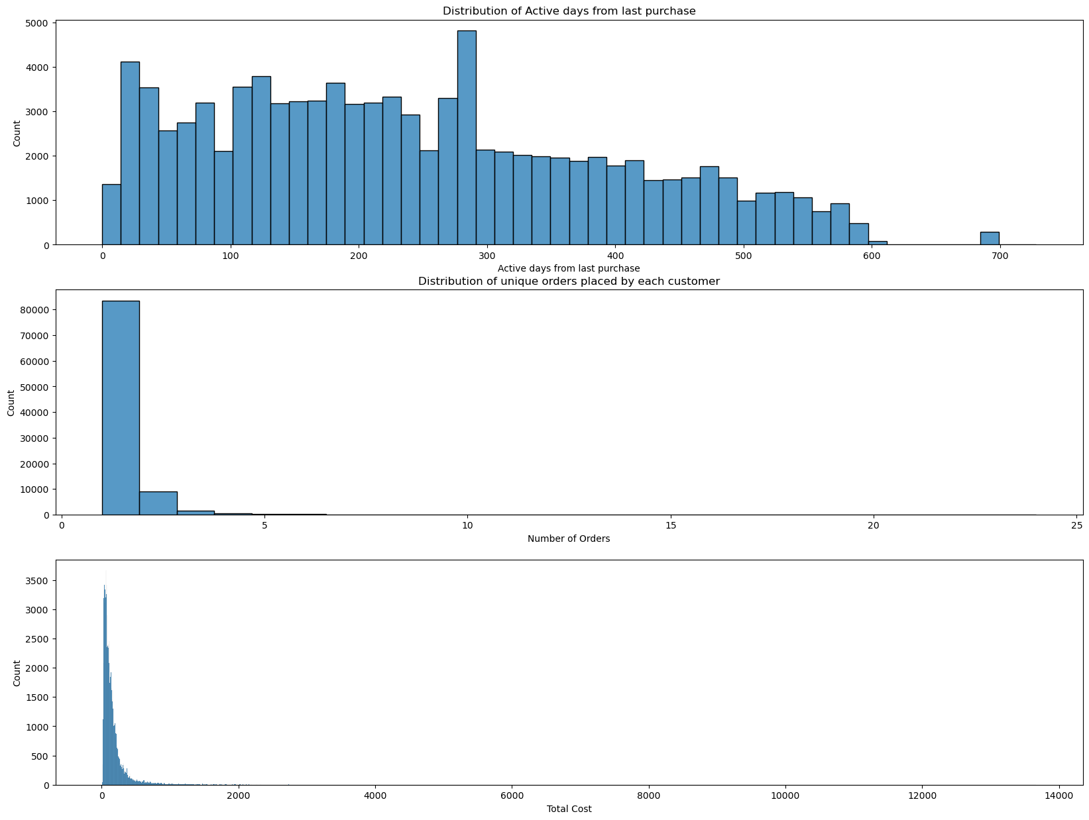
Exploratory of Data Analysis
~77% active customer based within one year of purchase, and ~23% (21952 out of 95420) has not been active purchasing for over one year.
Customer placed an average of 1 order with one user placed 24 orders.
Cost is not quite standardized, and be a problem.

Slide 9
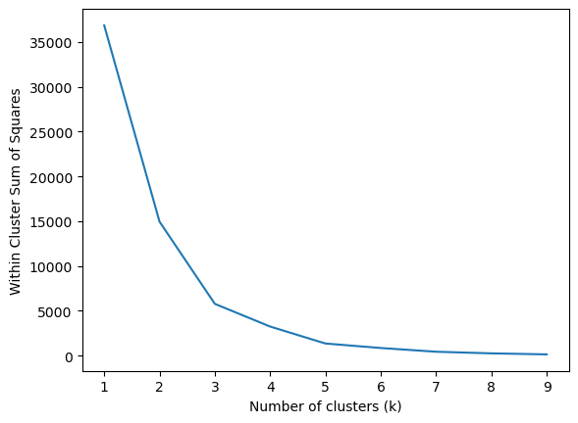
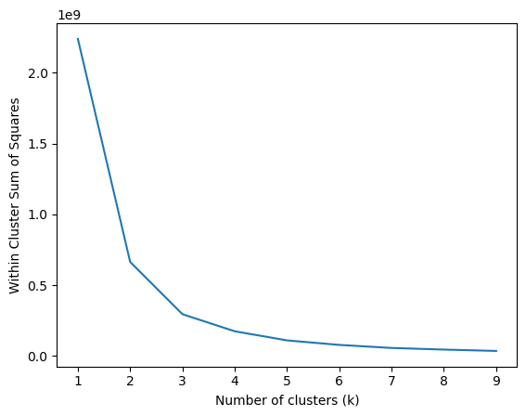
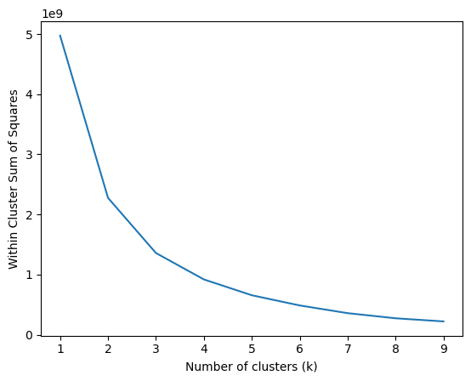
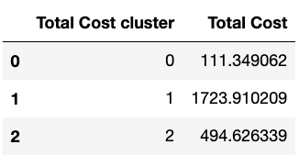
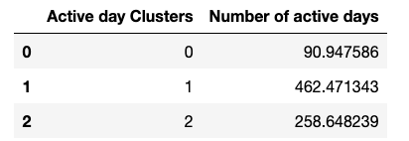
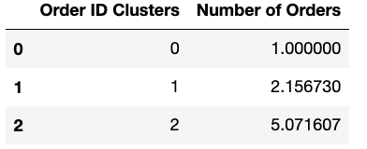
Clustering and segmentation technique
Data normalization is applied to avoid any dominance between classes.
All three models are applied with K-mean algorithm with the chosen 3 clusters for inactive days, number of orders, and total cost of products including price and freight value.
By elbow method in choosing k = 3 for K-mean clustering, and initialize centroid optimization with kmeans++, WCSS is ~295117508 for inactive days, 5780 for number of orders, and 1358423400 for total cost.

Slide 10
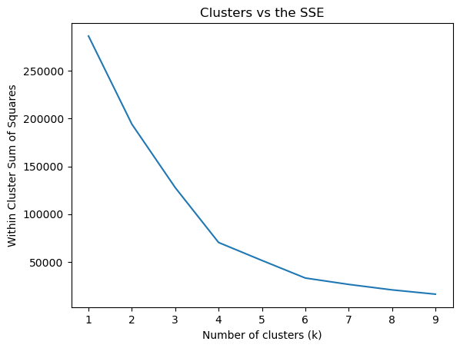
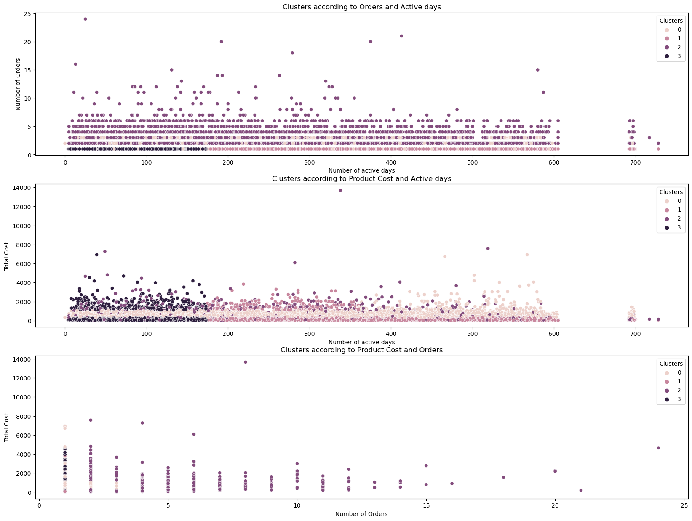
Clustering and segmentation
Assigned a final score to the total number of clusters from three classes. By choosing optimal k = 4 from elbow method. WCSS is around 64557.
High Frequency customers in group 3 tend to spend more or purchase more, and they usually stay loyal and active for 200 days horizon before become inactive.

Slide 11
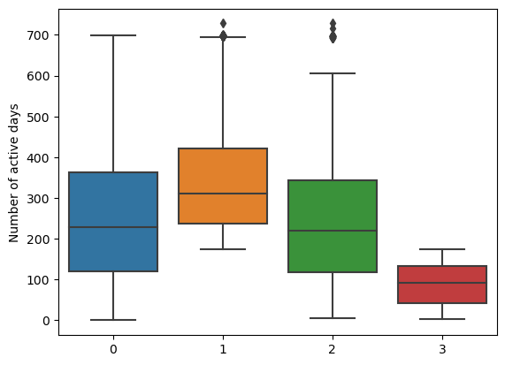
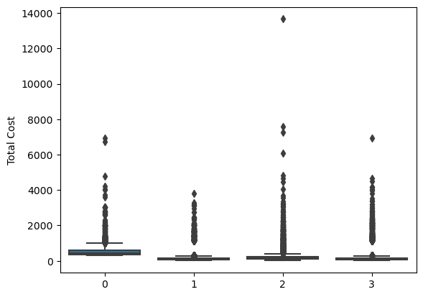
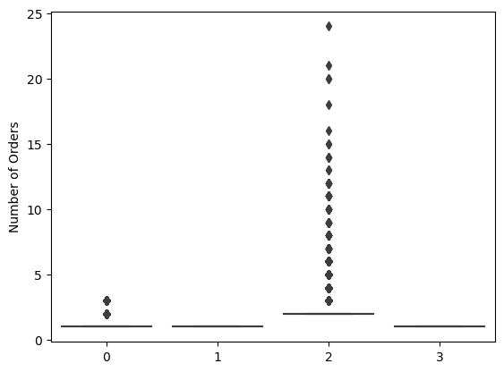
Clustering and segmentation
High frequency buyers in group 2 shows some outliers for being active since last purchase, suggesting their behavior can vary and business may need to take actions to retain them.

Slide 12
Conclusion
High ascending growth in sales in all year of 2017, and most products are sold in Nov 2017.
Growth in 2018 remains high but dataset is not comprehend to draw conclusion in remaining of the year.
Segmentation using K-Mean is effective in fitting the data and able to group some higher value to low value customers spending behavior for their shopping experience.
May explore sales forecasting or reviews from customers.

