Slide 1


Provide
The Rovers
Vladimir macko, Luigi Murialdo, Rachael Hagan, Yulia solntseva, Julio Pérez Olvera, alex tudorica, praveetha patalay

Slide 2
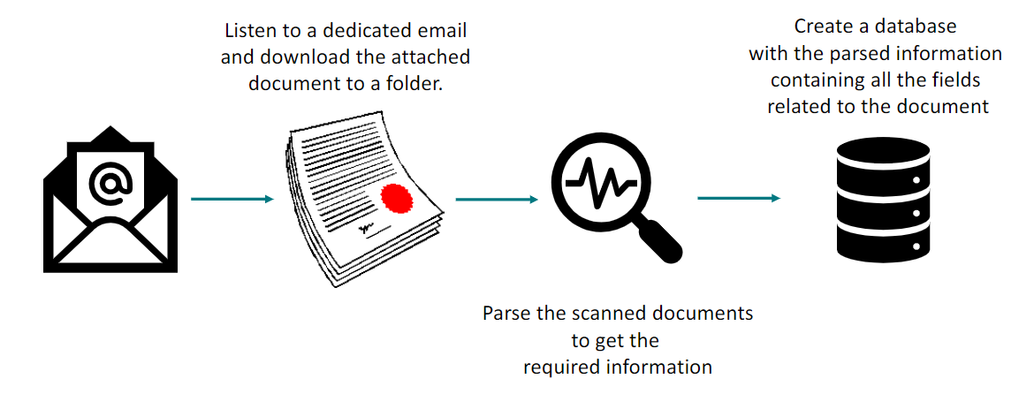
The Challenge

Slide 3
Tasks
Task 1: Identify new email and save attachment in a particular folder
Task 2: Detects a new file in the temporary folder
Task 3: Cuts a new file into pieces: manual cutting, or identifying dark pixels
Task 4: Read information/ text mining in each piece (text and checkboxes) and extract it and save it

Slide 4

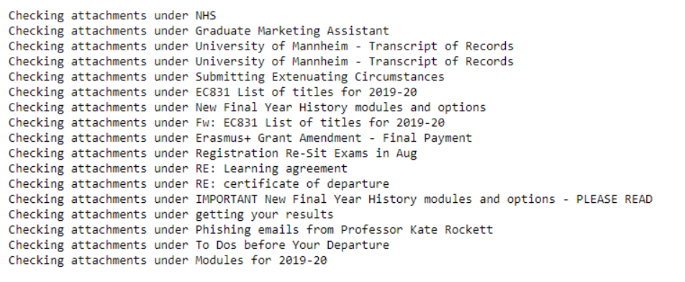
Task 1
https://github.com/ryancier/Rovers/blob/master/provider%20right%20(2).ipynb

Slide 5


Task 2
We used the Python watchdog API that monitors changes to a directory
It is a small Python script that takes action whenever a new file is uploaded to a directory or its contents change.
This allows us to monitor any attachments that have been downloaded to be imported for analysis in our python script
https://github.com/ryancier/Rovers/blob/master/getFilesFromDirectory.ipynb

Slide 6
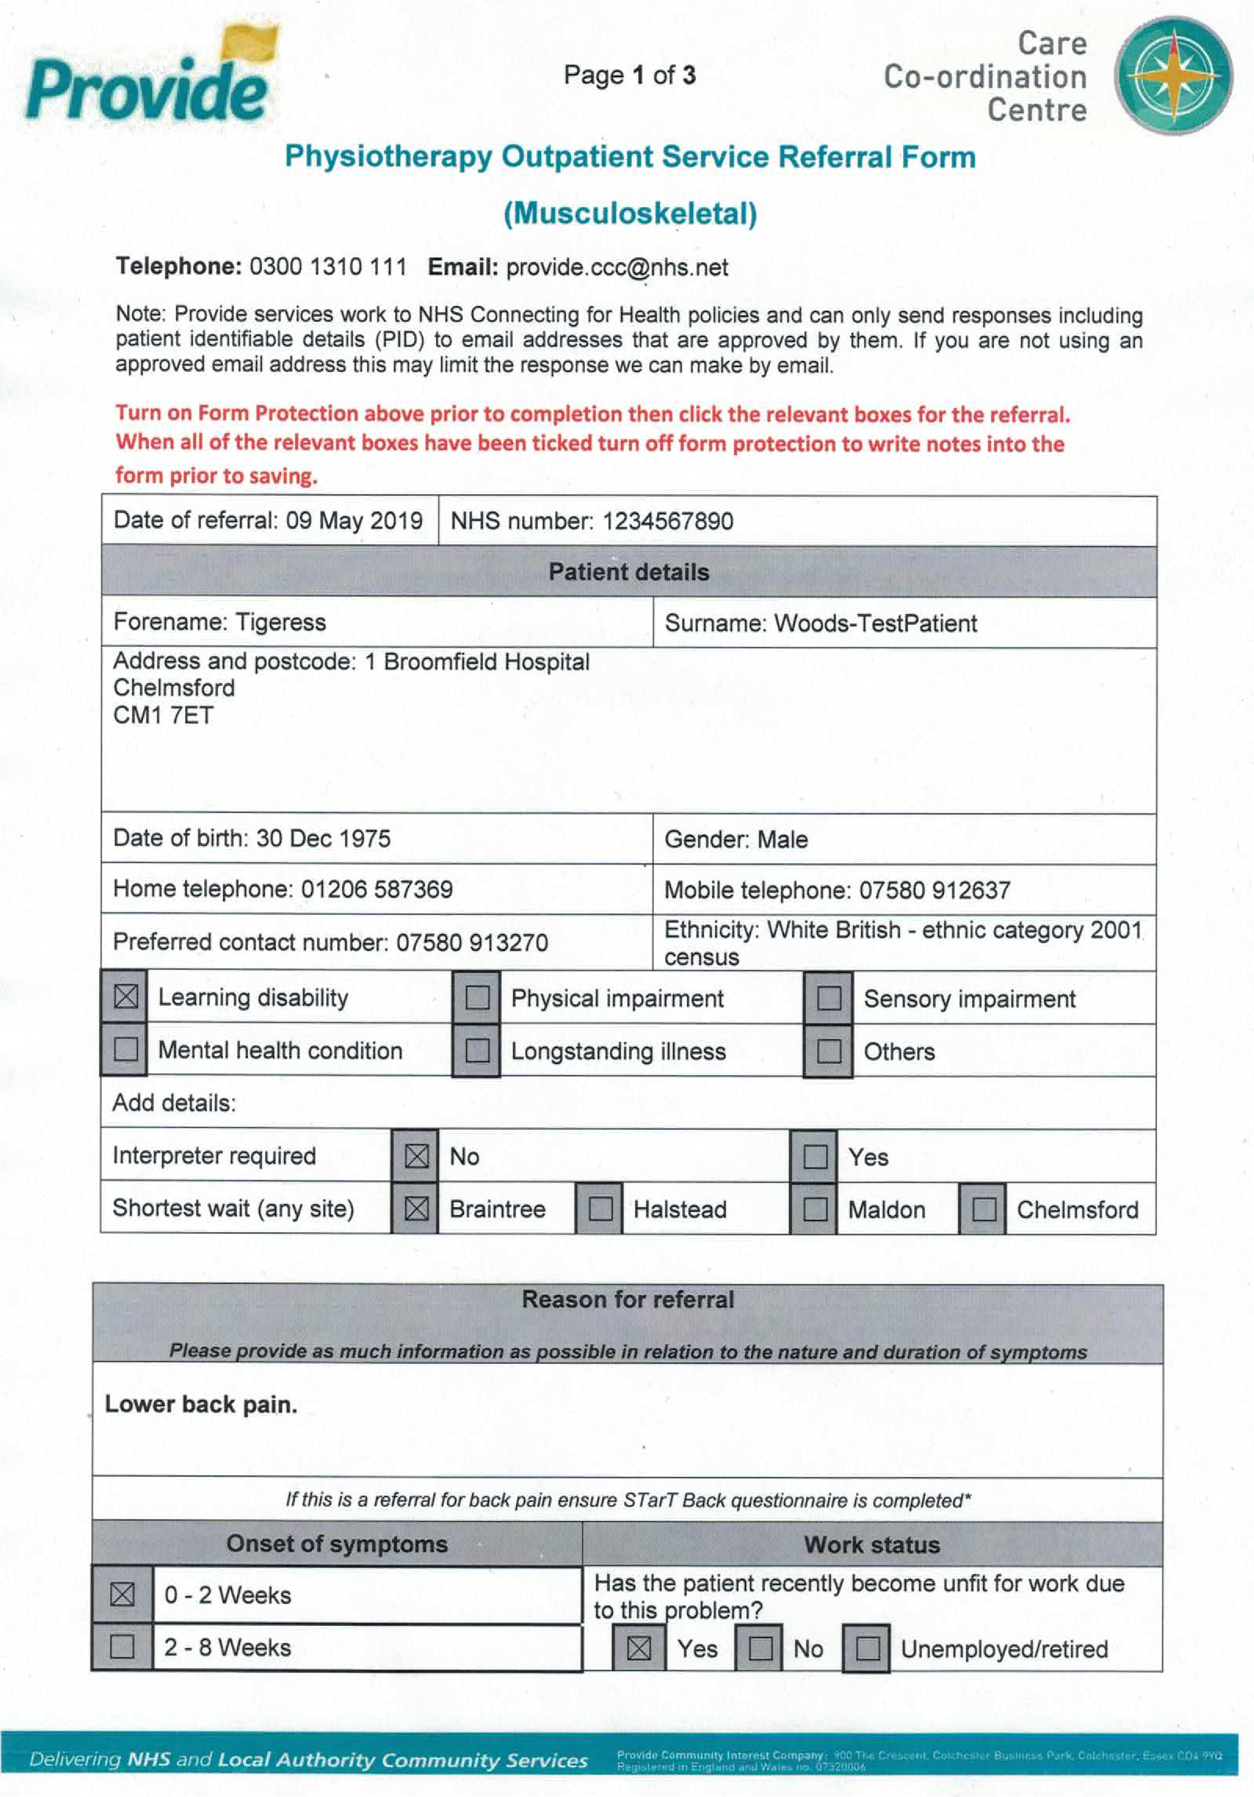

Slide 7
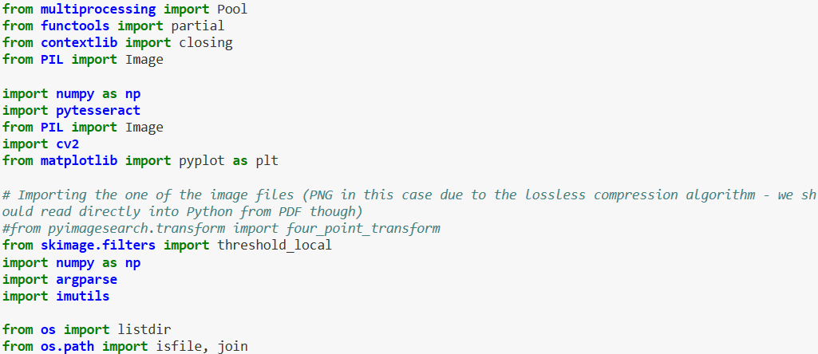
Task 3 & 4
https://github.com/ryancier/Rovers/blob/master/jn/Contoures.ipynb

Slide 8
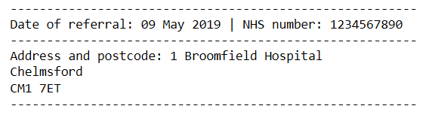
Future Work
Finalise the procedure for identifying and reading the check boxes.
From each text field read, the database entry should be identified and stored correctly (solvable with a set of if-statements
Cross check the procedure with more forms to test the stability

Slide 9
Conclusion
The goal:
To monitor a dedicated email address and download all attachments
To identify and read the text fields inside a medical form for Provide internal purposes
To store the collected information in a Database to automate procedures related to medical referrals.
Results:
The task was mostly completed and we feel with a longer time period a more robust solution could be delivered.

Slide 10
Thank you!
More information and code available on our GitHub: https://github.com/ryancier/Rovers

