Slide 1

Javascript
A brief introduction

Slide 2


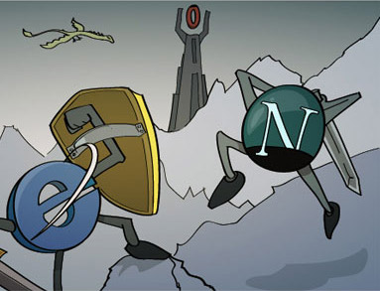
history
Brendan Eich
America heads online: 1995
Java, Netscape Mocha, and Douglas Crockford
Notes:
https://medium.com/@benastontweet/lesson-1a-the-history-of-javascript-8c1ce3bffb17

Slide 3
Info
Object Oriented
Functional
Problems
Engine based language

Slide 4

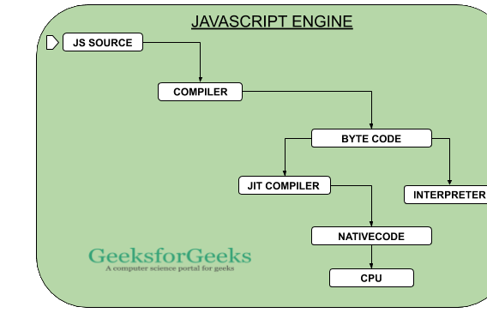
Classification
“make web pages alive”
Object Oriented & Functional
Programs or “scripts” run inside a web page
Executed as plain text (no compiler required to run)
Browser has a JavaScript virtual machine or “engine”
“Safe” programming language
Notes:
https://javascript.info/intro
https://www.geeksforgeeks.org/functional-programming-paradigm/

Slide 5
Cool… but what does it do?
Webpage manipulation
Interaction with user
Interaction with webserver
Ex: Change HTML elements, React to user actions, send network requests, cache data on client side

Slide 6
Implementation Issues
Different implementation of JavaScript in different browsers
Tried using browser sniffing
Gets the browser and uses that implementation of JavaScript
Was very error prone
Updates to browser would destroy browser sniffing code
Currently use the JQuery library
Compatible with the all browsers
Figure out implementation in the background
Notes:
https://developer.mozilla.org/en-US/docs/Learn/Tools_and_testing/Cross_browser_testing/JavaScript

Slide 7
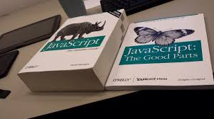
Design and Syntax Issues
Overloading of the + symbol
Used for addition
Used for concatenation
Automatic semi-colon insertion
Will insert semi-colons at the end of a line if not detected
Causes some line to have semi-colons even if they shouldn't
To many reserved words
Can't name variables as freely
Notes:
https://www.crockford.com/javascript/javascript.html

Slide 8
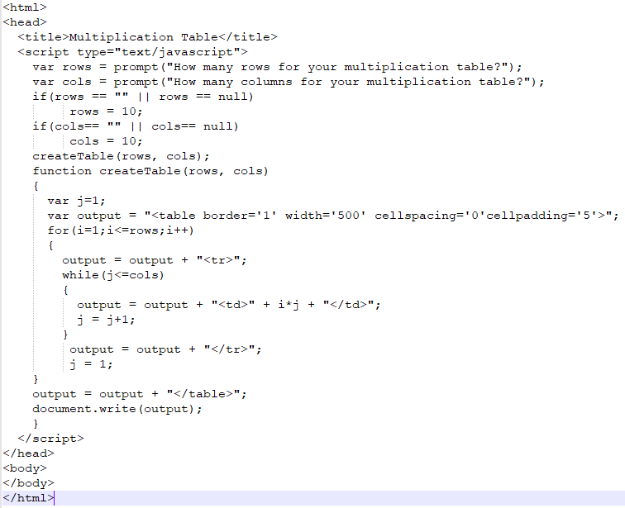
Notes:
https://www.guru99.com/practical-code-examples-using-javascript.html

Slide 9
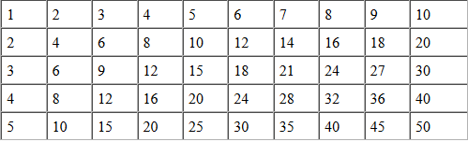
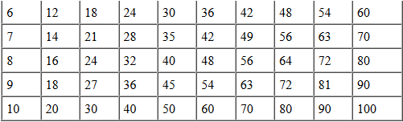

Slide 10
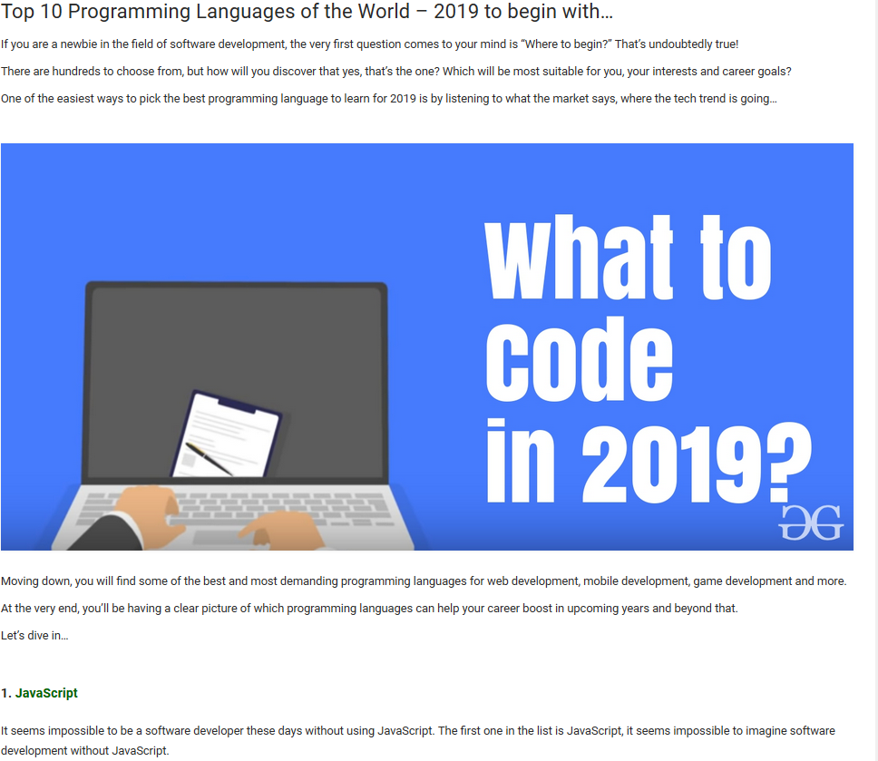
Notes:
https://www.geeksforgeeks.org/top-10-programming-languages-of-the-world-2019-to-begin-with/

Slide 11
Does it work?
Frequently used for interactive web pages
Can be used Front end and back end of webpage
Compatible with all major browsers
Notes:
https://medium.com/javascript-non-grata/the-top-10-things-wrong-with-javascript-58f440d6b3d8

Slide 12
General Everyday use
Code is abused
Poorly written and distributed – especially in libraries
Major compatibility allows for coding and learning by many individuals

