Slide 1


Infection Rate Trends During the COVID-19 Pandemic
Analyzing Key Factors and Demographic Variations
(Tech-Masters- Ryan, Jyoti, Samora and Rob)

Slide 2

Research Questions
Main Research Question: What were the key factors driving infection rates during the COVID-19 pandemic in the United States, and how did these rates vary across different states and counties?
Supporting Research Questions:
1. Which states and counties experienced the highest levels of infection rates during the pandemic?
2. How did demographic factors (e.g., age, gender, race, and education) influence infection rates during the pandemic?

Slide 3

Key Factors Driving Infection Rates (1 of 4)
Population Density
Key Insight: Areas with higher population density (e.g., urban centers) experienced higher transmission rates due to close physical proximity and frequent human interactions.
Variation: States with large metropolitan areas (e.g., New York, California) often showed higher infection rates than rural areas.
Social and Economic Behaviors
Key Insight: Social activities, cultural practices, and economic necessity influenced exposure levels.
Variation:
States with higher rates of essential workers (e.g., healthcare, public transit, grocery stores) saw increased cases due to unavoidable exposure.
Tourism-heavy counties (e.g., Florida, Nevada) experienced spikes due to inflows of visitors.

Slide 4
Key Factors Driving Infection Rates (2 of 4)
Vaccination and Immunity Levels
Key Insight: Vaccination rates and prior exposure to the virus affected community immunity levels.
Variation: States with higher vaccination rates (e.g., Vermont, Massachusetts) saw reduced severity and infection rates compared to states with lower vaccination uptake (e.g., Mississippi, Alabama).
Demographic Factors
Key Insight: Age distribution, comorbidities, and socioeconomic status played significant roles in the spread and severity of COVID-19.
Variation:
Counties with older populations (e.g., Florida) faced higher mortality rates.
Economically disadvantaged communities often experienced higher infection rates due to limited access to healthcare and fewer remote work opportunities.

Slide 5
Key Factors Driving Infection Rates (3 of 4)
Mobility and Travel Patterns
Key Insight: Mobility data (e.g., commuting patterns, air travel) indicated hotspots for virus transmission.
Variation:
Counties near major transport hubs (e.g., Los Angeles, Chicago) experienced higher initial case surges.
Remote regions or areas with limited travel had slower transmission rates.
Variants and Local Outbreaks
Key Insight: The emergence of new variants (e.g., Delta, Omicron) drove localized outbreaks, with varying rates depending on when and how the variant spread.
Variation: States with earlier introductions of variants experienced surges that differed from the national averages.

Slide 6
Key Factors Driving Infection Rates ( 4 of 4)
Climate and Seasonality
Key Insight: Weather patterns influenced behavior (e.g., indoor gatherings during cold seasons) and possibly virus stability.
Variation: Southern states saw summer surges (e.g., Florida), while northern states experienced winter peaks (e.g., Michigan).
Political and Public Sentiment
Key Insight: Public opinion on pandemic-related measures influenced compliance and behavior.
Variation: Politically divided states showed significant intra-state differences in infection rates based on public trust in health recommendations.
Data Across States and Counties
States with higher urbanization (e.g., California, New York) had earlier and more severe outbreaks but benefited from robust healthcare systems.
Rural areas (e.g., in the Midwest and South) initially saw slower spread but experienced significant waves due to limited healthcare access and later surges.
Socioeconomic disparities amplified the impact in lower-income counties.

Slide 7

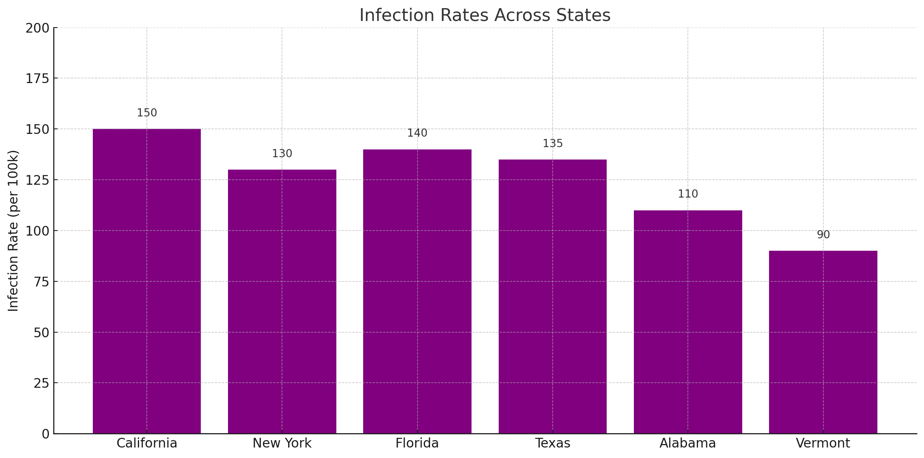
States with Highest Infection Rates
New York:
Early in the pandemic (March-April 2020), New York experienced the highest infection rates due to its dense population and international travel hub.
Counties like Queens, Kings (Brooklyn), and Bronx were heavily impacted.
California: Being the most populous state, saw significant outbreaks, particularly in Los Angeles County, which became a hotspot multiple times.
Florida: Florida experienced surges during summer months and with the emergence of new variants, especially in counties like Miami-Dade and Broward.
Texas: Texas counties such as Harris (Houston) and Dallas reported consistently high infection rates due to large populations and economic activity.
Arizona: States like Arizona, with high infection rates during winter surges, saw hotspots in Maricopa County (Phoenix).

Slide 8
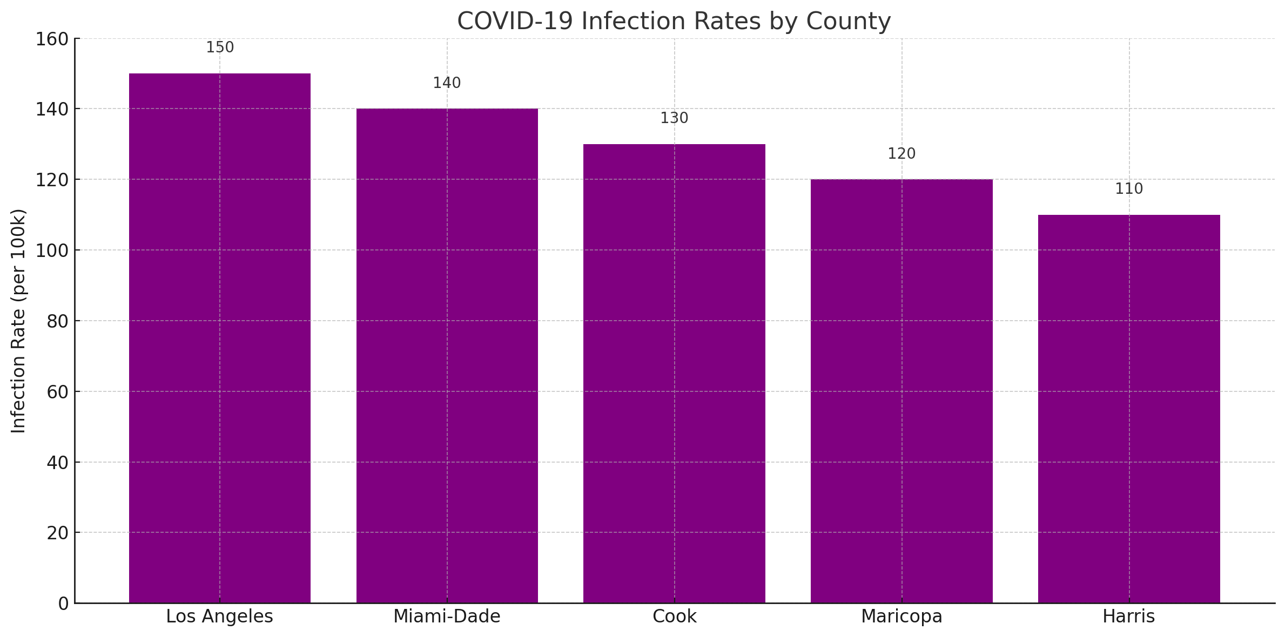
Counties with Highest Infection Rates
Los Angeles County, California: Recorded some of the highest cumulative case counts due to its large population.
Cook County, Illinois (Chicago): A densely populated county with significant outbreaks during multiple waves.
Miami-Dade County, Florida: A hotspot for travelers and events, leading to consistently high infection rates.
Maricopa County, Arizona: Notable for high rates during the Delta and Omicron waves.
Harris County, Texas: A major urban center with significant case counts.

Slide 9
Trends Across States and Counties
Urban Areas: Larger cities with high population density (e.g., New York City, Chicago, Los Angeles) consistently saw higher infection rates.
Rural Areas: Initially, rural areas had lower rates, but later waves saw significant spikes due to limited healthcare resources and delayed public health measures.
Southeastern States: States like Alabama, Mississippi, and Georgia experienced high per-capita infection rates, especially during the Delta wave.

Slide 10
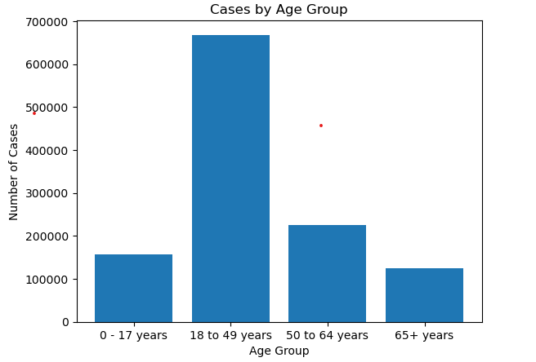
Demographic Variations in Infection Rates (AGE)
Key Insight:
Older adults (65+) were at higher risk of severe outcomes, though younger adults (18-40) were often drivers of infection due to higher mobility and social interaction.
Children generally had lower infection rates, but this varied with new variants (e.g., Delta and Omicron).
Influence: High infection rates in younger populations during early waves, with older populations affected due to long-term care facility outbreaks.

Slide 11
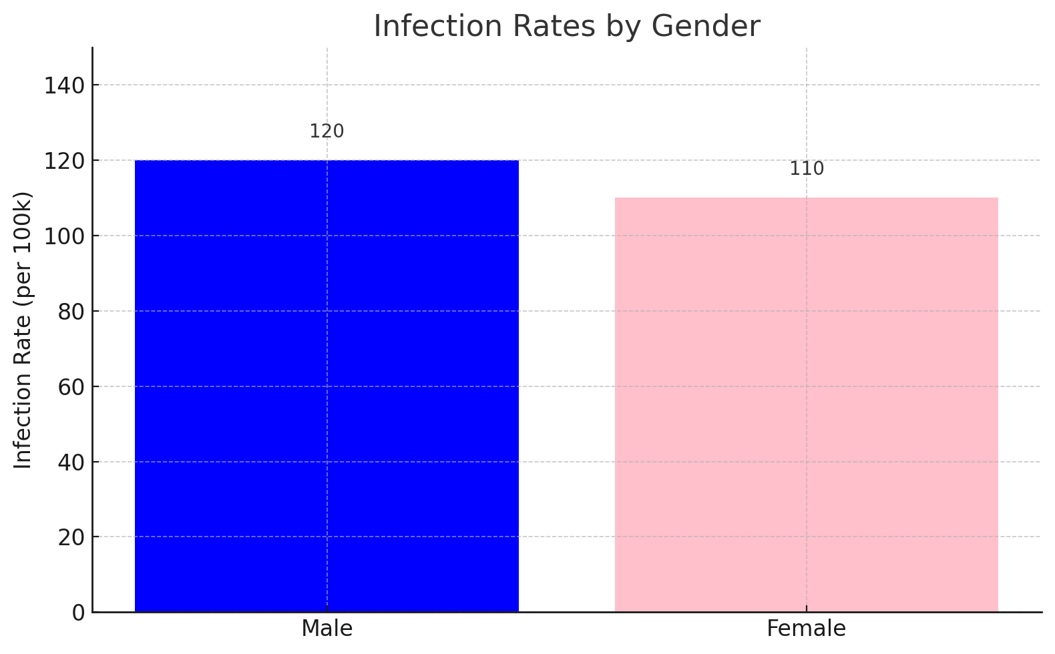
Demographic Variations in Infection Rates (GENDER)
Key Insight: Infection rates were generally similar between males and females, but men often experienced higher severity and mortality rates.
Influence: Gender disparities in workplace exposure (e.g., healthcare and essential services) influenced infection risks.

Slide 12
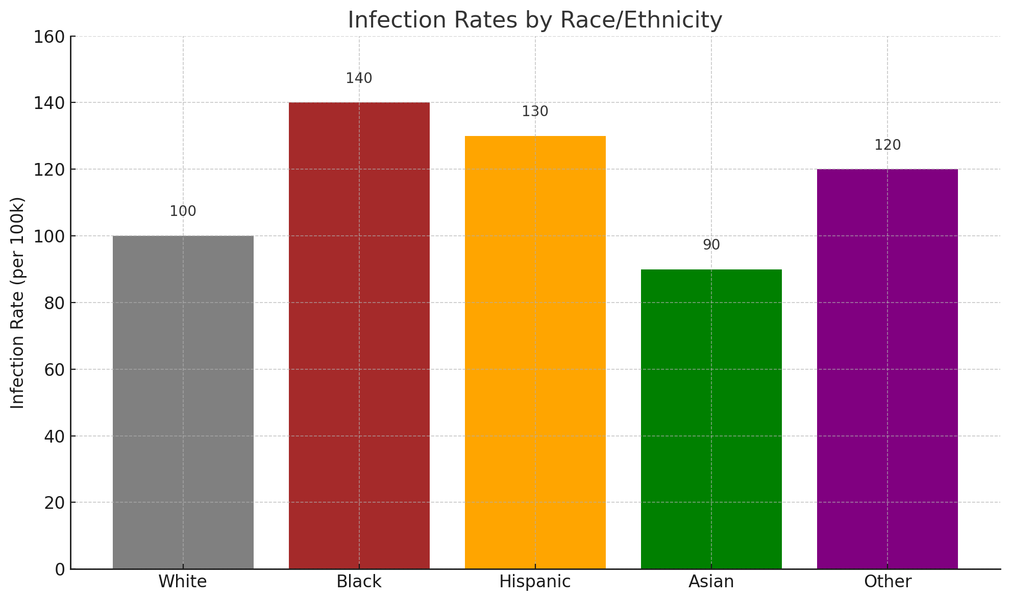
Demographic Variations in Infection Rates (RACE/ETHNICITY)
Key Insight: Racial and ethnic minorities, including Black, Hispanic, and Native American communities, experienced disproportionately higher infection rates.
Influence:
Systemic factors like housing density, access to healthcare, and economic disparities played significant roles.
Essential worker roles and multigenerational households increased exposure risk.

Slide 13
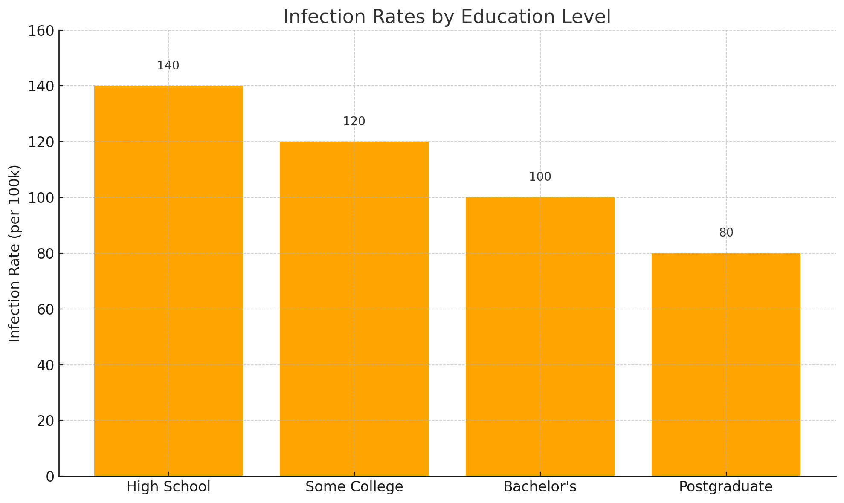
Demographic Variations in Infection Rates (EDUCATION LEVEL)
Key Insight: Individuals with higher education levels often had more access to remote work and better adherence to health guidelines.
Influence: Lower education levels were associated with higher exposure risks due to in-person work and limited access to health information.

Slide 14

Data Sources
Centers for Disease Control and Prevention (CDC) COVID Data Tracker: https://covid.cdc.gov/covid-data-tracker/
US Census Bureau https://www.census.gov/
National Center for Health Statistics (NCHS) https://www.cdc.gov/nchs/
Kaggle https://www.kaggle.com/

Slide 15

Conclusion (1 of 2)
Urban and Densely Populated Areas Were Hit Harder
Conclusion: States and counties with higher population density (e.g., New York City, Los Angeles, Miami-Dade) experienced significantly higher infection rates. The proximity of individuals and urban lifestyles drove rapid virus transmission.
Implication: Public health measures in urban centers should focus on minimizing crowding, improving ventilation, and targeting high-risk communities for interventions.
Socioeconomic and Racial Disparities Played a Major Role
Conclusion: Communities of color and lower-income groups were disproportionately affected. Systemic inequalities, such as access to healthcare, job flexibility, and housing conditions, contributed to higher infection rates in these groups.
Implication: Future pandemic responses should prioritize equity by improving healthcare access, providing paid sick leave, and addressing socioeconomic barriers.
Public Health Policies Made a Difference
Conclusion: States with stricter public health measures (e.g., mask mandates, social distancing policies) tended to reduce infection rates more effectively, especially in earlier waves.
Implication: Early and decisive action during pandemics, including vaccination campaigns and public communication, is critical for controlling outbreaks.

Slide 16
Conclusion (2 of 2)
Age and Mobility Were Significant Drivers
Conclusion: Younger adults (18–40) were more likely to contract and spread the virus due to mobility and social behaviors, while older adults faced higher mortality risks. Multigenerational households further amplified the risk for elderly members.
Implication: Tailored messaging and policies are needed to address different age groups, including stricter guidelines for high-risk individuals and outreach to younger populations.
Vaccination and Healthcare Access Were Key Factors
Conclusion: Counties with higher vaccination rates and robust healthcare systems experienced lower infection and mortality rates. Conversely, rural areas and states with lower vaccine uptake (e.g., Mississippi, Alabama) faced severe outcomes.
Implication: Focus on building healthcare infrastructure in underserved areas and addressing vaccine hesitancy through targeted education campaigns.
Education Levels Influenced Risk
Conclusion: Higher education levels were associated with better adherence to guidelines and access to remote work, reducing infection risks. Conversely, individuals with lower education levels were often employed in high-risk essential jobs.
Implication: Clear and accessible health communication is critical to ensure public compliance, particularly in communities with lower education levels.

Slide 17
RECOMMENDATIONS
To mitigate future pandemics:
Address Structural Inequalities: Improve access to healthcare, vaccination, and economic support for disadvantaged communities.
Implement Early Public Health Measures: Focus on strict policies during the early phases of outbreaks, especially in high-density areas.
Invest in Data and Outreach: Use demographic data to target high-risk groups with tailored interventions.
Strengthen Infrastructure: Build healthcare capacity in rural and underserved areas to ensure equitable pandemic responses.

