Slide 1
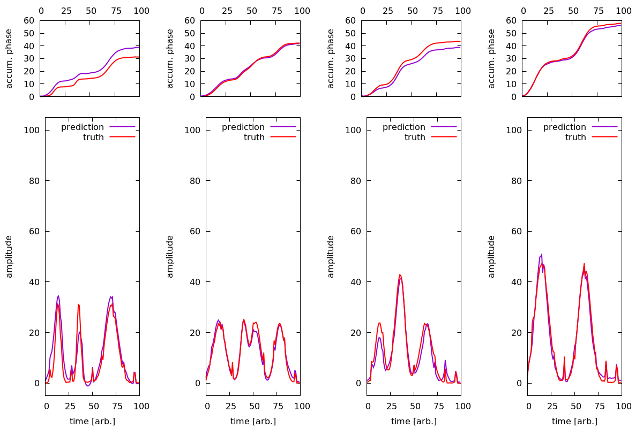

Machine Learning for X-ray Pulse Retrieval
Scientific Achievement
Machine Learning Inference Engine for reconstructing x-ray time-energy distribution.
Significance and Impact
FPGA-based inferencing will allow a pipelined data throughput for x-ray pulse reconstruction used in streaming data routing and veto decisions at LCLS-II(-HE)
Research Details
  Simulation based on measured waveforms in an under-sampling regime
  Demonstrates efficacy for a moderately deep convolutional neural network
  Next steps: shallower models, modularization with top layers compiled to the Xilinx Kintex KU115 FPGA in digitizer carrier card, Kernel Density Estimation for opposing versus 90 degree separated detectors.
Reconstructed pulses for a feed forward convolution neural network with input simulations based on measured instrument response functions.
Work was performed at the LCLS with the help of PULSE and TID with close integration into L2SI data systems efforts.
Notes:
HL Type: User___, Staff___, User & Staff___
1-2 paragraph description of highlight
Insert a ~ 200 word description of the highlight here.
Collaborating Institutions
Funding Overview Section (check all relevant sources)
BES Funding: MSED___, CSGB___, EFRC___, SUFD___
SC Funding: ASCR___, BES___, BER___, FES___, HEP___, NP___, WDTS___, SBIR___, etc.
Other Funding: DOD___, DOE___, NIH___, NSF___, etc.
Funding details for all sources:
Publication/ press releases/ related links:

