Slide 1
Project Title: Enabling long wavelength streaking for attosecond x-ray science
PI(s): Ryan N Coffee
Institution: SLAC National Accelerator Laboratory
Collaborations: LCLS, AD, L2SI, PULSE, DESY, XFEL, Stanford CS
Begin Date: 9/2018
End Date: 9/2020
Presenter Name: Ryan N Coffee

Slide 2
Project goals and accomplishments
Major goals:
Install eToF array on LCLS(-II) and benchmark time-energy resolution by end of Run 18 (Nov-Dec 2020)
Attosecond Streaking demonstration with streaming pulse reconstruction
Accomplishments:
Initial DESY tests for MCP depletion
Upgraded digitizers on order
Designed Detector Flange assembly and first two units in fabrication
Test set of small pore MCPs on order
Oversize ML model works well at 25 e-/angle/shot
Docker containers with Vivado HLS and spatial-lang for FPGA development
1) On schedule for hardware and electronics.
2) Slightly ahead of schedule for simulations and machine learning development.
3) On schedule for FPGA deployment.
Machine Learning successfully predicts x-ray temporal shape

Slide 3
Outline
Angular Streaking and the “CookieBox”
Machine Learning
Integrative Design
Engineering and Project coordination

Slide 4
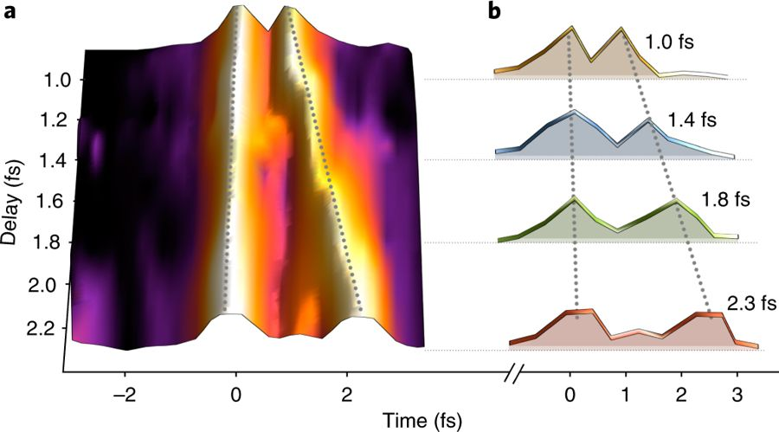
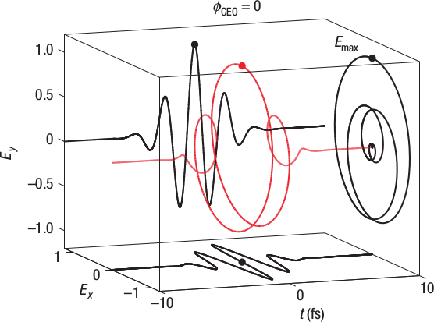
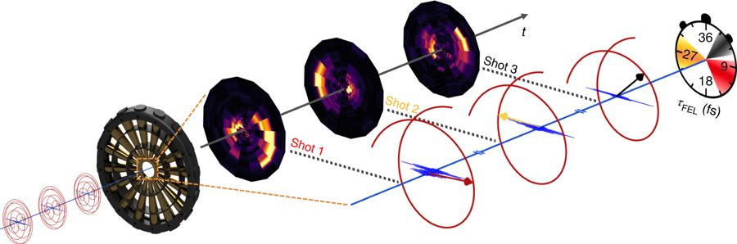
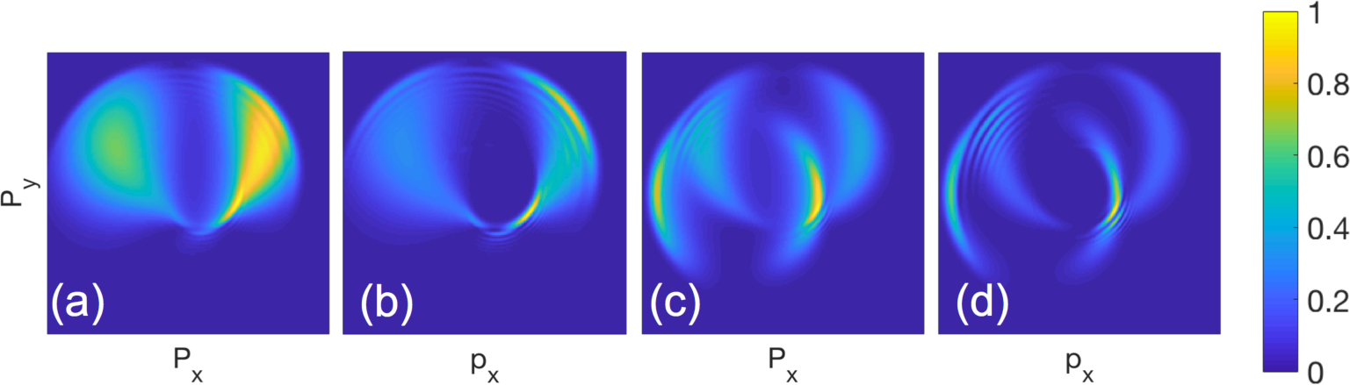
Attosecond Angular Streaking
Eckle et al., Nat. Phys. 4 565 (2008)
Li et al., Opt. Exp.26 4531 (2018)
Hartmann et al., Nat. Photon. 12 215 (2018)

Slide 5
Constraints
¼ eV over 50 eV window
Interleaved retardation
At least 8 angle samples (16 ideal)
Prefer >1e-3 collection
Single shot pulse recovery at beam rate
Latency for veto/sort decisions below 1ms
Schweizer et al., App. Sci. 8 1039 (2018)

Slide 6
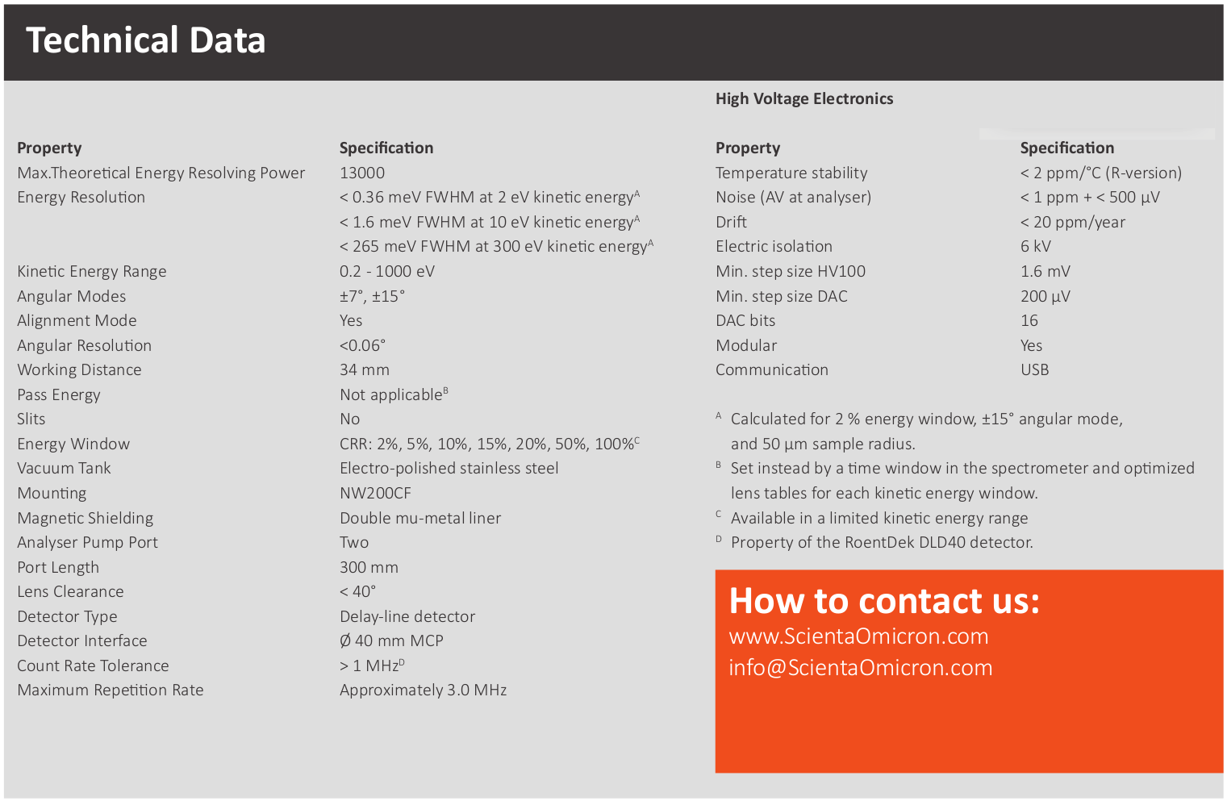
Why not ARTOF2?
Need 250 meV resolution over a 50 eV window with keV electrons
Energy spectrum in single pulse each angle
Analysis with ms scale latency for data routing and veto

Slide 7
MCP waveform measurements
Tests in Dec-18 / Jan-19
50 GSps scope
25 GHz BWD
Keep the electronics above 5GHz

Slide 8
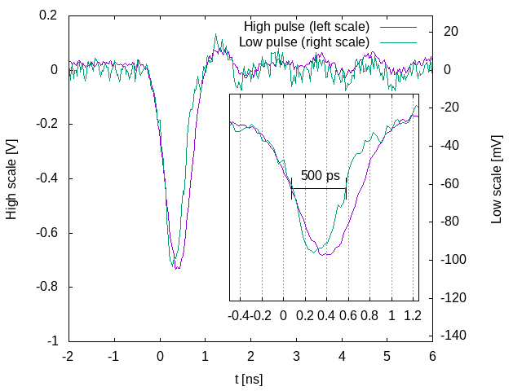
MCP waveform measurements
Tests in Dec-18 / Jan-19
50 GSps scope
25 GHz BWD
Keep the electronics above 5GHz
We’re going to hate gain in the end

Slide 9
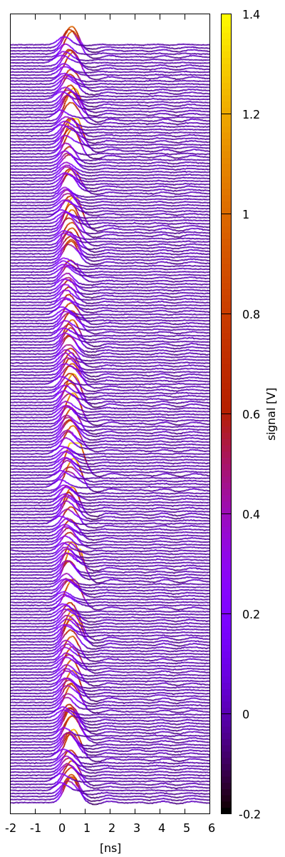
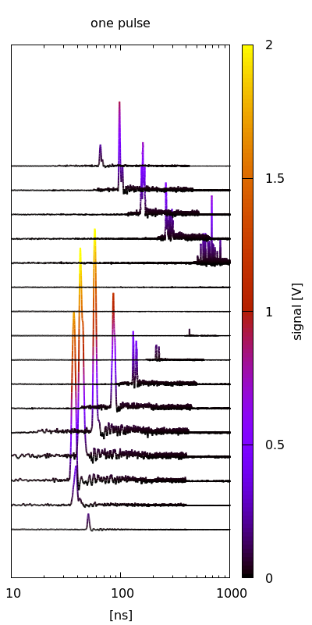
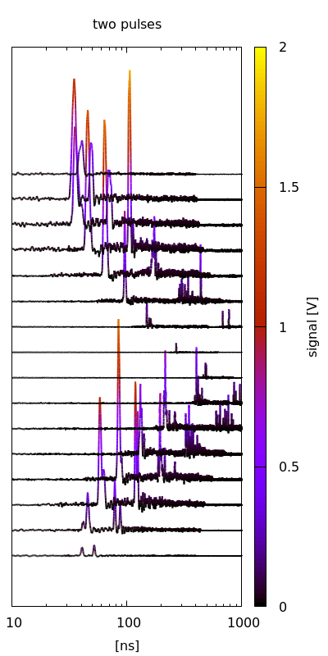
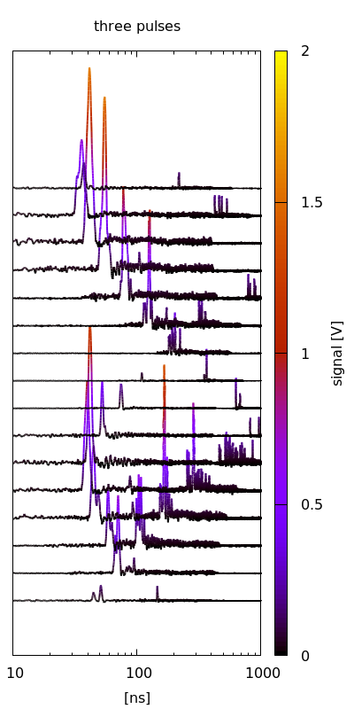
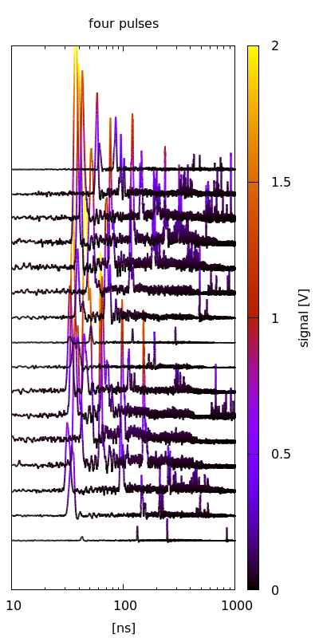
Measurement based Simulations

Slide 10
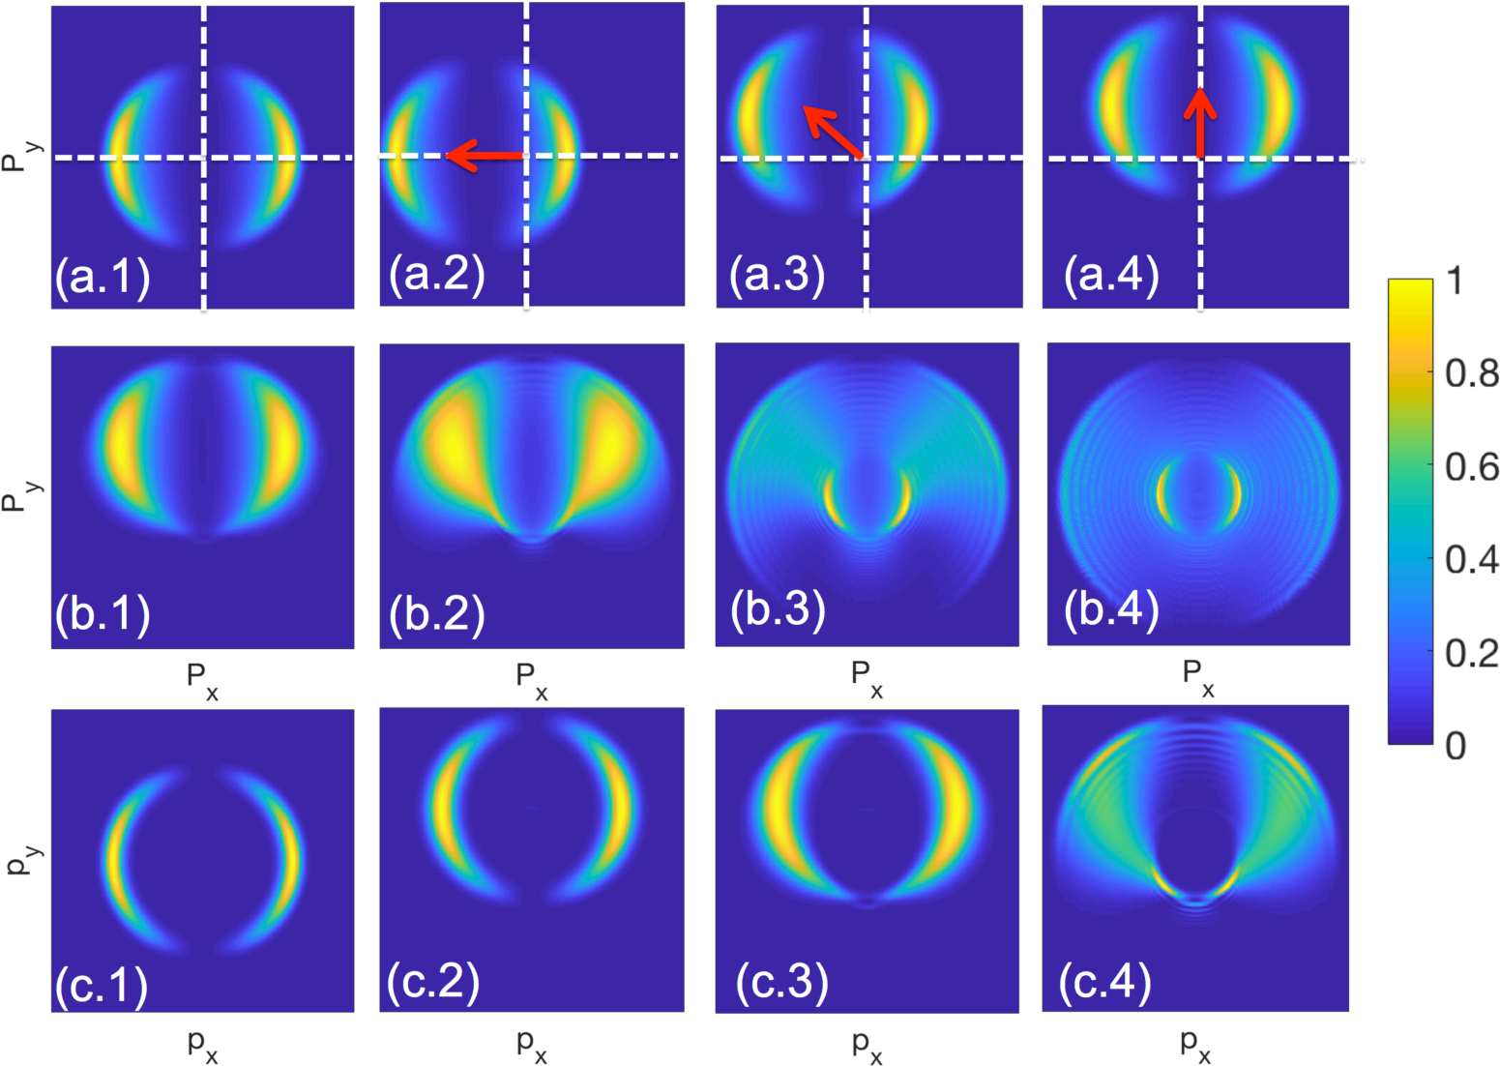
Machine Learning results
Compute the momentum distribution from Angular streaking simulation [1]
Sample the momentum space PDF
Convolve with measured impulse response
Feed temporal waveforms as if nX16 image
Li et al., Opt. Exp. 26 4531 (2018)

Slide 11
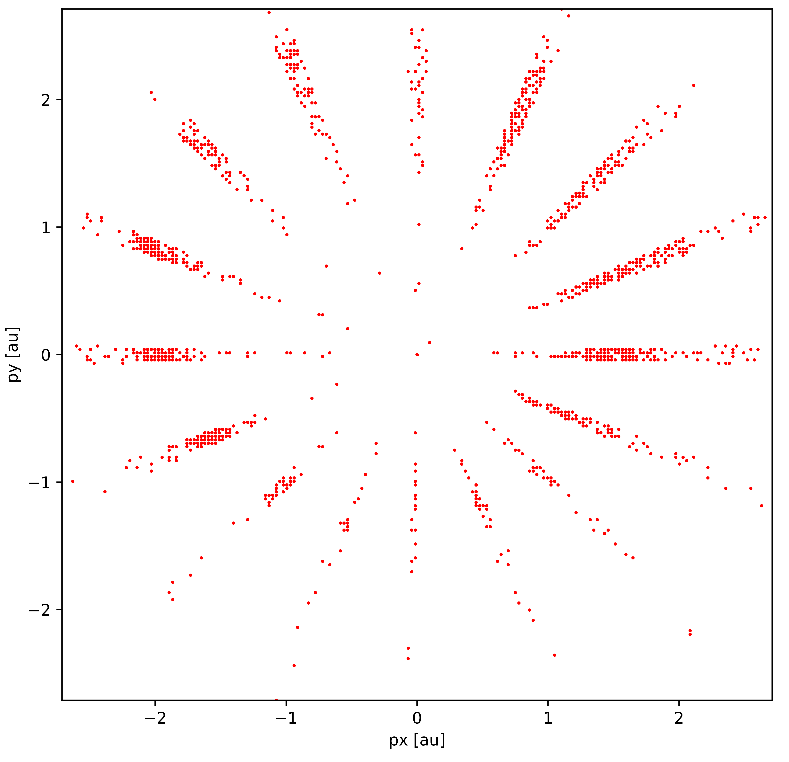
Machine Learning Results
Compute the momentum distribution from Angular streaking simulation
Sample the momentum space PDF
Convolve with measured impulse response
Feed temporal waveforms as if nX16 image

Slide 12
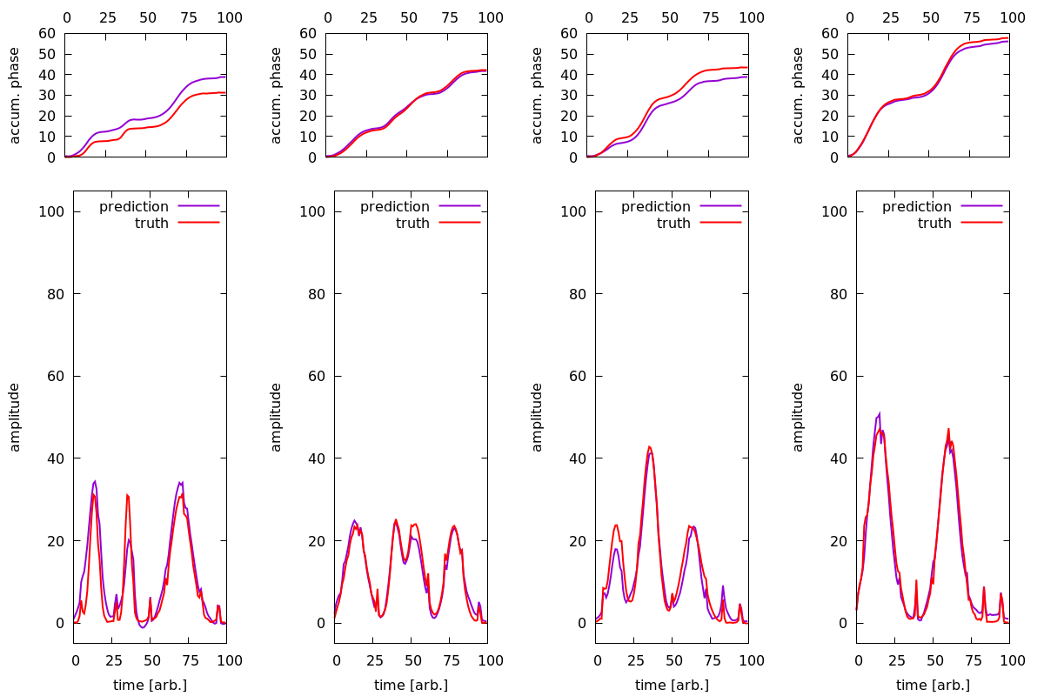
Machine Learning Results
Promising initial results for Machine Learning inference based on ~50 e-/shot
At ~12 e-/shot retrieval is challenging
Look into adaptive Kernel Density Estimation

Slide 13
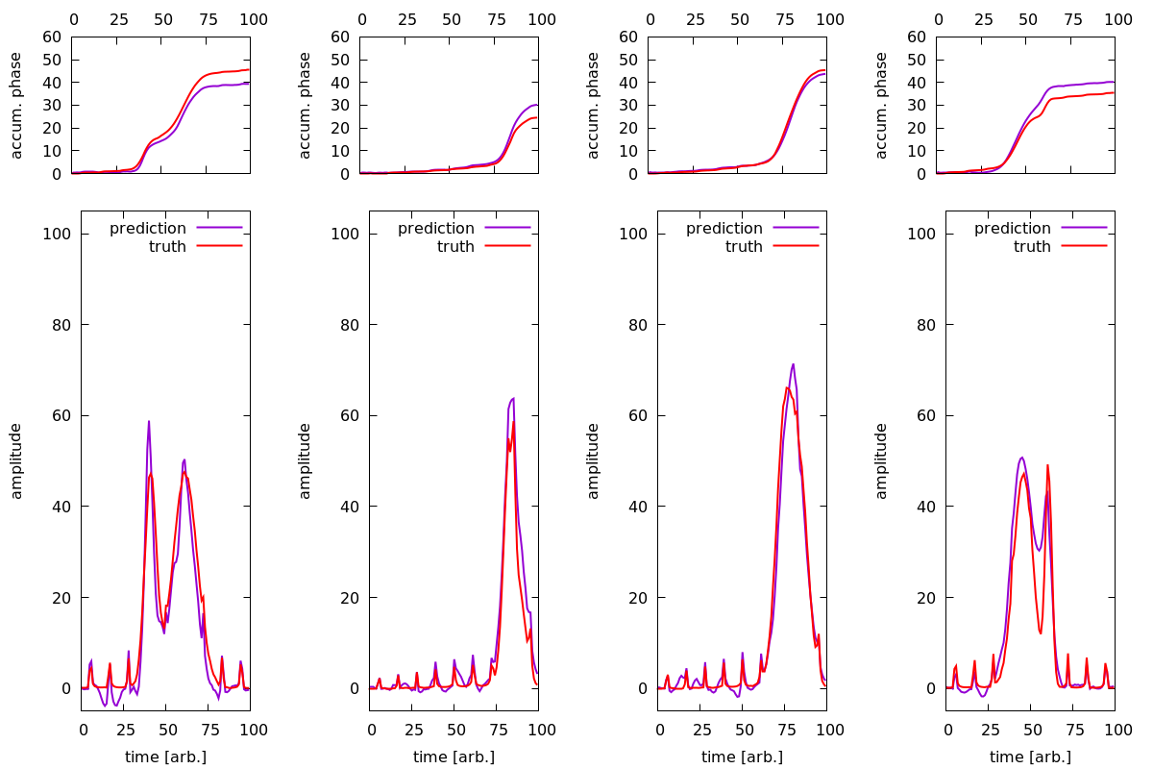
Machine Learning Results
Promising initial results for Machine Learning inference based on ~50 e-/shot
At ~12 e-/shot retrieval is challenging
Look into adaptive Kernel Density Estimation

Slide 14
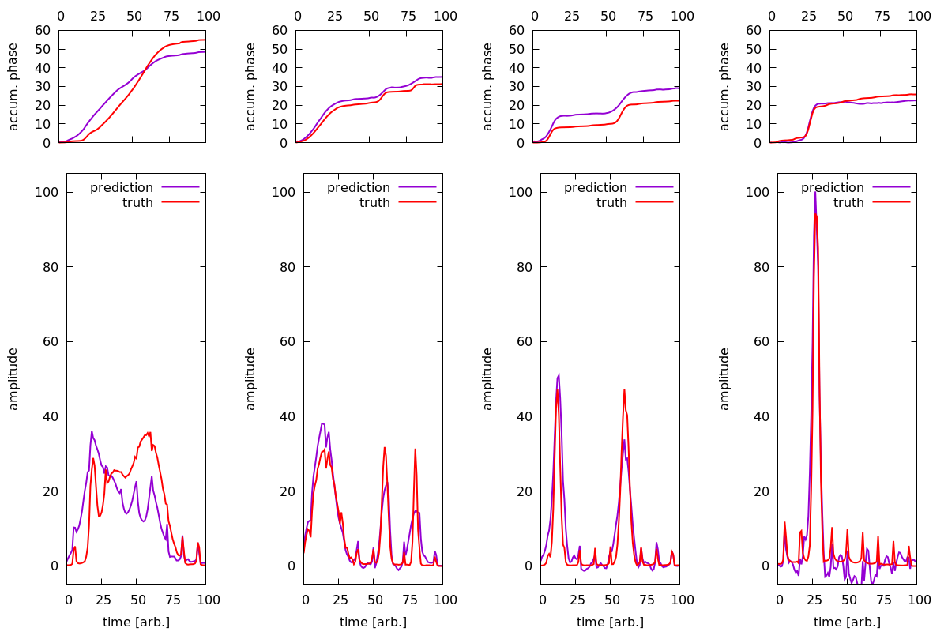
Machine Learning Results
Promising initial results for Machine Learning inference based on ~50 e-/shot
At ~12 e-/shot retrieval is challenging
Look into adaptive Kernel Density Estimation

Slide 15
MCP Depletion Study
FLASH beamtime ran Hamamatsu F9890-31 MCPs at 50 counts/shot with 1MHz bunch train (600 μsec duration)
Depletion of signal from 1V to 100mV by the end of the bunch train
Based on the Hamamatsu , we have ordered two model F9890-32 MCPs to test with PULSE EUV source and then with the Tavella High rep-rate source in neighboring lab.

Slide 16
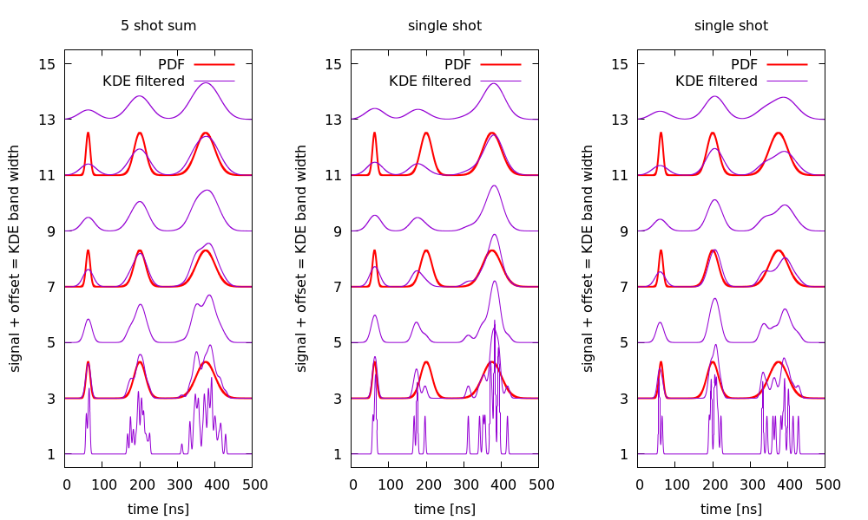
Kernel Density Estimation
Applied Physics student Debadri Das
Kernel shapes vary across the waveform
Not a typical CNN modality
Benefit by constraining center at this stage – motivates 2 channels into initial FPGA
Expand resources on FPGA

Slide 17
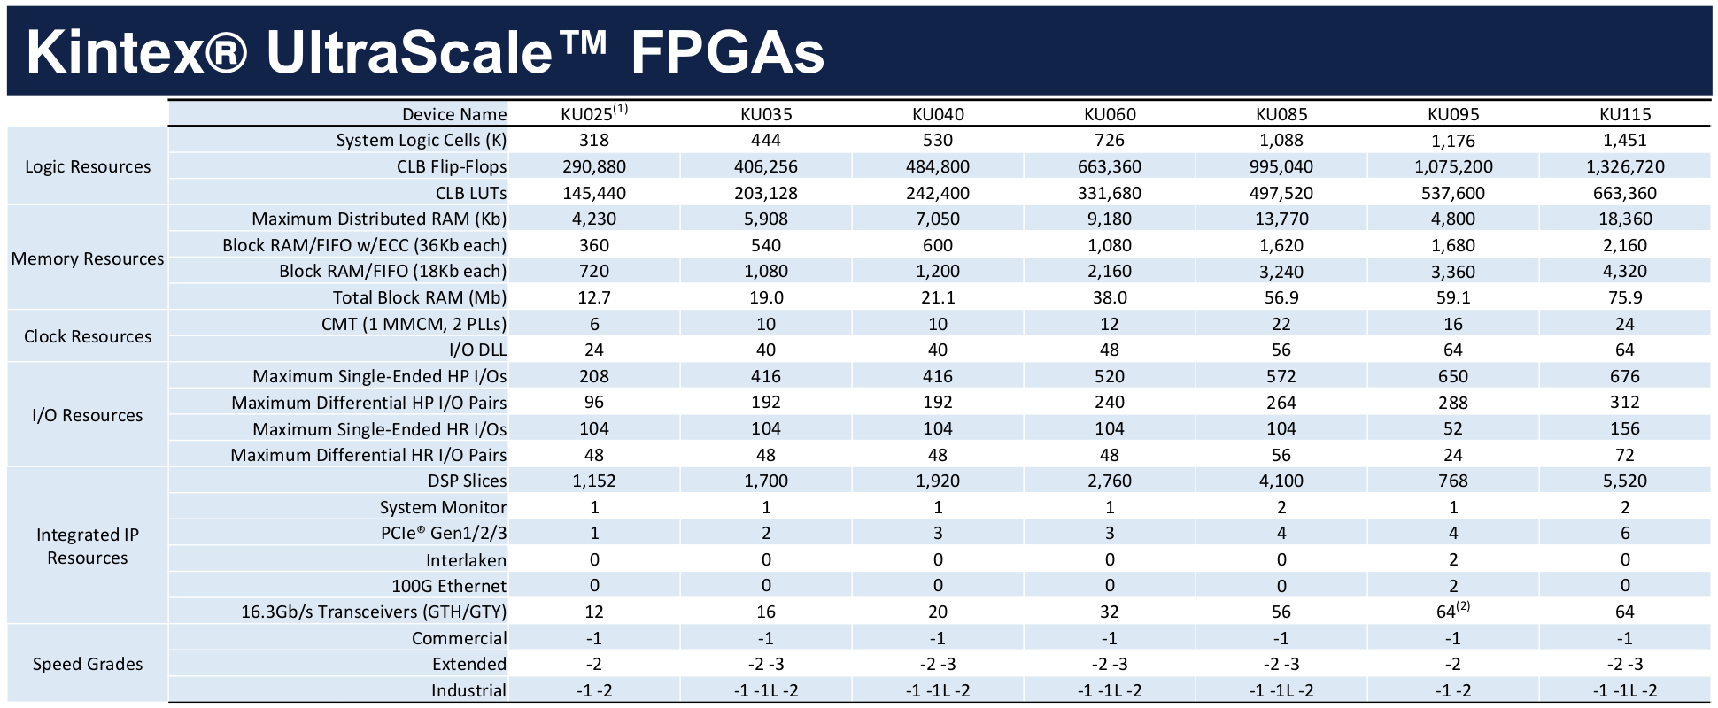
Kernel Density Estimation
Applied Physics student Debadri Das
Kernel shapes vary across the waveform
Not a typical CNN modality
Benefit by constrianing center at this stage – motivates 2 channels into initial FPGA
Expand resources on FPGA

Slide 18
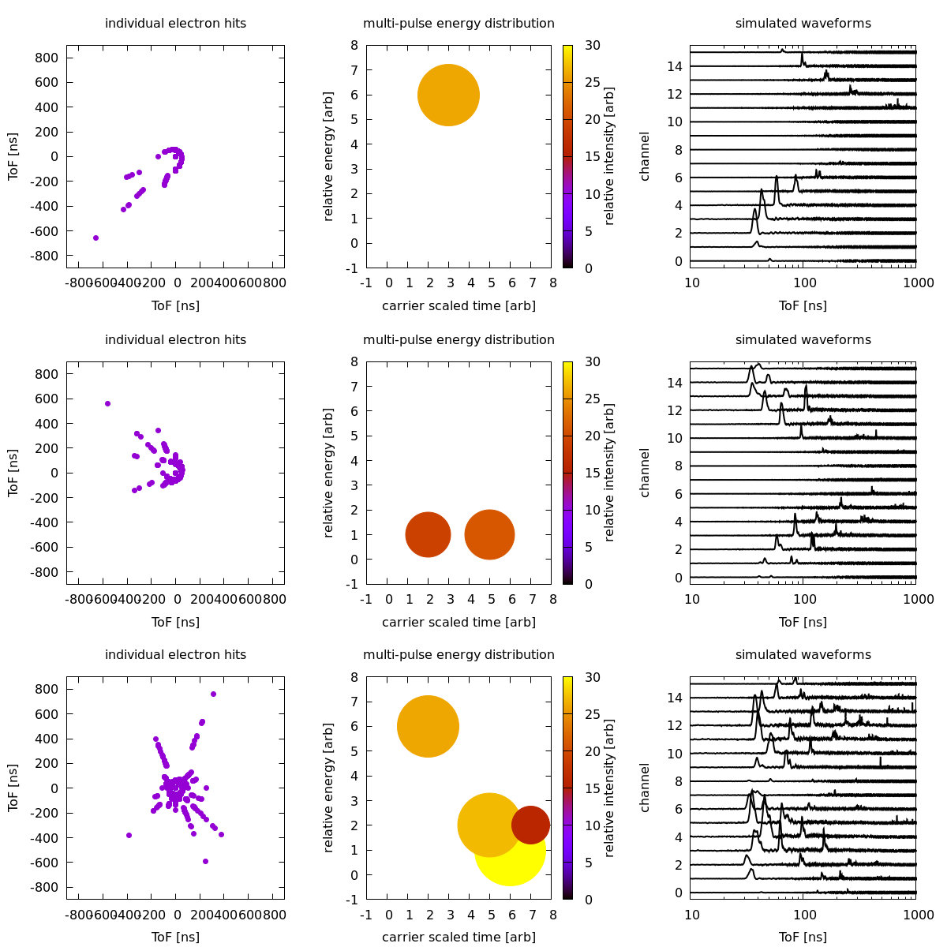
Alternative is Recurrent Neural Network
Hidden state evolves to final answer after processing sub-strings
Like processing sentences
Same word, different meanings depending on placement in the sentence string
16 sentences define an angular streaking measurement
Sentiment analysis of the 16 sentences uncovers ‘one-pulse’ or ‘delay-at-same-energy’, etc.

Slide 19
EdgeML LDRD + new TID-AIR LDRD
Co-leading and leveraging lab EdgeML initiative
Building industry partners
Defining a sharable development environment container image
Based on industry compatible development tools

Slide 20
Co-design principle
From MCP pore diameter to “Heavy Edge” machine learning
Integrative adaptation to sub-system shortcomings, e.g. MCP depletion, ToF collection, KDE on FPGA
Targeting a streaming decision maker diagnostic for data routing and veto in LCLS-II

Slide 21
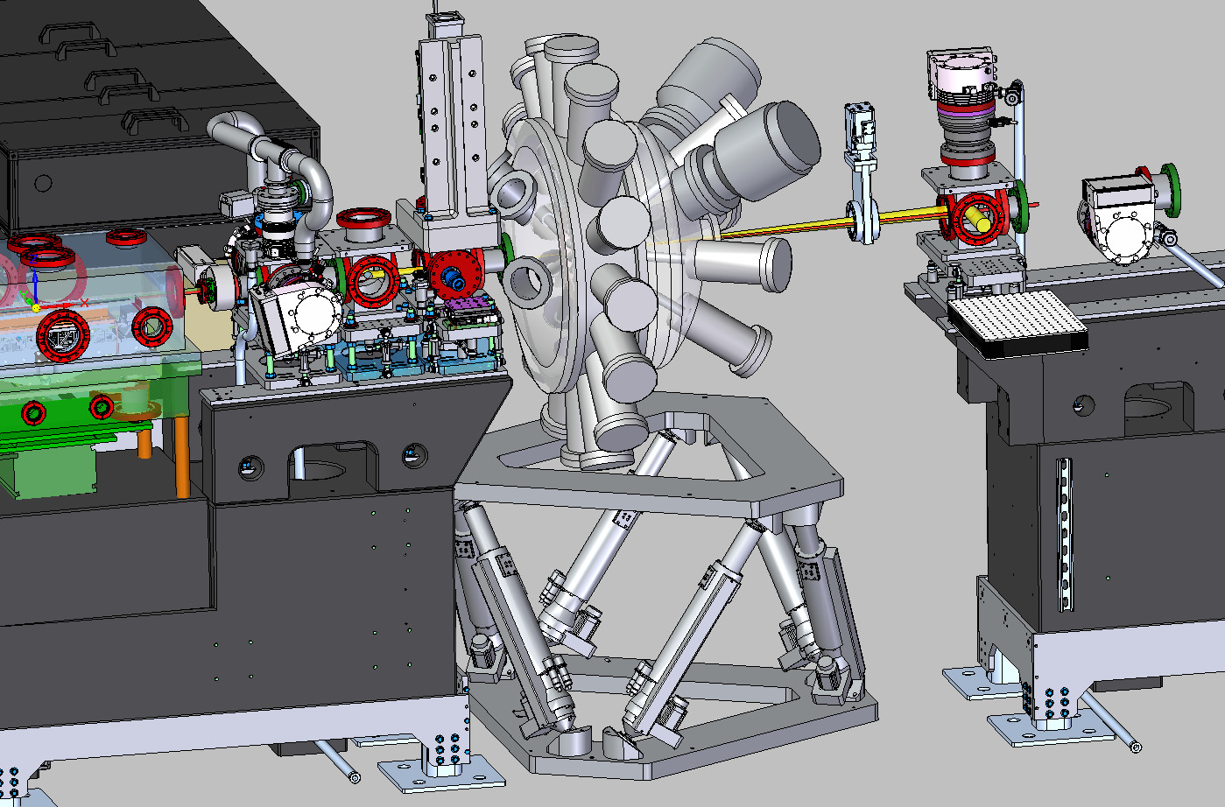
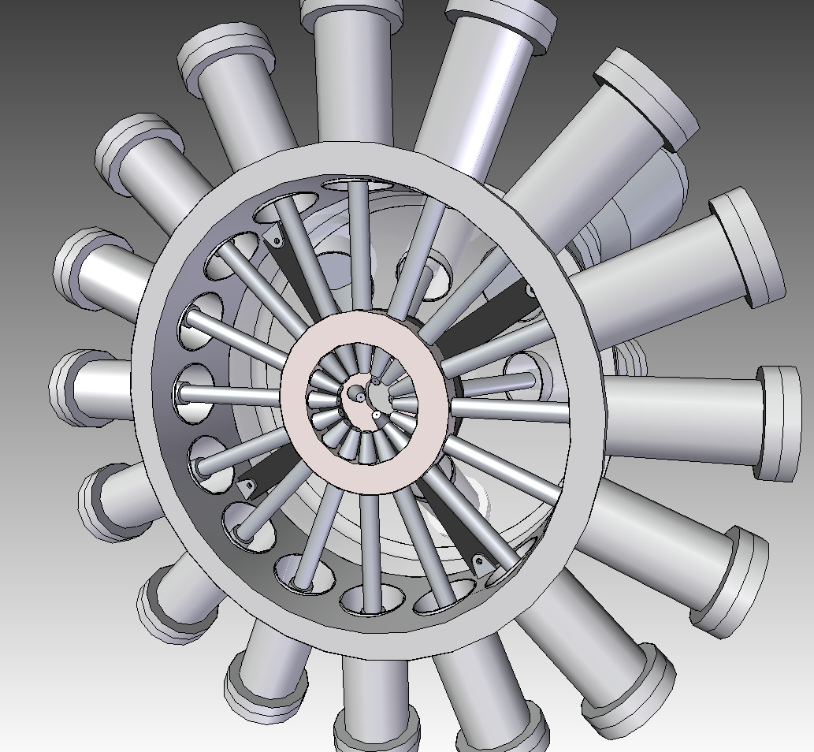
CookieBox Hutch Integration

Slide 22
Detector flange assembly
Standard 6” UHV flange and feed throughs
Custom parts in fabrication
1st of May arrival
40cm distance gives 3.5 10⁻³ collection / detector
Could increase resolution by extending flight tube
Design drawing courtesy of Taran Driver

Slide 23
Engineering Coordination Schedule
Phase | Task / Milestone | Description | Start date | Planned finish date | Actual finish date | Dependency | Comment
Phase I – FWP | 2 | Finalize R&D TOF design | Feb-19 | Jun-19 |  |  | Need Design Eng
 | 4 | Simulate reducing signal | Feb-19 | Jun-19 |  |  | Ongoing
 | 6 | Iterate Simulation and Eng. Design of R&D TOFs | Apr-19 | Jul-19 |  |  | Ongoing
 | 8 | Order 2 initial R&D TOFs | May-19 | Aug-19
 | 10 | Order 6 R&D TOFs | Sep-19 | Dec-19
 | 12 | Initial Digitizer arrival | Jan-19 | May-19
 | 14 | Other three digitizers | May-19 | Sept. 2019
 | 16 | Iterate Chamber Eng. Design | Jun-19 | Aug-19 |  |  | Need Design Eng
 | 18 | Order initial R&D MCP (2) | May-19 | Aug-19
 | 20 | Order full set of R&D MCPs (6) | Jul-19 | Nov. 2019
 | M1 | Prototype Chamber Final Design |  | Aug-19 |  | 16 | PEC for XIP
 | 22 | Order Prototype mu metal chamber | Sep-19 | Jan-20 |  | M1 | Lead time = 3-6 months
 | 24 | Assemble Prototype | Dec-19 | Feb. 2020 |  | M1, 22 | need 4-6 weeks
 | M2 | (Adjust) Final Design TMO version Chamber Design and make FDR |  | Feb. 2020 |  |  | XIP FDR
Phase II - XIP | 28 | Order Parts | Jan-20
 | 30 | Assemble | Jul-20
 | 32 | Test | Aug-20
 | 34 | Offline commissioning | Oct-20
 | M3 | RFI
 | 36 | Install MRCOFFE in TMO | Dec-20
 | M4 | TTO |  | Apr-21
 | M5 | Project closeout |  | Sept-21
L2SI coordination

Slide 24
Conclusions
~ ½ effort so far on ToF module design and simulation
  “Known” parts ordered for May/June tests in PULSE EUV lab
  Coordinating with L2SI to develop the final ToF and Chamber design by Sept-2019
~ ½ effort so far on matching detector electronics to pulse retrieval algorithm to support streaming analysis
  Quintessential “firehose” data source but required for ultralow latency decision making
  Design is informing also the data systems for LCLS-II
  ML requirements are presenting the upgrade path for PCDS Digitizer specifications
Very close cooperation with AD, L2SI, PCDS, PULSE, TID-AIR, and Stanford CS/EE

