Slide 1
EdgeML hardware
coPI: Ryan N Coffee
Institution: SLAC National Accelerator Laboratory
Collaborations: LCLS, DESY, XFEL, Stanford (CS/EE/Materials/ApPhys/Phys) , ANL, ORNL, NNSS, LANL
Private Sector Engagements: Red Hat, Enterprise Neurosystem, Cerebras, GraphCore, SambaNova, Nvidia, DeepMind, Google, Vision Research

Slide 2
SLAC EdgeML goals and accomplishments
Major goals:
Install both GPU an FPGA for EdgeAI inference bofore FY2022 startup
Framework for user models to FPGA that enables weights update without firmware update
Accomplishments:
Initial development of SLAC Neural-net Layers (SNL) implemented and shared on git (https://github.com/slaclab/snl.git)
Joint BES+ECE feature reduction (https://github.com/ryancoffee/edgeml_fes.git)
ConcurrentRT received software stack and shipment scheduled for end of month for validation for use in control system RedHawkOS at DIII-D
Firmware updated for remote push and removed from SLAC machine
Loan agreement between SLAC→GA and SLAC→ConcurrentRT in process
Hardware ready for shipment to DIII-D before end of November.

Slide 3
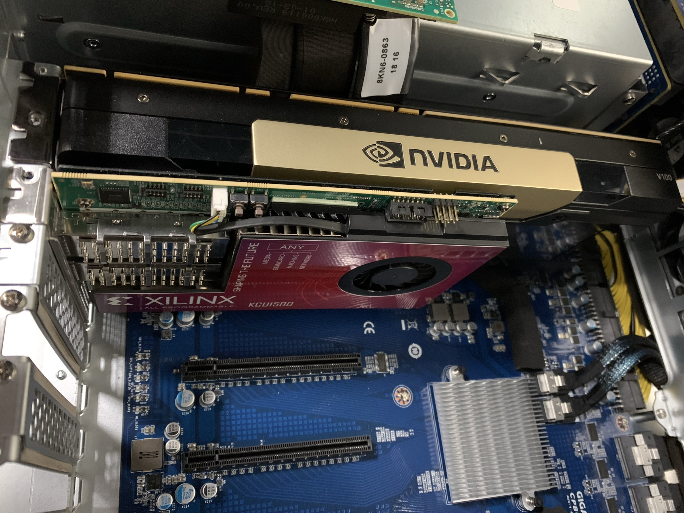
Hardware to DIII-D
Nvidia V100
  Only 30% performance loss compared to A100
  Supported by ConcurrentRT
Xilinx KCU1500
  Inference accelerator
  Replica with SLAC firmware is being shipped to ConcurrentRT this month for validation

Slide 4
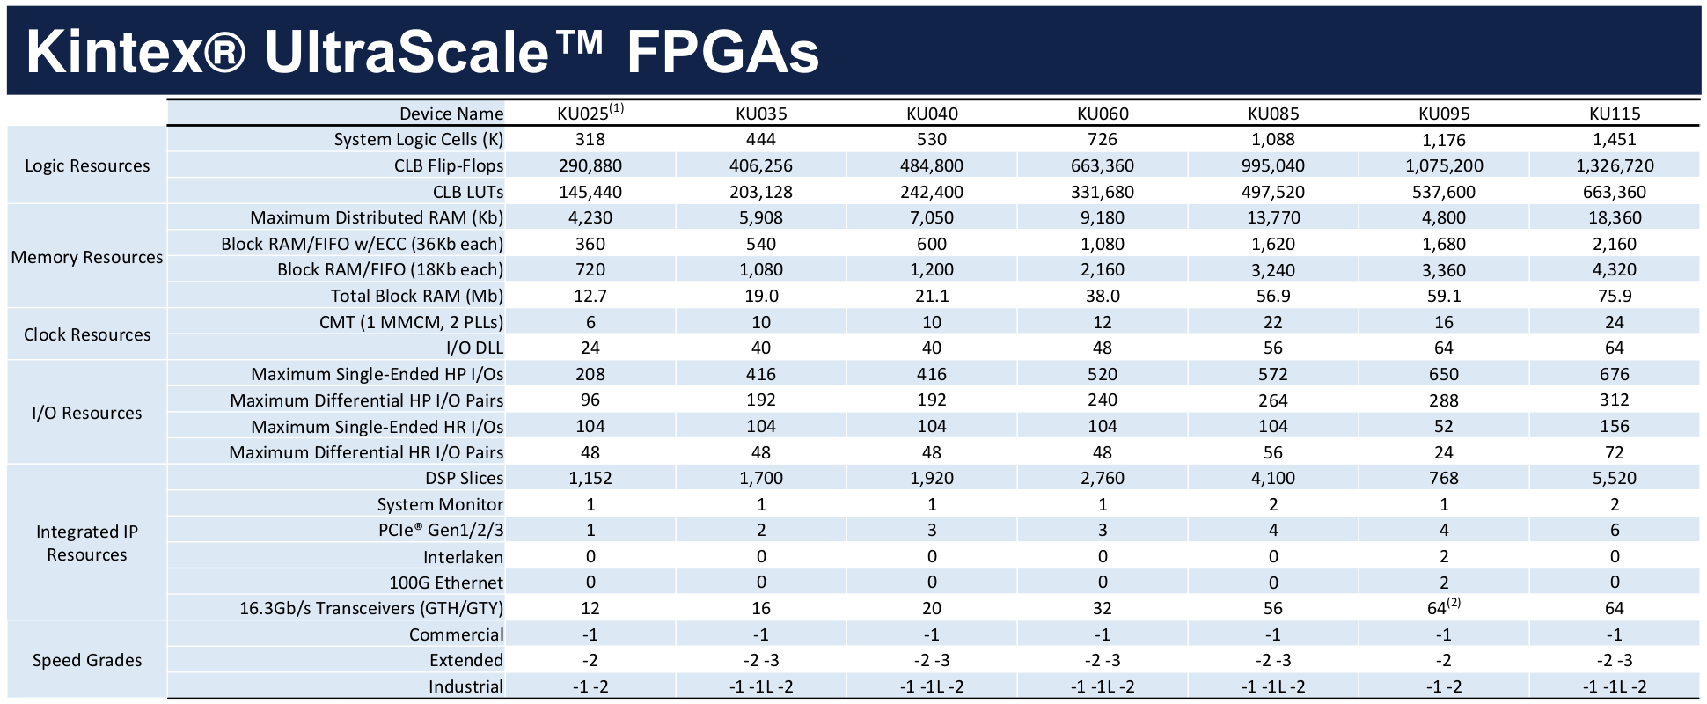
FPGA targeted by slaclab/snl
Applied Physics student Debadri Das
Kernel shapes vary across the waveform
Not a typical CNN modality
Benefit by constrianing center at this stage – motivates 2 channels into initial FPGA
Expand resources on FPGA

Slide 5
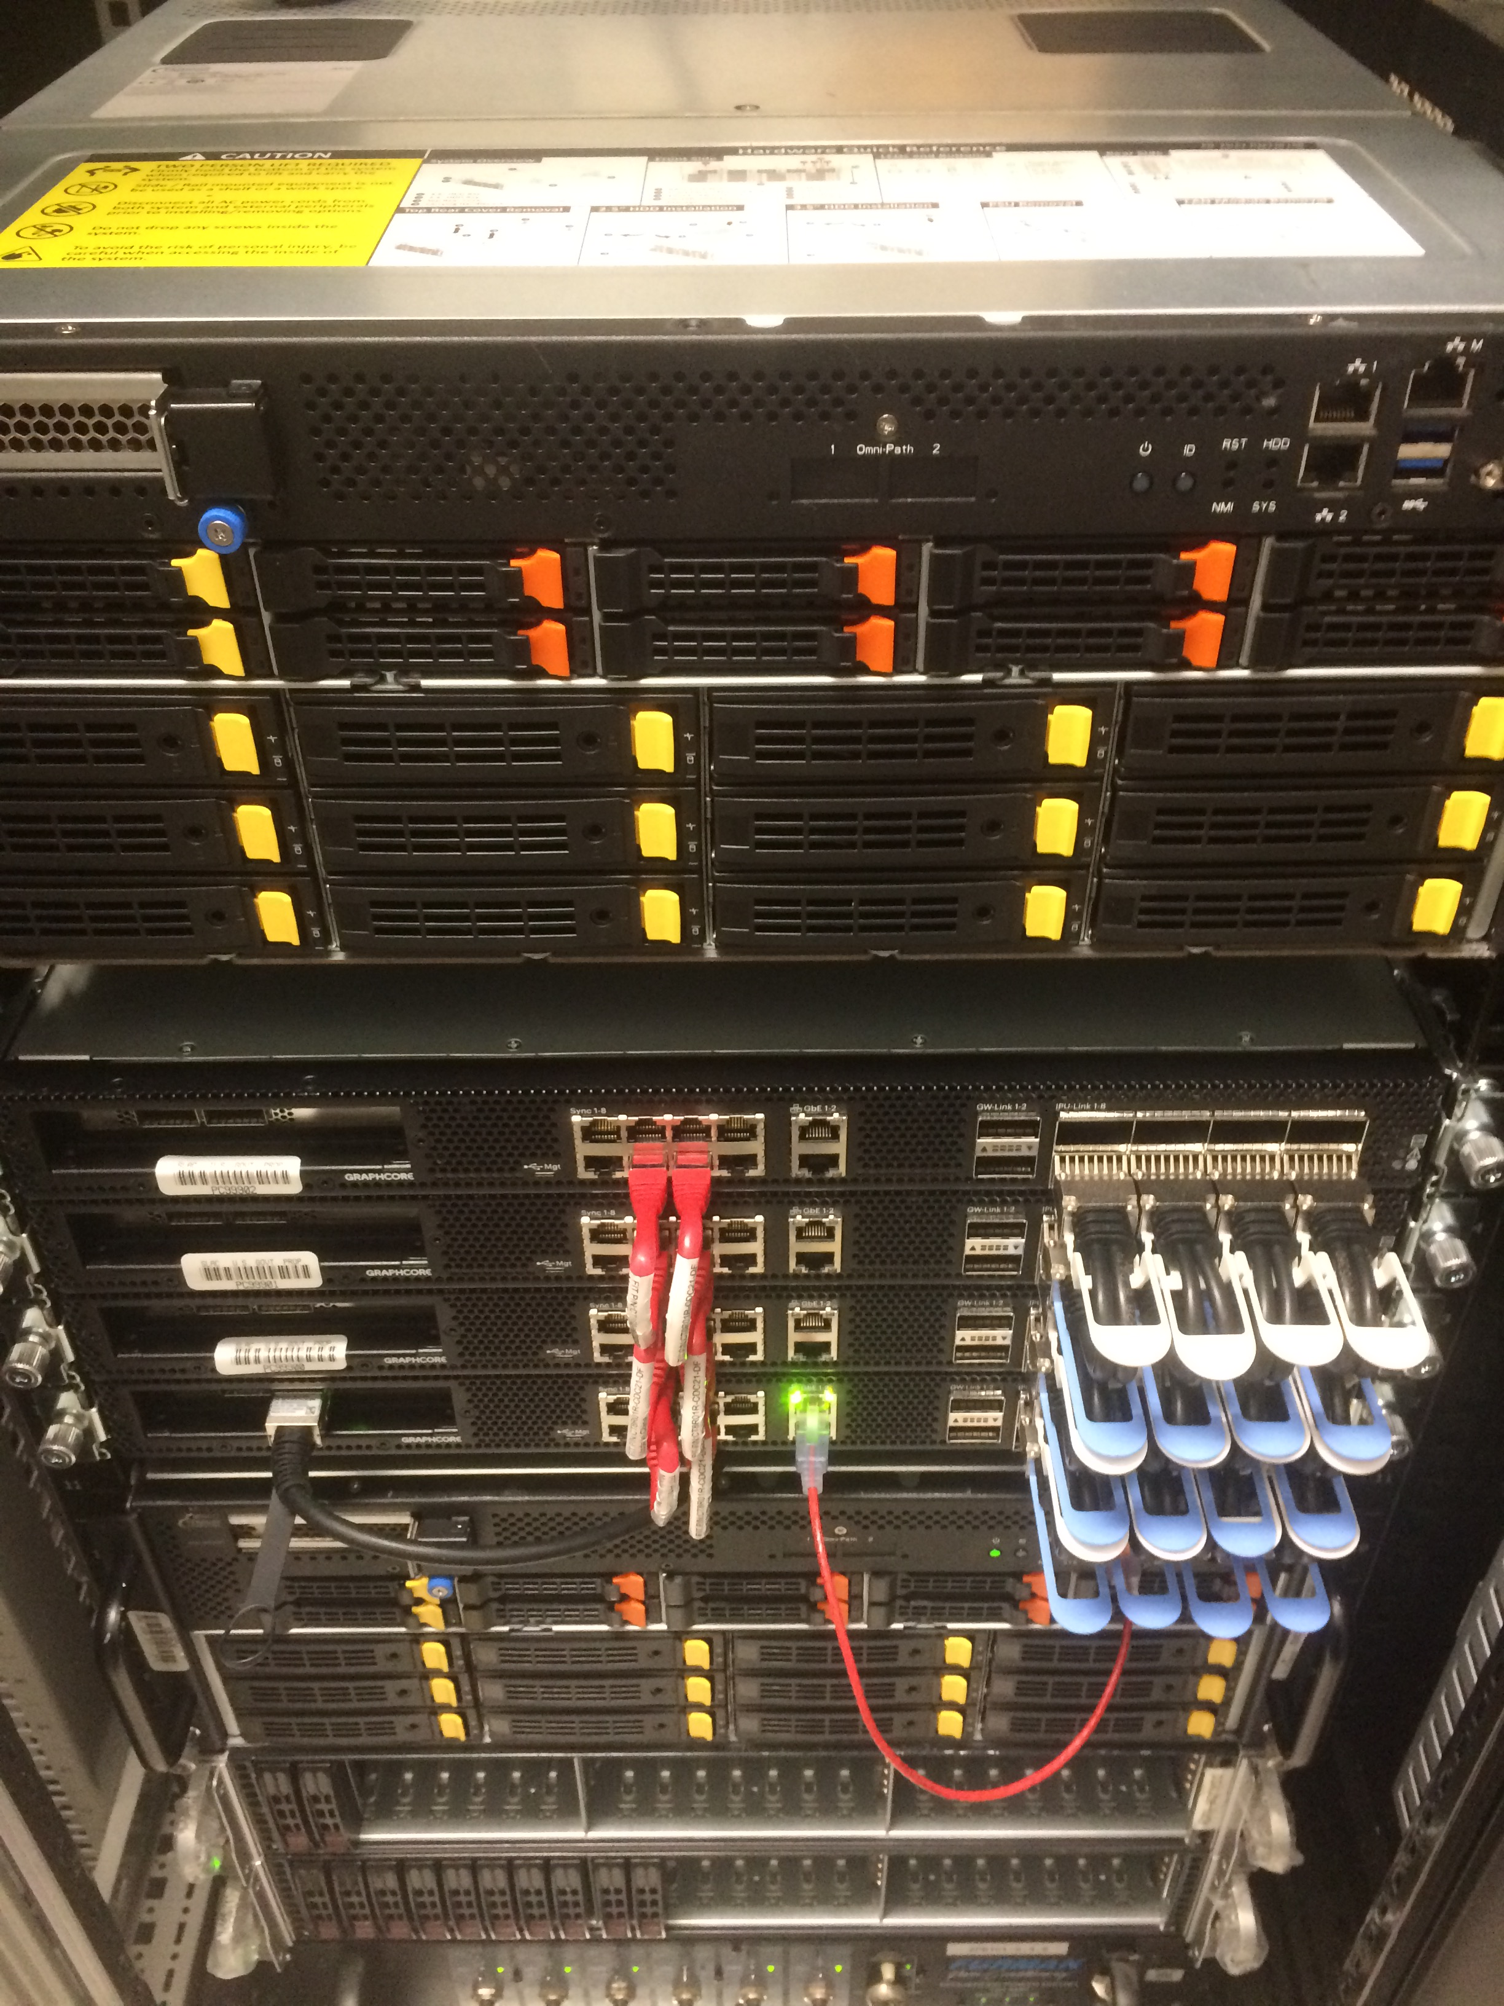
Hardware at SLAC for testing
Penguin Computing EdgeML Node as host
  Previous AI LDRD funded
  20 cores: Intel(R) Xeon(R) Gold 6248 CPU @ 2.50GHz
  790 GB RAM
GraphCore POD-16 for training and inference
  BES funded but using architecturally same models as FES project
  Similar penguin node as host/controller node
  16 Intelligent Processing Units (IPUs) work in unison for data parallel training
  Can be split for high throughput data parallel inference
    Demonstration of more than 100k inferences / sec for CNN AutoEncoder.
    Presupposes FPGA-based processing to 128x128 spectrograms
  Bi-weekly meetings with GC engineering team

Slide 6
Labor effort
Algorithms:
  Finn O’Shea, AI initiative, Project Scientist 50%
  Coffee 10%
FPGA team
  JJ Russell 50%
  Nathan Fronk, Electrical Engineer 10%
  Ryan Herbst, 10%
Caught up with spending by mid-FY22, on track after that.

Slide 7
Leveraged effort
Algorithms:
  Jack Hirschman, Stanford GA fellowship, synergistic (DOE-BES)
  Dennis Trujillo, ANL Post Doc in ML, synergistic (DOE-BES)
IT/Hardware/RTOS
  Larry Ruckman, SLAC Head of Elec. Sys. Dept.
  Omar Quijano, LCLS Exp Control Systems IT Department Head
Private Sector
  Harvard Data Analytics Group (HDAG)
  Bill Wright (Red Hat)
  Mrinal Iyer (GraphCore)
  Leo Hoarty (SweetVinyl)
  Christine Payne (OpenAI)
  Joachim Rahmfeld ()

Slide 8
Conclusions
Parallel effort for unifying both BES + ECE + CO2 diagnostics.
Feature reduction allows for more expressive models:
  Non-linear quantization
  Exchanges width for depth
  Better use of limited resources
  Less “over fitting” since we are label starved
  Maintain high throughput.
ConcurrentRT validating Xilinx hardware and SLAC firmware for control system.

Slide 9
Outreach
Contributed (AI@Stanford)
Invited:
  HZDresden
  HZB-Gregor
  Mlconf
  SMC

