Slide 1
EdgeML hardware
coPI: Ryan N Coffee
Institution: SLAC National Accelerator Laboratory
Collaborations: LCLS, DESY, XFEL, Stanford (CS/EE/Materials/ApPhys/Phys) , ANL, ORNL, NNSS, LANL
Private Sector Engagements: Red Hat, Enterprise Neurosystem, Cerebras, GraphCore, SambaNova, Nvidia, DeepMind, Google, Vision Research

Slide 2
Project goals and accomplishments
Major goals:
Install both GPU an FPGA for EdgeAI inference bofore FY2022 startup
Framework for user models to FPGA that enables weights update without firmware update
Accomplishments:
Initial development of SLAC Neural-net Layers (SNL) implemented and shared on git (
Joint BES+ECE feature reduction (https://github.com/ryancoffee/edgeml_fes.githttps://github.com/ryancoffee/edgeml_fes.git)
ConcurrentRT received software stack and shipment scheduled for end of month for validation for use in control system RedHawkOS at DIII-D
Firmware updated for remote push and removed from SLAC machine
Hardware ready for shipment to DIII-D by end of month.

Slide 3
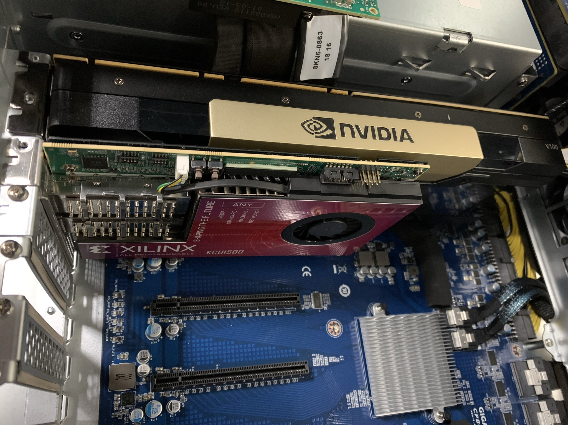
Hardware to DIII-D
Nvidia V100
  Only 30% performance loss compared to A100
  Supported by ConcurrentRT
Xilinx KCU1500
  Inference accelerator
  Replica with SLAC firmware is being shipped to ConcurrentRT this month for validation

Slide 4
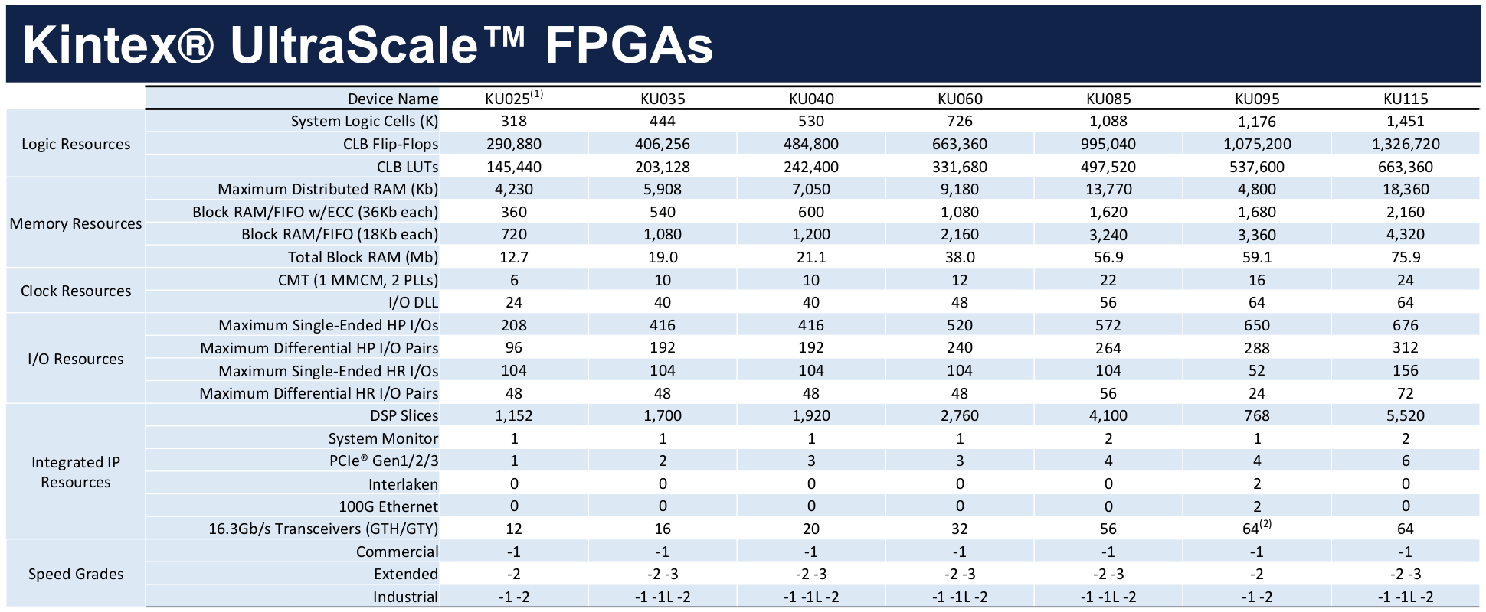
FPGA targeted by slaclab/snl
Applied Physics student Debadri Das
Kernel shapes vary across the waveform
Not a typical CNN modality
Benefit by constrianing center at this stage – motivates 2 channels into initial FPGA
Expand resources on FPGA

Slide 5
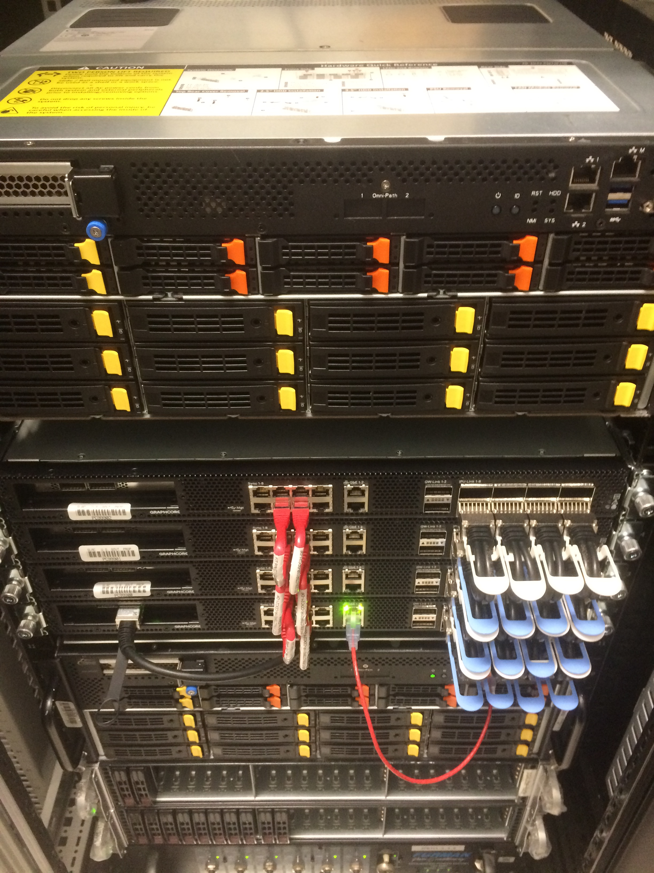
Hardware at SLAC for testing
Penguin Computing EdgeML Node as host
  20 cores: Intel(R) Xeon(R) Gold 6248 CPU @ 2.50GHz
  790 GB RAM
GraphCore POD-16 for training and inference
  Similar penguin node as host/controller node
  16 Intelligent Processing Units (IPUs) work in unison for data parallel training
  Can be split for high throughput data parallel inference
  Bi-weekly meetings with GC engineering team

Slide 6
Labor effort
Algorithms:
  Jack Hirschman, Stanford GA fellowship, synergistic (DOE-BES)
  Dennis Trujillo, ANL Post Doc in ML, synergistic (DOE-BES)
  Finn O’Shea, AI initiative, Project Scientist 50%
  Omar Quijano, LCLS Exp Control Systems IT Department Head
  Coffee 10%
FPGA team
  JJ Russell
  Nathan Fronk, Electrical Engineer
  Ryan Herbst, TID-AIR Electronics Systems Division Director
Caught up with spending for FY22

Slide 7
Conclusions
Parallel effort for unifying both BES + ECE + CO2 diagnostics.
Feature reduction allows for more expressive models:
  Non-linear quantization
  Exchanges width for depth
  Better use of limited resources
  Less “over fitting” since we are label starved
  Maintain high throughput.
ConcurrentRT agreed to validate hardware for control system.

