Slide 1
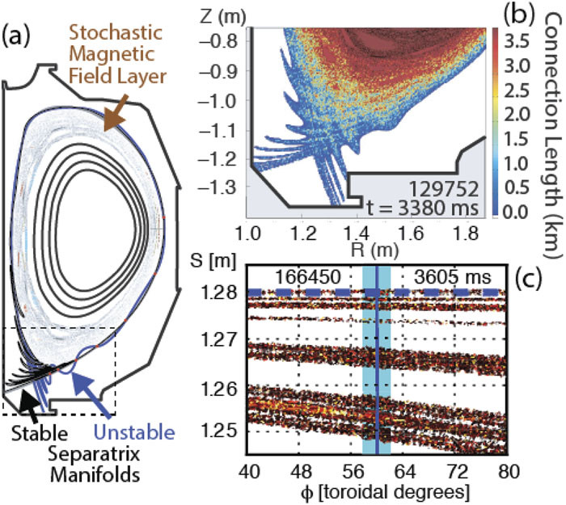
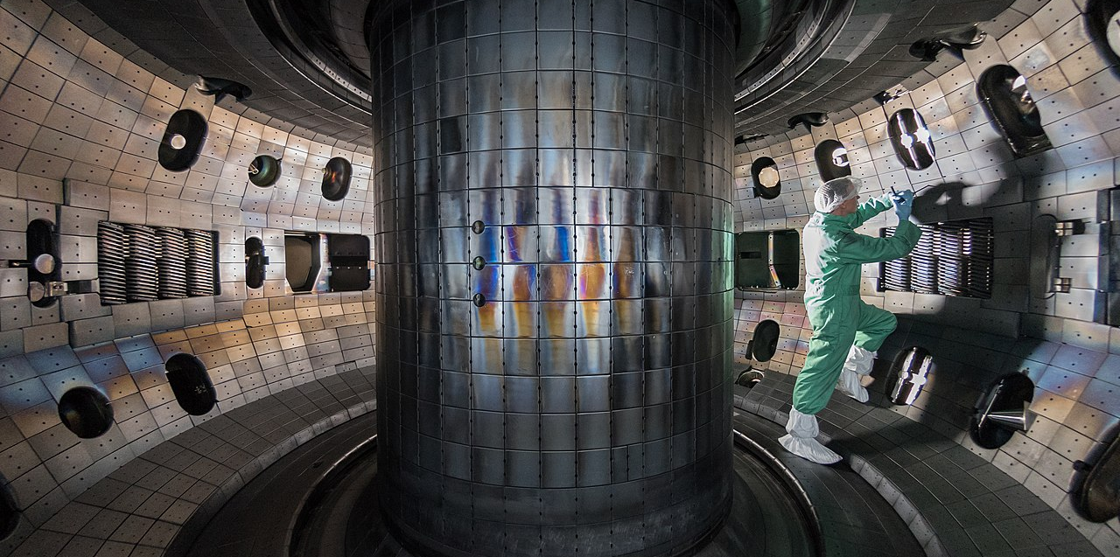
EdgeML for Tokamak Fusion Control
Lead PI: Egemen Kolemen (Princeton/PPPL)
coPIs: Ryan Coffee (SLAC), Dave Smith (UWisc), Jeff Schneider (CMU), Dan Boyer (PPPL)
Moyer et al., Rev. Sci. Instrum. 89, 10E106 (2018); https://doi.org/10.1063/1.5038350
By Rswilcox - Own work, CC BY-SA 4.0, https://commons.wikimedia.org/w/index.php?curid=73919081

Slide 2
Project goals and accomplishments
Major goals:
Validated EdgeML hardware for DIII-D reactor
Framework for remote model update without firmware update
Real-time AE mode identification and classifictation
1ms forecast of ELM event
Accomplishments:
Initial development of SLAC Neural-net Layers (SNL) implemented
Joint BES+ECE feature reduction (https://github.com/ryancoffee/edgeml_fes.githttps://github.com/ryancoffee/edgeml_fes.git)
Integrating inference model into RealTime RedHawkOS (ConcurrentRT) with B84 replica node.
Designed firmware for remote push/restart for remote reconfiguration.
FPGAs and GPUs for DIII-D run this year.

Slide 3
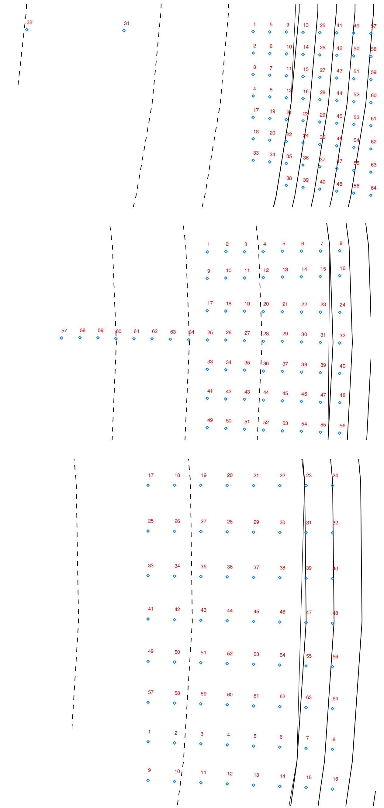
Channel layouts – BES
Particular shots have user chosen physical locations for BES sampling
ELM events are distributed typically across wide distribution
AE visibility may be more localized

Slide 4
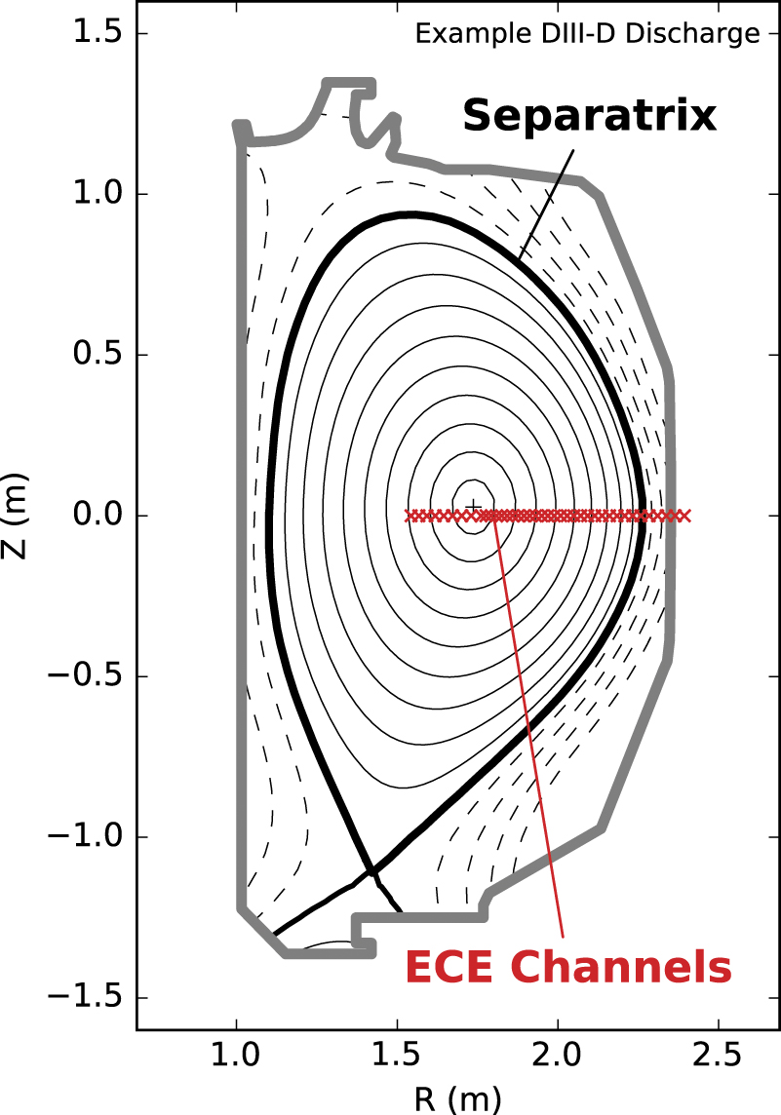
Channel layouts – ECE
The “depth” into plasma for ECE dynamically depends on the plasma density
Estimates from “magnetic” measurements and other slow diagnostics.
Within a shot the ECE channels are defined in frequency – various channels will cross the plasma frequency and “disappear” for a time.

Slide 5
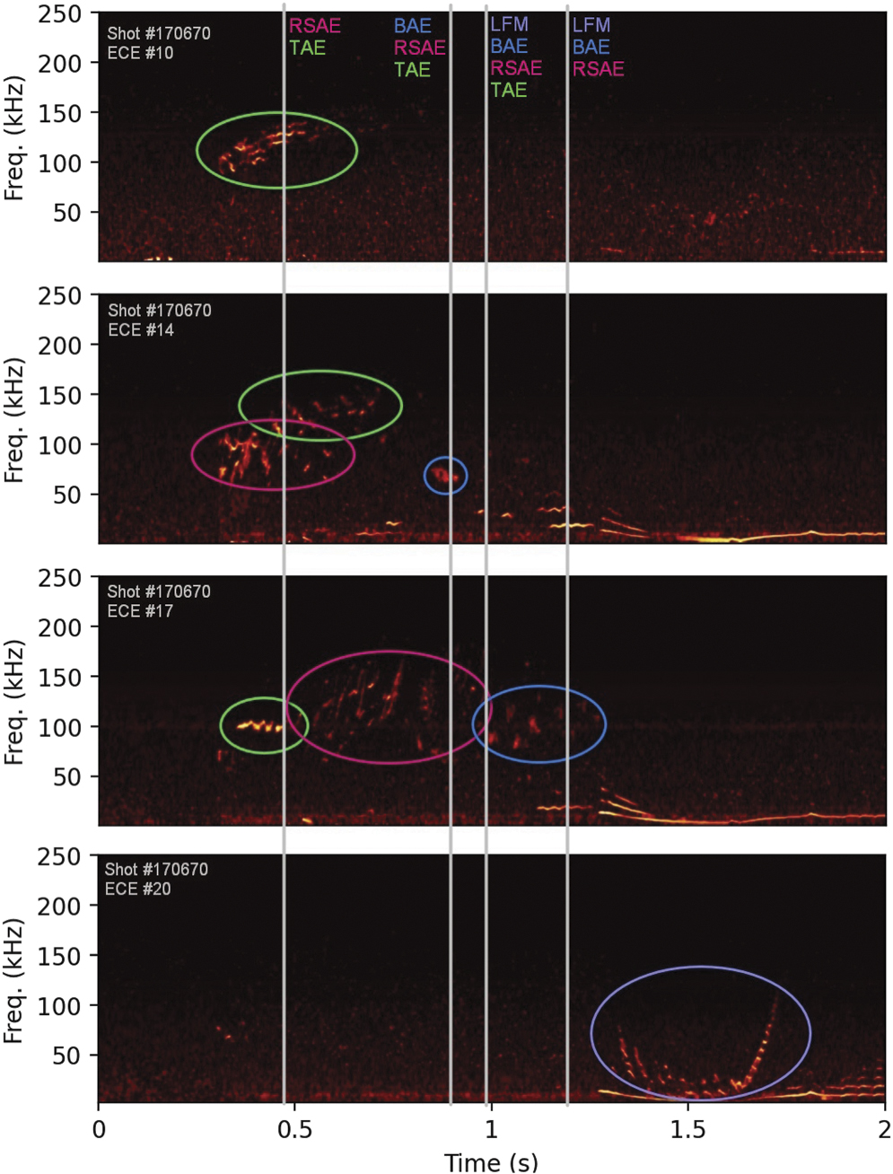
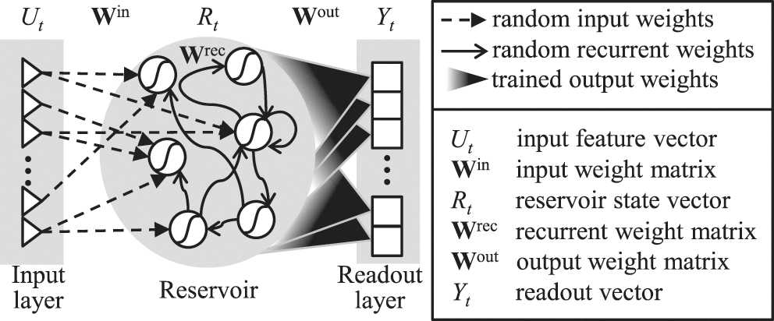
RCN for ECE
PPPL group is focusing on Reservoir Computing
Azarakhsh Jalalvand et al 2022 Nucl. Fusion 62 026007

Slide 6
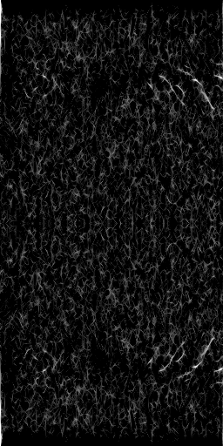
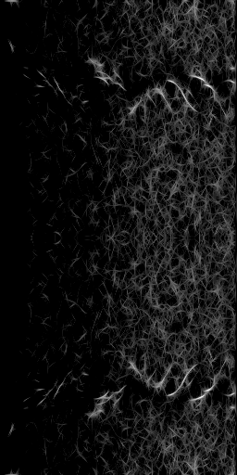
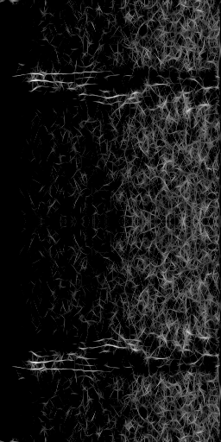
Edge Inference Considerations
ConcurrentRT must validate FPGA and firmware before even testing experiments with control system.
Available “fast” diagnostics: Beam Emission Spectroscopy (BES), Electron Cyclotron Emission (ECE), and CO₂ Interferometer (CO2)
BES 45
ECE 45
ECE 64

Slide 7
ECE looking “through” the channels
250
ConcurrentRT must validate FPGA and firmware before even testing experiments with control system.
F [kHz]
0
0
Time [s]
2

Slide 8
BES rastering “through” the channels
Common FPGA targeted pre-processing for ECE and BES
Preserved information (ELM isolation/removal)
Next step alternative embedding to raw/spectral
100
F [kHz]
0
0
Time [s]
2

Slide 9

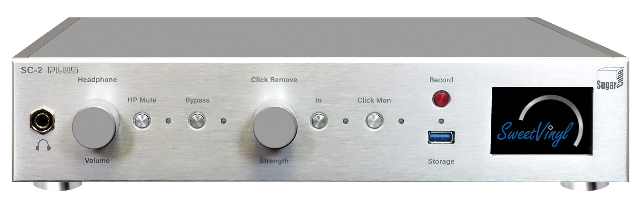
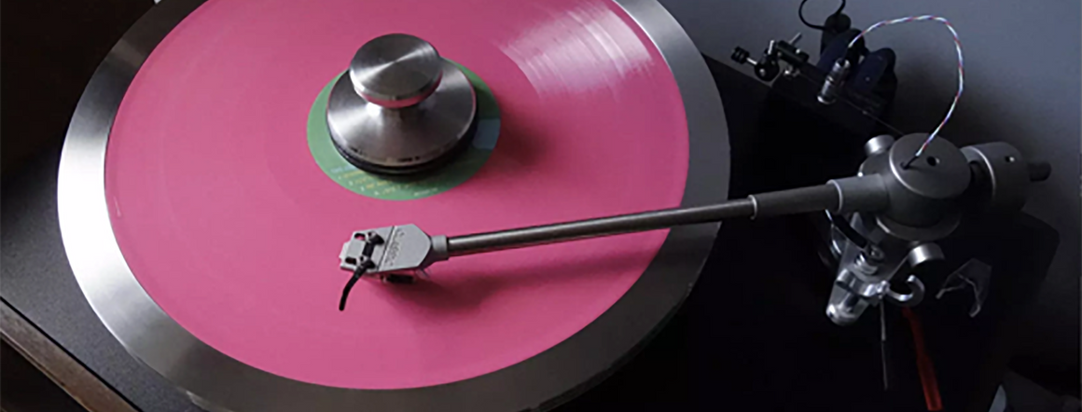

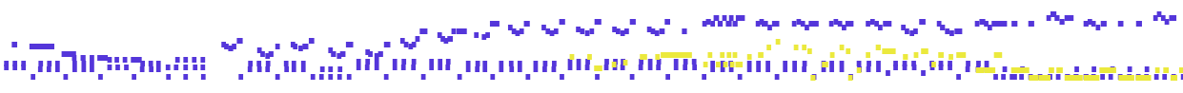
Transformers – BERT/GPT
Re-formulating signal representation as “words” or “notes” and “sentences”
Then could behave train like a Transformer model as is used in text interpretation/translation/generation
Scratch pre-training requires quite some data… but no labels!
Also appropriate for simulation training with data starved tuning
https://openai.com/blog/musenet/

Slide 10
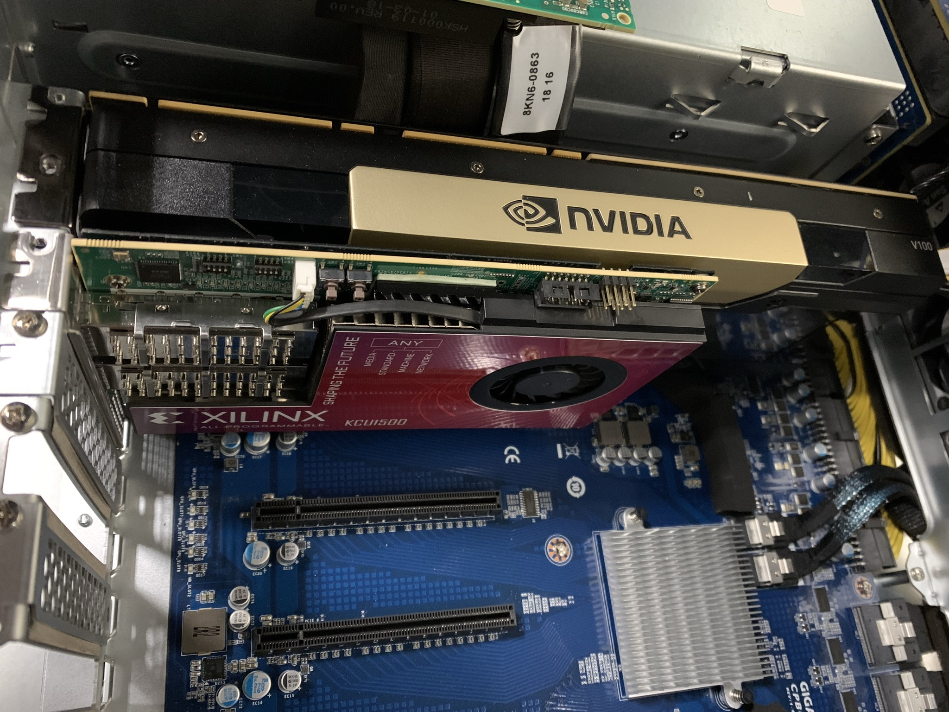
Hardware to DIII-D
Nvidia V100
  Only 30% performance loss compared to A100
  Supported by ConcurrentRT
Xilinx KCU1500
  Inference accelerator
  Seeking hardware and SLAC firmware validation from ConcurrentRT

Slide 11
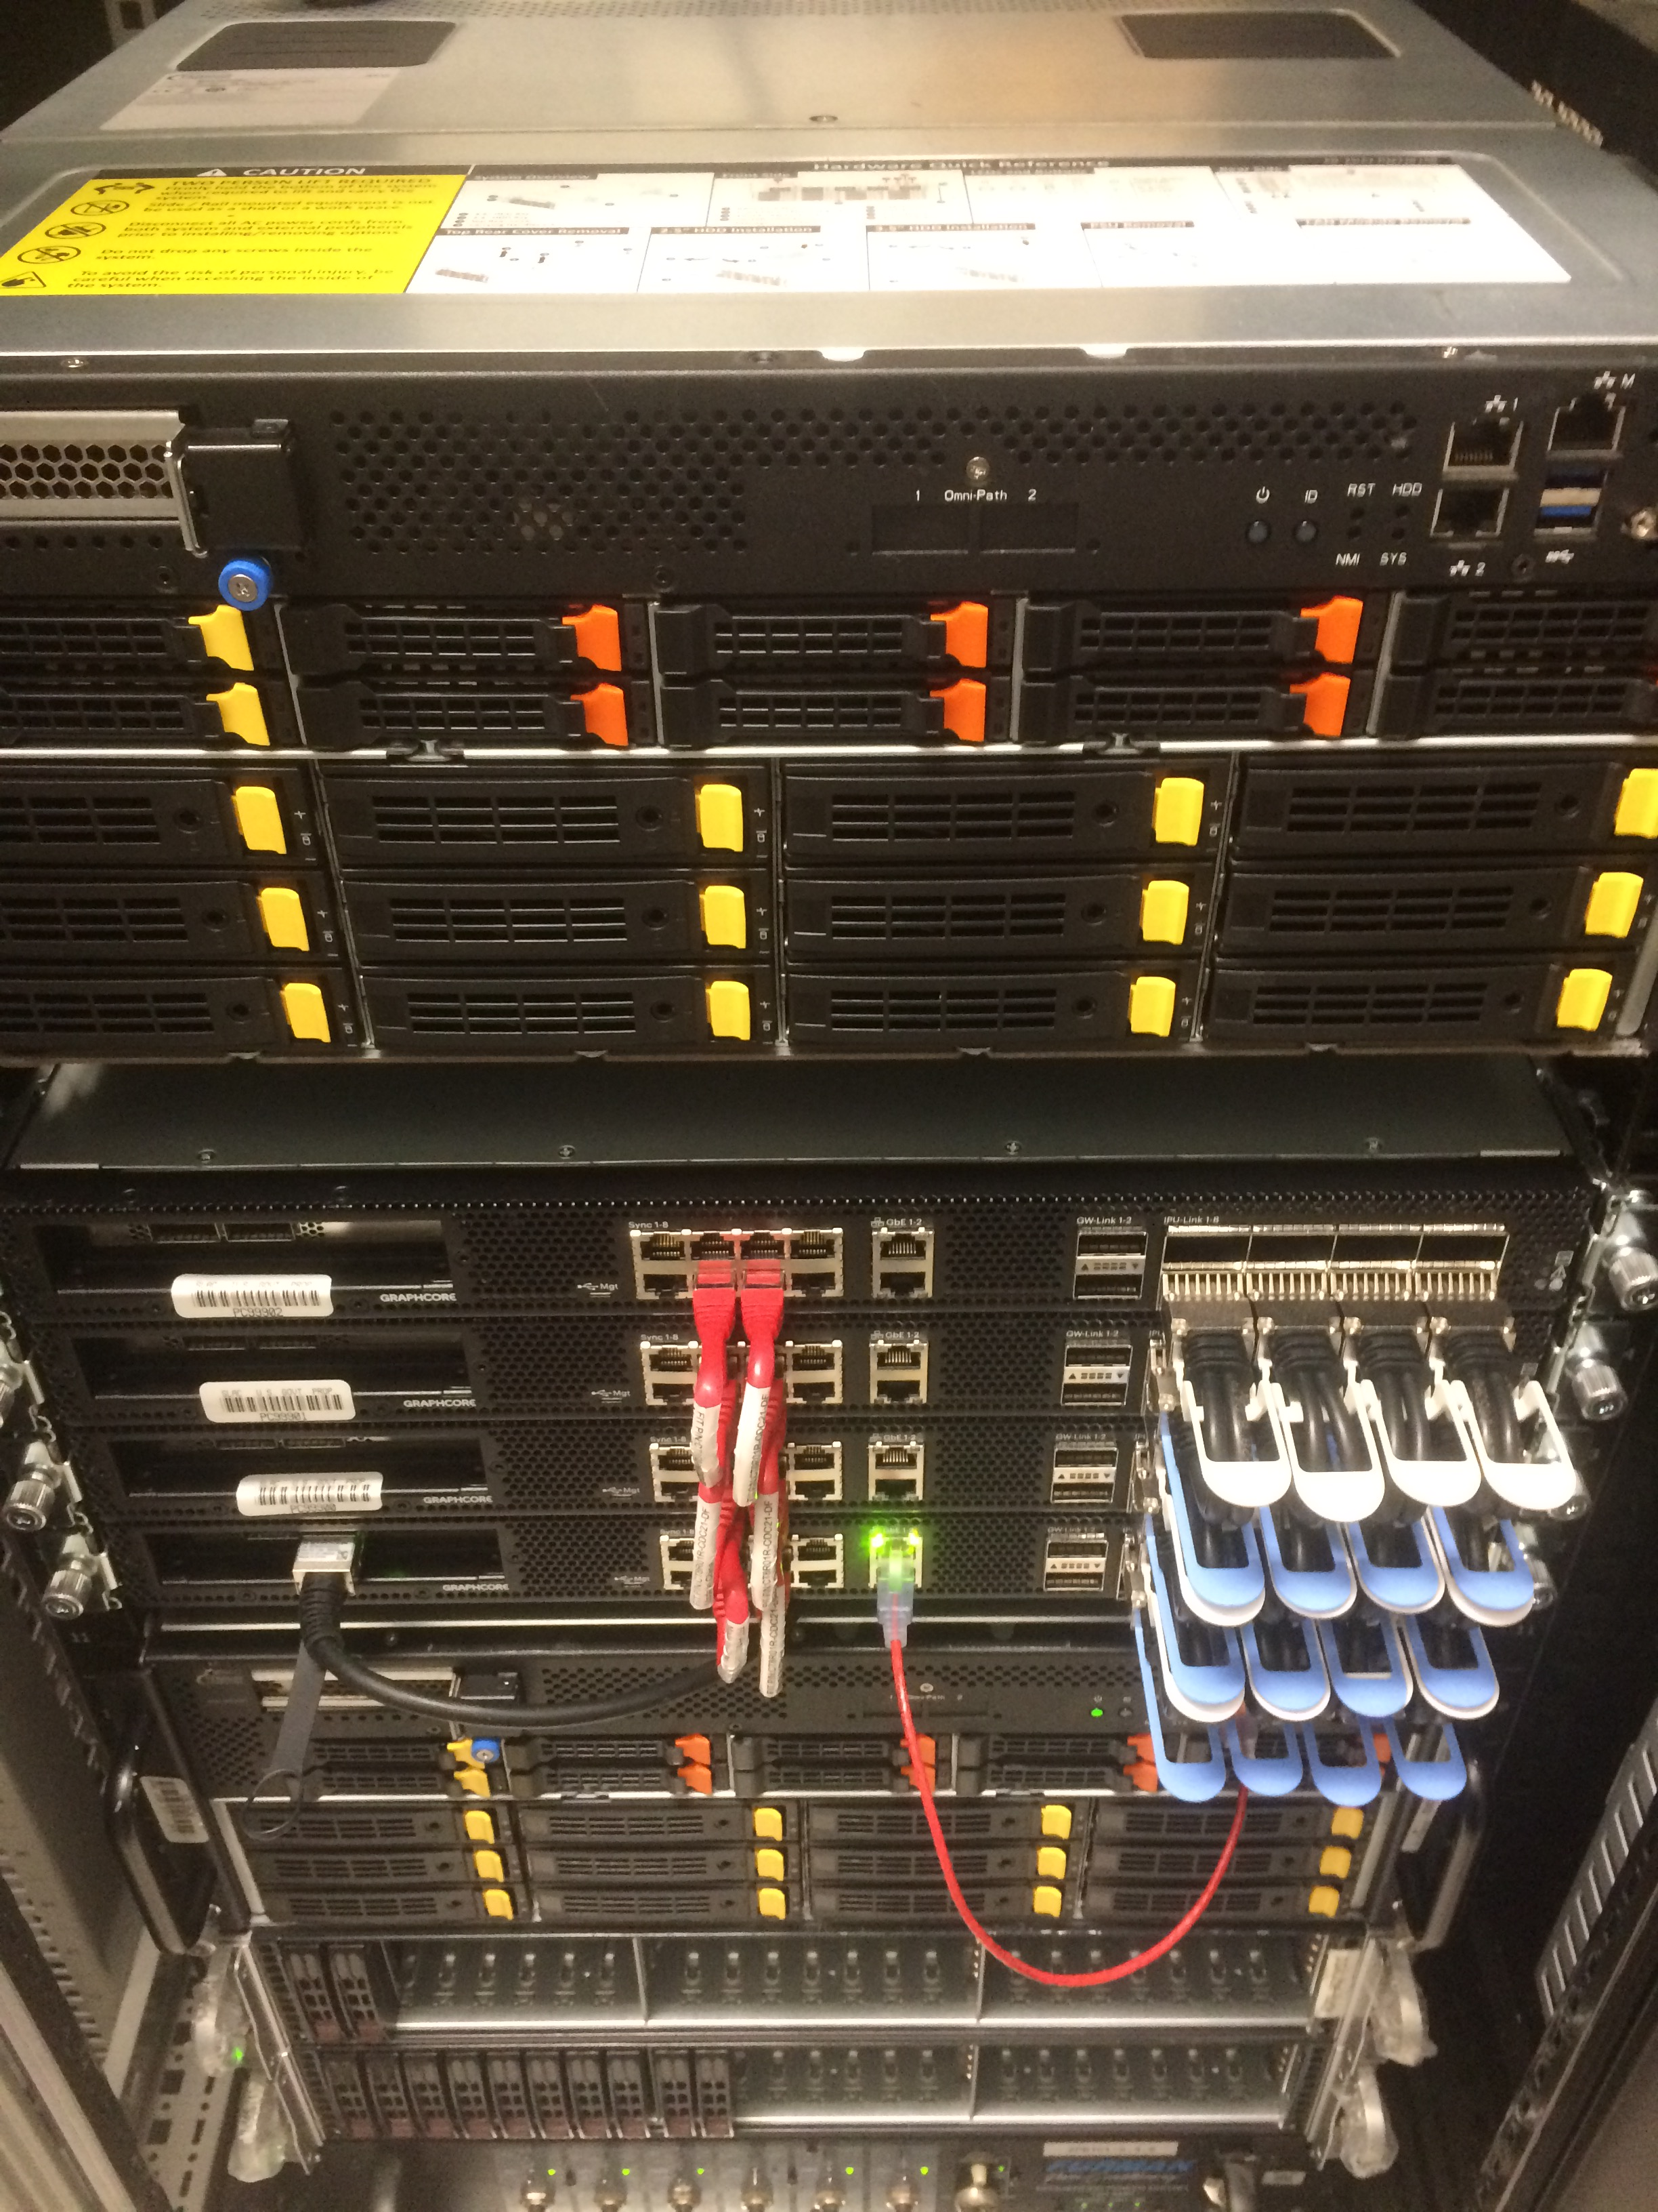
Hardware at SLAC for testing
Penguin Computing EdgeML Node as host
  20 cores: Intel(R) Xeon(R) Gold 6248 CPU @ 2.50GHz
  790 GB RAM
GraphCore POD-16 for training and inference
  Similar penguin node as host/controller node
  16 Intelligent Processing Units (IPUs) work in unison for data parallel training
  Can be split for high throughput data parallel inference
  Bi-weekly meetings with GC engineering team

Slide 12
The SLAC team
Algorithms:
  Jack Hirschman, Stanford GA fellowship, synergistic (DOE-BES)
  Dennis Trujillo, ANL Post Doc in ML, synergistic (DOE-BES)
  Finn O’Shea, AI initiative, Project Scientist
  Omar Quijano, LCLS
  Leo Hoarty, Founder/CTO SweetVinyl INC analog audio processing
  Coffee
FPGA team
  JJ Russell
  Kukee Kim
  Kuktae Kim
  Nathan Fronk
  Ryan Herbst
GC team
  Mike Krause
  Alex

Slide 13
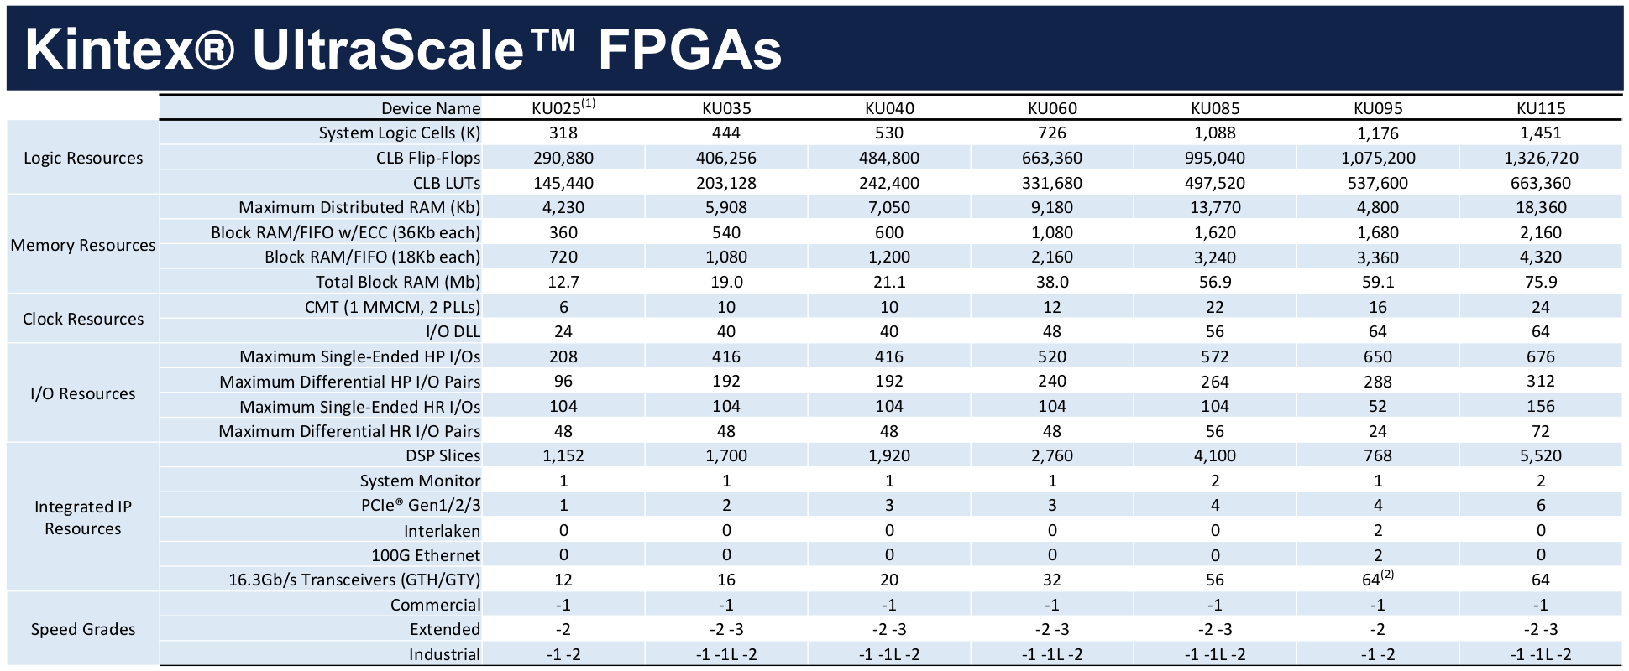
FPGA targeted by slaclab/snl
Applied Physics student Debadri Das
Kernel shapes vary across the waveform
Not a typical CNN modality
Benefit by constrianing center at this stage – motivates 2 channels into initial FPGA
Expand resources on FPGA

