Slide 1
CookieBox R&D update
Construction, Beamtime Preparations, and Outlook
March 18, 2021
Ryan N Coffee
LCLS/PULSE
SLAC National Accelerator Laboratory
coffee@slac.stanford.edu

Slide 2
Outline
  Publications/Presentations
  Construction
  Technical
  Schedule
  Future Outlook

Slide 3
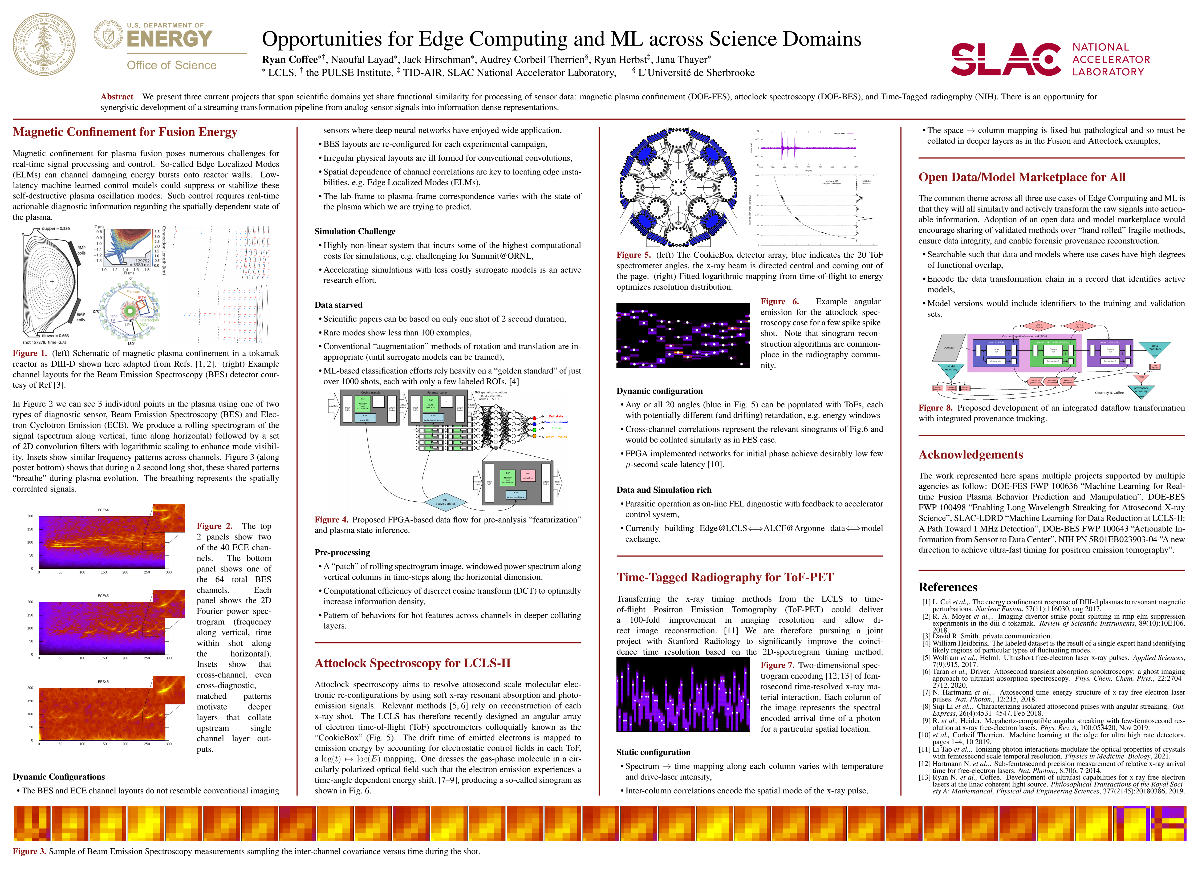
SLAC Science + Stanford AI: Bridging the Farm – Feb 9
  Poster from Bridge Workshop me and Naoufal

Slide 4
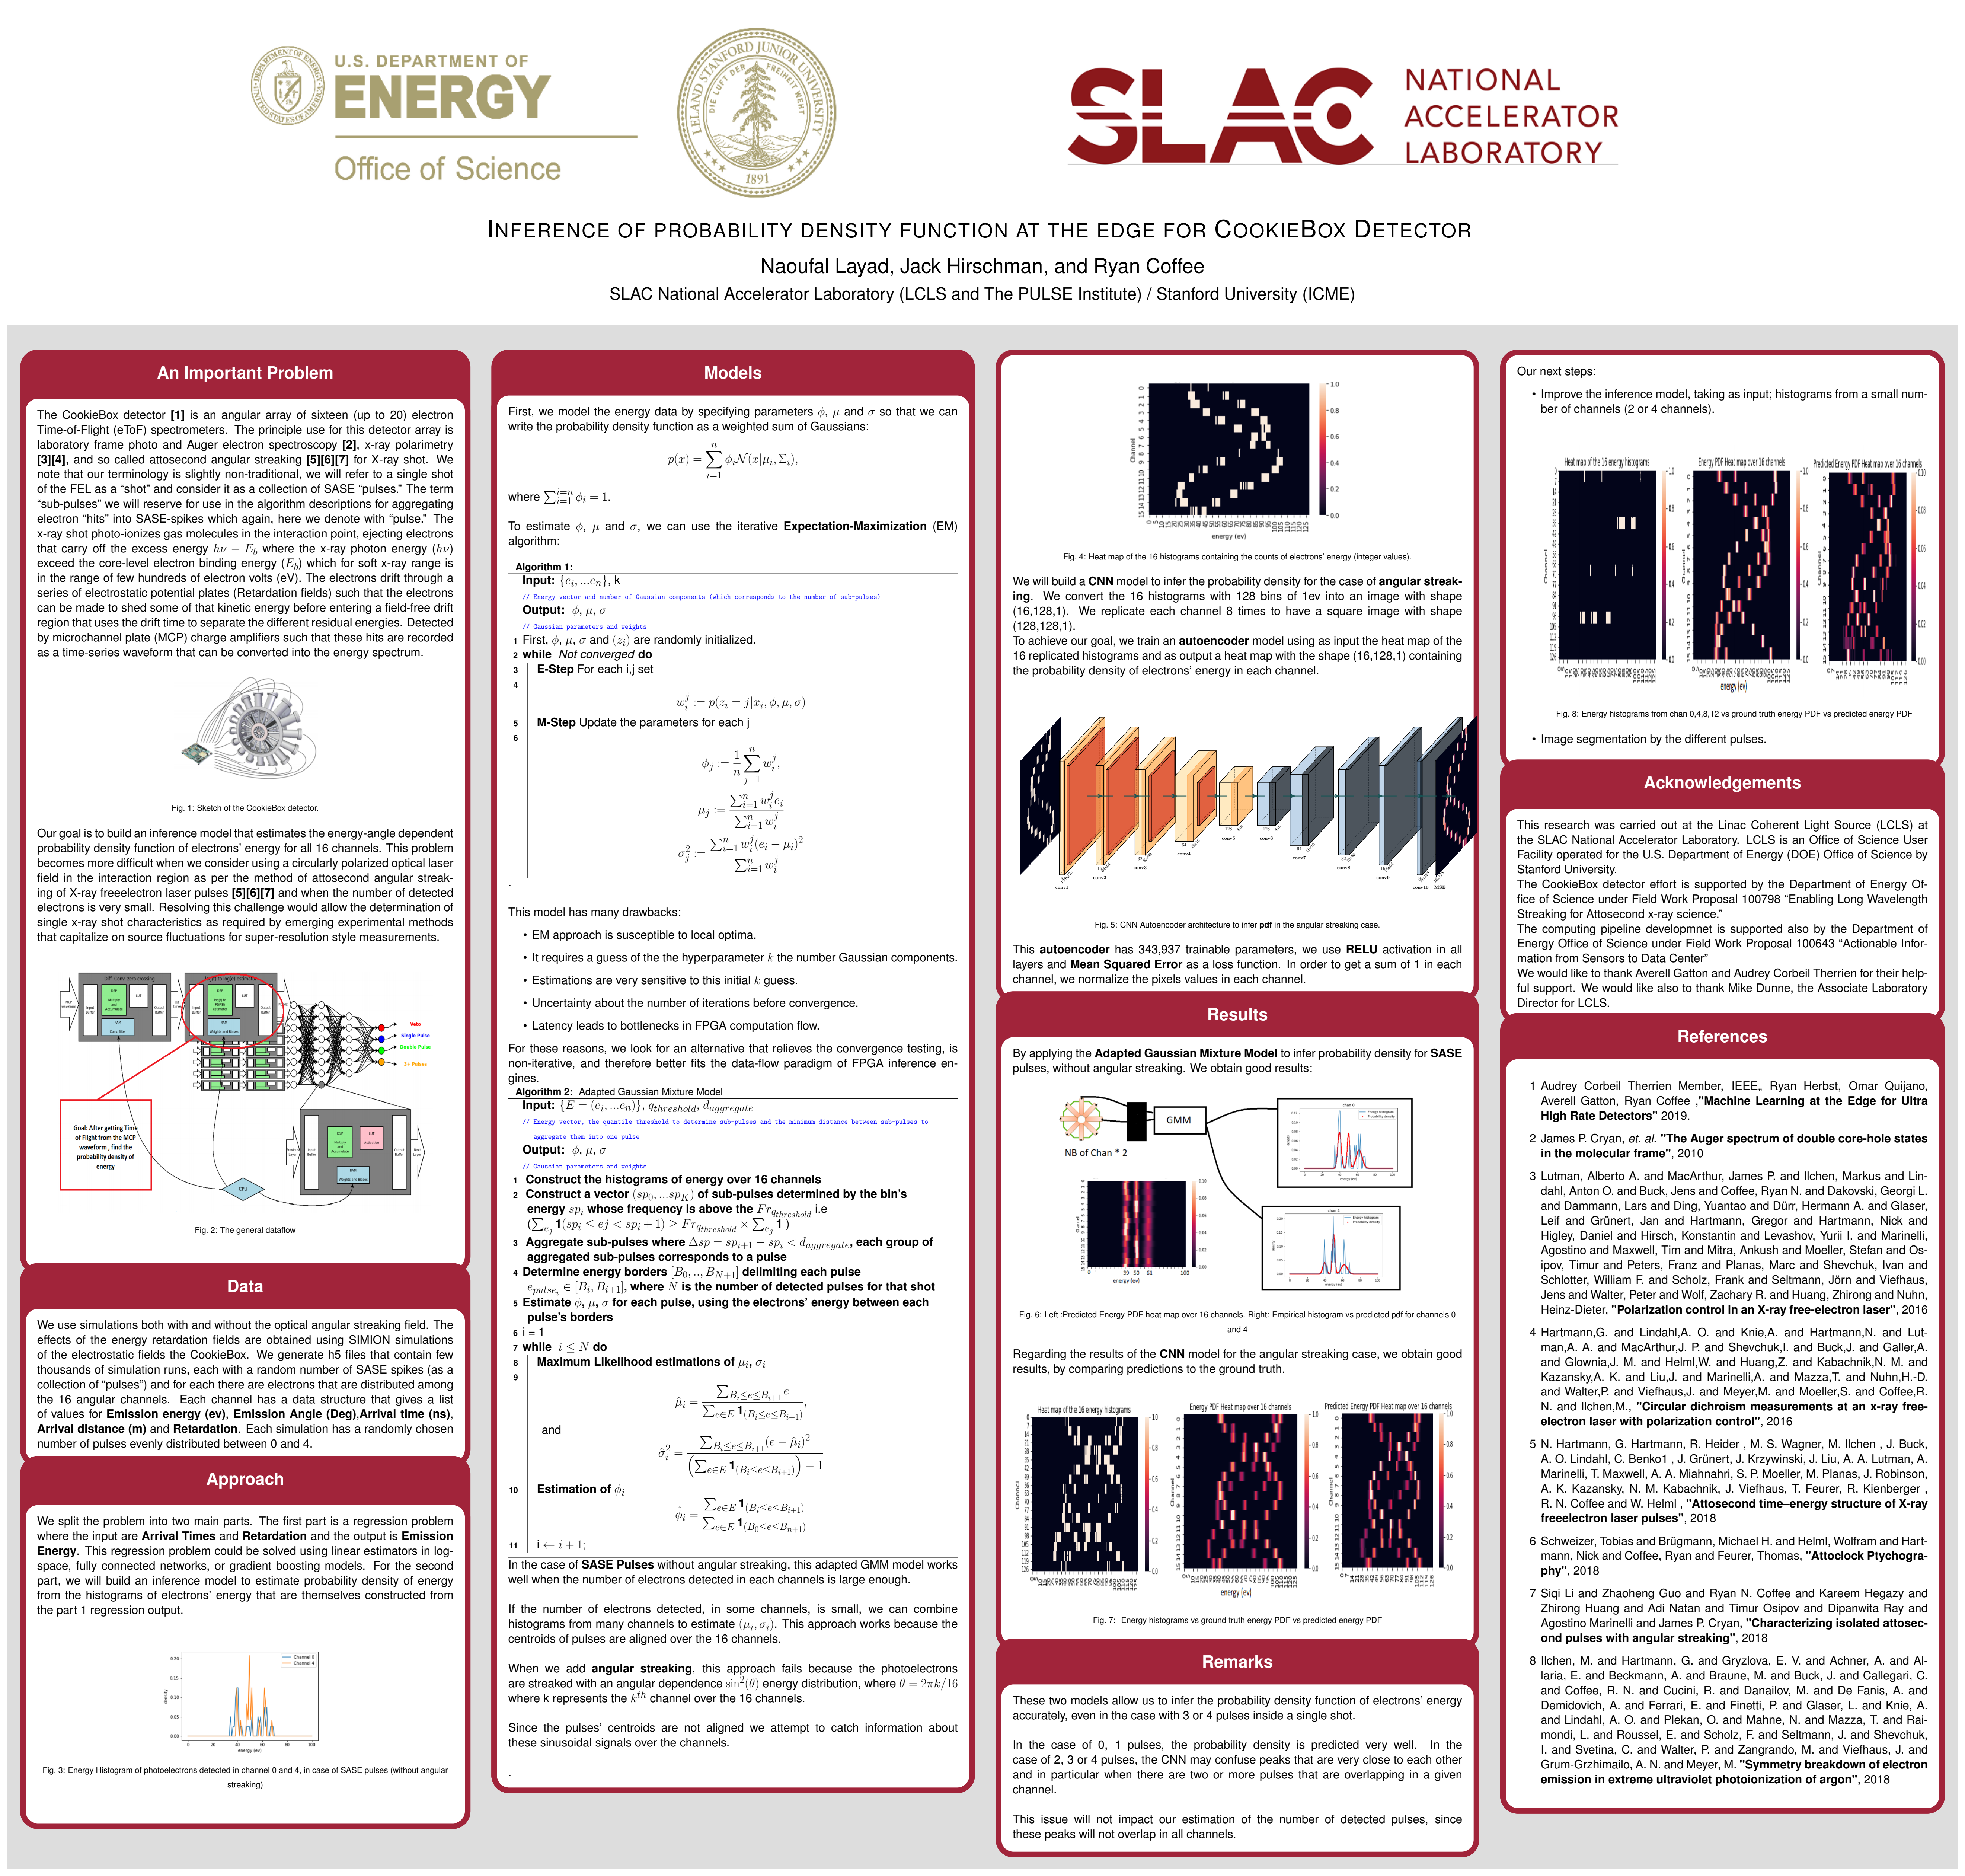
SLAC Science + Stanford AI: Bridging the Farm – Feb 9
  Poster from Bridge Workshop me and Naoufal

Slide 5
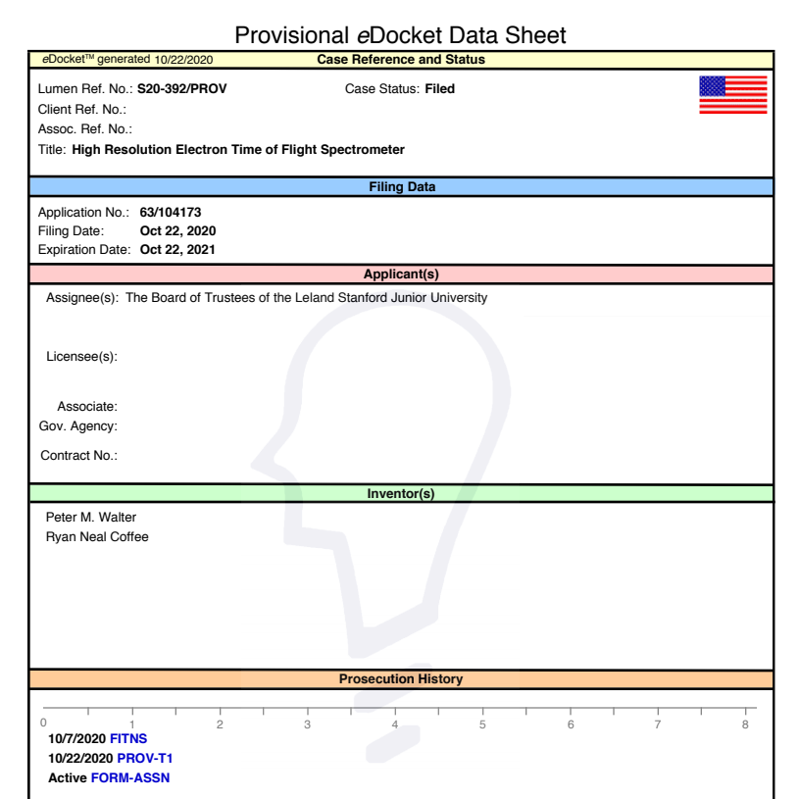
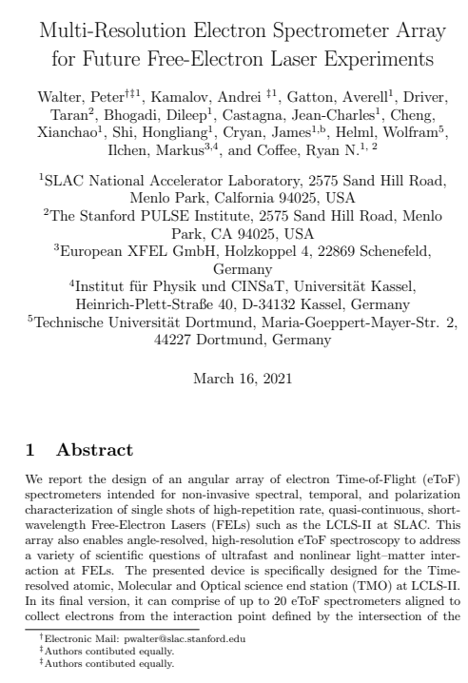
Prov. Patent and arXiv preprint for JSR Special Iss.
IUCr: Journal of Synchrotron Radiation, Special issue – PhotonDiag 2020 - The 5th FELs OF EUROPE Conference on FEL Photon Diagnostics, Instrumentation and Beamline Design
  Paper title page with arXiv details

Slide 6
Future paper plans
  Jack analog circuits (May submission)
  Naoufal Angular Streaking reconstruction (July submission)
  RSI of experiment results (Aug submission)

Slide 7
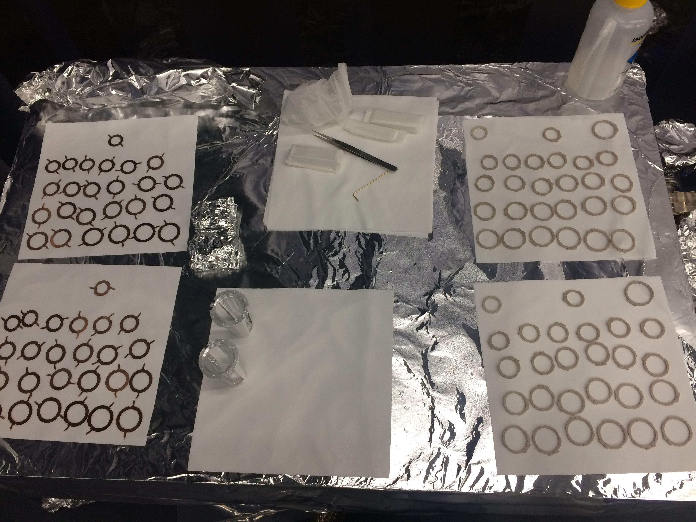
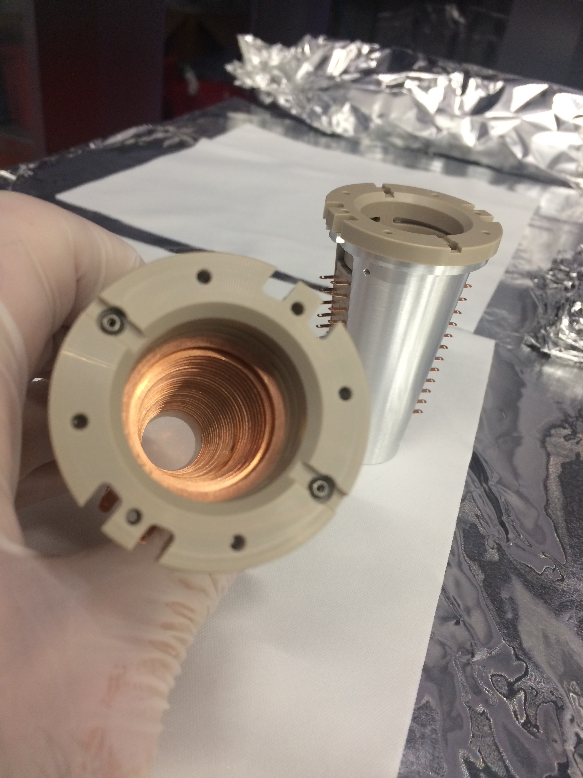
Construction Status
  6 of 8 compound electrostatic lenses came back with damaged meshes, replacement meshes due in two weeks, rebuild, re-solder upon arrival

Slide 8
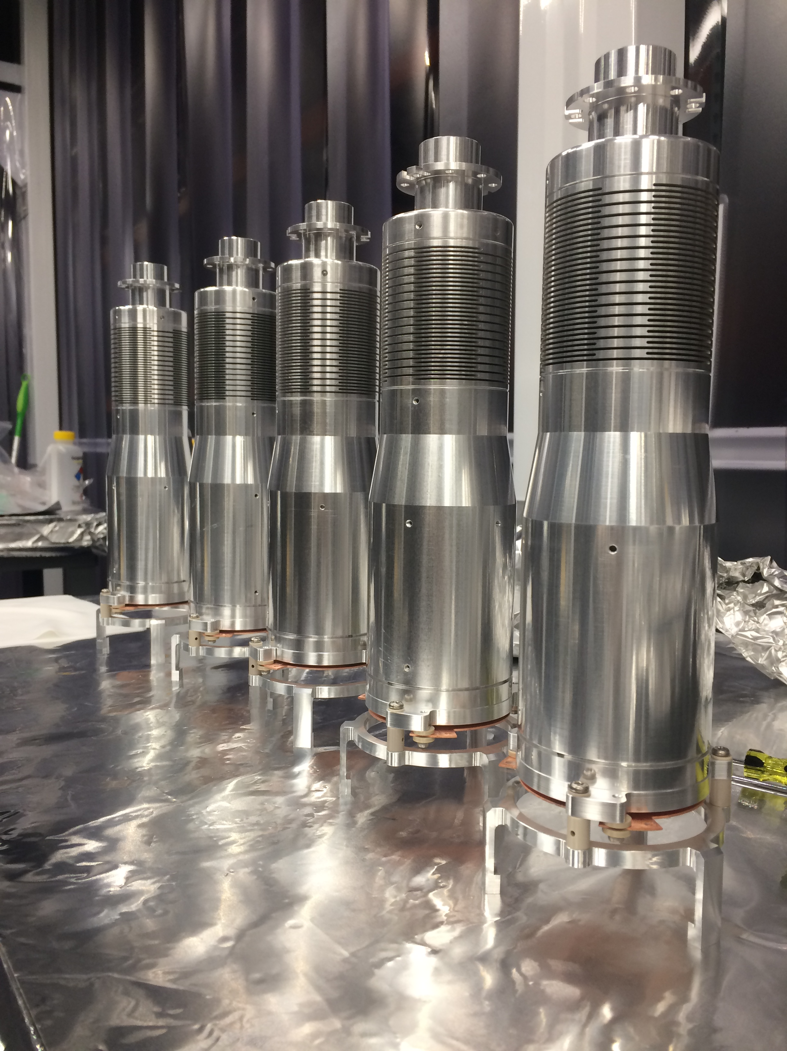
Construction Status
  All parts in from fab, cleaned and baked
  Flight tubes completed
  Chamber passed RGA and magnetic acceptance
  Construction stand populated with 2 of 4x capacity assembly line, in-vac HV cable wiring this afternoon
  Installing additional 2 MCP detectors to run bare (no ToF tubes) during June beamtime, e.g. demonstrate multi-resolution with 120 eV N photo-lines in NNO “for free”

Slide 9
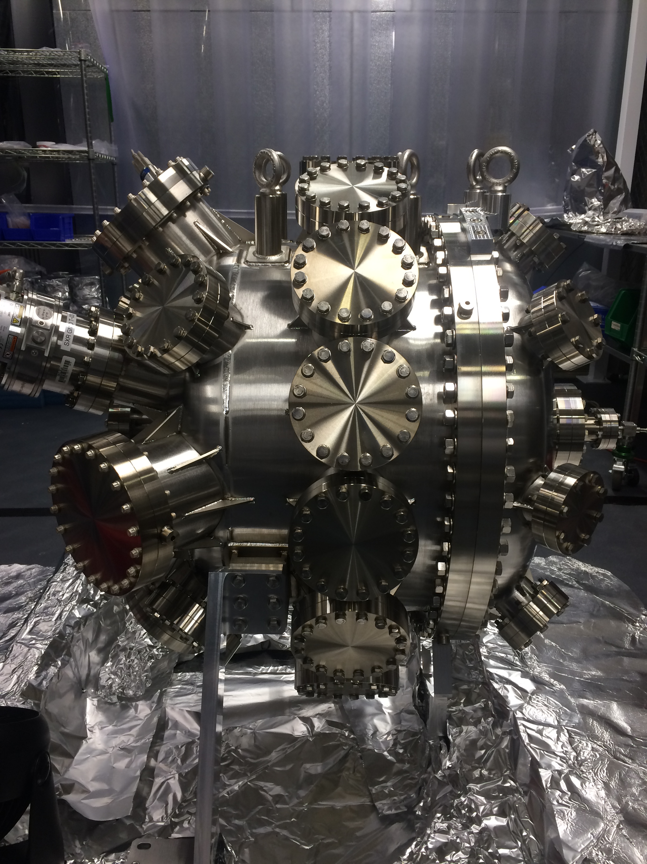
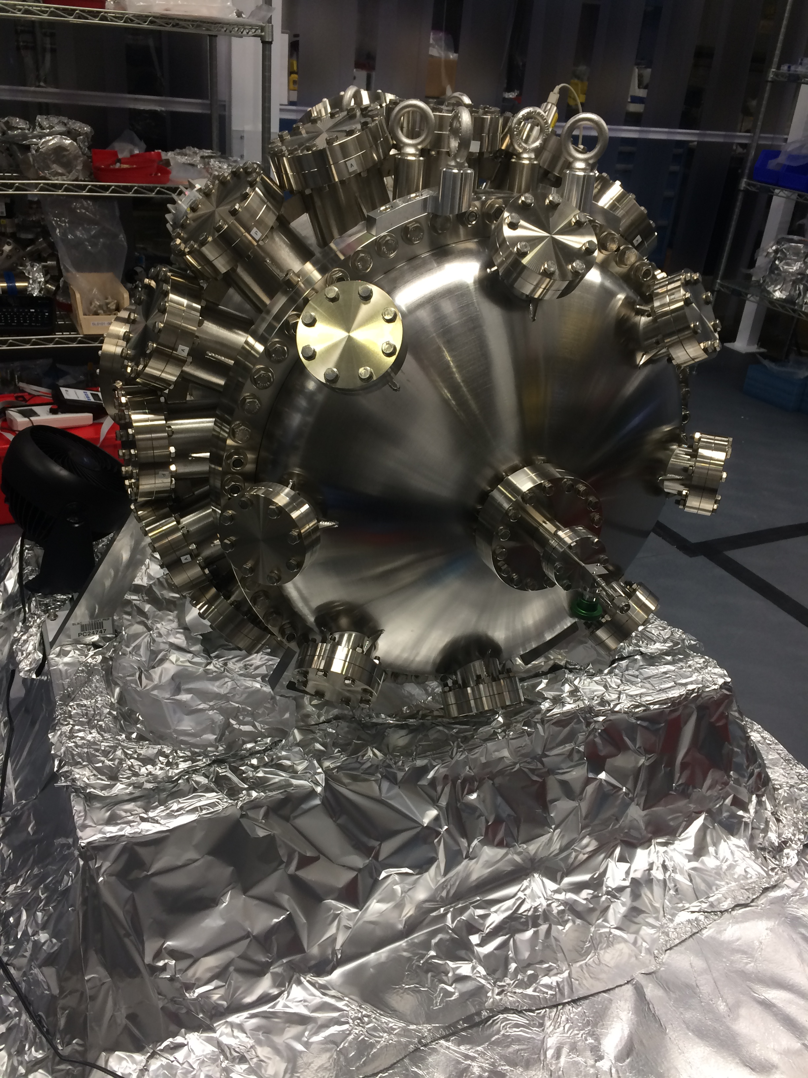
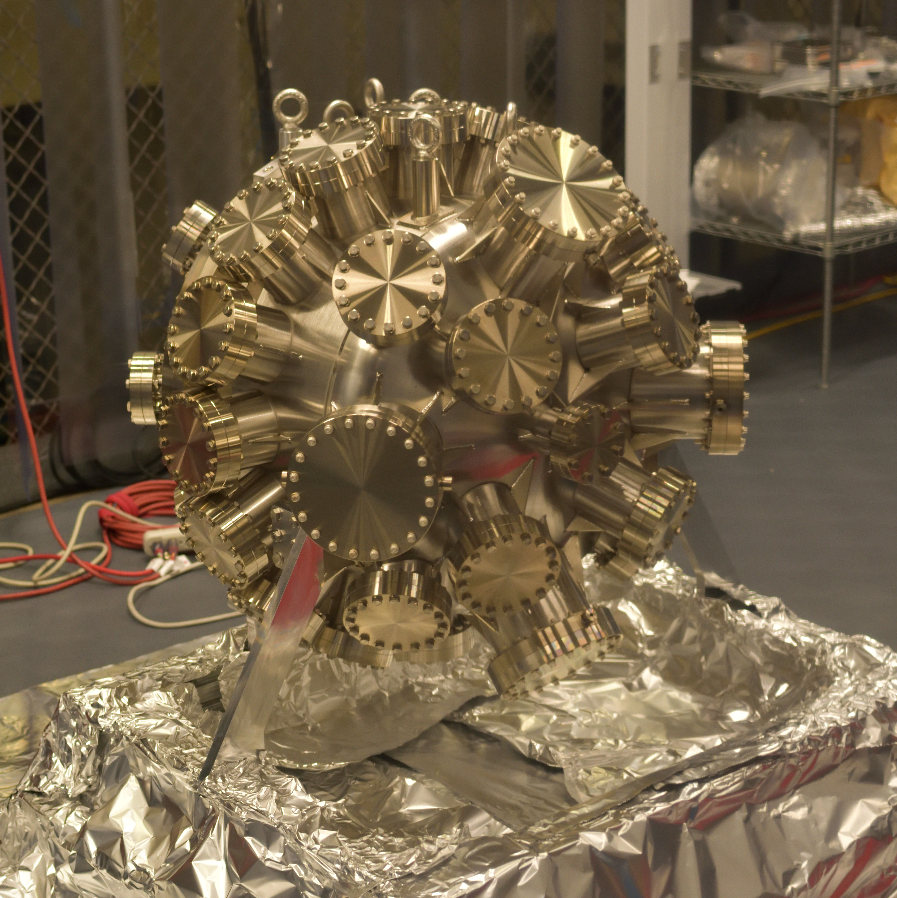
Construction Status
  Cite submitted paper

Slide 10
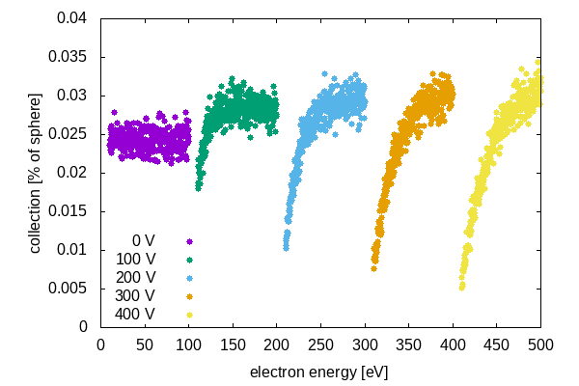
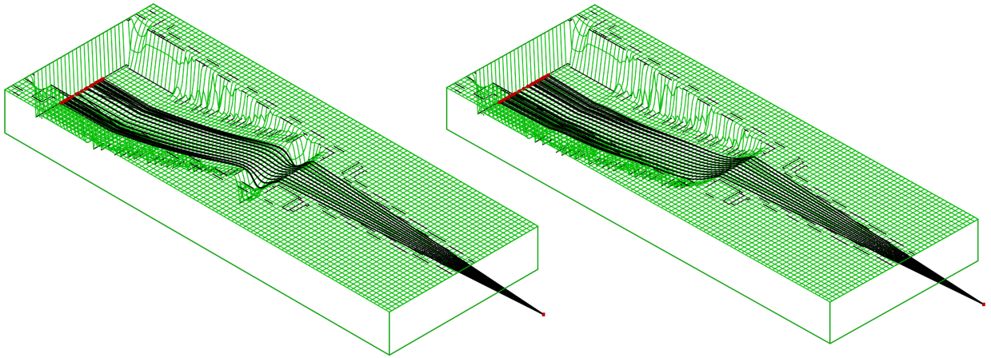
Collection versus survival and resolution
  Avoiding ‘sausaging’ chromatic lensing reduces hot central spots
  Comparable collection across appropriate retardations

Slide 11
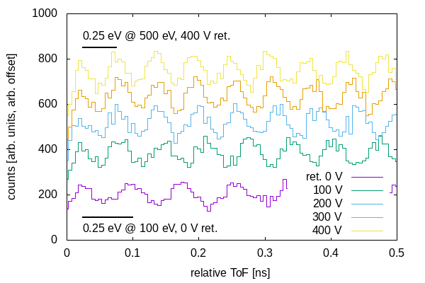
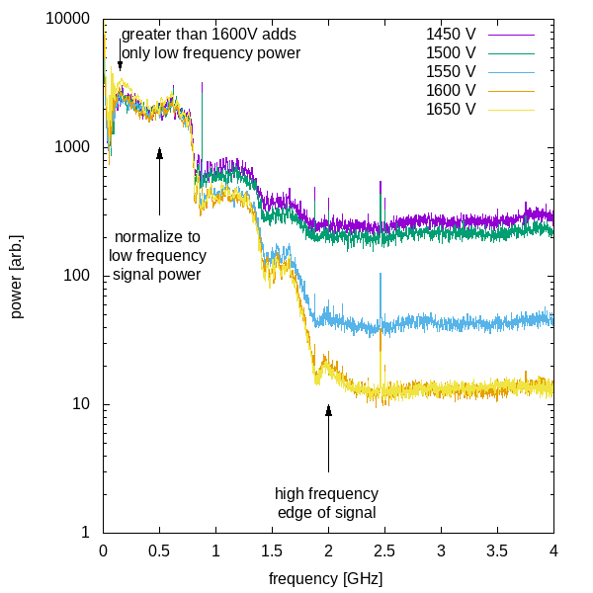
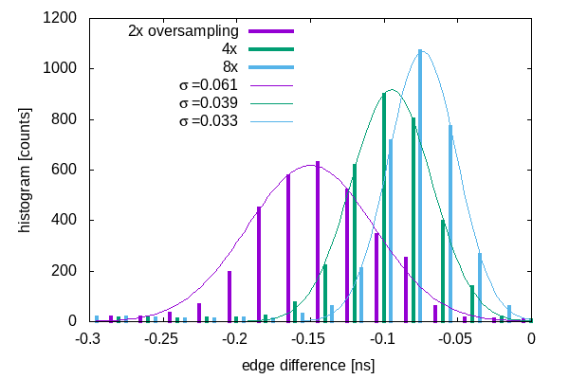
Resolution simulations and testing
  Laser lab signal allowed algorithm development
  Simulations show need for sub-sampling resolution

Slide 12
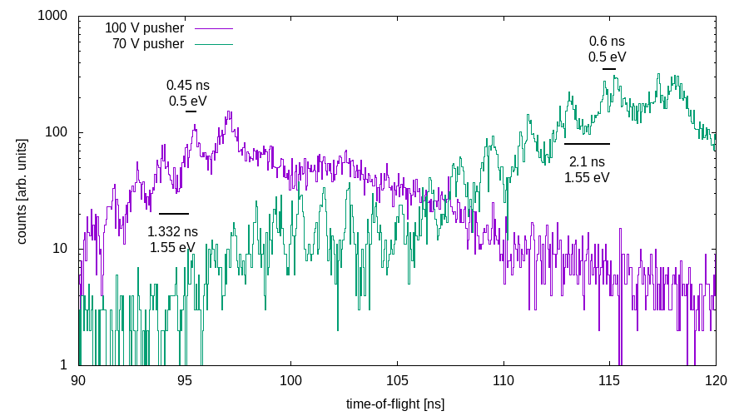
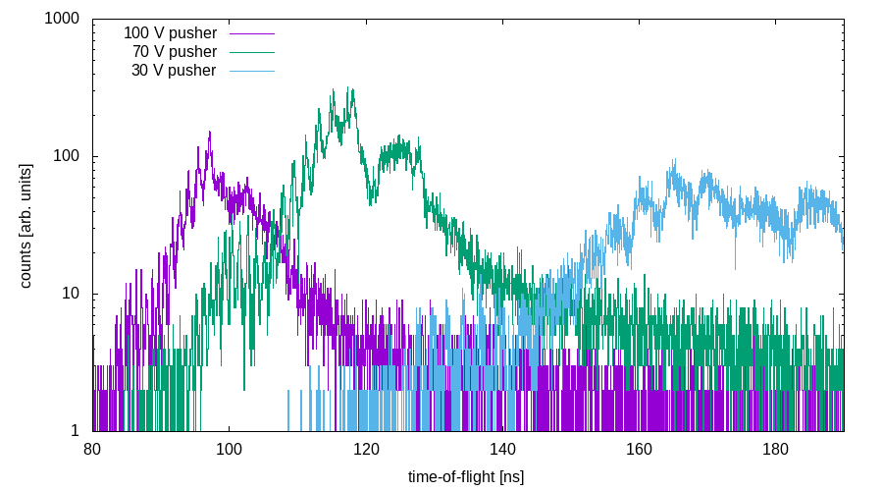
Resolution simulations and testing
  Pushing resolution below sampling
  Aiming for 0.25 eV resolution at 100 V
  30 V spoiled by magnetic fields in steel chamber

Slide 13
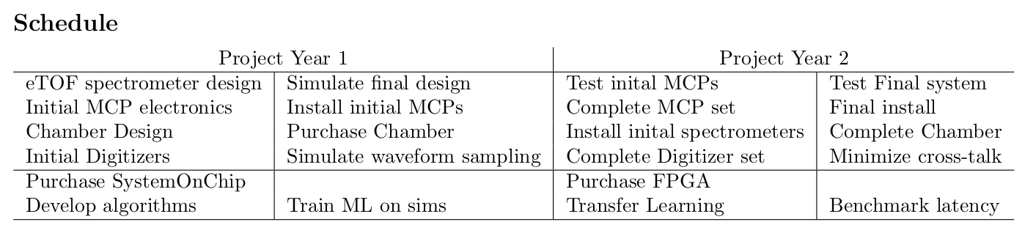
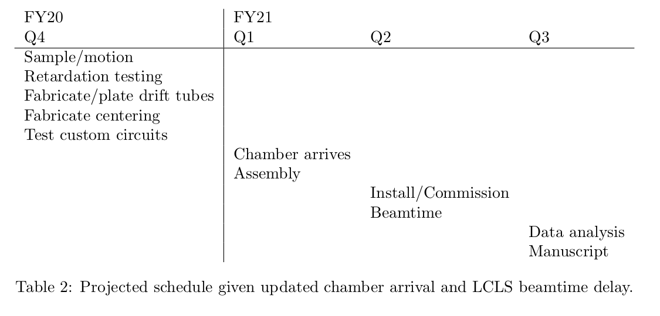
Schedule: March 15 – August 1
  Summary of original deliverable and dates
  \
  Summary of where we are and updated delivery dates
Potential for integrated RF electronics
Second COVID delay to June 17

Slide 14
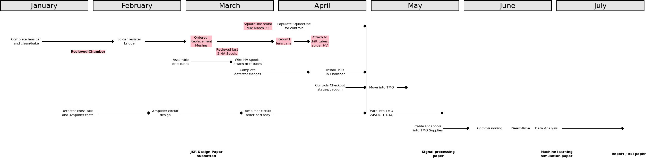
Schedule: January 1 – May 1
  Make a dia chart to show the time-line.

Slide 15
Schedule: May 1 – August 1
  Make a dia chart to show the time-line.

Slide 16
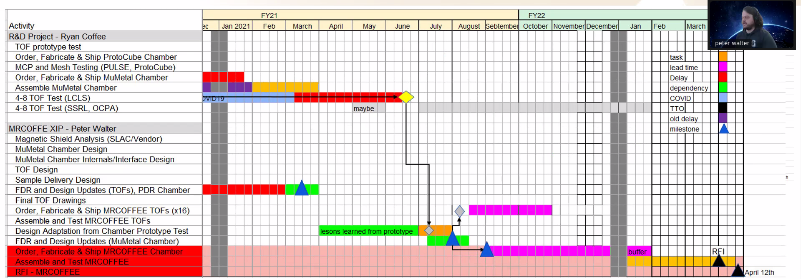
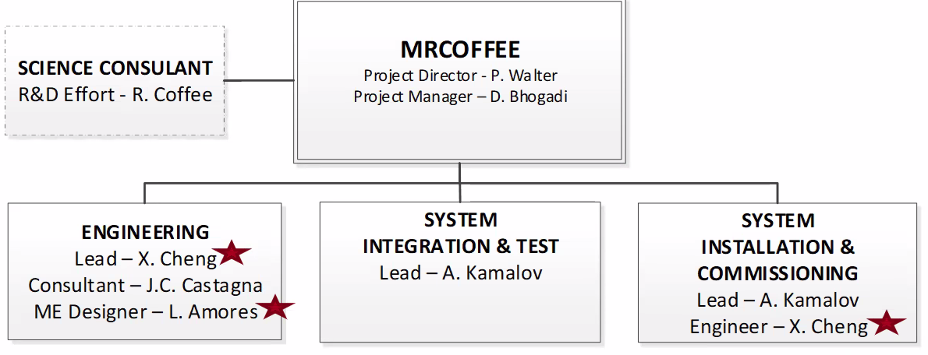
CookieBox to XIP User Project @ August 1
  CookieBox leads to XIP project – delivery to Users, 1 year hence

Slide 17
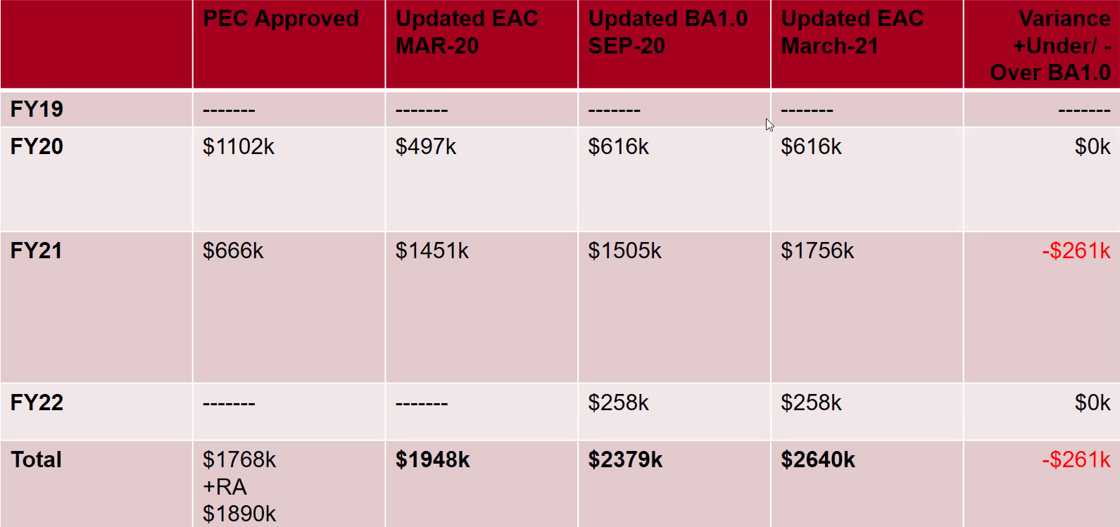
TMO user end station funding
  Output of the R&D project has triggered the XIP funding of a User Instrument for TMO for operations in Spring 2022.
  Early testing has triggered FY21 purchases already
  Principle design will be followed, only minor adjustments.

Slide 18
Near term R&D plans
  (R&D) Stereo ATI (StATI) with infrared 1 μm, 100 kHz pump laser in hpl-lab130 – Q1 Fy22
  (R&D) Carrier envelop phase (CEP) tagging for StATI using 100 kFps Vision Research S710 camera in hpl-lab130 – Q2 FY22
  (R&D) Demonstrate stream-sorting of StATI based on CEP tagging in hpl-lab130 – Q3 FY22
  (XIP) Long wavelength streaking campaign in TMO – Q3/Q4 FY22.

Slide 19
Enabling Accelerator R&D as well as Science
  LCLS-II developments CookieBox detector will support
    Ago’s double XLEAP
    Erik’s polarization shaping
    Alberto’s Fresh Slice methods
    Claudio’s Double Bunch and Harmonic Lasing
    … anything FEL shaping related and multi-bunch
  Scientific methods it will enable
    Ulf Saalman and Jan Michael Rost for enhancement of non-linear signals because of SASE
    “Spooktroscopy” and attoclock ptychography as super-resolution methods in the time-energy domain
    Dynamic Chirality by fs-scale time-dependent polarization shaping
    Attosecond Quantum Information in molecular systems – quantum state tomography as a time-domain “super resolution” (Marco Ruberti, Panofski applicant)

Slide 20
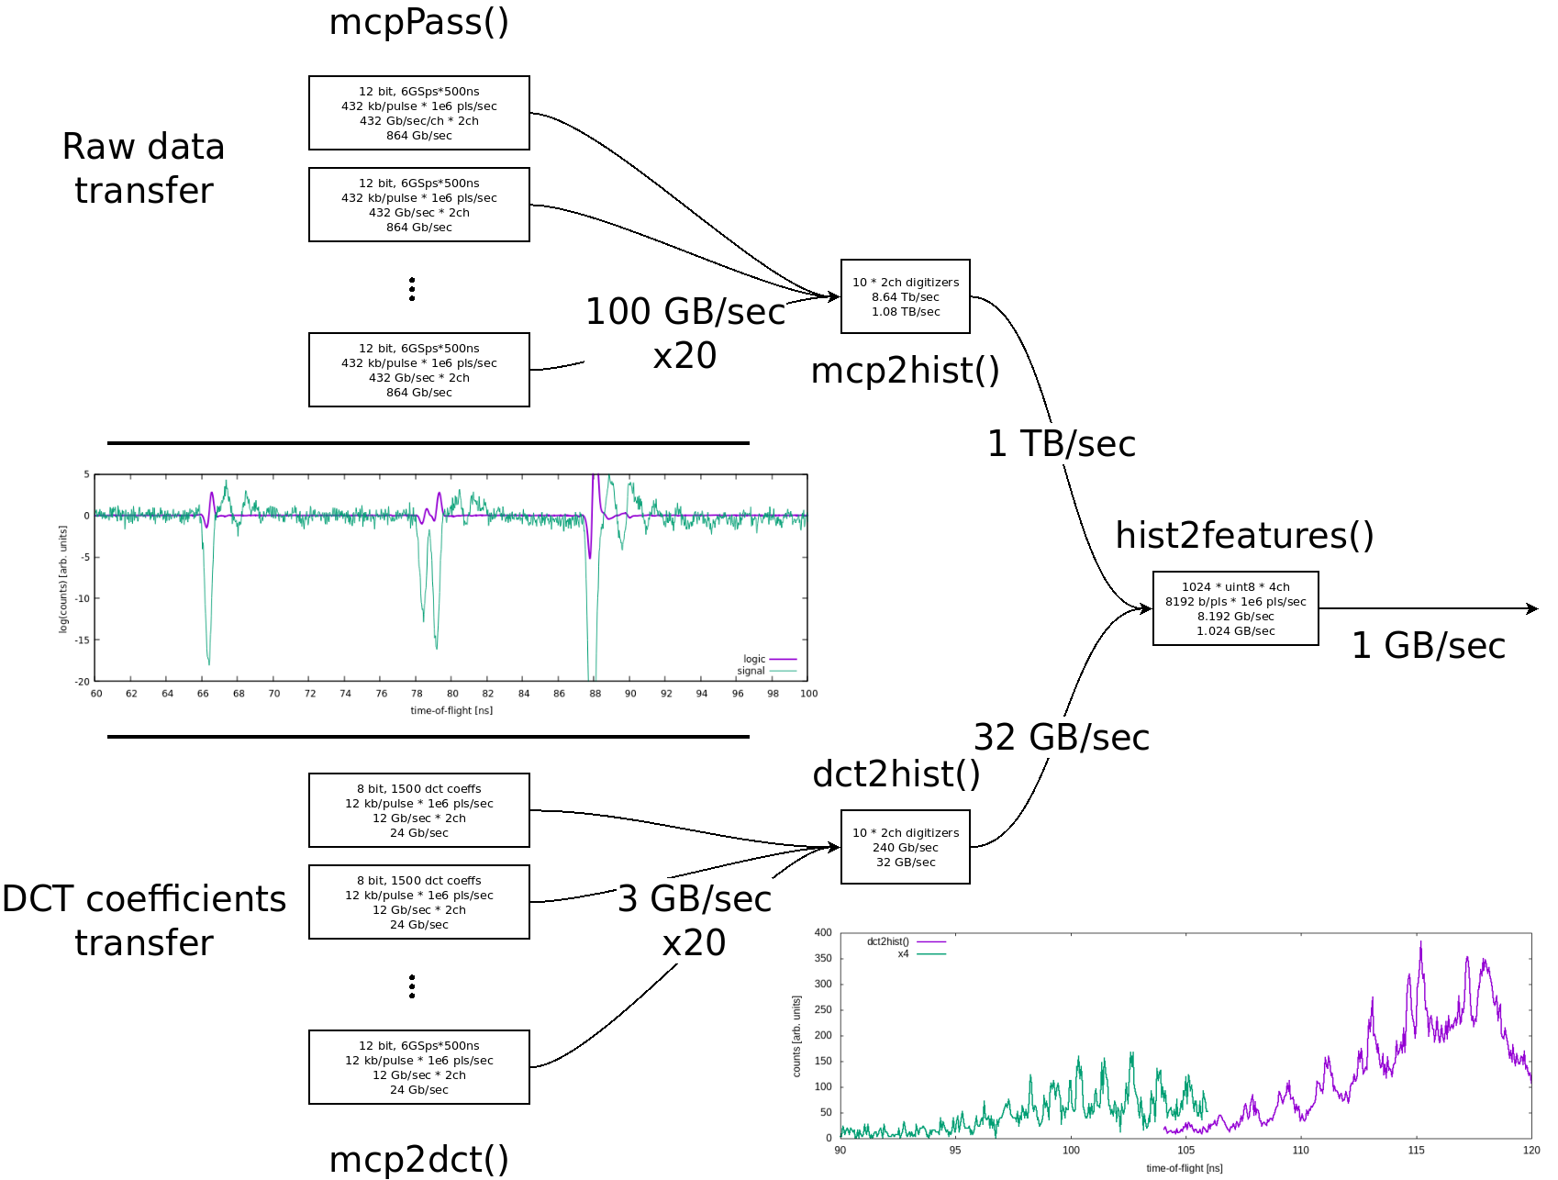
Resolution requires algorithm + compression
  Testing 6 GS/sec sampling
  Preserve 70V resolution compared to 40 GS/sec scope sampling
  32x signal compression

Slide 21
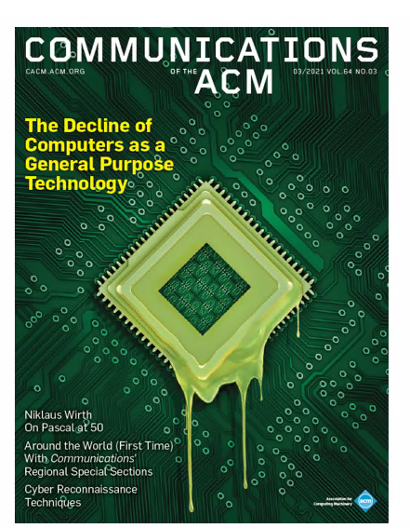
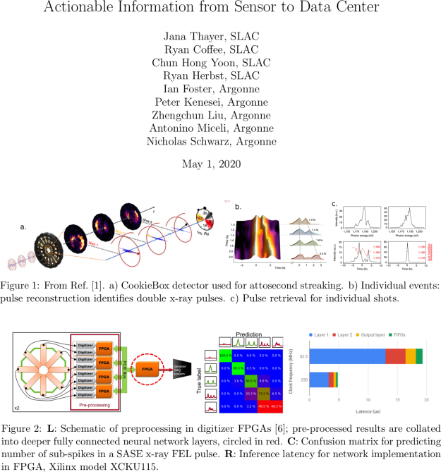
Enabling Strategic Developments – EdgeAI
  AISDC
  Tixel for ToFs
Svenja Spanuth and Neil Thompson
Corbeil Therrien et al., “Machine Learning at the Edge for Ultra High Rate Detectors” NSS-MIC, 1-4, (2019) doi: 10.1109/NSS/MIC42101.2019.9059671

Slide 22
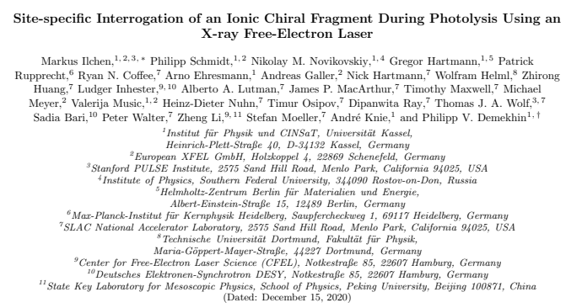
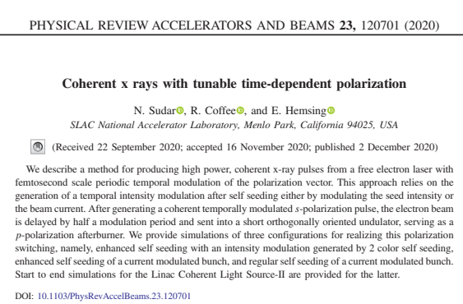
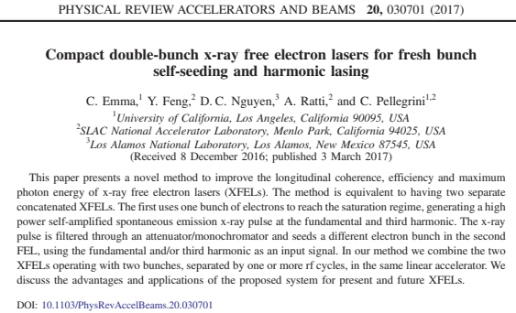
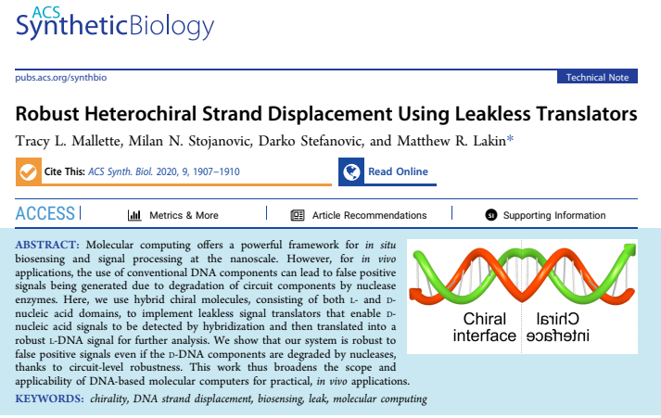
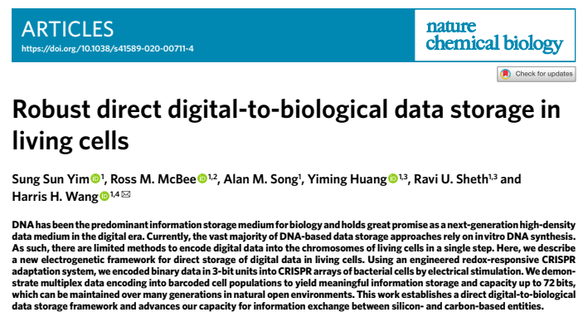
Chirality, Molecular dynamics and Polarization Shaping
  Outline
In vivo molecular computing

Slide 23
Beyond FY21 Technical R&D Topics
  <50 ps resolving area detector (Tixel) versus bucket detector (MCP)
  Bernhard Adams regarding glass embedded amplifier circuit with larger area MCP
  John Fox regarding custom MCP assembly for better RF signal decoupling
  Alternative to Zn/Ni/Au coating of ToF parts
  Re-explore mesh-less electrostatic lens design
  24 channel HV supply for auto-tuning of compound electrostatic lens: auto-CEL – a self-aware CookieBox

Slide 24
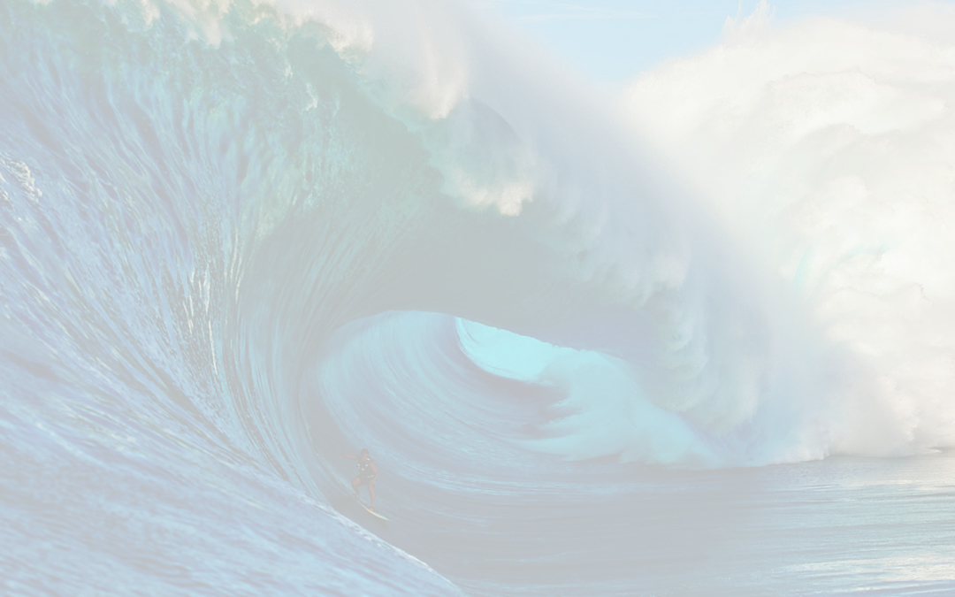
The CookieBox → MRCOFFEE Team
  Omar Quijano (TID-AIR Staff)
    EdgeML system admin
  Matt Feldman (EE/CS PhD Student) – Samba Nova
    Spatial-lang for FPGA
  Audrey Corbeil-Therrein (Banting Post-Doc Fellow) – Faculty @ U. Sherbrooke
    FPGA developer and ASIC design
  Andrei Kamalov (TMO Post-Doc)
    Laser lab testing and demonstration, CookieBox design and assembly, beamtime co-lead
  Razib Obaid (TMO Project Scientist)
    Detector R&D, CookieBox assembly, beamtime collaborator
  Averell Gatton (TMO Post-Doc) – (Clostra, Inc.)
    Simulations and model training, CookieBox design, beamtime author
  Debadri Das (Applied Physics PhD Student)
    Signal processing and algorithms
  Jack Hirschman (Applied Physics PhD and CS Student)
    RF electronics, FPGA, ASIC, and source control
  Naoufal Layad (Institute for Computational and Mathematical Engineering Masters Student)
    Surrogate modeling, Ensemble methods and Bayesian Networks
  Coffee (CookieBox lead), Walter (TMO/MRCOFFEE lead), Dragone (ASICs/Detectors), Herbst (FPGAs)

Slide 25
Title
  Outline

Slide 26
Future R&D plans – Time-of-flight
  24/36 channel HV supply for automatic tuning of compound electrostatic lens (auto-CEL)
  Replace resister bridge with capacitive bridge
  Zinc-free, Nickel-free Gold coating for aluminum ToF parts
  Explore mesh-free compound electrostatic lensing (maybe impossible)

Slide 27
Technical topics
  SquareOne delay
  Can’t coat gold due to Zn poisoning, Alternative failed, using bare aluminum for beamtime
  Copper Meshes without Ni are too delicate to have electronics shop construct, attempting to solder ourselves
  Resister bridge is fixed, future developments would use multipin connectors for individual resistance
  Mu-metal chamber was a nightmare from MDC, UK group was great, but MDC middle management is a mess, late and no communication. Biggest risk to project.
  Installing extra MCPs if an order from XIP budget can come in time, get up to 12 sampled angles in June maybe, 8 w retardation, 4 bare assemblies. Use commissioning to use photonis MCPs.
  Discussing Bernhard Adams MCPs with electronics embedded in glass vacuum window, his current low-capacitance wire anode has too long a decay and ideally doubles the number of digitizer channels needed. Looking at alternatives, but not for June.
  Still haven’t been able to test the pore-size dependence and charge depletion for high rep-rate. Working with Franz Tavella to do so after June beamtime in laser lab.
  Planning a stereo ATI experiment with Franz’s laser to demonstrate data acquisition and depletion in the protocube in the laser lab. Ideally move the R&D chamber if not using LCLS parasitic beam.

Slide 28
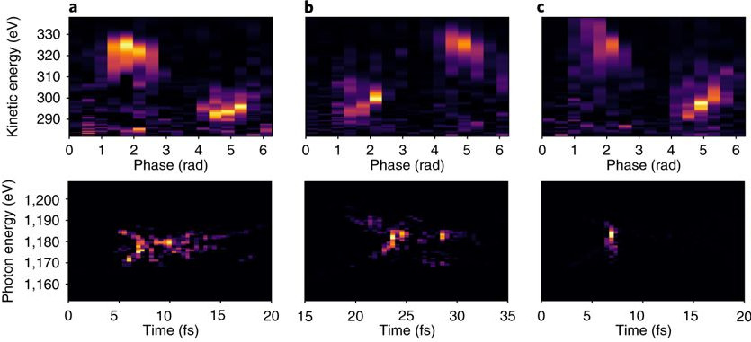
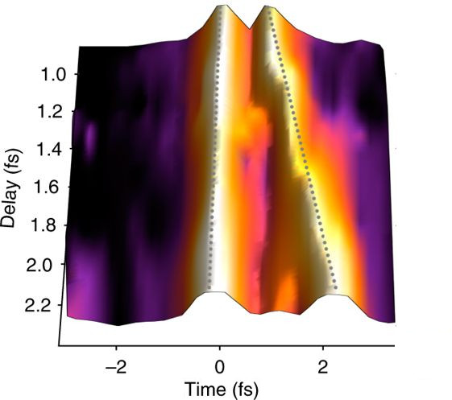
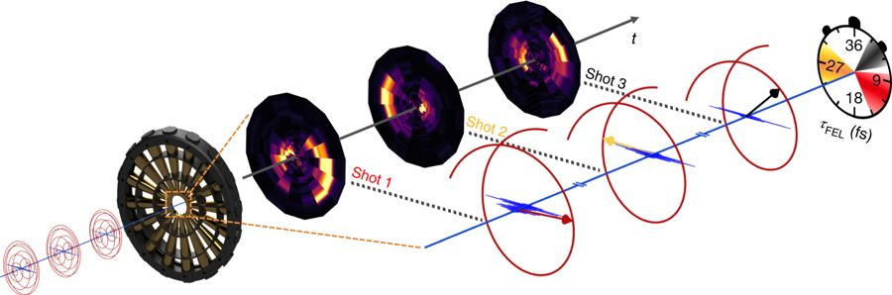
Ultrafast Inference … streaking example
  Need the Time-Energy distribution of the x-ray pulse
  Forward simulation is trivial
  Inference engine can learn to solve the inverse problem
  Informs detector chain actions
    Veto
    Delay sorting
    Corner case
Hartmann et al., Nat. Photon. 12 215 (2018)

Slide 29
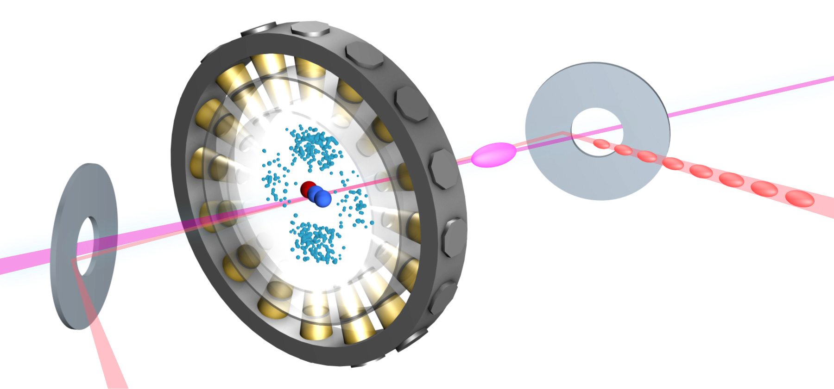
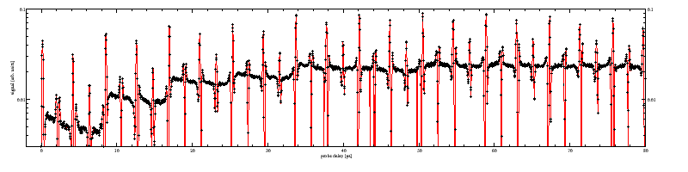
3 slide personal aside – Molecular spectroscopy (Varun)
  Electron spectroscopy in the molecular frame
  ARPES for gas phase molecules, but resonant Auger and so hybrid ARPES-RIXS
  We can pump ro-vibrational coherences

Slide 30
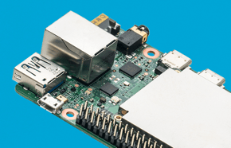
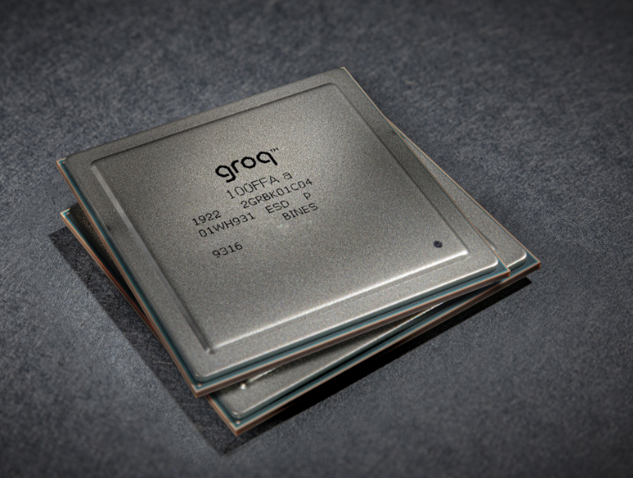
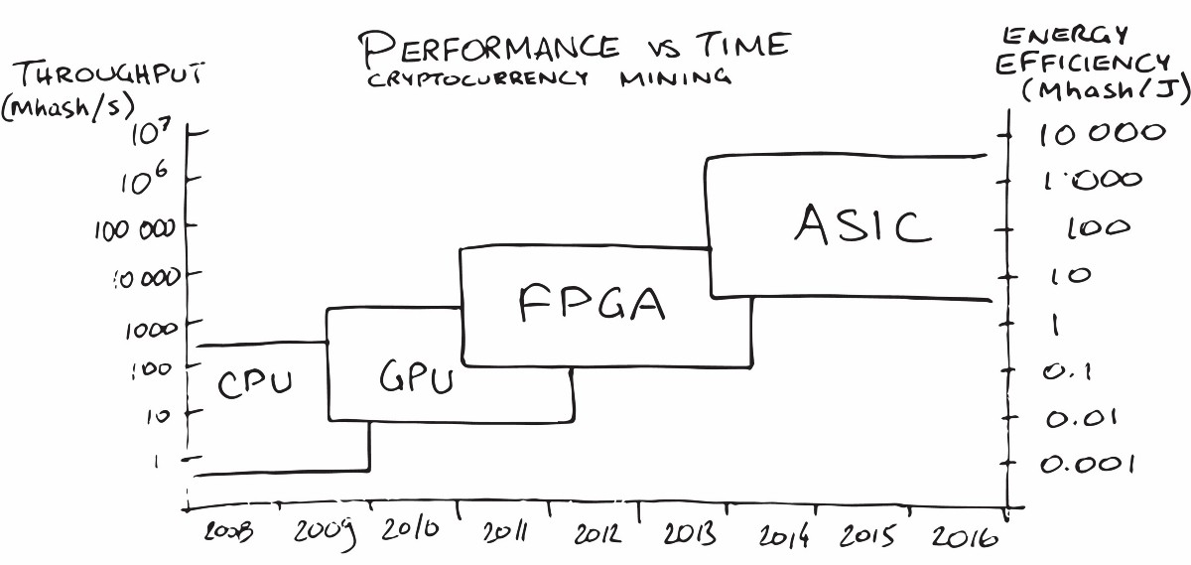


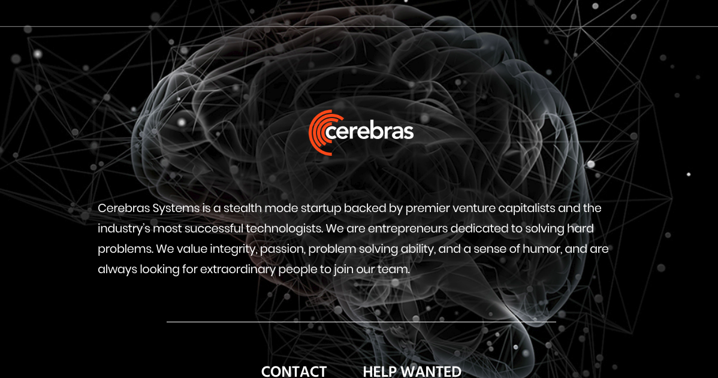
That ecosytem is getting more intelligent
Spectrogram of CookieBox
Edge TPU
https://hackernoon.com/the-future-of-machine-learning-hardware-c872a0448be8
  Each channel is treated in parallel then 2x combined
  2x channels are chosen by physical system, exploit angular correlations
  PCIe to KCU1500 for final combination

Slide 31
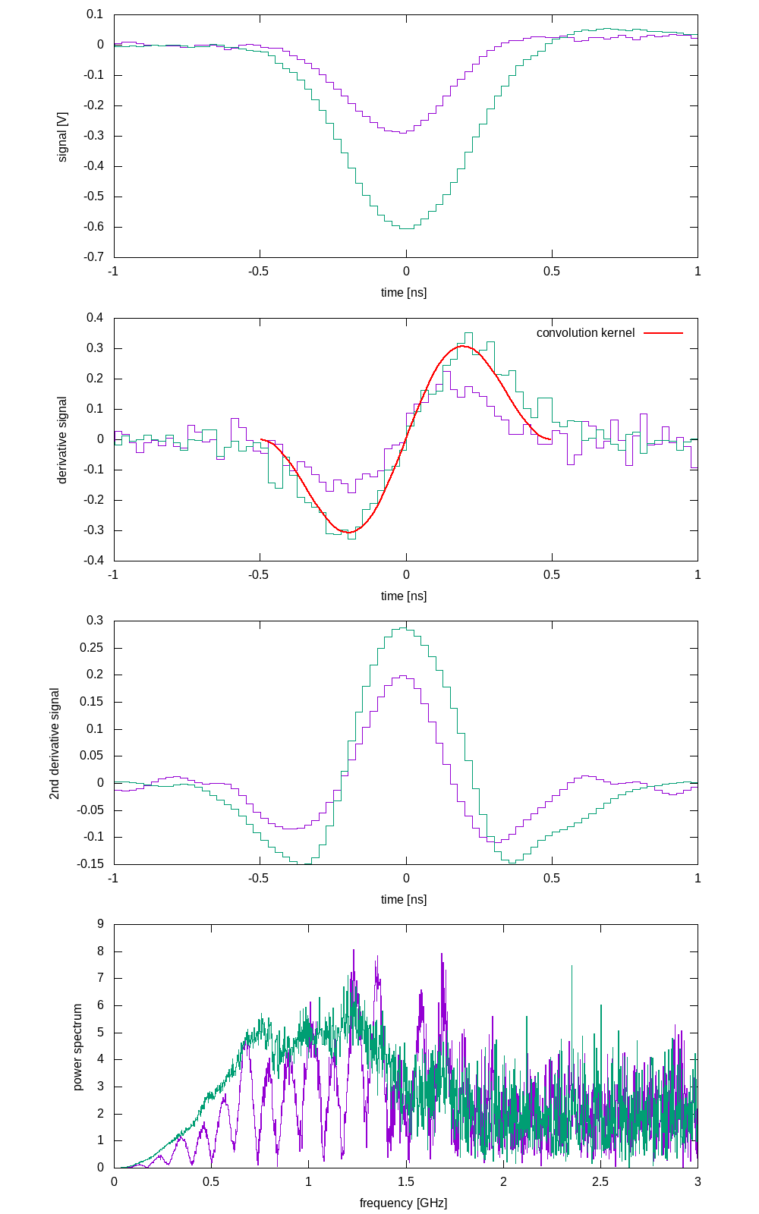
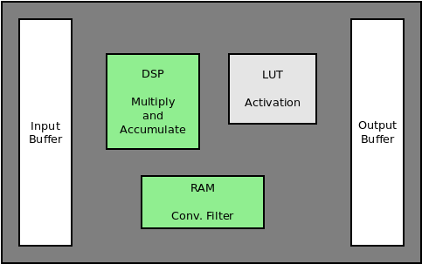
“Featurization”
  Here is Jack’s amp circuit
  In an FPGA, the brute force convolution is naturally “flowy”
  This should be the argument about resolution needs sub-sampling
  Use the inner product

Slide 32
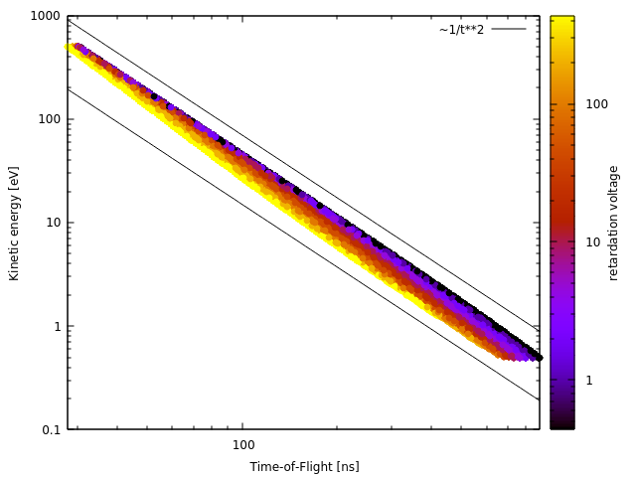
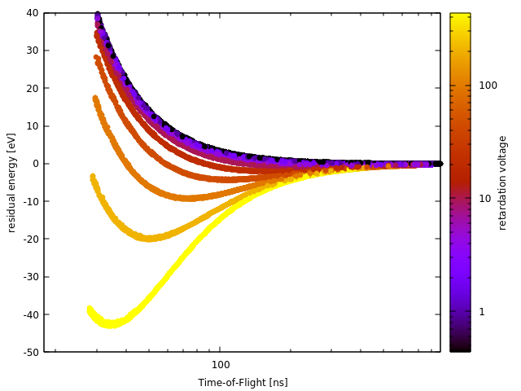
Everything is linear in log space
  Only proportionality matters
  Powers become linear in log-space
  Fit the residuals with downstream models
    2 features = (ToF, Ret.)
    Polynomial Kernel, linear regression for Θ
    Now this is a lean t2e model

Slide 33
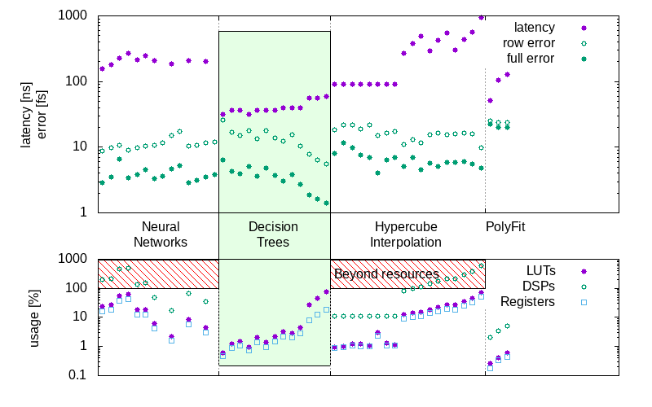
Make perturbation theory work for you
Matt Feldman in prep.

Slide 34
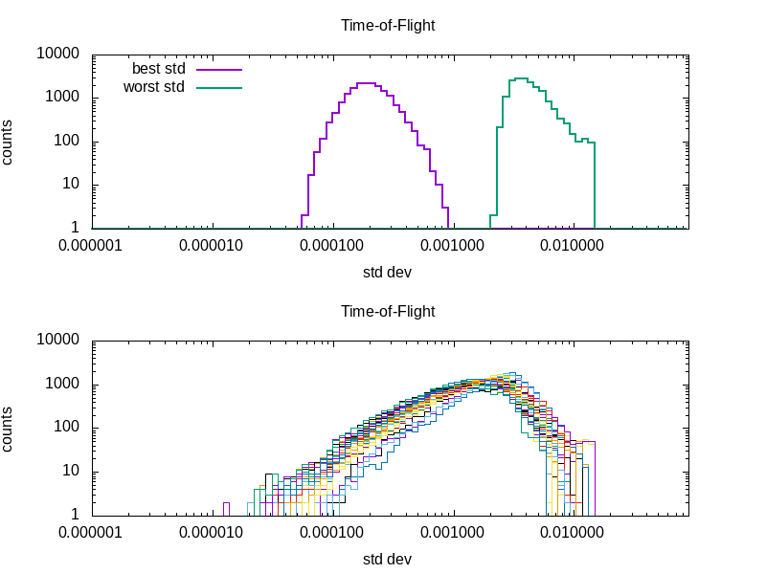
Ensembles
  Why I like Gaussian Processes for ensemble voting
  Decision Trees could use gini impurity, but it is leaf, not input dependent
  … should work the same though for a forest

Slide 35
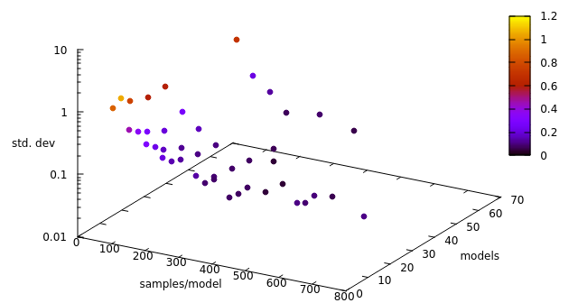
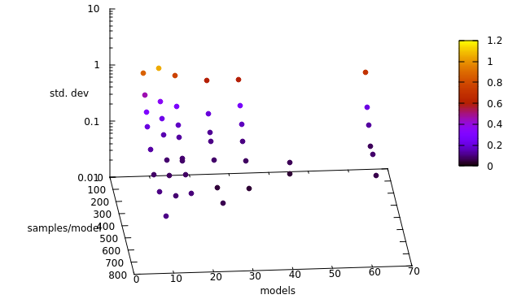
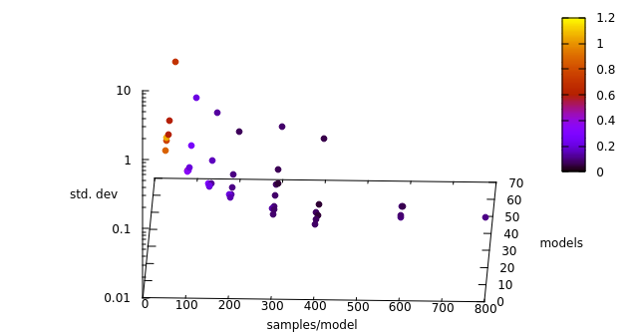
Ensembles
  Careful of building a lookup table
  More samples helps each model… but there is a latency price
  More models in ensemble has diminishing return, but model parallelism

Slide 36
Remember what we care about
  Kinetic energy versus angle
  1 sinusoid : how short, what color
  2 : how short are they, what color are they, and time separation
  3+ : if more pass to deeper model for full reconstruction
Hartmann et al., Nat. Photon. 12 215 (2018)

Slide 37



Everything is linear in log space
  Now what to do with list of times
  Physics tells you how time converts to energy… it is a power law, E ~ t**(-2)
  Let’s work in log space
  … but in the FPGA?!
  Unroll that loop and pipeline!
Jean-Pierre Deschamps, Gustavo D. Sutter, Enrique Canto,
Guide to FPGA Implementation of Arithmetic Functions
Courtesy Jack Hirschman

Slide 38

Dataflow paradigm
Digitizer FPGA, e.g. XCKU115
Xilinx Alveo or similar
  Think about resource usage, how does your chain “flow”

Slide 39

Dataflow paradigm
Digitizer FPGA, e.g. XCKU115
Xilinx Alveo or similar
A. C. Therrien, et al., 2019 IEEE NSS/MIC, 1-4 (2019)

Slide 40

Dataflow paradigm
Digitizer FPGA, e.g. XCKU115
Xilinx Alveo or similar
A. C. Therrien, et al., 2019 IEEE NSS/MIC, 1-4 (2019)

Slide 41
Dataflow paradigm – Naoufal’s work, show his network
Digitizer FPGA, e.g. XCKU115
Xilinx Alveo or similar

Slide 42

Hits2pdf
  Needs 16 energy domain histograms… lists of times is not really ideal

Slide 43

Dataflow paradigm
Digitizer FPGA, e.g. XCKU115
Xilinx Alveo or similar
  Think about resource usage, how does your chain “flow”

Slide 44

Dataflow paradigm – Show Jack’s unrolled log()
Digitizer FPGA, e.g. XCKU115
Xilinx Alveo or similar
  Think about resource usage, how does your chain “flow”

Slide 45

Embarrassingly similar infrastructure – Only digitizers
  Each channel is treated in parallel then 2x combined, then 8x combined
  2x channels are chosen by physical system to exploit angular correlations, e.g. 90 degrees
  PCIe to KCU1500 for combined inference

Slide 46

The Edge Ecosystem
  Detectors have potential for prohibitive data velocity – digest at the source
  Need an approachable programming model – Python, c++
  Experiments completely change every week – FPGAs more than ASICs
  Users are the domain experts, they should design/train the models – Docker, User PC/Cluster

Slide 47

The Edge Ecosystem
  Use two “in-house” cases
    TimeTool & CookieBox
    Both demonstrate real-time decision making, autonomous control, and data routing
    High visibility to broad user community
    Encourage users to develop at home
  One or both exist in the front-end enclosure radiation area

Slide 48

Thank you

