Slide 1
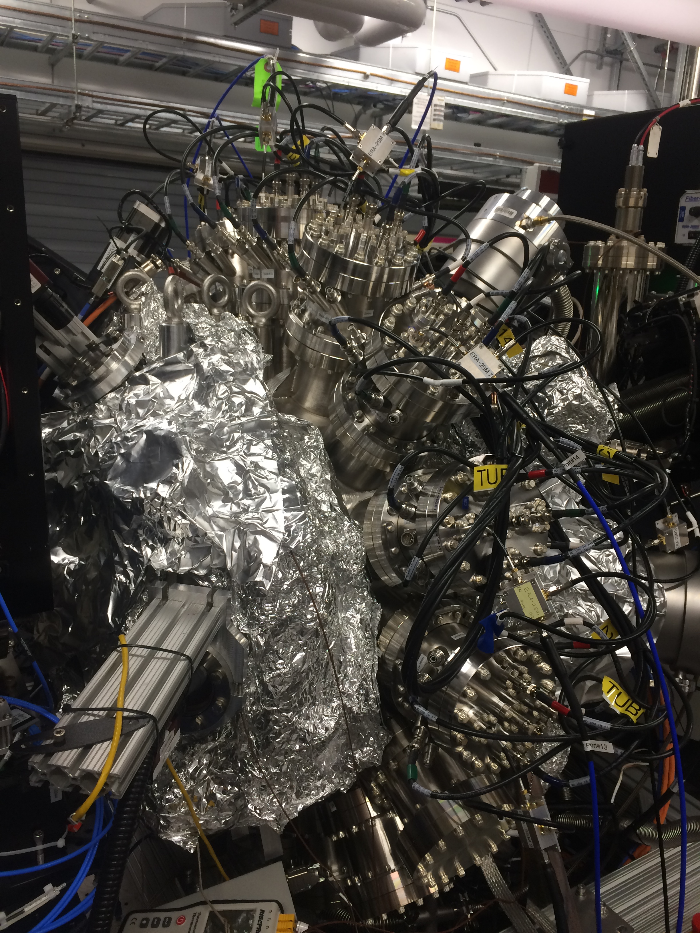
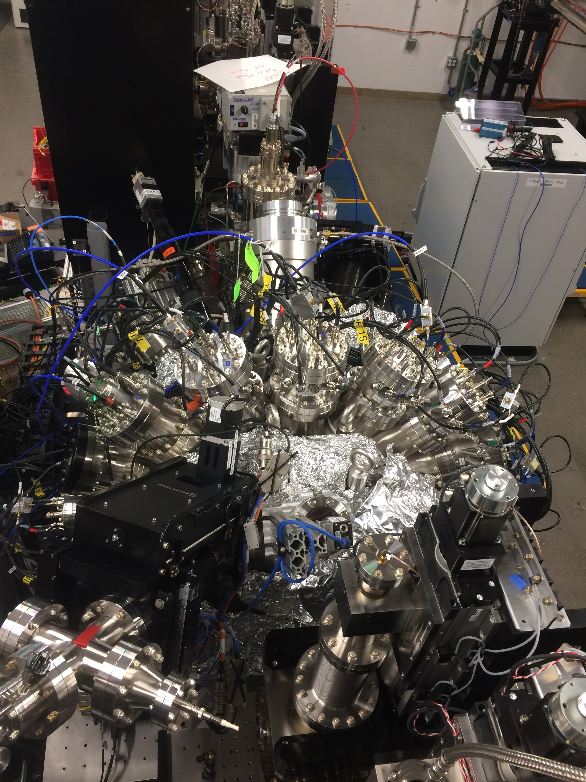
Installed system
Side view
Top view
  Cite submitted paper

Slide 2
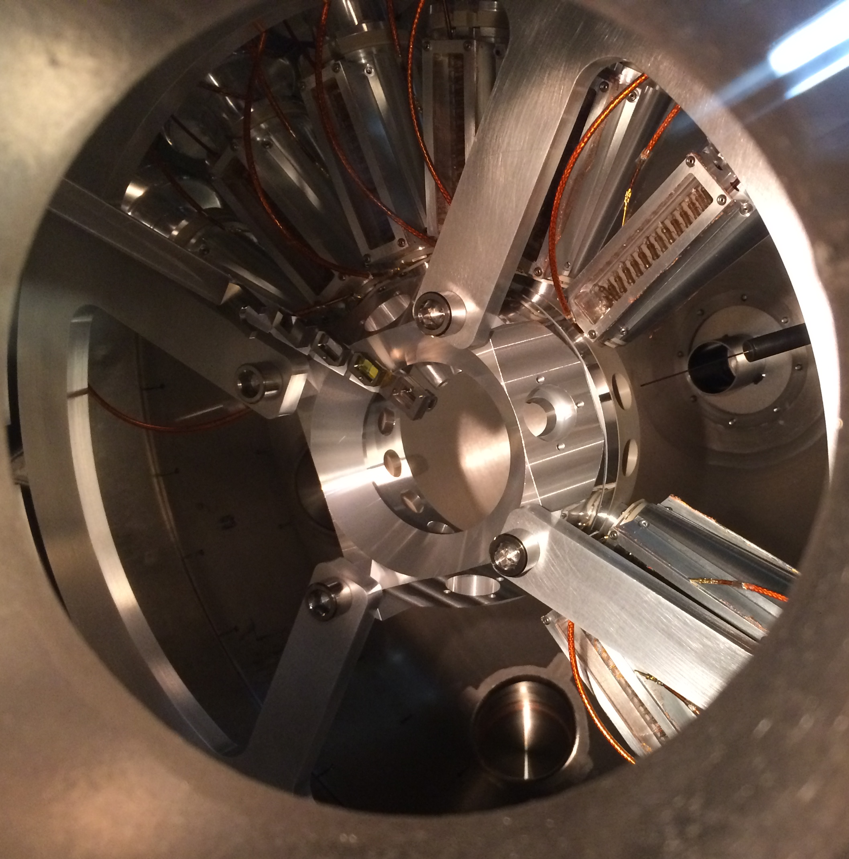
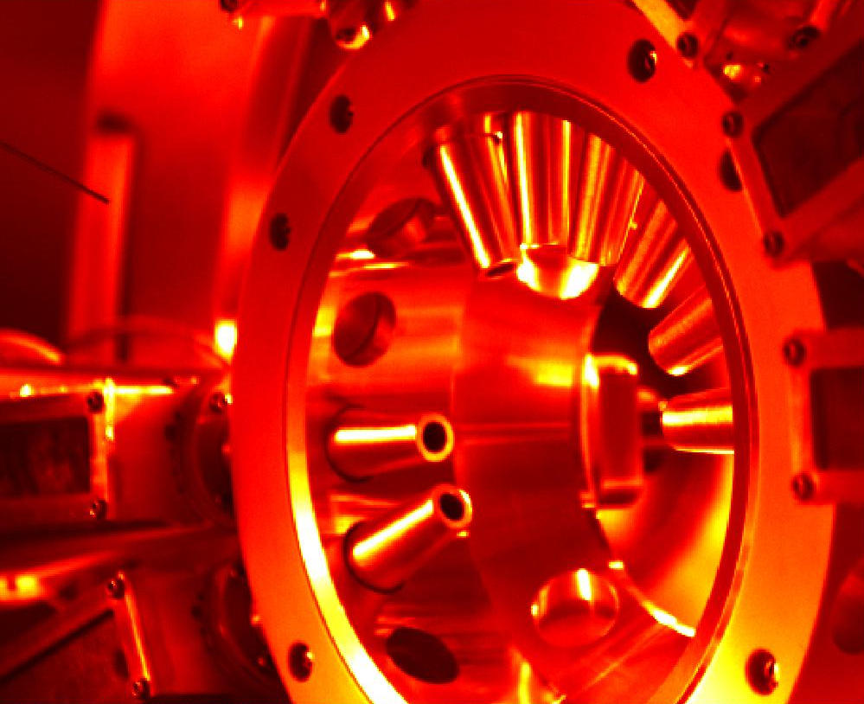
Inside the chamber
  8 ToFs installed, 2 bare MCPs for “Current mode” resilience testing
  Positioning paddle, Gas needle, 4 pumps
Front view
Back view

Slide 3
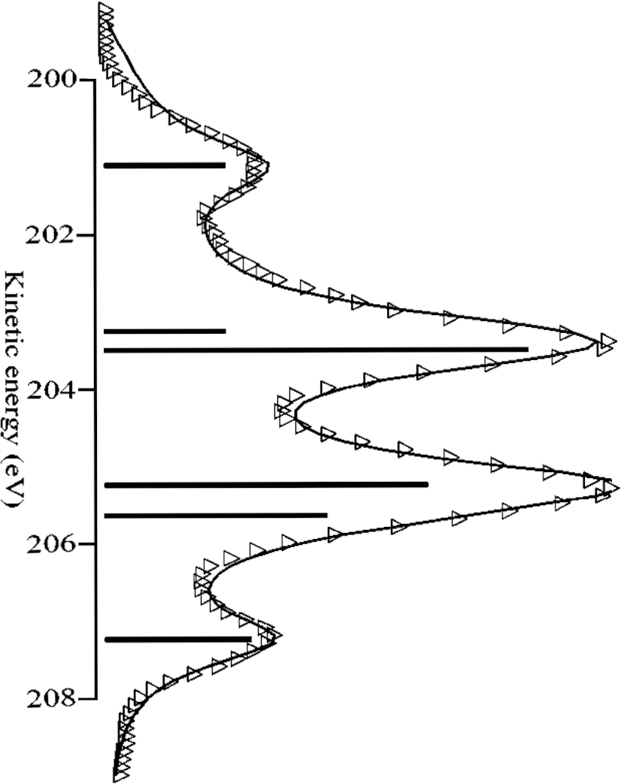
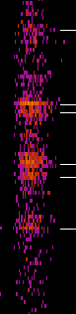
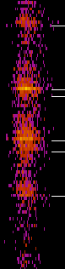
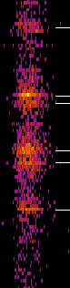
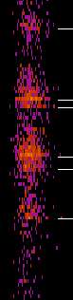



Resolution measurements with Argon LMM
  201, 203, 205, 207 eV spectral features with 100 V retardation
  Preliminarily ½ eV resolution at 100eV pass energy (maybe ¼ eV)
0
-90
90
Guillemin et al., Rev. Sci. Inst. 71, 4387 (2000)
90 112.5 -90 -45 -22.5 0 22.5

Slide 4
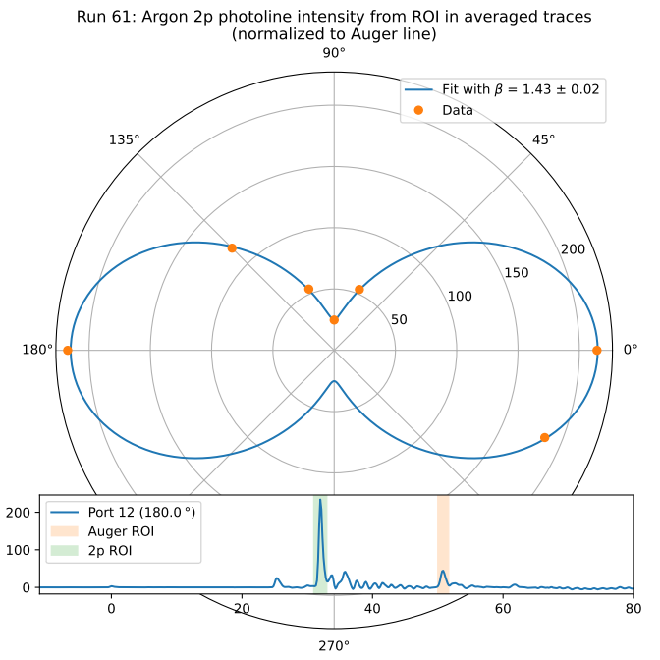
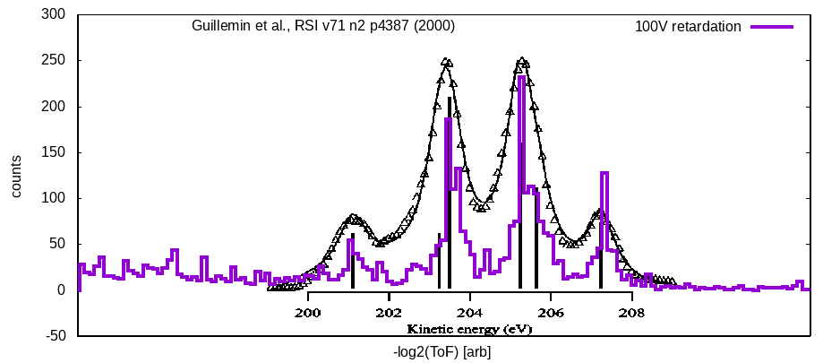
Argon LMM Auger resolution and 2p angular resolution
Courtesy Lars Funke
  Looks like simulation
  Measured 1.43 vs 1.465… validates use as polarimeter
  Potentially ½ or ¼ eV resolution at 100eV pass energy

Slide 5
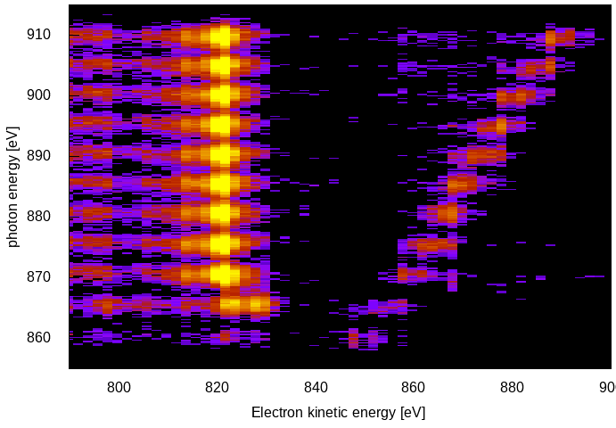
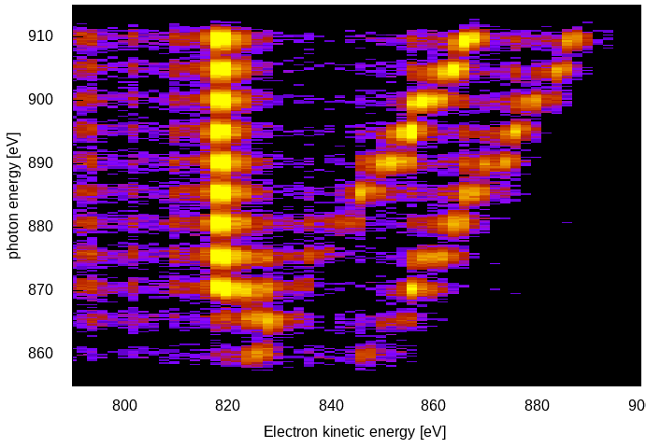
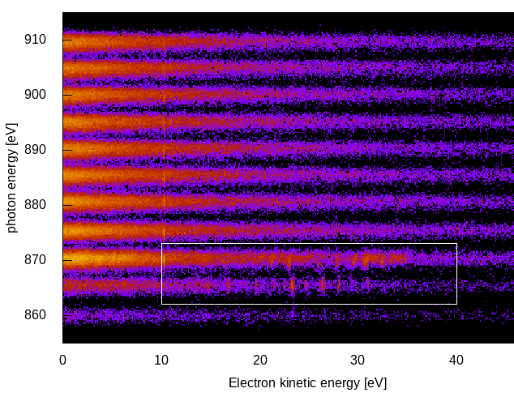
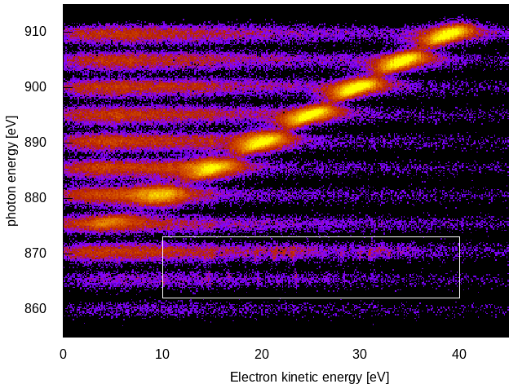
Neon Augers, Photos and Autoionizing 1s² 2s¹ 2p⁴ 3p E/dE > 200 for single 0 eV -- 1 keV spectral window
KLL
2s
2p
KLL
2s
2p
  Low energy electrons highly sensitive to magnetic fields
  Previous CookieBox experienced significant dependence of angular patterns to Helmholtz coil nulling fields
  Steel chamber tests were blind below 30eV
Vertical Horizontal
Secondaries
All the way down
to few eV
Autoionization

Slide 6

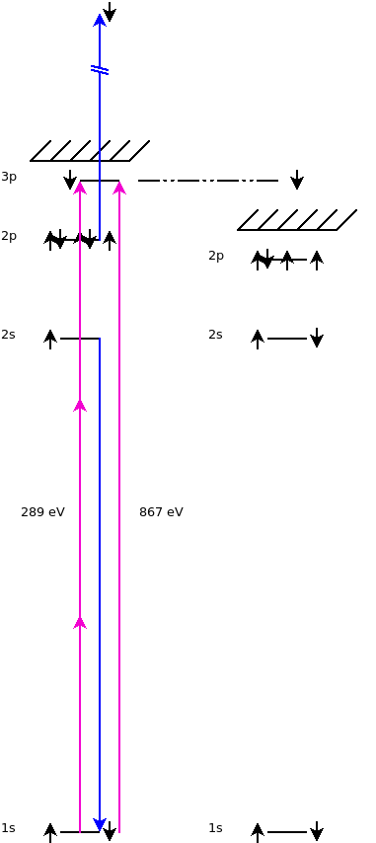
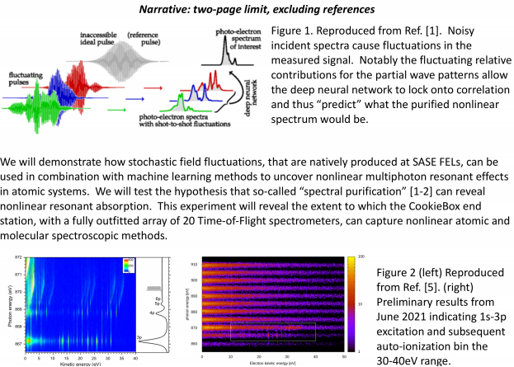
Autoionizing features motivates multi-path interference
Readout
channels
  Ulf Saalman and Jan Michael Rost for enhancement of non-linear signals because of SASE, Inhouse proposal submitted last Friday
    “Spooktroscopy” and attoclock ptychography as super-resolution methods in the time-energy domain … Daniel Ratner engaged, Alberto Lutman mode used in beamtime
    Dynamic Chirality by fs-scale time-dependent polarization shaping

Slide 7
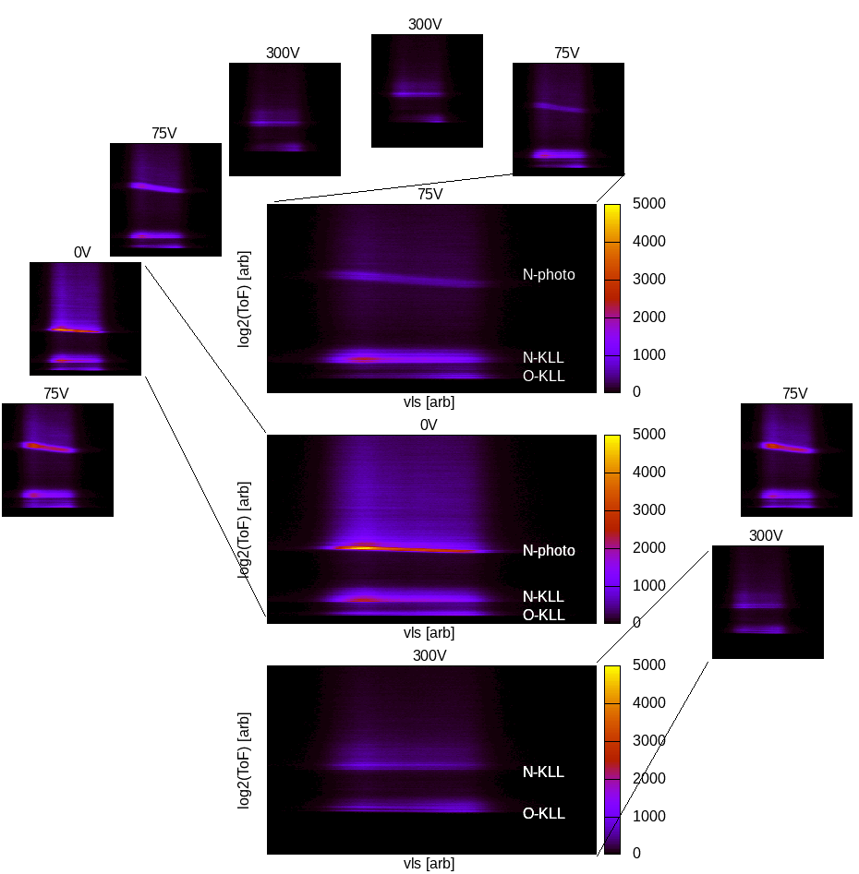
Multi-edge resolution
  N₂O Resonant Auger
  N 1s photoelectrons (75V)
  N KLL and O KLL Auger electrons (300V)
  Haven’t yet pushed resolution here yet
  Surrogate demonstration for multi-color measurements

Slide 8
Jack’s Analog Preprocessing
  Ideally integrated with detector flange

Slide 9
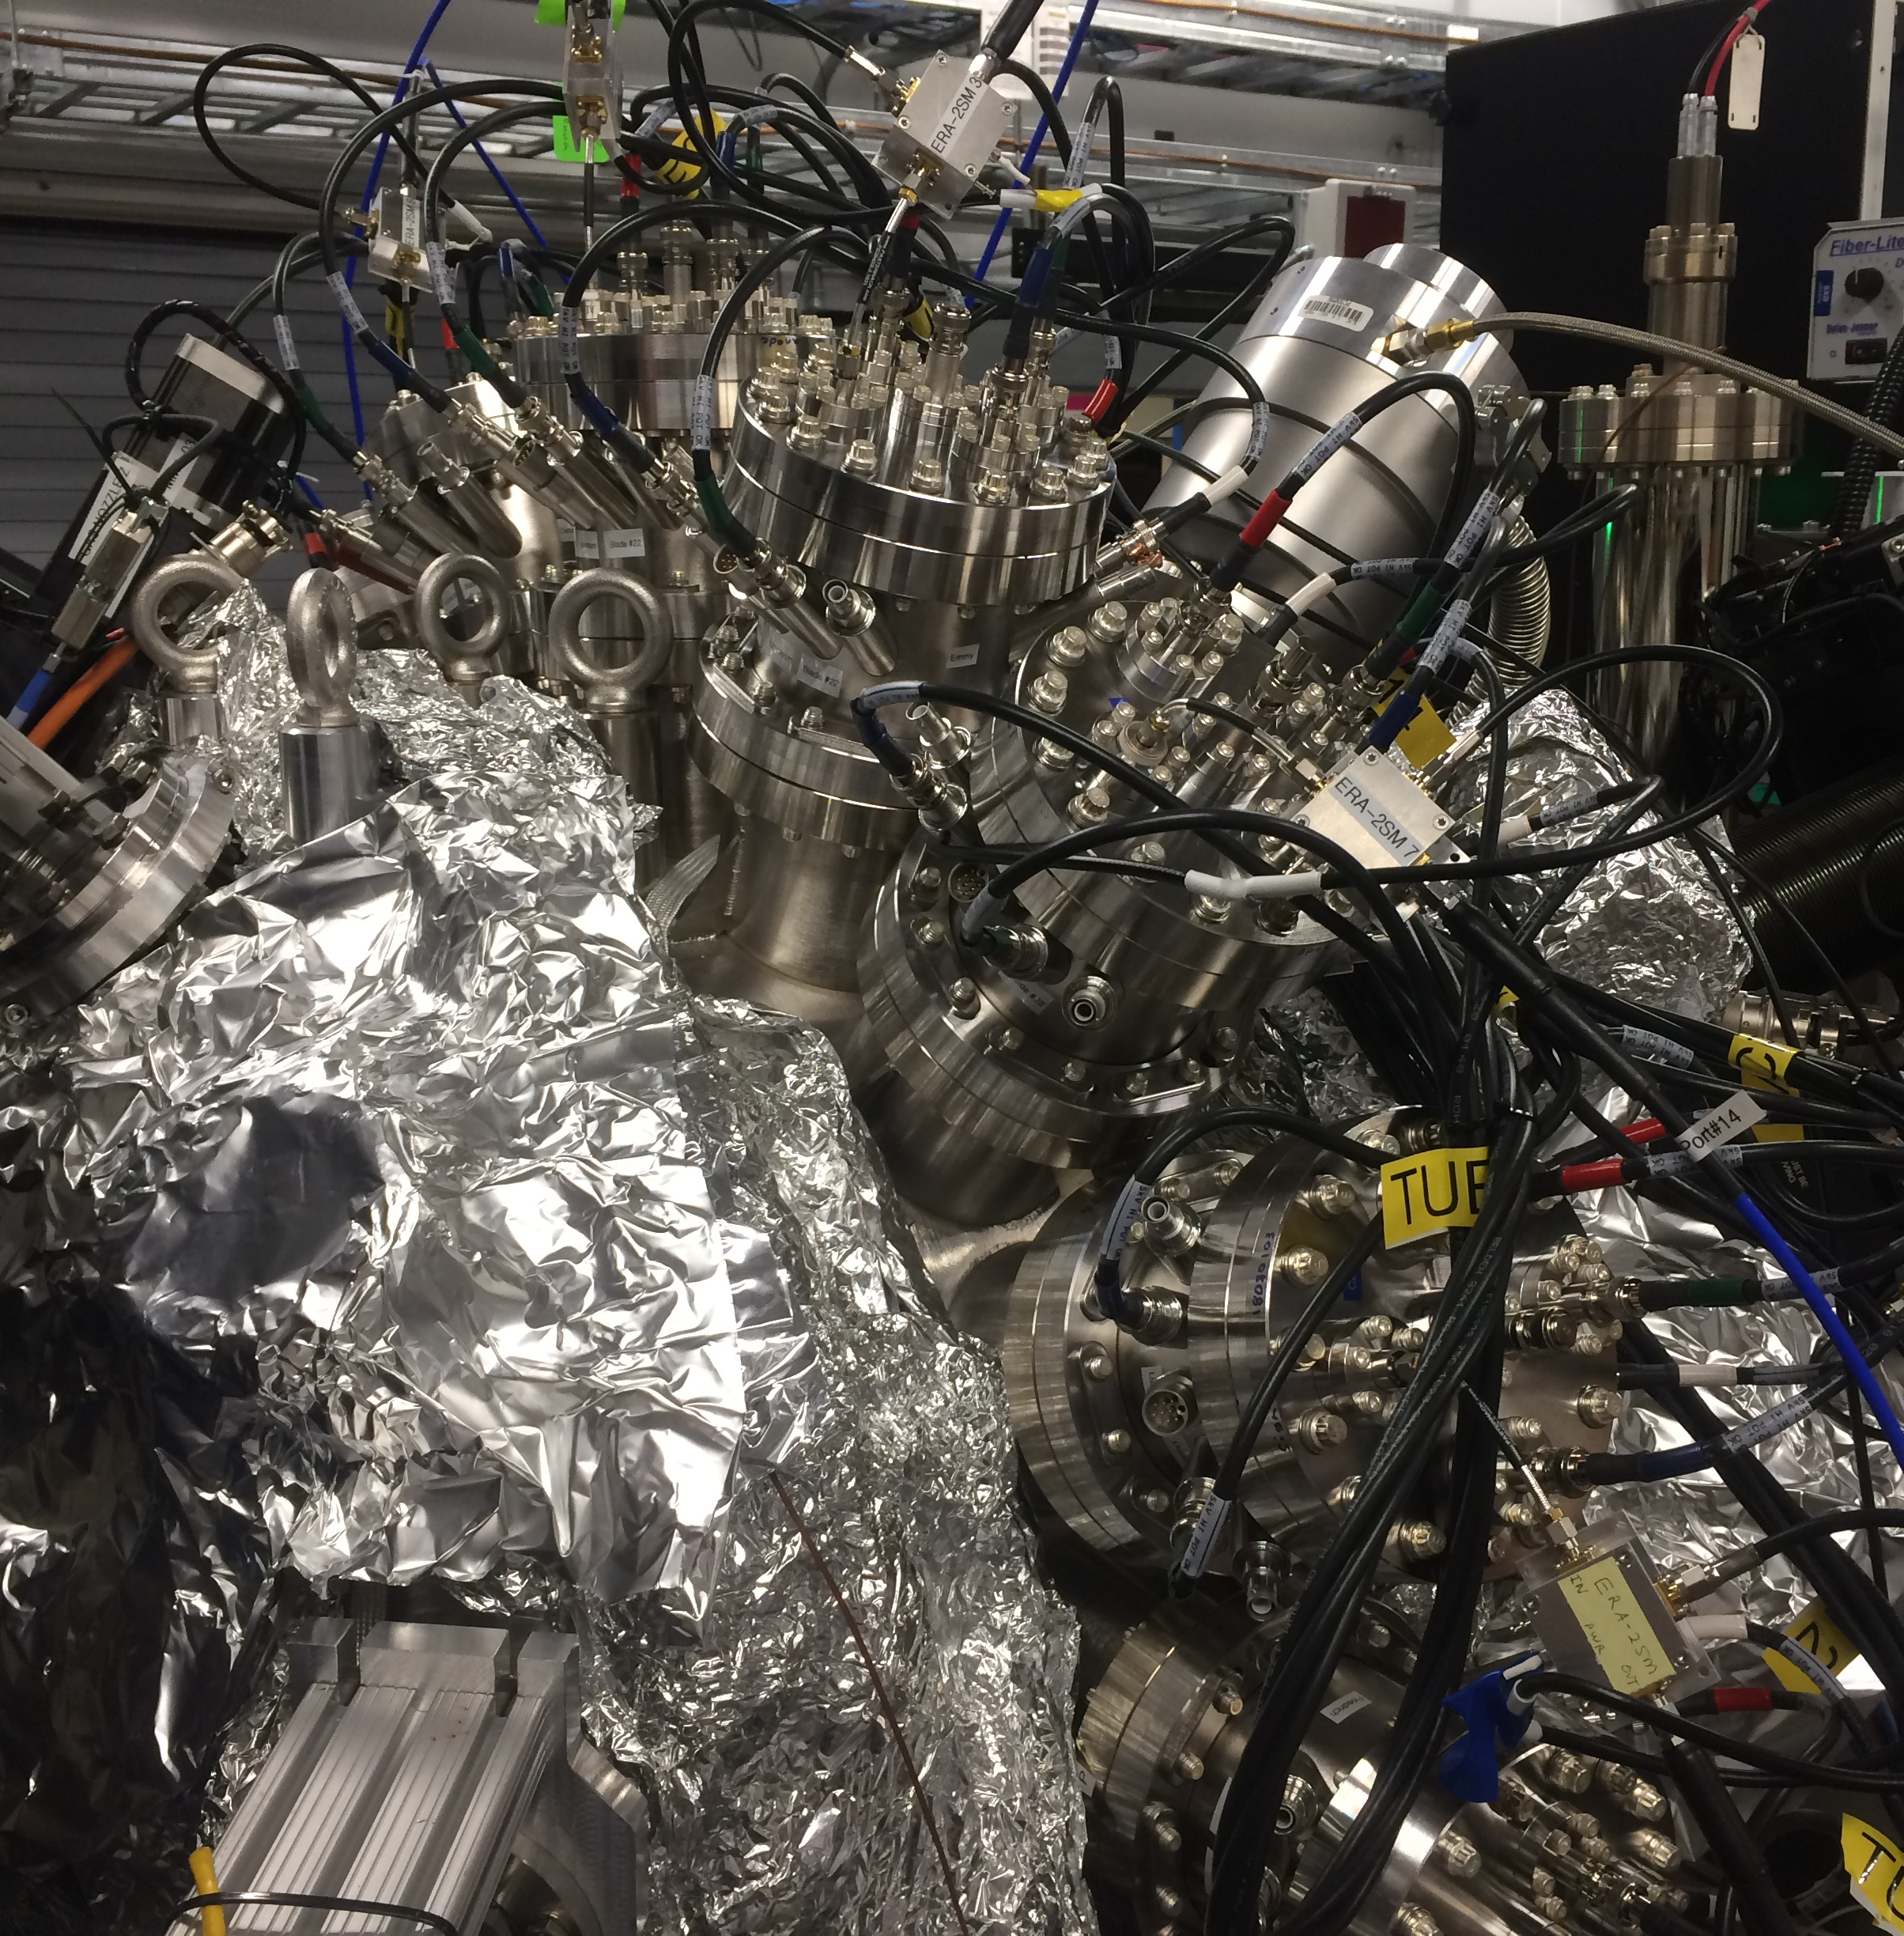
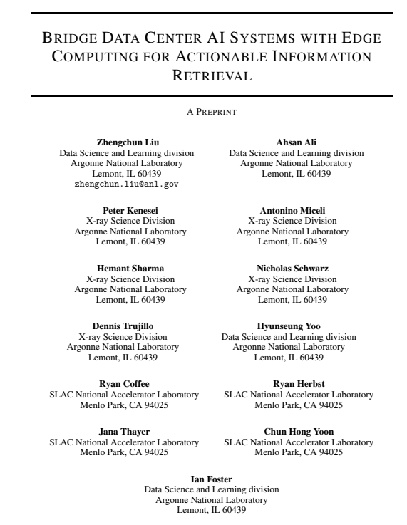
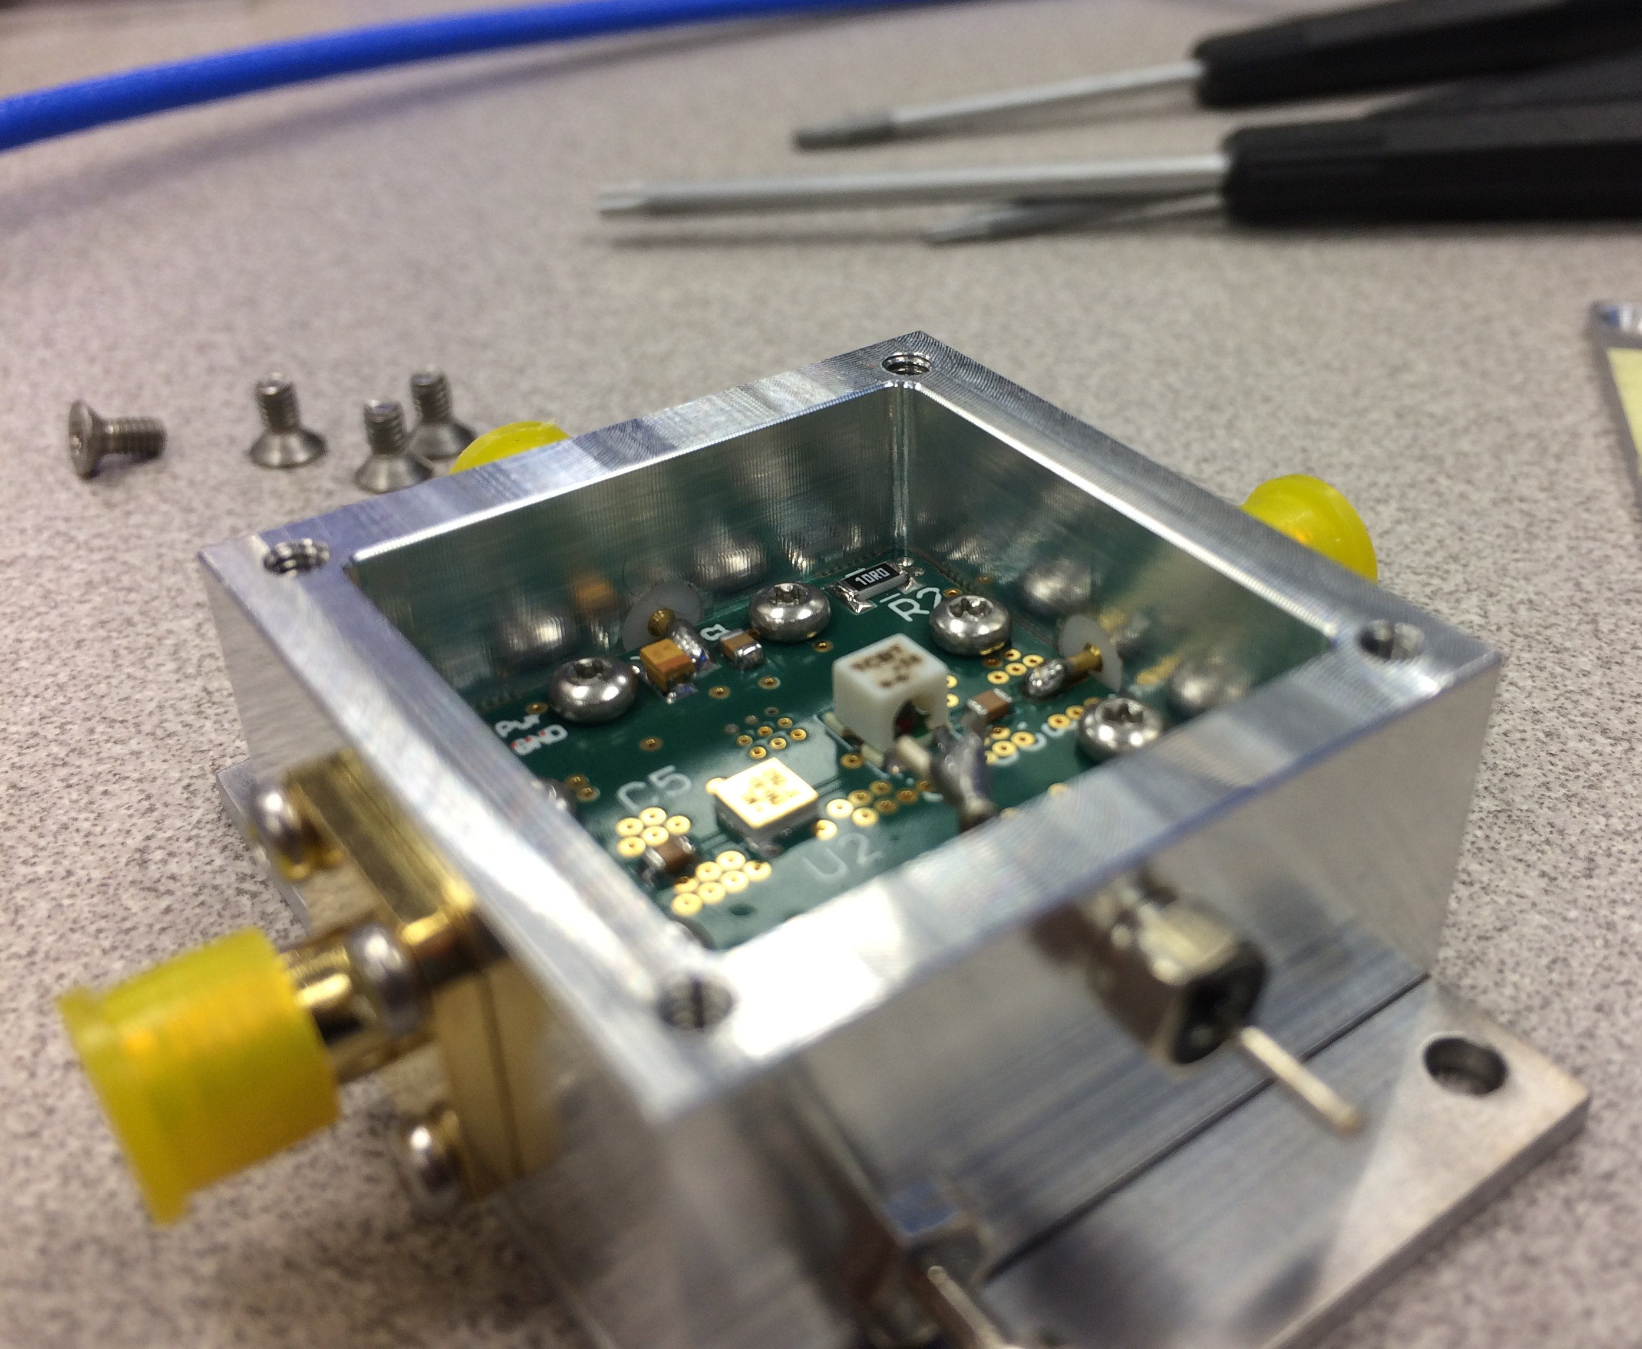
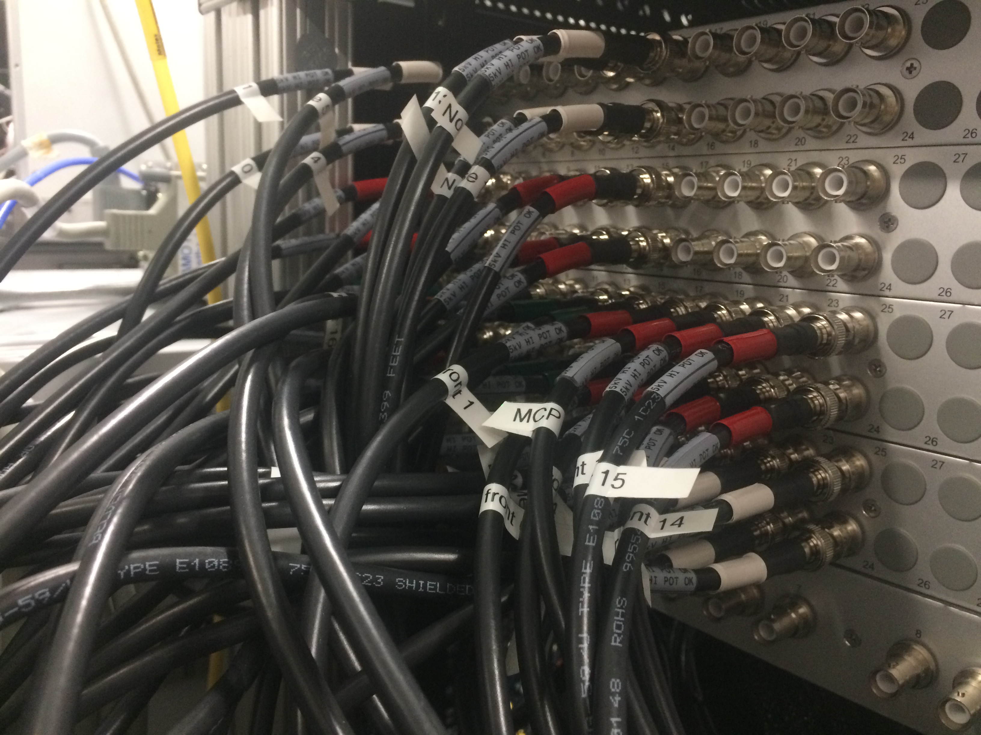
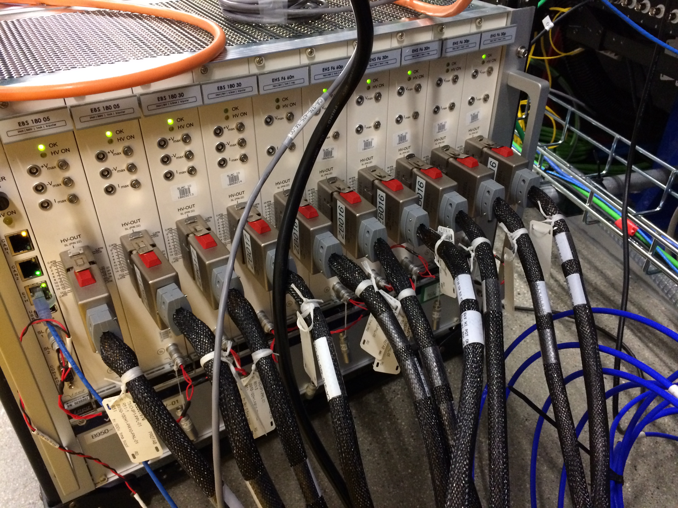
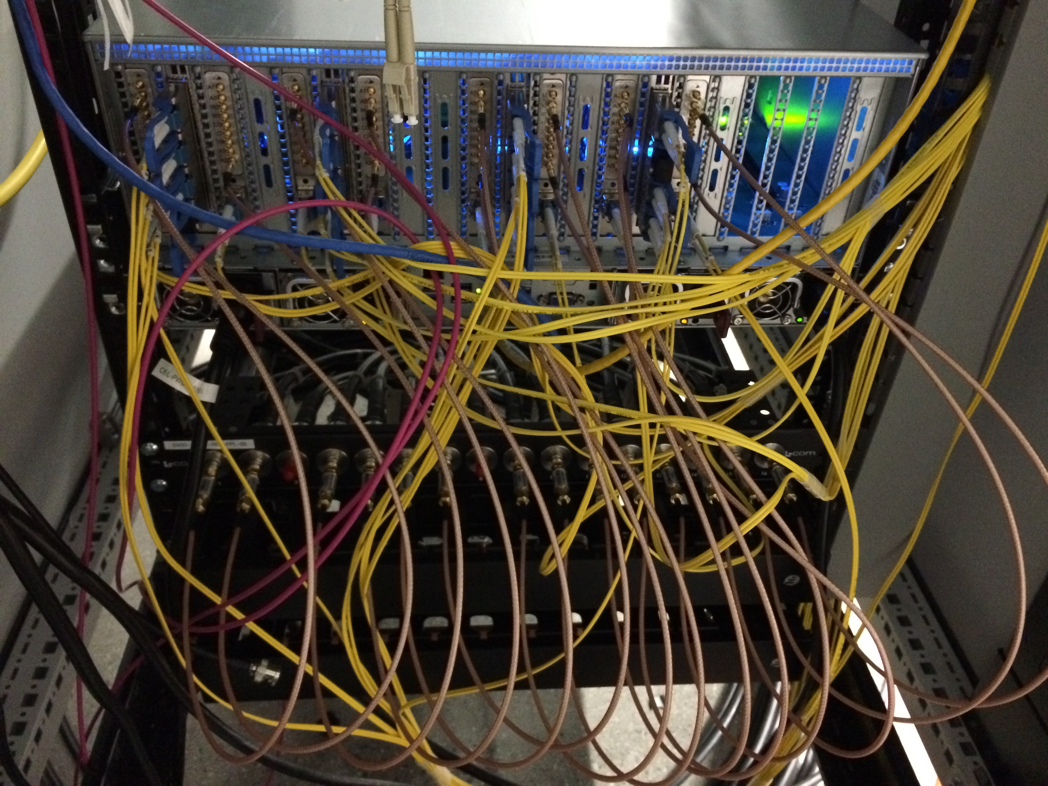
High Density HV, High Density Data
  From 70 SHV cables in June from patch panel...
  … to a full build out of 160 SHV channels
  Ideally MDC can do High Density vacuum feedthroughs in mu-metal spools
  Very “sensor” frontier of EdgeML
  Can we put an ADC, FPGA, and EdgeTPU actually on the flange?

Slide 10
High Density Data
  10 independent optical links from digitizer to DRP nodes (½ system)
  Ideally bring the FPGA/EdgeAI to the detector flange
  Could EdgeAI board plug in as a socket to the vacuum barrier?

Slide 11
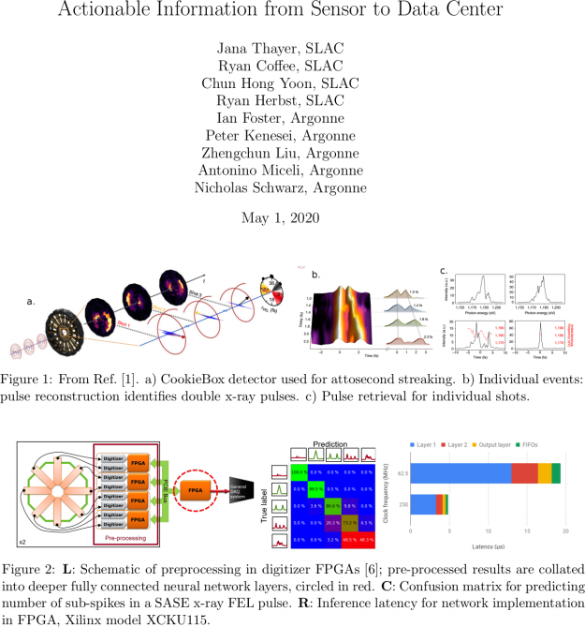

Enabling Strategic Developments – EdgeAI
  AISDC
  Tixel for ToFs
Corbeil Therrien et al., “Machine Learning at the Edge for Ultra High Rate Detectors” NSS-MIC, 1-4, (2019) doi: 10.1109/NSS/MIC42101.2019.9059671

Slide 12
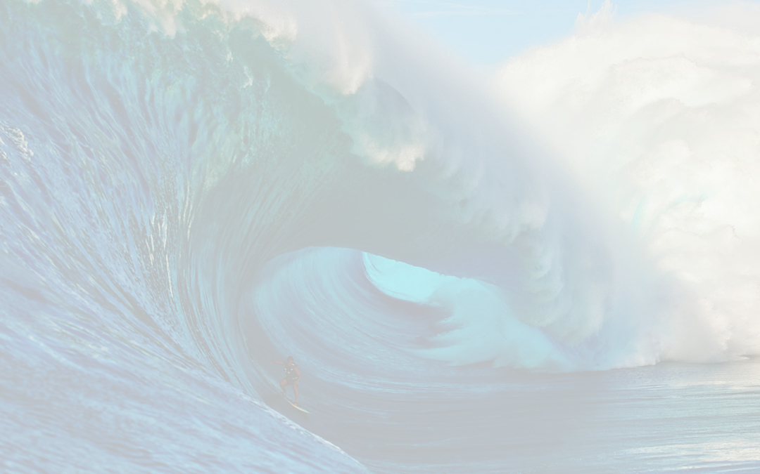
The CookieBox → MRCO Team
  Omar Quijano (TID-AIR Staff)
    EdgeML system admin
  Matt Feldman (EE/CS PhD Student) – Samba Nova
    Spatial-lang for FPGA
  Audrey Corbeil-Therrein (Banting Post-Doc Fellow) – Faculty @ U. Sherbrooke
    FPGA developer and ASIC design
  Andrei Kamalov (TMO Post-Doc)
    Laser lab testing and demonstration, CookieBox design and assembly, beamtime co-lead
  Razib Obaid (TMO Project Scientist)
    Detector R&D, CookieBox assembly, beamtime collaborator
  Averell Gatton (TMO Post-Doc) – (Clostra, Inc.)
    Simulations and model training, CookieBox design, beamtime author
  Debadri Das (Applied Physics PhD Student)
    Signal processing and algorithms
  Jack Hirschman (Applied Physics PhD and CS Student)
    RF electronics, FPGA, ASIC, and source control
  Naoufal Layad (Institute for Computational and Mathematical Engineering Masters Student)
    Surrogate modeling, Ensemble methods and Bayesian Networks
  Coffee (CookieBox lead), Walter (TMO/MRCO lead), Dragone (ASICs/Detectors), Herbst (FPGAs), Cryan (AMO)

Slide 13
Enabling Accelerator R&D and nonlinear x-ray methods
  Attoclocking in the FEE
    Bigest question was THz in the FEE
    Zhirong Huang, Alan Fisher, and Matthias Hoffman have beam-based THz development project that could directly feed the CookieBox in the FEE with long wavelength light at rate!
  LCLS-II developments CookieBox detector will support
    Ago’s double XLEAP
    Erik’s polarization shaping
    Alberto’s Fresh Slice methods… actually how we ran June beamtime
    Claudio’s Double Bunch and Harmonic Lasing
    … anything FEL shaping related and multi-bunch, e.g. in-line beam-based THz
  Scientific methods it will enable
    X-ray multi-photon signals enhanced by SASE, In-house proposal submitted last Friday
    “Spooktroscopy” and attoclock ptychography as super-resolution methods in the time-energy domain … Daniel Ratner engaged, Alberto Lutman mode used in beamtime
    Dynamic Chirality by fs-scale time-dependent polarization shaping, needs DELTA undulator

Slide 14
FY22 Technical R&D Topics
  Immediate CookieBox design adaptations
    Alternative to Zn/Ni/Au coating of ToF parts (although Aluminum worked well so far)
    High density HV feedtroughs to interface to solderless block
    Incorporate TIXEL area detector versus bucket detector MCP
  Direct signal processing for inference
    John Fox regarding custom MCP assembly for better RF signal decoupling
    Razib Obaid and Bernhard Adams regarding glass embedded amplifier circuit with larger area MCP
    Jack Hirschman’s idea to put ADC and FPGAs on the air side of the detector flange, e.g. featureize at the MCP.
  High density HV supply for auto-tuning of compound electrostatic lens: Self-aware CookieBox

