Slide 1
X42619 beamtime
August 24, 2021
Ryan N Coffee
coffee@slac.stanford.edu

Slide 2
Accomplishments
  Preliminary
  ~0.5 eV resolution at 100 eV above retardation
  Suppressed magnetic field deflection of low energy electrons
  Sub-sampling resolved waveform in pre-processing
  Multi-retardation for extended multi-color or multi-edge methods
  Partial wave analysis of emission as surrogate for spectral-polarimetry
  Left to do
  Single shot spectra from ~10s of counts/ToF
  FPGA implementation of featurization
  Single-shot pulse reconstruction via 3 micron streaking

Slide 3
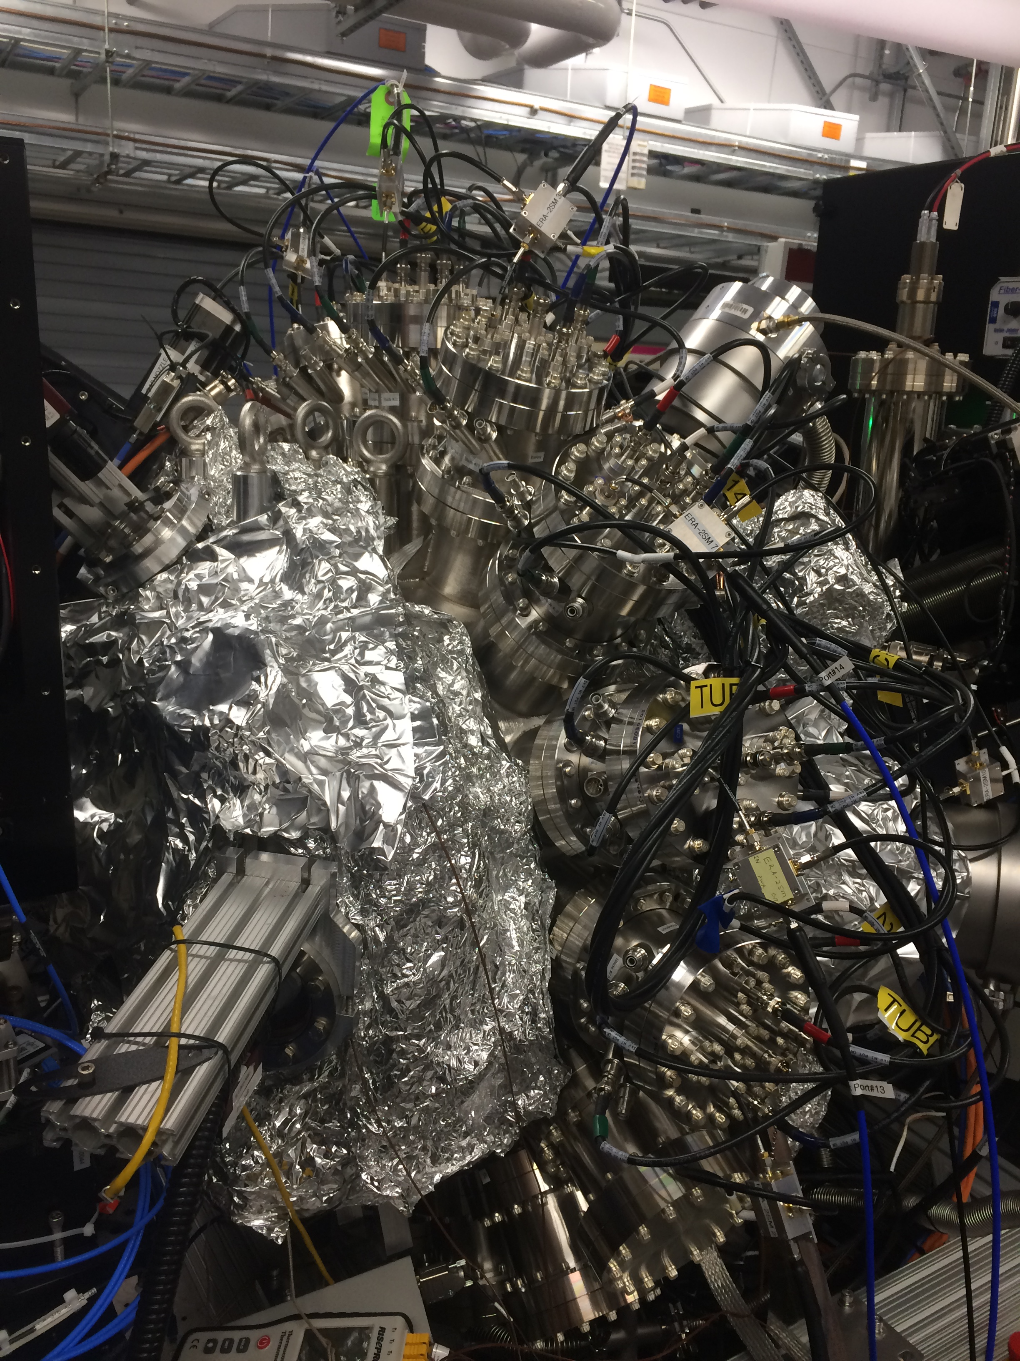
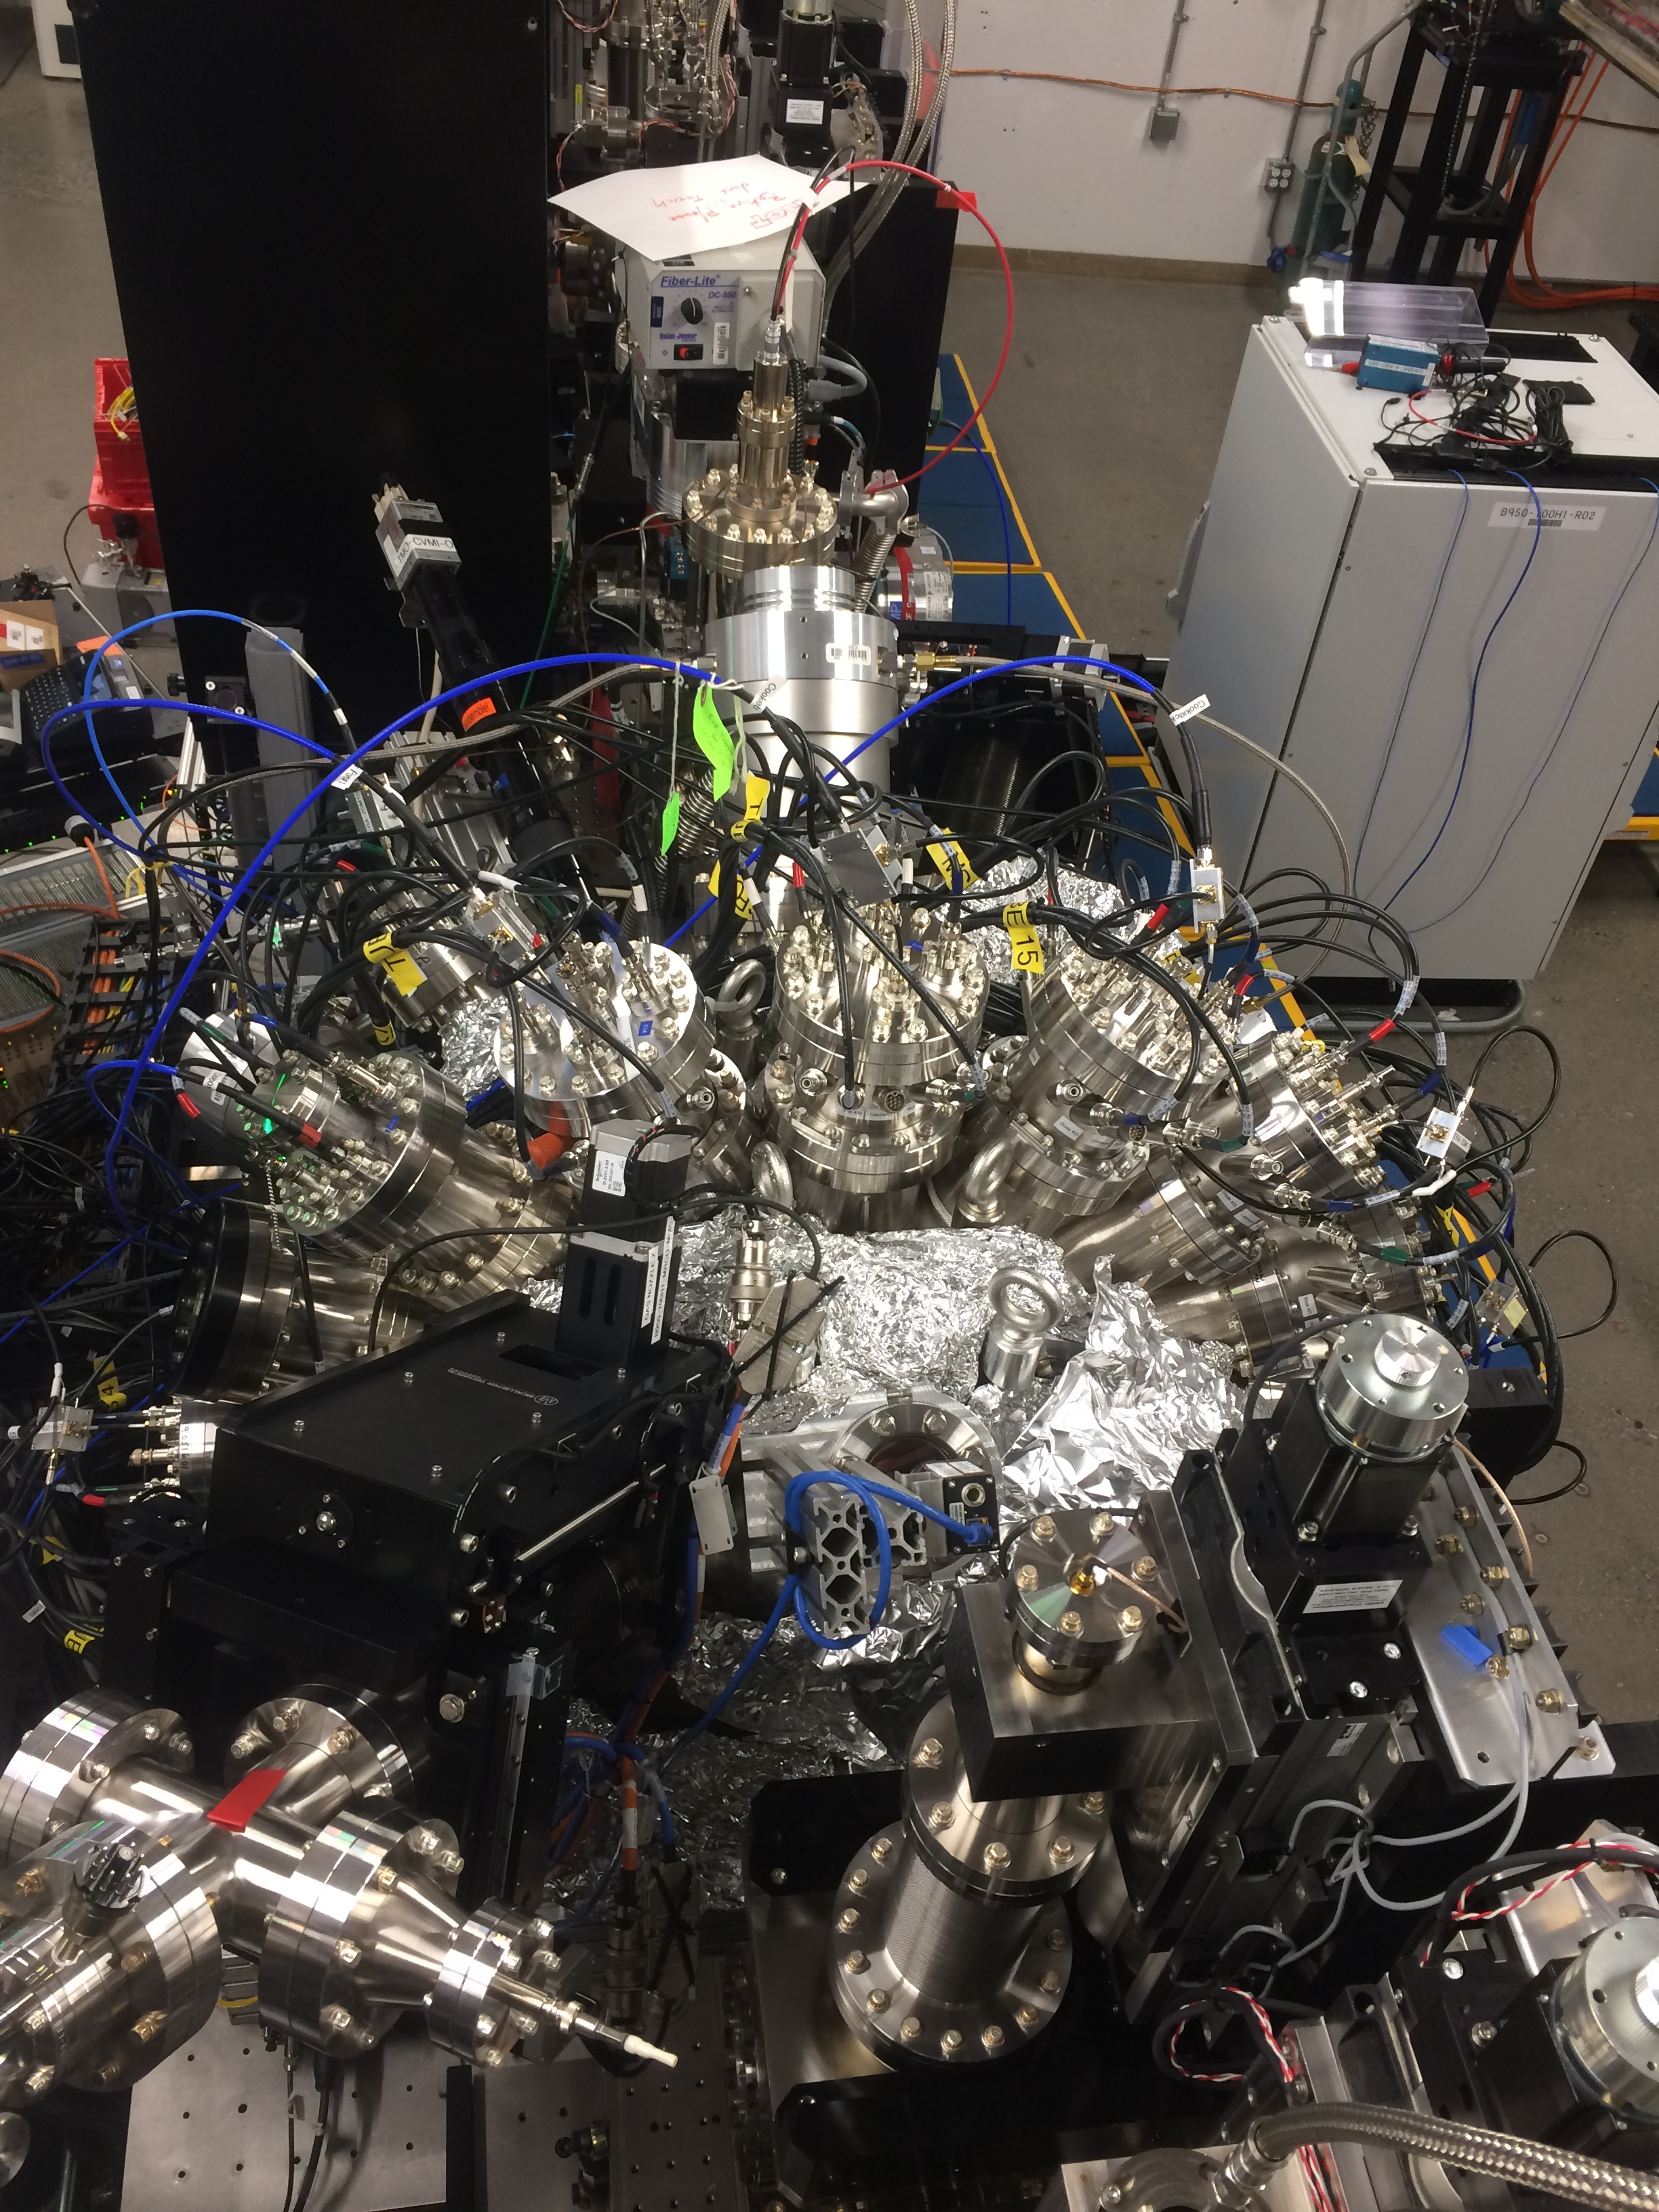
Installed system
Side view
Top view
  Cite submitted paper

Slide 4
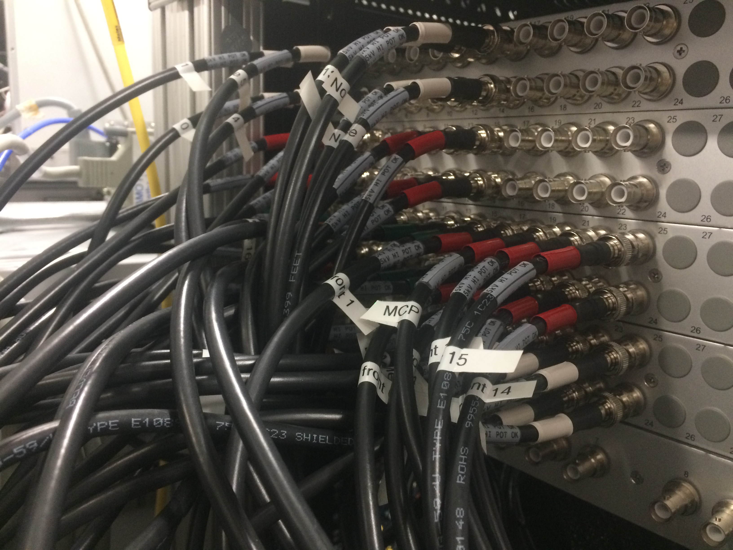
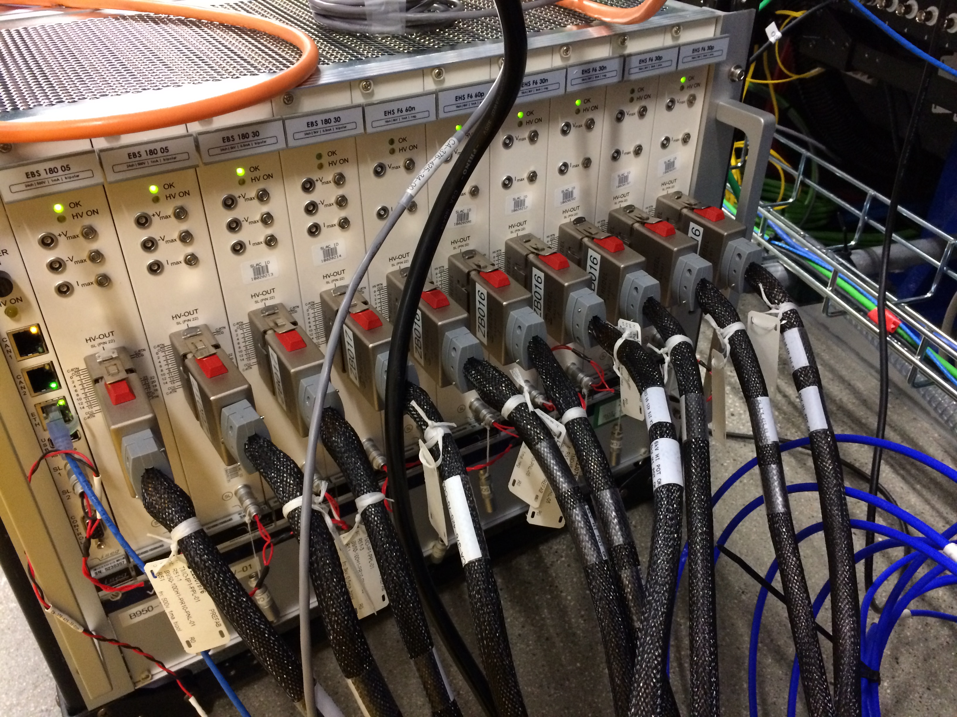
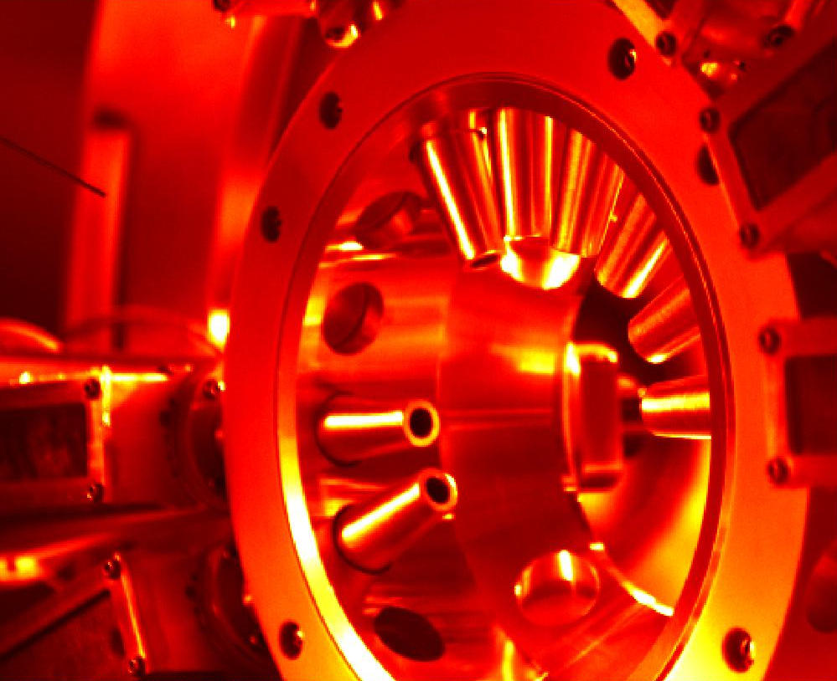
The system build out
  8 ToFs installed, 2 bare MCPs for “Current mode” resilience testing
  Positioning paddle, Gas needle, 4 pumps
  MPod High Density cables → 70 SHV cables from patch panel, a nightmare for Andrei, Aalayah and Nolan
  Full build out would require 160 SHV channels
  The 9-pin feed through failed (removing from XIP chamber design)
  Ideally design High Density vacuum feedthroughs

Slide 5
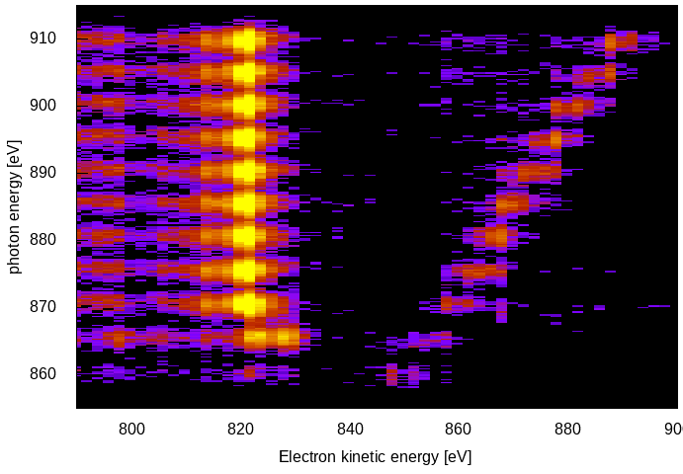
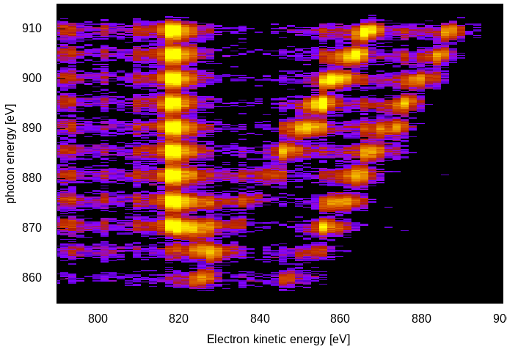
Neon Auger and valence photos
  Roughly 2 eV / bin at 800 eV
  No collection efficiency compensation… raw counts agree (qualitatively) with calculated cross-sections
KLL
2s
2p
KLL
2s
2p
Vertical Horizontal

Slide 6
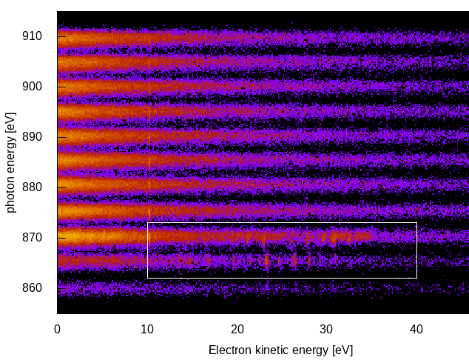
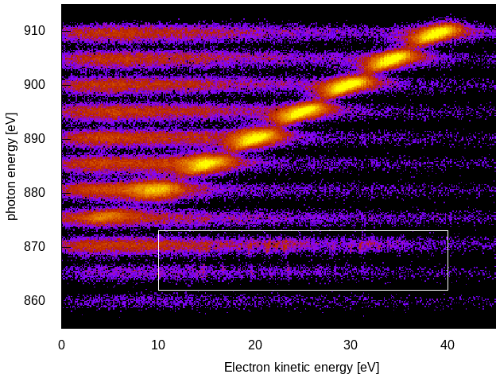
Neon Photos and Autoionizing 1s→3p resonance
  Low energy electrons highly sensitive to magnetic fields
  Previous CookieBox experienced significant dependence of angular patterns to Helmholtz coil nulling fields
  Steel chamber tests were blind below 30eV
Vertical Horizontal
Secondaries
Magnetic field
supression
Autoionization

Slide 7
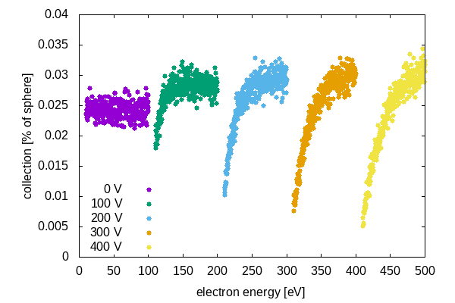
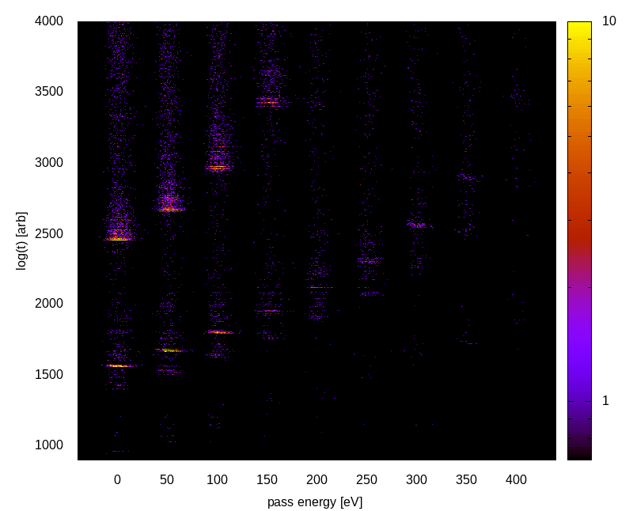
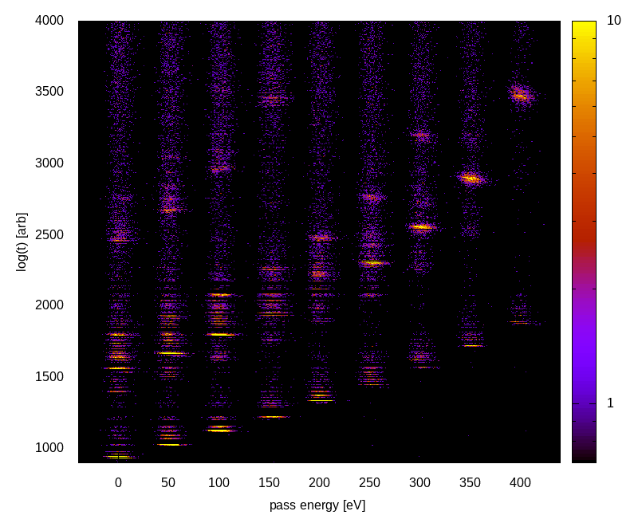
Collection versus retardation
  Loss of slow electrons only for highest retardations
  Partial waves can be analyzed versus retardation to look for magnetic deflection in drift tube
Vertical
Horizontal

Slide 8
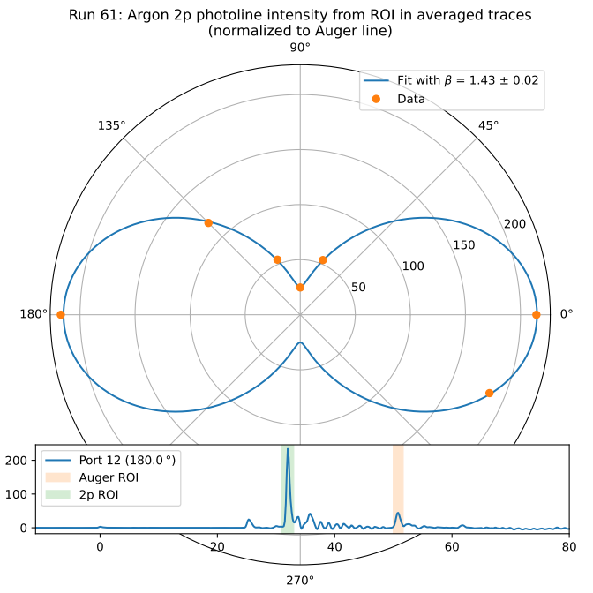
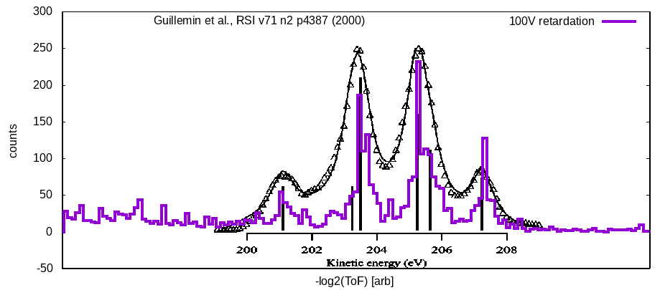
Angle and spectral resolution
  Raw signals, averaged, normalized by LMM Auger yields
  Β = 1.43 measured vs 1.465 theory
  Validates use as polarimeter
  Preliminary ½ eV resolution of Ar LMM lines … need to discount aliasing in histograms
Courtesy Lars Funke

Slide 9
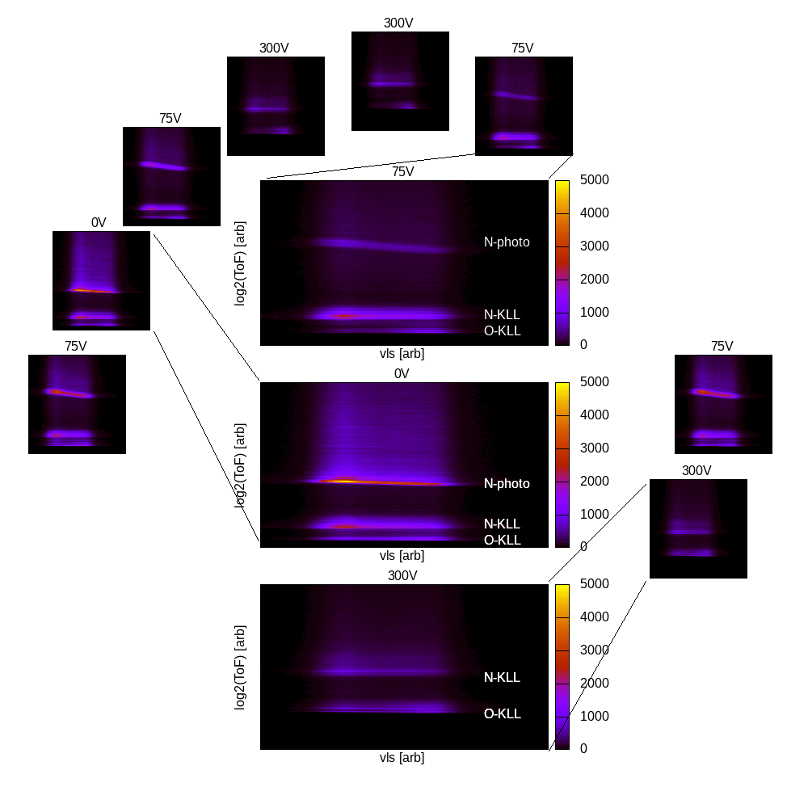
Multi-edge resolution
  N₂O Resonant Auger
  N 1s photoelectrons
  N KLL and O KLL Auger electrons
  Surrogate demonstration for multi-color measurements
  Port 13 short triggered ToF modifications as well as provided consistent “no retardation” channel during beamtime ;-)

Slide 10

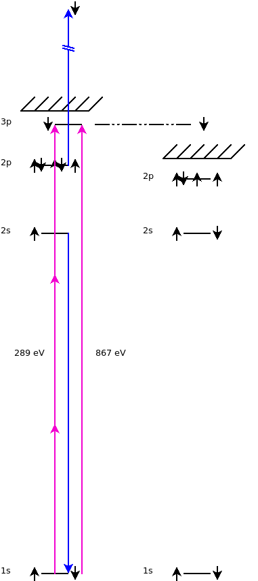
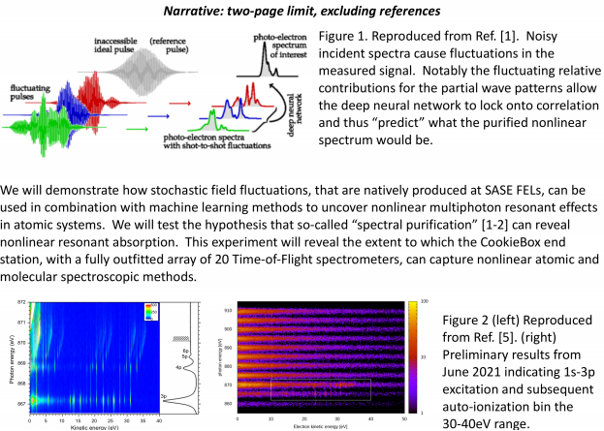
Multi-photon x-ray interference via stochastic fields
Readout
channels
  Ulf Saalman and Jan Michael Rost for enhancement of non-linear signals because of SASE, Inhouse proposal submitted last Friday
    “Spooktroscopy” and attoclock ptychography as super-resolution methods in the time-energy domain … Daniel Ratner engaged, Alberto Lutman mode used in beamtime
    Dynamic Chirality by fs-scale time-dependent polarization shaping

Slide 11
Enabling Accelerator R&D and nonlinear x-ray methods
  Attoclocking in the FEE
    Bigest question was THz in the FEE
    Bam-based THz development project that could directly feed the CookieBox in the FEE with long wavelength light at rate!
  LCLS-II developments CookieBox detector will support
    Ago’s double XLEAP
    Erik’s polarization shaping
    Alberto’s Fresh Slice methods… actually how we ran June beamtime
    Claudio’s Double Bunch and Harmonic Lasing
    … anything FEL shaping related, multi-bunch, multi-color, multi-polarization
  Scientific methods it will enable
    X-ray multi-photon signals enhanced by SASE, In-house proposal
    “Spooktroscopy” and attoclock ptychography as super-resolution methods in the time-energy domain … Daniel Ratner, Alberto Lutman mode used in beamtime
    Dynamic Chirality by fs-scale time-dependent polarization shaping, needs DELTA undulator

Slide 12
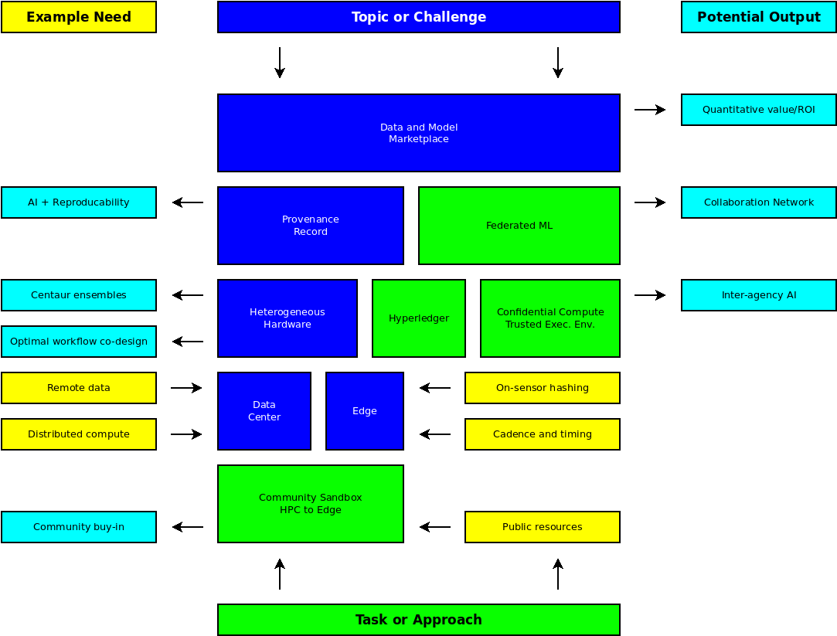
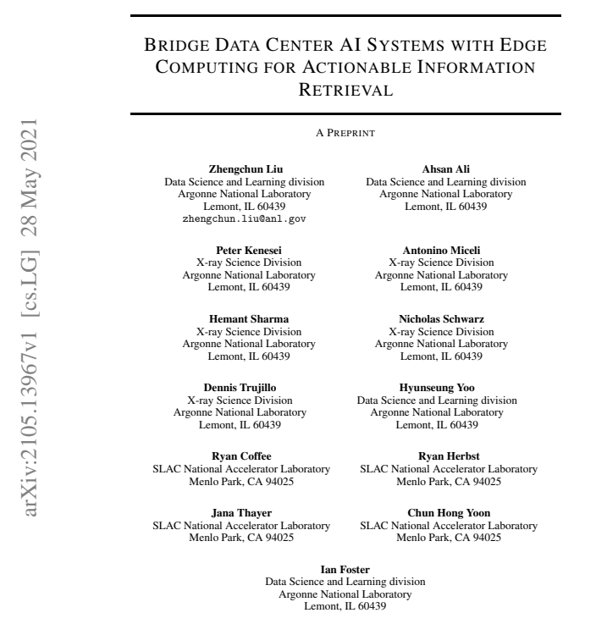
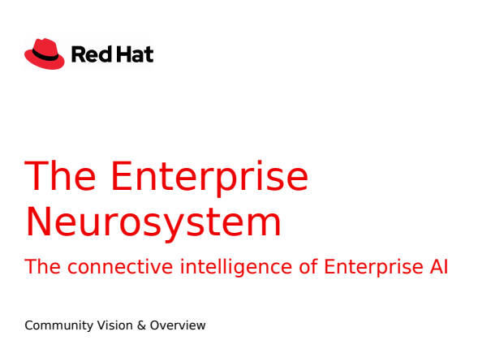
High Density Data
  Developing a whitepaper for ~100M hits / s / ToF … MCP+RF+ML design (Jack, Razib, B Adams)
  Could EdgeAI board plug in as a socket to the vacuum barrier?

Slide 13
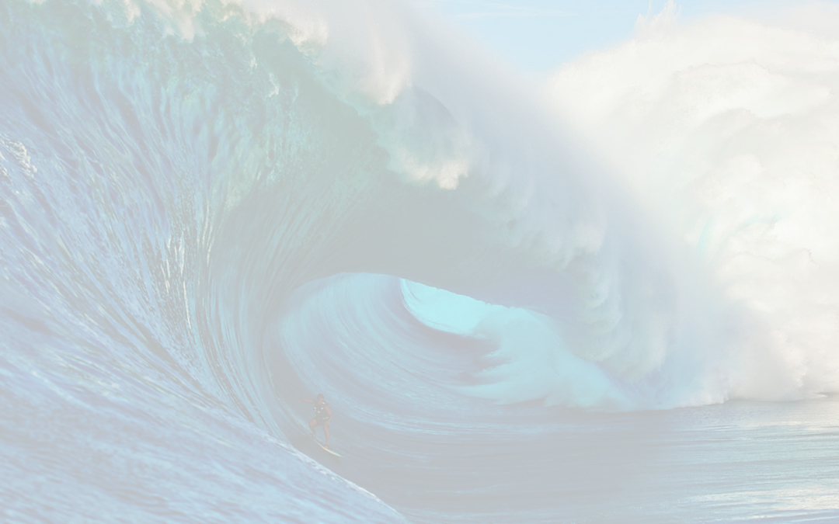
The CookieBox Team
  The long team
  Matt Feldman (EE/CS PhD Student / SambaNova), Audrey Corbeil-Therrein (Banting Post-Doc Fellow / Faculty @ U. Sherbrooke)
  Andrei Kamalov, Razib Obaid, Averell Gatton (Clostra, Inc.)
  Debadri Das, Jack Hirschman, Naoufal Layad
  Jean-Charles Castagna, Hongliang Shi, Xianchao (Tony) Cheng
  Peter (TMO/MRCO lead), Omar (Computing), Angelo (ASICs/Detectors), Ryan Herbst (FPGAs)
  Beamtime team:
  Xinxin, Xiang, Ming-Fu, Thomas, James
  Jeff, Aalayah, Nolan, Sameen
  Tong, Silke, Matt Weaver, Chris O’Grady
  Larger Collaboration
  Wolfram Helml (TU Dortmund), students: Lars Funke, Arne Held, Sara Savio
  Markus Ilchen (DESY), Jens Viefhaus (HZB)
  … and many others over the years

