Slide 1
CookieBox R&D post-beamtime update
Beamtime Results and Outlook
August 10, 2021
Ryan N Coffee
LCLS/PULSE
SLAC National Accelerator Laboratory
coffee@slac.stanford.edu

Slide 2
Outline
  Publications/Presentations
    JSR paper in finalizing stages
    Shifting AISDC simulations to CookieBox data
    Submitted multi-photon via stochastic fields in-house proposal
    Submitted LDRD with Bernhard Adams for detector design with integrated amplifiers in vacuum window.
  Construction
    Need design modification to avoid in-vacuum solder
  Technical
    Preliminarily seem to have achieved 0.25 eV resolution at 100 eV pass energy, 100 eV retardation.
    MU-metal chamber was a big win for sake of no steering of low energy electrons, even in interation (e.g. no retardation data from Neon.
  Schedule
    MRCO chamber (for users) is copy of CookieBox, but potentially modifying the upstream large flange
  Future Outlook
    TMO science is shifting to emphacize the spectroscopic capabilities as well as streaking capabilities of CookieBox.
    Compatible with TIXEL modules, but need to design interface flange and test

Slide 3
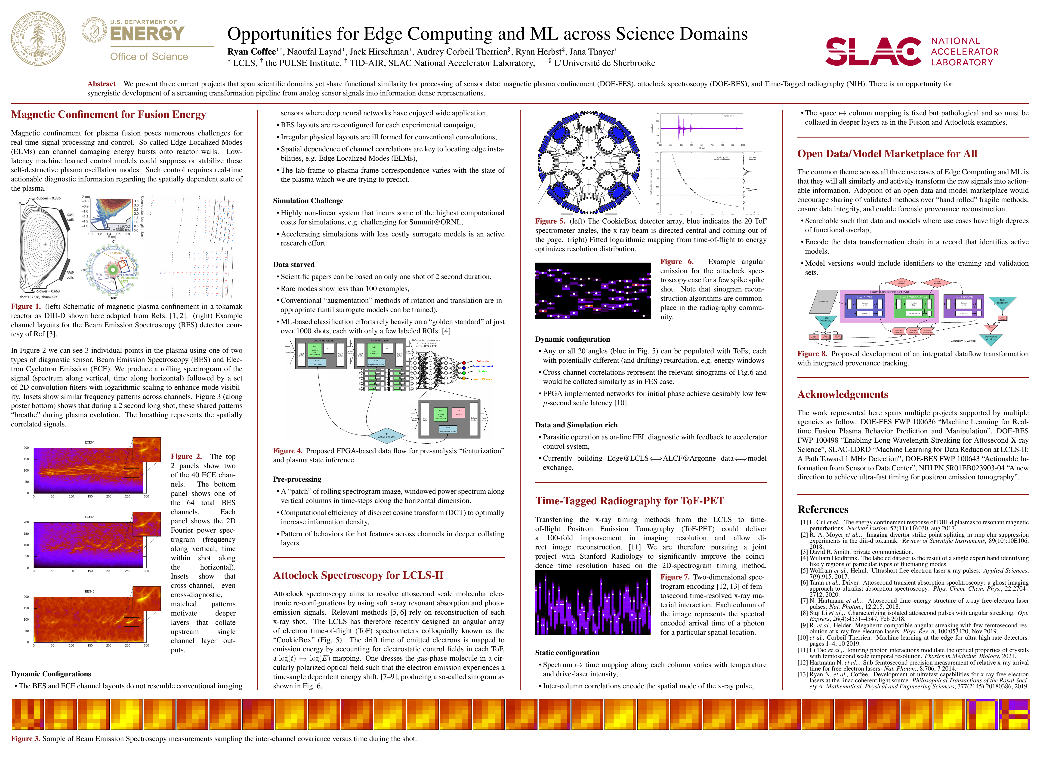
SLAC Science + Stanford AI: Bridging the Farm – Feb 9
  Poster from Bridge Workshop me and Naoufal

Slide 4
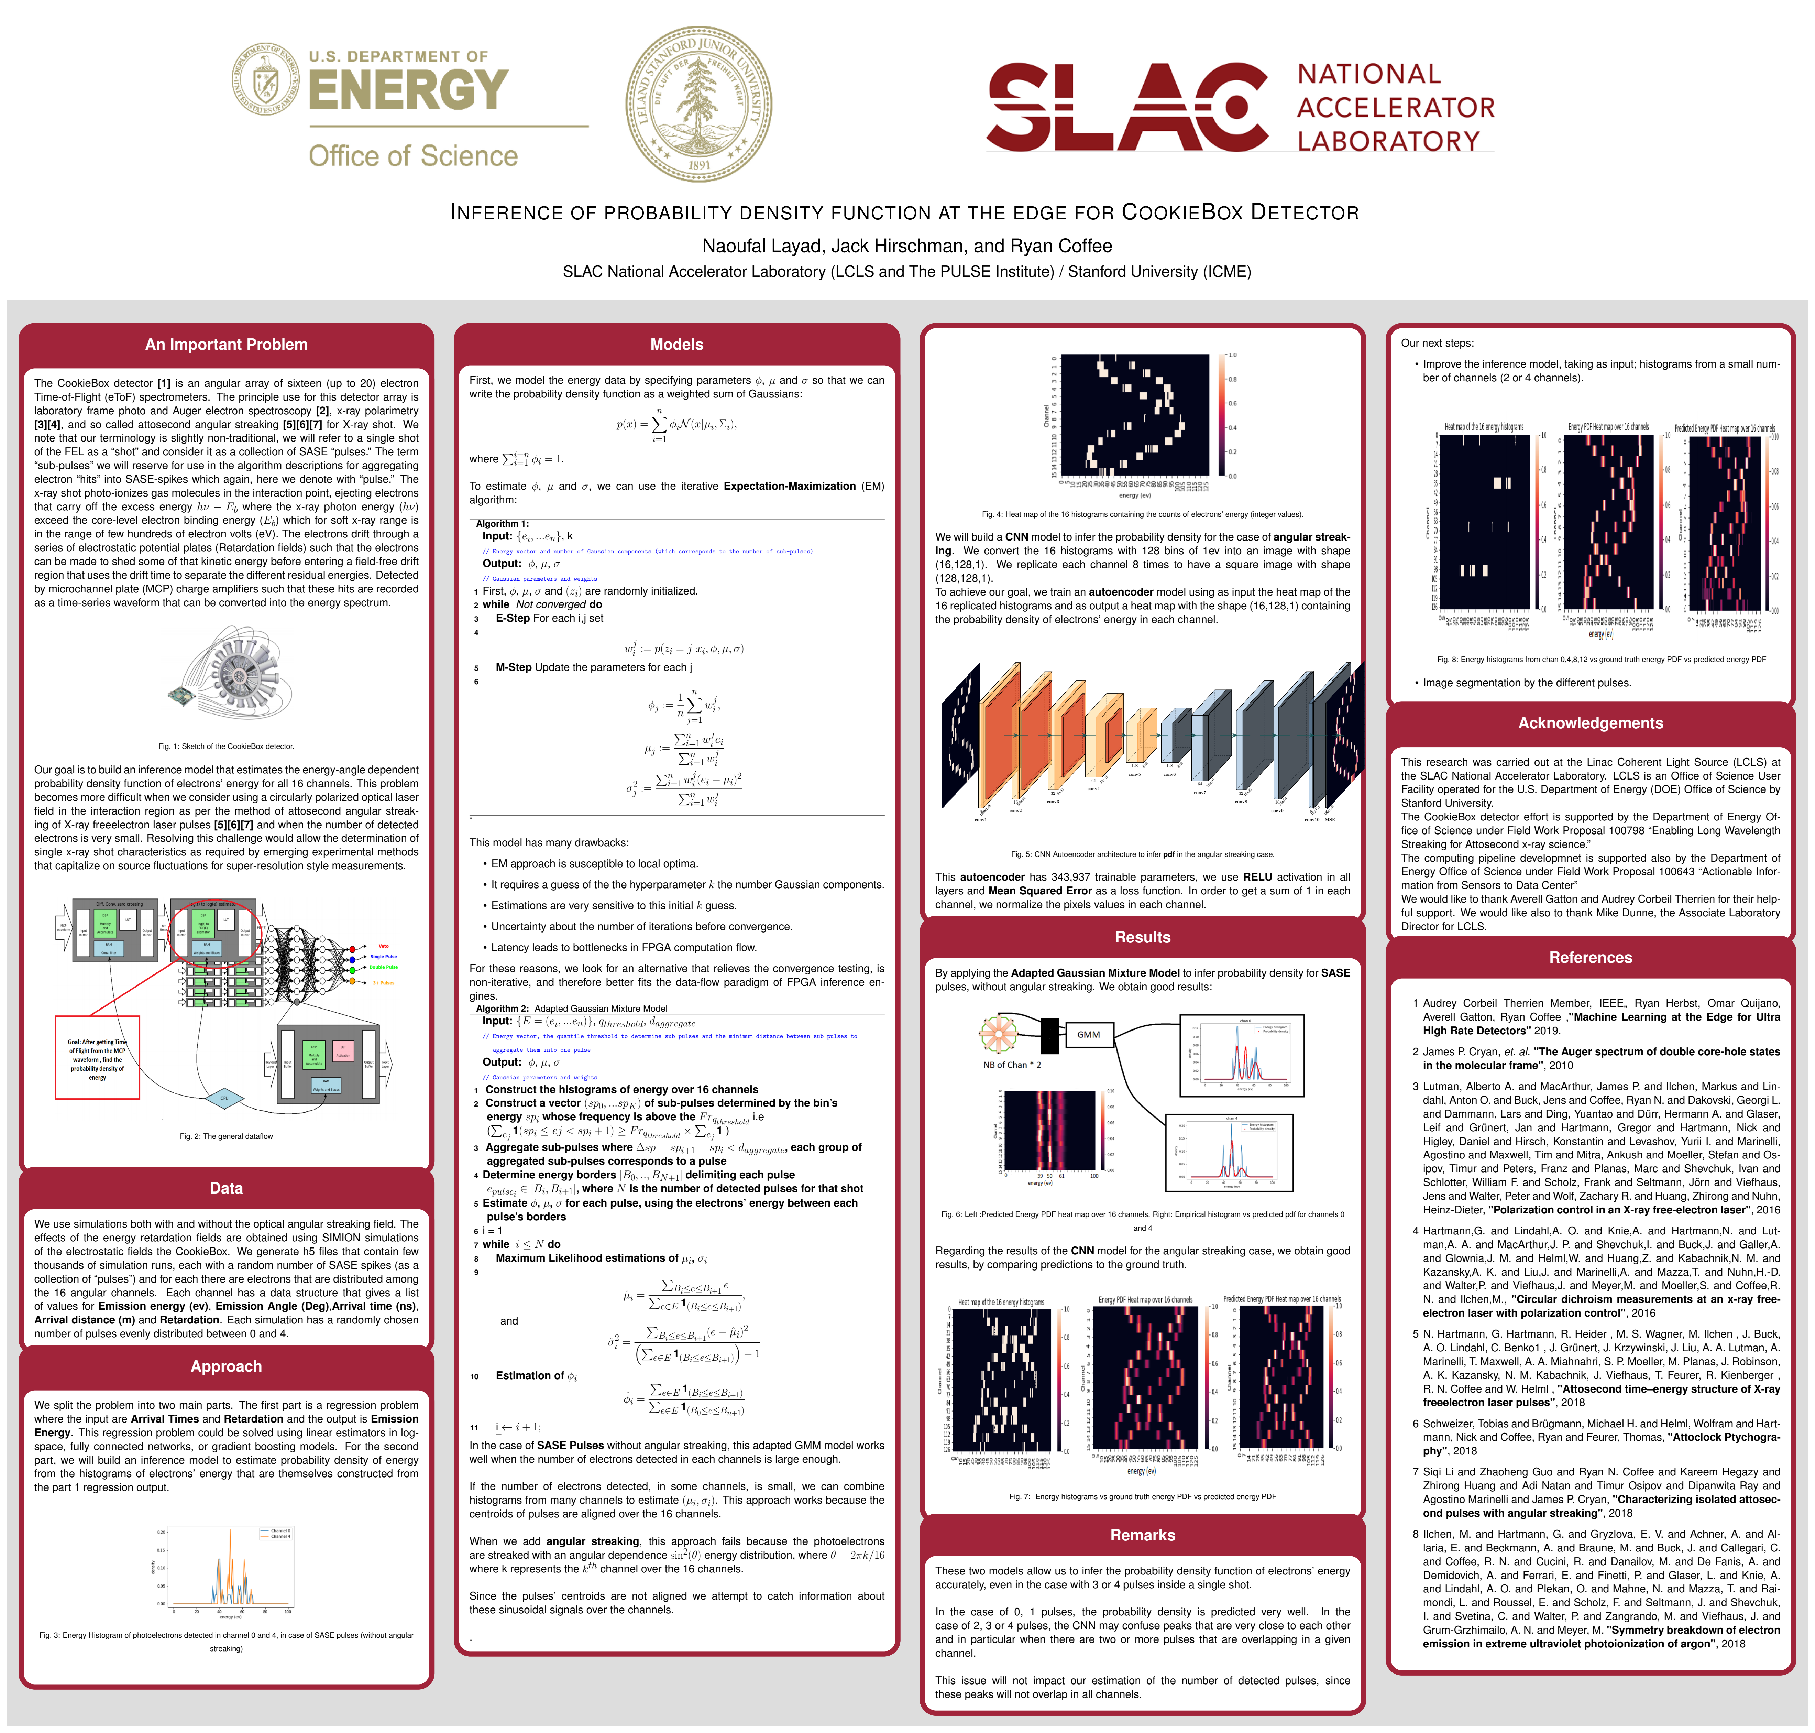
SLAC Science + Stanford AI: Bridging the Farm – Feb 9
  Poster from Bridge Workshop me and Naoufal

Slide 5
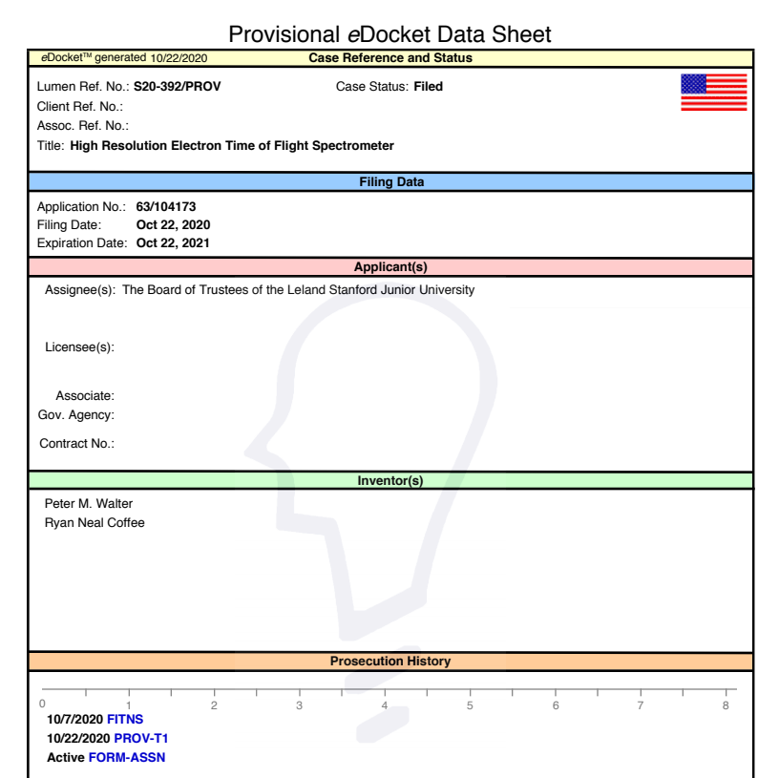
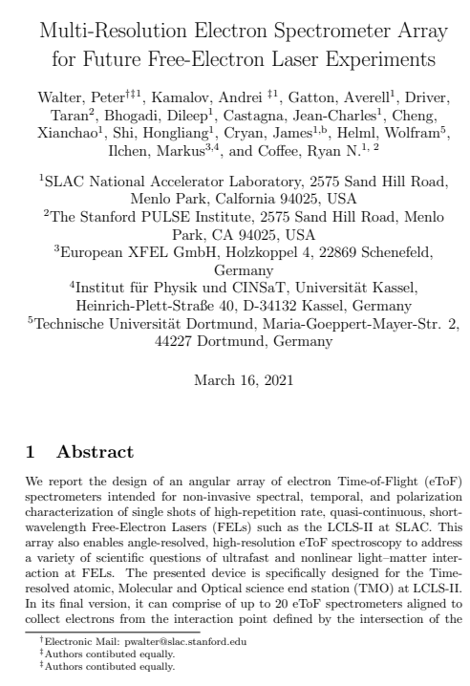
Prov. Patent and arXiv preprint for JSR Special Iss.
IUCr: Journal of Synchrotron Radiation, Special issue – PhotonDiag 2020 - The 5th FELs OF EUROPE Conference on FEL Photon Diagnostics, Instrumentation and Beamline Design
  Paper title page with arXiv details

Slide 6
Future paper plans
  Jack analog circuits (September submission to include data from beamtime)
  Naoufal Angular Streaking reconstruction (September submission)
  RSI of experiment results (Still targeting August submission)

Slide 7
Design Changes
  Reducing the number of required HV connections
  Replacing the 9-pin feedthrough with standard SHV

Slide 8
Wish list
  Detector:
    Find way to fund vacuum window embedded electronics
  ToF:
    Design and Prototype a solderless resister block plug
    Explore possability for high density HV feedtrough to interface to solderless block

Slide 9
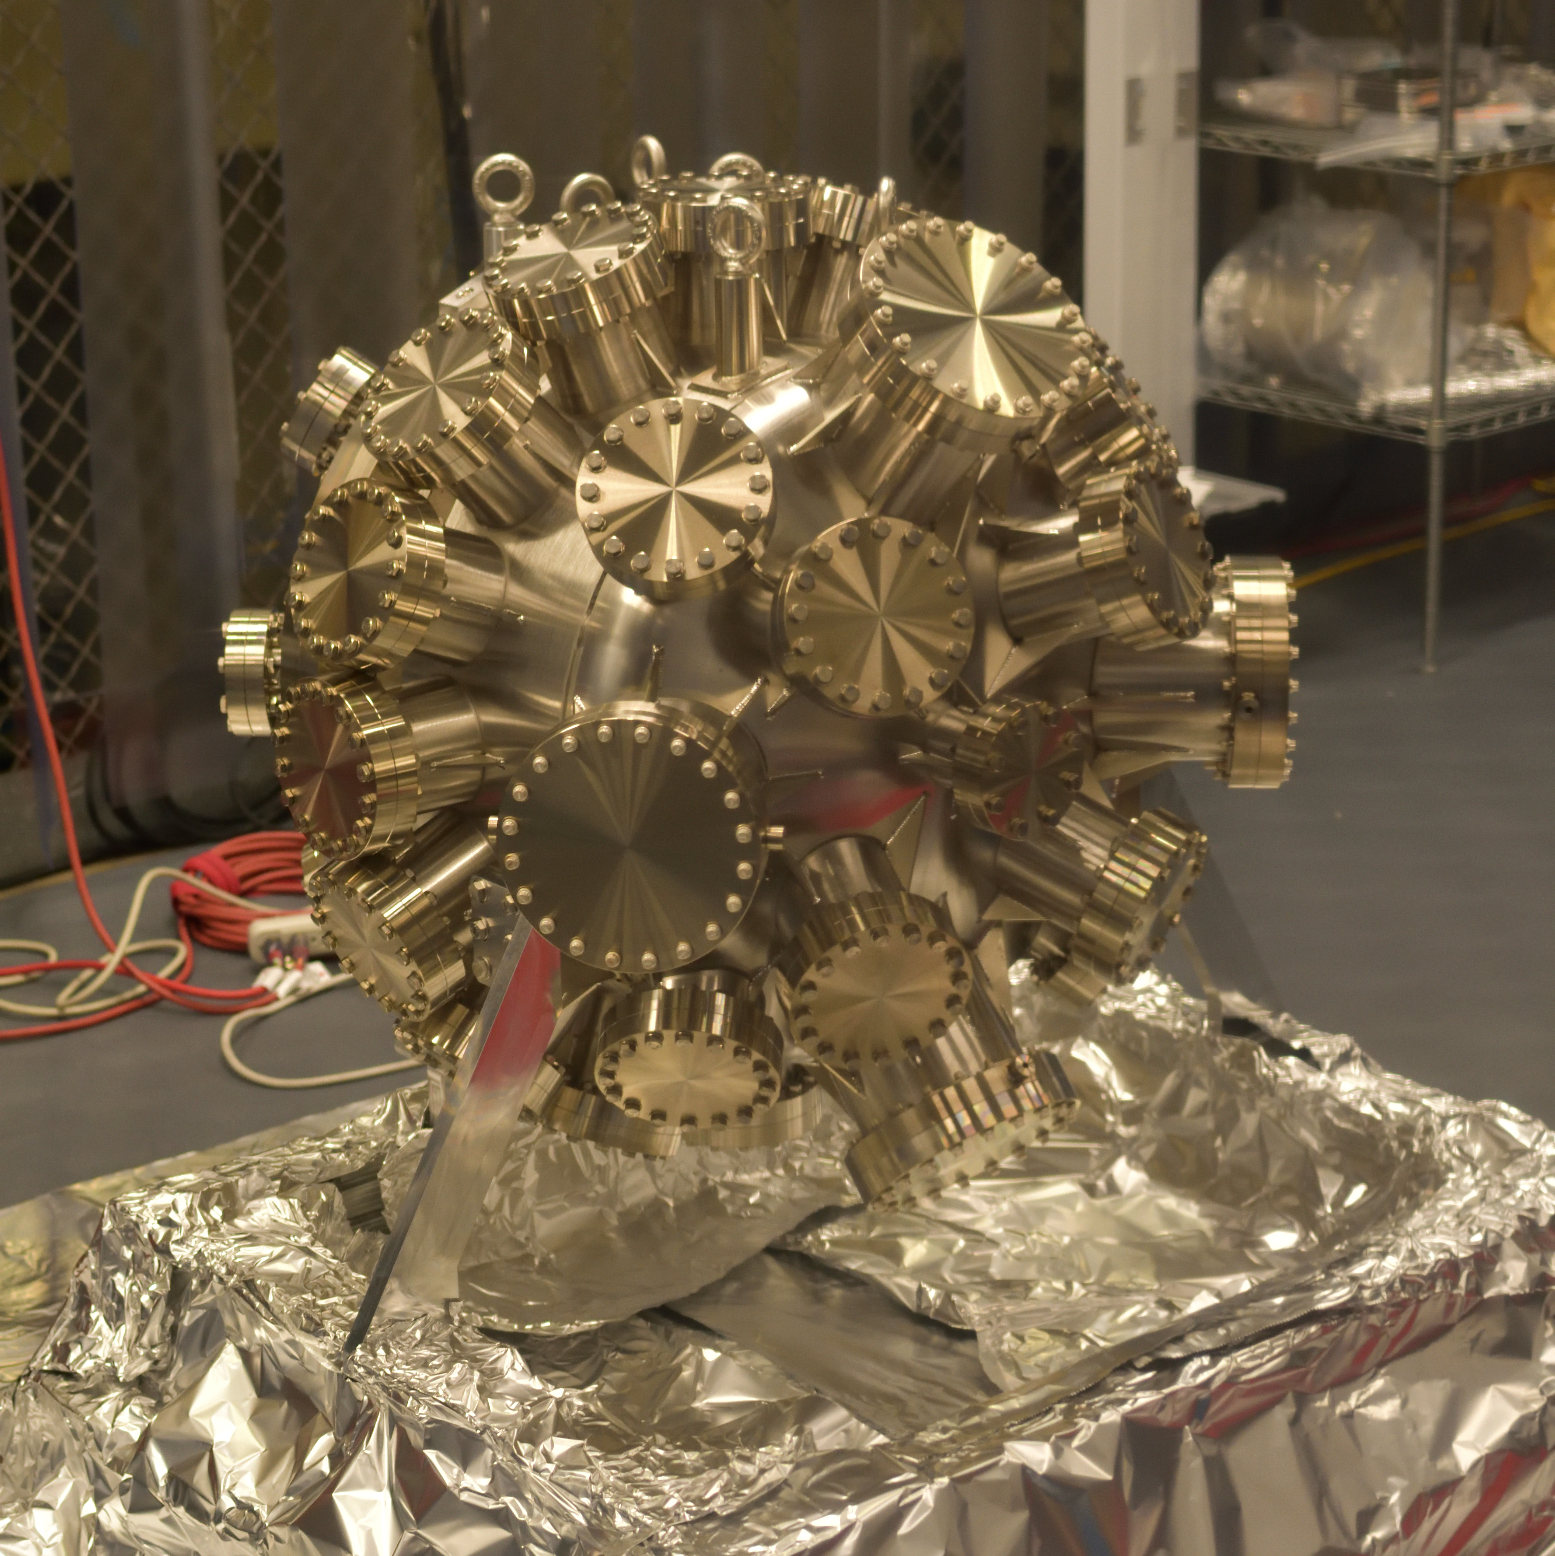
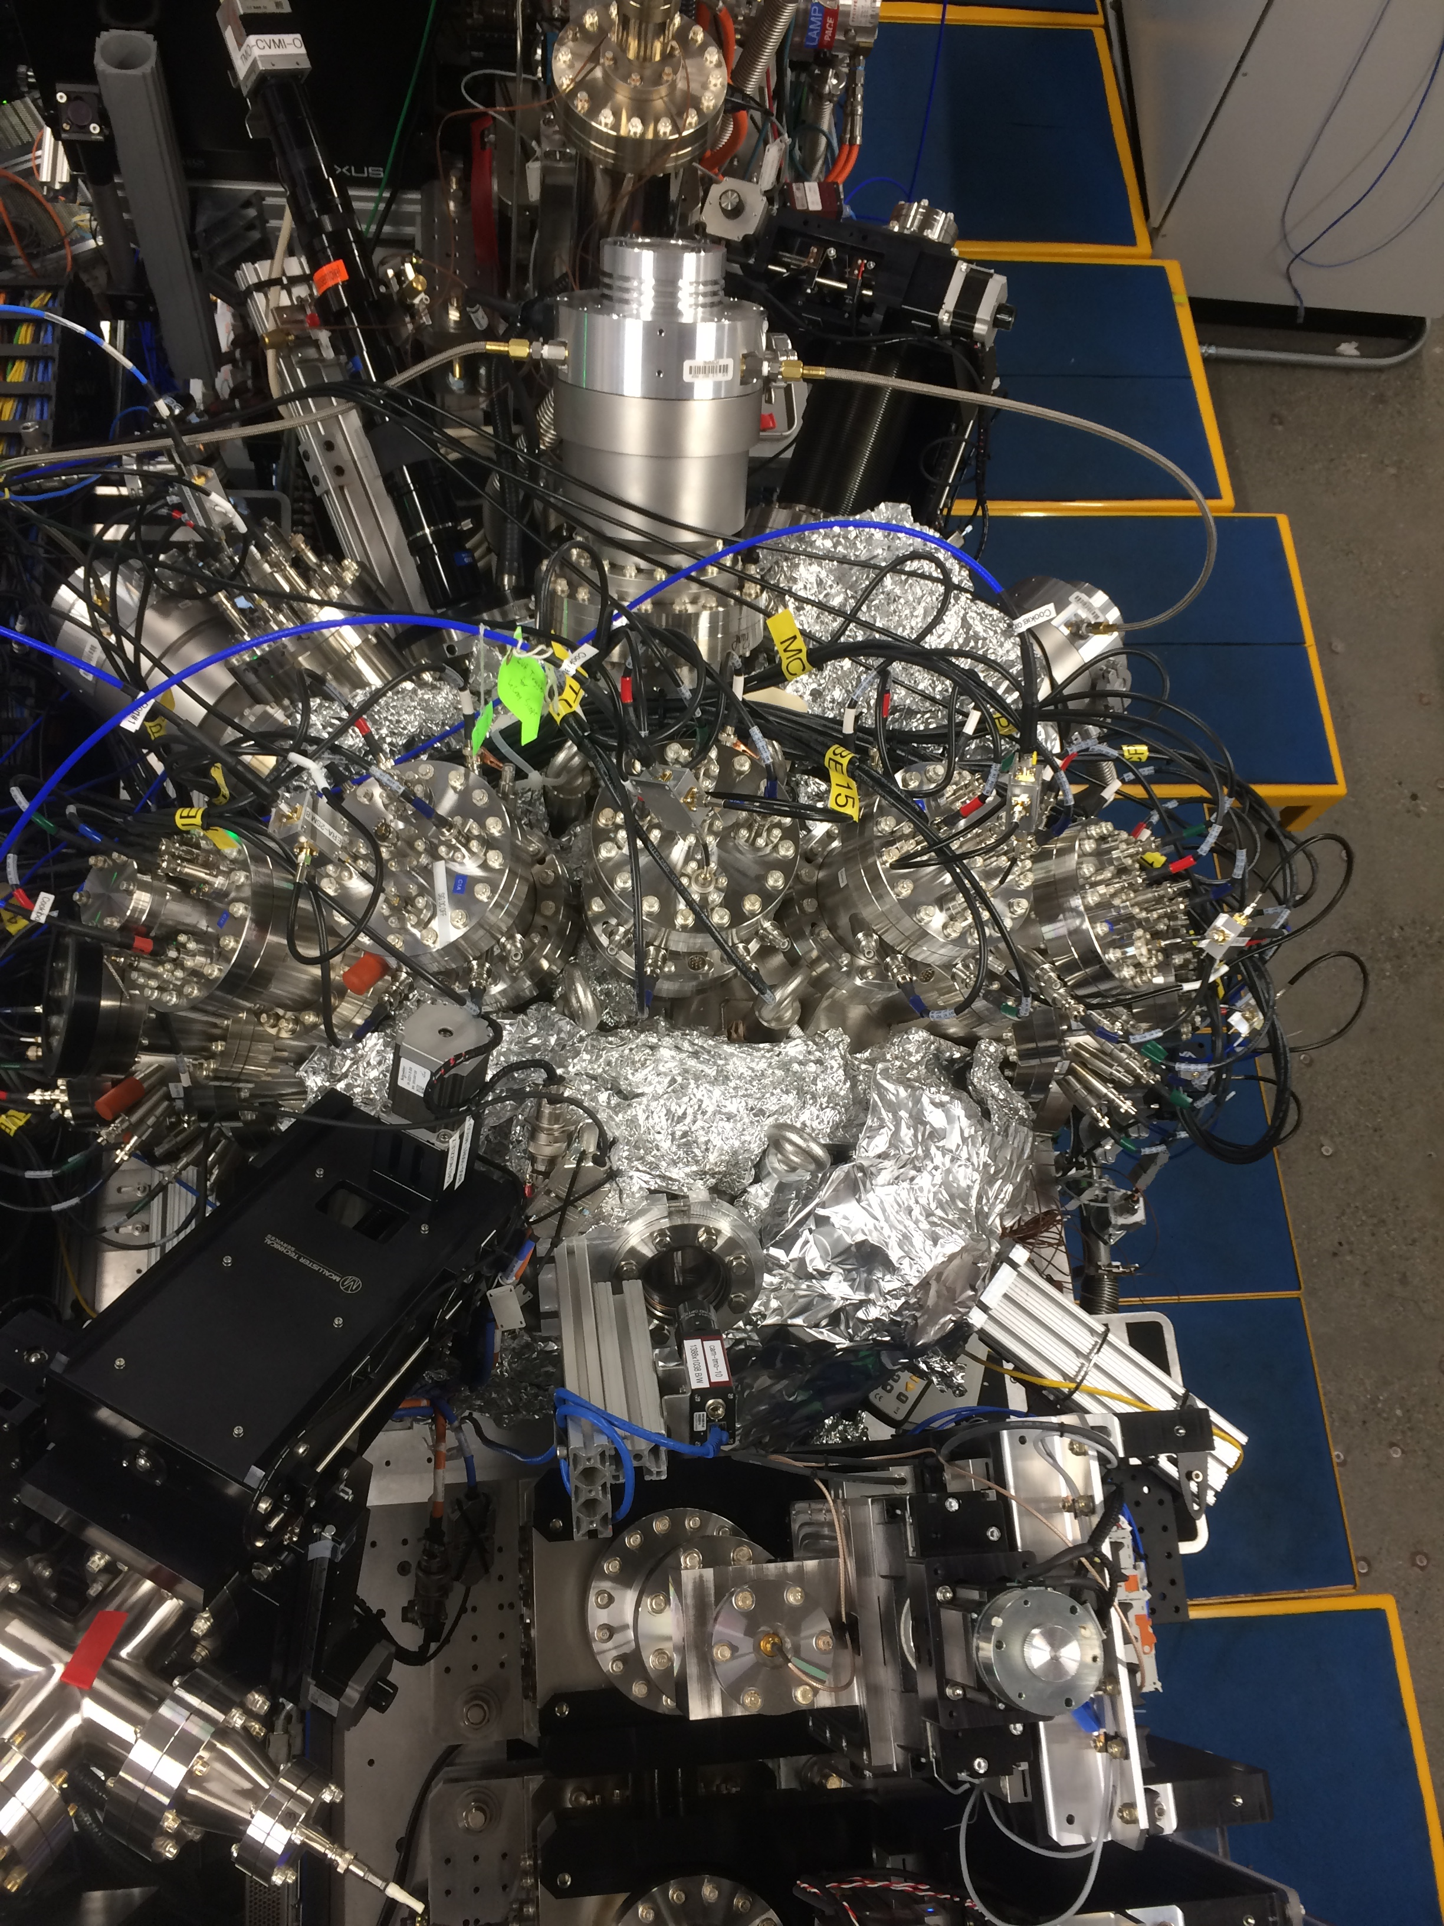
From here to there
  Cite submitted paper

Slide 10
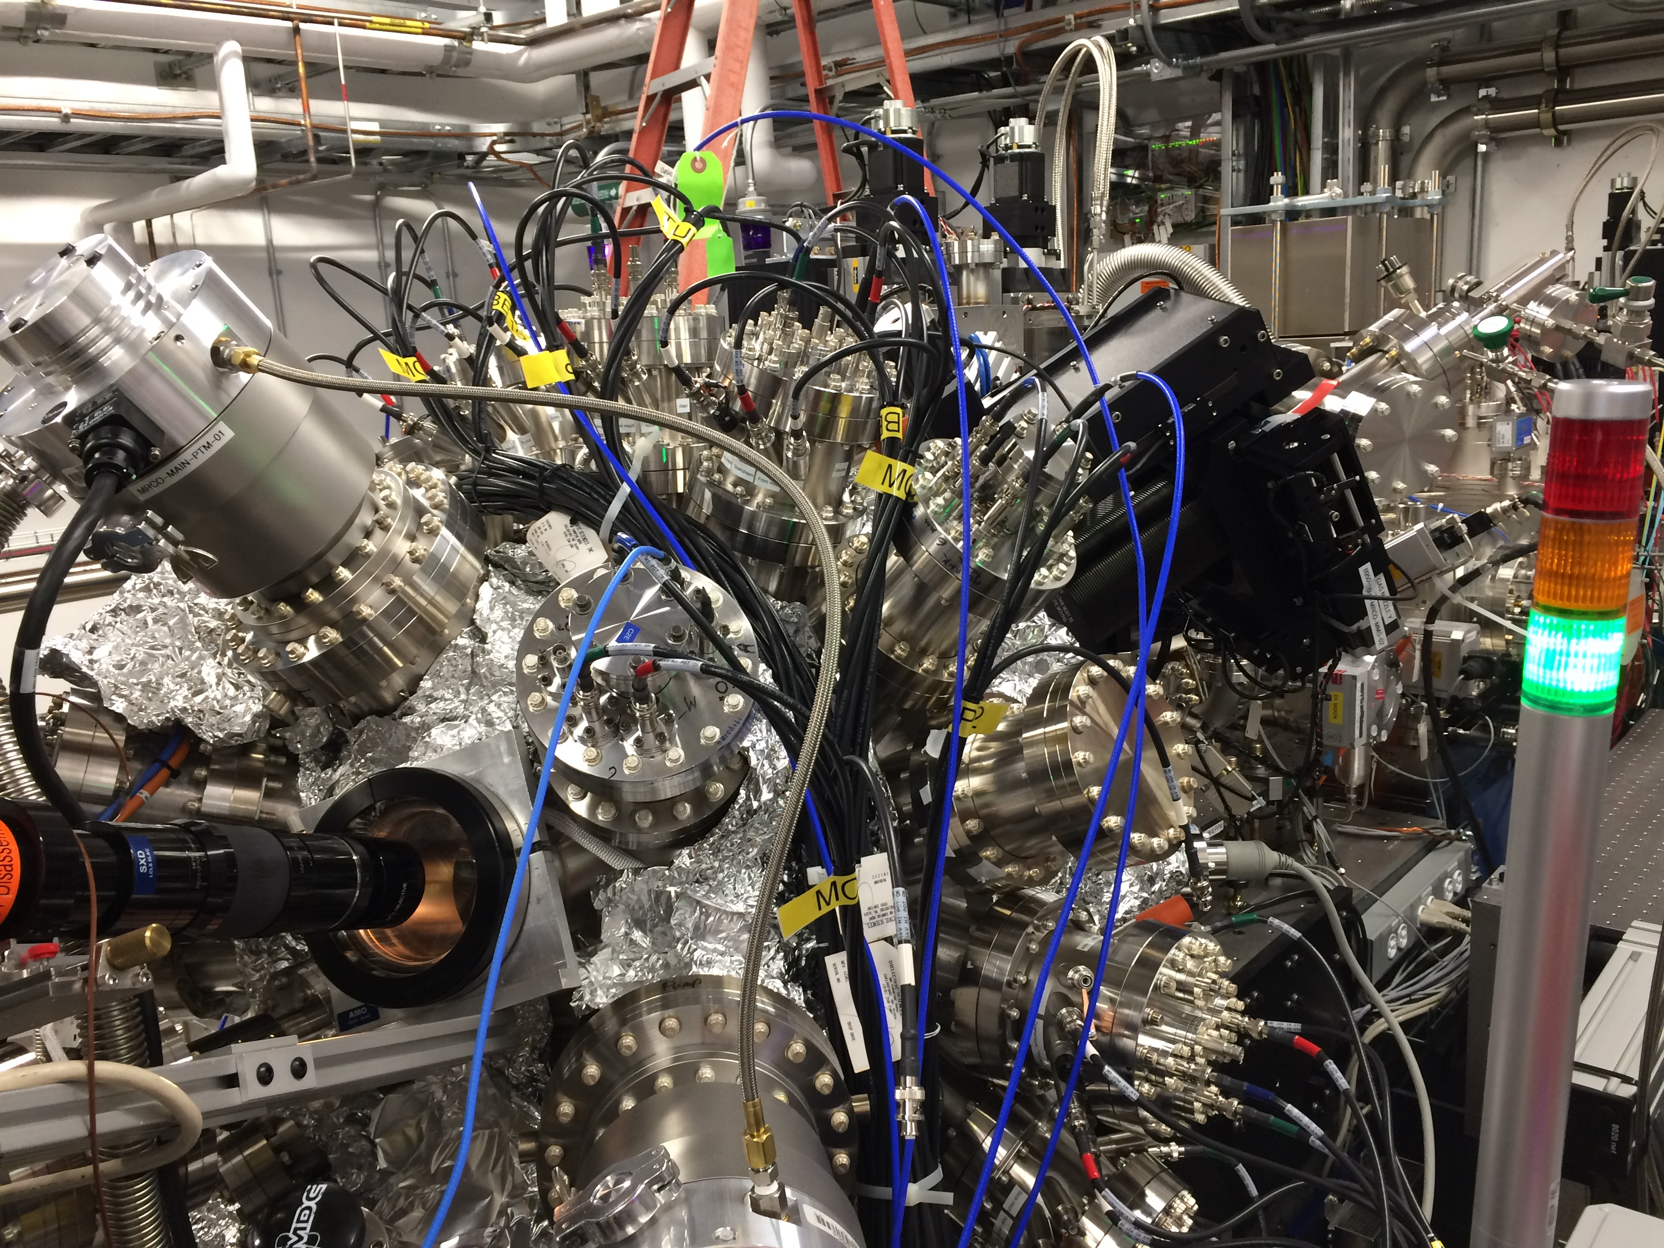
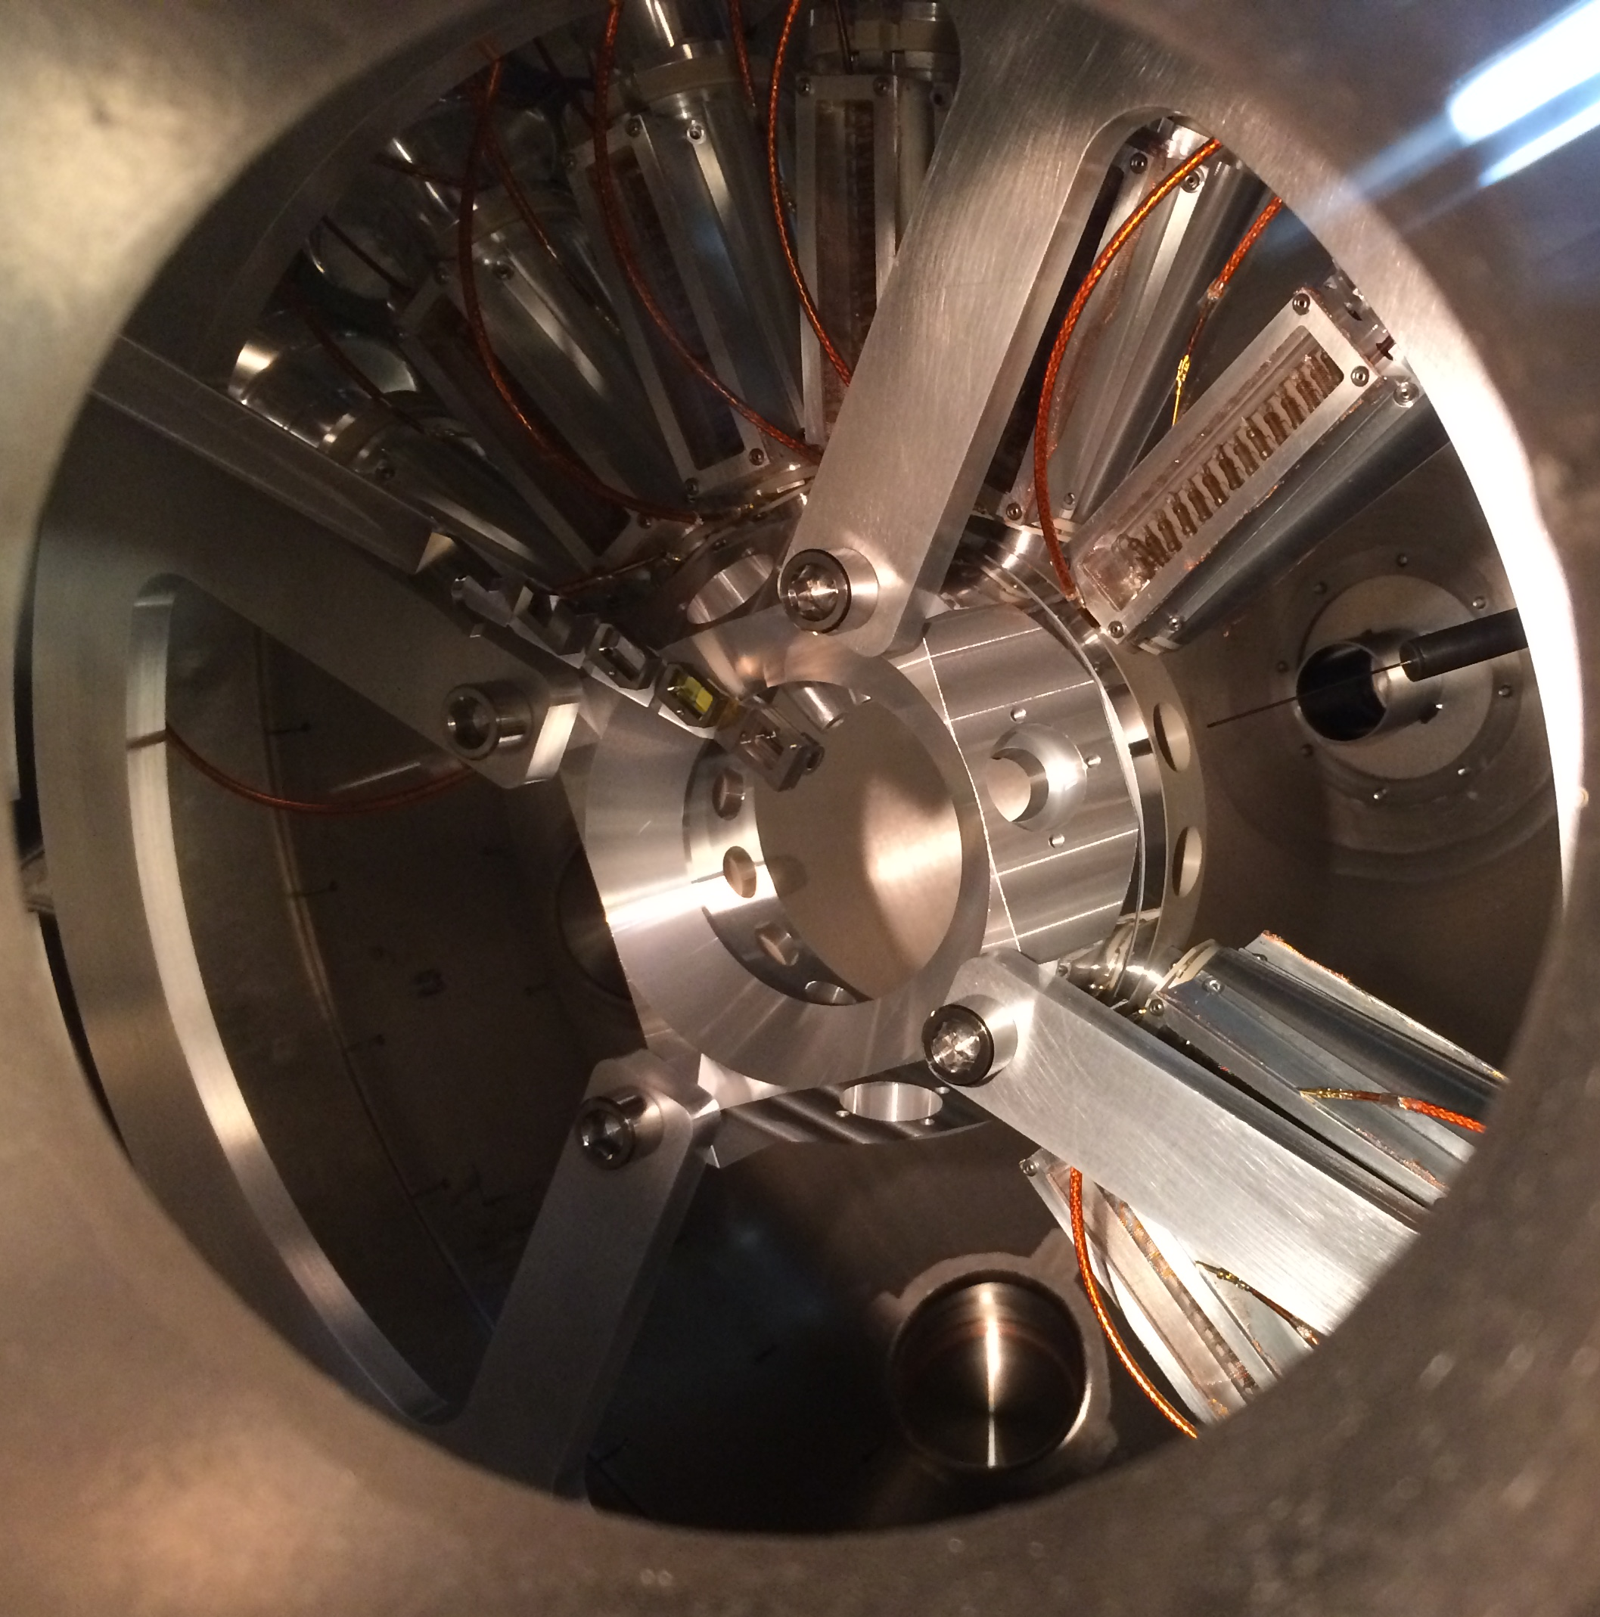
Construction Status
  sadfasdf

Slide 11
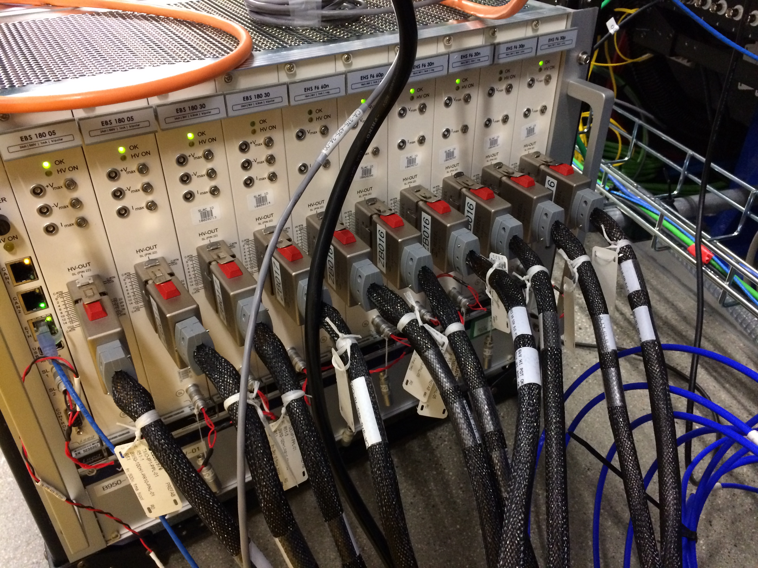
High Density HV
  Cite submitted paper

Slide 12
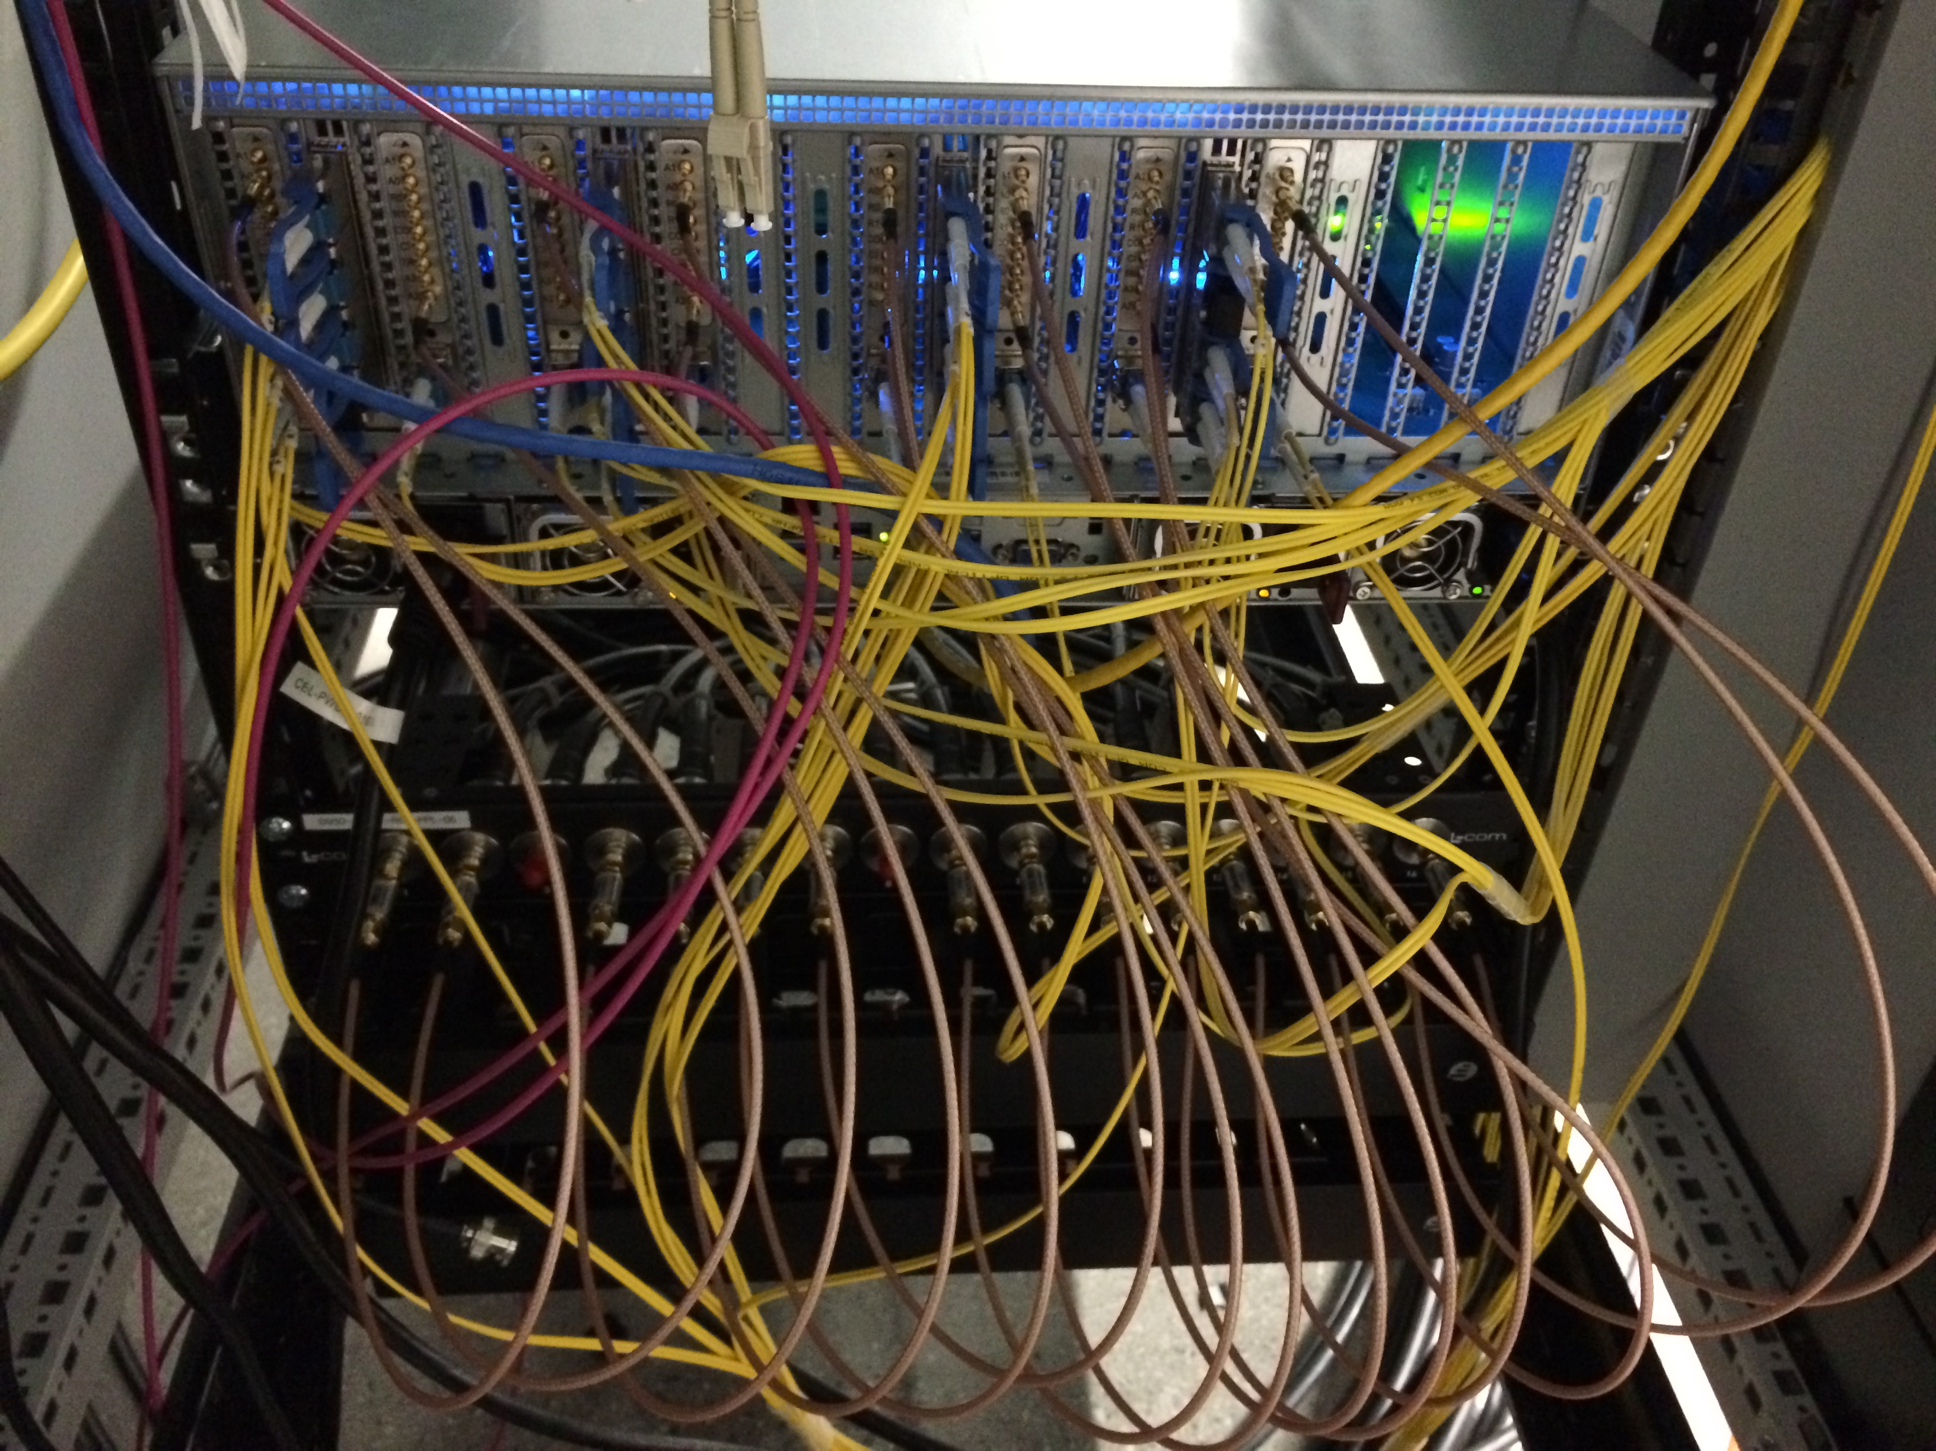
High Density Data
  Cite arXiv Zhengchun

Slide 13
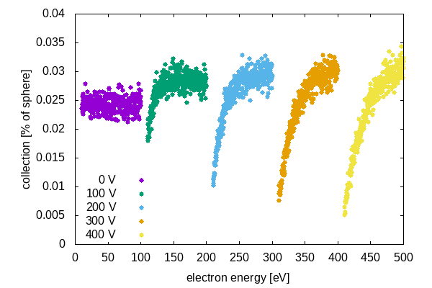
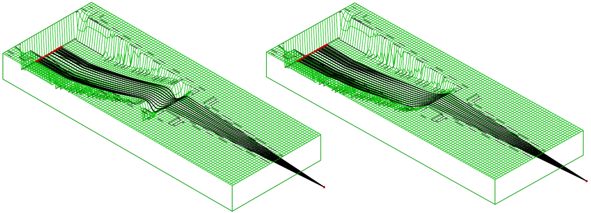
Collection versus survival and resolution
  Avoiding ‘sausaging’ chromatic lensing reduces hot central spots
  Comparable collection across appropriate retardations

Slide 14
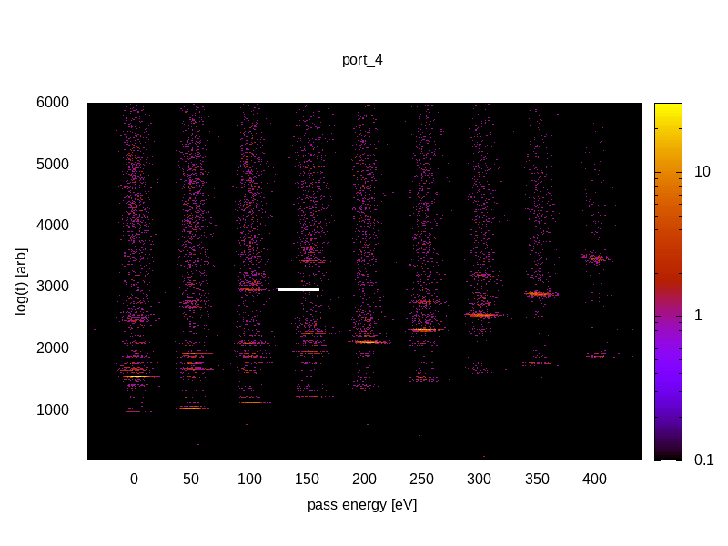
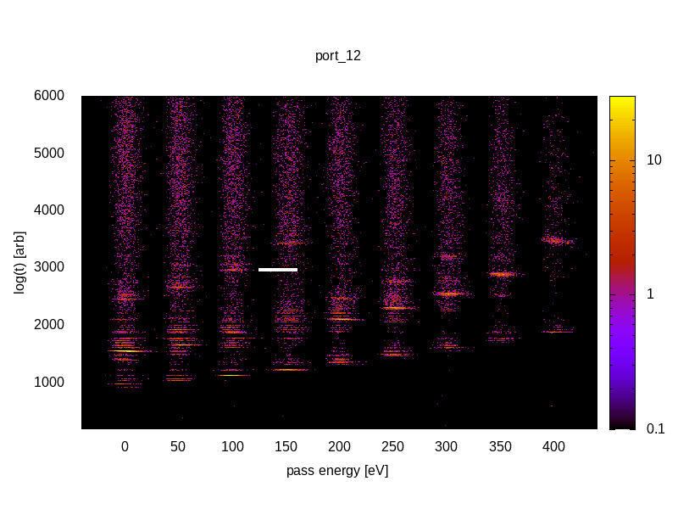
Collection versus survival and resolution
  Avoiding ‘sausaging’ chromatic lensing reduces hot central spots
  Comparable collection across appropriate retardations
  Argon data for high retardations
  Neon data for no retardation

Slide 15
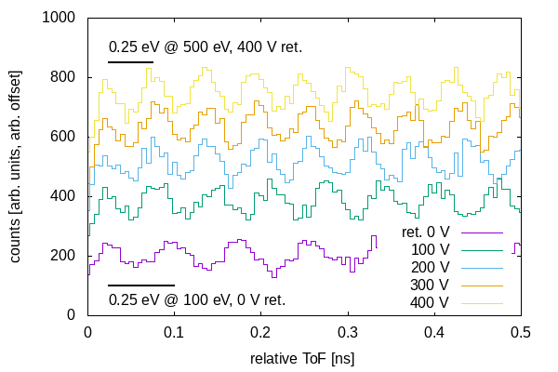
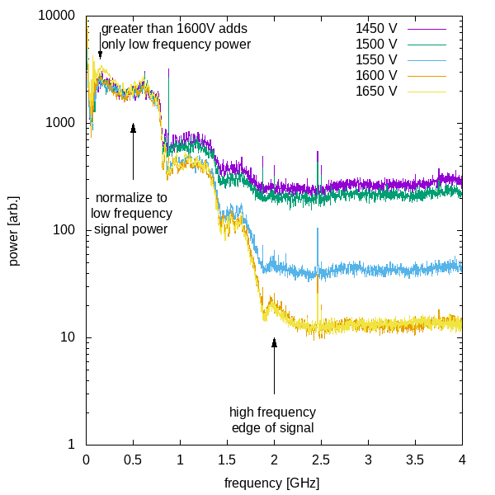
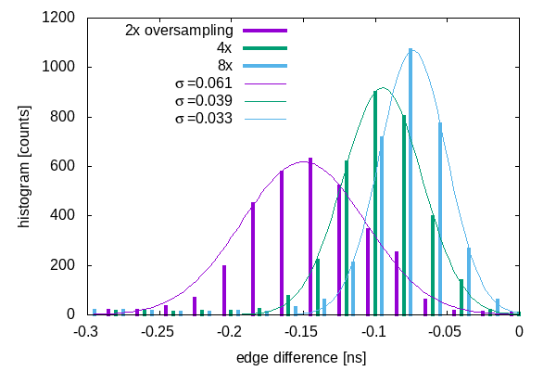
Resolution simulations and testing
  Laser lab signal allowed algorithm development
  Simulations show need for sub-sampling resolution

Slide 16
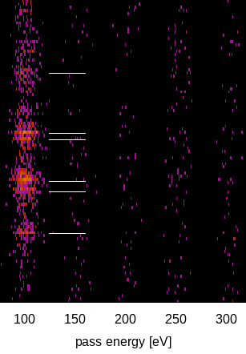
Resolution simulations and testing
  Laser lab signal allowed algorithm development
  Simulations show need for sub-sampling resolution
  Argon data for ¼ eV resolution e.g. 50ps arrival time resolution. Uses 4x upsampling

Slide 17
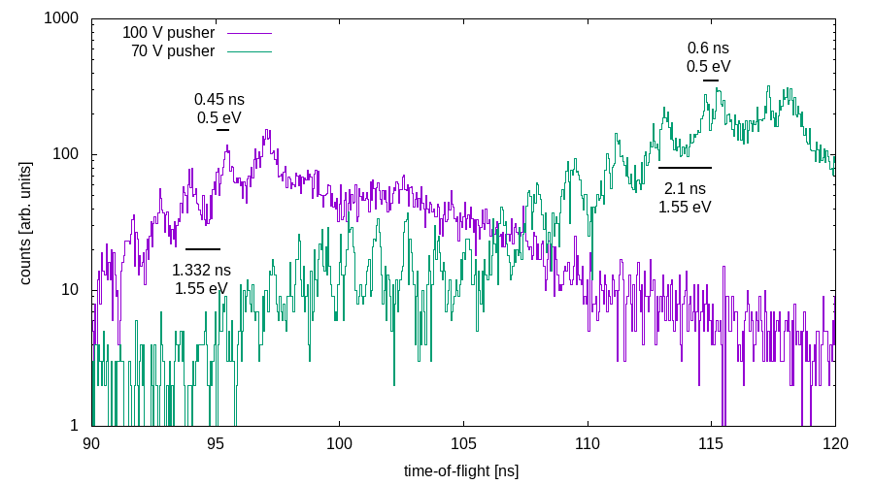
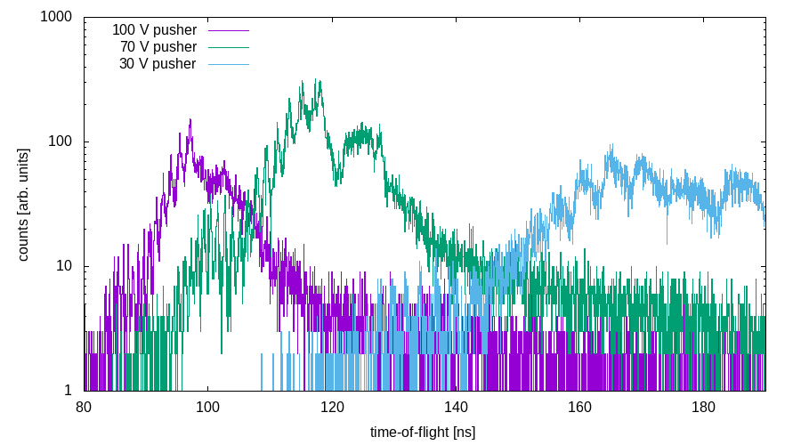
Resolution simulations and testing
  Pushing resolution below sampling
  Aiming for 0.25 eV resolution at 100 V
  30 V spoiled by magnetic fields in steel chamber

Slide 18
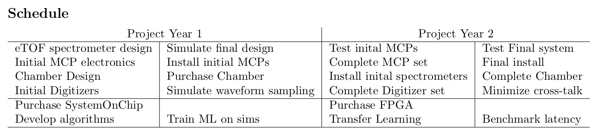
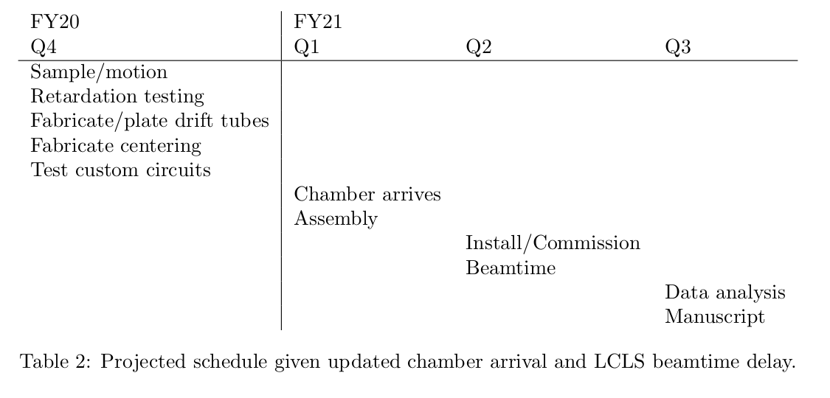
Schedule: March 15 – August 1
  Summary of original deliverable and dates
  \
  Summary of where we are and updated delivery dates
Potential for integrated RF electronics
Second COVID delay to June 17

Slide 19
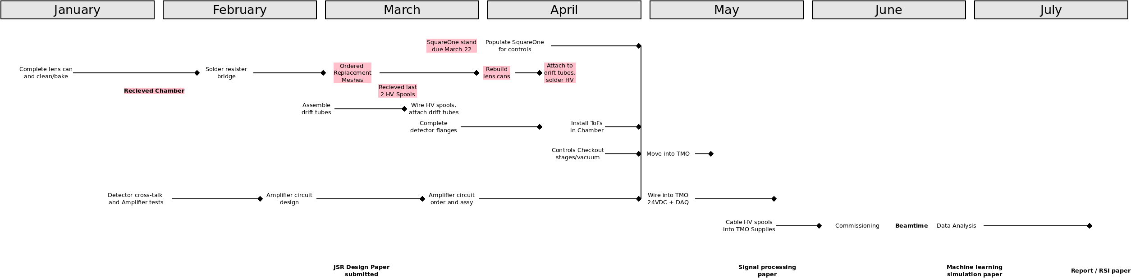
Schedule: January 1 – May 1
  Make a dia chart to show the time-line.

Slide 20
Schedule: May 1 – August 1
  Make a dia chart to show the time-line.

Slide 21
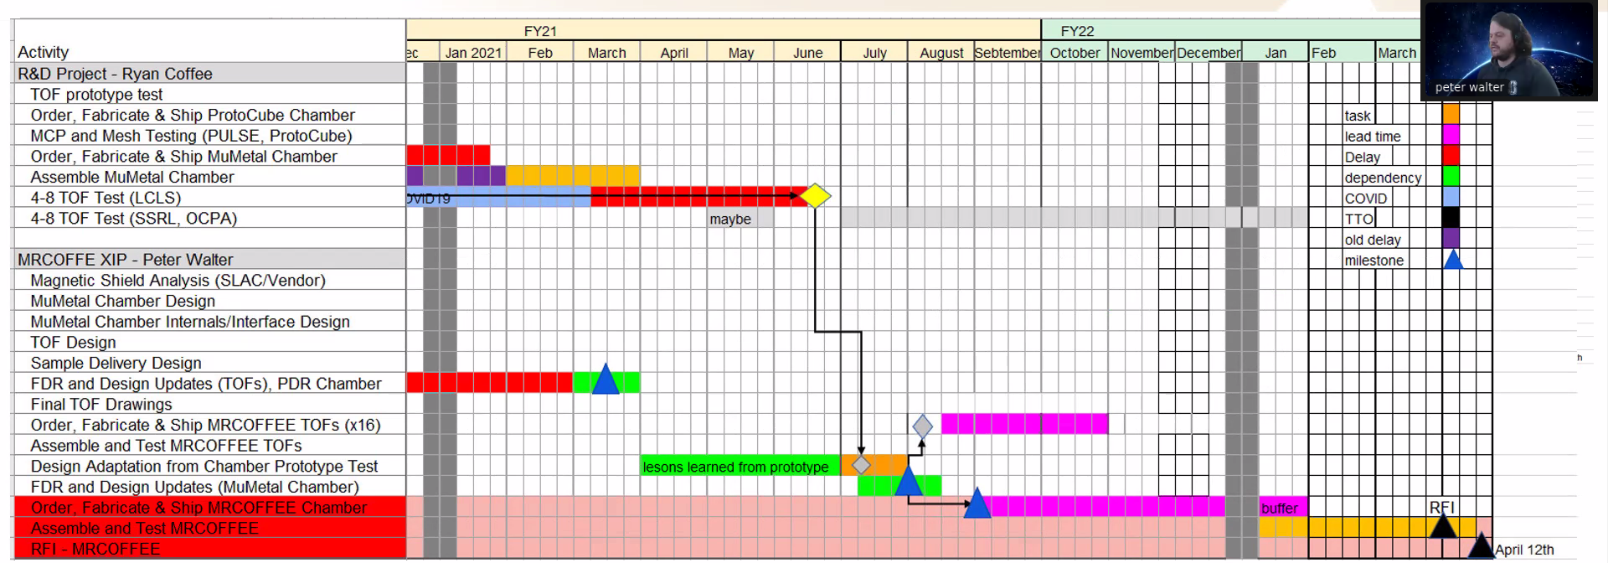
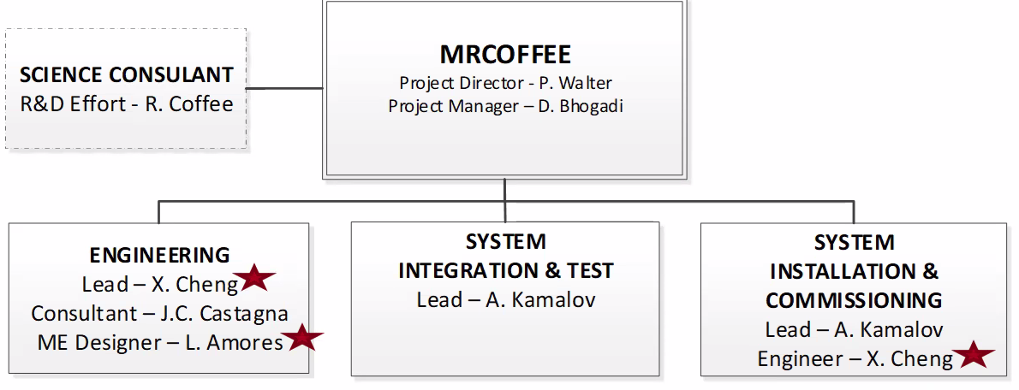
CookieBox to XIP User Project @ August 1
  CookieBox leads to XIP project – delivery to Users, 1 year hence

Slide 22
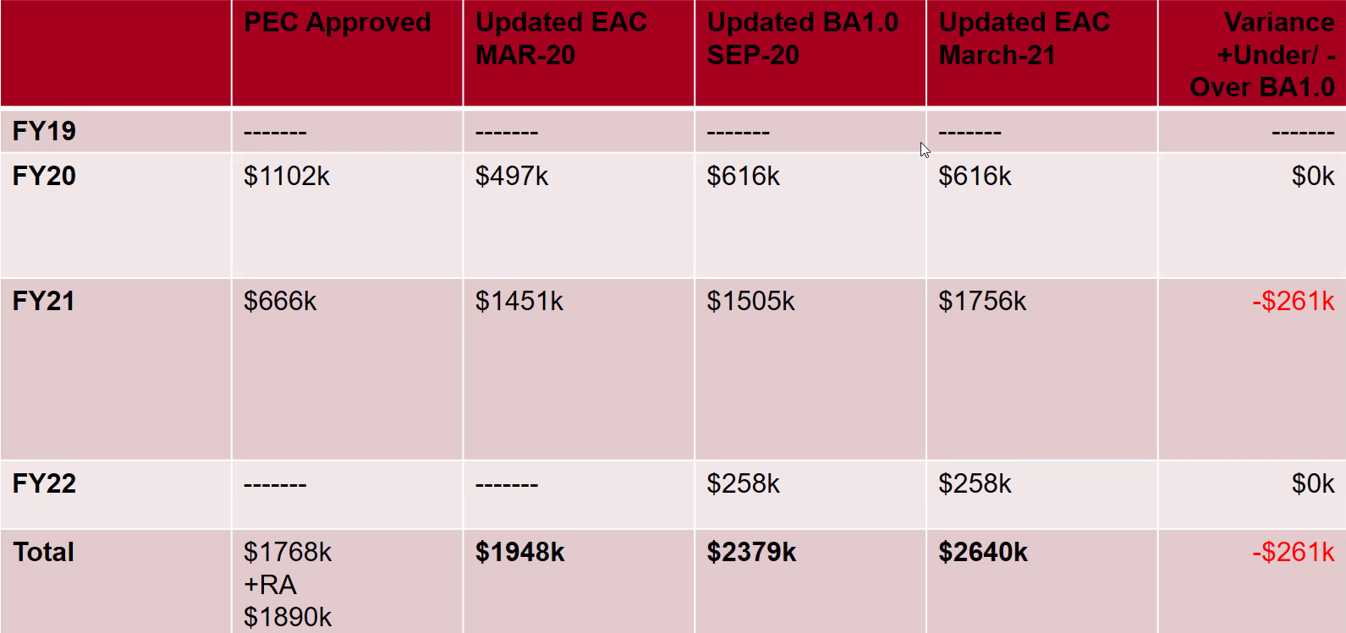
TMO user end station funding
  Output of the R&D project has triggered the XIP funding of a User Instrument for TMO for operations in Spring 2022.
  Early testing has triggered FY21 purchases already
  Principle design will be followed, only minor adjustments.

Slide 23
Near term R&D plans
  (R&D) Stereo ATI (StATI) with infrared 1 μm, 100 kHz pump laser in hpl-lab130 – Q1 Fy22
  (R&D) Carrier envelop phase (CEP) tagging for StATI using 100 kFps Vision Research S710 camera in hpl-lab130 – Q2 FY22
  (R&D) Demonstrate stream-sorting of StATI based on CEP tagging in hpl-lab130 – Q3 FY22
  (XIP) Long wavelength streaking campaign in TMO – Q3/Q4 FY22.
  (R&D) Multi-photon physics with stochastic fields – Q3/Q4 FY22 (Run 20 inhouse proposal)

Slide 24
Enabling Accelerator R&D and nonlinear x-ray methods
  Attoclocking in the FEE
    Bigest question was THz in the FEE
    Zhirong, Fisher, Hoffman have beam-based THz development project that could directly feed the CookieBox in the FEE with long wavelength light at rate!
  LCLS-II developments CookieBox detector will support
    Ago’s double XLEAP
    Erik’s polarization shaping
    Alberto’s Fresh Slice methods
    Claudio’s Double Bunch and Harmonic Lasing
    … anything FEL shaping related and multi-bunch
  Scientific methods it will enable
    Ulf Saalman and Jan Michael Rost for enhancement of non-linear signals because of SASE, Inhouse proposal submitted last Friday
    “Spooktroscopy” and attoclock ptychography as super-resolution methods in the time-energy domain … Daniel Ratner engaged, Alberto Lutman mode used in beamtime
    Dynamic Chirality by fs-scale time-dependent polarization shaping

Slide 25
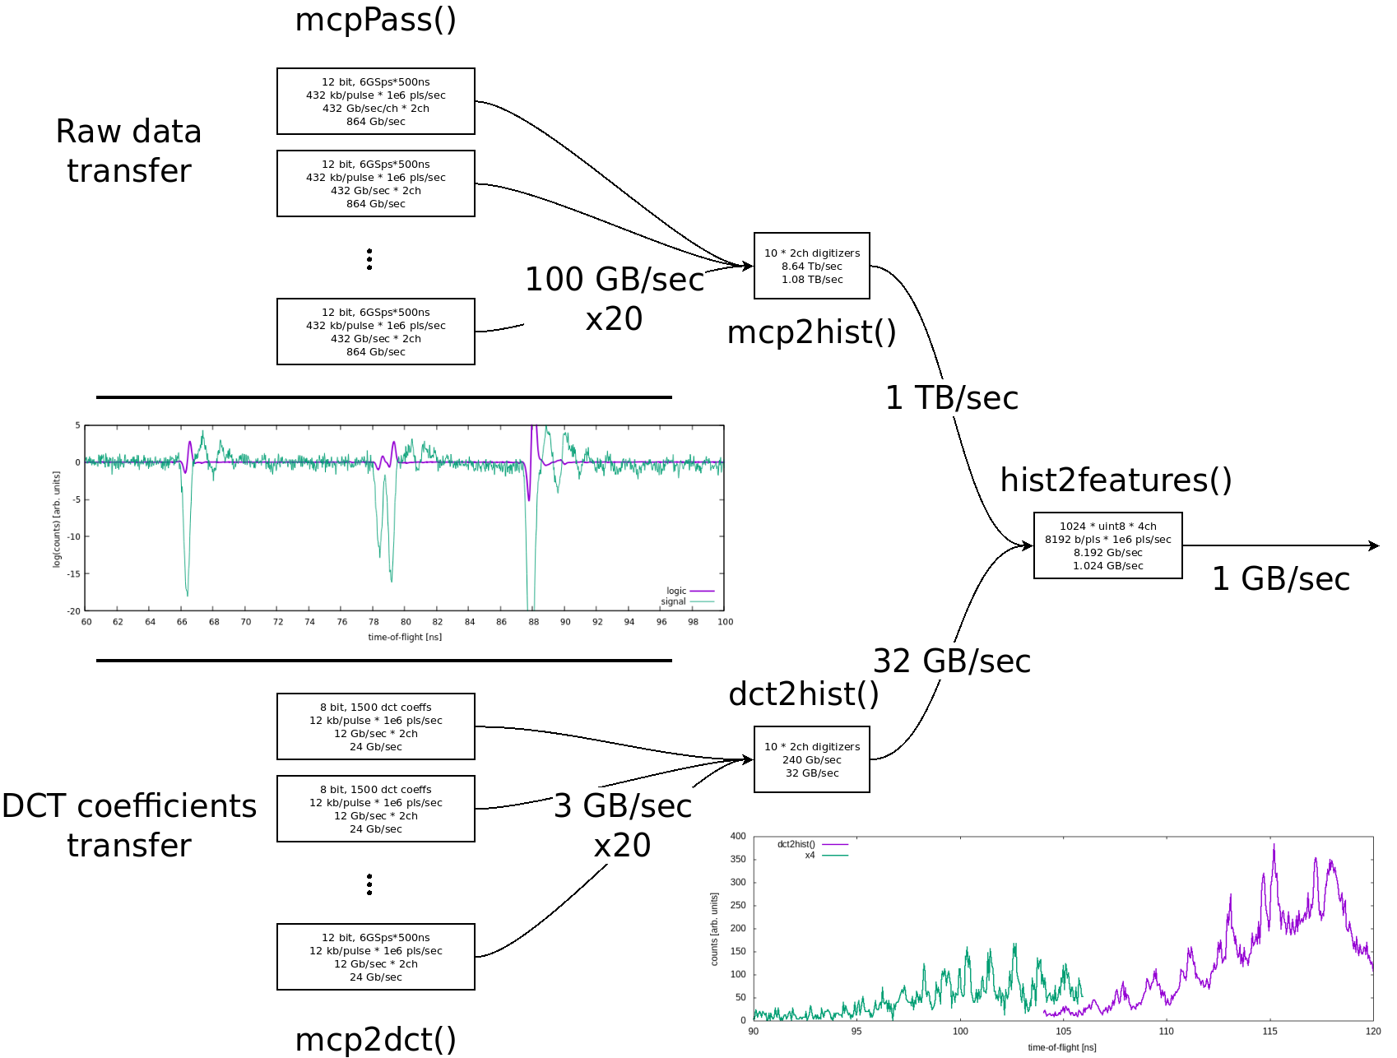
Resolution requires algorithm + compression
  Testing 6 GS/sec sampling
  Preserve 70V resolution compared to 40 GS/sec scope sampling
  32x signal compression

Slide 26
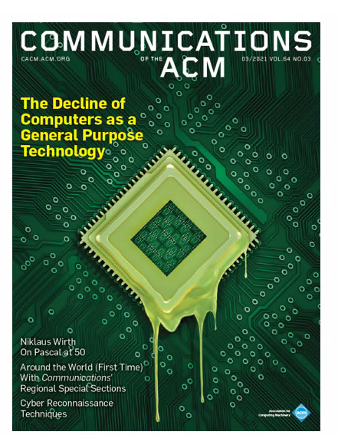
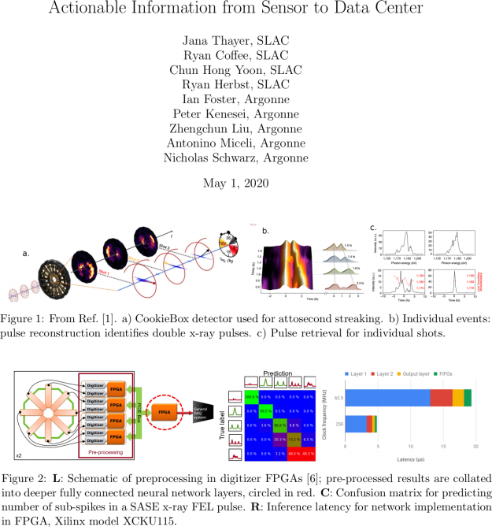
Enabling Strategic Developments – EdgeAI
  AISDC
  Tixel for ToFs
Svenja Spanuth and Neil Thompson
Corbeil Therrien et al., “Machine Learning at the Edge for Ultra High Rate Detectors” NSS-MIC, 1-4, (2019) doi: 10.1109/NSS/MIC42101.2019.9059671

Slide 27
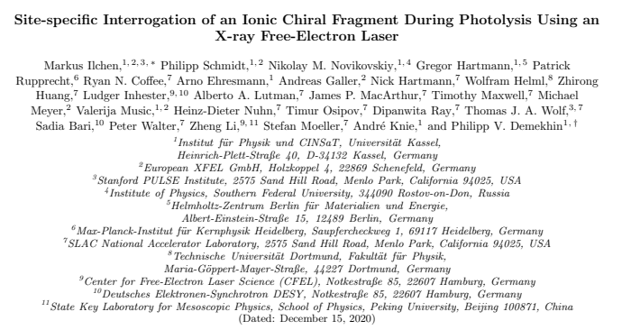
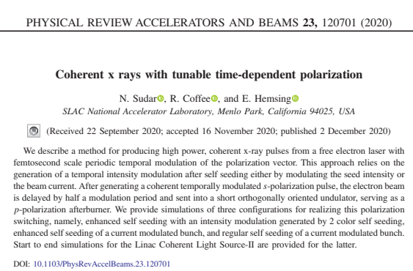
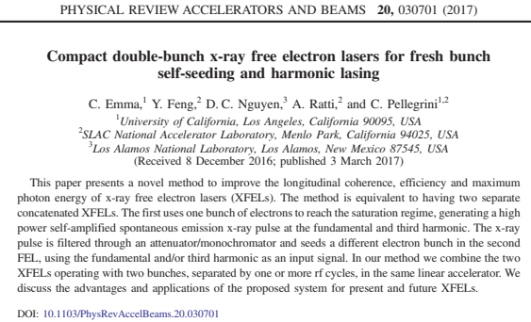
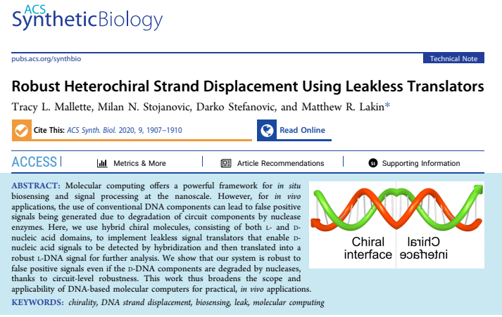
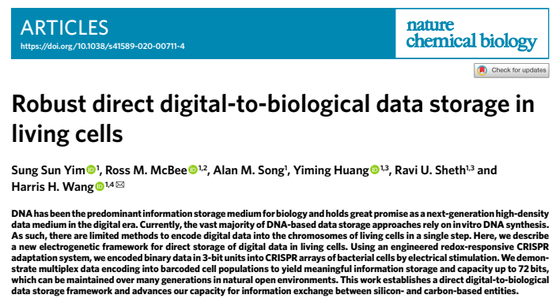
Chirality, Molecular dynamics and Polarization Shaping
  Outline
In vivo molecular computing

Slide 28
FY22 Technical R&D Topics
  Alternative to Zn/Ni/Au coating of ToF parts (although Aluminum worked well so far)
  <50 ps resolving area detector (Tixel) versus bucket detector (MCP)
  Direct signal processing for inference
    Bernhard Adams regarding glass embedded amplifier circuit with larger area MCP
    Jack’s idea to put ADC and FPGAs on the air side of the vacuum window.
    John Fox regarding custom MCP assembly for better RF signal decoupling
  24 channel HV supply for auto-tuning of compound electrostatic lens: auto-CEL – a self-aware CookieBox

Slide 29

The CookieBox → MRCOFFEE Team
  Omar Quijano (TID-AIR Staff)
    EdgeML system admin
  Matt Feldman (EE/CS PhD Student) – Samba Nova
    Spatial-lang for FPGA
  Audrey Corbeil-Therrein (Banting Post-Doc Fellow) – Faculty @ U. Sherbrooke
    FPGA developer and ASIC design
  Andrei Kamalov (TMO Post-Doc)
    Laser lab testing and demonstration, CookieBox design and assembly, beamtime co-lead
  Razib Obaid (TMO Project Scientist)
    Detector R&D, CookieBox assembly, beamtime collaborator
  Averell Gatton (TMO Post-Doc) – (Clostra, Inc.)
    Simulations and model training, CookieBox design, beamtime author
  Debadri Das (Applied Physics PhD Student)
    Signal processing and algorithms
  Jack Hirschman (Applied Physics PhD and CS Student)
    RF electronics, FPGA, ASIC, and source control
  Naoufal Layad (Institute for Computational and Mathematical Engineering Masters Student)
    Surrogate modeling, Ensemble methods and Bayesian Networks
  Coffee (CookieBox lead), Walter (TMO/MRCOFFEE lead), Dragone (ASICs/Detectors), Herbst (FPGAs), Cryan (AMO)

Slide 30
Title
  Outline

