Slide 1


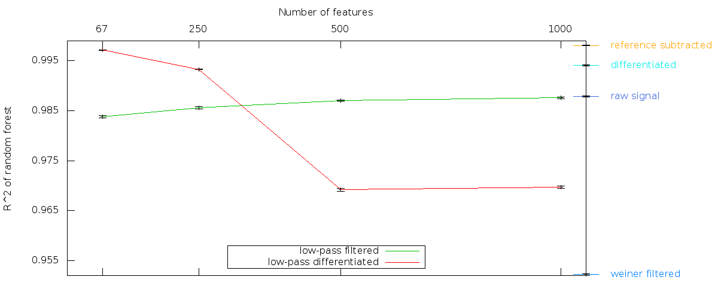
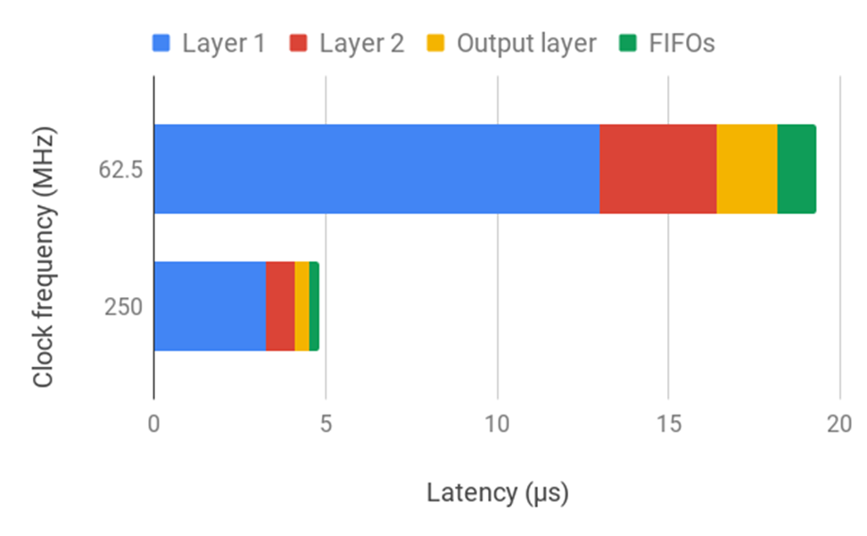
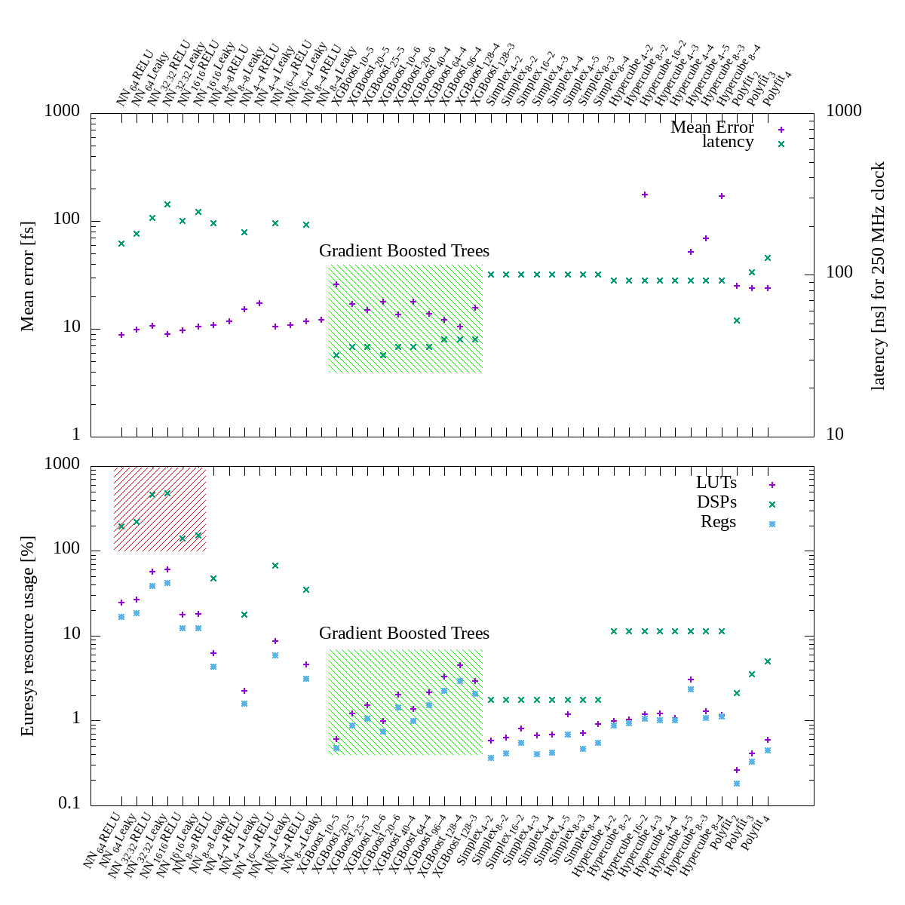
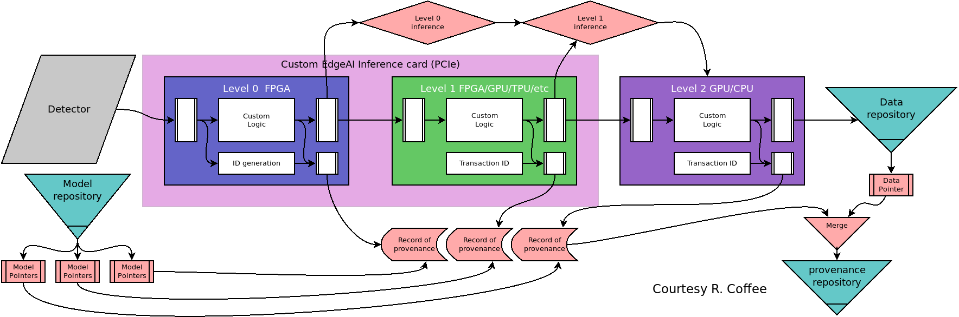
Machine Learning for Data Reduction at LCLS-II: A Path Toward 1MHz Detection
Ryan Coffee (PI), Amedeo Perazzo (co-PI), Kunle Olukotun (co-PI), Omar Quijano, Ryan Herbst, Audrey Corbeil Therrien, Abdullah Rashed Ahmed, Tim Aiken, Matt Feldman, and Katherine Fotion
Introduction
The goals of this project were three-fold
FPGA & GPU-based inference node design
Standardized interactive development environment
Optimizing compiler that targets FPGA deployment
An ancillary benefit of this project was that SLAC is now taking a leadership position related to EdgeAI, the detector-side of machine learning application for ultrafast autonomous data compression and machine control. SLAC’s use cases are emerging as exemplar cases that are inspiring industry partners in the Edge AI space.
Fig. 2. Random forest results for training and accuracy. Curves indicate importance of dimensional reduction via “featureization.” This is done by initial pattern matching convolutions in the FPGA and then using resulting parameters as inputs to the trained models rather than the raw image input.
Fig. 4. CookieBox digitizer solution predicting SASE sub-spikes based on 16 electron Time-of-Flight spectrometers. Latency for fully connected network of 3 layers with RELU activation.
Model Deployment
Project Exposure
Node Design
FPGA deployment is made by training models in the traditional python environment with TensorFlow. The fitted model is then compiled to FPGA byte-code via the Spatial language, a SCALA-like functional programming language used to define pre-analysis—featureization—and and model interactions. The deployment results are shown in Fig. 3 and demonstrate that Gradient Boosted Decision Trees minimize the FPGA resource usage (green patch) while maintaining comparably accurate predictions to fully connected neural networks that actually over-run the existing FPGA resources (red patch).
A.C.T. – IEEE NSSMIC 2019 [submission], DESY Instrumentation Seminar, BNL-IFDEPS, IEEE Real Time. R.N.C. – Global Innovation Forum 2019, Whitehouse OSTP workshop for data handling, NNSS data science for nuclear security workshop, Interview at Next AI Platform 2020, Nvidia GTC2020.
Industry engagement as a result of LDRD Project:
AI Chip startups – Cornami, SambaNova, Groc – plan to benchmark against our trained models.
Nvidia Edge R&D project planning to make demonstration case of either the 2dTimeTool or CookieBox example
VisionResearch (Visible imaging cameras), Euresys (capture cards), Abaco (digitizers) are in discussion about custom design and/or custom FPGA logic.
TID-AIR ePix family of detectors reaching Mfps based on Edge AI handling at the sensor.
We have one of each flavor of node: master, docker build, train/test, camera inference, and waveform inference.
Master node for launching kubernetes pods and services
Docker image build node
Train/test node – V100 training and inference GPU + P40 inference GPU + Xilinx KCU1500 FPGA
Vision Research camera node – 4x quad CXP12 image capture cards + V100 training and inference GPU + 1 dual Abaco digitizer card + Xilinx KCU1500 FPGA
CookieBox eToF spectrometer node – 4x dual Abaco digitizer cards + Xilinx KCU1500 FPGA + P40 inference GPU
Each of the three Edge nodes—Jerry Kevin and Stuart—have 2TB of local NVMe storage for model storage and training data. This storage allows for high speed access for model updates and eventual re-training.
Personnel Development
Development & Environment
Omar Quijano – LCLS IT/Networking department head, Audrey Corbeil Therrien – Faculty appointment, Univ. of Sherbrooke, Canada, Matt Feldman – PhD Candidate Stanford CS/EE, Consultant for SambaNova, Katie Fotion – ML Engineer at Cruise Autonomous Vehicles, Abdullah Rashed Ahmed – PhD Candidate at Brown in Computational Neuroscience, Tim Aiken – Developer at Gbanga Millform Inc.
Toward the goal of Edge AI information extraction as per Fig. 1, we explored the need for FPGA-based feature extraction, e.g. dimensional reduction, as shown in Fig. 2. It is clear that distilling the information into as few information dense features improves both the model accuracy and training, but also the testing and therefore inference latency.
For the development environment, we settled on a Kubernetes managed cluster of Docker images. We note that Singularity will equally well support the Docker image build recipes for use in HPC environments and thus allows extension of the Edge environment to user development at home istitutions or at HPC clusters. This ensures that simulations that require leadership HPC resources can nevertheless co-design the inference models in a compatible environment as will be served by LCLS.
Conclusions
We finalized three flavors of EdgeAI node and will use the visible image capture node to benchmark a 100 kFps 2D visible imaging camera in early March. The digitizer node will demonstrate 100 kFps shortly thereafter using the R&D laser in building 40. Edge processing of data is encouraging the continued development of very high frame rate 2D area sensors with close collaboration between data handeling in LCLS and detector development in TID-AIR.
Fig. 3. Error and latency (top) and FPGA resource usage (bottom) for compiled models. Here the inputs to the models are the resulting parameters of the initial convolution against the known “derivative filter” referenced in Fig. 2.
Acknowledgments
Fig. 1. Current concept for EdgeAI information extraction with provenance record. Currently seeking funding.
This LDRD project supported all of the computing hardware with the exception of the CookieBox digitizers which were purchased under DOE-BES FWP 100498. The LDRD partially supported R.N.C., A.R.A., K.F., O.Q., and T.A. A.C.T. was principally supported through a Banting Fellowship, M.F was supported via Stanford Graduate Fellowship in the CS department. R.H is supported through TID-AIR.

