Slide 1


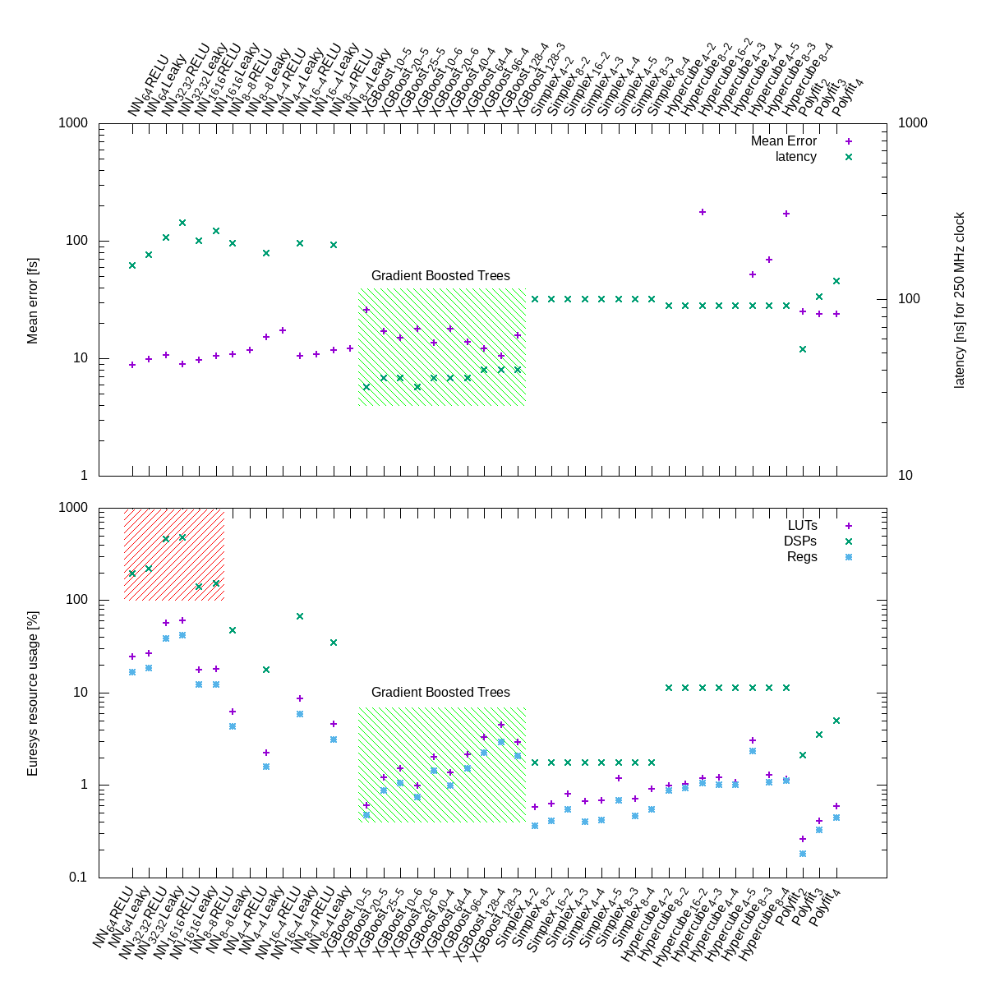
EdgeML
Ryan Coffee, Amedeo Perazzo, Kunle Olukotun, Omar Quejano, Audrey Corbeil-Therrien, Katherine Fotion, Abdullah Rashed-Ahmed, Matt Feldman
Introduction
We wanted to do this
Research
This is how we did it
Audrey paper/proceedings
Audrey talk DESY
Audrey talks
Ryan GIF, Whitehouse OSTP, NNSS, GTC2020, Next AI Platform
Cornami, SambaNova, Groc, VisionResearch, Euresys, Nvidia
Conclusions
Here is what we did and how we did it
Katie Fotion – Cruise Autonomous Vehicles
Abdullah Rashed-Ahmed – Brown Computational Neuroscience
Omar Quejano – LCLS IT deartment head
Matt Feldman – PhD Candidate CS/EE
Audrey Corbeil-Therrien – Faculty appointment
Matt Feldman – Gbanga Millform, Developer
Acknowledgments
LDRD funding, CookieBox funding, Audrey Fellowship, Stanford Grad Fellowship

