Slide 1
THE IRON
20.4 KGS
45
LBS
CORNER

Slide 2
THE IRON
20.4 KGS
45
LBS
CORNER

Slide 3
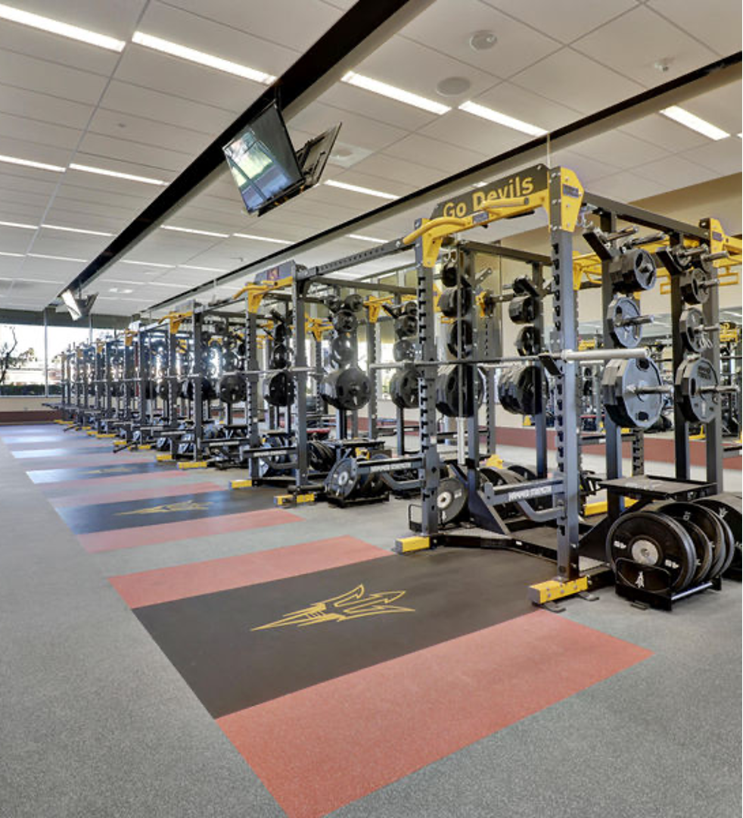
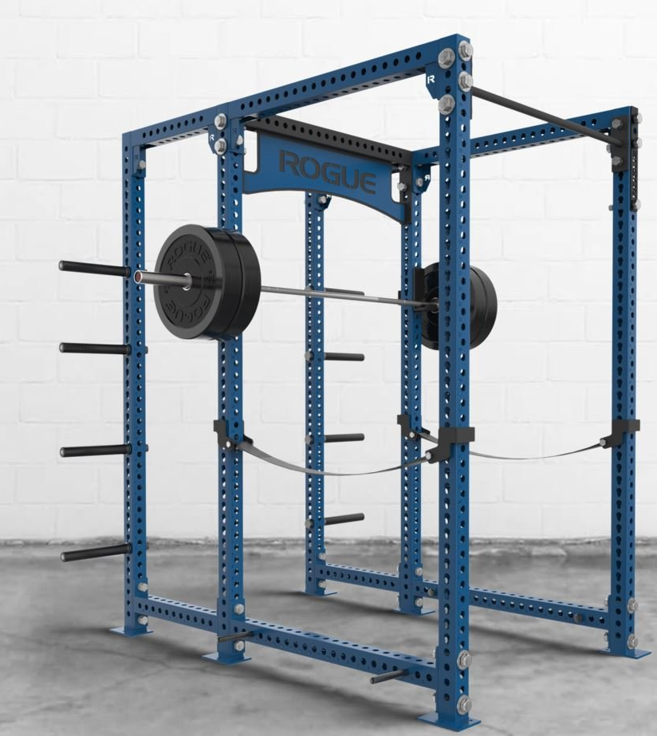
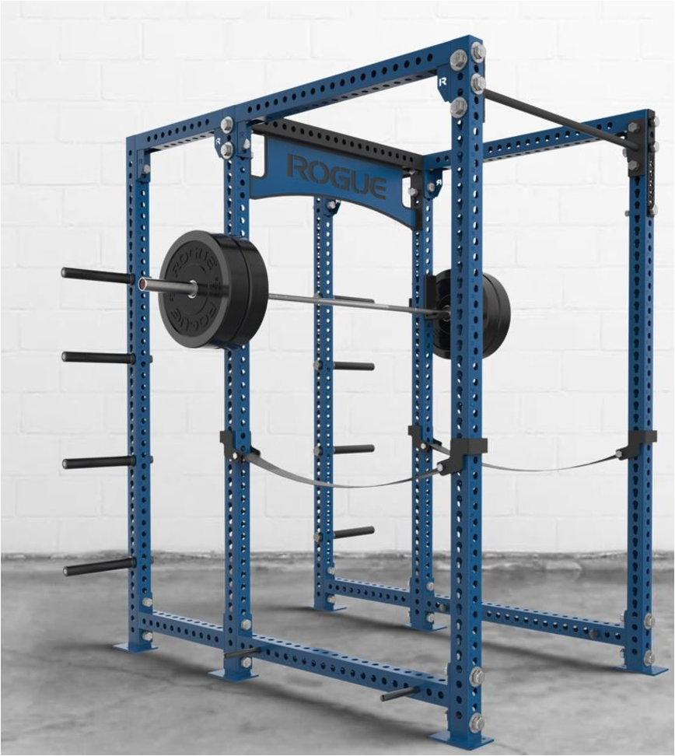

Slide 4
