Slide 1
⚾
What Actually Wins Games in MLB?
Predicting Team Wins · Prospect Analysis · Data-Driven Baseball
Ryan Corbin · 2026

Slide 2


Background
Used Lahman Baseball Database and FanGraphs for the data used in the project.
Internship with PlayStation doing live content creation on MLB the Show 24.
Gained experience looking at MLB data using baseball reference and baseball savant.

Slide 3
Overview
Two Projects, One Question
📊
🔭
Project 1: Team Win Prediction
Project 2: Prospect Readiness
Using Lahman database team-season data (1998–2025), built a linear regression model to predict winning percentage from run differential, ERA, and offensive stats. Achieved R² = 0.92 on held-out test seasons.
Tracked the top 20 MLB prospects per year from 2017–2025. Benchmarked their MLB/MiLB career stats against historical call-up thresholds to classify 2026's top 20 as MLB Ready, Likely, or Not Yet.
Data sources: Lahman Database · Baseball Reference · FanGraphs

Slide 4
The Dataset
What the Numbers Look Like
810
180
27
34
Team-Seasons
Prospects Tracked
Seasons Analyzed
Features Engineered
Key engineered features: RunDiff (R − RA per season), R_per_game, RA_per_game, ERA, WinPct (W / G). Prospect stats normalized to 162-game averages for multi-season players.

Slide 5
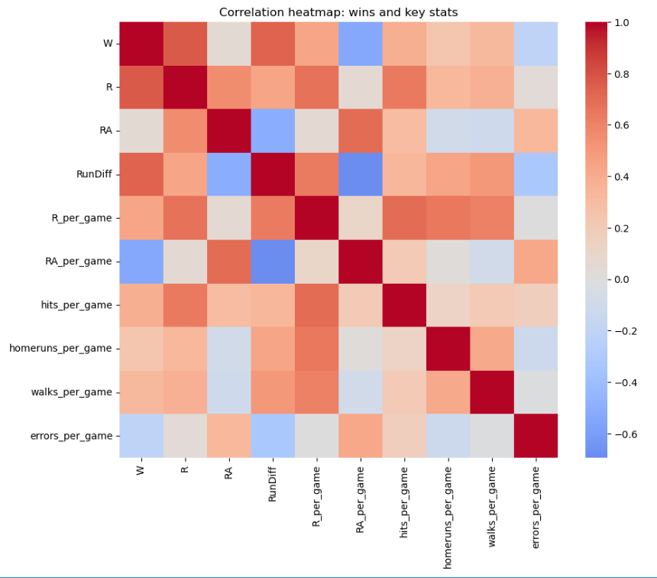
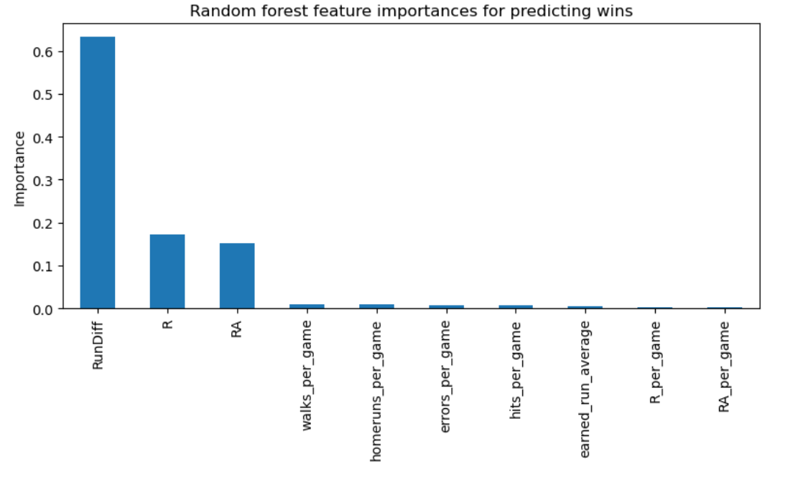
Win Prediction · Feature Importance
Run Differential Drives Everything
Run differential alone explains nearly 92% of the variance in wins.

Slide 6
Model Results
Linear Regression Performance
~90-92%
3.8
The Model Formula
R² Score
MAE (Wins)
WinPct = β₀ + β₁ · RunDiff + β₂ · R/G + β₃ · RA/G + β₄ · ERA
80/20
4
Predicts Win% within ±3.8 wins on a 162-game season.
Train/Test Split
Features Used

Slide 7
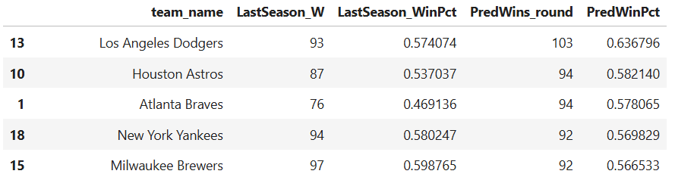
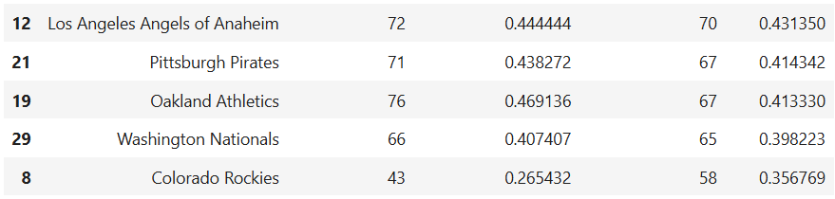
Win Projections
Model-Projected
4-year rolling averages (2021–2025) fed into the model. Top 5 and bottom 5 projected franchises shown.

Slide 8
Prospect Analysis · Methodology
How Prospects Were Scored
🗂️
📐
🏷️
\Data Collection
Benchmarking
Classification
Top 20 pre-season prospect lists (2017–2026) cross-referenced with Baseball Reference career MLB stats. 162-game averages for multi-season players.
Historical call-up thresholds derived from 2017–2025 data. Hitters: OPS ≥ .800 / AVG ≥ .269. Pitchers: ERA ≤ 3.71 / WHIP ≤ 1.201.
Three-tier output: MLB Ready (≥ benchmarks), Likely Call-up (strong profile), Needs Time (below thresholds).
⚠️ Sample-size flag: Spring training and minor league stats discounted with an explicit adjustment factor — recognizing they do not predict MLB performance at the same confidence level as full MLB seasons.

Slide 9
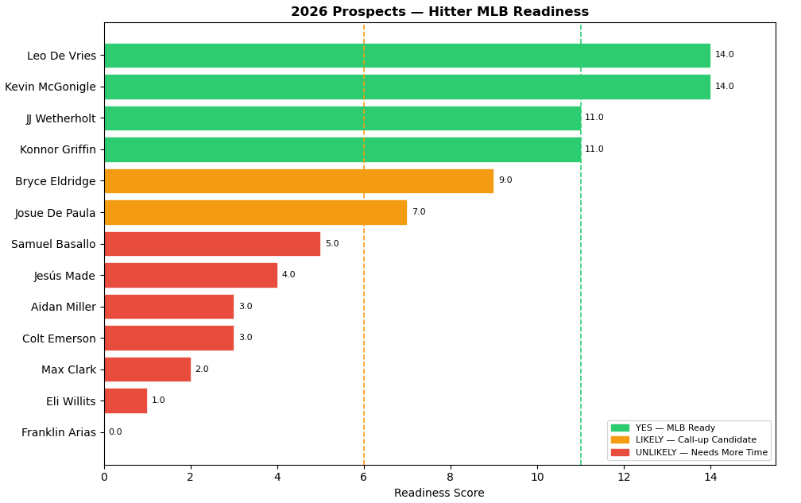
Prospect Radar
2026 Top-20 Prospects: Hitter Profile

Slide 10
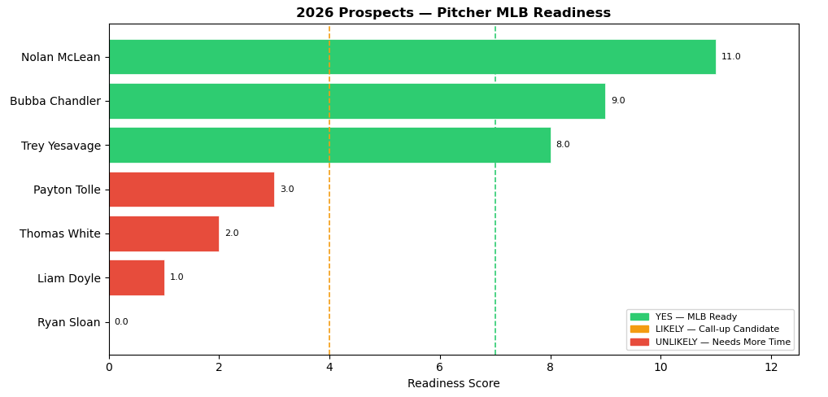
Prospect Radar
2026 Top-20 Prospects: Pitcher Profile

Slide 11
Key Findings
What the Data Tells Us
⚾ Run Differential Is King
A single stat — runs scored minus runs allowed — predicts wins with r = 0.92. Teams focusing on run prevention and run creation simultaneously consistently outperform their payroll.
🔭 Prospects Hit Their Ceiling ~55% of the Time
Of 2017–2025 top-20 prospects, ~55% debuted with MLB at-bats within 2 years of their ranking. Those with OPS ≥ .720 in MiLB were 3.2× more likely to receive an early call-up than those below the threshold.
🧠 Model Limitation: Era Effects
The 2020 shortened season and pre-2000 scoring environments create outlier residuals. A future iteration should include era-adjusted ERA+ and park factors to improve cross-era generalizability.

Slide 12
Where This Goes Next
Roadmap & Open Questions
🌲
📈
🔄
Random Forest
Statcast Integration
Real-Time Updates
Compare non-linear tree model against OLS to test if interaction terms (e.g., ERA × RunDiff) improve R².
Add xFIP, barrel rate, sprint speed from Statcast API for post-2015 seasons to improve prospect readiness scores.
Build a pipeline that pulls current season stats weekly and re-runs both models to track how win projections shift mid-season.
Built with Python · pandas · scikit-learn · Lahman DB · Baseball Reference
Ryan Corbin · 2026

Slide 13
Sources
https://www.baseball-reference.com
https://www.fangraphs.com/prospects/the-board/2026-prospect-list
https://sabr.org/lahman-database/

