Slide 1
[TACL] Modeling Word Forms Using Latent Underlying Morphs and Phonology
Ryan Cotterell and Nanyun Peng and Jason Eisner

Slide 2
What is Phonology?

Slide 3
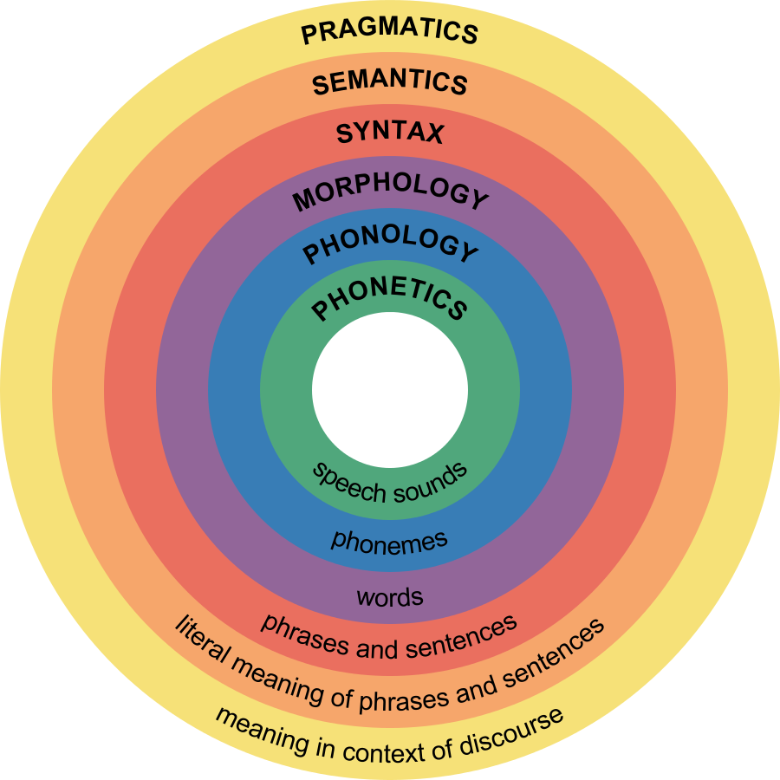
What is Phonology?

Slide 4
What is Phonology?

Slide 5
What is Phonology?

Slide 6
What is Phonology?

Slide 7
What is Phonology?

Slide 8
What is Phonology?
Orthography:
cat
[kæt]
Phonology:
Phonology explains regular sound patterns

Slide 9

What is Phonology?
Orthography:
cat
[kæt]
Phonology:
Phonetics:
Phonology explains regular sound patterns
Not phonetics, which deals with acoustics

Slide 10
Q: What do phonologists do?
A: They find sound patterns in sets of words!
Notes:
----- Meeting Notes (7/28/15 15:28) -----
sets of

Slide 11
A Phonological Exercise
[tɔk]
[tɔks]
[tɔkt]
[tɔkt]
[θeɪŋk]
[θeɪŋks]
[θeɪŋkt]
[θeɪŋkt]
[hæk]
[hæks]
[hækt]
[hækt]
Notes:
of experiments, of course, include much larger datasets. BUt we also show we can generate correctly from small amounts of data.
----- Meeting Notes (7/28/15 15:35) -----

Slide 12
A Phonological Exercise
Tenses
[tɔk]
[tɔks]
[tɔkt]
[tɔkt]
[θeɪŋk]
[θeɪŋks]
[θeɪŋkt]
[θeɪŋkt]
[hæk]
[hæks]
[hækt]
[hækt]
Verbs
Notes:
Mention that we train and test on larger datasets

Slide 13
A Phonological Exercise
Tenses
[tɔk]
[tɔks]
[tɔkt]
[tɔkt]
[θeɪŋk]
[θeɪŋks]
[θeɪŋkt]
[θeɪŋkt]
[hæk]
[hæks]
[hækt]
[hækt]
Verbs
Notes:
----- Meeting Notes (7/28/15 15:35) -----
It shows how verbs are proncouned in tense

Slide 14
A Phonological Exercise
Tenses
1P Pres. Sg.
3P Pres. Sg.
Past Tense
Past Part.
TALK
[tɔk]
[tɔks]
[tɔkt]
[tɔkt]
THANK
[θeɪŋk]
[θeɪŋks]
[θeɪŋkt]
[θeɪŋkt]
HACK
[hæk]
[hæks]
[hækt]
[hækt]
Verbs

Slide 15
A Phonological Exercise
Tenses
1P Pres. Sg.
3P Pres. Sg.
Past Tense
Past Part.
TALK
[tɔk]
[tɔks]
[tɔkt]
[tɔkt]
THANK
[θeɪŋk]
[θeɪŋks]
[θeɪŋkt]
[θeɪŋkt]
HACK
[hæk]
[hæks]
[hækt]
[hækt]
Verbs
CRACK
[kɹæks]
[kɹækt]
SLAP
[slæp]
[slæpt]
Notes:
----- Meeting Notes (7/28/15 15:35) -----
Orthography and phonology

Slide 16
A Phonological Exercise
Suffixes
/Ø/
/s/
/t/
/t/
1P Pres. Sg.
3P Pres. Sg.
Past Tense
Past Part.
/tɔk/
TALK
[tɔk]
[tɔks]
[tɔkt]
[tɔkt]
/θeɪŋk/
THANK
[θeɪŋk]
[θeɪŋks]
[θeɪŋkt]
[θeɪŋkt]
/hæk/
HACK
[hæk]
[hæks]
[hækt]
[hækt]
Stems
/kɹæk/
CRACK
[kɹæks]
[kɹækt]
/slæp/
SLAP
[slæp]
[slæpt]

Slide 17
A Phonological Exercise
Suffixes
/Ø/
/s/
/t/
/t/
1P Pres. Sg.
3P Pres. Sg.
Past Tense
Past Part.
/tɔk/
TALK
[tɔk]
[tɔks]
[tɔkt]
[tɔkt]
/θeɪŋk/
THANK
[θeɪŋk]
[θeɪŋks]
[θeɪŋkt]
[θeɪŋkt]
/hæk/
HACK
[hæk]
[hæks]
[hækt]
[hækt]
Stems
/kɹæk/
CRACK
[kɹæks]
[kɹækt]
/slæp/
SLAP
[slæp]
[slæpt]
Notes:
phonology students infer these latent variables.(but it's not as easy as it looks).

Slide 18
A Phonological Exercise
Suffixes
/Ø/
/s/
/t/
/t/
1P Pres. Sg.
3P Pres. Sg.
Past Tense
Past Part.
/tɔk/
TALK
[tɔk]
[tɔks]
[tɔkt]
[tɔkt]
/θeɪŋk/
THANK
[θeɪŋk]
[θeɪŋks]
[θeɪŋkt]
[θeɪŋkt]
/hæk/
HACK
[hæk]
[hæks]
[hækt]
[hækt]
Stems
/kɹæk/
CRACK
[kɹæk]
[kɹæks]
[kɹækt]
[kɹækt]
/slæp/
SLAP
[slæp]
[slæps]
[slæpt]
[slæpt]
Prediction!

Slide 19
A Model of Phonology
tɔk
s
Concatenate
tɔks
“talks”

Slide 20
A Phonological Exercise
Suffixes
/Ø/
/s/
/t/
/t/
1P Pres. Sg.
3P Pres. Sg.
Past Tense
Past Part.
/tɔk/
TALK
[tɔk]
[tɔks]
[tɔkt]
[tɔkt]
/θeɪŋk/
THANK
[θeɪŋk]
[θeɪŋks]
[θeɪŋkt]
[θeɪŋkt]
/hæk/
HACK
[hæk]
[hæks]
[hækt]
[hækt]
Stems
/kɹæk/
CRACK
[kɹæks]
[kɹækt]
/slæp/
SLAP
[slæp]
[slæpt]
/koʊd/
CODE
[koʊdz]
[koʊdɪd]
/bæt/
BAT
[bæt]
[bætɪd]

Slide 21
A Phonological Exercise
Suffixes
/Ø/
/s/
/t/
/t/
1P Pres. Sg.
3P Pres. Sg.
Past Tense
Past Part.
/tɔk/
TALK
[tɔk]
[tɔks]
[tɔkt]
[tɔkt]
/θeɪŋk/
THANK
[θeɪŋk]
[θeɪŋks]
[θeɪŋkt]
[θeɪŋkt]
/hæk/
HACK
[hæk]
[hæks]
[hækt]
[hækt]
Stems
/kɹæk/
CRACK
[kɹæks]
[kɹækt]
/slæp/
SLAP
[slæp]
[slæpt]
/koʊd/
CODE
[koʊdz]
[koʊdɪd]
/bæt/
BAT
[bæt]
[bætɪd]
z instead of s
ɪt instead of t

Slide 22
A Phonological Exercise
Suffixes
/Ø/
/s/
/t/
/t/
1P Pres. Sg.
3P Pres. Sg.
Past Tense
Past Part.
/tɔk/
TALK
[tɔk]
[tɔks]
[tɔkt]
[tɔkt]
/θeɪŋk/
THANK
[θeɪŋk]
[θeɪŋks]
[θeɪŋkt]
[θeɪŋkt]
/hæk/
HACK
[hæk]
[hæks]
[hækt]
[hækt]
Stems
/kɹæk/
CRACK
[kɹæks]
[kɹækt]
/slæp/
SLAP
[slæp]
[slæpt]
/koʊd/
CODE
[koʊdz]
[koʊdɪd]
/bæt/
BAT
[bæt]
[bætɪd]
/it/
EAT
[it]
[eɪt]
[itən]
eɪt instead of itɪt

Slide 23
A Model of Phonology
koʊd
s
Concatenate
koʊd#s
Phonology (stochastic)
koʊdz
“codes”
Modeling word forms using latent underlying morphs and phonology.
Cotterell et. al. TACL 2015
Notes:
Talk about represent by CPT
----- Meeting Notes (7/29/15 06:39) -----
phonology is noise process that distorts strings rather than distorts numbers

Slide 24
A Model of Phonology
rizaign
ation
Concatenate
rizaign#ation
Phonology (stochastic)
rεzɪgneɪʃn
“resignation”
Notes:
----- Meeting Notes (7/28/15 15:58) -----
To get resignation, we put the ation suffix on something. Simplification to make it easier to pronounce

Slide 25
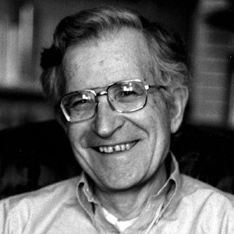

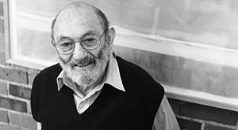
Generative Phonology
A system that generates exactly those attested forms
Primary research program in phonology since the 1950s
Example: [rezɪɡneɪʃən] “resignation” and [rizainz] “resigns”
Notes:
Optimality Theory
Contraints
----- Meeting Notes (7/28/15 15:58) -----
And ever since then, the linguistics have been hand engineering grammars that have these underlying forms. Almost all of the work that tries to automate has assumed that the URS are given
put back the matrix completion slide
MT for low resource languages
Cognitively interesting

Slide 26
Why this matters
Linguists hand engineer phonological grammars
Linguistically Interesting: can we create an automated phonologist?
Cognitively Interesting: can we model how babies learn phonology?
“Engineeringly” Interesting: can we analyze and generate words we haven’t heard before? (i.e., matrix completion for large vocabularies)
Notes:
Note that the framework can also handle orthography

Slide 27
A Probability Model
Describes the generating process of the observed surface words:
We model the morpheme M (a) ∈ M as an IID sample from a probability distribution M_{φ} (m).
We model the surface form S(u) as a sample from a conditional distribution S_{θ}(s | u)

Slide 28
The Generative Story
The process of generating a surface word:
Sample the parameters φ and θ from priors.
For each abstract morpheme a∈A, Sample the morph M(a)∼M_{φ}.
Whenever a new abstract word =a₁,a₂··· must be pronounced for the first time, construct its underlying form u by concatenating the morphs M(a₁),M(a₂) ··· , and sample the surface word S(u) ∼ S_{θ}(· | u).
Reuse this S(u) in future.

Slide 29
Why Probability?
A language’s morphology and phonology are deterministic
Advantages:
Soft models admit efficient learning and inference
Quantification of irregularity (“sing” and “sang”)
Our use is orthogonal to phonologists’ use of probability, e.g., to explain gradient phenomena

Slide 30
Phonology as an Edit Process
Upper Left Context
Upper Right Context
r
i
z
a
i
g
n
s
Lower Left Context
Notes:
Show which linguistically motivated features fire
----- Meeting Notes (7/28/15 16:29) -----
EDIT DISTANCE

Slide 31
Phonology as an Edit Process
Upper Left Context
Upper Right Context
r
i
z
a
i
g
n
s
COPY
Lower Left Context
r
Notes:
Show which linguistically motivated features fire
----- Meeting Notes (7/28/15 15:58) -----
Switch to Edit Distance

Slide 32
Phonology as an Edit Process
Upper Left Context
Upper Right Context
r
i
z
a
i
g
n
s
COPY
Lower Left Context
r
i
Notes:
Show which linguistically motivated features fire

Slide 33
Phonology as an Edit Process
Upper Left Context
Upper Right Context
r
i
z
a
i
g
n
s
COPY
Lower Left Context
r
i
z
Notes:
Show which linguistically motivated features fire

Slide 34
Phonology as an Edit Process
Upper Left Context
Upper Right Context
r
i
z
a
i
g
n
s
COPY
r
Lower Left Context
a
i
z
Notes:
Show which linguistically motivated features fire

Slide 35
Phonology as an Edit Process
Upper Left Context
Upper Right Context
r
i
z
a
i
g
n
s
COPY
Lower Left Context
r
i
z
a
i
Notes:
Show which linguistically motivated features fire

Slide 36
Phonology as an Edit Process
Upper Left Context
Upper Right Context
r
i
z
a
i
g
n
s
DEL
Lower Left Context
ɛ
r
i
z
a
i
Notes:
Show which linguistically motivated features fire

Slide 37
Phonology as an Edit Process
Upper Left Context
Upper Right Context
r
i
z
a
i
g
n
s
COPY
Lower Left Context
r
i
z
a
i
ɛ
n
Notes:
Show which linguistically motivated features fire

Slide 38
Phonology as an Edit Process
Upper Left Context
Upper Right Context
r
i
z
a
i
g
n
s
SUB
Lower Left Context
r
i
z
a
i
ɛ
n
z
Notes:
Show which linguistically motivated features fire

Slide 39
Phonology as an Edit Process
Upper Left Context
Upper Right Context
r
i
z
a
i
g
n
s
SUB
Lower Left Context
r
i
z
a
i
ɛ
n
z
Notes:
Show which linguistically motivated features fire

Slide 40
Phonology as an Edit Process
Upper Left Context
Upper Right Context
r
i
z
a
i
g
n
s
COPY
Lower Left Context
r
i
z
a
i
ɛ
n
Notes:
Show which linguistically motivated features fire

Slide 41
Phonology as an Edit Process
Upper Left Context
Upper Right Context
r
i
z
a
i
g
n
s
DEL
Lower Left Context
ɛ
r
i
z
a
i
Notes:
Show which linguistically motivated features fire

Slide 42
Phonology as an Edit Process
Upper Left Context
Upper Right Context
r
i
z
a
i
g
n
s
DEL
Lower Left Context
ɛ
r
i
z
a
i
Action Prob
DEL .75
COPY .01
SUB(A) .05 SUB(B) .03
... ...
INS(A) .02
INS(B) .01
... ...
Notes:
Show which linguistically motivated features fire

Slide 43
Phonology as an Edit Process
Upper Left Context
Upper Right Context
r
i
z
a
i
g
n
s
DEL
Lower Left Context
ɛ
r
i
z
a
i
Action Prob
DEL .75
COPY .01
SUB(A) .05 SUB(B) .03
... ...
INS(A) .02
INS(B) .01
... ...
Notes:
Show which linguistically motivated features fire

Slide 44
Phonology as an Edit Process
Upper Left Context
Upper Right Context
r
i
z
a
i
g
n
s
DEL
Lower Left Context
ɛ
r
i
z
a
i
Action Prob
DEL .75
COPY .01
SUB(A) .05 SUB(B) .03
... ...
INS(A) .02
INS(B) .01
... ...
Feature Function
Weights
Notes:
Show which linguistically motivated features fire

Slide 45
Phonology as an Edit Process
Upper Left Context
Upper Right Context
r
i
z
a
i
g
n
s
DEL
Lower Left Context
ɛ
r
i
z
a
i
Features
Feature Function
Weights
Notes:
Show which linguistically motivated features fire

Slide 46
Phonology as an Edit Process
Upper Left Context
Upper Right Context
r
i
z
a
i
g
n
s
DEL
Lower Left Context
ɛ
r
i
z
a
i
Features
Surface Form
Feature Function
Weights
Notes:
Show which linguistically motivated features fire

Slide 47
Phonology as an Edit Process
Upper Left Context
Upper Right Context
r
i
z
a
i
g
n
s
DEL
Lower Left Context
ɛ
r
i
z
a
i
Features
Surface Form
Transduction
Feature Function
Weights
Notes:
Show which linguistically motivated features fire

Slide 48
Phonology as an Edit Process
Upper Left Context
Upper Right Context
r
i
z
a
i
g
n
s
DEL
Lower Left Context
ɛ
r
i
z
a
i
Features
Surface Form
Transduction
Upper String
Feature Function
Weights

Slide 49
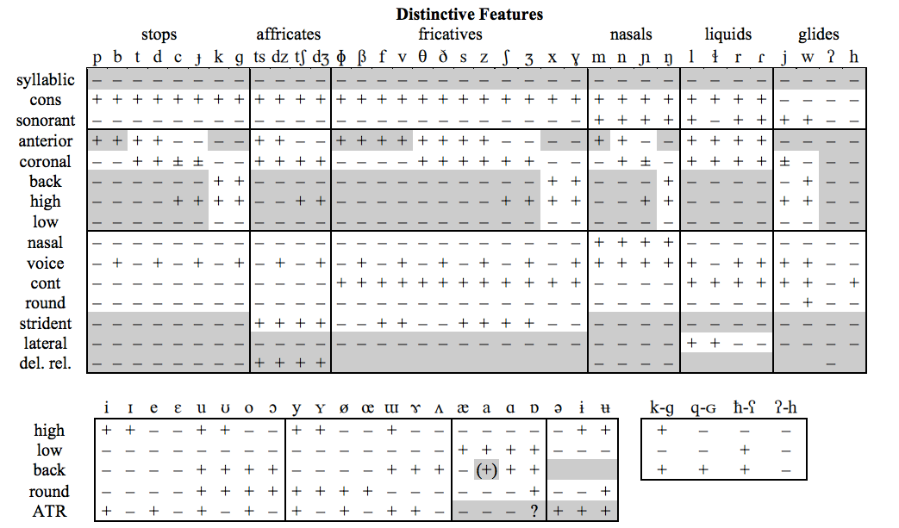
Phonological Attributes
Binary Attributes (+ and -)

Slide 50
Phonology as an Edit Process
Upper Left Context
Upper Right Context
r
i
z
a
i
g
n
s
DEL
Lower Left Context
ɛ
r
i
z
a
i

Slide 51
Phonology as an Edit Process
Upper Left Context
Upper Right Context
r
i
z
a
i
g
n
s
DEL
Lower Left Context
r
i
z
a
i
ɛ
Faithfulness Features
EDIT(g, ɛ)
EDIT(+cons, ɛ)
EDIT(+voiced, ɛ)

Slide 52
Phonology as an Edit Process
Upper Left Context
Upper Right Context
r
i
z
a
i
g
n
s
DEL
Lower Left Context
ɛ
r
i
z
a
i
Markedness Features
BIGRAM(a, i)
BIGRAM(-high, -low)
BIGRAM(+back, -back)
Notes:
Show which linguistically motivated features fire

Slide 53
Phonology as an Edit Process
Upper Left Context
Upper Right Context
r
i
z
a
i
g
n
s
Inspired by Optimality Theory:
A popular Constraint Based Phonology Formalism
DEL
Lower Left Context
ɛ
r
i
z
a
i
Markedness Features
BIGRAM(a, i)
BIGRAM(-high, -low)
BIGRAM(+back, -back)
Notes:
Show which linguistically motivated features fire

Slide 54
Outline
A generative model for phonology
Generative Phonology
A Probabilistic Model
Stochastic Edit Process for Phonology
Inference and Learning
A Hill Climbing Example
EM Algorithm with Finite State Operations
Evaluation and Results
Notes:
The goal of our model: Recovering the lexicon and the phonology.
Inference: Given the phonology and the lexicon generation model, recover the lexicon
Learning: Given the lexicon, learn the parameters for the phonology and the lexicon generation model.

Slide 55
A Generative Model of Phonology
z
rizajgn
rizajgnz
rizˈajnz
Notes:
analogies
----- Meeting Notes (7/28/15 16:29) -----
remove generative model

Slide 56
A Generative Model of Phonology
z
rizajgn
rizajgnz
rizˈajnz
Notes:
You can’t explain the stem and suffix this word. You can’t use one word to explain two latent variables. Analogy to matrix completion, you need more than one person and one movie to figure out general preferences of the audience. The logic here is simple: to figure out the underlying morphemes for a set of words, we need to look at a lot more surface forms so they can collaboratively decide what the URs should be.

Slide 57
A Generative Model of Phonology
A Directed Graphical Model of the lexicon
z
rizajgn
dæmnz
rizajgnz
dˈæmz
rizˈajnz
Notes:
analogies
----- Meeting Notes (7/28/15 16:29) -----
The reason that we think resign splits into this stem and this suffi

Slide 58
A Generative Model of Phonology
A Directed Graphical Model of the lexicon
z
rizajgn
dæmnz
rizajgnz
dˈæmz
rizˈajnz
Notes:
analogies

Slide 59
A Generative Model of Phonology
A Directed Graphical Model of the lexicon
z
dæmn
rizajgn
dæmnz
rizajgnz
dˈæmz
rizˈajnz
Notes:
analogies

Slide 60
A Generative Model of Phonology
A Directed Graphical Model of the lexicon
z
dæmn
rizajgn
dæmnz
rizajgnz
rizajgneɪʃən
dˈæmz
rizˈajnz
rˌɛzɪgnˈeɪʃən
Notes:
analogies

Slide 61
A Generative Model of Phonology
A Directed Graphical Model of the lexicon
z
dæmn
rizajgn
dæmnz
rizajgnz
rizajgneɪʃən
dˈæmz
rizˈajnz
rˌɛzɪgnˈeɪʃən
Notes:
analogies

Slide 62
A Generative Model of Phonology
A Directed Graphical Model of the lexicon
eɪʃən
z
dæmn
rizajgn
dæmnz
rizajgnz
rizajgneɪʃən
dˈæmz
rizˈajnz
rˌɛzɪgnˈeɪʃən
Notes:
analogies

Slide 63
A Generative Model of Phonology
A Directed Graphical Model of the lexicon
eɪʃən
z
dæmn
rizajgn
dæmnz
dæmneɪʃən
rizajgnz
rizajgneɪʃən
dˈæmz
rizˈajnz
rˌɛzɪgnˈeɪʃən
Notes:
analogies

Slide 64
A Generative Model of Phonology
A Directed Graphical Model of the lexicon
eɪʃən
z
dæmn
rizajgn
dæmnz
dæmneɪʃən
rizajgnz
rizajgneɪʃən
dˈæmz
dˌæmnˈeɪʃən
rizˈajnz
rˌɛzɪgnˈeɪʃən
Notes:
analogies
----- Meeting Notes (7/28/15 16:29) -----
damnation and damation
----- Meeting Notes (7/28/15 16:37) -----
I put in the answer
make the underlying forms vanisha
move solved problem heres

Slide 65
Graphical models are flexible
Matrix completion: each word built from one stem (row) + one suffix (column). WRONG
Graphical model: a word can be built from any # of morphemes (parents). RIGHT
gə
liːb
t
gəliːbt
gəliːpt
“geliebt” (German: loved)
Notes:
More general than the matrix completion problem!

Slide 66
A Generative Model of Phonology
A Directed Graphical Model of the lexicon
dˈæmz
rizˈajnz
rˌɛzɪgnˈeɪʃən
Notes:
analogies
----- Meeting Notes (7/28/15 16:29) -----
damnation and damation
----- Meeting Notes (7/28/15 16:37) -----
I put in the answer
make the underlying forms vanisha
move solved problem heres

Slide 67
A Generative Model of Phonology
A Directed Graphical Model of the lexicon
(Approximate) Inference
MCMC – Bouchard-Côté (2007)
Belief Propagation – Dreyer and Eisner (2009)
Expectation Propagation – Cotterell and Eisner (2015)
Dual Decomposition – Peng et al. (2015)
dˈæmz
rizˈajnz
rˌɛzɪgnˈeɪʃən
Notes:
analogies
----- Meeting Notes (7/28/15 16:29) -----
damnation and damation
----- Meeting Notes (7/28/15 16:37) -----
I put in the answer
make the underlying forms vanisha
move solved problem heres

Slide 68
A Generative Model of Phonology
A Directed Graphical Model of the lexicon
(Approximate) Inference
MCMC – Bouchard-Côté (2007)
Belief Propagation – Dreyer and Eisner (2009)
Expectation Propagation – Cotterell and Eisner (2015)
Dual Decomposition – Peng et al. (2015)
dˈæmz
rizˈajnz
rˌɛzɪgnˈeɪʃən
Notes:
analogies
----- Meeting Notes (7/28/15 16:29) -----
damnation and damation
----- Meeting Notes (7/28/15 16:37) -----
I put in the answer
make the underlying forms vanisha
move solved problem heres

Slide 69
A Generative Model of Phonology
A Directed Graphical Model of the lexicon
dˈæmz
rizˈajnz
rˌɛzɪgnˈeɪʃən
Notes:
analogies
----- Meeting Notes (7/28/15 16:29) -----
damnation and damation
----- Meeting Notes (7/28/15 16:37) -----
I put in the answer
make the underlying forms vanisha
move solved problem heres

Slide 70
A Generative Model of Phonology
Distribution Over Surface Form:
UR Prob
dæmeɪʃən .80
dæmneɪʃən .10
dæmineɪʃən. .001
dæmiineɪʃən .0001
… … chomsky .000001
… …
A Directed Graphical Model of the lexicon
dˈæmz
rizˈajnz
rˌɛzɪgnˈeɪʃən
Notes:
analogies
----- Meeting Notes (7/28/15 16:29) -----
damnation and damation
----- Meeting Notes (7/28/15 16:37) -----
I put in the answer
make the underlying forms vanisha
move solved problem heres

Slide 71
A Generative Model of Phonology
Encoded as Weighted Finite-State Automaton
Distribution Over Surface Form:
UR Prob
dæmeɪʃən .80
dæmneɪʃən .10
dæmineɪʃən. .001
dæmiineɪʃən .0001
… … chomsky .000001
… …
A Directed Graphical Model of the lexicon
s
a
h
e
r
i
n
g
dˈæmz
u
rizˈajnz
rˌɛzɪgnˈeɪʃən
e
ε
Notes:
damnation and damation.
Would be able to analyze “damnation”
----- Meeting Notes (7/28/15 16:37) -----
I put in the answer
make the underlying forms vanisha
move solved problem heres

Slide 72
Discovering the Underlying Forms = Inference in a Graphical Model
????
????
????
????
????
????
????
????
dˈæmz
????
rizˈajnz
rˌɛzɪgnˈeɪʃən
Notes:
This has reduced to a problem we know how to solve.
Mention other inference methods: EP and DD. The results we are going to show you here are based on BP, but you can get the same results faster with EP and you can 1-best inference better with DD, which actually
works better with learning, as it turns out. This paper simply shows how to automate this bit of linguistics. mention bouchard cote

Slide 73
Discovering the Underlying Forms = Inference in a Graphical Model
????
????
????
????
????
????
????
????
dˈæmz
????
rizˈajnz
rˌɛzɪgnˈeɪʃən
Notes:
This has reduced to a problem we know how to solve.
Mention other inference methods: EP and DD. The results we are going to show you here are based on BP, but you can get the same results faster with EP and you can 1-best inference better with DD, which actually
works better with learning, as it turns out. This paper simply shows how to automate this bit of linguistics. mention bouchard cote

Slide 74
Belief Propagation (BP) in a Nutshell
z
dæmn
eɪʃən
rizajgn
dæmnz
dæmneɪʃən
rizajgnz
rizajgneɪʃən
dˈæmz
dˌæmnˈeɪʃən
rizˈajnz
rˌɛzɪgnˈeɪʃən

Slide 75
Belief Propagation (BP) in a Nutshell
z
dæmn
eɪʃən
rizajgn
Factor to Variable Messages
dæmnz
dæmneɪʃən
rizajgnz
rizajgneɪʃən
dˈæmz
dˌæmnˈeɪʃən
rizˈajnz
rˌɛzɪgnˈeɪʃən

Slide 76
Belief Propagation (BP) in a Nutshell
z
dæmn
eɪʃən
rizajgn
Variable to Factor Messages
dæmnz
dæmneɪʃən
rizajgnz
rizajgneɪʃən
dˈæmz
dˌæmnˈeɪʃən
rizˈajnz
rˌɛzɪgnˈeɪʃən

Slide 77
Belief Propagation (BP) in a Nutshell
z
dæmn
eɪʃən
rizajgn
a
s
a
e
h
s
e
h
r
i
n
g
r
i
n
g
u
e
e
e
a
e
u
e
e
ε
s
e
h
s
a
ε
r
i
n
g
e
h
Encoded as Finite-State Machines
r
i
n
g
a
s
e
h
s
a
u
e
e
h
ε
e
u
ε
r
i
n
g
r
i
n
g
dæmneɪʃən
u
e
e
u
dæmnz
rizajgnz
rizajgneɪʃən
e
ε
e
ε
dˈæmz
dˌæmnˈeɪʃən
rizˈajnz
rˌɛzɪgnˈeɪʃən

Slide 78
Belief Propagation (BP) in a Nutshell
z
dæmn
eɪʃən
rizajgn
dæmnz
dæmneɪʃən
rizajgnz
rizajgneɪʃən
dˈæmz
dˌæmnˈeɪʃən
rizˈajnz
rˌɛzɪgnˈeɪʃən

Slide 79
Belief Propagation (BP) in a Nutshell
z
dæmn
eɪʃən
rizajgn
s
a
e
h
r
i
n
g
dæmneɪʃən
u
e
dæmnz
rizajgnz
rizajgneɪʃən
e
ε
e
s
a
e
h
r
i
n
g
e
u
e
e
ε
dˈæmz
dˌæmnˈeɪʃən
rizˈajnz
rˌɛzɪgnˈeɪʃən

Slide 80
Belief Propagation (BP) in a Nutshell
z
dæmn
eɪʃən
rizajgn
Point-wise product
(finite-state intersection) yields marginal belief
s
a
e
h
dæmneɪʃən
r
i
n
g
dæmnz
rizajgnz
rizajgneɪʃən
s
a
e
h
s
u
a
h
e
n
g
e
e
e
r
i
r
i
ε
n
g
e
u
e
e
u
e
ε
e
ε
e
dˈæmz
dˌæmnˈeɪʃən
rizˈajnz
rˌɛzɪgnˈeɪʃən

Slide 81
Belief Propagation (BP) in a Nutshell
z
dæmn
eɪʃən
rizajgn
Distribution Over Underlying Forms:
UR Prob
rizajgnz .95
rezajnz .02
rezigz .02
rezgz .0001
… … chomsky .000001
… …
s
a
e
h
dæmneɪʃən
r
i
n
g
dæmnz
rizajgnz
rizajgneɪʃən
s
a
e
h
s
u
a
h
e
n
g
e
e
e
r
i
r
i
ε
n
g
e
u
e
e
u
e
ε
e
ε
e
dˈæmnz
dˌæmnˈeɪʃən
rizˈajnz
rˌɛzɪgnˈeɪʃən

Slide 82
Training the Model
Trained with EM (Dempster et al. 1977)
E-Step:
Finite-State Belief Propagation
M-Step:
Train stochastic phonology with gradient descent
s
a
e
h
s
a
h
r
i
n
g
e
r
i
n
g
e
u
e
e
e
u
ε
ε
r
i
z
a
i
g
n
s
COPY
r
i
z
a
i
Notes:
Analogy to an HMM
It would be easy to solve this problem if we knew what the URs were?

Slide 83
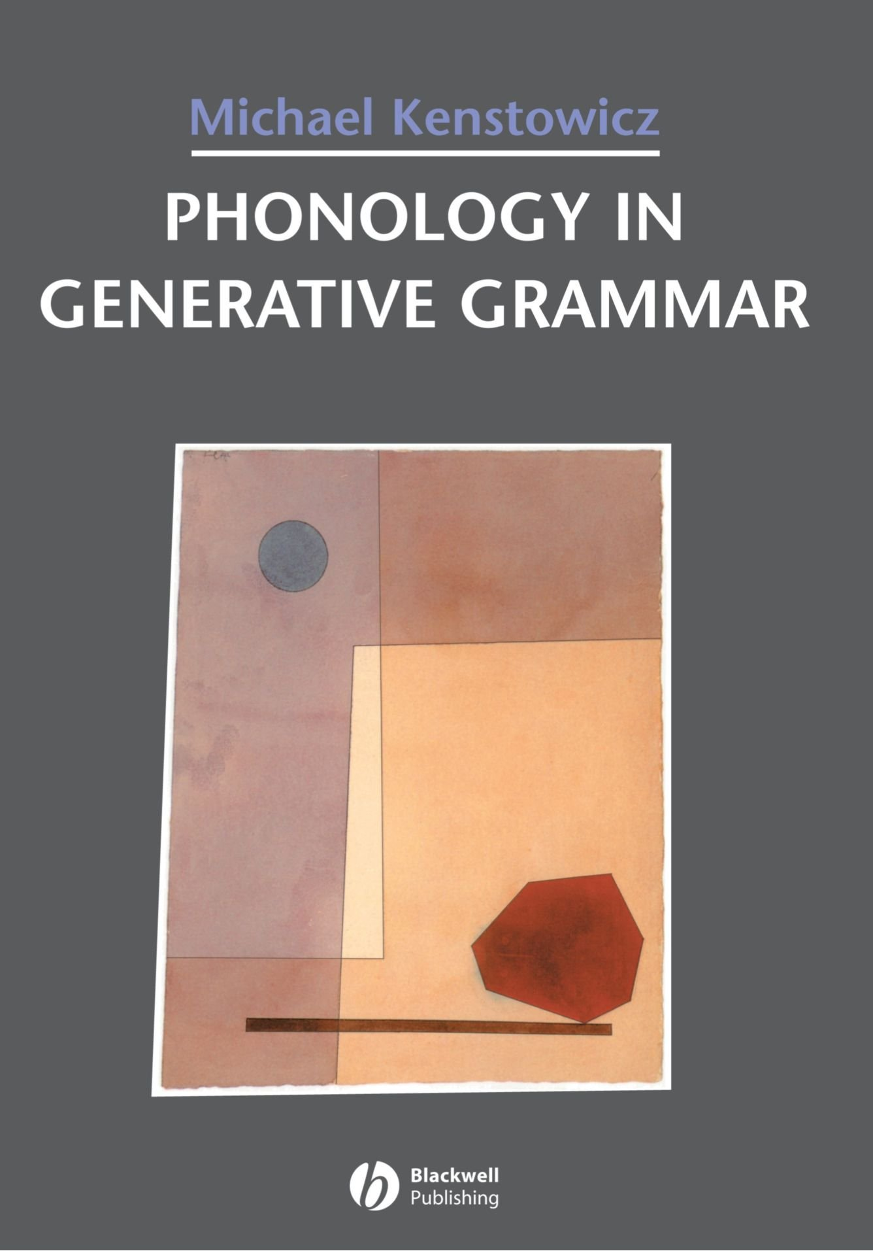
Datasets
Experiments on 7 languages from different families
English (CELEX)
Dutch (CELEX)
German (CELEX)
Maori (Kenstowicz)
Tangale (Kenstowicz)
Indonesian (Kenstowicz)
Catalan(Kenstowicz)
Notes:
list the languages from and show where they came from

Slide 84
A Generative Model of Phonology
eɪʃən
z
dæmn
rizajgn
dæmnz
dæmneɪʃən
How do you pronounce this word?
rizajgneɪʃən
rizajgnz
dˈæmz
????
rizˈajnz
rˌɛzɪgnˈeɪʃən
Notes:
analogies
----- Meeting Notes (7/29/15 04:02) -----
switch n

Slide 85
A Generative Model of Phonology
eɪʃən
z
dæmn
rizajgn
dæmnz
dæmneɪʃən
How do you pronounce this word?
rizajgneɪʃən
rizajgnz
dˈæmz
dˈæmnˈeɪʃən
rizˈajnz
rˌɛzɪgnˈeɪʃən
Notes:
analogies

Slide 86
Evaluation
Metrics: (Lower is Always Better)
1-best error rate (did we get it right?)
cross-entropy (what probability did we give the right answer?)
expected edit-distance (how far away on average are we?)
Average each metric over many training-test splits
Comparisons:
Lower Bound: Phonology as noisy concatenation
Upper Bound: Oracle URs from linguists
Notes:
Talk about prediction power: we’re evaluating on language learners: how it is able to learn, rather than how it learned. We generalized to new languages that never seen in the training.

Slide 87
Exploring the Evaluation Metrics
Distribution Over Surface Form:
UR Prob
dæmeɪʃən .80
dæmneɪʃən .10
dæmineɪʃən. .001
dæmiineɪʃən .0001
… … chomsky .000001
… …
1-best error rate
Is the 1-best correct?
Notes:
Complementary Metrics – make the point (highlight in yellow)

Slide 88
Exploring the Evaluation Metrics
Distribution Over Surface Form:
UR Prob
dæmeɪʃən .80
dæmneɪʃən .10
dæmineɪʃən. .001
dæmiineɪʃən .0001
… … chomsky .000001
… …
1-best error rate
Is the 1-best correct?
Cross Entropy
What is the probability of the correct answer?
Notes:
Complementary Metrics – make the point (highlight in yellow)

Slide 89
Exploring the Evaluation Metrics
Distribution Over Surface Form:
UR Prob
dæmeɪʃən .80
dæmneɪʃən .10
dæmineɪʃən. .001
dæmiineɪʃən .0001
… … chomsky .000001
… …
1-best error rate
Is the 1-best correct?
Cross Entropy
What is the probability of the correct answer?
Expected Edit Distance
How close am I on average?
Notes:
Complementary Metrics – make the point (highlight in yellow)

Slide 90
Exploring the Evaluation Metrics
Distribution Over Surface Form:
UR Prob
dæmeɪʃən .80
dæmneɪʃən .10
dæmineɪʃən. .001
dæmiineɪʃən .0001
… … chomsky .000001
… …
1-best error rate
Is the 1-best correct?
Cross Entropy
What is the probability of the correct answer?
Expected Edit Distance
How close am I on average?
Average over many training-test splits
Notes:
Complementary Metrics – make the point (highlight in yellow)

Slide 91
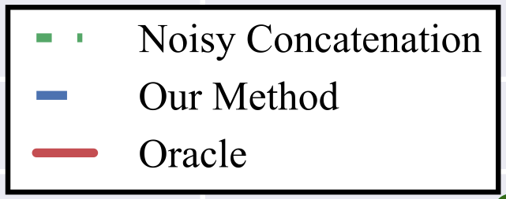
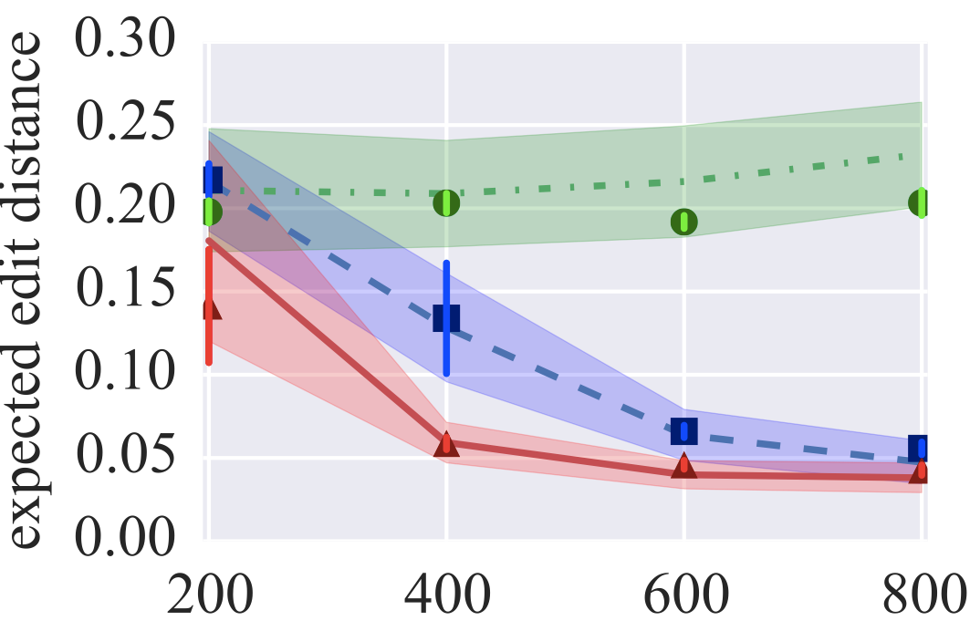
German Results
Error Bars with bootstrap resampling!
Notes:
sampling
error bars
make note that edit distance in in *characters*

Slide 92
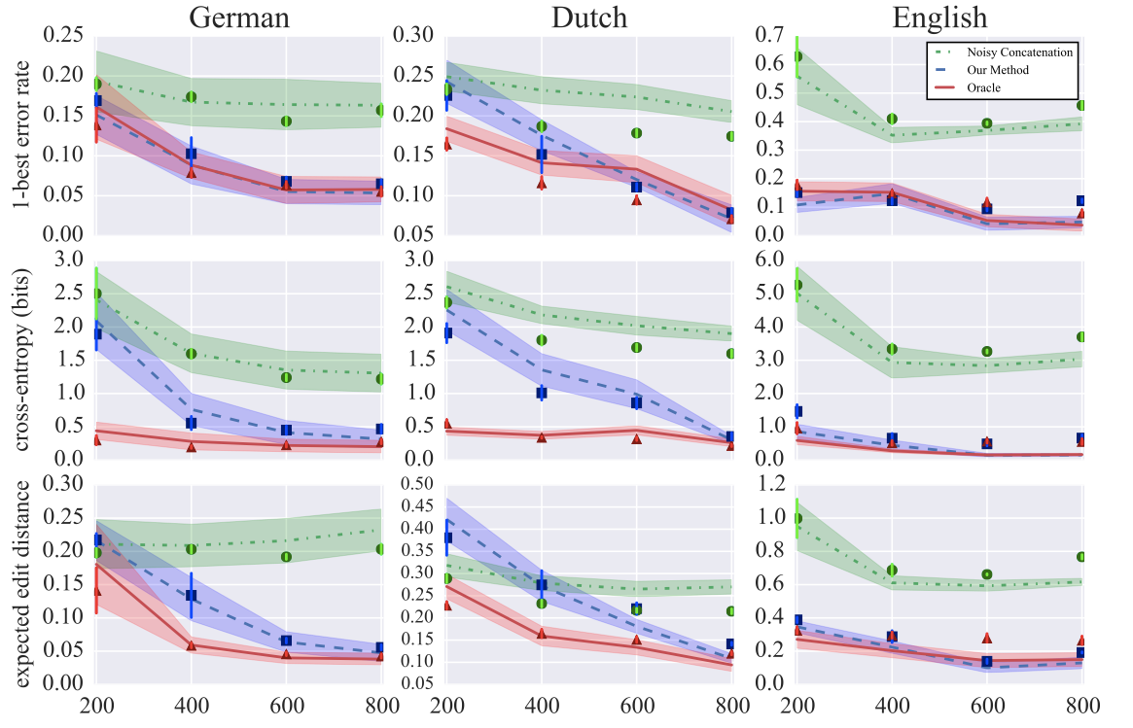
CELEX Results
Notes:
cross-entropy is less than 1 bits the correct form has more than half the probability mass. (show with red line). Animate one at a time.

Slide 93
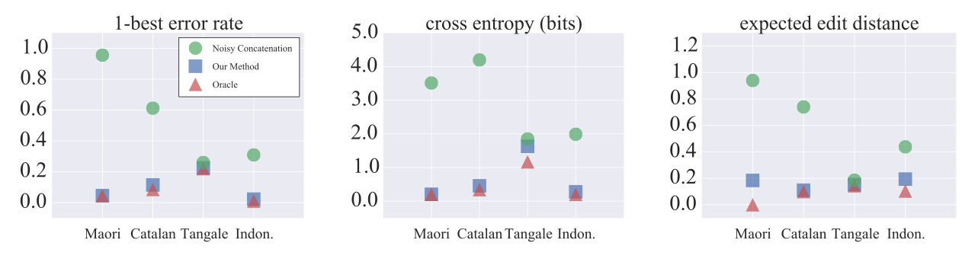
Phonological Exercise Results

Slide 94
Conclusion
We presented a novel framework for computational phonology
New datasets for research in the area
A fair evaluation strategy for phonological learners

Slide 95
Fin
Thank you for your attention!

Slide 96
A Generative Model of Phonology
A Directed Graphical Model of the lexicon
eɪʃən
z
dæmn
rizajgn
dæmnz
dæmneɪʃən
rizajgnz
rizajgneɪʃən
dˈæmz
dˌæmnˈeɪʃən
rizˈajnz
rˌɛzɪgnˈeɪʃən
Notes:
analogies
----- Meeting Notes (7/28/15 16:29) -----
damnation and damation
----- Meeting Notes (7/28/15 16:37) -----
I put in the answer
make the underlying forms vanisha
move solved problem heres

Slide 97
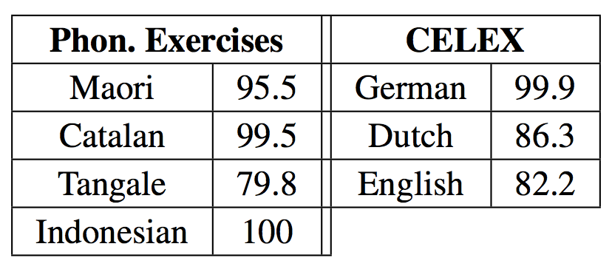
Gold UR Recovery
Notes:
Mention “damn” and “damnation”. N might not be in the underlying form

