Slide 1


Context-Aware Derivation
Prediction
Ekaterina Vylomova, Ryan Cotterell, Tim Baldwin, Trevor Cohn

Slide 2
SIGMORPHON SHARED TASK ON INFLECTION
run + PRESENT PARTICIPLE running
Ekaterina Vylomova, evylomova@gmail.com

Slide 3
SIGMORPHON SHARED TASK ON INFLECTION
run + PRESENT PARTICIPLE running
ran + PAST + PRESENT PARTICIPLE running
Ekaterina Vylomova, evylomova@gmail.com

Slide 4
SIGMORPHON SHARED TASK ON INFLECTION
run + PRESENT PARTICIPLE running
ran + PAST + PRESENT PARTICIPLE running
GRAMMAR TAGS
Ekaterina Vylomova, evylomova@gmail.com

Slide 5
SIGMORPHON SHARED TASK ON INFLECTION
run + PRESENT PARTICIPLE running
ran + PAST + PRESENT PARTICIPLE running
GRAMMAR TAGS
Well-studied
Regular
High Accuracy
Ekaterina Vylomova, evylomova@gmail.com

Slide 6
WHAT ABOUT DERIVATION?
STEM | AGENT | PATIENT | RESULT | ABILITY
bring | bringer
stand | standee
simulate | simulator |  | simulation | simulatable
employ | employer | employee | employment | employable
Ekaterina Vylomova, evylomova@gmail.com

Slide 7
WHAT ABOUT DERIVATION?
Derivational slots?
STEM | AGENT | PATIENT | RESULT | ABILITY
bring | bringer
stand | standee
simulate | simulator |  | simulation | simulatable
employ | employer | employee | employment | employable
Empty cells
Ekaterina Vylomova, evylomova@gmail.com

Slide 8
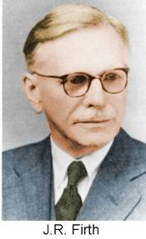
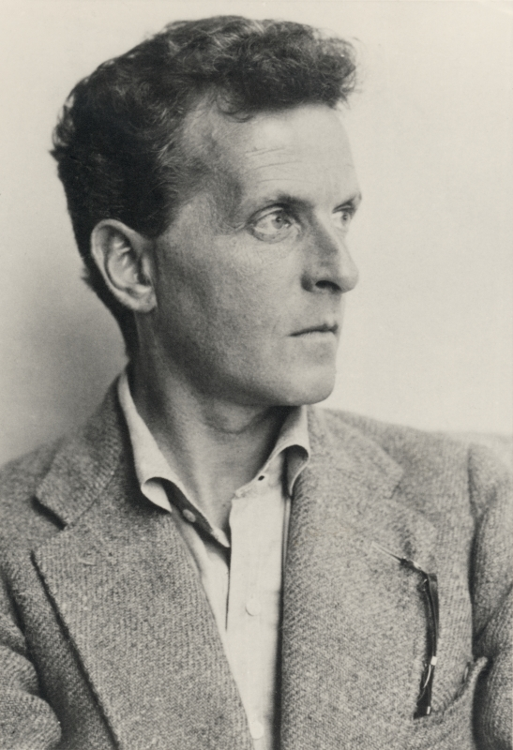
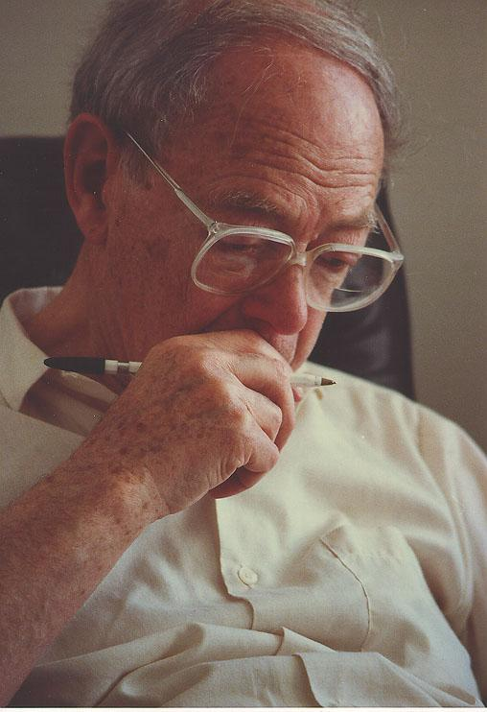
DISTRIBUTIONAL SEMANTICS
L. WITTGENSTEIN
Z. HARRIS
J.R.FIRTH
Ekaterina Vylomova, evylomova@gmail.com

Slide 9
MOTIVATION
How well we can predict derivations directly from the context?
. . the ergometer ’s inability to properly SIMULATE
the larger rowers drag on a boat . . .
. . . this SIMULATE package is based on Simula 's object
oriented features and its coroutine concept . . .
. . . Bay pilots trained for the visit on a SIMULATE
at the California Maritime Academy . . .
Ekaterina Vylomova, evylomova@gmail.com

Slide 10
MOTIVATION
How well we can predict derivations directly from the context?
. . the ergometer ’s inability to properly SIMULATE
the larger rowers drag on a boat . . .
. . . this SIMULATE package is based on Simula 's object
oriented features and its coroutine concept . . .
. . . Bay pilots trained for the visit on a SIMULATE
at the California Maritime Academy . . .
Ekaterina Vylomova, evylomova@gmail.com

Slide 11
MOTIVATION
How well we can predict derivations directly from the context?
. . the ergometer ’s inability to properly SIMULATE
the larger rowers drag on a boat . . .
. . . this SIMULATION package is based on Simula 's object
oriented features and its coroutine concept . . .
. . . Bay pilots trained for the visit on a SIMULATE
at the California Maritime Academy . . .
Ekaterina Vylomova, evylomova@gmail.com

Slide 12
MOTIVATION
How well we can predict derivations directly from the context?
. . the ergometer ’s inability to properly SIMULATE
the larger rowers drag on a boat . . .
. . . this SIMULATION package is based on Simula 's object
oriented features and its coroutine concept . . .
. . . Bay pilots trained for the visit on a SIMULATOR
at the California Maritime Academy . . .
Ekaterina Vylomova, evylomova@gmail.com

Slide 13
BASELINE : 3-gram Modified KN smoothing
log p
This | SIMULATE | package is based on Simula 's object oriented features ... | -47.9
This | SIMULATES | package is based on Simula 's object oriented features ... | -50.0
This | SIMULATED | package is based on Simula 's object oriented features ... | -49.0
This | SIMULATING | package is based on Simula 's object oriented features ... | -49.5
This | SIMULATION | package is based on Simula 's object oriented features ... | -46.1
This | SIMULATOR | package is based on Simula 's object oriented features ... | -48.9
This | SIMULATORS | package is based on Simula 's object oriented features ... | -50.7
Ekaterina Vylomova, evylomova@gmail.com

Slide 14
BASELINE : 3-gram Modified KN smoothing
log p
This | SIMULATE | package is based on Simula 's object oriented features ... | -47.9
This | SIMULATES | package is based on Simula 's object oriented features ... | -50.0
This | SIMULATED | package is based on Simula 's object oriented features ... | -49.0
This | SIMULATING | package is based on Simula 's object oriented features ... | -49.5
This | SIMULATION | package is based on Simula 's object oriented features ... | -46.1
This | SIMULATOR | package is based on Simula 's object oriented features ... | -48.9
This | SIMULATORS | package is based on Simula 's object oriented features ... | -50.7
Ekaterina Vylomova, evylomova@gmail.com

Slide 15
DATASET
English Verb Nominalizations only
CELEX: <accusation, accuse+ation>
24 suffix classes / 1,456 base lemmas / 3,079 unique lemma pairs
Contexts: 107,041 contextual instances from English Wikipedia
Pre-trained word embeddings: word2vec trained on Google News
Ekaterina Vylomova, evylomova@gmail.com

Slide 16
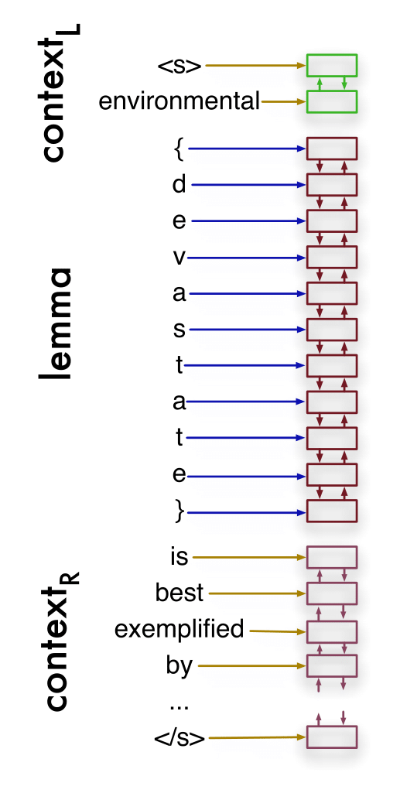
ARCHITECTURE OF THE MODEL
Ekaterina Vylomova, evylomova@gmail.com

Slide 17
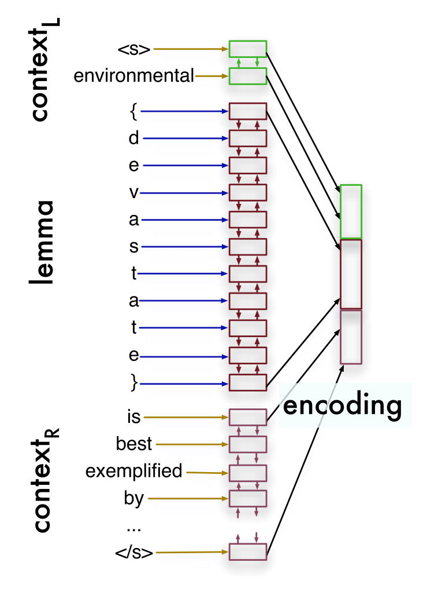
ARCHITECTURE OF THE MODEL
Ekaterina Vylomova, evylomova@gmail.com

Slide 18
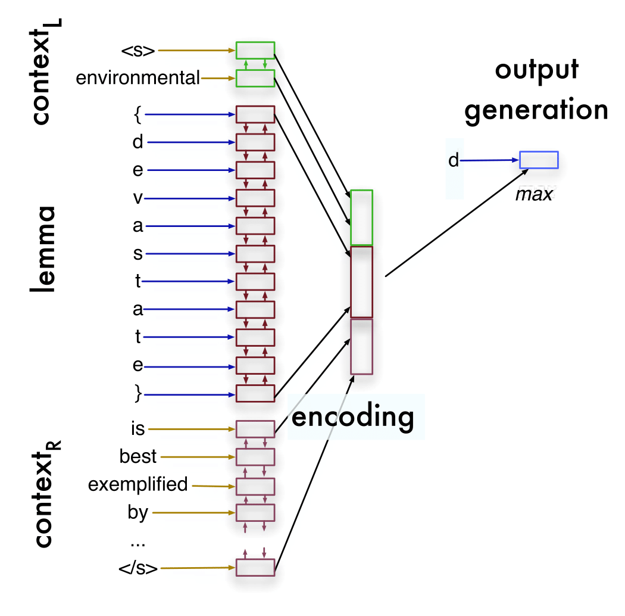
ARCHITECTURE OF THE MODEL
Ekaterina Vylomova, evylomova@gmail.com

Slide 19
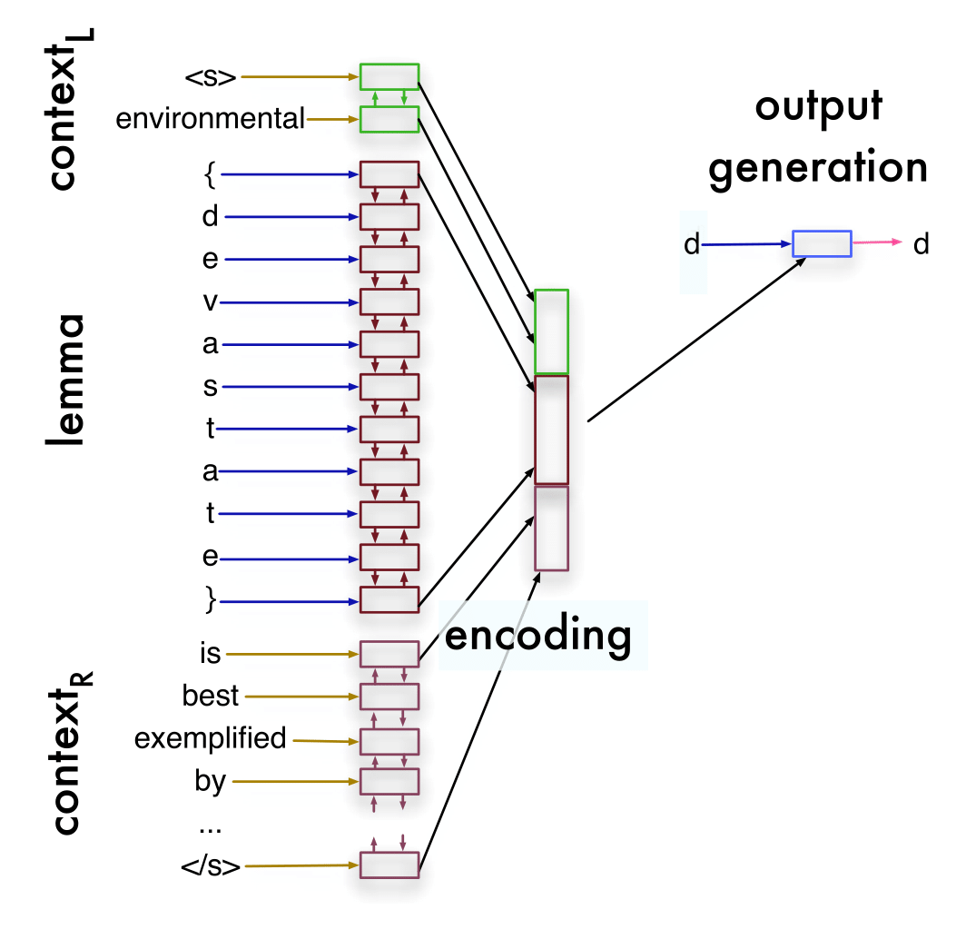
ARCHITECTURE OF THE MODEL
Ekaterina Vylomova, evylomova@gmail.com

Slide 20
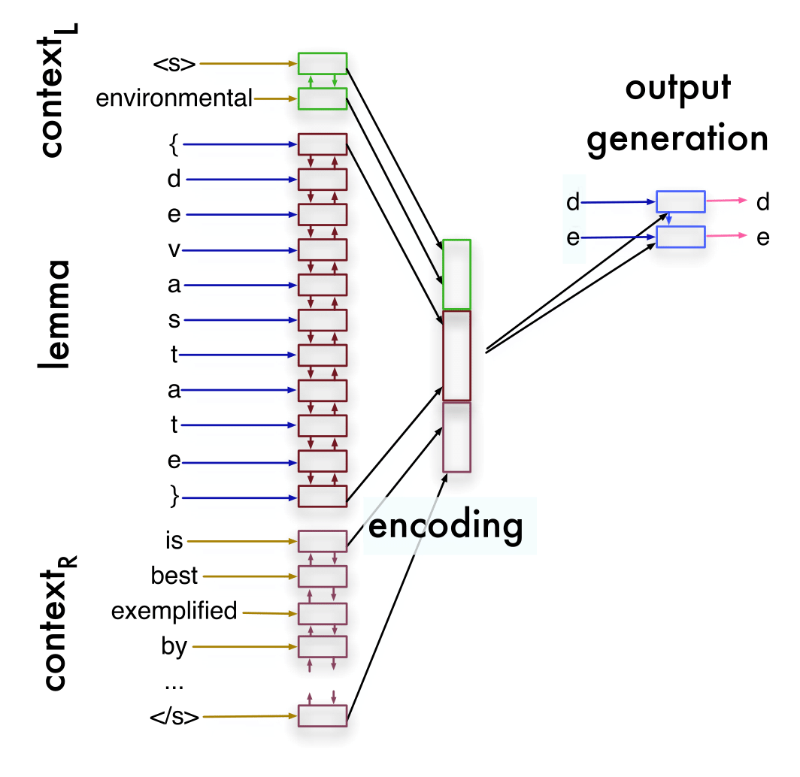
ARCHITECTURE OF THE MODEL
Ekaterina Vylomova, evylomova@gmail.com

Slide 21
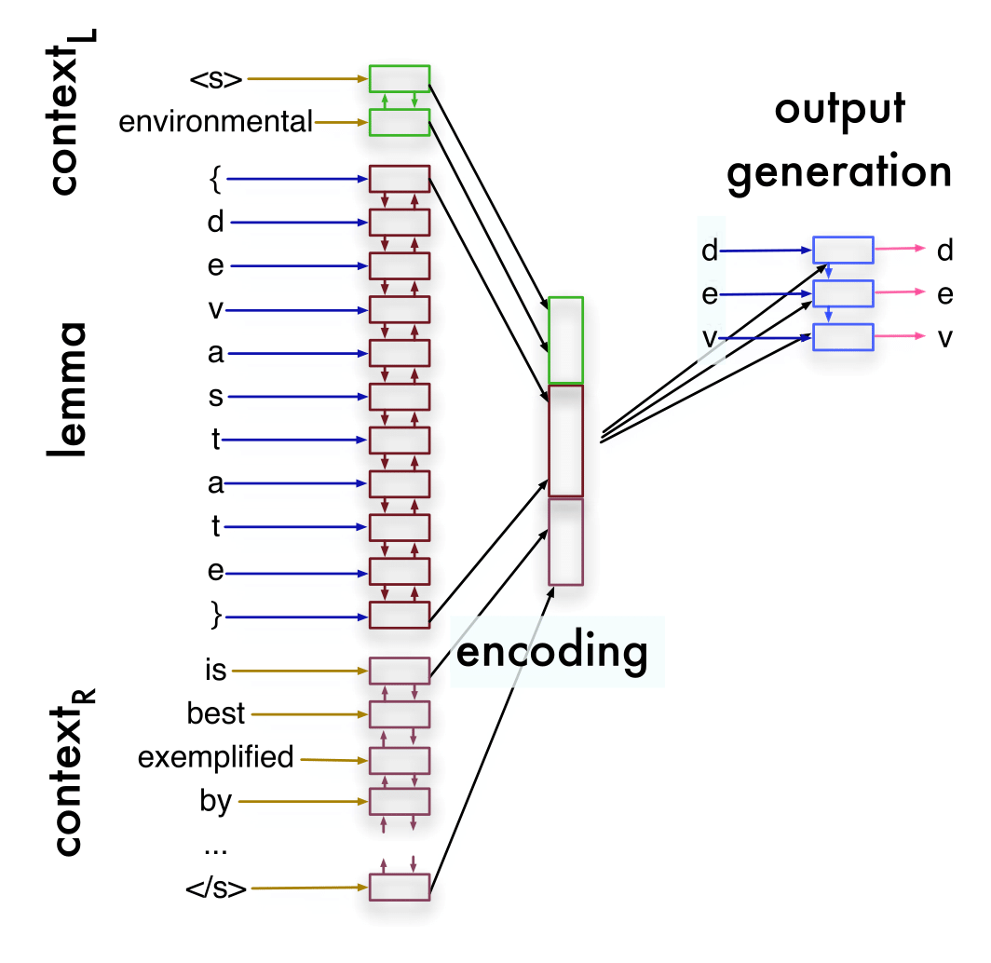
ARCHITECTURE OF THE MODEL
Ekaterina Vylomova, evylomova@gmail.com

Slide 22
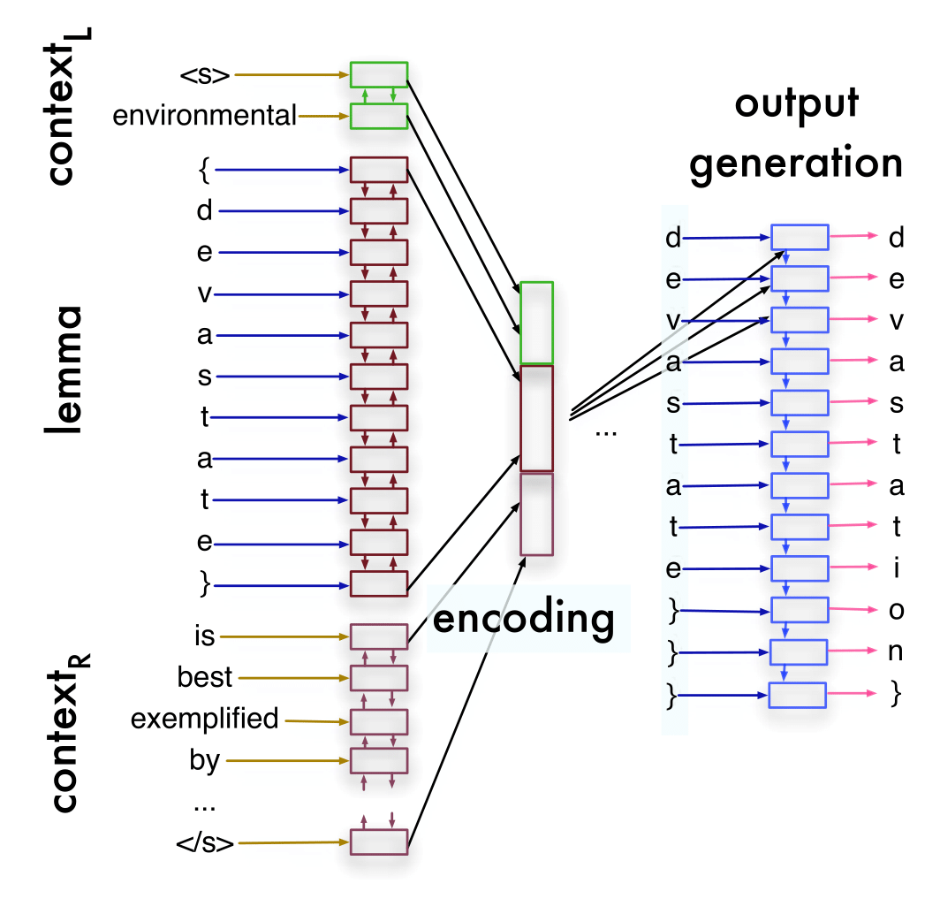
ARCHITECTURE OF THE MODEL
Ekaterina Vylomova, evylomova@gmail.com

Slide 23
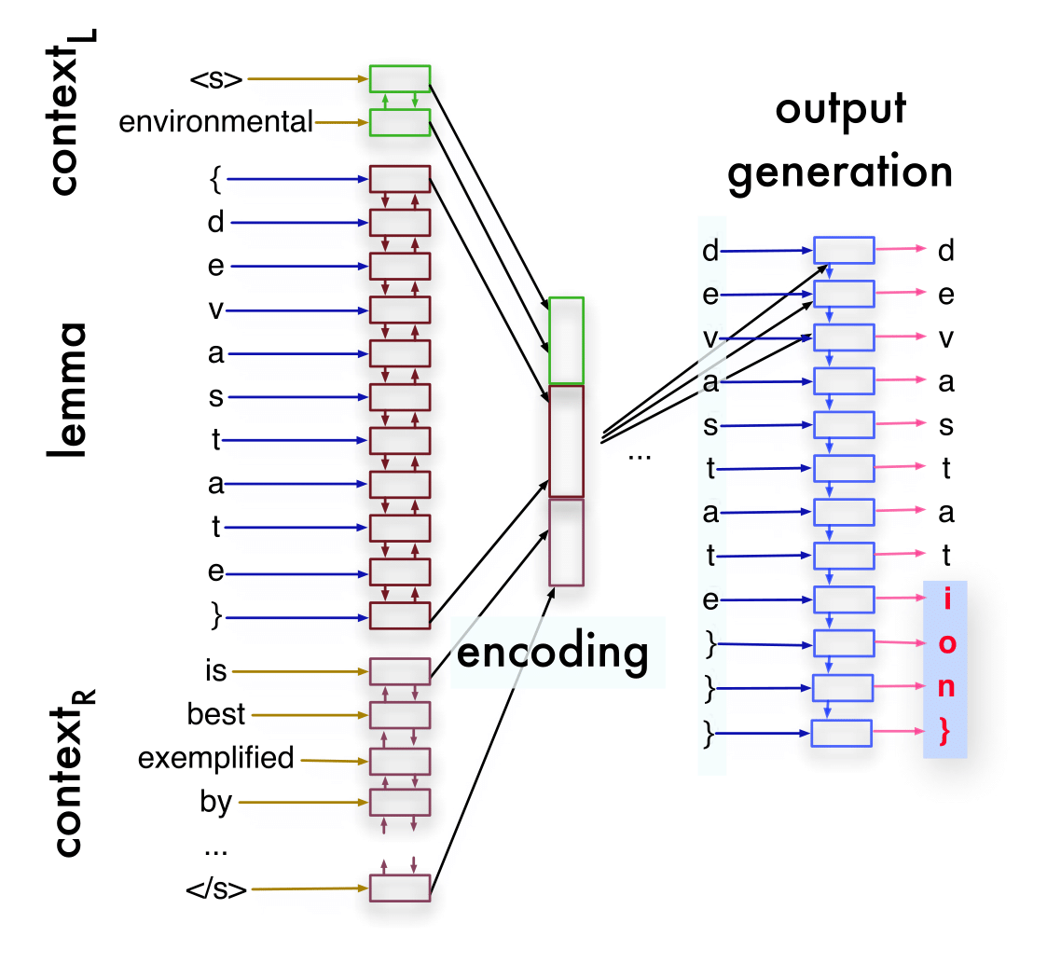
ARCHITECTURE OF THE MODEL
Ekaterina Vylomova, evylomova@gmail.com

Slide 24
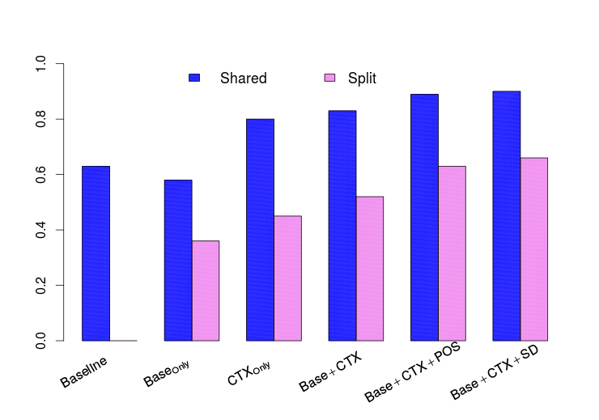
Accuracy For Predicted Lemmas (inc. bases)
BASELINE
Base Only
CTX Only
Base+CTX
Base+CTX
Base+CTX
+POS
+POS+SD
Ekaterina Vylomova, evylomova@gmail.com

Slide 25
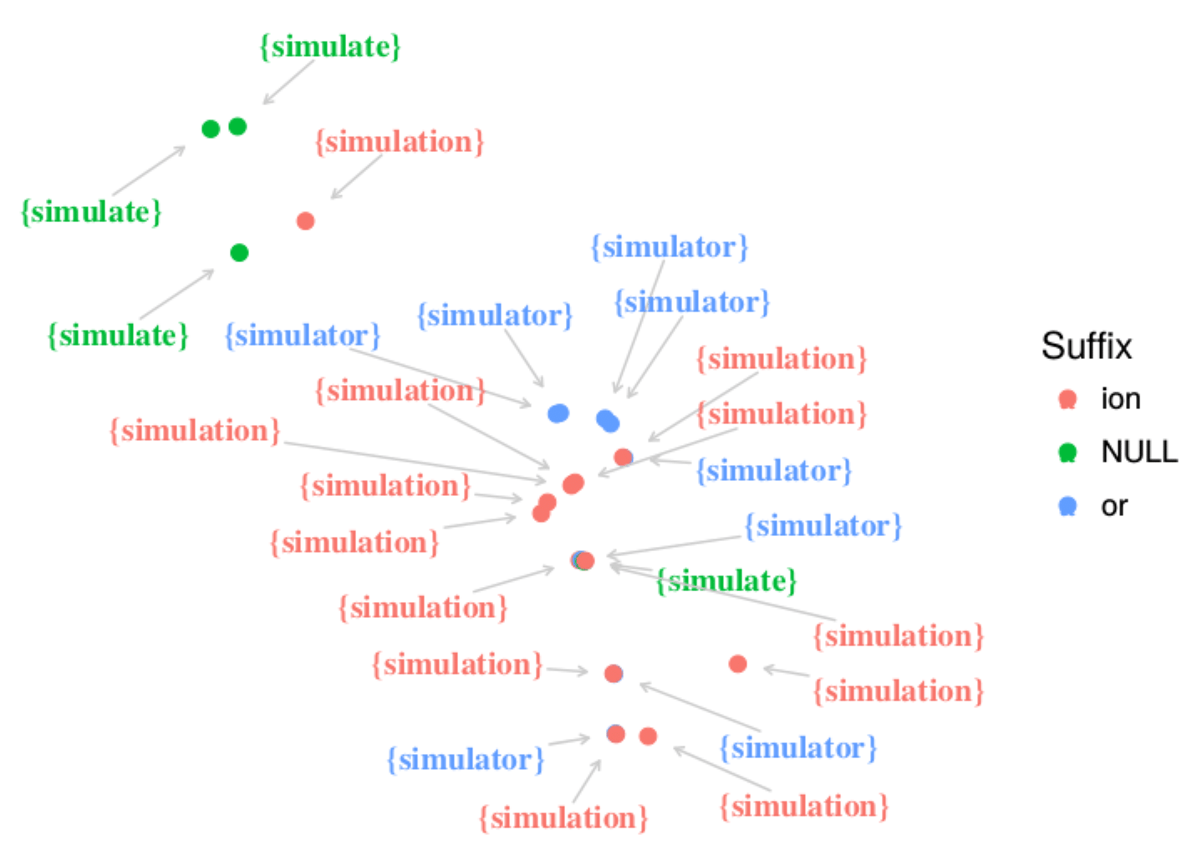
ERROR ANALYSIS: ambiguity and vagueness
Ekaterina Vylomova, evylomova@gmail.com

Slide 26
ERROR ANALYSIS
Correct (Context of ...) | Predicted
Extra Variety of Forms
student | studint, studion, studyant, student
Especially in Split Lexicon Setting
trailer | trailer, trailation, trailment
Ekaterina Vylomova, evylomova@gmail.com

Slide 27
ERROR ANALYSIS
Correct (Context of ...) | Predicted
Lack of Forms
government and governance | government
Bias Towards Productive Suffixes
stoppage | stoption
Ekaterina Vylomova, evylomova@gmail.com

Slide 28
NONCE WORDS
transcribe | laptify | fape | crimmle | beteive
transcription | laptification | fape | crimmle | beterve
transcription | laptification | fapery | crimmler | betention
transcription | laptification | fapication | crimmler | beteption
transcription | laptification | fapionment | crimmler | betention
transcription | laptification | fapist | crimmler | betention
transcription | laptification | fapist | crimmler | beteption
transcript | laptification | fapery | crimmler | betention
transcript | laptification | fapist | crimmler | beteption
Ekaterina Vylomova, evylomova@gmail.com

Slide 29
CONCLUSION
There is regularity in derivational processes!
Ekaterina Vylomova, evylomova@gmail.com

Slide 30
CONCLUSION
There is regularity in derivational processes!
Code and data available at https://github.com/ivri/dmorph
Thank you for your { A T T E N D } !
Ekaterina Vylomova, evylomova@gmail.com

