Slide 1
Penalized EP for Graphical Models Over Strings
Ryan Cotterell and Jason Eisner

Slide 2
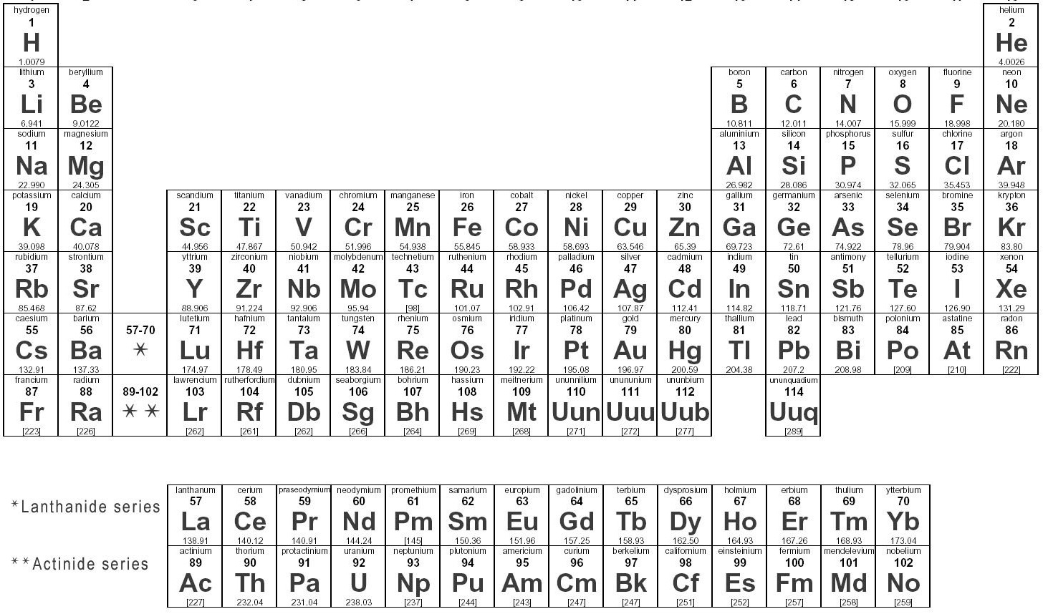
Natural Language is Built from Words
Notes:
Just as we can arrange the elements form the periodic table, we can
structure words in a similar way.
Here is an indexed table with various layers of information
about each word.
Sentences are built out of words. The words are the atomic elements of the language …
Store various information about each element in a table – name, symbol, atomic weight, boiling point, electronegativity, etc.
The elements are idiosyncratic, so this is the easiest way to do it.
It’s like adding a proton to Carbon and you get Nitrogen, which is totally different.

Slide 3

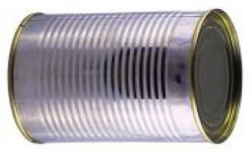

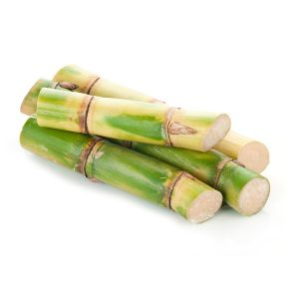
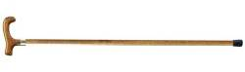
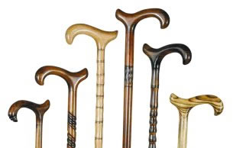
Can store info about each word in a table
Index | Spelling | Meaning | Pronunciation | Syntax
123 | ca |  | [si.ei] | NNP (abbrev)
124 | can |  | [kɛɪn] | NN
125 | can |  | [kæn], [kɛn], … | MD
126 | cane |  | [keɪn] | NN (mass)
127 | cane |  | [keɪn] | NN
128 | canes |  | [keɪnz] | NNS
Notes:
Here is an indexed table with various layers of information
about each word.
The words can be quite idiosyncratic too. As you add letters to the spelling, the info can change quite radically.
So you should just memorize it all, right?

Slide 4
Problem: Too Many Words!
Technically speaking, # words = ∞
Really the set of (possible) words is ∑*
Names
Neologisms
Typos
Productive processes:
friend → friendless → friendlessness → friendlessnessless → …
hand+bag → handbag (sometimes can iterate)
Notes:
While adopting this view seems natural, we run into a problem.
Technicallhy speaking, the number of words is infinite.
This isn't always something we think about it. It would
be absurd to posit that all English sentences are attested in Wikipedia,
and indeed we adapt our parsers and other syntactic / semantic
models to cope. Yet in NLP we often *don't* apply the
same level of interest in the generative story of individual words!
Just to review, new words arrise throuh various processes --
names, neologisms typos and productive morphological proceses.
In many languaes, the morphological generation is
highly productive, take for instance the Gemran
word Flugzeugentfuehrung (airline hijacking), it's generative process
takes the form of a tree as show.
Plane hijacking = aircraft + hijacking= (flight+stuff)-((away-lead)-ing)”
----- Meeting Notes (5/29/15 19:57) -----
Animate derivational morphology

Slide 5
Solution: Don’t model every cell separately
Noble gases
Positive ions
Notes:
Sentences are built out of words. The words are the atomic elements of the language …
Store various information about each element in a table – name, symbol, atomic weight, boiling point, electronegativity, etc.
The elements are idiosyncratic, so this is the easiest way to do it.
It’s like adding a proton to Carbon and you get Nitrogen, which is totally different.

Slide 6
Can store info about each word in a table
Index | Spelling | Meaning | Pronunciation | Syntax
123 | ca |  | [si.ei] | NNP (abbrev)
124 | can |  | [kɛɪn] | NN
125 | can |  | [kæn], [kɛn], … | MD
126 | cane |  | [keɪn] | NN (mass)
127 | cane |  | [keɪn] | NN
128 | canes |  | [keɪnz] | NNS
Notes:
The words can be quite idiosyncratic too. As you add letters to the spelling, the info can change quite radically.
So you should just memorize it all, right?

Slide 7
Can store info about each word in a table
Index | Spelling | Meaning | Pronunciation | Syntax
123 | ca |  | [si.ei] | NNP (abbrev)
124 | can |  | [kɛɪn] | NN
125 | can |  | [kæn], [kɛn], … | MD
126 | cane |  | [keɪn] | NN (mass)
127 | cane |  | [keɪn] | NN
128 | canes |  | [keɪnz] | NNS
Ultimate goal: Probabilistically reconstruct all missing entries of this infinite multilingual table, given some entries and some text.
Approach: Linguistics + generative modeling + statistical inference.
Modeling ingredients: Finite-state machines + graphical models.
Inference ingredients: Expectation Propagation (this talk).
Notes:
The words can be quite idiosyncratic too. As you add letters to the spelling, the info can change quite radically.
So you should just memorize it all, right?
Our goal at JHU

Slide 8
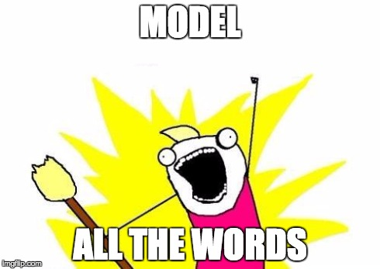
Can store info about each word in a table
Index | Spelling | Meaning | Pronunciation | Syntax
123 | ca |  | [si.ei] | NNP (abbrev)
124 | can |  | [kɛɪn] | NN
125 | can |  | [kæn], [kɛn], … | MD
126 | cane |  | [keɪn] | NN (mass)
127 | cane |  | [keɪn] | NN
128 | canes |  | [keɪnz] | NNS
Ultimate goal: Probabilistically reconstruct all missing entries of this infinite multilingual table, given some entries and some text.
Approach: Linguistics + generative modeling + statistical inference.
Modeling ingredients: Finite-state machines + graphical models.
Inference ingredients: Expectation Propagation (this talk).
Notes:
Our goal is model all the words, which includes historical linguistics, social media, transliteration , inflections.
Ideally, we would like a joint model of all of the above

Slide 9
Predicting Pronunciations of Novel Words (Morpho-Phonology)
eɪʃən
dæmn
z
rizajgn
How do you pronounce this word?
dæmnz
dæmneɪʃən
rizajgnz
rizajgneɪʃən
????
dˌæmnˈeɪʃən
rizˈajnz
rˌɛzɪgnˈeɪʃən
damns
damnation
resigns
resignation
Notes:
Linguists say that this is how word are generated

Slide 10
Predicting Pronunciations of Novel Words (Morpho-Phonology)
eɪʃən
dæmn
z
rizajgn
How do you pronounce this word?
dæmnz
dæmneɪʃən
rizajgnz
rizajgneɪʃən
dˌæmz
dˌæmnˈeɪʃən
rizˈajnz
rˌɛzɪgnˈeɪʃən
damns
damnation
resigns
resignation
Notes:
What p should broadcast

Slide 11
Graphical Models over Strings
Use Graphical Model Framework to model many strings jointly!
aardvark | 0.1
… | …
rang | 3
ring | 4
rung | 5
… | …
s
a
e
h
X₁
ring | 1
rang | 2
rung | 2
X₁
X₁
r
i
n
g
e
u
e
ε
e
 | ring | rang | rung
ring | 2 | 4 | 0.1
rang | 7 | 1 | 2
rung | 8 | 1 | 3
r
a
s
u
ψ₁
ψ₁
 | aardvark | … | rang | ring | rung | …
aardvark | 0.1 |  | 0.2 | 0.1 | 0.1
…
rang | 0.1 |  | 2 | 4 | 0.1
ring | 0.1 |  | 7 | 1 | 2
rung | 0.2 |  | 8 | 1 | 3
…
ψ₁
s
i
n
g
r
a
n
g
u
e
a
ε
ε
a
X₂
ring | 10.2
rang | 13
rung | 16
X₂
X₂
s
a
e
h
r
i
n
g
e
u
ε
Notes:
Simple model – finite support
Where did the support come from

Slide 12
Zooming in on a WFSA
Compactly represents an (unnormalized) probability distribution over all strings in
Marginal belief: How do we pronounce damns?
Possibilities: /damz/, /dams/, /damnIz/, etc..
n/.25
z/.5
d/1
a/1
m/1
s/.25
z/1
I/1
z/1
Notes:
more than thus three forms

Slide 13
Log-Linear Approximation
Given a WFSA distribution p, find a log-linear approximation q
min KL(p || q) “inclusive KL divergence”
q corresponds to a smaller/tidier WFSA
Two Approaches:
Gradient-Based Optimization (Discussed Here)
Closed Form Optimization
Notes:
Log-linear model = exponential family

Slide 14
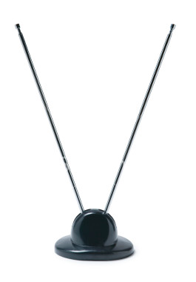


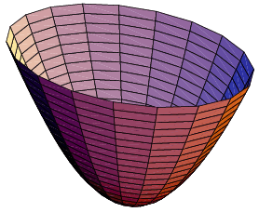
ML Estimation = Moment Matching
fo = 3
foo = 1
foo | 1.2
bar | 0.5
baz | 4.3
bar = 2
az = 4
Broadcast n-gram counts
Fit model that predicts same counts

Slide 15
FSA Approx. = Moment Matching
fo = 3
foo = 1
foo | 1.2
bar | 0.5
baz | 4.3
s
a
h
e
bar = 2
r
i
n
g
s
a
e
h
zz= 0.1
u
e
e
i
n
e
g
r
ε
az = 4
e
u
e
ε
e
xx = 0.1
Fit model that predicts same counts
Compute with forward-backward!
Notes:
point out small counts

Slide 16
Deterministic Machine q
We use a set of n-gram count features
Resulting log-linear model is a character language model
Can easily be encoded as a weighted DFA
Advantages of Determinism
Fast
One best string
Inverse partition function
Notes:
PICTURE
So our log-linear model q. We're going to encode it as a deterministic
WFSA. Why? We're going to use a bunch of n-gram features so
this model is going to simply be a character-leve log-linear language model,
which is very natrually encoded as a DFA>
Determinism also opens up a garden of delights. For one, determinsitic
machines are fast. This speed is a prime reason we want to determinize.
Second, it is tractable to compute the one one-best. In a non-determinsitic
machine, Viterbi gives us the one-best derivation, whose corresponding
derived string may not correspond to the 1-best string in the whole machine.
Third, we can compute the inverse parition function, that is 1/Z, by simplying
inverting the weights. Stay tuned for a cool use case of this in our future work.
----- Meeting Notes (5/29/15 19:57) -----
deterministic approximation Finite-state machine

Slide 17
Gradient-Based Minimization
Objective:
Gradient with respect to
Difference between two expectations of feature counts, which are determined by the weighted DFA q
Features are just n-gram counts!
Arc weights are determined by a parameter vector - just like a log-linear model
Notes:
REFORMAT
Gradient-based minimization
Our objective is to minimize the KL divergence and I've added a theta here
since, while our modeled is encoded as a DFA, it has as simple parameter vector
just like any log-linear model.
We take the gradient with respect to theta and we get the difference between
two feature expectations, just as were are used to. The first is the
observed feature expectations, that is, how often we see that feature
fire under the true distribution p and the second is expected feature
expectation, which is what our approximation currenty things.
As I said earlier, the features here are just n-gram counts.
----- Meeting Notes (5/29/15 19:57) -----
Don't mention closed form solutions

Slide 18
Extracting Feature Counts
We just need expected feature counts Just run Forward-Backward on original FSA p!
Trigram Example: extract all trigram scores
j/ 5.3
h/ 1.7
u/ 2.5
a/ 9.1
j/ 5.3
x/ 7.4
c/ 7.2
t/ 8.0
w/ 2.9
Notes:
So we just need expected feature counts to get the gradient.
So how do we extract n-gram counts from our true distribution p.
We rely on the well-known forward-backward algorithm.
Here's an example of extracting a particular trigram. We have our machine p.
1) We look a lenght 3 path.
2) We run forward
3) we run backward
4) We get a weight, that we can renormalize by the sum over all
paths to get a probability.
So as you can see, extractin these counts is very efficient
and only requires simple algorithms that we have seen before.
Run forward-backward. Extract n-gram counts. Then we can just count and divide as with a traditional unsmoothed language model. Note that are counts here are
Fractional.
----- Meeting Notes (5/29/15 19:57) -----
cut locally normalized part
'

Slide 19
Extracting Feature Counts
We just need expected feature counts Just run Forward-Backward on original FSA p!
Trigram Example: extract all trigram scores
j/ 5.3
h/ 1.7
u/ 2.5
a/ 9.1
j/ 5.3
x/ 7.4
c/ 7.2
t/ 8.0
w/ 2.9
Notes:
Run forward-backward

Slide 20
Extracting Feature Counts
We just need expected feature counts Just run Forward-Backward on original FSA p!
Trigram Example: extract all trigram scores
j/ 5.3
h/ 1.7
u/ 2.5
a/ 9.1
j/ 5.3
x/ 7.4
c/ 7.2
t/ 8.0
w/ 2.9
Notes:
Run forward-backward

Slide 21
Extracting Feature Counts
We just need expected feature counts Just run Forward-Backward on original FSA p!
Trigram Example: extract all trigram scores
j/ 5.3
h/ 1.7
u/ 2.5
a/ 9.1
j/ 5.3
x/ 7.4
c/ 7.2
t/ 8.0
w/ 2.9
Notes:
Run forward-backward

Slide 22
Extracting Feature Counts
Result: Weight of trigram jhu
Fortunately, we exactly jump to a locally normalized solution if we choose
Extract all n-gram probabilities
j/ 5.3
h/ 1.7
u/ 2.5
a/ 9.1
j/ 5.3
x/ 7.4
c/ 7.2
t/ 8.0
w/ 2.9
Notes:
Run forward-backward

Slide 23
Does q need a lot of features?
Game: what order of n-grams do we need to put probability 1 on a string?
Word 1: noon
Bigram model? No - Trigram model
Word 2: papa
Trigram model? No - 4-gram model - very big!
Word 3: abracadabra
6-gram model – way too big!
Notes:
MOTIVATE VERY CLEARLY
So how ot choose q? So I said earlier that q was deterministic,
but clearly more to say about the subject. In fact, topology
of the q machine deterministic more or less which features
we can throw in our log-linear mode.
So get some intuitions across, let's play a simple game.
The game is how order n-grams do we need to put probability
1 on a string?
First Word 1: How order model do we need to put probability 1
on the string noon. Well, it's a bigram, because we have
two differnet contexts with 0
Second Word 2: Papa
Third Word 3 : Abracabra
So we often want to put high probability on this words,
but the cost of such a model is prohibitive.
----- Meeting Notes (5/29/15 20:42) -----
TimV: Almost - picture of a distribution
Table of words that a unigram didn't work
abracabra
you could have gotten away with much less

Slide 24
Variable Order Approximations
Intuition: In NLP marginals are often peaked
Probability mass mostly on a few similar strings!
q should reward a few long n-grams
also need short n-gram features for backoff
6-gram table.
Too Big!
abra | 5.0
^a | 5.0
b | 4.3
^abrab | 5.0
abraca | 5.0
zzzzzz | -500
Variable order table.
Very Small!
Notes:
ANTENNA – the antenna only tunes in to strong frequency
COUNT ARC NOT STATES
The solution to this lies in variable order approximations.
Mention Bayesian language models or RNN language models
Sparse estimation problem
We actual use group lasso – structured sparsity
The intuition is that we only want to put a lot of probability mass on
a few strings
We simply need a machine with just a few longer n-grams
so that the encoding is compact, but we can still put most
of the probability mass where we want it.
To achieve this in practice, we used a penalized approximation, which
means that we incur a penalty for each n-gram we throw in the machine.
The details of this are in the paper.
Now we consider our example abracabadra again. The corresponding 5-gram
table will be huge compared to a variable order machine
that will have a few 5-grams with mostly unigrams and bigrams.
----- Meeting Notes (5/29/15 19:57) -----
None of the points were very crisp
memorize an arbitrarily long string

Slide 25
Variable Order Approximations
Moral: Use only the n-grams you really need!
Notes:
----- Meeting Notes (5/29/15 20:42) -----
split the equation over two lines (generally reformat)
This Work should not be in the title (NEW STICK instead of this work)
point out that this is a small modification to the algorithm

Slide 26
Graphical Models over Strings
In NLP we model complex joint distributions
Factor Graphs are convenient formalism
Factor Graph for Graphical Model Over Strings
Variables: string valued
Unary Factors: Weighted Finite-State Acceptors
Binary Factors: Weighted Finite-State Transducers
Inference with loopy belief propagation can be performed with standard finite-state operations
Dreyer and Eisner (2009)
Notes:
Back to graphicalk models over strings,
To review, in NLP we want complex joint distributions
Factor graphs are convenient formalism for representing them
Factor graphs for sring-valued models
Variables are string-valued
Unary Factors are finite-state acceptors
Binary Factors are finite-state transducers
And inference can be performed with loop belief propagation
using standard finite-state oprations - see Dreyer and Eisner (2009)
for the details
----- Meeting Notes (5/29/15 19:57) -----
missing parenthesis
unary, binary, string-valued variables

Slide 27
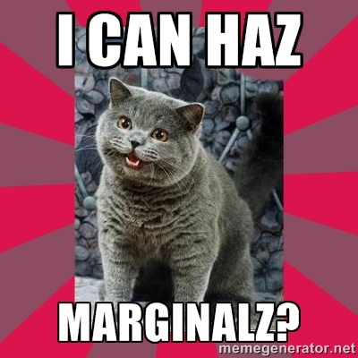
Belief Propagation (BP) in a Nutshell
X₆
X₃
X₁
X₄
X₂
X₅
Notes:
So I had this problem of inference in my graphical model. The actual algorithm I used was a pruned version of belief propagation. This work
can be thought of as a more principled pruning strategy

Slide 28
Belief Propagation (BP) in a Nutshell
X₆
X₃
X₁
n/.25
z/.5
d/1
a/1
m/1
s/.25
X₄
z/1
X₂
I/1
z/1
X₅
Notes:
This answers the question: how do we pronounce damn

Slide 29
Belief Propagation (BP) in a Nutshell
X₆
X₃
X₁
X₄
X₂
X₅
Notes:
Belief propagation is a messaing passing algorthim. We pass messages from variables to factors and factors to variables. Messages are just opinions expressed as non-negative functions.
A message tells a variable what its neighbors think its values should be – rescored by the factors

Slide 30
Computing Marginal Beliefs
X₇
X₃
X₁
X₄
X₂
X₅
Notes:
So now I think we've motivated the problem of inference
in string-valued graphical models. We are going
to present a novel variant of EP as a solution.
So there is some what of a cloud of mystery
surrounding the algorithm, which is a shame because
it's quite straight-forward and very uesful for NLP.
A quick note. The EP literature uses the term exponential
family to refer to a log-linear model. In general,
these two terms are synonymous so as an NLP person, I will
stick to log-linear model to cut down on the statistical jargon.
So, consider passing messages to a variable. We have a bunch of
incomming messages.
Recall these are really finite-state acceptors in our framewwork
So say we want to compute the belief? We imsply intersect them
all. And we get a big mess...that looks like a giant hairball.
We need some sort of approximation.

Slide 31
Computing Marginal Beliefs
X₇
X₃
X₁
X₄
X₂
X₅
Notes:
TO COMPUTE THE MARGINAL BELIEF, we simply take the consensus of the messages to get the marginal beleif

Slide 32
Belief Propagation (BP) in a Nutshell
s
a
e
h
r
i
n
g
X₆
e
u
e
e
s
a
h
ε
e
r
i
n
g
e
u
ε
a
s
e
h
X₃
r
i
n
g
e
u
e
e
s
a
e
h
X₁
ε
r
i
n
g
e
u
ε
X₄
X₂
X₅
Notes:
Factor graph defines a joint probability distribution over the following 6 variables
----- Meeting Notes (5/29/15 20:24) -----
each variable communicates to the a factor a distribution over values it would like to take
two arrows missing

Slide 33
Computing Marginal Beliefs
X₇
s
a
e
h
r
i
n
g
e
u
ε
X₃
s
a
e
h
s
a
e
h
r
i
n
g
X₁
r
i
n
g
u
e
u
e
ε
ε
s
a
e
h
X₄
r
i
n
g
e
u
ε
X₂
X₅
Notes:
----- Meeting Notes (5/29/15 20:24) -----
Product of these messages is very big
SHOW CLOUD OF CARTESIAN

Slide 34
Computing Marginal Beliefs
C
X₇
s
a
e
h
Computation of belief results in large state space
r
i
n
g
e
u
s
a
h
a
ε
e
s
a
i
n
h
g
s
r
e
h
e
g
r
i
u
n
r
i
n
g
X₃
e
ε
s
a
e
h
u
a
s
u
a
h
s
e
h
e
e
e
ε
ε
r
i
n
g
i
a
g
X₁
r
i
n
g
r
s
n
e
h
u
u
e
u
s
a
r
i
n
g
ε
e
e
e
h
ε
ε
u
r
i
n
g
a
e
ε
s
u
h
e
e
ε
X₄
r
i
n
g
e
u
ε
X₂
X₅
Notes:
----- Meeting Notes (5/29/15 20:24) -----
Product of these messages is very big
SHOW CLOUD OF CARTESIAN

Slide 35

Computing Marginal Beliefs
C
X₇
s
a
e
h
Computation of belief results in large state space
r
i
n
g
e
u
s
a
h
a
ε
e
s
a
i
n
h
g
s
r
e
h
e
g
r
i
u
n
r
i
n
g
X₃
e
ε
s
a
e
h
u
a
s
u
a
h
s
e
h
e
e
e
ε
ε
r
i
n
g
i
a
g
X₁
r
i
n
g
r
s
n
e
h
u
u
e
u
s
a
r
i
n
g
ε
e
e
e
h
ε
ε
u
r
i
n
g
a
e
ε
s
u
h
e
e
ε
X₄
r
i
n
g
e
u
What a hairball!
X₂
ε
X₅
Notes:
----- Meeting Notes (5/29/15 20:24) -----
Product of these messages is very big
SHOW CLOUD OF CARTESIAN

Slide 36
Computing Marginal Beliefs
X₇
s
a
e
h
r
i
n
g
Approximation Required!!!
e
u
ε
X₃
s
a
e
h
s
a
e
h
r
i
n
g
X₁
r
i
n
g
u
e
u
e
ε
ε
s
a
e
h
X₄
r
i
n
g
e
u
ε
X₂
X₅

Slide 37
BP over String-Valued Variables
In fact, with a cyclic factor graph, messages and marginal beliefs grow unboundedly complex!
a
X₁
a
a
a
a
ε
ψ₁
ψ₂
a
X₂
a
a
Notes:
So, BP for strings has some special problems. Namely, if naively
implement the algorithm and pass strings around we get that the strings blow up.
This is because the vector matrix operations in standard BP correspond
to finite-state operations. The point-wise product required
corresponds to finite-state composition, which has a Cartesian
product constructions.
So the messages grow to an unbounded size (SHOW ANIMATION)

Slide 38
BP over String-Valued Variables
In fact, with a cyclic factor graph, messages and marginal beliefs grow unboundedly complex!
a
a
X₁
a
a
a
a
ε
ψ₁
ψ₂
a
X₂
a
a
Notes:
But these machines can get bigger and bigger and bigger!

Slide 39
BP over String-Valued Variables
In fact, with a cyclic factor graph, messages and marginal beliefs grow unboundedly complex!
a
a
a
X₁
a
a
a
a
ε
ψ₁
ψ₂
a
X₂
a
a
a
Notes:
But these machines can get bigger and bigger and bigger!

Slide 40
BP over String-Valued Variables
In fact, with a cyclic factor graph, messages and marginal beliefs grow unboundedly complex!
a
a
a
X₁
a
a
a
a
ε
ψ₁
ψ₂
a
X₂
a
a
a
a
Notes:
But these machines can get bigger and bigger and bigger!

Slide 41
BP over String-Valued Variables
In fact, with a cyclic factor graph, messages and marginal beliefs grow unboundedly complex!
a
a
a
a
a
a
a
a
a
a
a
a
X₁
a
a
a
a
ε
ψ₁
ψ₂
a
X₂
a
a
a
a
a
a
a
a
a
a
a
a
a
a
Notes:
But these machines can get bigger and bigger and bigger!

Slide 42
Expectation Propagation (EP) in a Nutshell
X₇
s
a
e
h
r
i
n
g
e
u
ε
X₃
s
a
e
h
s
a
e
h
r
i
n
g
X₁
r
i
n
g
u
e
u
e
ε
ε
s
a
e
h
X₄
r
i
n
g
e
u
ε
X₂
X₅

Slide 43
Expectation Propagation (EP) in a Nutshell
X₇
foo | 1.2
bar | 0.5
baz | 4.3
X₃
s
a
e
h
s
a
e
h
r
i
n
g
X₁
r
i
n
g
u
e
u
e
ε
ε
s
a
e
h
X₄
r
i
n
g
e
u
ε
X₂
X₅

Slide 44
Expectation Propagation (EP) in a Nutshell
X₇
foo | 1.2
bar | 0.5
baz | 4.3
X₃
s
a
e
h
X₁
foo | 1.2
bar | 0.5
baz | 4.3
r
i
n
g
e
u
ε
s
a
e
h
X₄
r
i
n
g
e
u
ε
X₂
X₅

Slide 45
Expectation Propagation (EP) in a Nutshell
X₇
foo | 1.2
bar | 0.5
baz | 4.3
foo | 1.2
bar | 0.5
baz | 4.3
X₃
X₁
foo | 1.2
bar | 0.5
baz | 4.3
s
a
e
h
X₄
r
i
n
g
e
u
ε
X₂
X₅

Slide 46
Expectation Propagation (EP) in a Nutshell
X₇
foo | 1.2
bar | 0.5
baz | 4.3
foo | 1.2
bar | 0.5
baz | 4.3
X₃
X₁
foo | 1.2
bar | 0.5
baz | 4.3
foo | 1.2
bar | 0.5
baz | 4.3
X₄
X₂
X₅
Notes:
Maintains sparsity . The machine that comes out of the intersection has the same intersection.
----- Meeting Notes (5/29/15 20:24) -----
How do we approximate a single message?
We want to update a message
You need a slide to represent the cavity belief on THIS slide

Slide 47
EP In a Nutshell
X₇
foo | 1.2
bar | 0.5
baz | 4.3
Approximate belief is now a table of n-grams.
The point-wise product is now super easy!
foo | 4.8
bar | 2.0
baz | 17.2
foo | 1.2
bar | 0.5
baz | 4.3
X₃
X₁
foo | 1.2
bar | 0.5
baz | 4.3
foo | 1.2
bar | 0.5
baz | 4.3
X₄
X₂
X₅
Notes:
----- Meeting Notes (5/29/15 20:24) -----
How do we approximate a single message?
We want to update a message
You need a slide to represent the cavity belief on THIS slide

Slide 48
How to approximate a message?
foo
bar
baz
θ
s
a
e
h
KL( || )
i
n
g
u
ε
s
a
e
h
foo
bar
baz
r
i
n
g
e
u
ε
foo | 1.2
bar | 0.5
baz | 4.3
foo | 0.2
bar | 1.1
baz | -0.3
foo | 1.2
bar | 0.5
baz | 4.3
foo | 0.2
bar | 1.1
baz | -0.3
=
a
=
a
s
e
h
s
e
h
i
n
g
i
n
g
u
u
ε
Minimize with respect to the parameters θ
ε
Notes:
We want to approximate a finite-state function (message) with a log-linear function
But wait, messages aren’t distributions - we might not even be able to normalize them.
To key insight here is to approximate each message in context – that is. estimate hthe belief

Slide 49
How to approximate?
Minimize with respect the parameters
KL( || )
foo | 1.2
bar | 0.5
baz | 4.3
foo | 1.2
bar | 0.5
baz | 4.3
s
a
e
h
foo
bar
baz
r
i
n
g
e
u
ε
True Message
p
Approximate Message
q
Approximate Belief
Approximate Belief
Notes:
----- Meeting Notes (5/29/15 20:24) -----
say approximate belief
which numbers are being adjusted
adjust the message
Do put in a theta
drop this on top of previous graph
go back to rainbow colors

Slide 50
Expectation Propagation: The Details
A belief at at variable is just the point-wise product of message:
Key Idea: For each message, , we seek an approximate message
Algorithm:
for each
Notes:
We can always normalize belief

Slide 51
EP: An Overview
Problem: how to approximate a product of finite-state message (= belief)?
Iterative Algorithm:
Approximate each acceptors with a log-linear model
Efficient: we can generally compute the approximations very quickly
Conservative: no string will receive 0 probability (in contrast to pruning)
Awesome: General purpose method for all kinds of scenarios (beyond finite-state machines!)
Notes:
----- Meeting Notes (5/29/15 20:24) -----
acceptors

Slide 52
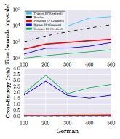
Results
Question 1: Does EP work in general (comparison to baseline)?
Question 2: Do variable order approximations improve over fixed n-grams?
Unigram EP (Green) – fast, but inaccurate
Bigram EP (Blue) – also fast and inaccurate
Trigram EP (Cyan) – slow and accurate
Penalized EP (Red) – fast and accurate
Baseline (Black) – accurate and slow (pruning based)
Notes:
----- Meeting Notes (5/29/15 20:24) -----
show just one language
tell the audience what the axis were
variable-order approximations are better than fixed topologies
What questions did we ask?

Slide 53
Fin
Thanks for you attention!
For more information on structured models and belief propagation, see the Structured Belief Propagation Tutorial at ACL 2015 by Matt Gormley and Jason Eisner.

