Slide 1
Dual Decomposition Inference for Graphical Models over Strings
Nanyun (Violet) Peng
Ryan Cotterell
Jason Eisner
Johns Hopkins University

Slide 2
Attention!
Don’t care about phonology?
Listen anyway. This is a general method for inferring strings from other strings (if you have a probability model).
So if you haven’t yet observed all the words of your noisy or complex language, try it!

Slide 3
A Phonological Exercise
Tenses
1P Pres. Sg.
3P Pres. Sg.
Past Tense
Past Part.
TALK
[tɔk]
[tɔks]
[tɔkt]
[tɔkt]
THANK
[θeɪŋk]
[θeɪŋks]
[θeɪŋkt]
[θeɪŋkt]
HACK
[hæk]
[hæks]
[hækt]
[hækt]
Verbs
CRACK
[kɹæks]
[kɹækt]
SLAP
[slæp]
[slæpt]
Notes:
----- Meeting Notes (7/28/15 15:35) -----
Orthography and phonology

Slide 4



Matrix Completion: Collaborative Filtering
Movies
-37
29
19
29
-36
67
77
22
Users
-24
61
74
12
-79
-41
-52
-39

Slide 5
Matrix Completion: Collaborative Filtering
Movies
[
[
[
[
-6
-3
2
9
-2
1
9
-7
2
4
3
-2
[
[
[
[
[ 4 1 -5]
-37
29
19
29
[ 7 -2 0]
-36
67
77
22
Users
[ 6 -2 3]
-24
61
74
12
[-9 1 4]
-79
-41
[ 3 8 -5]
-52
-39

Slide 6
Matrix Completion: Collaborative Filtering
Movies
[
[
[
[
-6
-3
2
9
-2
1
9
-7
2
4
3
-2
[
[
[
[
[
[ 4 1 -5]
-37
29
19
29
[ 7 -2 0]
-36
67
77
22
Users
[ 6 -2 3]
-24
61
74
12
[-9 1 4]
59
-79
-80
-41
[ 3 8 -5]
-52
6
-39
46
Prediction!

Slide 7
Matrix Completion: Collaborative Filtering
[1,-4,3]
[-5,2,1]
Dot Product
-10
Gaussian Noise
-11
Notes:
it accounts for the difference between the observed data and the prediction with Gaussian noise, which allows for a bit of wiggle room.

Slide 8
A Phonological Exercise
Tenses
1P Pres. Sg.
3P Pres. Sg.
Past Tense
Past Part.
TALK
[tɔk]
[tɔks]
[tɔkt]
[tɔkt]
THANK
[θeɪŋk]
[θeɪŋks]
[θeɪŋkt]
[θeɪŋkt]
HACK
[hæk]
[hæks]
[hækt]
[hækt]
Verbs
CRACK
[kɹæks]
[kɹækt]
SLAP
[slæp]
[slæpt]

Slide 9
A Phonological Exercise
Suffixes
/Ø/
/s/
/t/
/t/
1P Pres. Sg.
3P Pres. Sg.
Past Tense
Past Part.
/tɔk/
TALK
[tɔk]
[tɔks]
[tɔkt]
[tɔkt]
/θeɪŋk/
THANK
[θeɪŋk]
[θeɪŋks]
[θeɪŋkt]
[θeɪŋkt]
/hæk/
HACK
[hæk]
[hæks]
[hækt]
[hækt]
Stems
/kɹæk/
CRACK
[kɹæks]
[kɹækt]
/slæp/
SLAP
[slæp]
[slæpt]

Slide 10
A Phonological Exercise
Suffixes
/Ø/
/s/
/t/
/t/
1P Pres. Sg.
3P Pres. Sg.
Past Tense
Past Part.
/tɔk/
TALK
[tɔk]
[tɔks]
[tɔkt]
[tɔkt]
/θeɪŋk/
THANK
[θeɪŋk]
[θeɪŋks]
[θeɪŋkt]
[θeɪŋkt]
/hæk/
HACK
[hæk]
[hæks]
[hækt]
[hækt]
Stems
/kɹæk/
CRACK
[kɹæks]
[kɹækt]
/slæp/
SLAP
[slæp]
[slæpt]
Notes:
phonology students infer these latent variables.(but it's not as easy as it looks).

Slide 11
A Phonological Exercise
Suffixes
/Ø/
/s/
/t/
/t/
1P Pres. Sg.
3P Pres. Sg.
Past Tense
Past Part.
/tɔk/
TALK
[tɔk]
[tɔks]
[tɔkt]
[tɔkt]
/θeɪŋk/
THANK
[θeɪŋk]
[θeɪŋks]
[θeɪŋkt]
[θeɪŋkt]
/hæk/
HACK
[hæk]
[hæks]
[hækt]
[hækt]
Stems
/kɹæk/
CRACK
[kɹæk]
[kɹæks]
[kɹækt]
[kɹækt]
/slæp/
SLAP
[slæp]
[slæps]
[slæpt]
[slæpt]
Prediction!

Slide 12
A Model of Phonology
tɔk
s
Concatenate
tɔks
“talks”

Slide 13
A Phonological Exercise
Suffixes
/Ø/
/s/
/t/
/t/
1P Pres. Sg.
3P Pres. Sg.
Past Tense
Past Part.
/tɔk/
TALK
[tɔk]
[tɔks]
[tɔkt]
[tɔkt]
/θeɪŋk/
THANK
[θeɪŋk]
[θeɪŋks]
[θeɪŋkt]
[θeɪŋkt]
/hæk/
HACK
[hæk]
[hæks]
[hækt]
[hækt]
Stems
/kɹæk/
CRACK
[kɹæks]
[kɹækt]
/slæp/
SLAP
[slæp]
[slæpt]
/koʊd/
CODE
[koʊdz]
[koʊdɪt]
/bæt/
BAT
[bæt]
[bætɪt]

Slide 14
A Phonological Exercise
Suffixes
/Ø/
/s/
/t/
/t/
1P Pres. Sg.
3P Pres. Sg.
Past Tense
Past Part.
/tɔk/
TALK
[tɔk]
[tɔks]
[tɔkt]
[tɔkt]
/θeɪŋk/
THANK
[θeɪŋk]
[θeɪŋks]
[θeɪŋkt]
[θeɪŋkt]
/hæk/
HACK
[hæk]
[hæks]
[hækt]
[hækt]
Stems
/kɹæk/
CRACK
[kɹæks]
[kɹækt]
/slæp/
SLAP
[slæp]
[slæpt]
/koʊd/
CODE
[koʊdz]
[koʊdɪt]
/bæt/
BAT
[bæt]
[bætɪt]
z instead of s
ɪt instead of t

Slide 15
A Phonological Exercise
Suffixes
/Ø/
/s/
/t/
/t/
1P Pres. Sg.
3P Pres. Sg.
Past Tense
Past Part.
/tɔk/
TALK
[tɔk]
[tɔks]
[tɔkt]
[tɔkt]
/θeɪŋk/
THANK
[θeɪŋk]
[θeɪŋks]
[θeɪŋkt]
[θeɪŋkt]
/hæk/
HACK
[hæk]
[hæks]
[hækt]
[hækt]
Stems
/kɹæk/
CRACK
[kɹæks]
[kɹækt]
/slæp/
SLAP
[slæp]
[slæpt]
/koʊd/
CODE
[koʊdz]
[koʊdɪt]
/bæt/
BAT
[bæt]
[bætɪt]
/it/
EAT
[it]
[eɪt]
[itən]
eɪt instead of itɪt

Slide 16
A Model of Phonology
koʊd
s
Concatenate
koʊd#s
Phonology (stochastic)
koʊdz
“codes”
Modeling word forms using latent underlying morphs and phonology.
Cotterell et. al. TACL 2015
Notes:
Talk about representation as CPT
----- Meeting Notes (7/29/15 06:39) -----
phonology is noise process that distorts strings rather than distorts numbers

Slide 17
A Model of Phonology
rizaign
ation
Concatenate
rizaign#ation
Phonology (stochastic)
rεzɪgneɪʃn
“resignation”
Notes:
----- Meeting Notes (7/28/15 15:58) -----
To get resignation, we put the ation suffix on something. Simplification to make it easier to pronounce

Slide 18
Fragment of Our Graph for English
3rd-person singular suffix: very common!
1) Morphemes
rizaign
z
eɪʃən
dæmn
Concatenation
2) Underlying words
rεzɪgn#eɪʃən
rizajn#z
dæmn#eɪʃən
dæmn#z
Phonology
3) Surface words
r,εzɪgn’eɪʃn
riz’ajnz
d,æmn’eɪʃn
d’æmz
“resignation”
“resigns”
“damnation”
“damns”

Slide 19
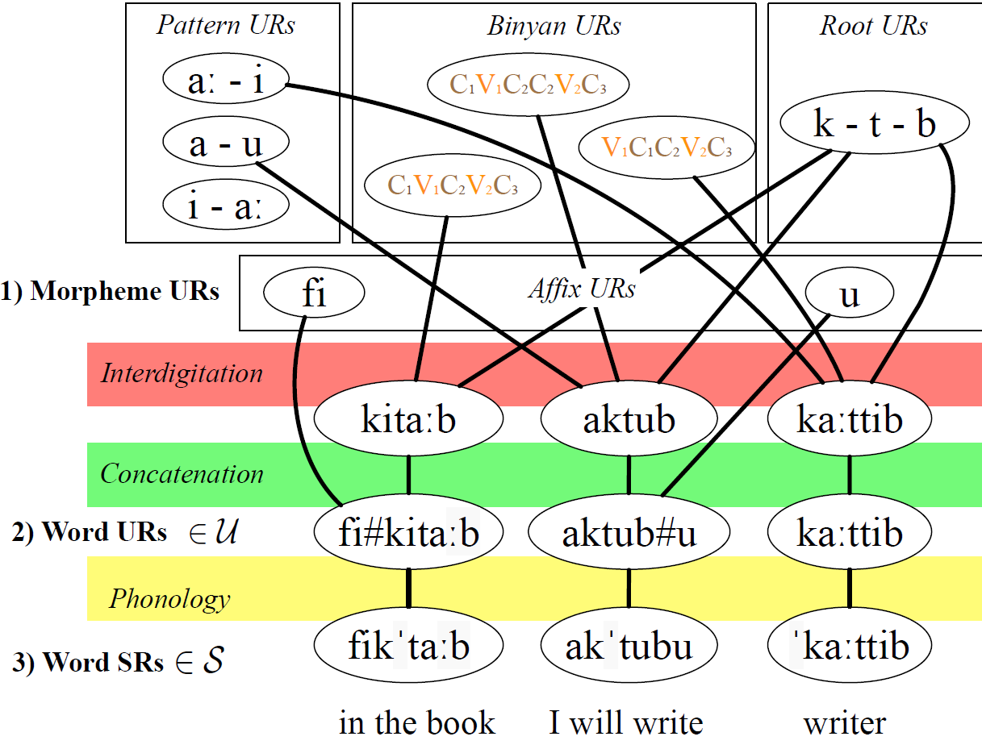
Limited to concatenation? No, could extend to templatic morphology …

Slide 20
Outline
A motivating example: phonology
General framework:
graphical models over strings
Inference on graphical models over strings
Dual decomposition inference
The general idea
Substring features and active set
Experiments and results

Slide 21
Graphical Models over Strings?
Joint distribution over many strings
Variables
Range over Σ* ⇨ infinite set of all strings
Relations among variables
Usually specified by (multi-tape) FSTs
A probabilistic approach to language change
(Bouchard-Côté et. al. NIPS 2008)
Graphical models over multiple strings.
(Dreyer and Eisner. EMNLP 2009)
Large-scale cognate recovery
(Hall and Klein. EMNLP 2011)
Notes:
Connect from graphical model over discrete valued variable ➔ string valued random variable ➔ They are observations

Slide 22
Graphical Models over Strings?
Strings are the basic units in natural languages.
Use
Orthographic (spelling)
Phonological (pronunciation)
Latent (intermediate steps not observed directly)
Size
Morphemes (meaningful subword units)
Words
Multi-word phrases, including “named entities”
URLs

Slide 23
What relationships could you model?
spelling ⬄ pronunciation
word ⇨ noisy word (e.g., with a typo)
word ⇨ related word in another language (loanwords, language evolution, cognates)
singular ⬄ plural (for example)
root ⬄ word
underlying form ⬄ surface form
Notes:
Relation: that’s where you model with graphical: model interaction between many strings
Relate each relation with a specific task
Mention only applications and animate each item on the slide

Slide 24
Chains of relations can be useful
Misspelling or pun
= spelling ⇨ pronunciation ⇨ spelling
Cognate
= word ⇨ historical parent ⇨ historical child

Slide 25
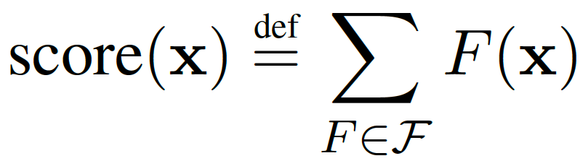
Factor Graph for phonology
1) Morpheme URs
1) Morpheme URs
rizajgn
z
rizajgn
z
eɪʃən
dæmn
eɪʃən
dæmn
Concatenation (e.g.)
Concatenation (e.g.)
2) Word URs
2) Word URs
rεzɪgn#eɪʃən
rizajn#z
dæmn#eɪʃən
dæmn#z
rεzɪgn#eɪʃən
rizajn#z
dæmn#eɪʃən
dæmn#z
Phonology (PFST)
Phonology (PFST)
r,εzɪgn’eɪʃn
riz’ajnz
d,æmn’eɪʃn
r,εzɪgn’eɪʃn
riz’ajnz
d,æmn’eɪʃn
d’æmz
3) Word SRs
d’æmz
3) Word SRs
log-probability Let’s maximize it!

Slide 26
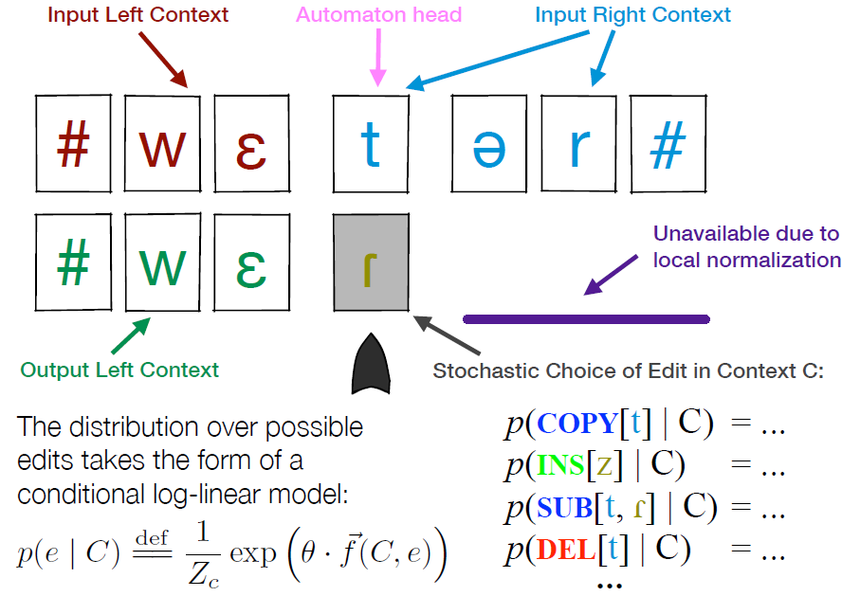
Contextual Stochastic Edit Process
Stochastic contextual edit distance and probabilistic FSTs. (Cotterell et. al. ACL 2014)
Notes:
Any string to any string, unbounded length

Slide 27
Probabilistic FSTs
Stochastic contextual edit distance and probabilistic FSTs. (Cotterell et. al. ACL 2014)

Slide 28
Inference on a Factor Graph
1) Morpheme URs
?
?
?
?
2) Word URs
?
?
?
3) Word SRs
r,εzɪgn’eɪʃn
riz’ajnz
riz’ajnd
Notes:
Before we get to a concrete example, I’d like to briefly introduce factor graph:
Nodes: still represent variables. encoding the possible values and the corresponding probability of variables.
Factors: scoring functions encode constraints. Usually represented by CPT in discrete case.
A graph representing the factorization of a function. The score of the whole graph configuration can be decomposed into the product of all the factors.

Slide 29
Inference on a Factor Graph
1) Morpheme URs
foo
bar
s
da
2) Word URs
?
?
?
3) Word SRs
r,εzɪgn’eɪʃn
riz’ajnz
riz’ajnd
Notes:
Before we get to a concrete example, I’d like to briefly introduce factor graph:
Nodes: still represent variables. encoding the possible values and the corresponding probability of variables.
Factors: scoring functions encode constraints. Usually represented by CPT in discrete case.
A graph representing the factorization of a function. The score of the whole graph configuration can be decomposed into the product of all the factors.

Slide 30
Inference on a Factor Graph
1) Morpheme URs
foo
bar
s
da
2) Word URs
bar#foo
bar#s
bar#da
3) Word SRs
r,εzɪgn’eɪʃn
riz’ajnz
riz’ajnd

Slide 31
Inference on a Factor Graph
8e-3
0.01
0.05
0.02
1) Morpheme URs
foo
bar
s
da
2) Word URs
bar#foo
bar#s
bar#da
3) Word SRs
r,εzɪgn’eɪʃn
riz’ajnz
riz’ajnd

Slide 32
Inference on a Factor Graph
8e-3
0.01
0.05
0.02
1) Morpheme URs
foo
bar
s
da
2) Word URs
bar#foo
bar#s
bar#da
2e-1300
6e-1200
7e-1100
3) Word SRs
r,εzɪgn’eɪʃn
riz’ajnz
riz’ajnd

Slide 33
Inference on a Factor Graph
8e-3
0.01
0.05
0.02
1) Morpheme URs
foo
bar
s
da
2) Word URs
bar#foo
bar#s
bar#da
☹
2e-1300
6e-1200
7e-1100
3) Word SRs
r,εzɪgn’eɪʃn
riz’ajnz
riz’ajnd

Slide 34
Inference on a Factor Graph
?
1) Morpheme URs
foo
far
s
da
2) Word URs
far#foo
far#s
far#da
3) Word SRs
r,εzɪgn’eɪʃn
riz’ajnz
riz’ajnd

Slide 35
Inference on a Factor Graph
?
1) Morpheme URs
foo
size
s
da
2) Word URs
size#foo
size#s
size#da
3) Word SRs
r,εzɪgn’eɪʃn
riz’ajnz
riz’ajnd

Slide 36
Inference on a Factor Graph
?
1) Morpheme URs
foo
…
s
da
2) Word URs
…#foo
…#s
…#da
3) Word SRs
r,εzɪgn’eɪʃn
riz’ajnz
riz’ajnd

Slide 37
Inference on a Factor Graph
1) Morpheme URs
foo
rizajn
s
da
2) Word URs
rizajn#foo
rizajn#s
rizajn#da
3) Word SRs
r,εzɪgn’eɪʃn
riz’ajnz
riz’ajnd

Slide 38
Inference on a Factor Graph
1) Morpheme URs
foo
rizajn
s
da
2) Word URs
rizajn#foo
rizajn#s
rizajn#da
2e-5
0.01
0.008
3) Word SRs
r,εzɪgn’eɪʃn
riz’ajnz
riz’ajnd

Slide 39
Inference on a Factor Graph
1) Morpheme URs
eɪʃn
rizajn
s
d
2) Word URs
rizajn#eɪʃn
rizajn#s
rizajn#d
0.001
0.01
0.015
3) Word SRs
r,εzɪgn’eɪʃn
riz’ajnz
riz’ajnd

Slide 40
Inference on a Factor Graph
1) Morpheme URs
eɪʃn
rizajgn
s
d
2) Word URs
rizajgn#eɪʃn
rizajgn#s
rizajgn#d
☺
0.008
0.008
0.013
3) Word SRs
r,εzɪgn’eɪʃn
riz’ajnz
riz’ajnd

Slide 41
Inference on a Factor Graph
eɪʃn
rizajgn
s
d
rizajgn#eɪʃn
rizajgn#s
rizajgn#d
☺
0.013
0.008
0.008
r,εzɪgn’eɪʃn
riz’ajnz
riz’ajnd
Notes:
Challenge: you cannot try every possible value of the latent variables, and it’s a joint decision. Have to design some smarter way.
TACL BP, NAACL EP, all approximate.
Q: can we do exact inference? Answer: if we stick to 1-best and not marginal inference, then we can use DD, which is exact if it terminates, even though it’s maximizing over an infinite space owing to unbounded string length (Note that MAP inference under this setting can't be done by ILP or even by brute force, because the strings are unbounded. Indeed, the inference problem is undecidable in general).

Slide 42
Challenges in Inference
Global discrete optimization problem.
Variables range over a infinite set … cannot be solved by ILP or even brute force. Undecidable!
Our previous papers used approximate algorithms: Loopy Belief Propagation, or Expectation Propagation.
Q: Can we do exact inference?
A: If we can live with 1-best and not marginal inference, then we can use Dual Decomposition … which is exact.
(if it terminates! the problem is undecidable in general …)
Notes:
Messages from different factors don’t agree.
Majority vote would not necessarily give the best answer
Computationally prohibitive to get marginal distribution on a high-degree node.

Slide 43
Outline
A motivating example: phonology
General framework:
graphical models over strings
Inference on graphical models over strings
Dual decomposition inference
The general idea
Substring features and active set
Experiments and results

Slide 44
Graphical Model for Phonology
1) Morpheme URs
rεzign
rizajgn
z
eɪʃən
eɪʃən
dæmn
Concatenation (e.g.)
2) Word URs
rεzɪgn#eɪʃən
rizajn#z
dæmn#eɪʃən
dæmn#z
Phonology (PFST)
3) Word SRs
r,εzɪgn’eɪʃn
riz’ajnz
d,æmn’eɪʃn
d’æmz
Jointly decide the values of the inter-dependent latent variables, which range over a infinite set.
Notes:
Decompose the high-degree nodes into several independent subproblems, make copies, optimize the subproblems separately and force consensus among subproblems by communicating.
You can decompose the problem: we choose this way for this particular problem, each surface form got to choose their own stem and suffix

Slide 45
General Idea of Dual Decomp
rεzign
rizajgn
z
eɪʃən
eɪʃən
dæmn
rεzɪgn#eɪʃən
rizajn#z
dæmn#eɪʃən
dæmn#z
r,εzɪgn’eɪʃn
riz’ajnz
d,æmn’eɪʃn
d’æmz
Notes:
Decompose the high-degree nodes into several independent subproblems, make copies, optimize the subproblems separately and force consensus among subproblems by communicating.
You can decompose the problem: we choose this way for this particular problem, each surface form got to choose their own stem and suffix

Slide 46
General Idea of Dual Decomp
rεzɪgn
eɪʃən
rizajn
z
dæmn
eɪʃən
dæmn
z
rεzɪgn#eɪʃən
rizajn#z
dæmn#eɪʃən
dæmn#z
r,εzɪgn’eɪʃn
riz’ajnz
d,æmn’eɪʃn
d’æmz
Subproblem 1
Subproblem 2
Subproblem 3
Subproblem 4
Notes:
They want to communicate this message. But how?
Thought bubbles: add weights, features

Slide 47
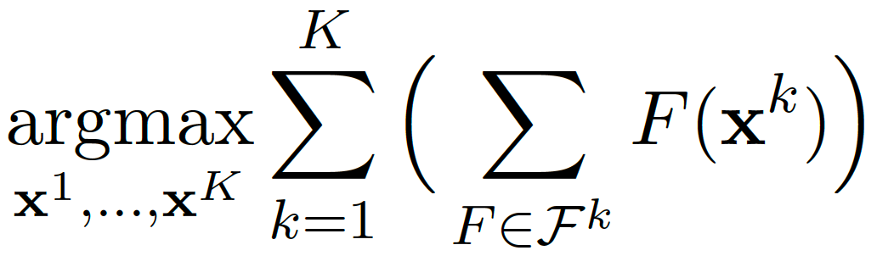
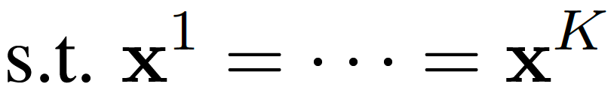
General Idea of Dual Decomp
I prefer rεzɪgn
I prefer rizajn
rεzɪgn
eɪʃən
rizajn
z
dæmn
eɪʃən
dæmn
z
rεzɪgn#eɪʃən
rizajn#z
dæmn#eɪʃən
dæmn#z
r,εzɪgn’eɪʃn
riz’ajnz
d,æmn’eɪʃn
d’æmz
Subproblem 1
Subproblem 2
Subproblem 3
Subproblem 4
Notes:
They want to listen to each other’s messages. But how?

Slide 48
Outline
A motivating example: phonology
General framework:
graphical models over strings
Inference on graphical models over strings
Dual decomposition inference
The general idea
Substring features and active set
Experiments and results

Slide 49
rεzɪgn
eɪʃən
rizajn
z
dæmn
eɪʃən
dæmn
z
rεzɪgn#eɪʃən
rizajn#z
dæmn#eɪʃən
dæmn#z
r,εzɪgn’eɪʃn
riz’ajnz
d,æmn’eɪʃn
d’æmz
Subproblem 1
Subproblem 2
Subproblem 3
Subproblem 4
Notes:
They want to communicate this message. But how?

Slide 50


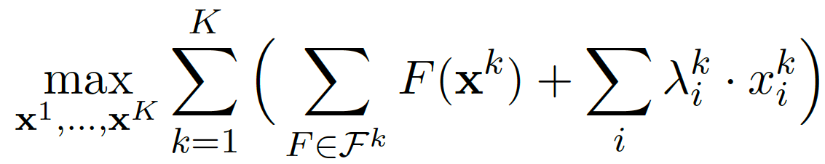
Substring Features and Active Set
Less i, a, j;
more ε, ɪ, g
(to match others)
I prefer rizajn
rεzɪgn
rizajn
eɪʃən
z
dæmn
eɪʃən
dæmn
z
Less ε, ɪ, g; more i, a, j
(to match others)
I prefer rεzɪgn
rεzɪgn#eɪʃən
rizajn#z
dæmn#eɪʃən
dæmn#z
r,εzɪgn’eɪʃn
riz’ajnz
d,æmn’eɪʃn
d’æmz
Subproblem 1
Subproblem 1
Subproblem 1
Subproblem 1
Notes:
Heuristic for expanding active set
We have infinitely many dual variables (Lagrange multipliers), and we let more and more of them move away from 0 as needed until we get agreement, but only finitely many (correspond to disagreed substring features) are nonzero at each step
Show the weights in this picture. Tie to dual variable

Slide 51
Features: “Active set” method
How many features?
Infinitely many possible n-grams!
Trick: Gradually increase feature set as needed.
Like Paul & Eisner (2012), Cotterell & Eisner (2015)
Only add features on which strings disagree.
Only add abcd once abc and bcd already agree.
Exception: Add unigrams and bigrams for free.
Notes:
Remind why we need active set
EP

Slide 52
Fragment of Our Graph for Catalan
?
?
?
?
?
Stem of “grey”
?
?
?
?
gris
grizos
grize
grizes
Separate these 4 words into 4 subproblems as before …

Slide 53
Redraw the graph to focus on the stem …
?
?
?
?
?
?
?
?
?
gris
grizos
grize
grizes

Slide 54
Separate into 4 subproblems – each gets its own copy of the stem
？
？
？
？
?
?
?
?
?
?
?
?
gris
grizos
grize
grizes

Slide 55
Iteration: 1
nonzero features: { }
ε
ε
ε
ε
?
?
?
?
?
?
?
?
gris
grizos
grize
grizes

Slide 56
Iteration: 3
nonzero features: { }
g
g
g
g
?
?
?
?
?
?
?
?
gris
grizos
grize
grizes

Slide 57
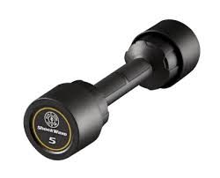
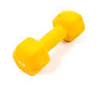
Iteration: 4
nonzero features: {s, z, is, iz, s$, z$ }
Feature weights (dual variable)
gris
griz
griz
griz
?
?
?
?
?
?
?
?
gris
grizos
grize
grizes

Slide 58
Iteration: 5
nonzero features: {s, z, is, iz, s$, z$,
o, zo, o$ }
Feature weights (dual variable)
gris
griz
grizo
griz
?
?
?
?
?
?
?
?
gris
grizos
grize
grizes

Slide 59
Iteration: 6
nonzero features: {s, z, is, iz, s$, z$,
o, zo, o$ }
Iteration: 13
Feature weights (dual variable)
gris
griz
grizo
griz
?
?
?
?
?
?
?
?
gris
grizos
grize
grizes

Slide 60
Iteration: 14
nonzero features: {s, z, is, iz, s$, z$,
o, zo, o$ }
Feature weights (dual variable)
griz
griz
grizo
griz
?
?
?
?
?
?
?
?
gris
grizos
grize
grizes

Slide 61
Iteration: 17
nonzero features: {s, z, is, iz, s$, z$,
o, zo, o$ }
Feature weights (dual variable)
griz
griz
griz
griz
?
?
?
?
?
?
?
?
gris
grizos
grize
grizes

Slide 62
Iteration: 18
nonzero features: {s, z, is, iz, s$, z$, o, zo, o$, e, ze, e$}
Feature weights (dual variable)
griz
griz
griz
grize
?
?
?
?
?
?
?
?
gris
grizos
grize
grizes

Slide 63
Iteration: 19
nonzero features: {s, z, is, iz, s$, z$, o, zo, o$, e, ze, e$}
Iteration: 29
Feature weights (dual variable)
griz
griz
griz
grize
?
?
?
?
?
?
?
?
gris
grizos
grize
grizes

Slide 64
Iteration: 30
nonzero features: {s, z, is, iz, s$, z$, o, zo, o$, e, ze, e$}
Feature weights (dual variable)
griz
griz
griz
griz
?
?
?
?
?
?
?
?
gris
grizos
grize
grizes

Slide 65
Iteration: 30
nonzero features: {s, z, is, iz, s$, z$, o, zo, o$, e, ze, e$}
Converged!
griz
griz
griz
griz
?
?
?
?
?
?
?
?
gris
grizos
grize
grizes

Slide 66
Why n-gram features?
Positional features don’t understand insertion:
In contrast, our “z” feature counts the number of “z” phonemes, without regard to position.
These solutions already agree on “g”, “i”, “z” counts … they’re only negotiating over the “r” count.
I’ll try to arrange for r not i at position 2, i not z at position 3, z not ε at position 4.
griz
giz
griz
giz
I need more r’s.

Slide 67
Why n-gram features?
Adjust weights λ until the “r” counts match:
Next iteration agrees on all our unigram features:
Oops! Features matched only counts, not positions ☹
But bigram counts are still wrong … so bigram features get activated to save the day ☺
If that’s not enough, add even longer substrings …
griz
giz
I need more r’s … somewhere.
griz
girz
I need more gr, ri, iz, less gi, ir, rz.

Slide 68
Outline
A motivating example: phonology
General framework:
graphical models over strings
Inference on graphical models over strings
Dual decomposition inference
The general idea
Substring features and active set
Experiments and results

Slide 69
7 Inference Problems (graphs)
EXERCISE (small)
4 languages: Catalan, English, Maori, Tangale
16 to 55 underlying morphemes.
55 to 106 surface words.
CELEX (large)
3 languages: English, German, Dutch
341 to 381 underlying morphemes.
1000 surface words for each language.
# vars (unknown strings)
# subproblems

Slide 70
Experimental Setup
Model 1: very simple phonology with only 1 parameter, trained by grid search.
Model 2S: sophisticated phonology with phonological features trained by hand-crafted morpheme URs: full supervision.
Model 2E: sophisticated phonology as Model 2S, trained by EM.
Evaluating inference on recovered latent variables under the different settings.

Slide 71
Experimental Questions
Is exact inference by DD practical?
Does it converge?
Does it get better results than approximate inference methods?
Does exact inference help EM?

Slide 72
primal (function of strings x)
dual (function of weights λ)
≤
DD seeks best λ via subgradient algorithm ⇨ reduce dual objective ⇨ tighten upper bound on primal objective
If λ gets all sub-problems to agree (x¹ = … = x^{K}) ⇨ constraints satisfied ⇨ dual value is also value of a primal solution ⇨ which must be max primal! (and min dual)

Slide 73
Convergence behavior (full graph)
optimal!
Dual (tighten upper bound)
primal (improve strings)
Catalan
Maori
English
Tangale
Notes:
Under model 1, exercise dataset

Slide 74
Comparisons
Compare DD with two types of Belief Propagation (BP) inference.
Approximate MAP inference
(max-product BP)
(baseline)
Approximate marginal inference
(sum-product BP)
(TACL 2015)
Exact MAP inference
(dual decomposition)
(this paper)
variational approximation
Viterbi approximation
Exact marginal inference
(we don’t know how!)
Notes:
Infeasible to do exact marginal inference
Enphasize the hardness of our problem, undicidable

Slide 75
Inference accuracy
Model 1 – trivial phonology
Model 2S – oracle phonology
Model 2E – learned phonology (inference used within EM)
Approximate MAP inference
(max-product BP)
(baseline)
Model 1, EXERCISE: 90%
Model 1, CELEX: 84%
Model 2S, CELEX: 99%
Model 2E, EXERCISE: 91%
improves
improves more!
Approximate marginal inference
(sum-product BP)
(TACL 2015)
Exact MAP inference
(dual decomposition)
(this paper)
Model 1, EXERCISE: 95%
Model 1, EXERCISE: 97%
Model 1, CELEX: 86%
Model 1, CELEX: 90%
Model 2S, CELEX: 96%
worse
Model 2S, CELEX: 99%
Model 2E, EXERCISE: 95%
Model 2E, EXERCISE: 98%

Slide 76
Conclusion
A general DD algorithm for MAP inference on graphical models over strings.
On the phonology problem, terminates in practice, guaranteeing the exact MAP solution.
Improved inference for supervised model; improved EM training for unsupervised model.
Try it for your own problems generalizing to new strings!

