Slide 1





Weighting Finite-State Transductions With Neural Context
Pushpendre Rastogi
Ryan Cotterell
Jason Eisner
Notes:
Speaker notes were mostly copied from the transcript of the talk video at
http://techtalks.tv/talks/weighting-finite-state-transductions-with-neural-context/62271/

Slide 2

Notes:
This talk is very serious and important. But you’re here at 9am, so I’m also going to make it fun for you.
This is the North American ACL, so there was this movie called Cowboys & Aliens.
The whole draw was the title, really.
You were going to see two totally separate genres duke it out.

Slide 3
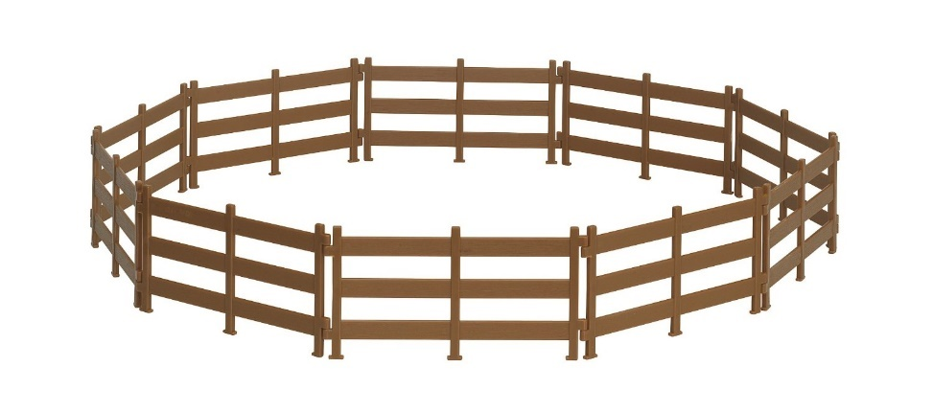
The Setting:
string-to-string transduction
Morphology!
Pronunciation!
Transliteration!
break
bathe
Washington
broken
beð
واشنطون
Segmentation!
Tagging! Supertagging!
日文章魚怎麼 說
Time flies like an arrow
日文 章魚 怎麼 說
N
V
P
D
N
Notes:
So today's talk will entertain you with a similar contest.
The setting is string-to-string transduction problems.
As you can see from the trailers here, that’s plenty exciting.
Throughout this talk, the input is a red string, and the output is a blue string that’s somehow related.
Our experiments focused on morphology.
But several applications are shown here, and I could have included more, like spelling correction, or transducing a word sequence into a sequence of actions that build a chunk or a parse tree.
Tagging is a special case where every input symbol maps to exactly one output symbol; but in general, the output sequence could be shorter or longer than the input; in fact the output is unbounded.
So, string transduction. what’s your favorite way to solve structured prediction problems?
[Segmentation example from Sproat via Bert Xue; transliteration example from Yoon, Kim, & Sproat.]

Slide 4

The Setting:
string-to-string transduction
The Cowboys:
Finite-state transducers
Notes:
Playing the part of the cowboys, at home here in the semiring, will be [click] finite-state transducers.
They were once the frontier of NLP, but now they're part of our heritage.
We revere their old-fashioned sense of honor. They live by a code.
They remember the old values, like grammars … probabilities … latent variables … dynamic programming.
[mention hand-crafted regexps? linguistic theories?]

Slide 5

The Setting:
string-to-string transduction
The Cowboys:
The Aliens:
Finite-state transducers
seq2seq models (recurrent neural nets)
Notes:
And the away team is represented by [click] deep sequence-to-sequence models.
Stacks of LSTMs doing something squishy.
No one knows quite how these things work or what they're thinking.
But they're said to have uncanny, unfamiliar powers.
Let’s review the vitals of our two teams.

Slide 6
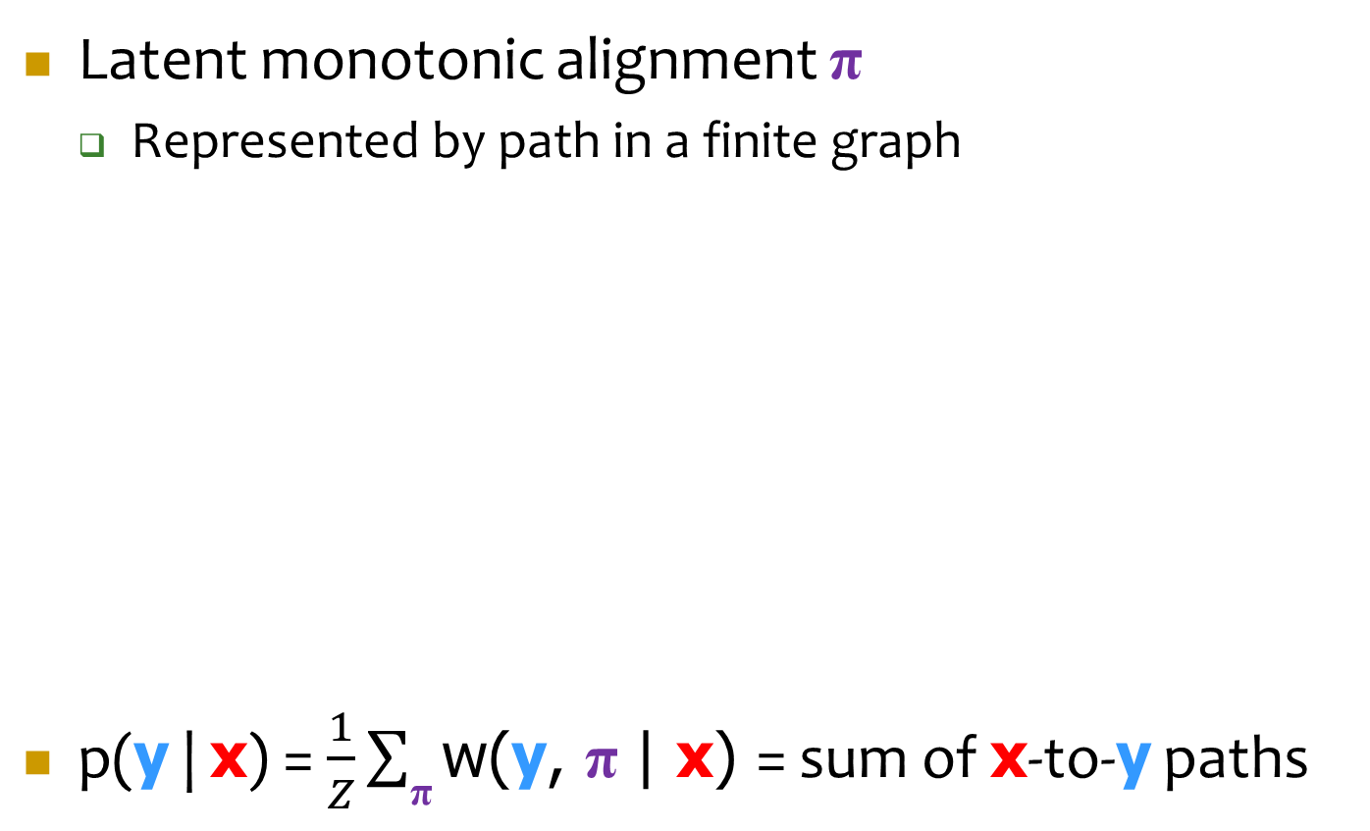
Review: Weighted FST
Latent monotonic alignment π
Represented by path in a finite graph
p(y | x) = $\frac{1}{Z}\sum_{\text{π}}{\text{w}\text{(}\text{y}\text{, }\text{π} \text{| }\text{x}\text{)}}$ = sum of $\text{x}$-to-$\text{y}$ paths
x = break
y = broken
b r ea k
b r e a k
π ∈ { , , … }
b r o k e n
b r ok e n
ea:o
k:k
r:r
ε:e
b:b
ε:n
r:ε
e:r
a:ok
k:e
Notes:
We'd like to transduce input to output, x to y, "break" to "broken".
And according to this [FST] model, there is a latent alignment between these two strings,
we'll call that pi.
So one example value of pi is shown at the left here, but there are many other possibilities.
In this one, the [digraph] "ea" turns into "o", and we have to insert "e" and "n".
And each of these alignments is represented by some path in a finite graph.
So there are lots of other edges not shown here. Here, for example, is a different path,
which represents the alignment shown on the right.
And if you want to know the probability that if you put in x, you get y,
we sum up the weights of all of the paths that transduce x to y.
So this top path has that property,
because if you concatenate the red labels you get "break", and if you concatenate the blue labels you get "broken".

Slide 7
Review: Weighted FST
Enforces hard, monotonic alignments (latent path variable)
Globally normalized ➔ no label bias
Exact computations by dynamic programming
Don’t need beam search! Can sum over all paths, and thus …
compute Z, p(y | x), expected loss; sample random strings
compute gradients (training), Viterbi or MBR string (testing)
ea:o
k:k
r:r
ε:e
b:b
ε:n
r:ε
e:r
a:ok
k:e
p(y | x) = $\frac{1}{Z}\sum_{\text{π}}{\text{w}\text{(}\text{y}\text{, }\text{π} \text{| }\text{x}\text{)}}$ = sum of $\text{x}$-to-$\text{y}$ paths
Notes:
Why do we like cowboys? [click] Well, according to this model, there is an alignment between x and y. It’s one of these paths – we just don’t know which. In contrast to MT, it’s a monotonic alignment – we move from left to right through the input string, copying or editing, and we never go back.
[click] This model is globally normalized – a state’s outgoing edges don’t have to sum to 1 – so there’s no label bias.
And what’s really great is that the model is tractable. We can search for the best path by dynamic programming, not beam search. And we can sum over all paths. Since paths overlap, even a small machine can have exponentially many paths … or infinitely many if there are cycles. In fact, that’s why the blue output can be unbounded. But the algorithms are linear-time in the number of arcs.

Slide 8

Review: seq2seq model (see Faruqui et al. 2016 – next talk!)
x = break
y = broken
b
r
e
a
k
#
LSTM
b
r
o
k
e
n
#
p(y | x) reads x, then stochastically emits chars of y, 1 by 1, like a language model
Notes:
And why are aliens so cute?
They just gobble up the red string with their LSTM neural network and they digest it as they go along.
Then they poop out the blue string. Or different blue strings with different probabilities.
There’s no Markov property here, so you have to find the best blue string by beam search.

Slide 9
Notes:
All right, ready to rumble?

Slide 10
Exact-match accuracy on 4 morphology tasks
Heck, I can look at context too. I just need more states.
Now using my weird soft alignment … I call it “attention”
Your attention’s unsteady, friend. You’re shooting all over the input.
Ha! You ain’t got any alignment!
I sluuuurp features right out of the context
But you cannot learn what context to look at :-P
Not from 500 examples you can’t …
I can learn anything … !
Notes:
So here’s how the movie goes. The cowboys are riding … they’re doing pretty well on these 4 morphology tasks.
The aliens invade! But they actually can’t solve these tasks at all.
The cowboys gloat. The aliens do not understand human morphology.
But wait – suddenly the aliens are winning!
That’s why seq2seq models were extended with an attention mechanism: it’s a kind of soft alignment.
Now, the aliens still don’t know it should be a monotonic alignment – morphology can’t scramble the input letters, it just edits them from left to right.
So they’re underconstrained … that could be important prior knowledge – monotonicity – when generalizing from small data.
Ok. You’ll notice that the aliens are still winning.
Because they get to look at the context of an edit operation, to see whether that edit operation is good in that context.
But, you know, finite state machines can look at context too, if you give them enough states.
Although that doesn't (in this particular comparison) always make the cowboys win,
and the alien here has a good point, that we had to build the set of states into the finite-state machine when we designed it,
whereas the alien's LSTM is figuring out what's important from the context.
All right. So, neither one is consistently ahead at this point in the comparison.

Slide 11

You can guess the ending …
You’re rooting for the cowboys, ain’t ya?
Dreyer, Smith, & Eisner (2008)
“Latent-variable modeling of string transductions with finite-state methods”
Beats everything in this paper by a couple of points
More local context (trigrams of edits)
Latent word classes
Latent regions within a word (e.g., can find stem vowel)
But might have to redesign for other tasks (G2P?)
And it’s quite slow – this FST has lots of states
Notes:
Now, you might guess how the movie ends. (spoilers!) It's a tough fight but the cowboys win.
You were rooting for the cowboys, right?
Okay then! That’s still the state of the art in NLP, too.
Our original paper with these tasks is still ahead, using just an FST.
But that’s only because we worked hard to design the FST by hand.
If we wanted another string-to-string task, we’d probably need to expand the FST topology.
And this particular system was quite slow, because the states were making lots of distinctions about things that *might* happen in context.
And as a result, it had to have lots of states. So, cowboys: yay.

Slide 12


The inevitable sequels (not this paper)
Return of the aliens? More monotonic …
Encourage attention to move left to right (Cohn et al. 2016)
Allow a special “copy” operation (Gu et al. 2016)
Revenge of the cowboys? Less monotonic …
HMM alignment model (Vogel et al. 1996)
Quasi-synchronous grammar (Smith & Eisner 2006)
I.e., they could try to emulate each other’s weapons.
Or else …

Slide 13




The Alternate Ending …
Notes:
So cowboys, yay.
But cowboys & aliens was actually a terrible movie. Too predictable.
I think it would have been better as a love story.
Instead of a war of the worlds, maybe we can get the best of both worlds.

Slide 14


How do we give a cowboy alien genes?
First, we’ll need to upgrade our cowboy.
The new weapon comes from CRFs.
Discriminative training? Already doing it.
Global normalization? Already doing it.
Conditioning on entire input (like seq2seq)? Aha!
Notes:
To get the best of both worlds, we're going to have to upgrade our cowboy.
The new weapon here comes from conditional random fields.
So you're wondering, "What's this weapon? What's this magic weapon? Is it discriminative training?“
No, we already had that on the previous slides.
"Ok, so it must be global normalization.“No, we had that too.
No, the new weapon is getting to condition on the entire input string, which is also what the LSTM model is doing.
So let's go back for a moment and review conditional random fields.

Slide 15
CRF: p(y | x) conditions on entire input
emission weights
transition weights
But CRF weights can depend freely on all of x!
Hand-designed feature templates typically don’t
But recurrent neural nets do exploit this freedom
x =
Time flies like an arrow
y =
N
V
P
D
N
x =
Time flies like an arrow
y =
N
V
P
D
N
Notes:
So the yellow material here is what a feature gets to look at when it's computing some part of the weight of x and y jointly,
which is then normalized to give p(y | x).
And these emission features are inspired by hidden Markov models, so we get to look at every input-output symbol pair,
and we also get to look at small configurations of the blue output, at once.
But that's an HMM. In the case of a CRF, this domain of locality, the yellow stuff that a feature gets to look at, is expanded to include all of x.
Hand-engineered features don’t usually exploit that freedom.
But recurrent neural nets really will look at the entire context.
---
CRFs are fine for tagging, but we have a more general setting that requires FSTs.
The input and output strings are different lengths and there’s a latent alignment.
So let's try to take this idea and move it to FSTs.

Slide 16


What do FST weights depend on?
A path is a sequence of edits applied to input
Path weight = product of individual arc weights
Arc weight depends only on arc: input:output strings and the states
That’s why we can do dynamic programming
ea:o
k:k
r:r
ε:e
b:b
ε:n
r:ε
e:r
a:ok
k:e
Notes:
What does an FST weight depend on?
A path in the FST is a sequence of edits applied to the input.
If we go from left to right, we see these different edits -- we copy the "b", we copy the "r", we replace the "ea", we copy the "k", we insert "e" and "n" -- and the weight of this path is the product of the weights of the individual arcs.
And how about the weight of an individual arc? That depends only on the arc.
And an arc’s weight depends only on that arc: its red input, its blue output, and the purple states that it transitions between.
Because a path probability decomposes in this way, we can do dynamic programming.

Slide 17
What’s wrong with FSTs
All dependence on context must be captured in the state (Markov property)
Need lots of states to get the linguistics right
Our choice of states limits the context we can see
But does it have to be this way?
ea:o
k:k
r:r
ε:e
b:b
ε:n
r:ε
e:r
a:ok
k:e
Notes:
So the problem here is that all dependence on the context has to be captured in the state.
So we need lots of states to get the linguistics right. And our choice of states -- the alien's point before -- limits the context that we get to see.
So here's the technical idea of this paper. We've missed a trick. I've been missing this trick for 15 years

Slide 18

What’s wrong with FSTs
We haven’t been using the full power.
The FST community is in love with modularity:
Start with lots of little weighted FST models
Combine them to get bigger ones – closure properties
Few underlying parameters, even if many weighted arcs
But we don’t have to tie parameters like this!
Notes:
I had a paper at ACL 2002 where I said this was a great thing, because we got automatic parameter tying – we could learn models from small data.
But we don’t have to tie the parameters like this! We don’t have to tie them at all, if we have big data. Or if we do tie them, we could use a different scheme, like a neural net.
Regular expressions; standard operations on prob distributions

Slide 19

Find all paths turning given x into any y
a
a
a
a
input x =
2
3
4
0
1
°
a:b
a:c
define weights at F
hand-built FST F =
E
D
a:c
a:b
so F specifies the full model p(y | x)
a:b
a:b
a:b
a:b
a:c
a:c
a:c
a:c
paths G =
0E
1D
2E
3D
4E
G simply inherits F’s weights – note tied parameters
now run our dynamic programming algorithms on G
Notes:
For 15 years, we’ve been defining finite-state conditional distributions, p(y | x).
In this example, we can replace “a” with either “b” or “c”.
There are actually 2 arcs that [replace "a" by "c"], and they have different probabilities. That's because they're coming from different states.
This one on top is going to be used to transduce "a" if we've seen an even number of input symbols, and this one if we've seen an odd number. And those have different probabilities distinguished by the state they're coming from: "E" for "Even", "D" for "odD". So how do we actually use this?
Suppose we've got an input string, "aaaa". If we want to find all the paths that transduce "aaaa" to anything,
we've got this lattice down here, G, through finite-state composition, and G simply inherits the weights from F.
So every arc in G is obtained by applying some edit in F to some substring of x. So we're showing the origin for this arc down here at the bottom in G. This one comes from a different a:c arc, this one goes back to the first a:c arc, and notice the yellow highlight advancing in the input string x at the top.
So we have tied parameters here, in the sense that these two a:c arcs are both inherited from the same arc in F, so they have to have the same weight.
So they're both coming from an even state, they're distinguished from these two arcs, which are also tied to each other. But all the distinctions were already set when we created F.
That was the mistake.

Slide 20

Find all paths turning given x into any y
a
a
a
a
input x =
2
3
4
0
1
°
a:b
a:c
define weights at F
hand-built FST F =
E
D
a:c
a:b
a:b
a:b
a:b
a:b
a:c
a:c
a:c
a:c
paths G =
0E
1D
2E
3D
4E
new generalization: define weights on G directly!
now run our dynamic programming algorithms on G
Notes:
We run our dynamic programming algorithm on G, so we require G to have the Markov property. So what we should have done was to just define the weights on G directly.
We apply the weight here.
So now, the weight of this yellow is able to look at the state that it's coming from and the state that it's going to, as well as the edit,
and you can see that the states are labeled with where they came from. It comes from E and it goes to D, so you know it's already read an even number of characters.
And we can also see that it's going from position 2 to position 3 in the input. So we're applying this particular [purple] edit type at a particular position, a particular substring, to get an edit token.
F defines the legal edit types, like this purple TYPE: edit a:c in state E.
But now, not all tokens of that type will have the same weight. So we get a nonstationary model.
The yellow edit token applies the purple type in a particular context.
In particular, it applies the purple edit type to this pink substring of the input, from 2 to 3.
The important thing is that these states here carry enough information to know what edit type we're applying and what we're applying it to.
So the weight of the yellow edit token depends on both purple and on pink in context.
[That’s possible because these two states record where they came from in the two automata above.]
Even though it’s nonstationary, dynamic programming still works, just as in a CRF.
So that's how to make an FST like a CRF.

Slide 21


So that’s how to make an FST like a CRF
Now an edit’s weight can depend freely on input context.
(Dynamic programming is still just as efficient!)
So now we can use LSTMs to help score the edits in context – learn to extract context features.
a:c
2E
3D
Notes:
Ok, we’ve upgraded our cowboy.
Now he’s compatible with that charming and powerful alien.
Now we can use LSTMs to help score the edit in context.
We can learn to extract our context features.

Slide 22
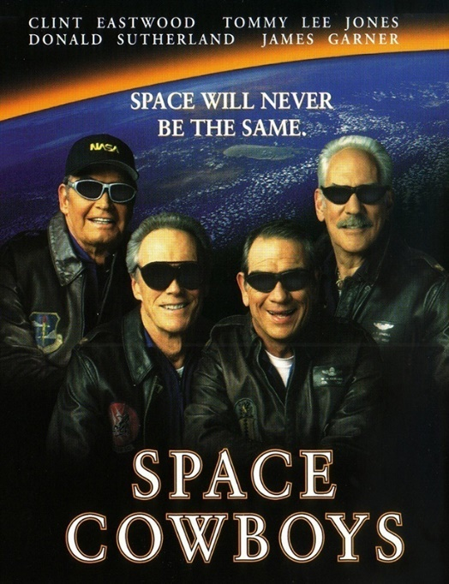
Cowboy + Alien = ?
Notes:
By the way, what do you get when you cross a cowboy with an alien?
Another movie. I haven’t seen it, but I’ll tell you the plot anyway.

Slide 23
BiLSTM to extract features from input
β₀
β₁
β₂
β₃
β₄
β₅
right to left LSTM
b
r
e
a
k
left to right LSTM
α₀
α₁
α₂
α₃
α₄
α₅

Slide 24
BiLSTM to extract features from input
β₄
right to left LSTM
b
r
e
a
k
left to right LSTM
α₂

Slide 25
Scoring an arc using neural context
β₄
To score this edit token:
ea:o
∈ G
2E
4D
First encode the edit type,
then combine with context:
ea:o
∈ F
b
r
e
a
k
E
D
α₂
weight

Slide 26
So that’s how we define weights of G’s arcs
a
a
a
a
input x =
2
3
4
0
1
°
a:b
a:c
hand-built FST F =
E
D
a:c
a:b
a:b
a:b
a:b
a:b
a:c
a:c
a:c
a:c
paths G =
0E
1D
2E
3D
4E
now run our dynamic programming algorithms on G

Slide 28

Exact-match accuracy on 4 morphology tasks
Notes:
Cowboys start …
Aliens start … aliens pull ahead …
Cowboys sort of catch up …
And then, they make love not war! Hybrid vigor! That’s what we need in NLP!

Slide 29

Conclusions
Cowboys are good
Monotonic hard alignments, exact computation
Aliens are good
Learn to extract arbitrary features from context
They’re compatible: “FSTs w/ neural context”
We can inject LSTMs into classical probabilistic models for structured prediction [not just FSTs]
This is limit of efficient exact computation (?)
More powerful models could use this model as a proposal distribution for importance sampling

Slide 30
Weighting Finite-State Transductions With Neural Context
Questions?
Pushpendre Rastogi
Ryan Cotterell
Jason Eisner
Notes:
`

Slide 31
Exact-match accuracy on 4 morphology tasks
Heck, I can look at context too. I just need more states.
Now using my weird soft alignment … I call it “attention”
Your attention’s unsteady, friend. You’re shooting all over the input.
Ha! You ain’t got any alignment!
But you cannot learn what context to look at :-P
Not from 500 examples you can’t …
I can learn anything … !

