Slide 1
2023 NFL Win Predictions
By Ryan Coughlin

Slide 2
Data Source: https://nflverse.nflverse.com/
This package is an R package developed by Sebastian Carl, Ben Baldwin, Lee Sharpe, Tan Ho, John Edwards. It pulls data from a number of different sources and is updated on a weekly basis
It us up-to-date with data from all of the 2022 season including the Super Bowl between the Chiefs and Eagles.
The goal of my project is to predict the number of wins each team in the NFL will have next season

Slide 3
Response Variable: Number of Wins in the 2023 Season
Predictor Variables: Predictor Variables are made up of 3 different datasets from nflverse, player stats, roster data, team data.

Slide 4
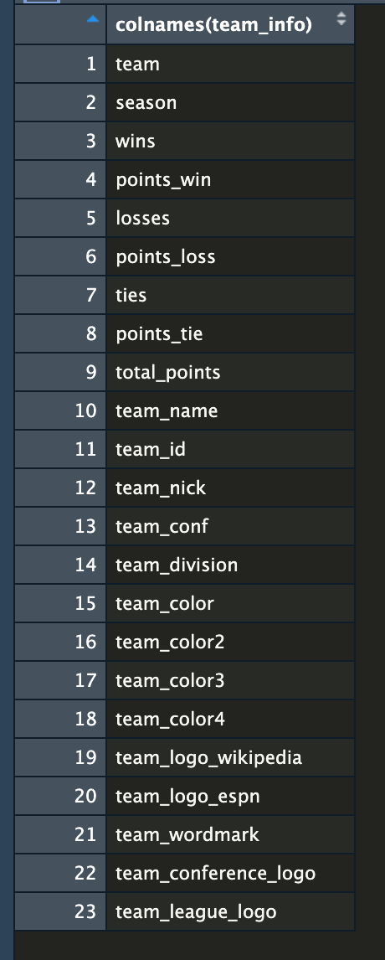
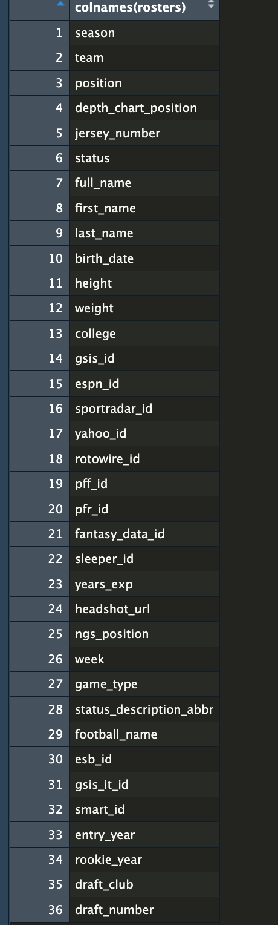
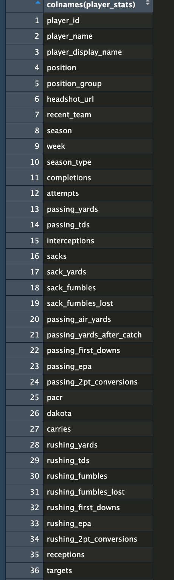
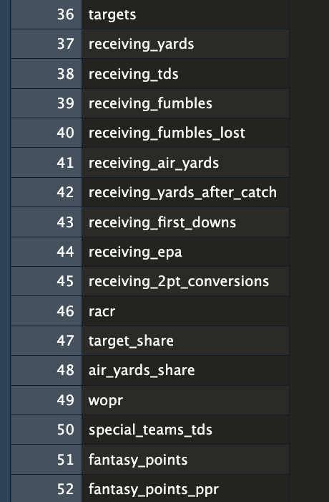

Slide 5
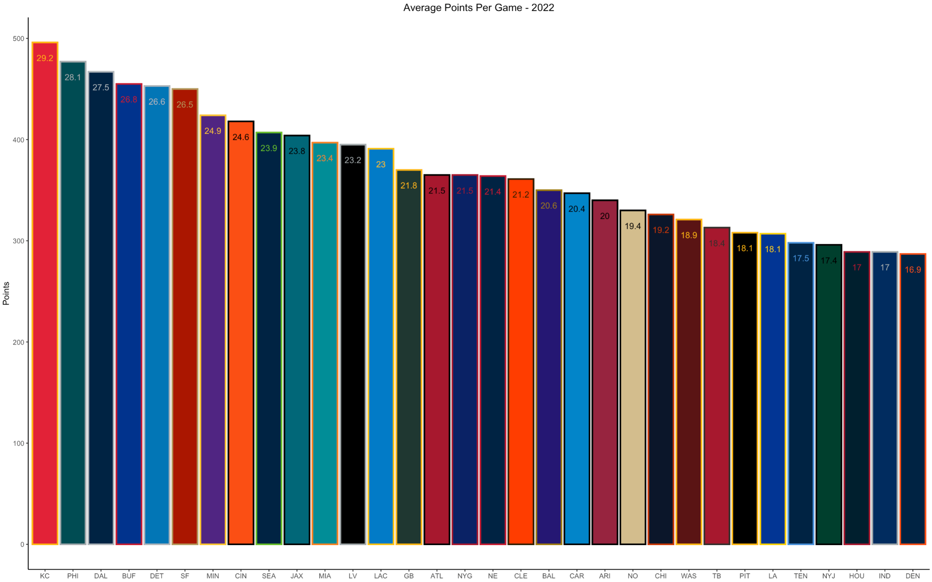

Slide 6
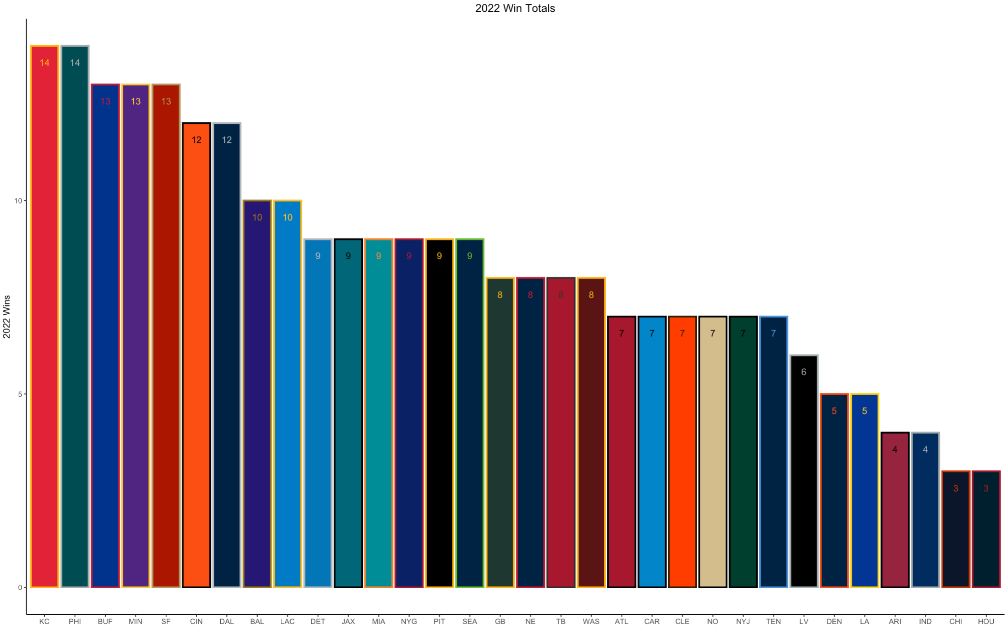

Slide 7
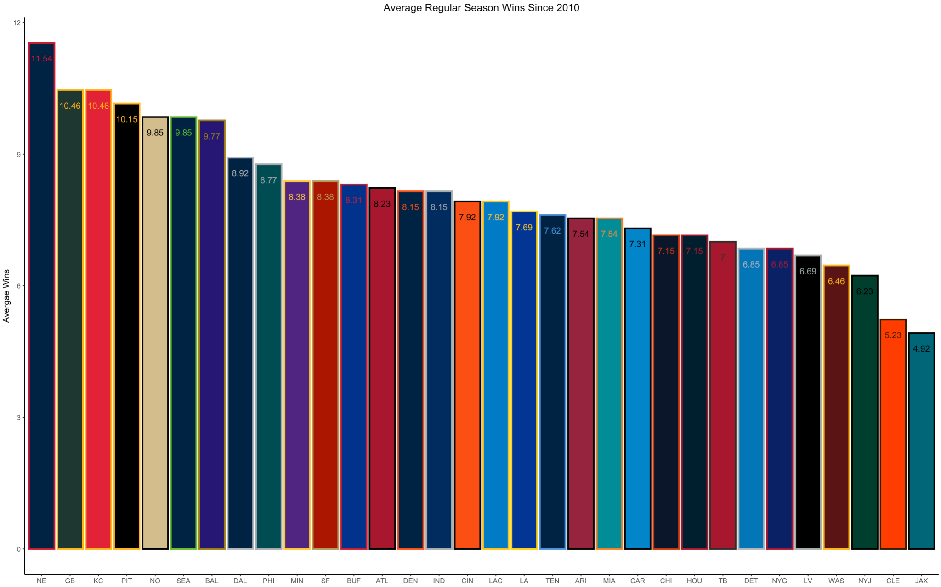

Slide 8
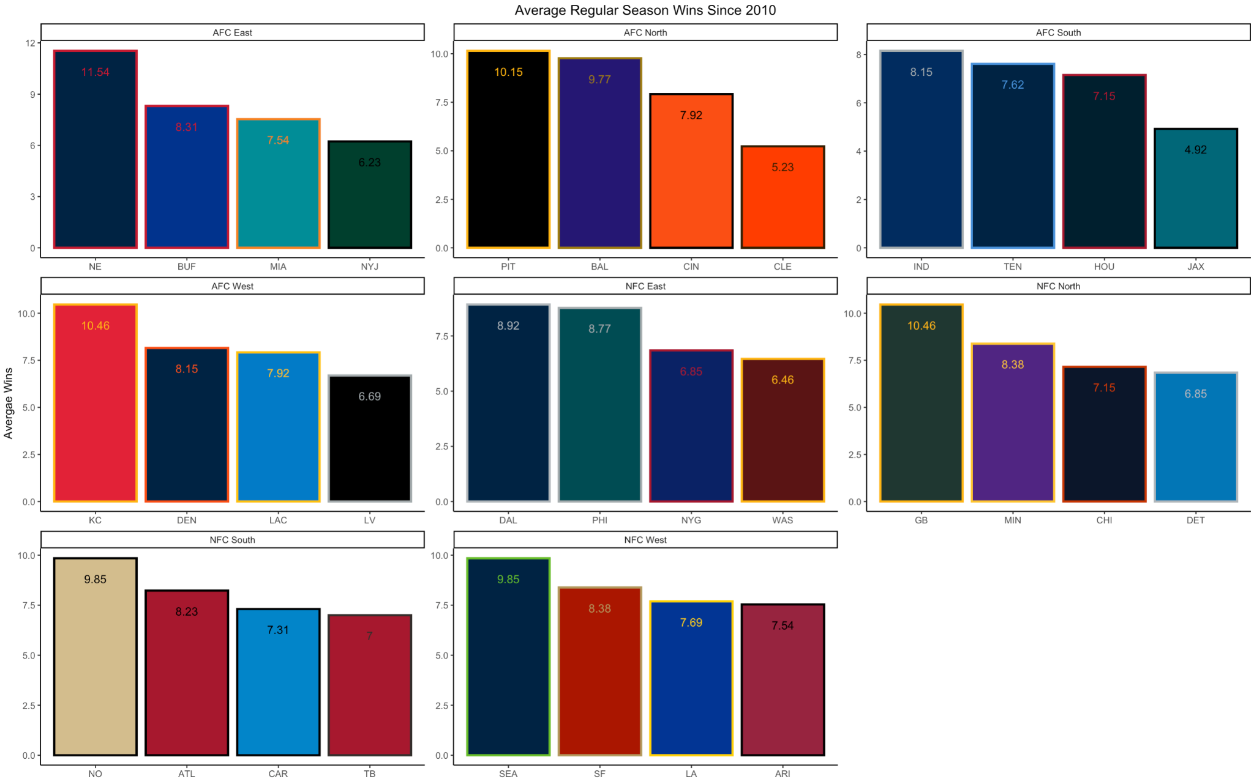

Slide 9
