Slide 1
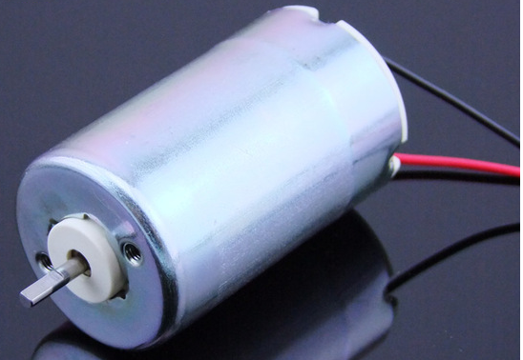
Boost Converter 9V input, 12 - 24 V Output

Slide 2
Topology

Slide 3
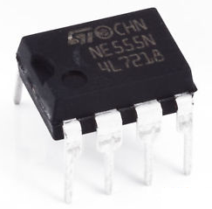
Gate Driving Circuit
ST NE555 Precision Timer
Operating conditions
<18V
<100 kHz
220 mA output current
Potentiometer control
Use diodes to ensure correct
frequency with varying duty cycle.

Slide 4
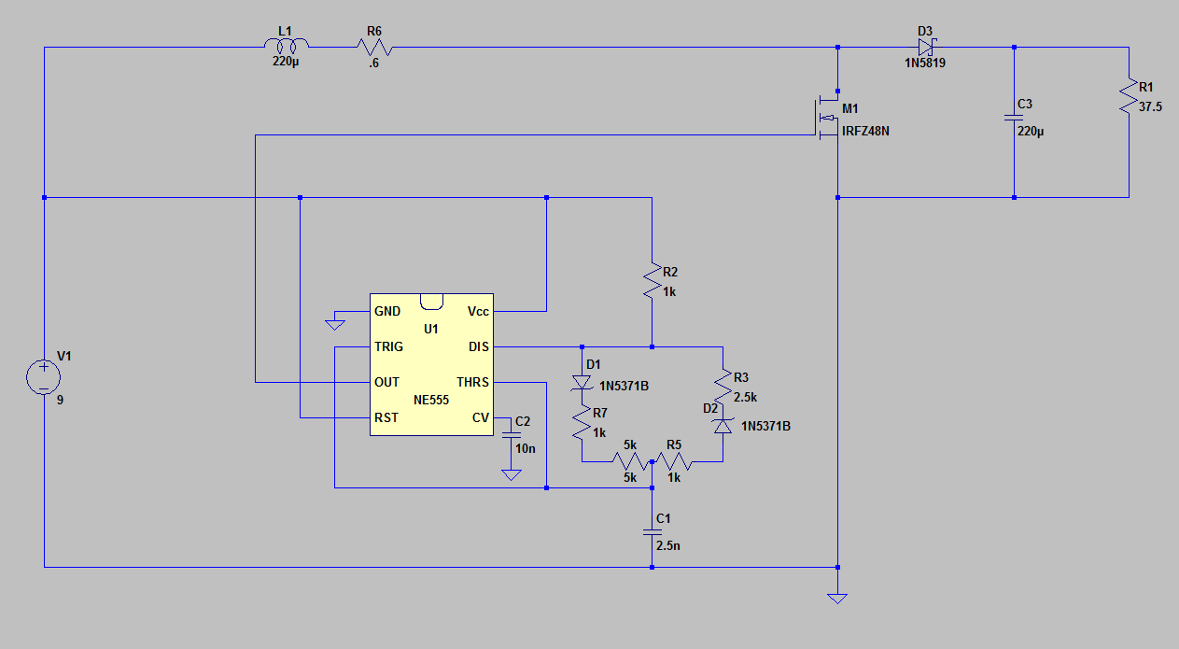

Slide 5
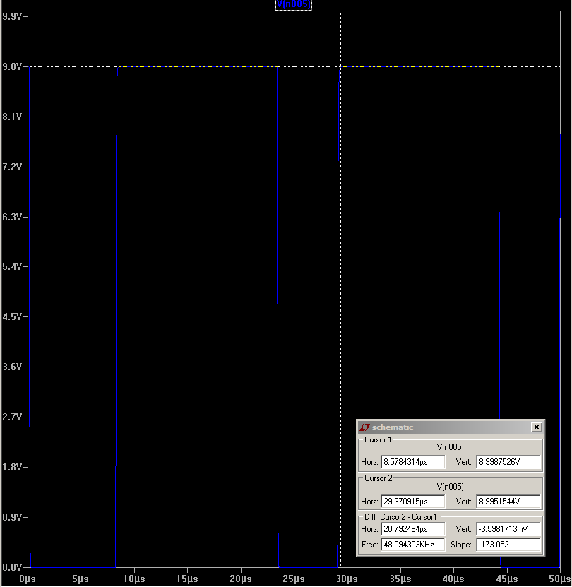
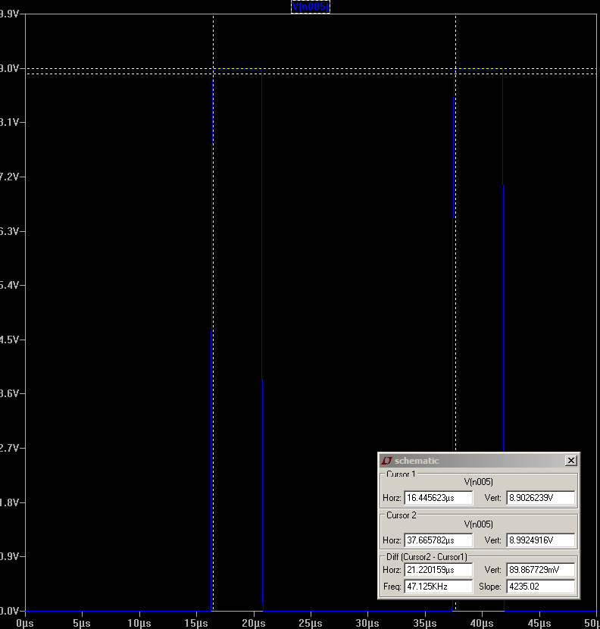
Simulation of Gate Driver Output
Frequency = 48 kHz, Duty cycle = 72%
Frequency = 47.1 kHz, Duty cycle = 19.3%

Slide 6
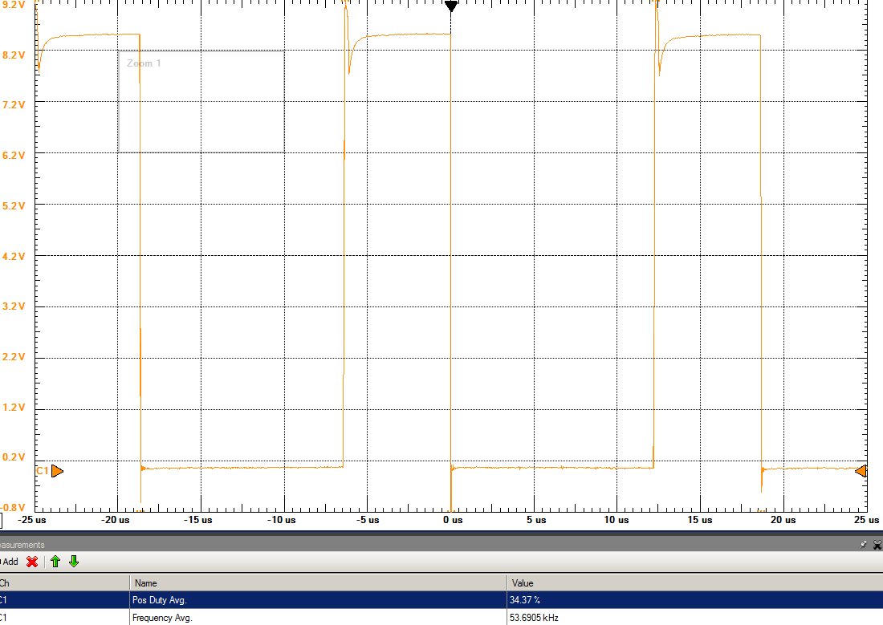
Hardware Gate Driver Output

Slide 7
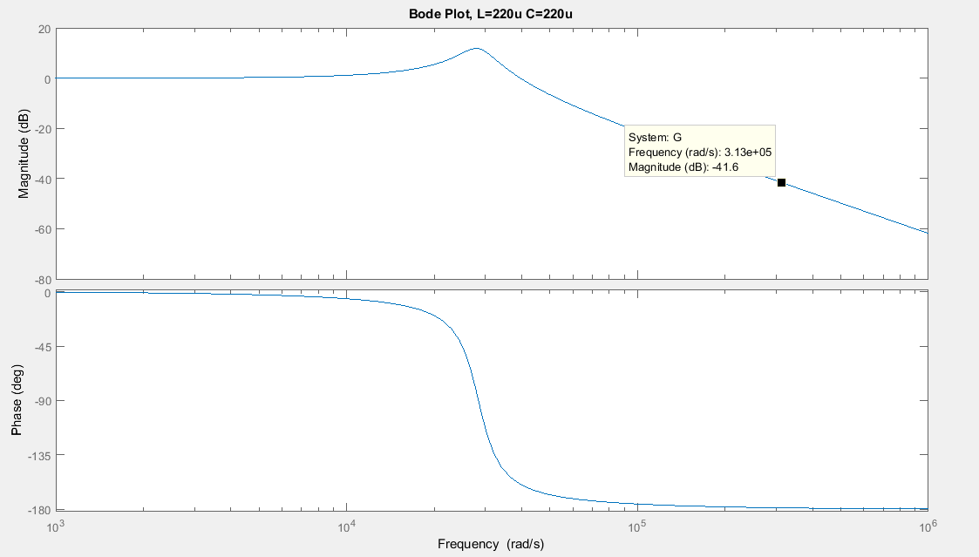

Slide 8
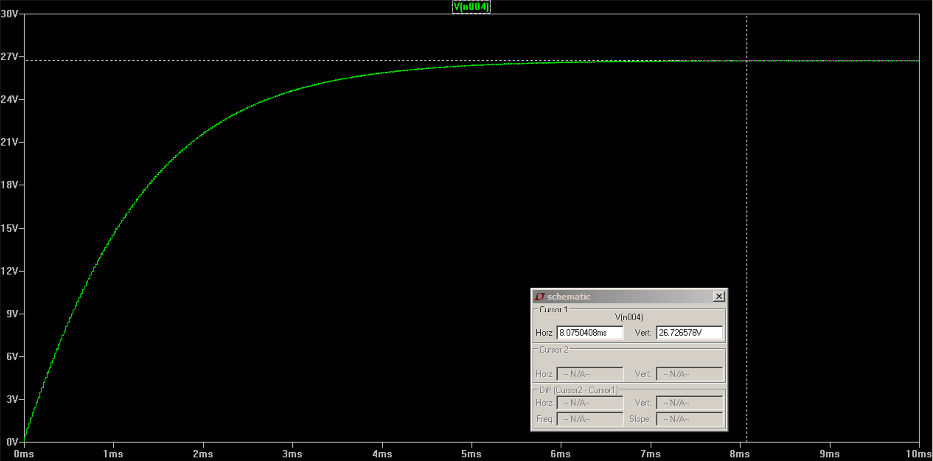

Slide 9
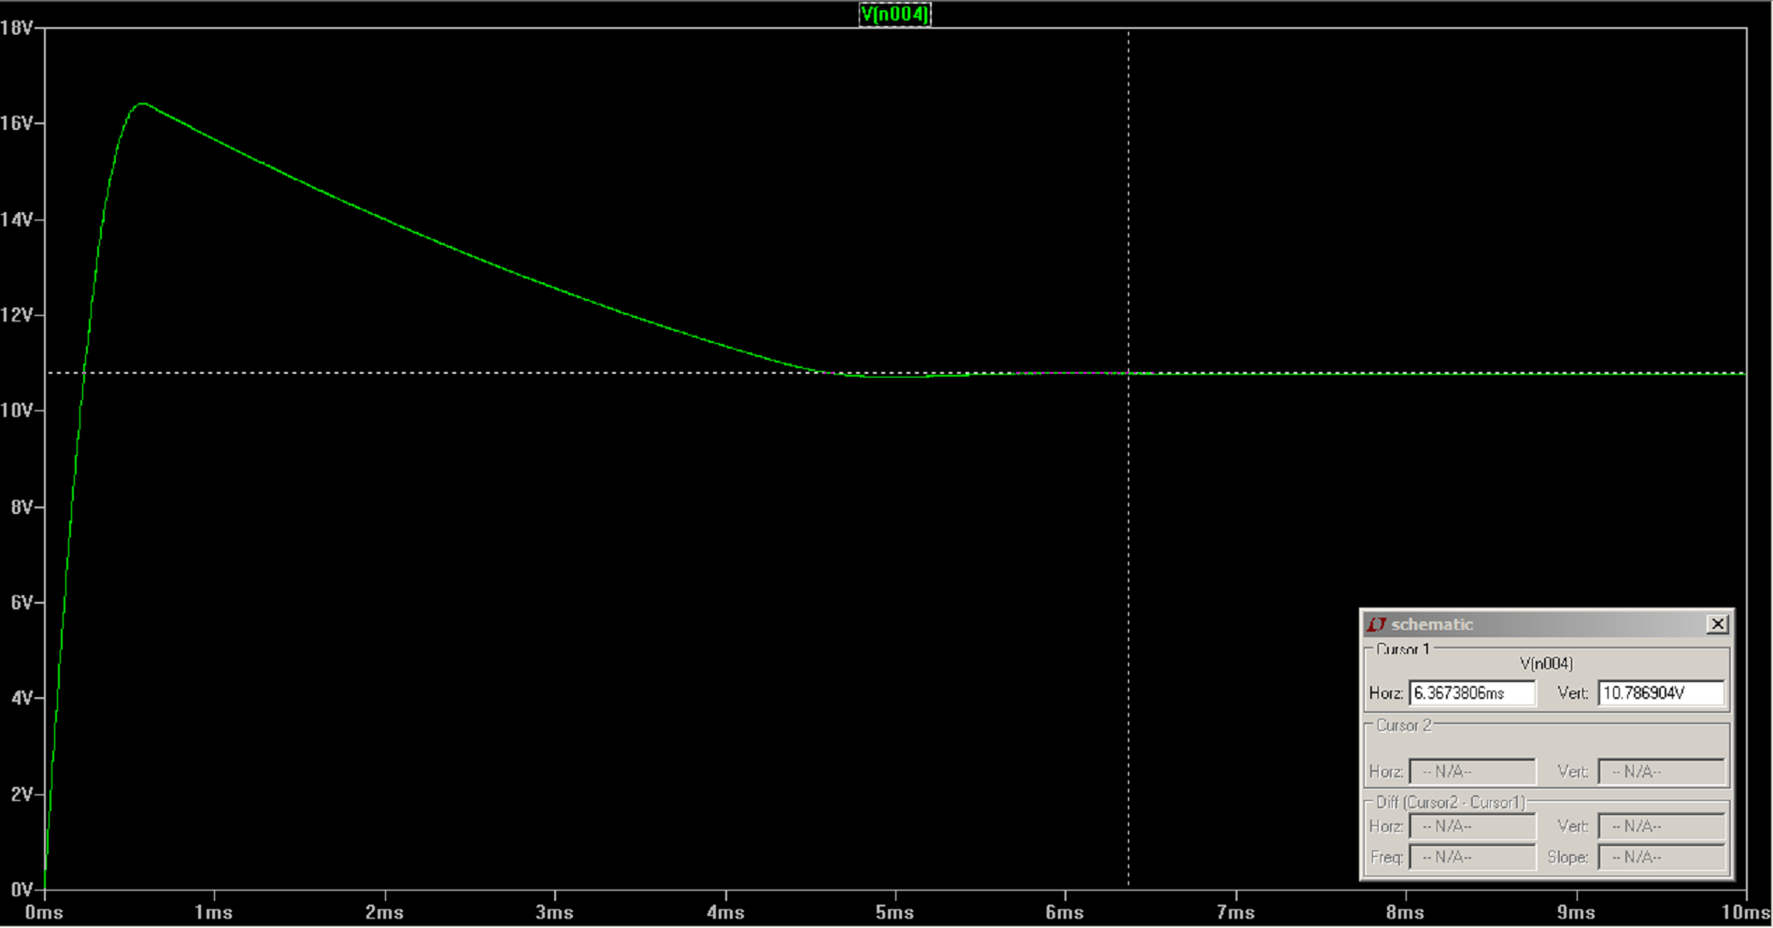

Slide 10
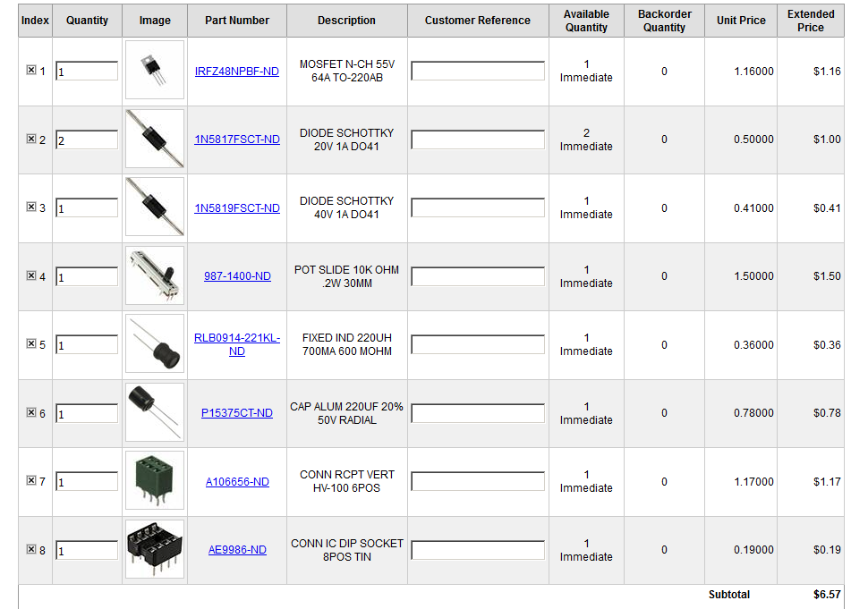
Digi-Key Shopping Cart

