Slide 1

A Novel Machine-Learning Approach for the Prediction of Disorder Proteins
Bi Zhao, Chengbin Hu, Yi Li, Yu Liang
11-29-2017

Slide 2
Overview
Background
Motivation
Datasets Preparation
Single Amino Acid Classifier
Whole Protein Classifier
Conclusion

Slide 3
Background
Many proteins or partial regions of proteins are lacking of stable and well-defined three-dimensional structures
These intrinsically disordered proteins (IDPs) or intrinsically disordered regions (IDRs) are critical for biological function and associated with many diseases.
Current predictors have the limitation to predict N- and C-terminal regions
As the increasing of the datasets, the accuracies of these predictors are challenged.

Slide 4
Motivation
Develop an optimal meta-strategy by applying Decision-tree based algorithm, Naive Bayes, Support Vector Machine, and Neural Network.
Find out the best strategy to improve the performance of disordered protein prediction.

Slide 5
Dataset Preparation
Disprot(Training)
http://www.disprot.org
PDB x-Ray(Testing)
http://www.rcsb.org/pdb/
PDB NMR(Testing)
http://www.rcsb.org/pdb/
Remove redundant by similarity 30%
Label the instances
Obtain the values of Attributes

Slide 6
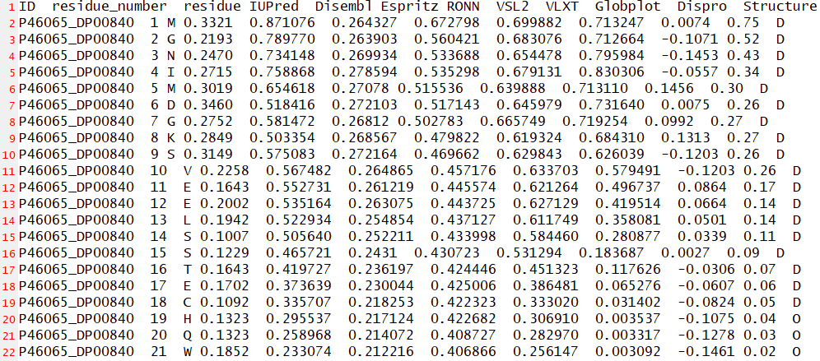
Dataset Preparation
IUPred, Disembl, Espritz, RONN, VSL2, VLXT, Globplot, and Dispro
These predictors are widely used in scientific research
These predictors have well-maintained software packages or webservers

Slide 7
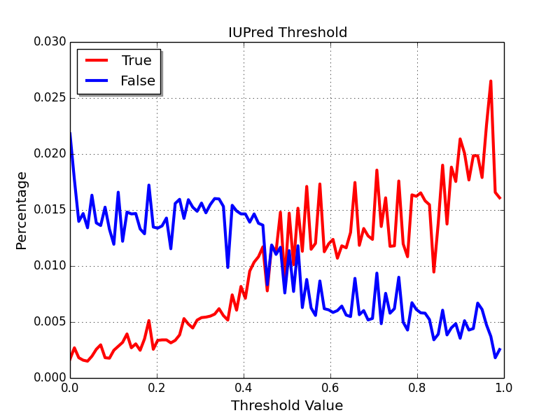
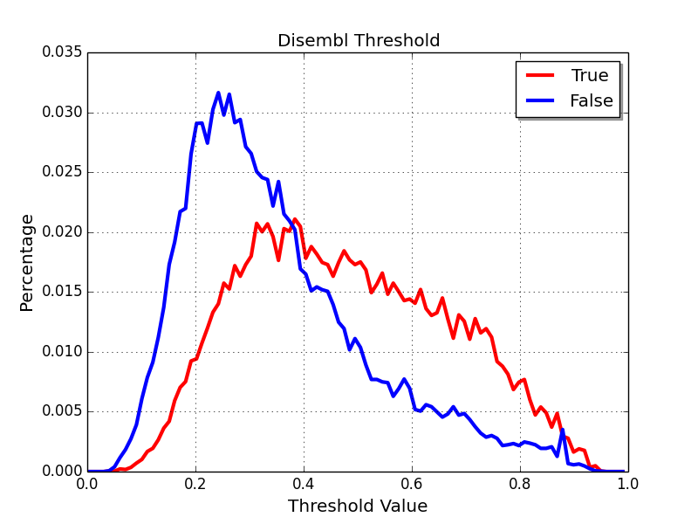
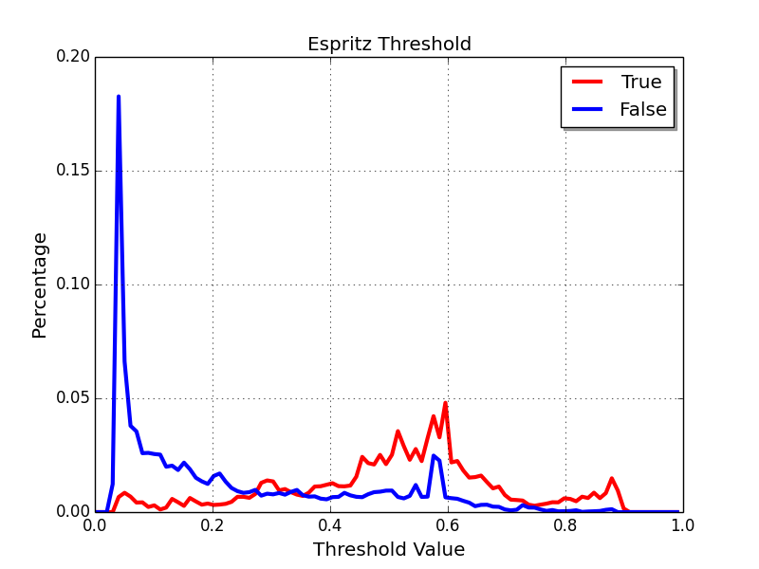
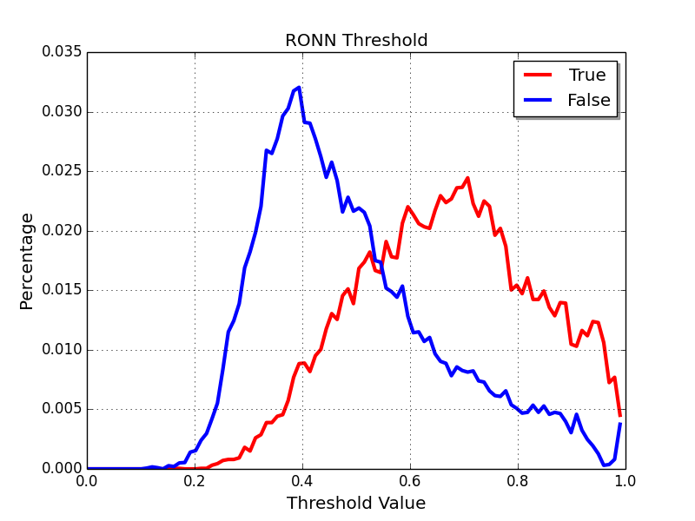
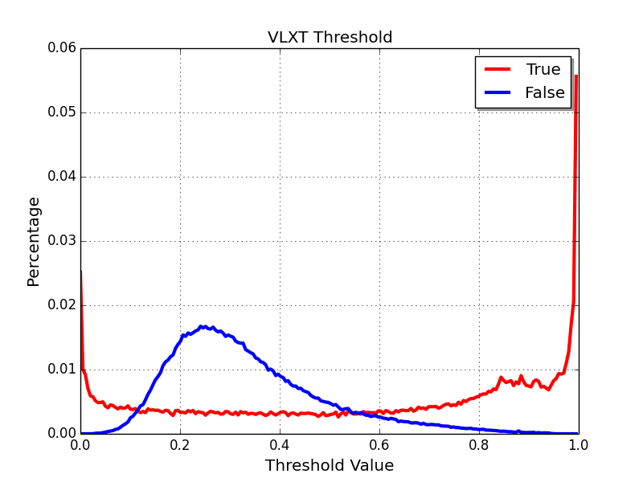
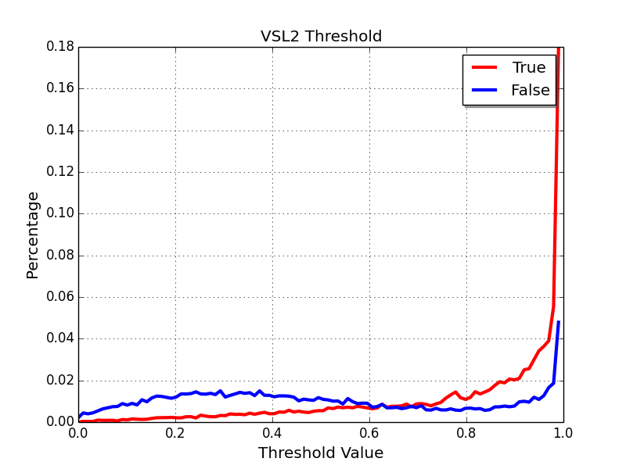
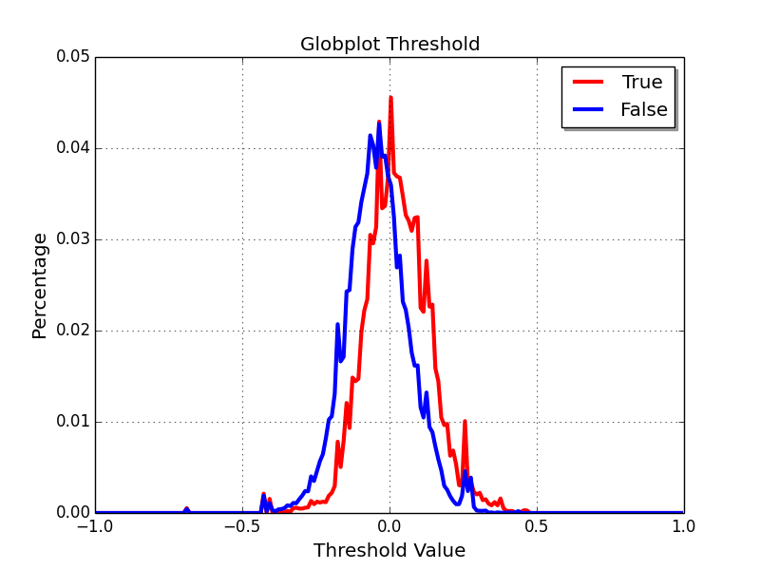
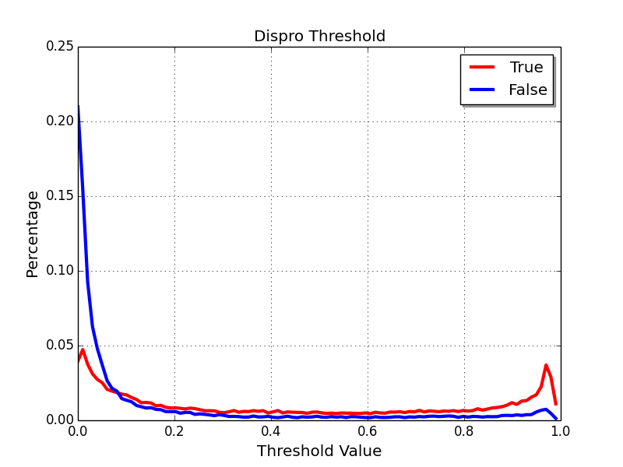
Dataset Preparation
Disorder | 92360
Structure | 316331
Total | 408691

Slide 8
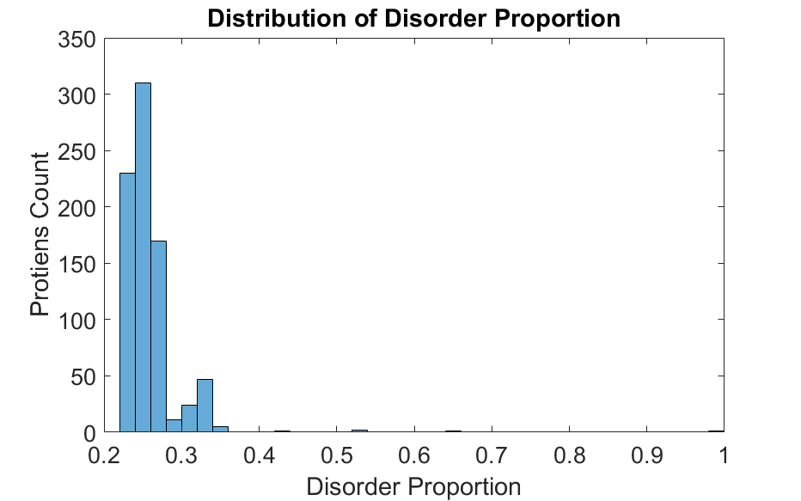
Dataset Preparation
802 Proteins
Average Disorder Proportion: 0.2583

Slide 9
Predictor | TP | FN | TN | FP | acc
Performance Individual Predictors
IUPred | 0.627 | 0.373 | 0.761 | 0.239 | 0.723
Disembl | 0.390 | 0.610 | 0.854 | 0.146 | 0.722
Espritz | 0.460 | 0.540 | 0.892 | 0.108 | 0.768
RONN | 0.747 | 0.253 | 0.644 | 0.356 | 0.673
VSL2 | 0.796 | 0.204 | 0.599 | 0.401 | 0.655
Globplot | 0.564 | 0.436 | 0.688 | 0.312 | 0.652
Dispro | 0.353 | 0.647 | 0.896 | 0.104 | 0.740
Performance Meta Predictors
PONDRFIT | 0.662 | 0.338 | 0.737 | 0.263 | 0.714
MFDp | 0.737 | 0.263 | 0.716 | 0.284 | 0.722
DisMeta | 0.629 | 0.371 | 0.771 | 0.229 | 0.736
Dataset Preparation

Slide 10
Single Amino Acid Classifiers
Decision tree-J48
Naive Bayes
Random Forest
Multilayer Preceptron(NN)

Slide 11
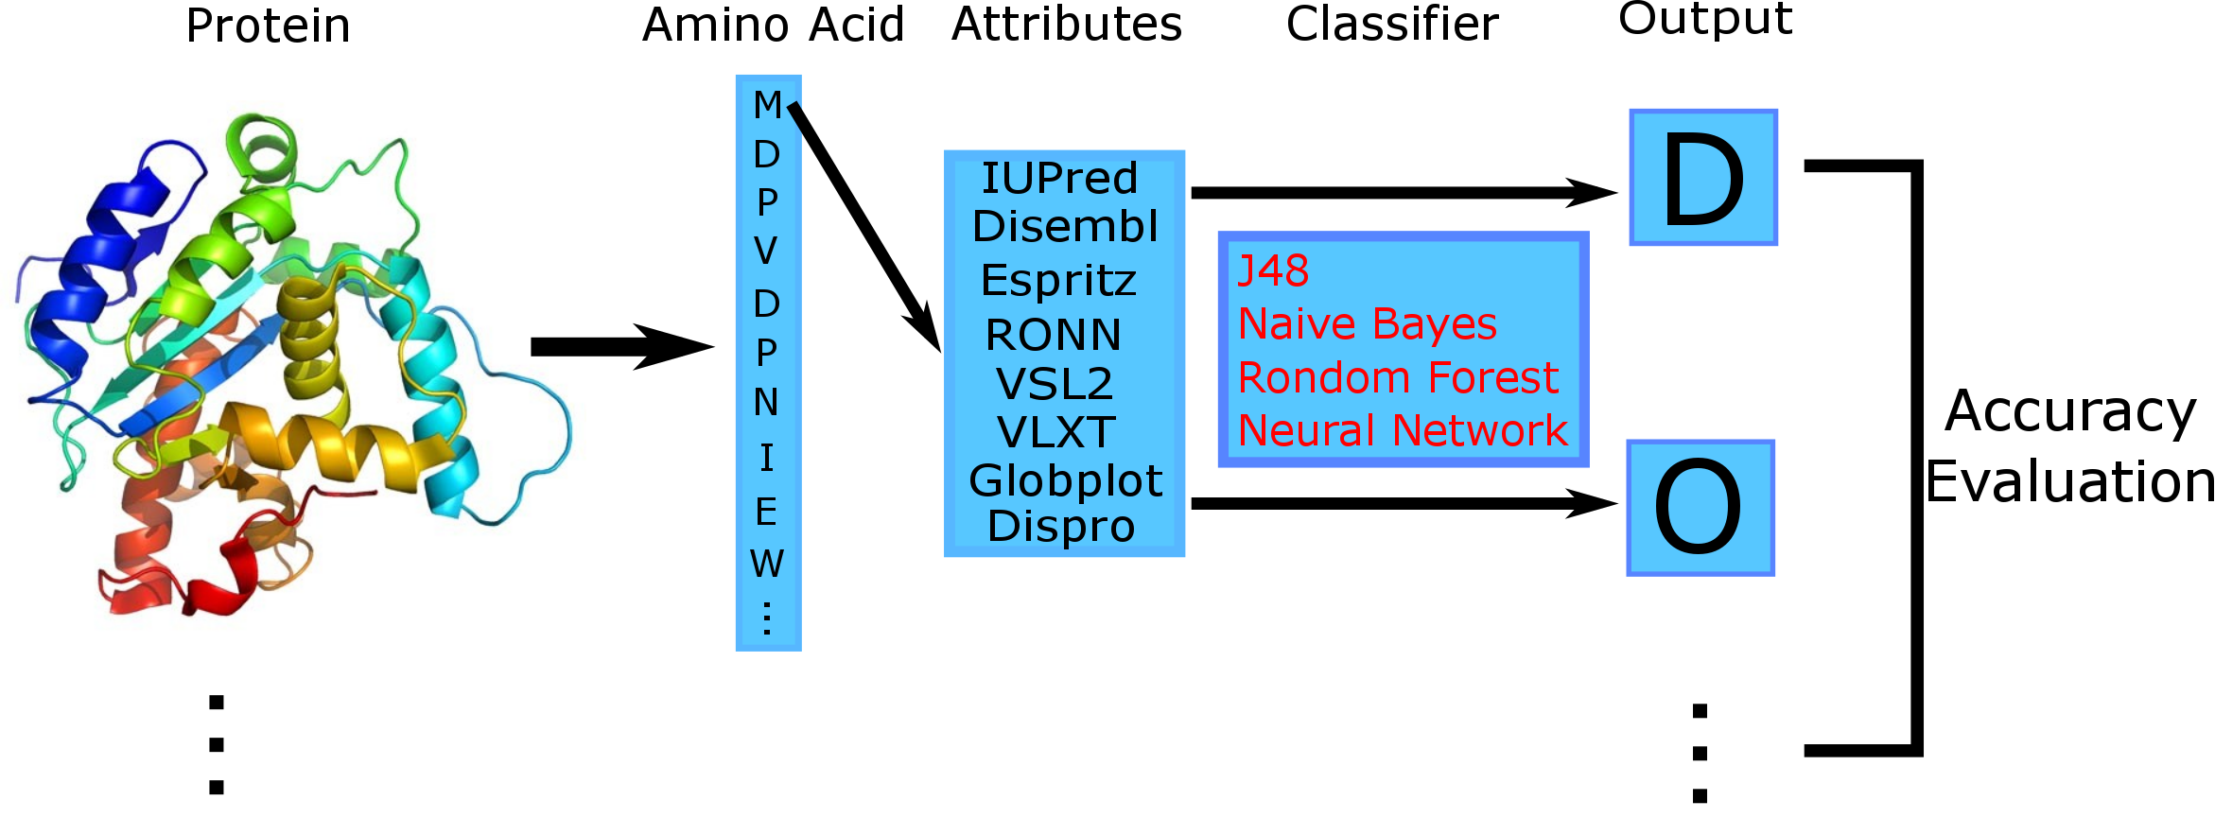
Workflow
or
10-fold Cross-validation
Instances: 408,691

Slide 12
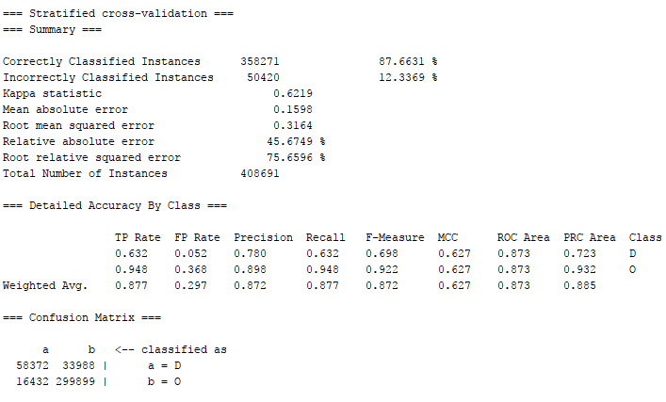
J48
Accuracy: 87.6631%
 | D | O
D | 58372 | 33988
O | 16432 | 299899
<---- Classified as

Slide 13
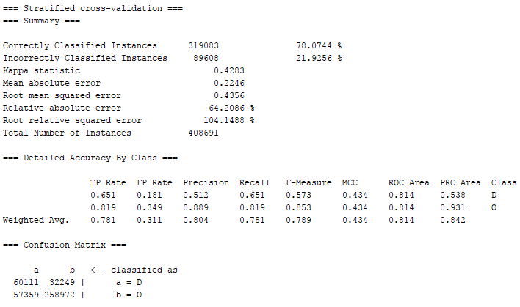
Naive Bayes
Accuracy: 78.0744%
 | D | O
D | 60111 | 32249
O | 57359 | 258972
<---- Classified as

Slide 14
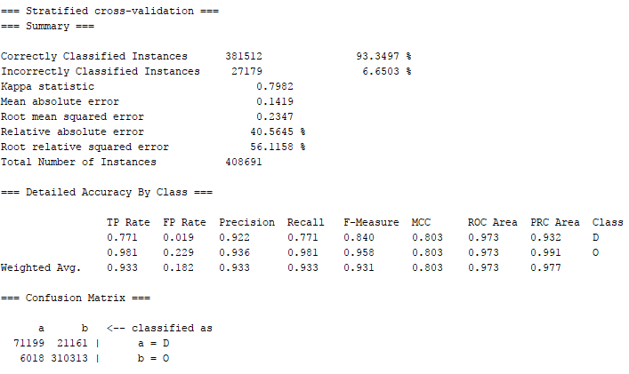
Random Forest
Accuracy: 93.3497%
 | D | O
D | 71199 | 21161
O | 6018 | 310313
<---- Classified as

Slide 15

Multilayer Preceptron
Accuracy: 82.1334%
 | D | O
D | 43698 | 48662
O | 24357 | 291974
<---- Classified as

Slide 16
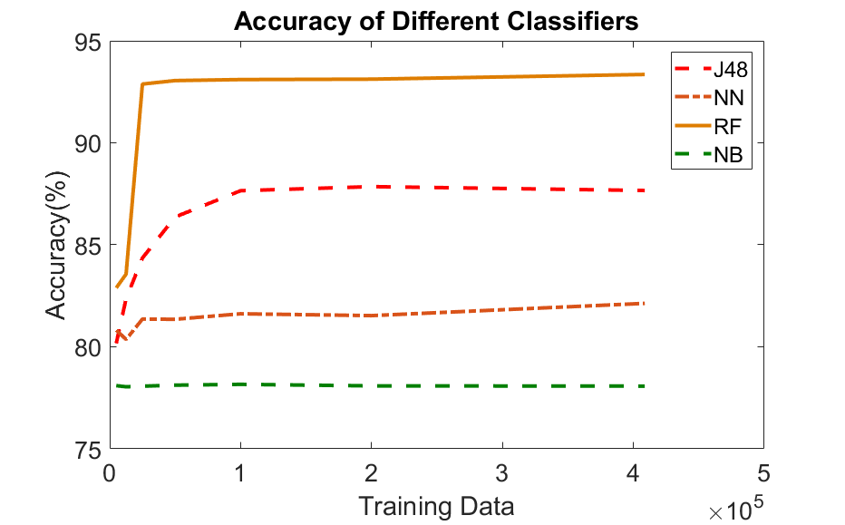

Slide 17
Results
Classifier | TP Rate | FP Rate | Precision | Recall | F-Measure | MCC | ROC Area | Accuracy
J48 | 0.877 | 0.297 | 0.872 | 0.877 | 0.872 | 0.627 | 0.873 | 87.67%
NB | 0.781 | 0.311 | 0.804 | 0.781 | 0.789 | 0.434 | 0.814 | 78.07%
RF | 0.933 | 0.182 | 0.933 | 0.933 | 0.931 | 0.803 | 0.973 | 93.35%
NN | 0.821 | 0.425 | 0.809 | 0.821 | 0.811 | 0.445 | 0.843 | 82.13%

Slide 18
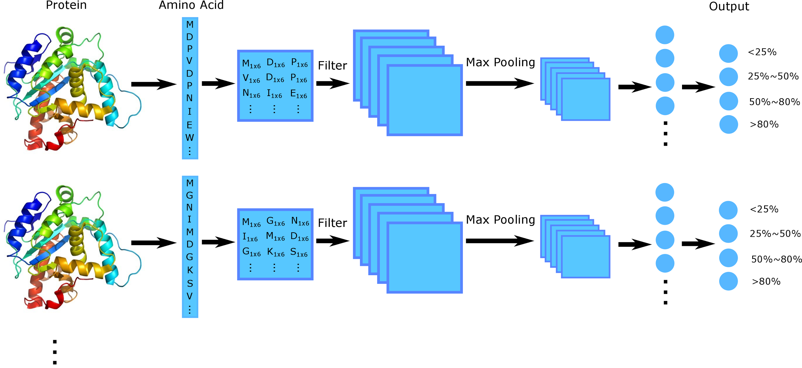
802 proteins

Slide 19
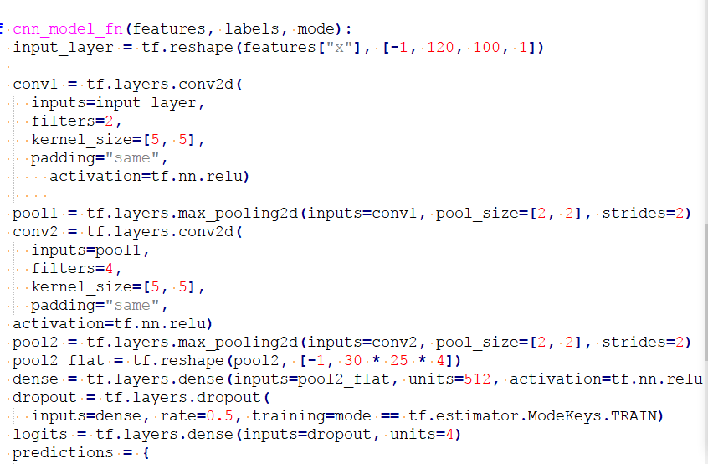
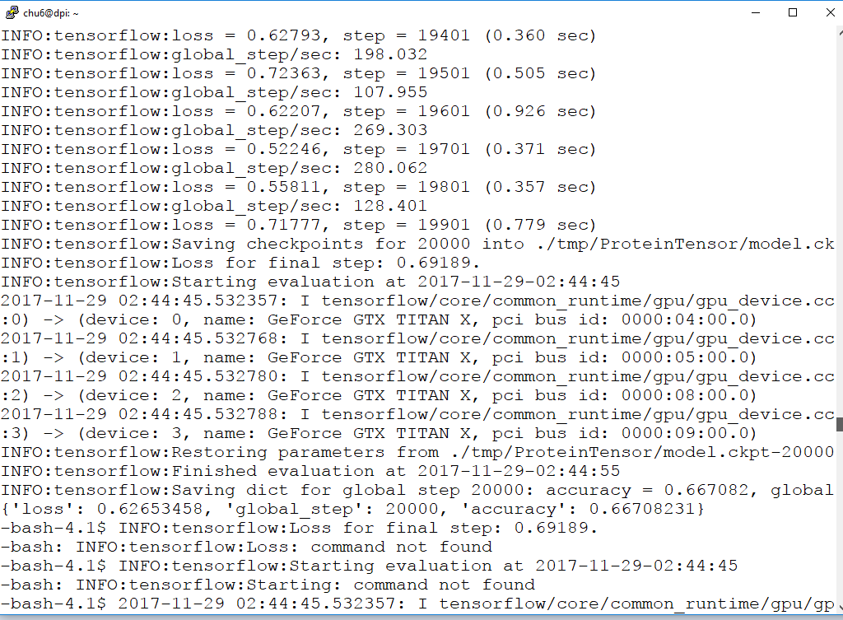
2 convolutional layer with 2 and 4 filters. 1 fully connected layer with 0.5 dropout.
Accuracy = 66.708%

Slide 20
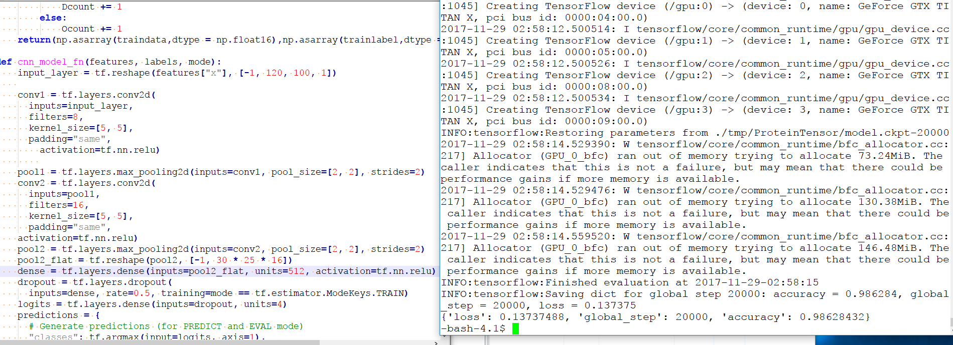
2 convolutional layer with 8 and 16 filters. 1 fully connected layer with 0.5 dropout.
Accuracy = 98.628%

Slide 21
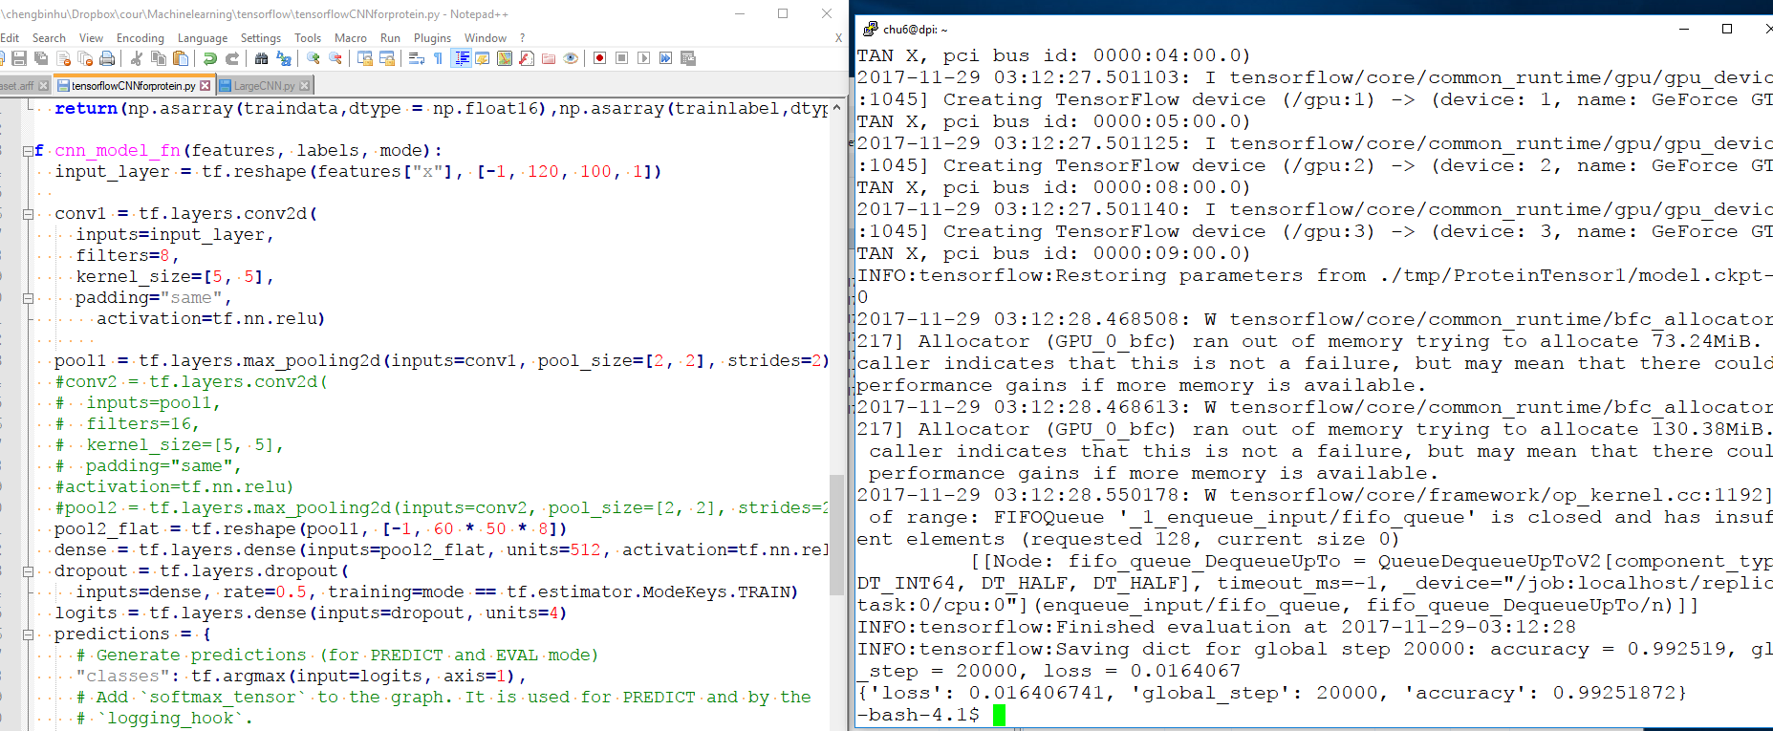
1 convolutional layer with 8 filters. 1 fully connected layer with 0.5 dropout.
Accuracy = 99.252%

Slide 22
Conclusions
The random forests shows highest accuracy for classifying single amino acid.
CNN works very well on protein classification. Currently, we got 99.252% accuracy on classifying proteins to four classes according to the ratio of disorder amino acids. (<25%, 25%~50%, 50~80%, >80%)

Slide 23
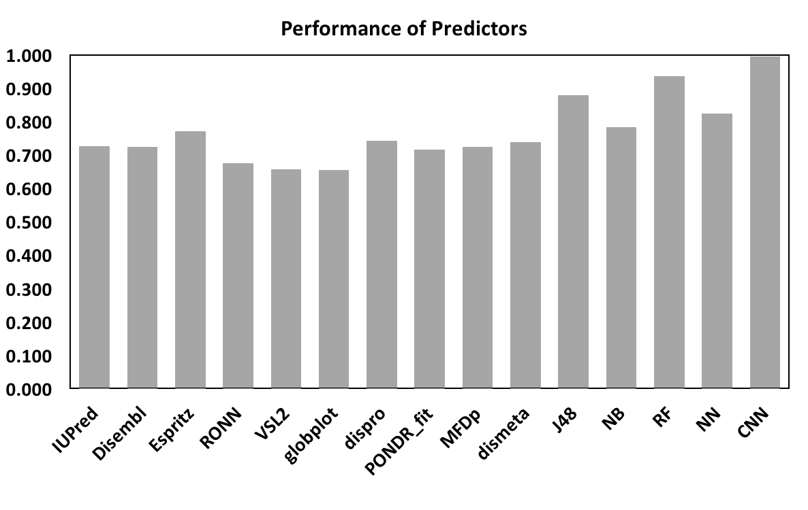
Comparison with Current Predictors

Slide 24
Work Cited
[1] Vladimir N Uversky, Joel R Gillespie, and Anthony L Fink. Why are “natively unfolded” proteins unstructured under physiologic conditions? Proteins: structure, function, and bioin- formatics, 41(3):415–427, 2000.
[2] Avner Schlessinger, Jinfeng Liu, and Burkhard Rost. Natively unstructured loops differ from other loops. PLoS computational biology, 3(7):e140, 2007.
[3] Jun-Feng Xia, Xing-Ming Zhao, and De-Shuang Huang. Predicting protein–protein interac- tions from protein sequences using meta predictor. Amino acids, 39(5):1595–1599, 2010.
[4] DRGHR Williams and Geoffrey Hinton. Learning representations by back-propagating errors. Nature, 323(6088):533–538, 1986.
[5] Corinna Cortes and V. Vapnik. Support-vector networks. Machine learning, 1995.
[6] Nitish Srivastava, Geoffrey E Hinton, Alex Krizhevsky, Ilya Sutskever, and Ruslan Salakhut- dinov. Dropout: a simple way to prevent neural networks from overfitting. Journal of Machine Learning Research, 15(1):1929–1958, 2014.
[7] Zheng Rong Yang, Rebecca Thomson, Philip McNeil, and Robert M Esnouf. Ronn: the bio- basis function neural network technique applied to the detection of natively disordered regions in proteins. Bioinformatics, 21(16):3369–3376, 2005.

Slide 25
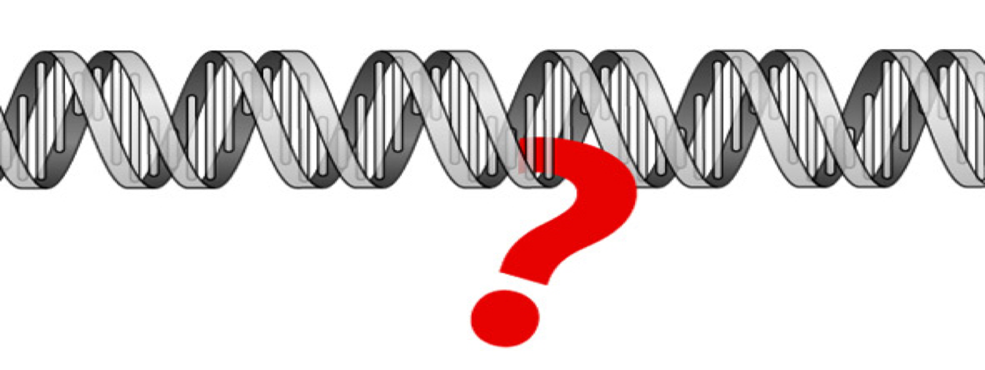
Thank You

