Slide 1
PowerShell: Function & Form
March 24th 2018
Ryan Coates
@ryandcoates
An introduction to PowerShell Toolmaking with Advanced Functions

Slide 2



About Ryan
Azure practice lead @ PCM
PowerShell nut
IT Infrastructure guy for over 20 years
Evangelist for DevOps in Operations
github.com/ryandcoates
@ryandcoates
linkedin.com/in/ryandcoates

Slide 3
Agenda
What is a function?
Functions in PowerShell
Controller Scripts
Modules

Slide 4
What is a function?
Hint: it’s just a tool to help you type less!

Slide 5
What is a function?
A function is just a reusable block of code
Functions exist in a number of programming languages
Functions are roughly equivalent to subroutines

Slide 6
Functions in PowerShell
function do-thing { $thing }

Slide 7
Functions in PowerShell
Functions are easy to define
Wrap your code in function <name> {}
Functions can be loaded from ps1. files via dot sourcing
. ./myfunctioninafile.ps1
Or interactively via the ISE
Functions appear in the function store at function:
Get-ChildItem function:

Slide 8
[Demo] Your First Function

Slide 9
Controller Scripts
Make life easy, by asking questions

Slide 10
Controller Scripts
If functions are written to be flexible, reusable pieces of code often from the perspective of a headless automation engine, Controller scripts are used to operate them more interactively, from a human perspective
Imagine running this
New-AzureRmVm `
-ResourceGroupName "myResourceGroup" `
-Name "myVM" `
-Location "East US" `
-VirtualNetworkName "myVnet" `
-SubnetName "mySubnet" `
-SecurityGroupName "myNetworkSecurityGroup" `
-PublicIpAddressName "myPublicIpAddress" `
-OpenPorts 80,3389

Slide 11
Controller Scripts
Verses this
New-CustomAzureRmVm
And being asked a number of interactive questions at runtime
Please provide a Server name: TestServer01
Please provide a Resource Group name: TestRG
..Building your new VM TestRG\TestServer01

Slide 12
Controller Scripts
Controller scripts build on the enhancements of AdvancedFunctions and the [Parameter()] block by allowing complex data validation, hygiene and computation tasks to occur prior to running the function proper

Slide 13
[DEMO] Reusable Tooling

Slide 14
Modules
Like zip files for Functions

Slide 15
Would you like to know more?
Service guarantees citizenship!

Slide 16
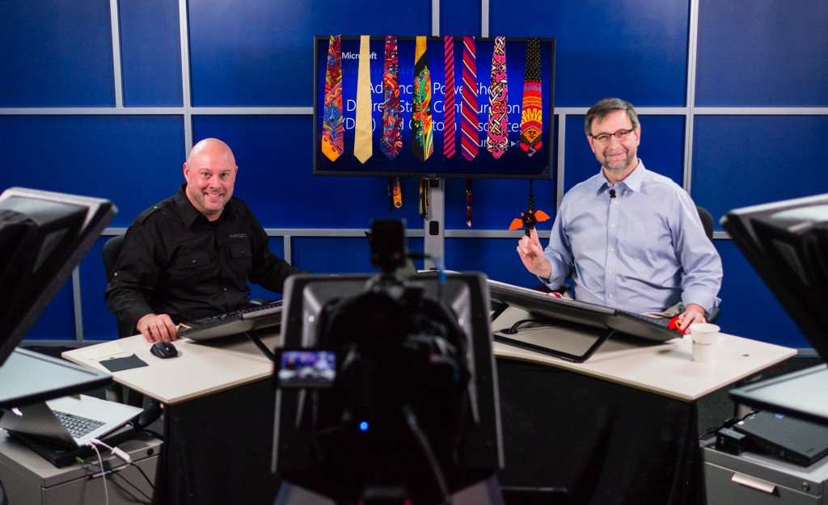
Advanced Tools & Scripting with PowerShell
https://goo.gl/XwMvgz

Slide 17
Advanced Tools & Scripting with PowerShell
https://goo.gl/XwMvgz

Slide 18
Questions & Discussion

