Slide 1
PowerShell: Function & Form
March 23rd 2019
Ryan Coates
@ryandcoates
An introduction to PowerShell Toolmaking with Advanced Functions

Slide 2
Agenda
What is a function?
Functions in PowerShell
Controller Scripts
Modules

Slide 3
What is a function?
Hint: it’s just a tool to help you type less!

Slide 4
What is a function?
A function is just a reusable block of code
Functions exist in a number of programming languages
Functions are roughly equivalent to subroutines

Slide 5
Functions in PowerShell
function do-thing { $thing }

Slide 6
Functions in PowerShell
Functions are easy to define
Wrap your code in function <name> {}
Functions can be loaded from ps1. files via dot sourcing
. ./myfunctioninafile.ps1
Or interactively via the ISE
Functions appear in the function store at function:
Get-ChildItem function:

Slide 7
[Demo] Your First Function

Slide 8
Controller Scripts
Make life easy, by asking questions

Slide 9
Controller Scripts
If functions are written to be flexible, reusable pieces of code often from the perspective of a headless automation engine, Controller scripts are used to operate them more interactively, from a human perspective
Imagine running this
New-AzureRmVm `
-ResourceGroupName "myResourceGroup" `
-Name "myVM" `
-Location "East US" `
-VirtualNetworkName "myVnet" `
-SubnetName "mySubnet" `
-SecurityGroupName "myNetworkSecurityGroup" `
-PublicIpAddressName "myPublicIpAddress" `
-OpenPorts 80,3389

Slide 10
Controller Scripts
Verses this
New-CustomAzureRmVm
And being asked a number of interactive questions at runtime
Please provide a Server name: TestServer01
Please provide a Resource Group name: TestRG
..Building your new VM TestRG\TestServer01

Slide 11
Controller Scripts
Controller scripts build on the enhancements of AdvancedFunctions and the [Parameter()] block by allowing complex data validation, hygiene and computation tasks to occur prior to running the function proper

Slide 12
[DEMO] Reusable Tooling

Slide 13
Modules
Like zip files for Functions

Slide 14
Would you like to know more?
Service guarantees citizenship!

Slide 15

Advanced Tools & Scripting with PowerShell
https://goo.gl/XwMvgz

Slide 16
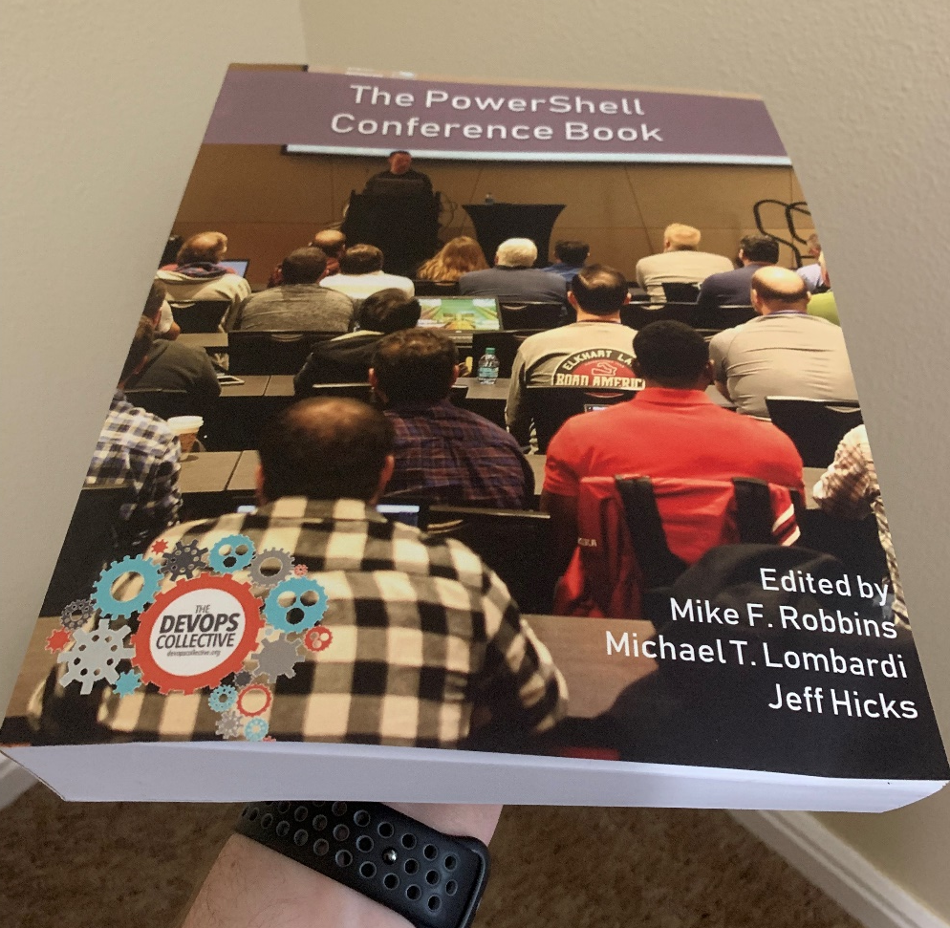
Giveaway!
As penance for not contributing to the PowerShell Conference book, last year I agreed to give away a copy a month for 12 months.
This is the March giveaway ☺
The PowerShell Conference book is a community effort from over 30 community members and sits at almost 600 pages
Available as an eBook from LeanPub: https://leanpub.com/powershell-conference-book
Or from Amazon in dead tree format: https://www.amazon.com/PowerShell-Conference-Book-Books/dp/1720169977
Fill in your feedback form for a chance to win.

Slide 17



About Ryan | Questions & Discussion
Senior Azure Architect @ Global financial services company
PowerShell nut
IT Infrastructure guy for over 20 years
Evangelist for DevOps in Operations
github.com/ryandcoates
@ryandcoates
linkedin.com/in/ryandcoates

