Slide 1
Building and Publishing Reusable PowerShell Tools
Jeff Brown
Bsky: @jeffbrowntech
1 / 15

Slide 2
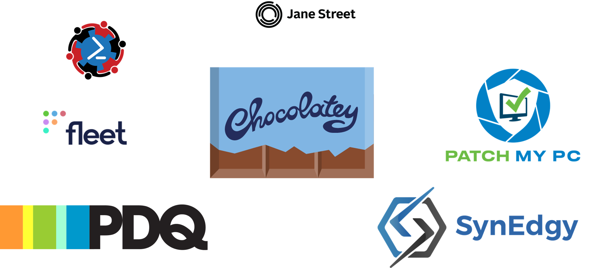

Slide 3
Jeff Brown
19 years experience from Systems Administrator to DevOps Engineer
Started with VBScript
Moved to PowerShell for managing Lync & Exchange Servers
Social
LinkedIn: https://linkedin.com/in/jeffbrowntech
BlueSky: @JeffBrownTech
Blog: https://jeffbrown.tech
YouTube: Jeff Brown Tech

Slide 4
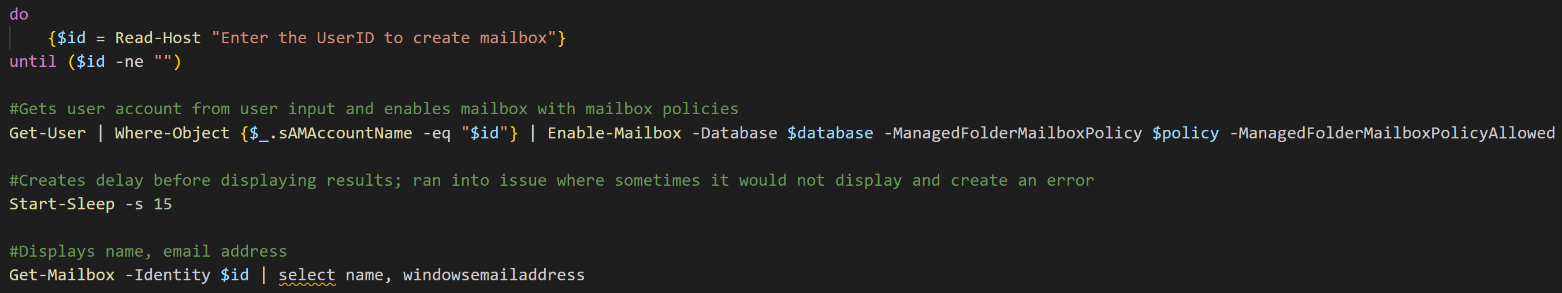
PowerShell Beginnings

Slide 5
Agenda
Identify the problem
Create a tool to solve the problem
Make the tool better
Group multiple tools into a module
Publish the module to help others
Automate the whole thing
PowerAzPlus Module

Slide 6
The PowerShell Journey
You Are Here?
Completing a task using command line
Make process repeatable using a script
Create your own tools with functions
Put functions together in a module
Publishing a module

Slide 7
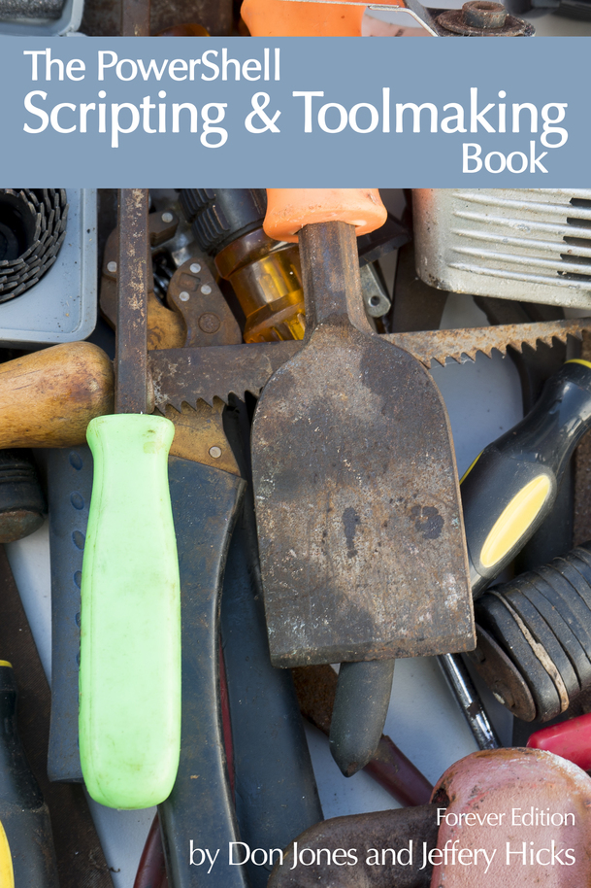
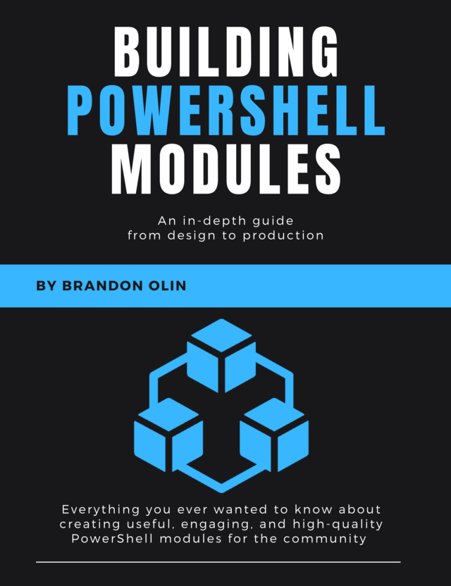
Learn More

Slide 8
Sessions
Everything On-Prem: From Git to Gallery with Open Source Emrys MacInally
From Script to Tool: Building Robust, Meaningful Tools with PowerShell Matt McElreath
Mastering PowerShell Parameters: Advanced Techniques and Best Practices Jeff Hicks
Take your PowerShell to the next level with error handling and debugging Matt McElreath
Publish PowerShell help content using PlatyPS v1.0 Sean Wheeler, Stephen Valdinger

Slide 9
THANK YOU
Feedback is a gift
Please review this session
via the mobile App

