Slide 2
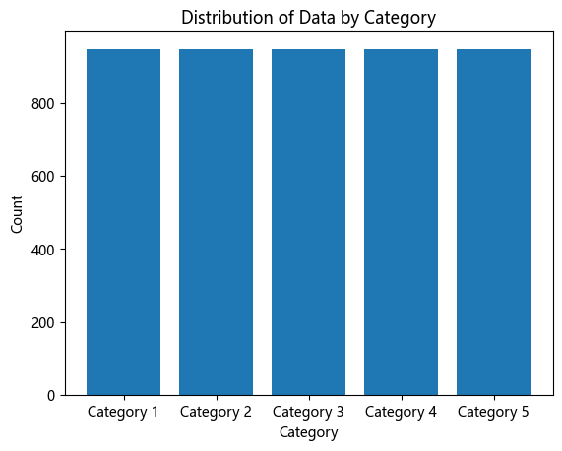
預測值轉換
將預測欄位根據數據量等分成五等距，數量如表，每級距數量為948~949。
category | 最小值 | 最大值 | 數量
Category 1 | 0 | 3.25476 | 949
Category 2 | 3.295444 | 85.3288 | 948
Category 3 | 85.48633 | 313.4337 | 948
Category 4 | 313.6411 | 861.542 | 948
Category 5 | 861.6216 | 14379.52 | 949

Slide 3
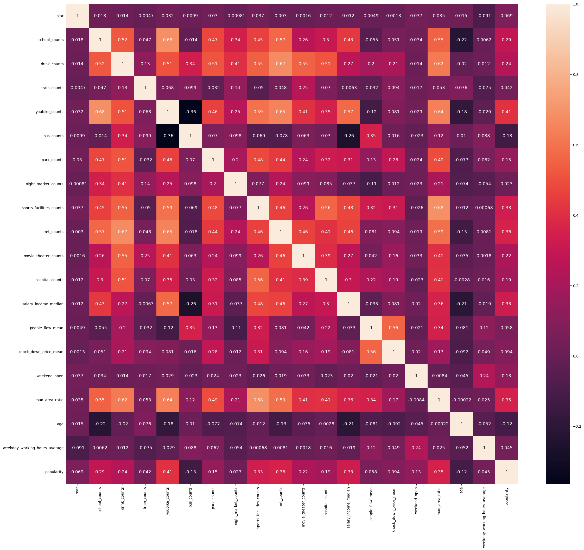
熱力圖

Slide 4
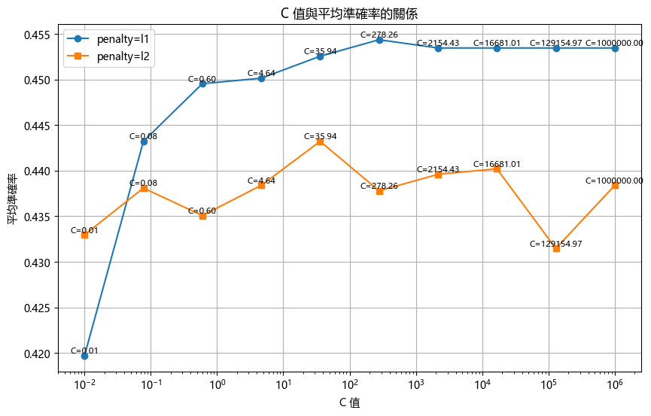
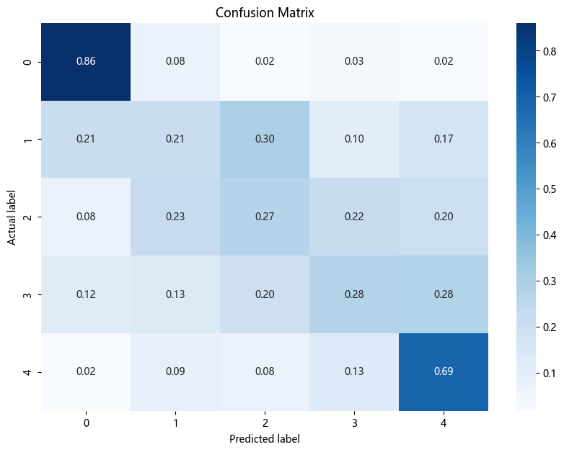
LogisticRegression
交叉驗證結果，平均準確率: 0.39
超參數調整(Hyperparameter tuning)
超參數調整如表
最佳參數為：
C: 278.25
penalty: L1
預測準確率: 0.47
超參數調整後模型交叉預測平均準確率: 0.45
Notes:
當 C 的值增大，表示正則化強度減小，模型將更傾向於擬合訓練資料，增加模型的複雜度。
當 C 的值減小，表示正則化強度增加，可以減少模型的複雜度，有助於防止過擬合，使模型對未見過的資料具有更好的泛化能力。

Slide 5
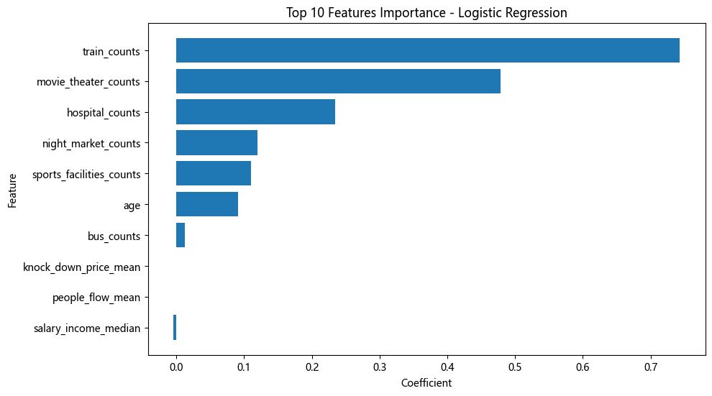
LogisticRegression 變數重要性
 | Feature | Coefficient
3 | train_counts | 0.743272
10 | movie_theater_counts | 0.478435
11 | hospital_counts | 0.234261
7 | night_market_counts | 0.119488
8 | sports_facilities_counts | 0.110515
17 | age | 0.091454
5 | bus_counts | 0.012343
14 | knock_down_price_mean | -0.000033
13 | people_flow_mean | -0.000165
12 | salary_income_median | -0.004689
2 | drink_counts | -0.017495
4 | youbike_counts | -0.032587
6 | park_counts | -0.052289
1 | school_counts | -0.08239
18 | weekday_working_hours_average | -0.110884
15 | weekend_open | -0.470156
9 | mrt_counts | -0.680448
0 | star | -1.43428
16 | road_area_ratio | -8.091701
由 LogisticRegression 結果可得出，重要性前的三名為
movie_theater_countstrain_counts
movie_theater_counts
hospital_counts
由此可表示，在考慮開店地點合適時需要優先考慮周遭火車站數量、電影院數量、醫院數量

Slide 6
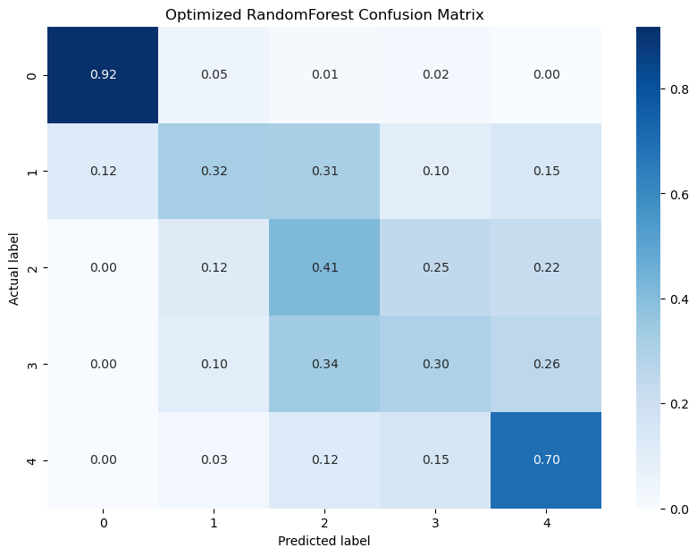
RandomForest
'n_estimators'：您希望測試的決策樹數量。
'max_depth'：每棵決策樹的最大深度。如果為 None，則表示沒有限制。
'min_samples_split'：內部節點分裂所需的最小樣本數。
'min_samples_leaf'：葉節點所需的最小樣本數。
'max_features'：在尋找最佳分割時要考慮的特徵數量。
交叉驗證結果，平均準確率: 0.48
超參數調整(Hyperparameter tuning)
最佳參數：
GridSearchCV: {'max_depth': 10,
'max_features': 'sqrt',
'min_samples_leaf': 8,
'min_samples_split': 2,
'n_estimators': 400}
最佳參數的混淆矩陣如右
平均準確率: 0.51

Slide 7
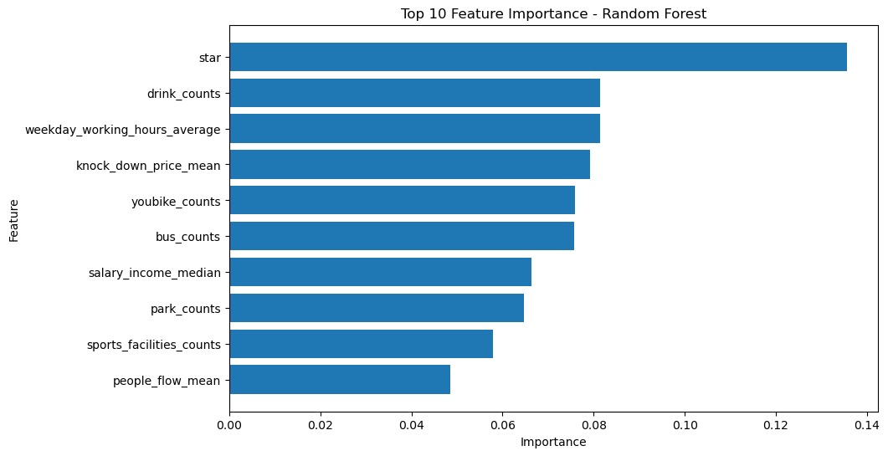
RandomForest
 | Feature | Importance
0 | star | 0.135583
2 | drink_counts | 0.08139
18 | weekday_working_hours_average | 0.081331
14 | knock_down_price_mean | 0.079199
4 | youbike_counts | 0.075875
5 | bus_counts | 0.075747
12 | salary_income_median | 0.066292
6 | park_counts | 0.064691
8 | sports_facilities_counts | 0.05797
13 | people_flow_mean | 0.048618
1 | school_counts | 0.045446
9 | mrt_counts | 0.043394
16 | road_area_ratio | 0.042576
15 | weekend_open | 0.03063
11 | hospital_counts | 0.019544
10 | movie_theater_counts | 0.017272
17 | age | 0.016682
7 | night_market_counts | 0.012795
3 | train_counts | 0.004966

Slide 8
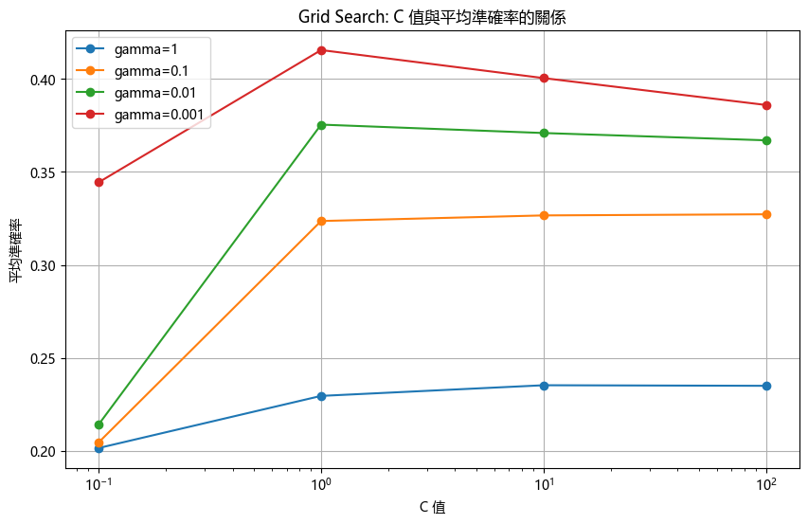
SVM
交叉驗證結果：平均準確率: 0.35
超參數調整(Hyperparameter tuning)
最佳參數 (Grid Search CV): {'C': 1, 'gamma': 0.001}
最佳準確率 (Grid Search CV): 0.4154895600501553

Slide 9
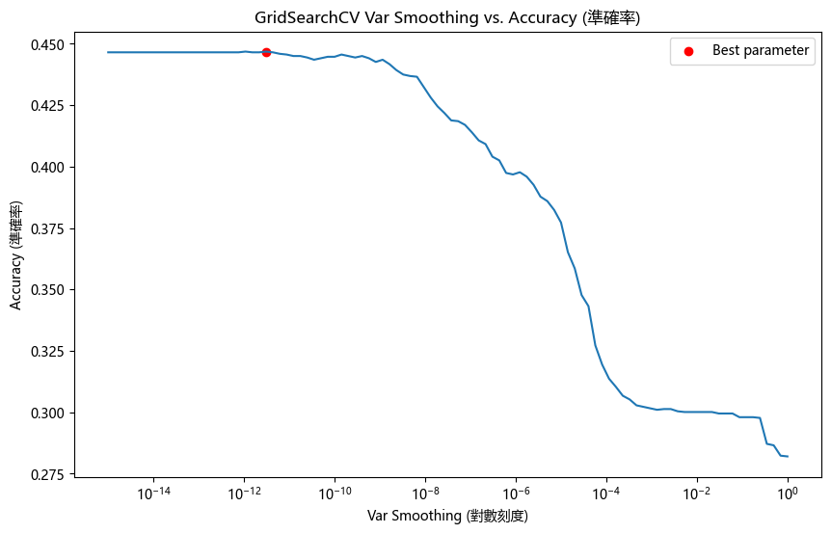
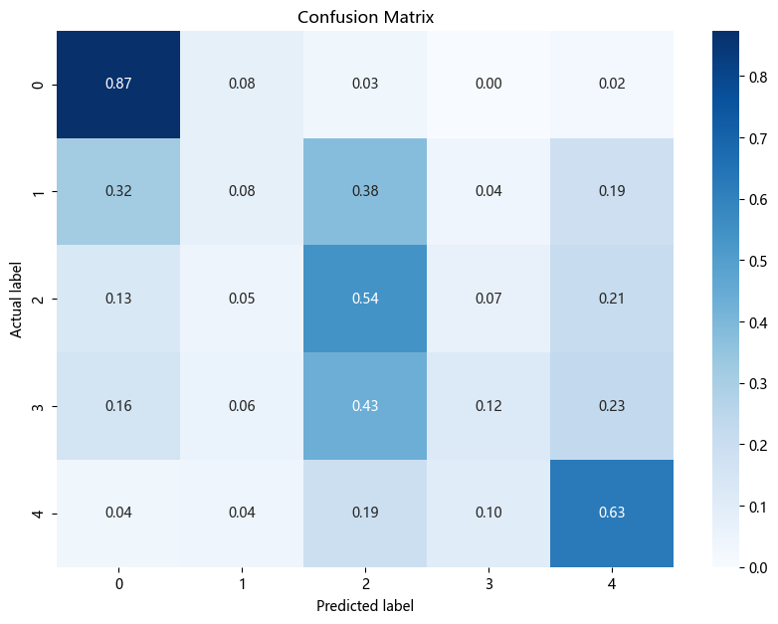
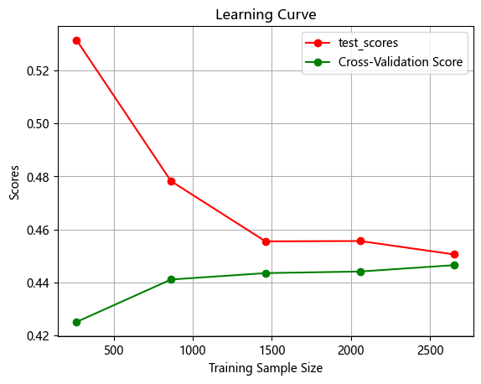
高斯貝式分類器 GaussianNB
平均準確率: 0.44290
最佳參數：'var_smoothing': 3.0538555088334124e-12
平均準確率: 0.446824
訓練和測試分數的差異百分比0.89%

Slide 10
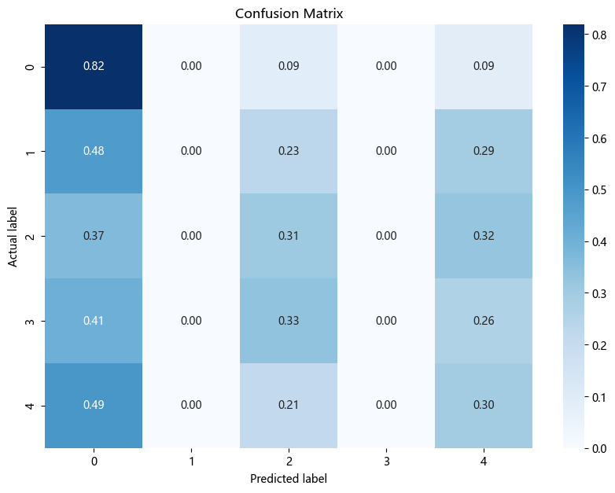
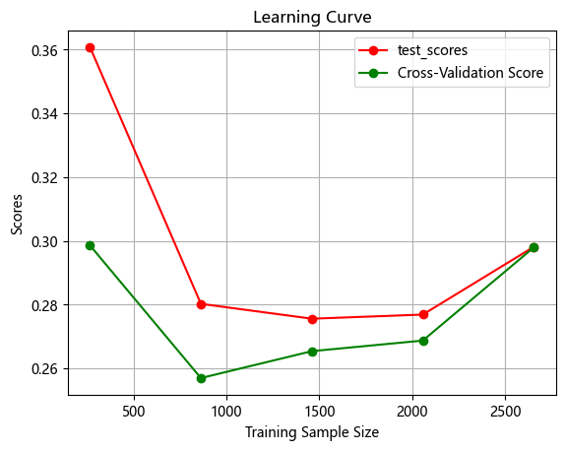
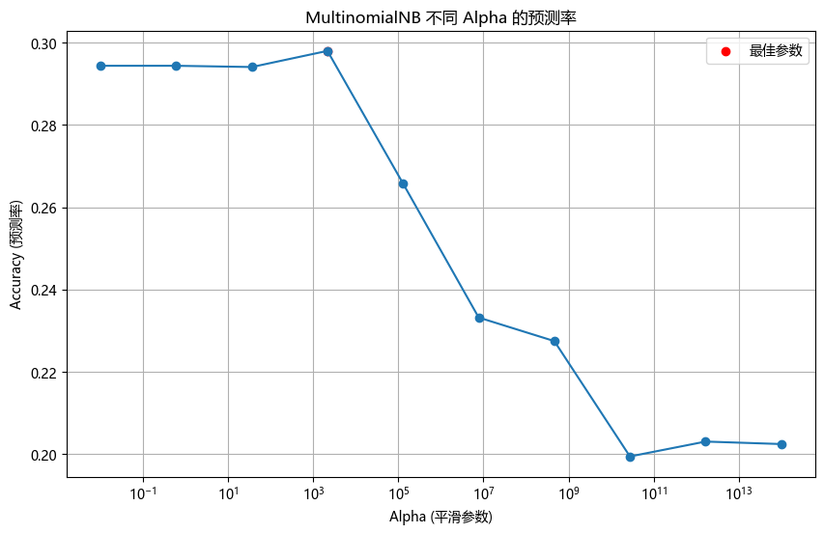
多項式貝氏分類器 MultinomialNB
平均準確率: 0.294367
Best parameters: {'alpha': 2154.4346900318824} Best cross-validation score: 0.29798424467099166
平均準確率: 0.29798424467099166
訓練和測試分數的差異百分比0.06%
利用最佳參數來做

Slide 11
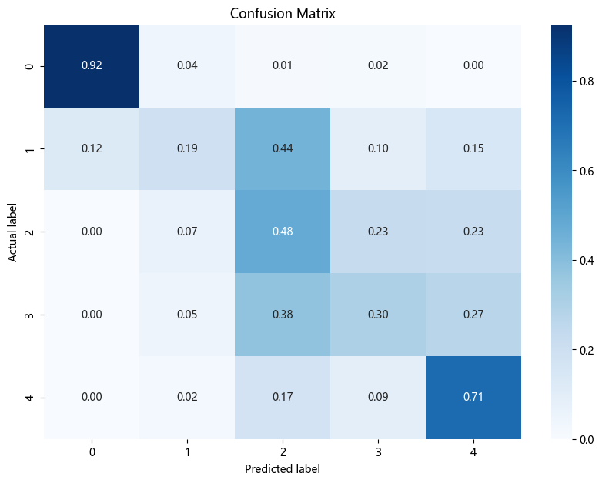
XGBOOST
平均準確率: 0.33317149297728454
參數調整(Parameter Tuning)
找到的最佳參數: {'colsample_bytree': 1, 'learning_rate': 0.01, 'max_depth': 4, 'n_estimators': 200, 'objective': 'multi:softmax', 'subsample': 0.8}
最佳模型準確率: 0.5298664792691496

Slide 12
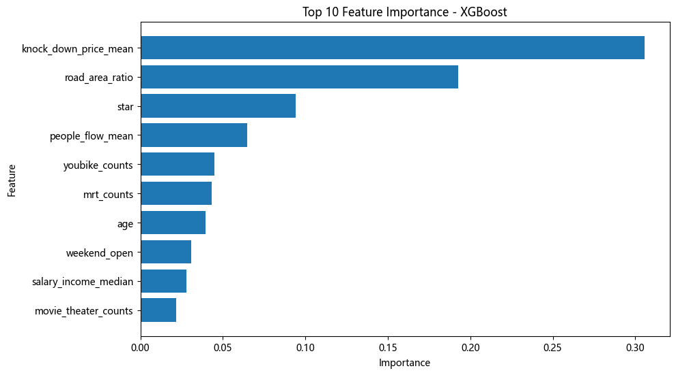
XGBOOST
 | Feature | Importance
14 | knock_down_price_mean | 0.305537
16 | road_area_ratio | 0.192518
0 | star | 0.094009
13 | people_flow_mean | 0.064875
4 | youbike_counts | 0.044751
9 | mrt_counts | 0.043032
17 | age | 0.03933
15 | weekend_open | 0.030636
12 | salary_income_median | 0.027679
10 | movie_theater_counts | 0.021787
5 | bus_counts | 0.019797
18 | weekday_working_hours_average | 0.019186
11 | hospital_counts | 0.017673
8 | sports_facilities_counts | 0.017552
6 | park_counts | 0.016657
2 | drink_counts | 0.016189
7 | night_market_counts | 0.010528
1 | school_counts | 0.009891
3 | train_counts | 0.008375

Slide 13
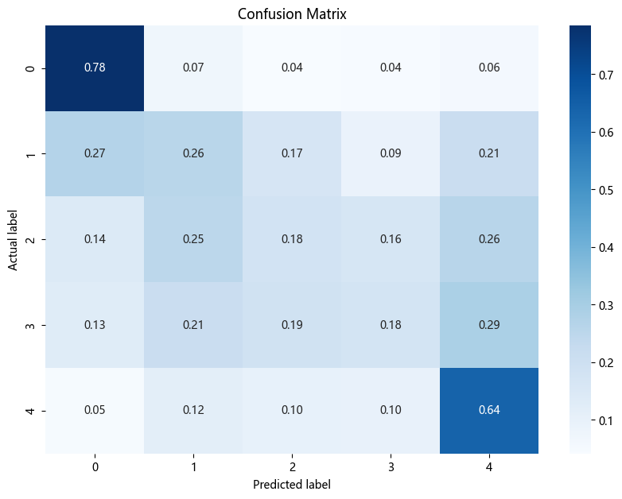
AdaBoost
Accuracy (準確率): 0.4701335207308503
最價參數
learning_rate': 1, 'n_estimators': 97
平均準確率: 0.3968

Slide 14
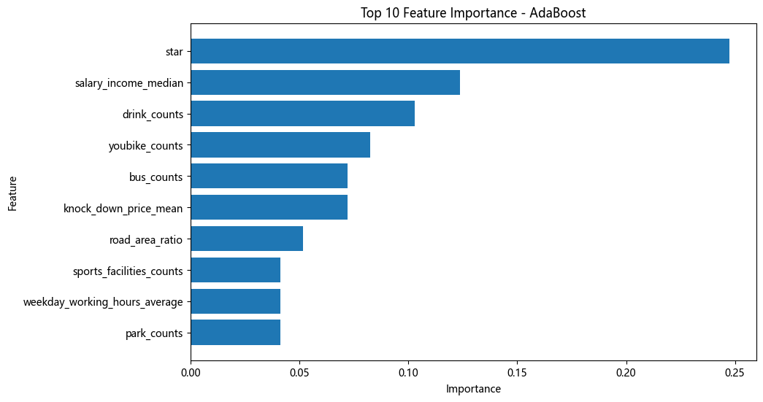
AdaBoost
 | Feature | Importance
0 | star | 0.247423
12 | salary_income_median | 0.123711
2 | drink_counts | 0.103093
4 | youbike_counts | 0.082474
5 | bus_counts | 0.072165
14 | knock_down_price_mean | 0.072165
16 | road_area_ratio | 0.051546
8 | sports_facilities_counts | 0.041237
18 | weekday_working_hours_average | 0.041237
6 | park_counts | 0.041237
10 | movie_theater_counts | 0.020619
11 | hospital_counts | 0.020619
13 | people_flow_mean | 0.020619
17 | age | 0.020619
1 | school_counts | 0.010309
7 | night_market_counts | 0.010309
15 | weekend_open | 0.010309
9 | mrt_counts | 0.010309
3 | train_counts | 0

Slide 15
集呈式學習

Slide 16
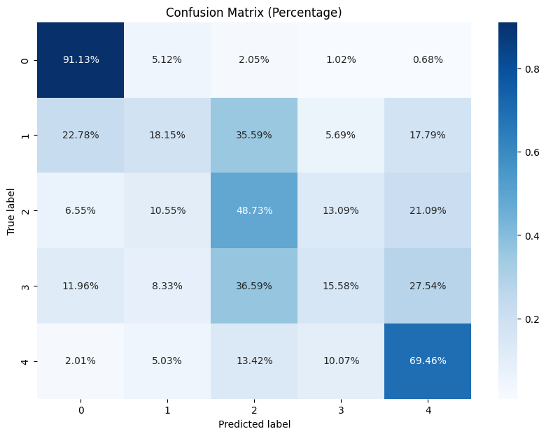
voting
平均準確率：0.4293406783956463

Slide 17
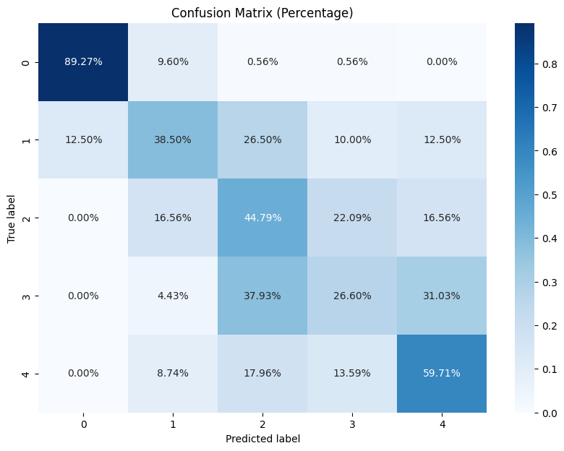
stacking
Average score: 0.51280

