Slide 1

Green Pace
Security Policy Presentation
Developer: Ryan DeBraal
Notes:
INTRODUCTION
Hello, my name is Ryan DeBraal.
I’m presenting our brand-new security policy.

Slide 2

OVERVIEW: DEFENSE IN DEPTH
External threats are evolving so we must evolve faster.
Notes:
OVERVIEW: DEFENSE IN DEPTH
Secure coding is at the heart of all the development.
Important to stay in sync with each other
Today we will review our principles and best practices.
Defense in depth requires many layers of redundant protection.

Slide 3
THREATS MATRIX
Likely STD-002-CPP STD-004-CPP STD-005-CPP STD-007-CPP STD-010-CPP | Priority STD-002-CPP STD-003-CPP STD-004-CPP STD-005-CPP
Low priority STD-001-CPP STD-006-CPP STD-007-CPP STD-008-CPP STD-009-CPP STD-010-CPP | Unlikely STD-001-CPP STD-003-CPP STD-006-CPP STD-008-CPP STD-009-CPP
Notes:
THREATS MATRIX
Cross section of standards.
Mix between priorities and likelihood.
A threat analysis should be done to prioritize High Priority and Likely threats.

Slide 4
10 PRINCIPLES
1. Validate Input Data
2. Heed Compiler Warnings
3. Architect and Design for Security Policies
4. Keep It Simple
5. Default Deny
6. Adhere to the Principle of Least Privilege
7. Sanitize Data Sent to Other Systems
8. Practice Defense in Depth
9. Use Effective Quality Assurance Techniques
10. Adopt a Secure Coding Standard

Slide 5
CODING STANDARDS
Rule Severity Likelihood Remediation Cost
STD-001-CPP Medium Unlikely Medium
STD-002-CPP High Probable High
STD-003-CPP High Unlikely Medium
STD-004-CPP High Likely Medium
STD-005-CPP High Likely Medium
STD-006-CPP Low Unlikely High
STD-007-CPP Medium Probable High
STD-008-CPP Medium Unlikely Medium
STD-009-CPP Medium Unlikely Low
STD-010-CPP Medium Probable High

Slide 6
ENCRYPTION POLICIES
Encryption in rest
This policy is designed to prevent an attacker from accessing unencrypted data by ensuring the data is encrypted when on disk.
Encryption at flight
This policy is designed to prevent an attacker from accessing unencrypted data while it is in transit.
Encryption in use
This policy is designed to prevent an attacker from accessing unencrypted data while it is in use.
Notes:
ENCRYPTION POLICIES
Encryption in rest
If an attacker were to obtain a hard drive with encrypted data but not the encryption keys, the attacker would need to defeat the encryption to read the data.
Encryption at flight
This protection is achieved by encrypting the data before transmission, authenticating the endpoints, and decrypting and verifying the data on arrival.
Encryption in use
This type of encryption comes in many forms including CPU-based key storage (CPU registers hold encryption keys instead of RAM), enclaves (data is encrypted in RAM but seen as clear test by CPU), and homomorphic encryption (perform computations on its encrypted data without first decrypting it).

Slide 7
TRIPLE-A POLICIES
Authentication
This policy is designed to provide a method of identifying a user
Authorization
This policy is designed to only allow a user to perform certain tasks within a system based on their assigned level of authorization.
Accounting
This policy is designed to monitor the resources a user consumes during network access.
Notes:
TRIPLE-A POLICIES
Authentication
Authentication is based on each user having a unique set of login credentials for gaining network access.
Authorization
After logging in to a system, for instance, the user may try to issue commands. The authorization process determines whether the user has the authority to issue such commands.
Accounting
This can include the amount of system time, or the amount of data sent and received during a session. Anything anomalous (when compared to existing analytics) may be evidence of a data breach.

Slide 8
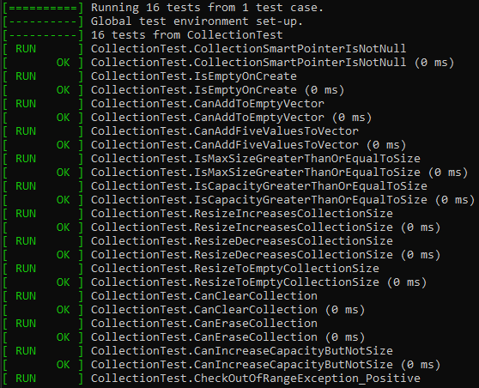
Unit Testing
Testing collections for size, capacity and content

Slide 9
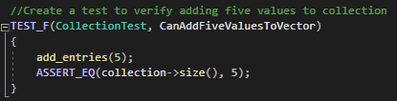
Unit Testing
Can Add Five Values To Collection

Slide 10
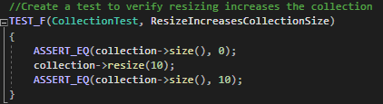
Unit Testing
Resize Increases Collection Size

Slide 11
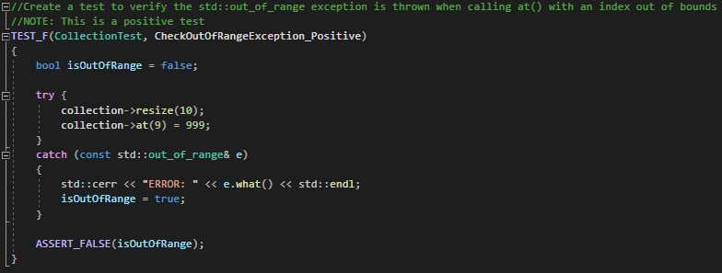
Unit Testing
Check Out of Range Exception (Positive)

Slide 12
Unit Testing
Check Out of Range Exception (Positive)

Slide 13
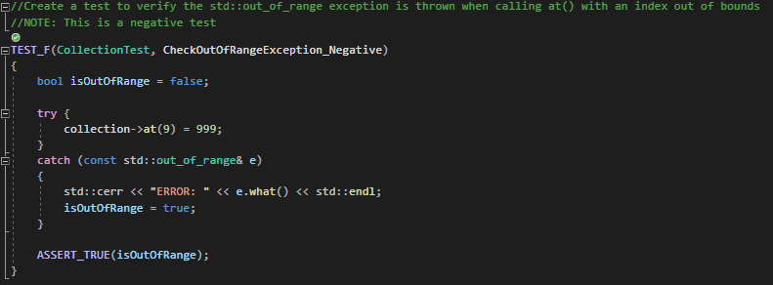
Unit Testing
Check Out of Range Exception (Negative)

Slide 14

AUTOMATION SUMMARY
Notes:
AUTOMATION SUMMARY
Continuous Integration and Continuous Deployment is an important practice in the SDLC.
In order to ensure our software is “healthy” we must be aware of its condition at every stage.

Slide 15
TOOLS
Notes:
TOOLS
DevSecOps isn’t just a buzzword, it’s a way of operating a secure business.
Jira ticketing system to maintain user stories
Git repo to store code
Maven to implement automated builds
JUnit for functional testing
Selenium for UI testing
Jenkins for automated deployment
AWS for hardware resources
Docker for containers
Ansible for configuration
Splunk for logging

Slide 16
RISKS AND BENEFITS
Early adoption gives us better security now.
Future proofing ourselves against threats gives us peace of mind
Saves time and money in the long run
Use the latest technology now to attached the best talent
Early adoption comes with a learning curve.
Future proofing now will comes with a temporarily loss of productivity
Upfront costs my be prohibitive and effect the bottom line
What we implement today may not be the standard of tomorrow.

Slide 17
RECOMMENDATIONS
Today Green Pace must remediate high severity gaps immediately to increase or risk posture Tomorrow
Green Pace should plan to remediate all medium severity gaps in the relatively near future Going Forward
Green Pace should make remediation of all low severity gaps a part of “business as usual”

Slide 18
CONCLUSIONS
Being proactive now will pay dividends in the future.

Slide 19
REFERENCES
Britton , J. (2021, April 26). CON50-CPP. Do not destroy a mutex while it is locked. CON50-CPP. Do not destroy a mutex while it is locked - SEI CERT C++ Coding Standard - Confluence. https://wiki.sei.cmu.edu/confluence/display/cplusplus/CON50-CPP.+Do+not+destroy+a+mutex+while+it+is+locked.
Britton , J. (2021, April 26). FIO51-CPP. Close files when they are no longer needed. FIO51-CPP. Close files when they are no longer needed - SEI CERT C++ Coding Standard - Confluence. https://wiki.sei.cmu.edu/confluence/display/cplusplus/FIO51-CPP.+Close+files+when+they+are+no+longer+needed.
Britton, J. (2021, April 26). Confluence. STR53-CPP. Range check element access - SEI CERT C++ Coding Standard - Confluence. https://wiki.sei.cmu.edu/confluence/display/cplusplus/STR53-CPP.+Range+check+element+access.
Britton, J. (2021, April 26). MSC50-CPP. Do not use std::rand() for generating pseudorandom numbers. MSC50-CPP. Do not use std::rand() for generating pseudorandom numbers - SEI CERT C++ Coding Standard - Confluence. https://wiki.sei.cmu.edu/confluence/display/cplusplus/MSC50-CPP.+Do+not+use+std%3A%3Arand%28%29+for+generating+pseudorandom+numbers.
Razmyslov , S. (2021, June 25). Confluence. MEM50-CPP. Do not access freed memory - SEI CERT C++ Coding Standard - Confluence. https://wiki.sei.cmu.edu/confluence/display/cplusplus/MEM50-CPP.+Do+not+access+freed+memory.
Razmyslov, S. (2021, June 25). Confluence. CTR53-CPP. Use valid iterator ranges - SEI CERT C++ Coding Standard - Confluence. https://wiki.sei.cmu.edu/confluence/display/cplusplus/CTR53-CPP.+Use+valid+iterator+ranges.
Razmyslov, S. (2021, June 25). Confluence. INT50-CPP. Do not cast to an out-of-range enumeration value - SEI CERT C++ Coding Standard - Confluence. https://wiki.sei.cmu.edu/confluence/display/cplusplus/INT50-CPP.+Do+not+cast+to+an+out-of-range+enumeration+value.
Snavely , W. (2018, February 12). VOID ERR12-CPP. Do not allow exceptions to transmit sensitive information. Confluence. https://wiki.sei.cmu.edu/confluence/display/cplusplus/VOID+ERR12-CPP.+Do+not+allow+exceptions+to+transmit+sensitive+information
Snavely, W. (2018, February 12). Confluence. Confluence. https://wiki.sei.cmu.edu/confluence/display/cplusplus/VOID+STR02-CPP.+Sanitize+data+passed+to+complex+subsystems.
Snavely, W. (2018, February 12). VOID DCL03-CPP. Confluence. https://wiki.sei.cmu.edu/confluence/display/cplusplus/VOID+DCL03-CPP.+Use+a+static+assertion+to+test+the+value+of+a+constant+expression.

