Slide 1

SteamCharts
What's Popular?
Searching for trends and hidden gems amongst the most popular games on Steam.
Ryan McDermott | DSCI510 Final Project

Slide 2
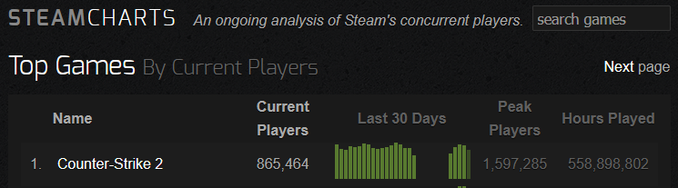


DATA Sources
Dataset | Description/Type | Processing Approach | Data Size
SteamCharts | Website that presents the most popular games on Steam currently. Includes game names, appids, current players and peak players | The site is scraped via beautifulsoup to collect information one the requested number of games. | 375 rows x 4 columns
Steam Store Web API | API that returns specific information such as price, discounts, if it’s free, release dates | The Steam appids scraped from SteamCharts are used to request information from the Steam Store Web API. | 375 rows x 9 columns
OpenCritic API | API that returns review information such as top critic review, median critic scores, % recommended, total reviews and a ranking tier. | The OpenCritic API is used to and the game name is searched and the initial results returned. | 375 rows x 7 columns

Slide 3
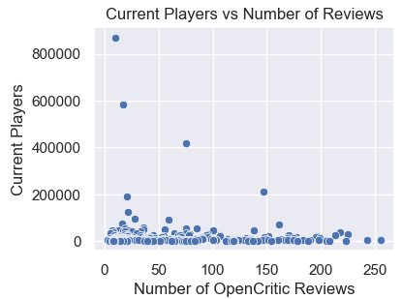
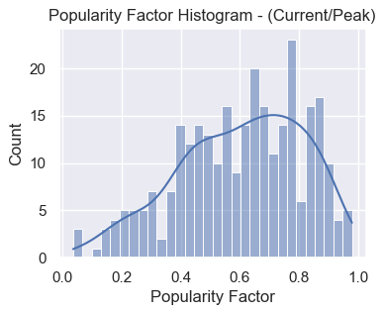
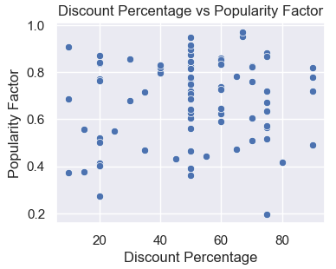
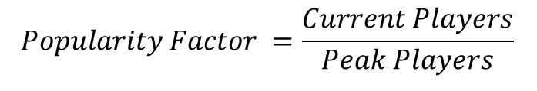
Ratings, Discounts, & Popularity
Data was cleaned to remove games that didn’t have any OpenCritic reviews and were marked as not free but had a price of 0$.
This data set went from 375 games to 286 games.
and then split between Free and Paid games
60 Free Games
226 Paid Games
  86 of which were discounted
$$Popularity Factor =\frac{Current Players}{Peak Players}$$
Notes:
Some of the most popular games have some of the fewest reviews
A lot of the popular games are near their peaks
Discounts don’t track well to their popularity

Slide 4
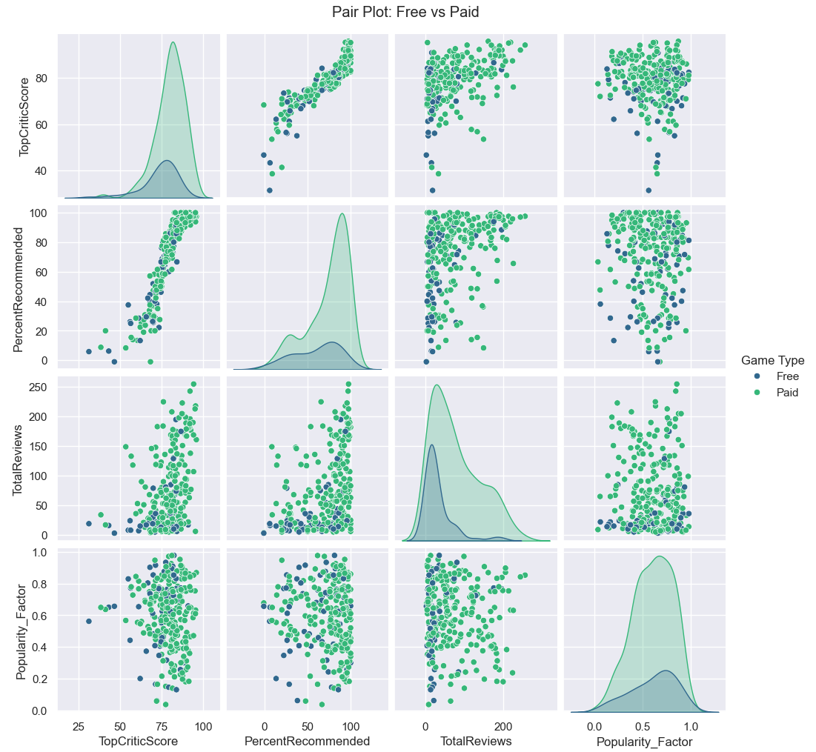
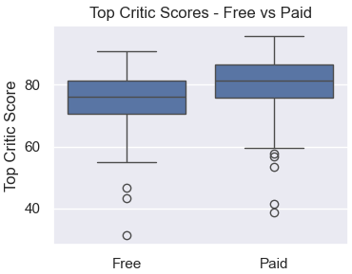
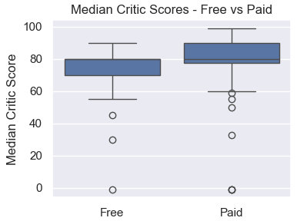
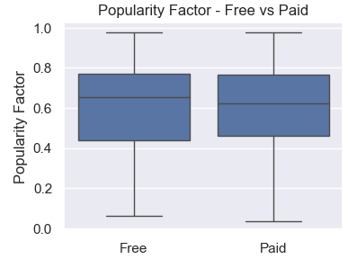
Free vs PAID
Interestingly, paid games tend to carry higher critic scores – both top and median, but free games edge out on popularity.

Slide 5
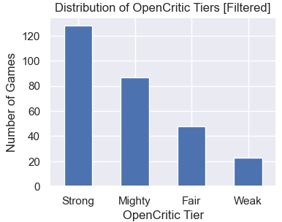
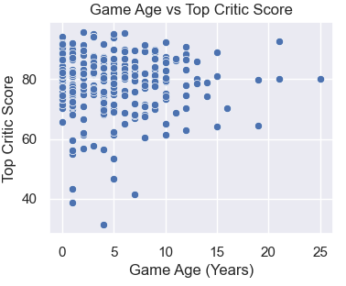
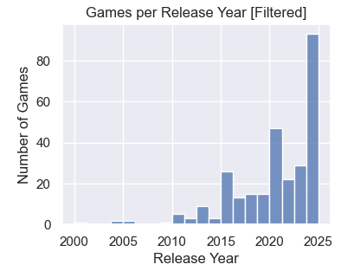
Release Dates and AGING
Unsurprisingly, the best rated games were the most popular per the OpenCritic tiers.
The older a game is in the list, the more likely it was reviewed highly.
The most popular games are currently dominated by newer games.

Slide 6
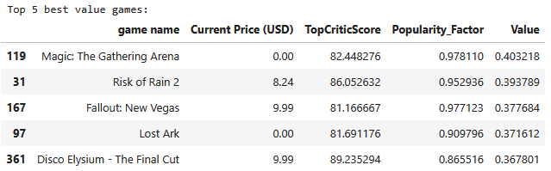
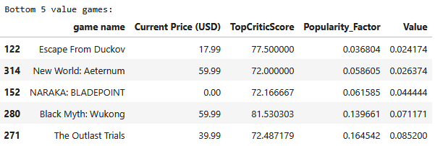
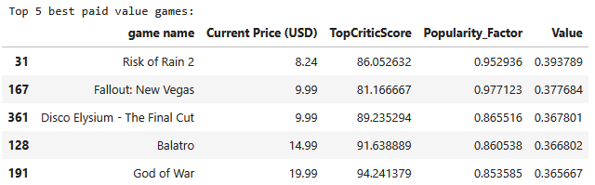
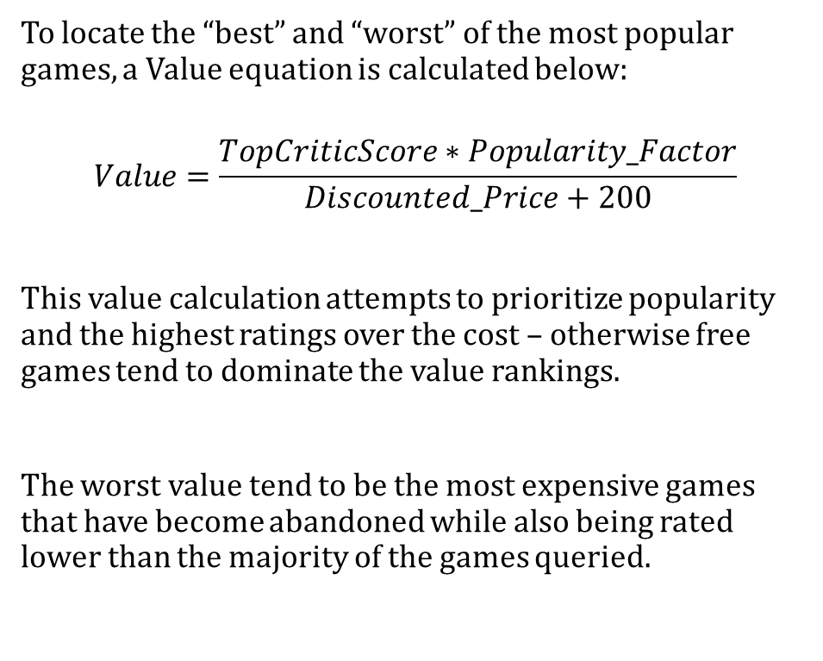
Hidden Gems
To locate the “best” and “worst” of the most popular games, a Value equation is calculated below:
$$Value=\frac{TopCriticScore∗Popularity_Factor}{Discounted_Price+200}$$
This value calculation attempts to prioritize popularity and the highest ratings over the cost – otherwise free games tend to dominate the value rankings.
The worst value tend to be the most expensive games that have become abandoned while also being rated lower than the majority of the games queried.

Slide 7
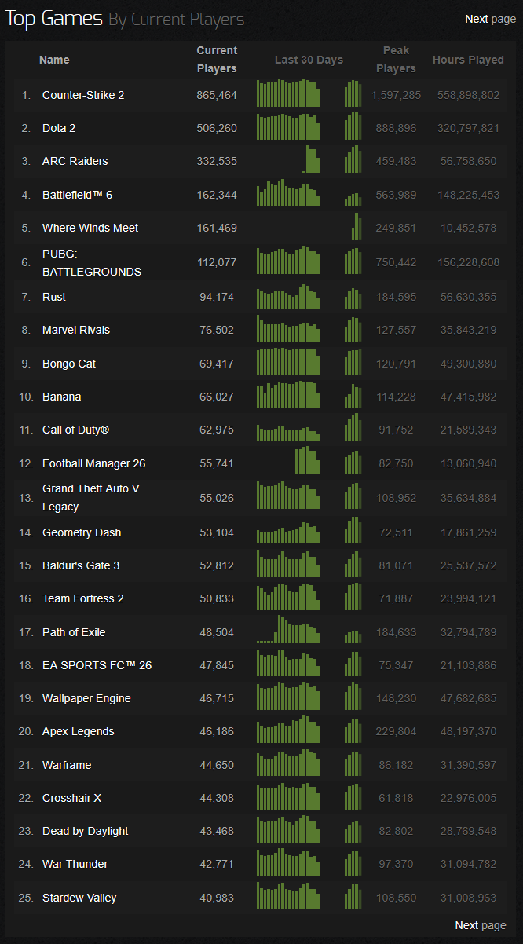

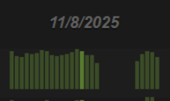


Challenges / Issues
Initial SteamCharts scraping limited to 25 games due to the charts only displaying 25 at a time. Had to scrape through multiple pages.
Steam Store Web API request limitations. API calls continued to fail after some point. Discovered I was limited to 200 requests every 5 minutes and found I could use time.sleep to slow my requests to >1.5 seconds and prevent the request limit from being hit.
SteamCharts presents dynamic tables that include player counts per day, unsuccessfully tried to scrape data for the previous 7 days.
Dynamic Selection Example

