Slide 1

Travel Assured
Our customers are our future
Report prepared by ryan mclean, data analyst
Notes:
Hello everyone, welcome to our annual data meeting. My name is Ryan McLean and I am a data analyst with Travel Assured.
Today, we will be evaluating a new initiative for our advertising efforts. The focus of this initiative is to understand and target the right sector of the market for maximum revenue and growth

Slide 2
Since the start of the pandemic, company profits are down
Marketing budget is down by 50%
Only 35% of recent quotes converted to insurance purchases
Notes:
As you all know, profits have decreased since the beginning of the pandemic. Our budget for marketing and advertisting has decreased by 50% and only about 35% of recent quotes have converted to insurance purchases.

Slide 3
More than ever before, Travel Assured needs to focus advertising to the right people through the right channels. That starts with knowing our customers
Notes:
Today, I will be presenting an analysis that examines our customer profiles, so we know where to focus our efforts and get the most out of every advertising dollar. To do this, I examined all of the recent insurance quotes and separated them into groups based on whether the user decided to purchase travel insurance. By doing this, I pinpointed 5 characteristics with the biggest disparity between customers and non-customers.

Slide 4
Getting to know our customers
An independent samples t-test was used to evaluate group differences. The proportion of Customer’s and Non-Customer’s were found to be at the p < .05 level of statistical significance.
Notes:
The first two characteristics are travel preferences. On the left, we see the percentage of users who have travelled abroad and on the right, we see the percentage of users that classify as frequent flyers. As you can see, 42% of our customers have travelled abroad and 34% of our customers are frequent flyers and for both metrics, those numbers are considerably higher than the percentage of non-customers.
To further compare customers and non-customers, I chose to use an independent samples t-test and detected significant differences at a p < .05 level. That gives us greater confidence that we will continue to see this trend moving forward.
As you can see, Travel Assured customers like to travel abroad and they like to travel frequently. This should come as no surprise but it does present an opportunity for advertisting on websites focused on frequent and international vacations.

Slide 5
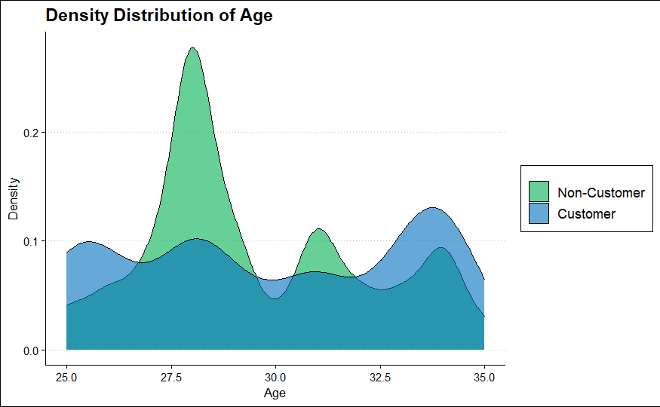
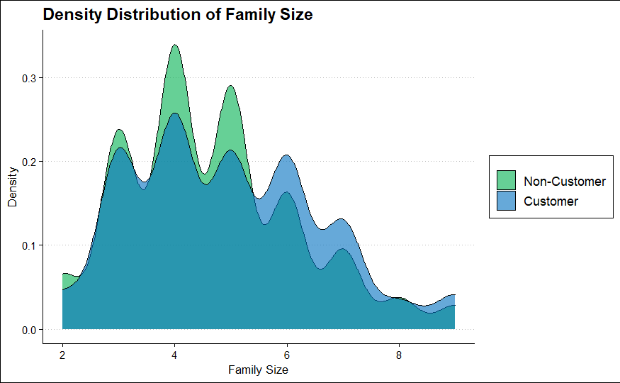
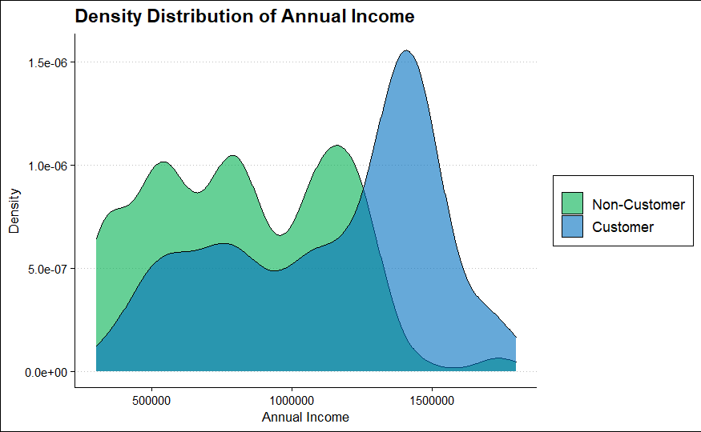
Zooming in on our market
There is a big spike of customers at age 34 and non-customers at age 28
There is a huge spike of customers making ~ 1.5 million
There is a larger proportion of users with family sizes over 5.
Notes:
The other characteristics of interest are age, income, and family size. From these graphs, I pull a few insights.
First, there is a big spike of customers at age 34 and non-customers at 28.
Second, there is a big spike of customers making ~ 1.5 million.
Third, there is a tipping point that happens for family size at 5 members where customers have bigger families than non-customers

Slide 6
Additional Insights
An independent samples t-test was used to evaluate group differences. The proportion of Customer’s and Non-Customer’s were found to be at the p < .05 level of statistical significance.
Notes:
From those insights, I separated these users into groups. As you can see, a majority of our customers make over 1 million dollars in annual income, come from family sizes of 5 or more, and are at least 30 years old. Using these characteristics, we can input filters into our advertising campaigns to target the right people that have the highest probability of becoming our customers.
An additional note for all my statisticians out there, the differences between customers and non-customers were significant for all three of these metrics as well. Another note here is that I similarly examined employment type, whether the user graduated from college, and whether the user was diagnosed with a chronic disease and found that customer and non-customer profiles were similar and so I excluded them from this presentation.

Slide 7
Prioritizing our efforts
The probability of purchasing insurance increases the most for customers who have travelled abroad, have an income over 1 million and are frequent flyers.
Values were obtained by converting standardized logistic regression coefficients to probability values through odds ratios
Notes:
As a final analysis, I took these 5 characteristics of interest that had the biggest disparity between customers and non-customers and put them into a logistic regression model. This model allows us to look at an increase in probability for each characteristic and order them accordingly to know which profiles are the most important.
As you can see, the probability that a user becomes a customer is 52% higher if they have travelled abroad. The probability is 21% higher for users with an income over 1 million and so on.
This analysis shows us that our priority should be to target users who enjoy frequent trips and like to travel abroad. Extra bonus points if this person makes over 1 million dollars a year and matches our other characteristic of interest.

Slide 8

As we focus our advertising efforts to the right people through the right channels, we will make the future of Travel Assured secure
Top 3 Advertising Priorities
Have travelled abroad
Annual Income over 1 million
Frequent Flyers
Notes:
In conclusion,

