Slide 1

Inn the Neighborhood
Accessing the key to rental spaces
Report prepared by Ryan McLean, Data Scientist

Slide 2
Inn the Neighborhood strives to create a premium online platform for short-term rentals
In the last decade, short-term house rentals have increased dramatically
A variety of people in San Francisco visit our site to list their apartment, home, etc.
Only 2% of site visitors actually list their home for rental

Slide 3
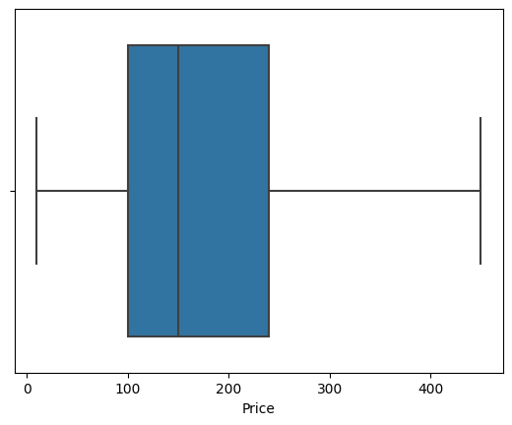
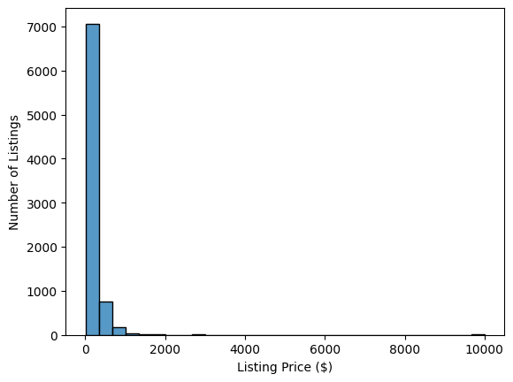
Although 50% of potential customers list their home between $100 and $240 per night, the variation in the data suggests that customers don’t have a good sense for the amount they could be making by renting

Slide 4

Our plan forward
The data and analytics team will use machine learning to accurately predict how much a user could earn; increasing customer confidence, conversion, and retention
Confidence
Conversion
Retention

Slide 5
Final list of home features that predict price Model trained on 7,251 homes entered on our site
# of Bedrooms
# of Bathrooms
Latitude
Longitude
Minimum nights of the stay
Room Type (entire home, private room)
Property type (apartment, house, condo)

Slide 6
Data Processing Steps
Outliers: Taking out the most extreme listings to get an accurate model (house size, nights per stay, price). Removed about 10% of total sample
Missing values: Many customers did not complete the form with # of beds and bathrooms, so these were filled in with the average
Price changes: Since there was such a large dispersion of listing choices, the data were logarithmically transformed to strengthen the model after removing top 5% of the sample
Property Type: Over 95% of listings fell into 5 categories so the 26 categories were condensed for clarity
Bathrooms: Outliers removed and missing values imputed
Bedrooms: Outliers removed and missing values imputed
Minimum Nights: Outliers removed
Machine Learning Preprocessing: I performed dummy encoding for categorical features and variable scaling to ensure that the information was scaled and interpreted correctly within the model

Slide 7
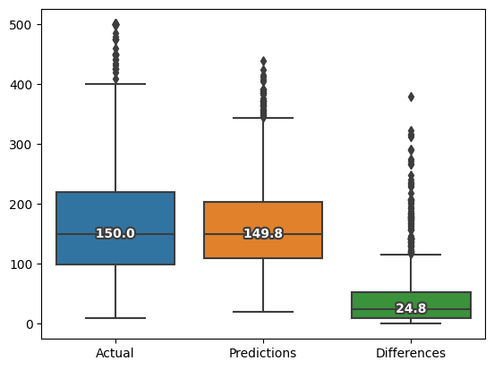
After evaluating multiple algorithms, the Random Forest algorithm was chosen for best performance
The main KPI of the model was to estimate price within $25 of the actual price.
The trained model had a median difference of $25 between estimated and actual price per night
25% of all estimations were within $10
75% of all estimations were within $53

Slide 8
Price is driven by size, location, and level of privacy
Listing price was most strongly predicted by the number of bedrooms and the location, followed by the minimum nights of the stay and whether the room was shared or private.
Using this algorithm, the median difference between estimated and actual listing price was $25
With this information, we can provide customers with confidence about what they can earn by listing their property with us, increasing customer conversion and retention

Slide 9
Conclusion
Data Science will help us unlock the key to the rental landscape

